Slide 1


IPC Revision Management System
Functional Scope & Current Status

Slide 2

Speaker Introduction
Julia Teryokhina
Senior Project Manager at SaM Solutions
Team Manager at IPCRMS project
Overall experience in IT ~16 years

Slide 3
Agenda
General Overview
IPCRMS Functional Scope
IPCRMS Timeline
IPCRMS Availability and Helpdesk

Slide 4

General Overview

Slide 5
Main IPCRMS workflow
Create a Project
Draft and propose amendment(s)
Comment amendment(s)
Create a session
Make a decision
Translate amendment(s) in authentic language(s)
Generate Master Files
Provide National Translations
Validate data at every step
Generate reports in the context of Session and Project

Slide 6
IPCRMS audience
IPCRMS Users and Permissions
Visitor
IP Office
IB Operator
Rapporteur / Translator
  View IPC Data
  Login to the system
  Comment amendments
  Provide counterproposals
  Draft and propose amendments
  Translate proposed amendments
  Create Projects and Sessions
  Make a decision
  Generate Master Files

Slide 7
Integration with WIM
WIM – WIPO Identity Manager
Single Sign On, i.e. the user shouldn’t additionally logged in to each WIPO system
Personal user data and permissions are managed in a unified way
IPCRMS is integrated with WIPO Identity Manager
IPCRMS provides secure connection to WIM

Slide 8
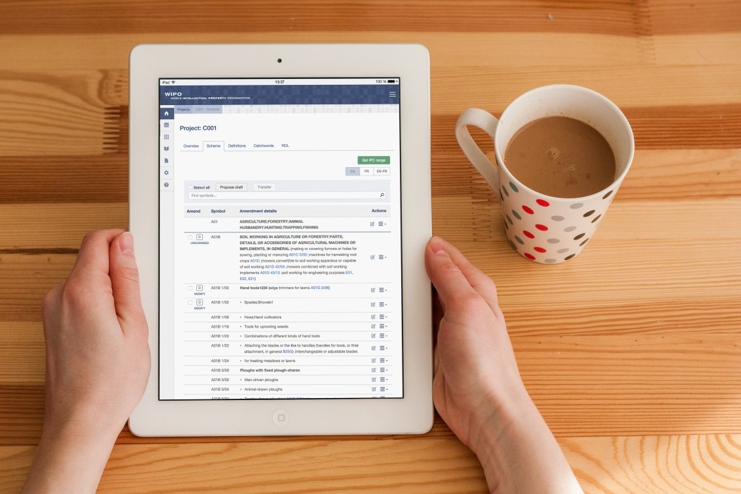
Responsive design
High attention to usability and performance
✓
Unified design both for Desktop and Tablet browsers
✓
Flexible design: information is automatically adjusted to screen resolution
✓
Optimal viewing, easy reading and navigation
✓
Resizing, panning, and scrolling with a mouse or a finger
✓
Unique proper-based URL

Slide 9

IPCRMS Functional Scope

Slide 10
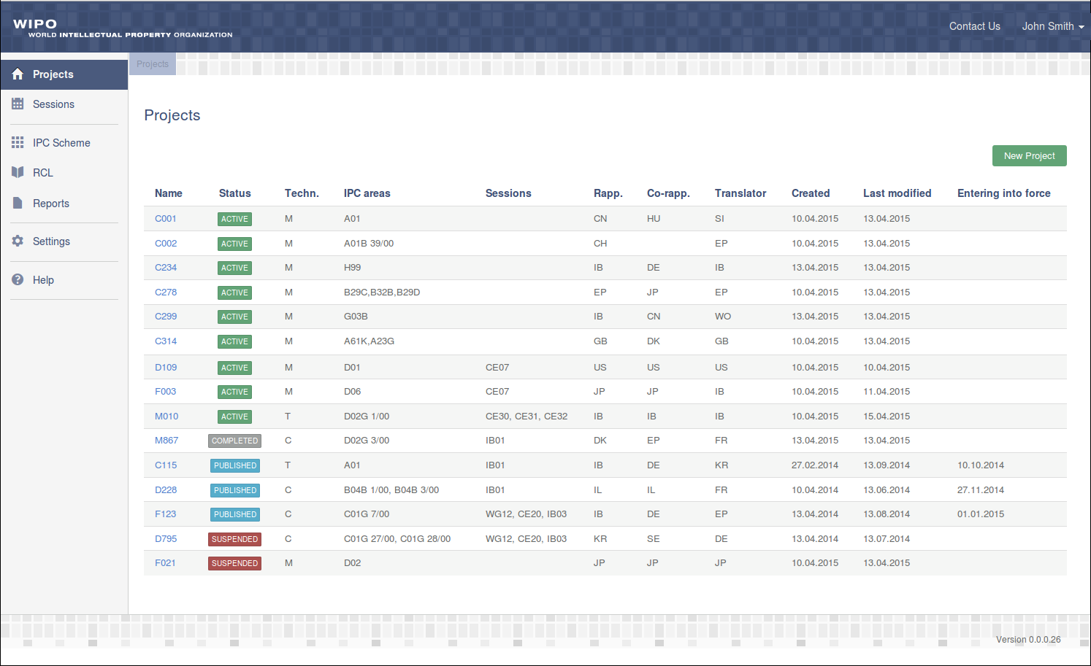
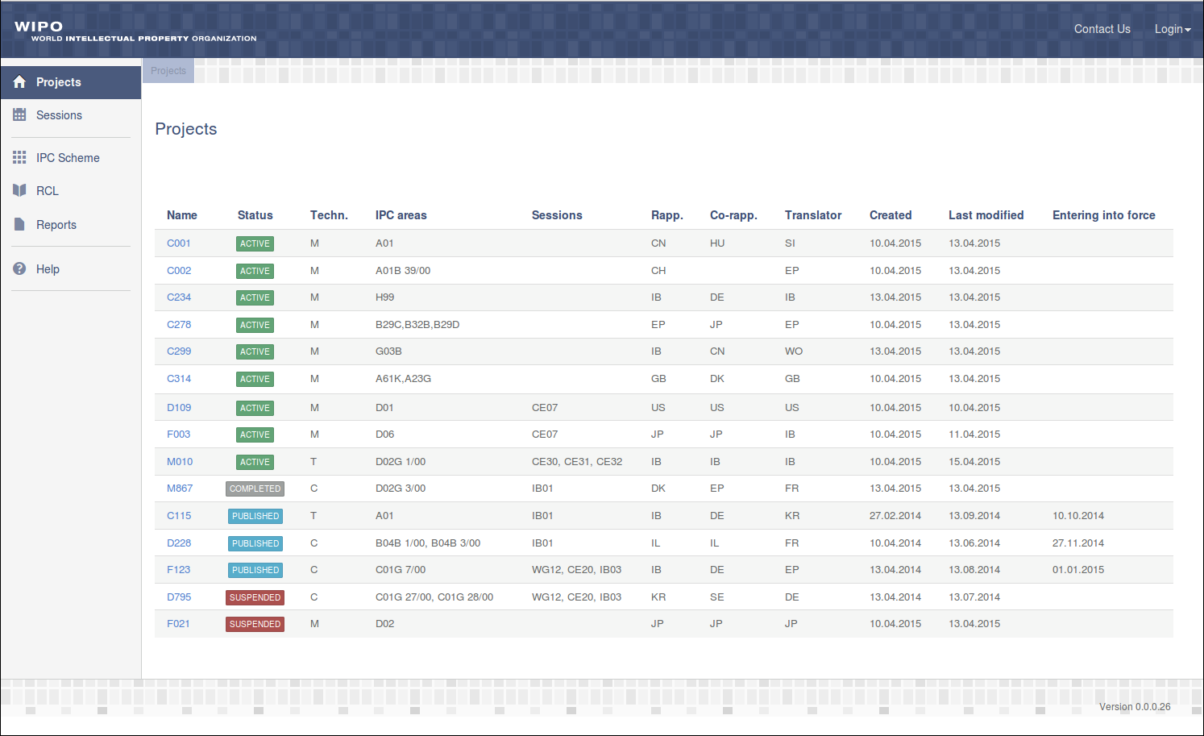
IPCRMS Home Page
Visitors and
IP Offices:
View Projects
IB Operator:
Create / delete Projects

Slide 11
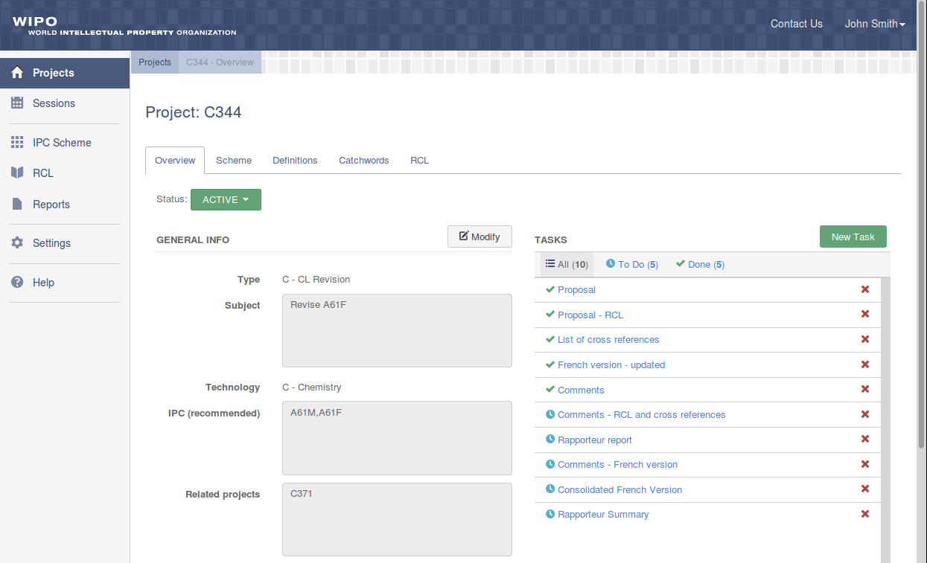
Project Details
Visitors and
IP Offices:
View Project details
View tasks
IB Operator:
Modify Project details
Create / delete tasks
Assign Rapporteur, Translator, Co-Rapporteur

Slide 12
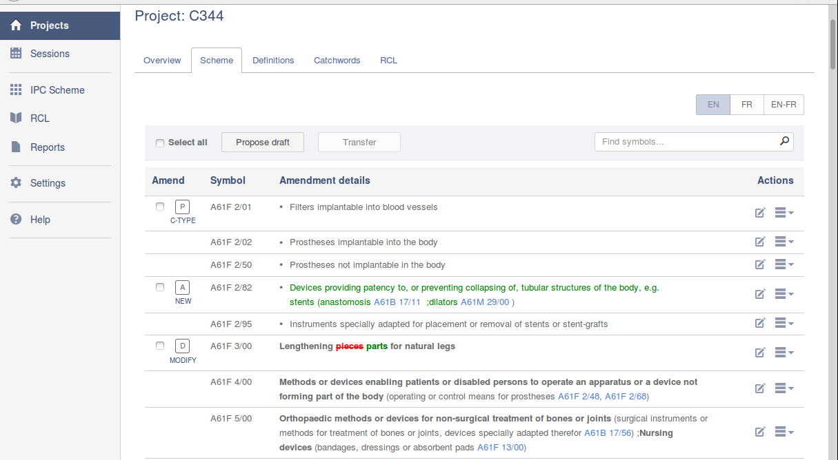
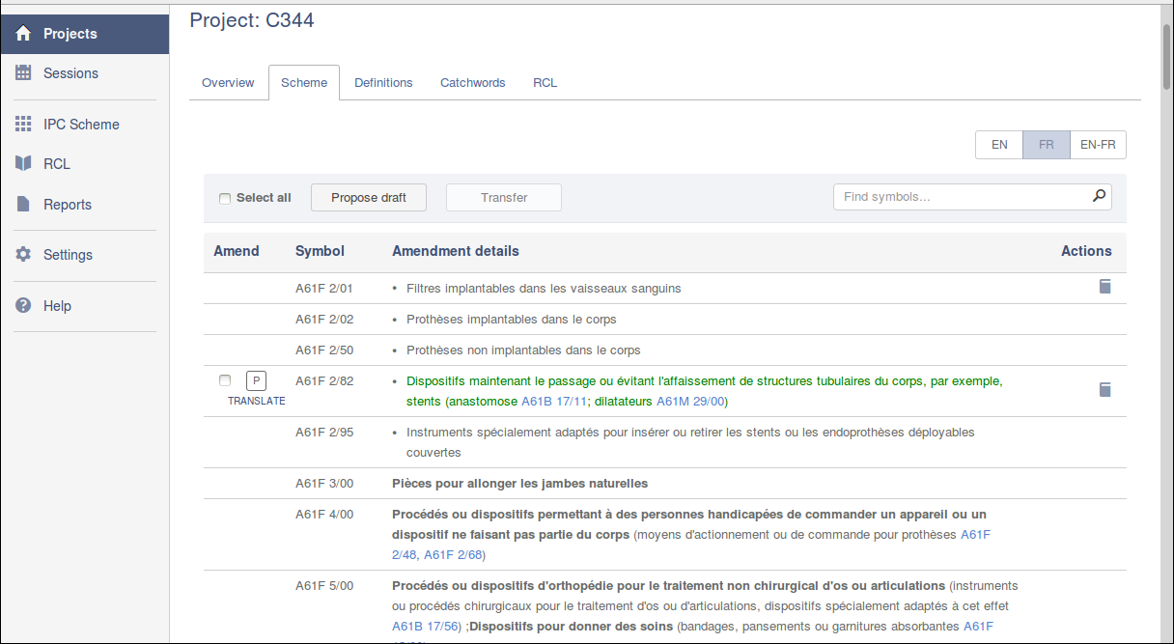
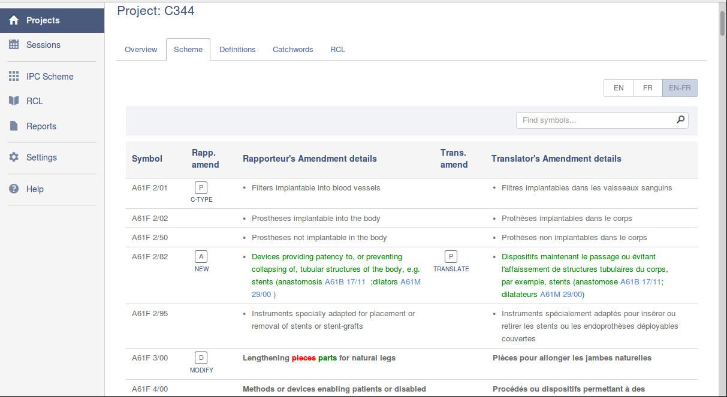
Project Scheme
Visitors and
IP Offices:
View proposed amendments
Compare original and amended entry
Rapporteur:
Draft and propose amendments
Translator:
Translate proposed amendments

Slide 13
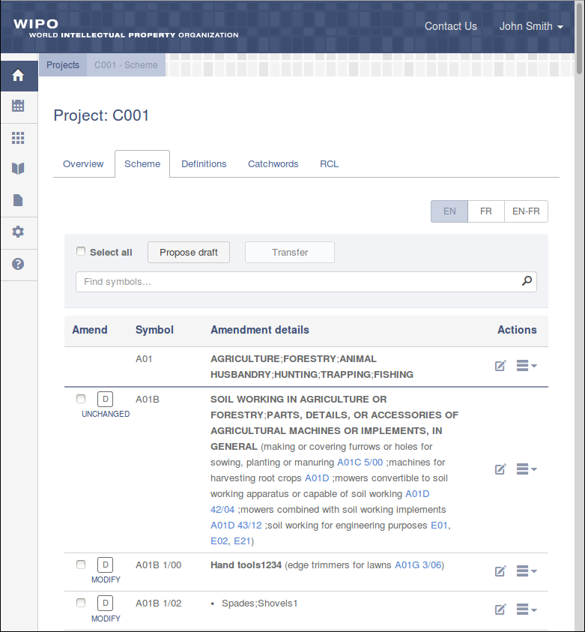
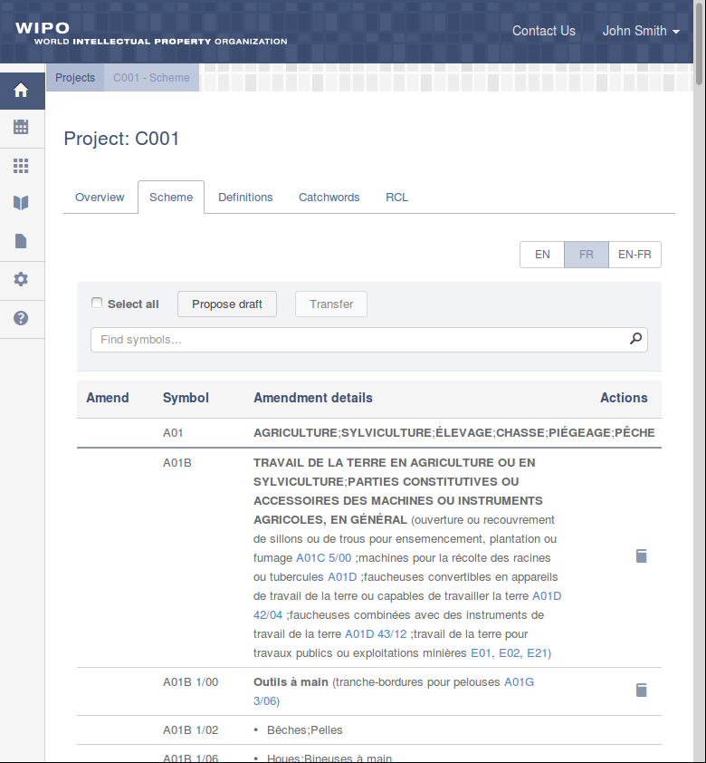
Project Scheme, Tablet view

Slide 14
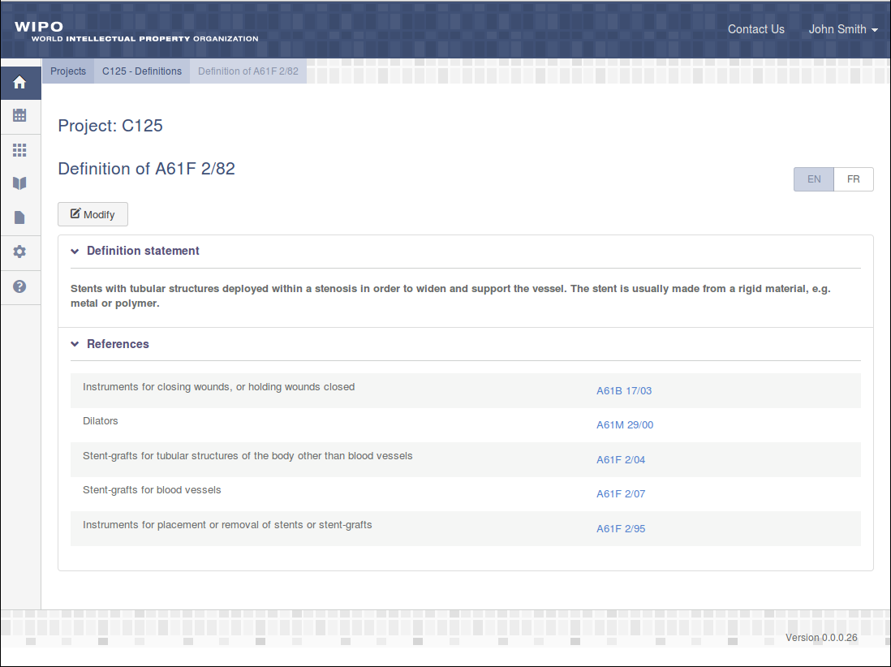
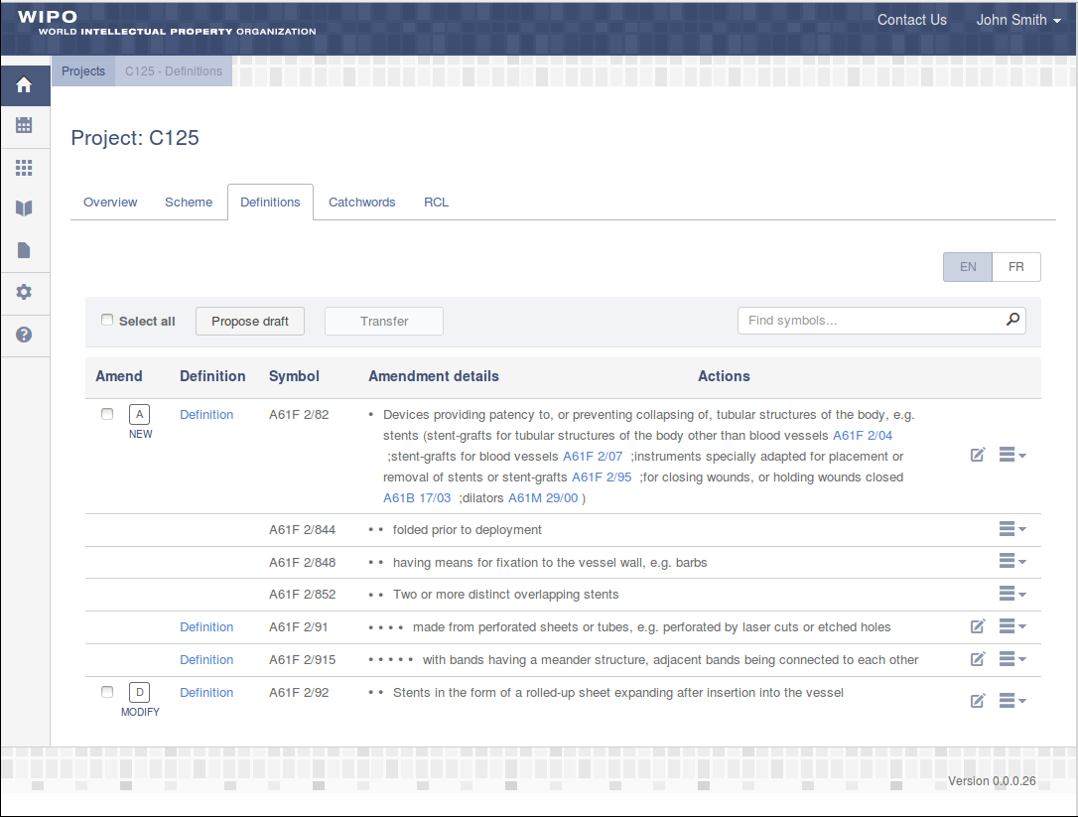
Project Definitions
Visitors and IP Offices:
View proposed amendments
View Definitions
Rapporteur:
Draft and propose Definitions amendments
Translator:
Translate proposed amendments

Slide 15
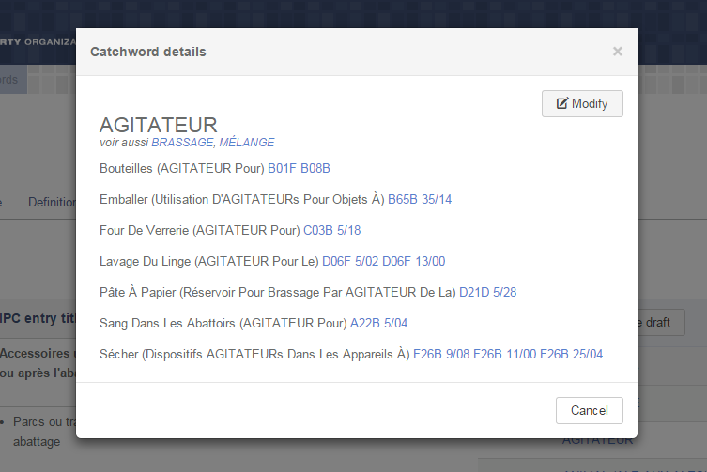
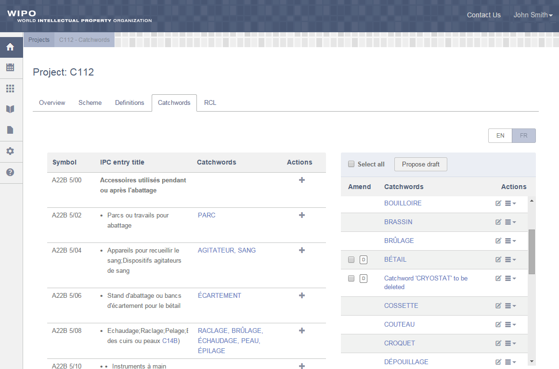
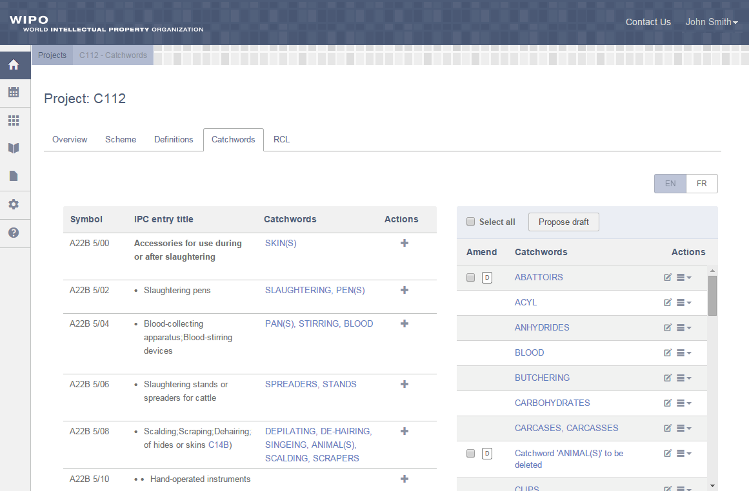
Project Catchwords
Visitors and IP Offices:
View proposed amendments in English
View proposed amendments in French
View Catchword
Rapporteur:
Draft and propose Catchword in default language
Translator:
Draft and propose Catchword in translation language

Slide 16
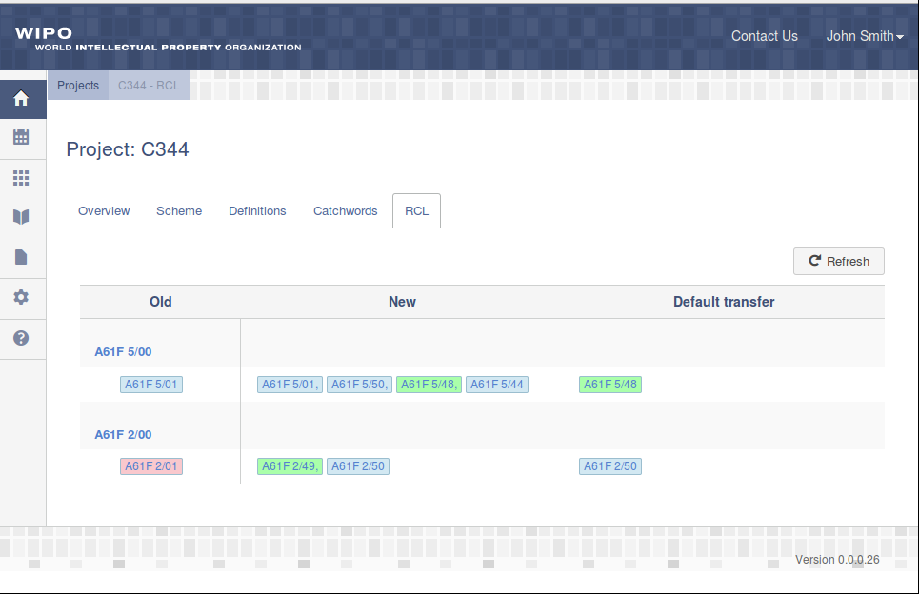
Project RCL
Visitors, IP Offices and Translators:
View proposed C-Type amendments
Rapporteur and
IB Operator:
View draft C-Type amendments

Slide 17
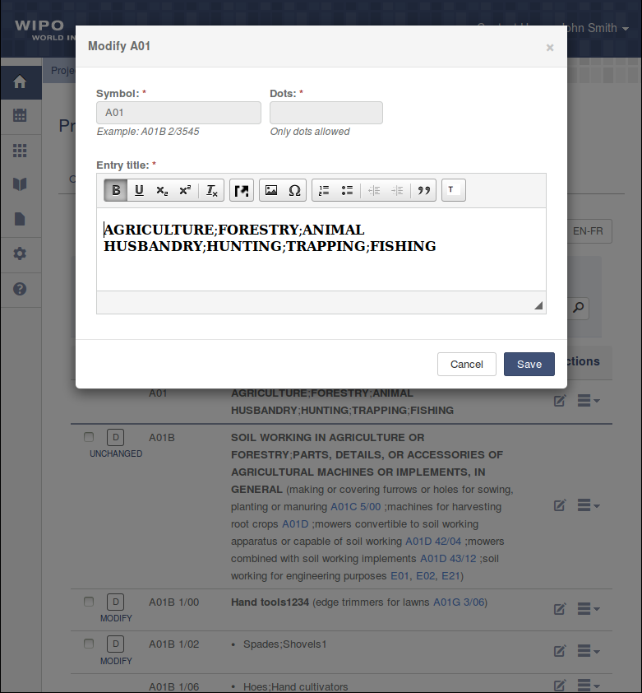
DRAFT Amendment
✓
Any user of Rapporteur Office can draft and propose amendment
✓
Usable editor to format text
✓
Possibility to insert images and illustrations where applicable
✓
Possibility to work with tables where applicable

Slide 18
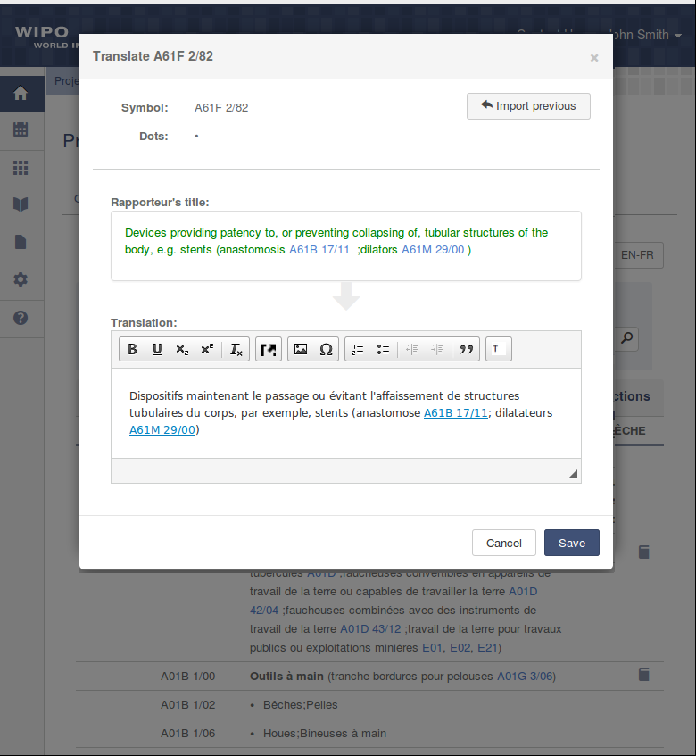
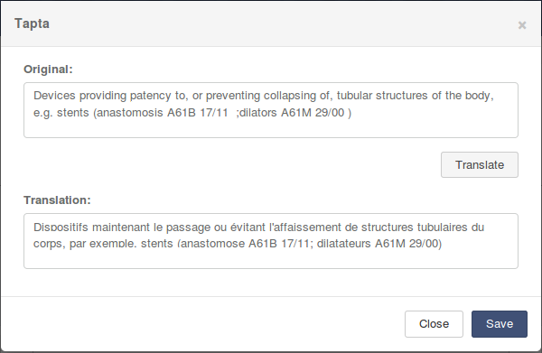
Translate amendment
✓
Any user of Translator Office can translate proposed amendment
✓
Possibility to see what was changed in the original entry
✓
Usable editor to format text, insert images and tables
✓
Using TAPTA service as translation assistant

Slide 19
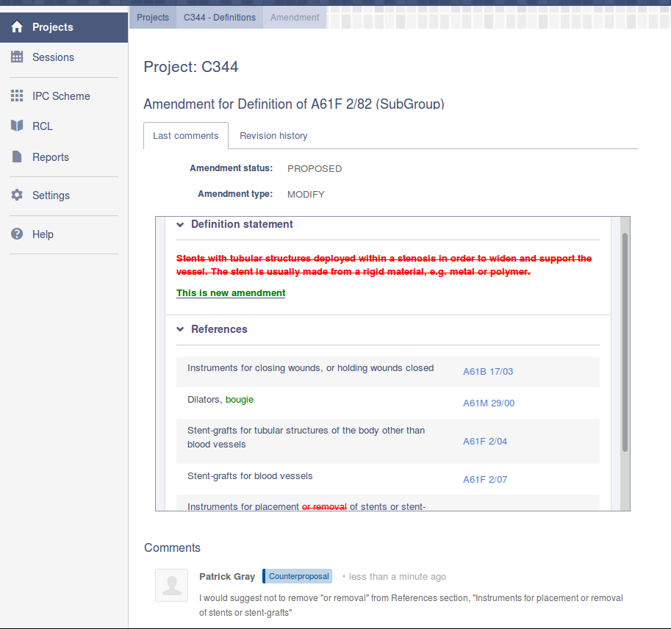
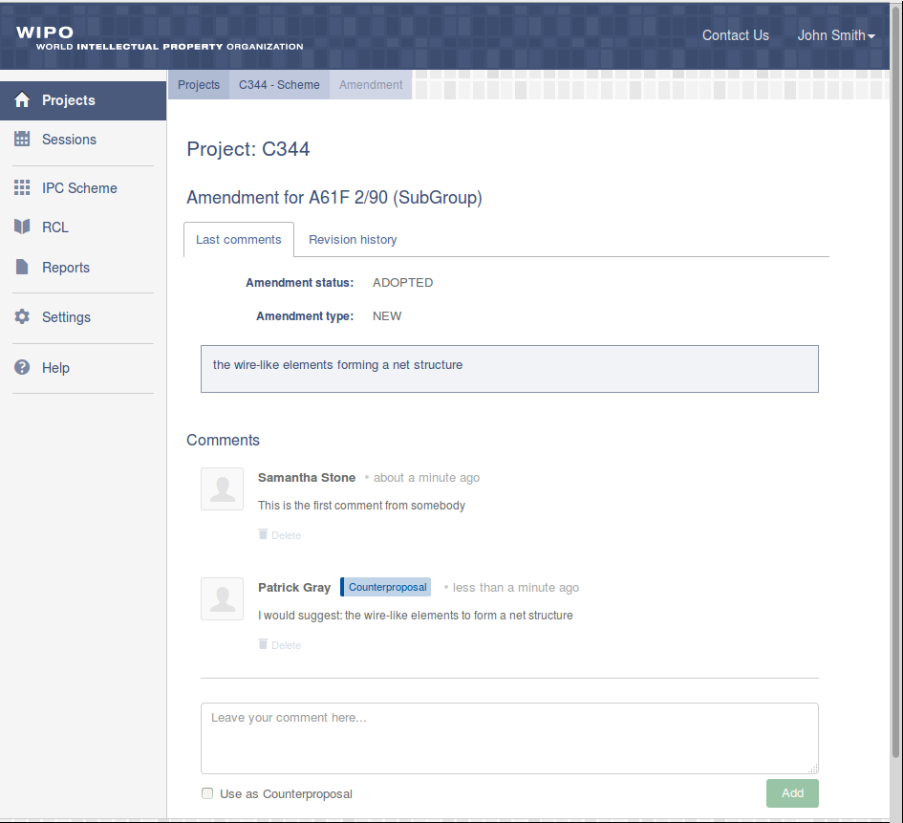
Collaborative work on amendments
Visitors:
View amendments incl. comparison with original entry
View comments and counterproposals
IP Offices:
Provide comments
Provide counterproposals
Rapporteur / Translator:
Remove amendment
Propose a new amendment on the basis of counterproposal(s)

Slide 20
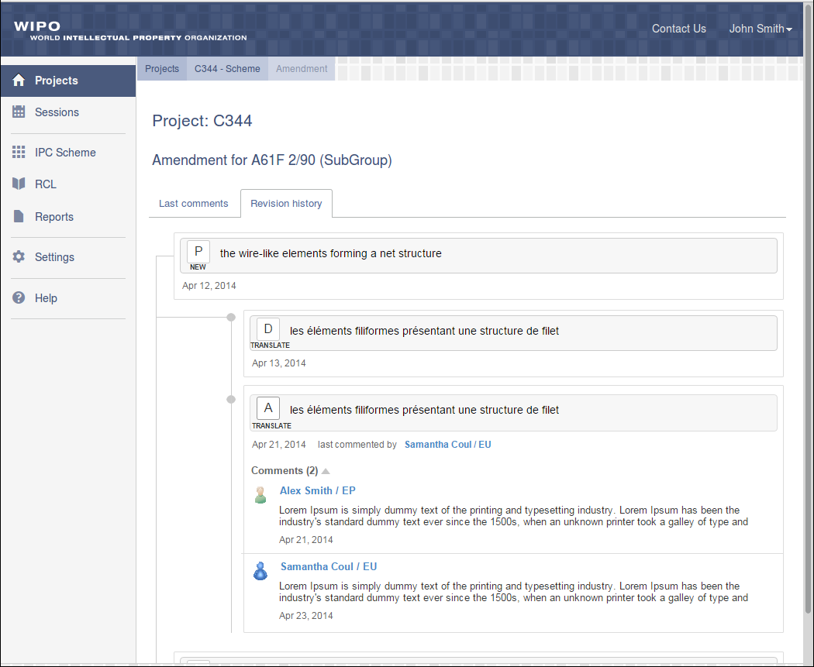
Revision history and possibility to undo changes
Visitors and IP Offices:
View revision history for proposed amendments along with comments
Rapporteur / Translator:
Possibility to import previous amendment from the revision history

Slide 21
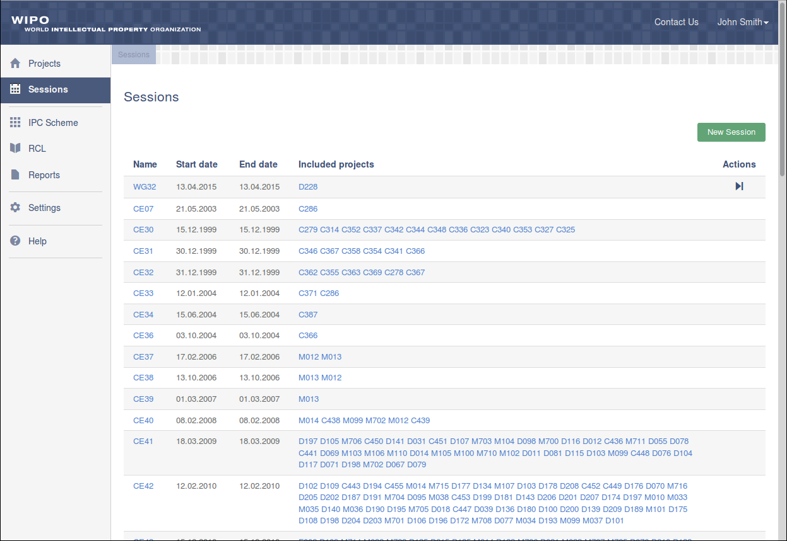
Sessions
Visitors and
IP Offices:
View Sessions
IB Operator:
Create / delete Sessions
Open / close Sessions

Slide 22
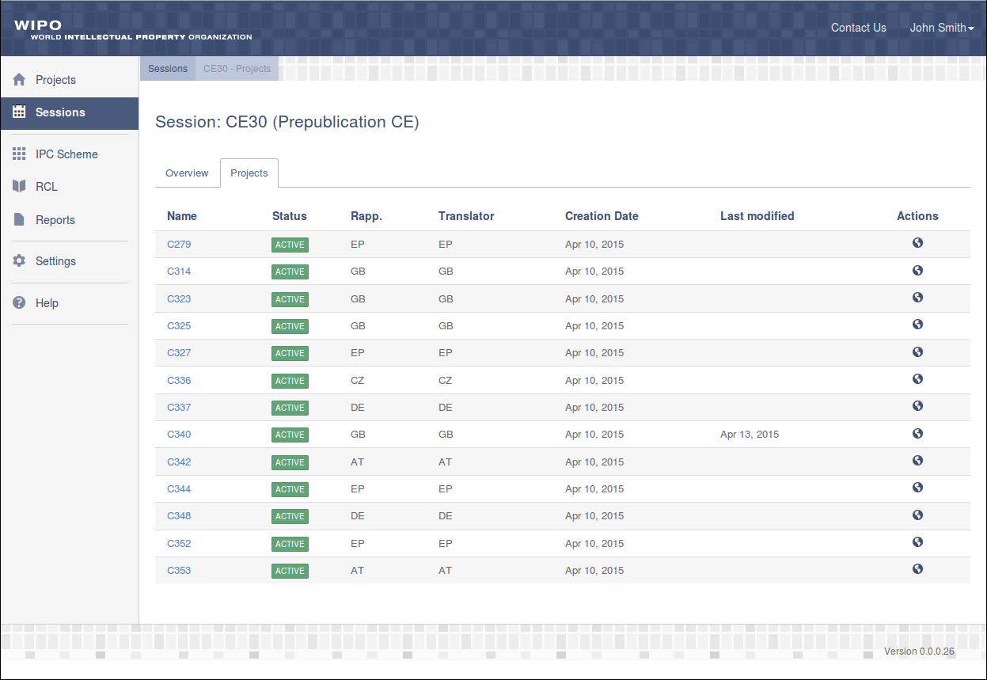
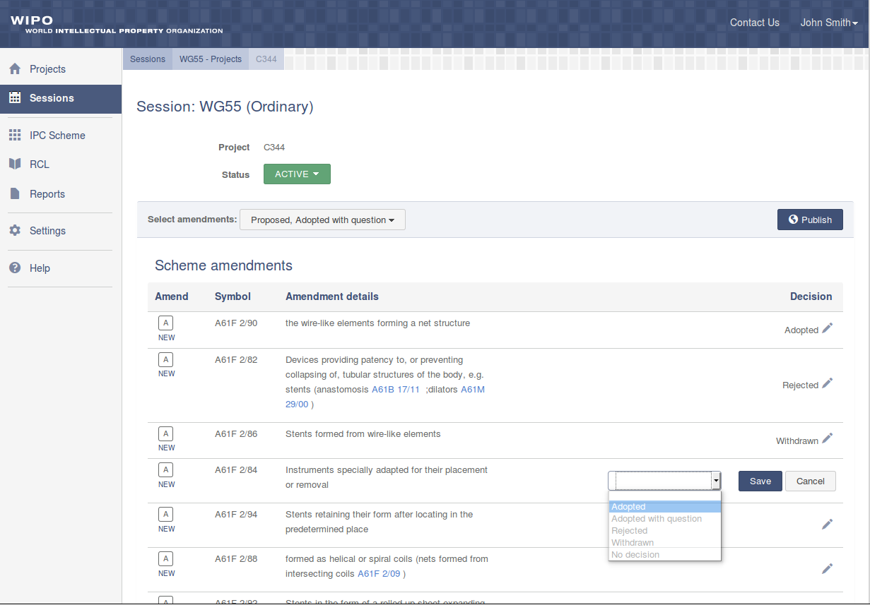
Session Details
Visitors and
IP Offices:
View Session Projects
View decision on amendments
IB Operator:
Change Session scope
Make decision on amendments

Slide 23
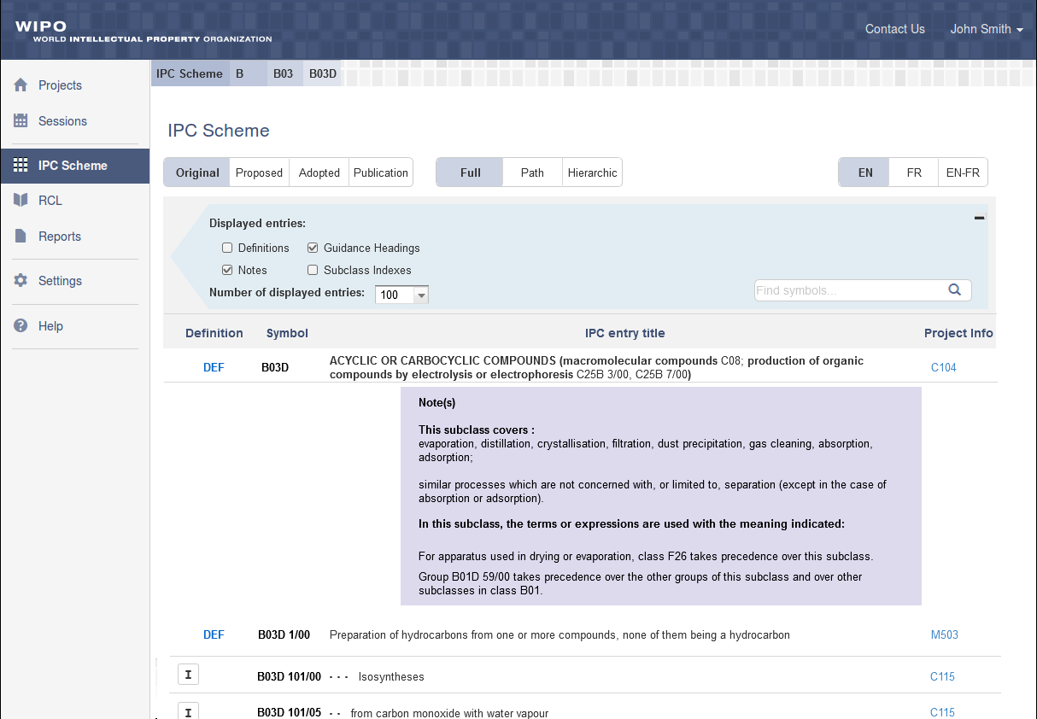
IPC-Scheme
All users:
View the whole IPC Scheme
Apply different view modes:
  Original Scheme
  Scheme with proposed amendments
  Scheme with adopted amendments
  Scheme with adopted amendment from the completed projects only
View reference to the project

Slide 24
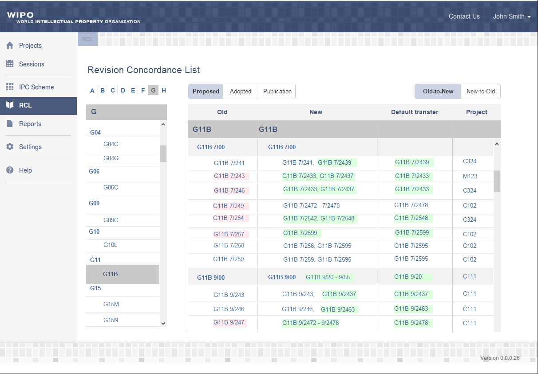
Revision Concordance List
All users:
View the whole RCL
Apply different view modes:
  All proposed amendments
  All adopted amendments
  Adopted amendment from completed projects only
View reference to the project

Slide 25
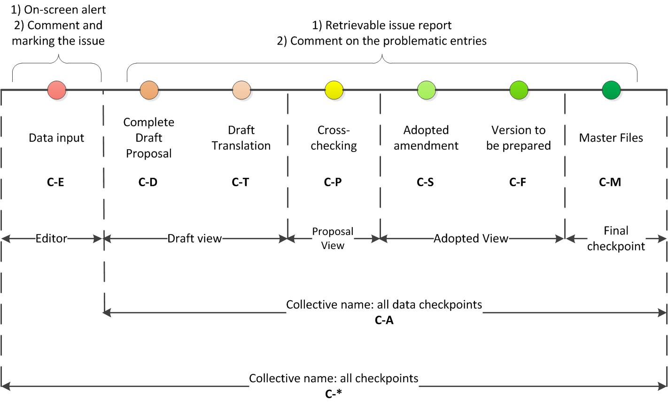
Quality Criteria: Checkpoints
IPC data quality is to be checked at every step
Ensure quality at every step
Require user actions depending on issue severity
Retrieve issue report

Slide 26
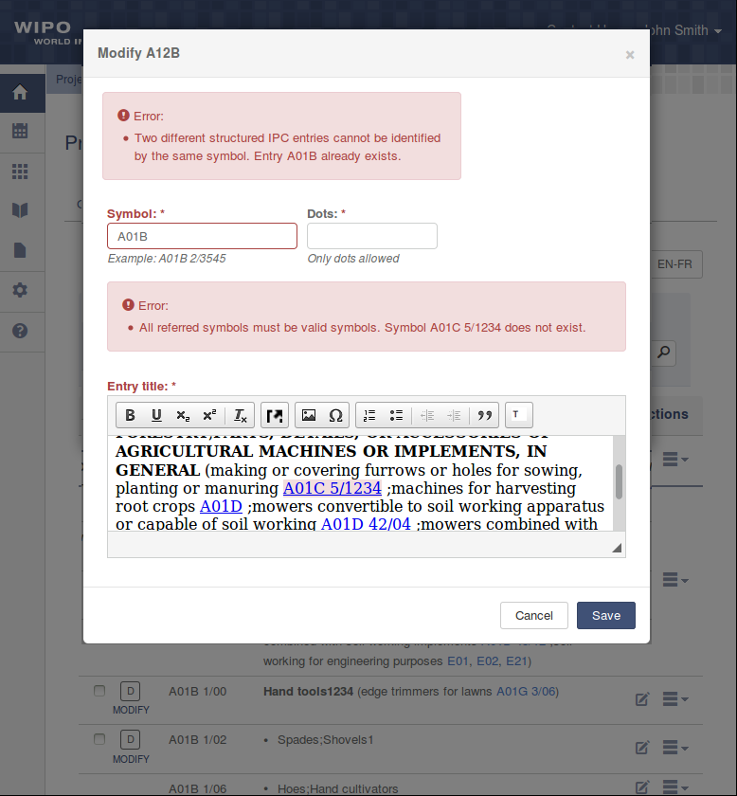
Quality Criteria: on-Screen Alerts
Editor checkpoint: provide on-screen alerts to improve user experience
✓
Assist user during data input
✓
Prevent data incorrectness
✓
Possibility to comment and mark issue
✓
Ensure data integrity

Slide 27
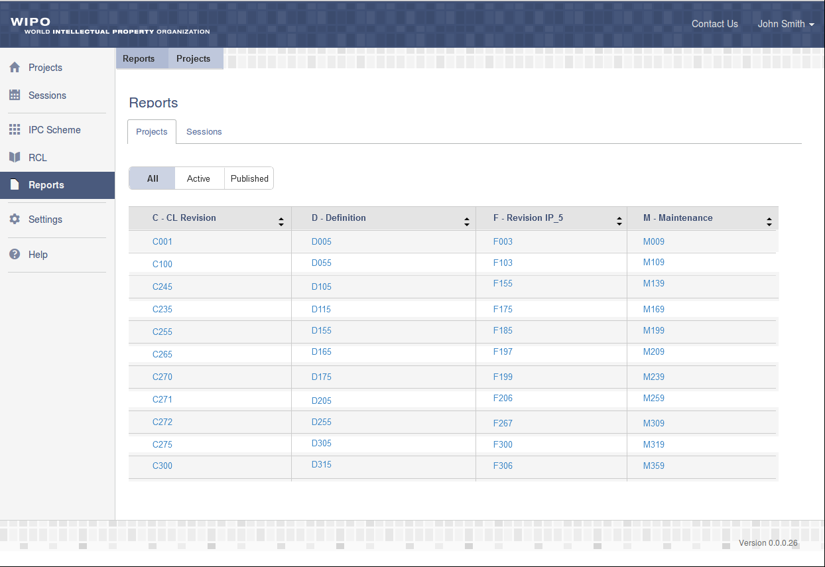
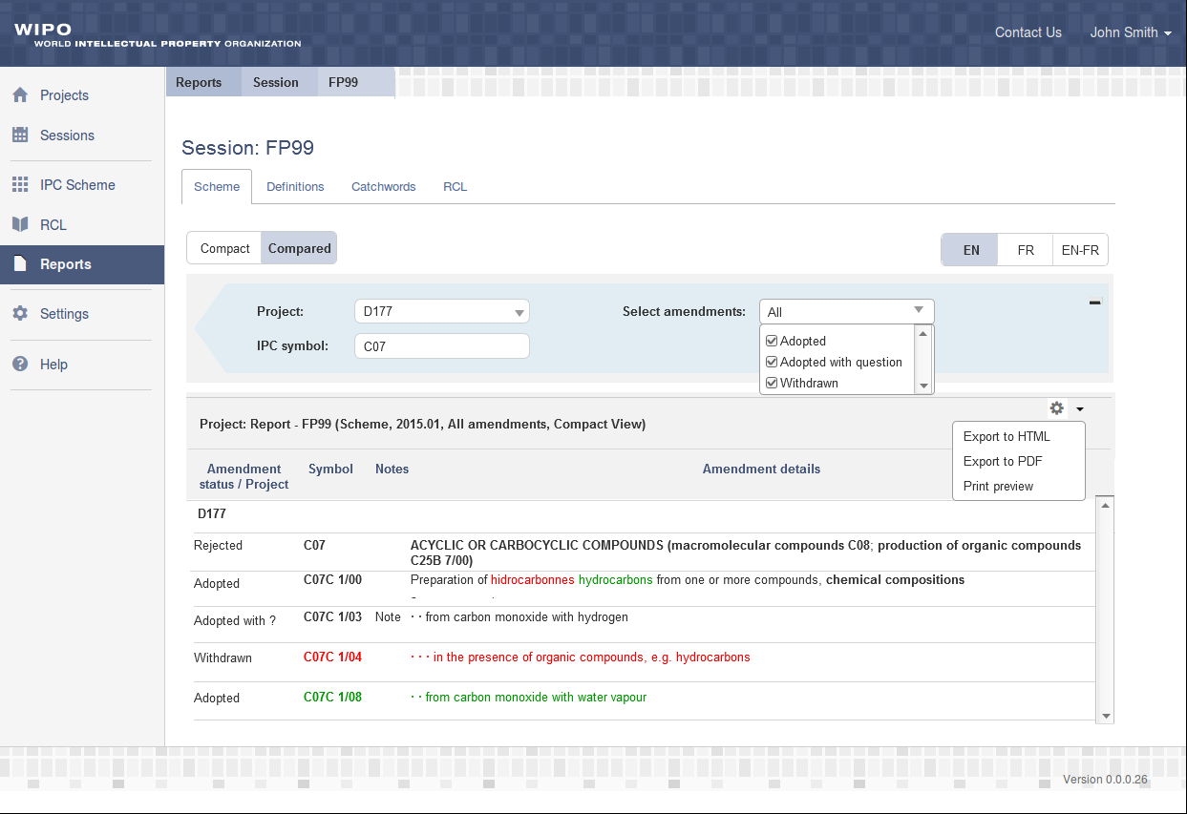

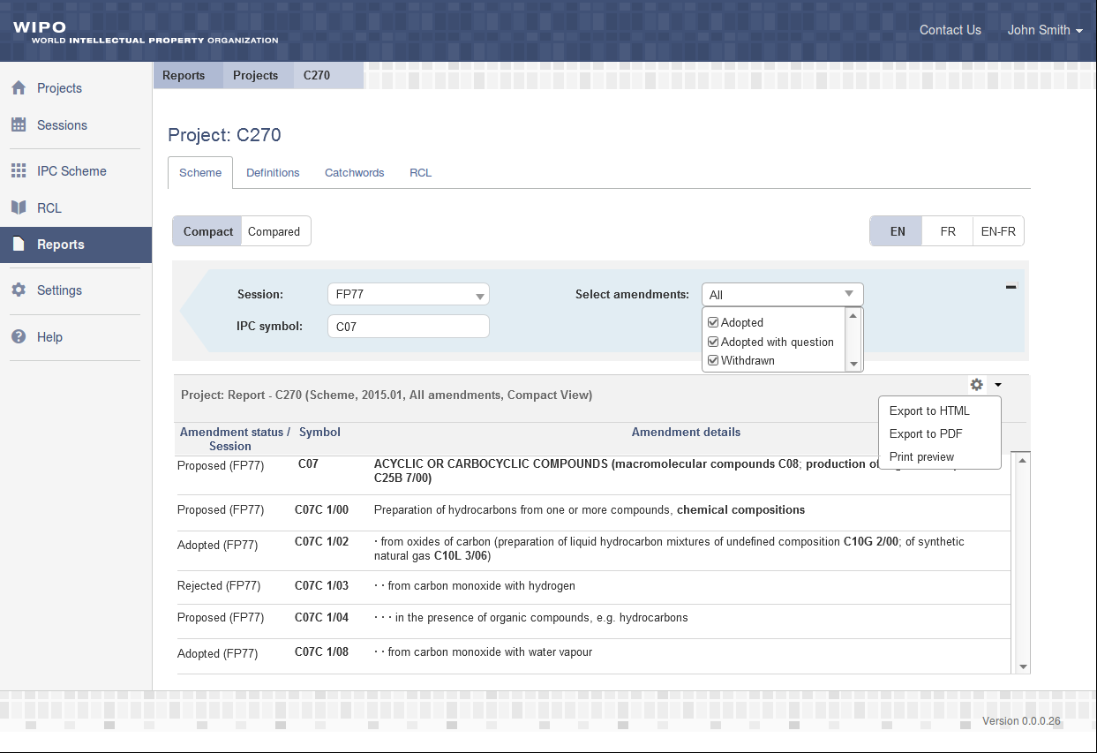
IPCRMS REPORTS
Generate reports in the context of Projects
Generate reports in the context of Sessions
View amendments with selected statuses
Compared view mode

Slide 28
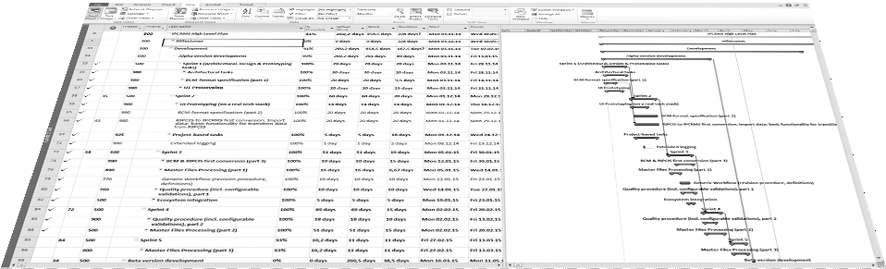
IPCRMS TIMELINE

Slide 29
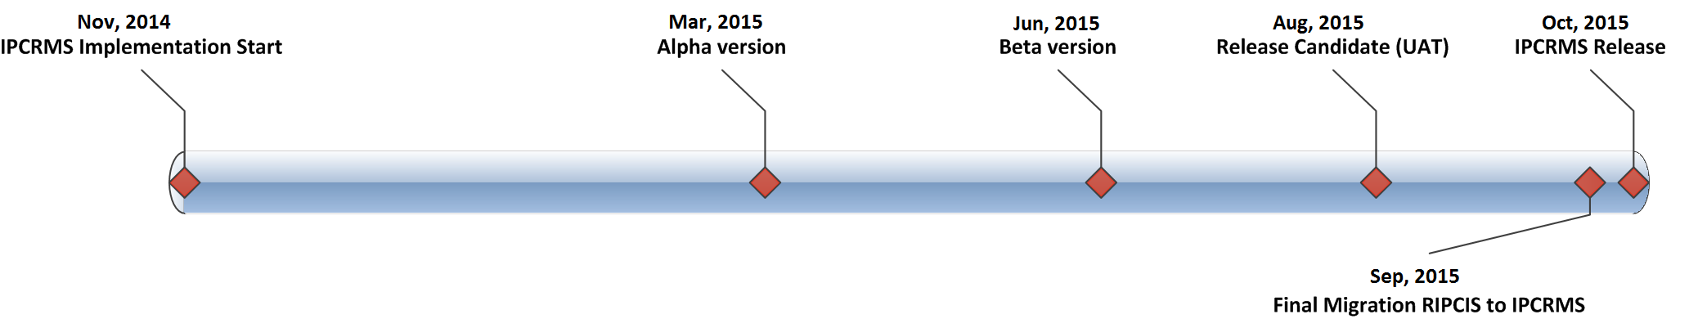
IPCRMS TimeLine
The most important IPCRMS milestones
Alpha version
Beta version
Release candidate (UAT)
Migration RIPCIS to IPCRMS
IPCRMS Release

Slide 30



IPCRMS Roadmap
Alpha version scope:
Projects & Sessions;
Proposing amendments for structured entries, Definitions and Catchwords;
Comments & counterproposals;
Make a decision.
Scope is limited by IB and Rapporteur roles.
Beta version scope:
Integration with WIM;
Proposing amendments for unstructured entries;
Illustrations and images;
Revision history;
Different view modes and data filtration;
Quality criteria.
Scope is extended by Translator and Co-Rapporteur roles.
Final release scope:
National Translations;
Reports;
System administration;
Integration with WIPO Ecosystem.
RIPCIS data is migrated to IPCRMS.

Slide 31
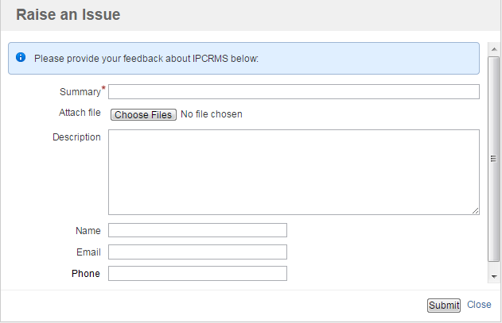
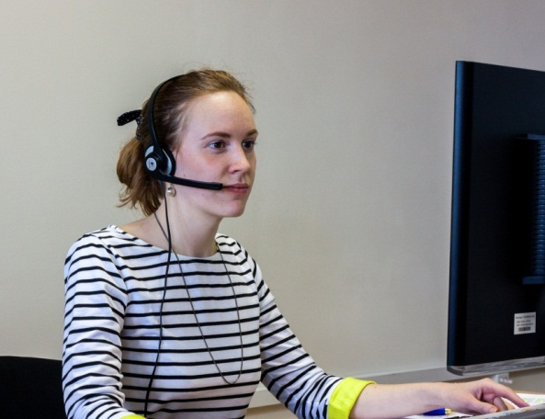
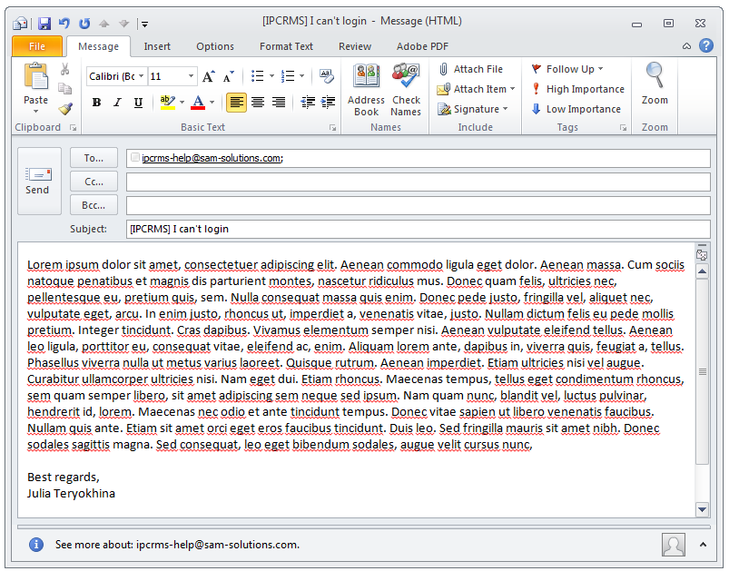
IPCRMS Availability and Helpdesk
✓
IPCRMS Availability: 24x6 worldwide
✓
Different options to get user assistance:
✓
First-level support (availability 12x5)
✓
Submit request to Helpdesk via IPCRMS
✓
Submit request via Helpdesk e-mail

Slide 32

Any Questions?

Slide 33
Thank YOU

