Slide 1
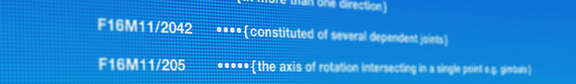
CPC Update
IPC Committee of Experts 2019
Nelson das Neves - Pierre Held - Dimple Bodawala
Geneva, 19 February 2019
Geneva, 20 February 2017

Slide 2
CPC and National Offices

Slide 3
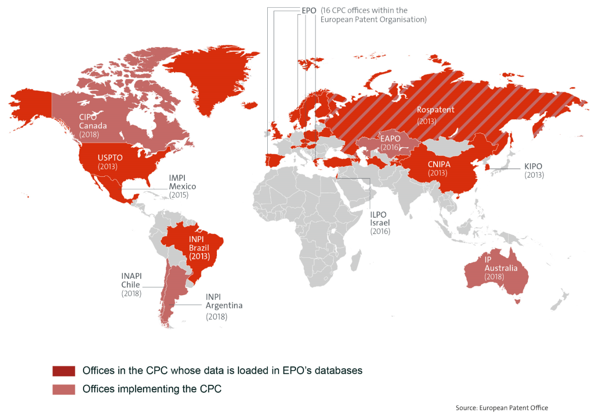
29 Offices participating in the CPC
Notes:
The Cooperative Patent Classification or CPC was launched on 1st January 2013 by the EPO and USPTO.
Since then, 27 other Patent Offices have decided to adopt the CPC as their internal classification scheme, including China, South Korea, and more recently Canada and Australia, extending the CPC community to 29 offices worldwide.
Furthermore CPC is used for search by more than 45 Patent Offices and more than 25000 examiners worldwide.
This means that within 5 years, the CPC has become an international classification standard.

Slide 4
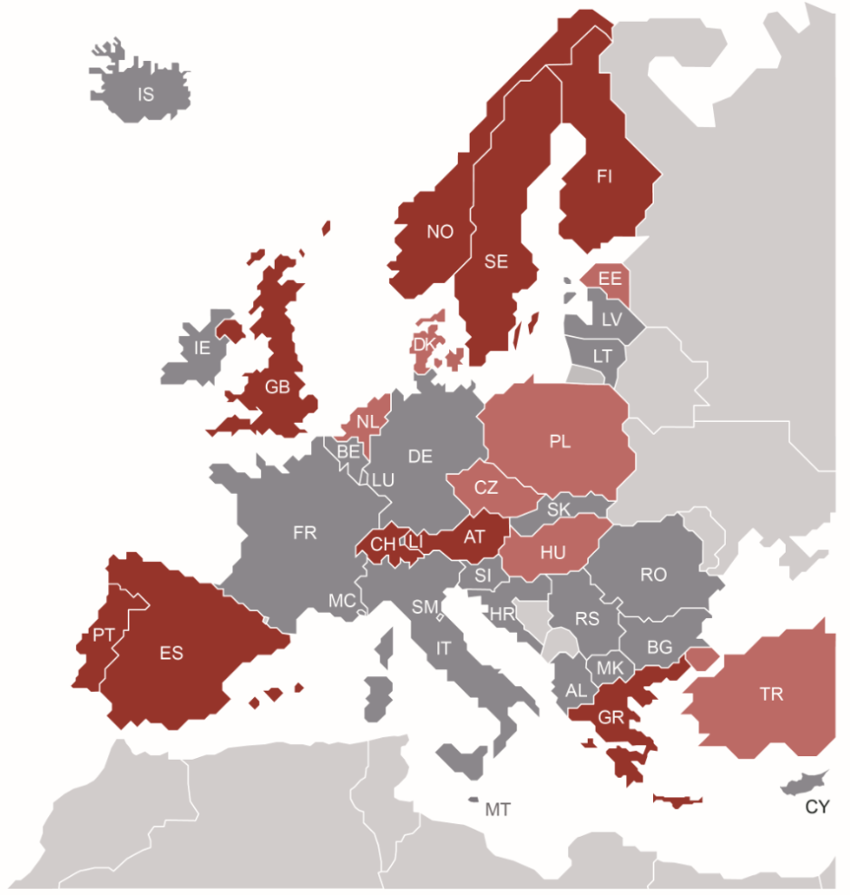

... including 16 EPO Member States
Notes:
Within the European Patent Organisation, 16 offices have decided to classify in the CPC.
9 of them are actually classifying and sending CPC data to the EPO.

Slide 5
CPC coverage
Much more than EP & US documents

Slide 6
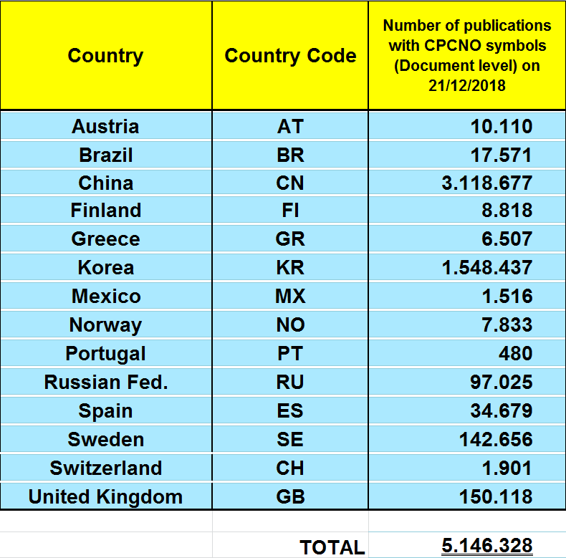
Publications with National Office (CPCNO) allocations
53.5 M patent documents classified in CPC
49.4 M
5.1 M
5.1 M patent documents at document level
49.4 M patent documents at simple patent family level
1.0 M patent documents both at document and family level
Updated 21 December 2018
Notes:
To date, apart from the EPO and USPTO, 14 CPC National Offices are actually classifying in the CPC and delivering CPC data to the EPO.
This table shows the number of publications classified in the CPC by National Offices and uploaded in EPO databases.
Overall, 53.5 million documents are classified in the CPC (at Family or Document level).
This includes 49.3 million documents classified at simple patent family level, including 48.3 million documents classified at simple patent family level only
and 5.1 million documents classified in CPC at document level, (i.e. they are bearing CPCNO allocations), including 4.1 million documents bearing only CPCNO symbols (i.e. without CPC allocations at family level)
There are 1,032,494 documents classified both at document and family level

Slide 7
CPC Update

Slide 8
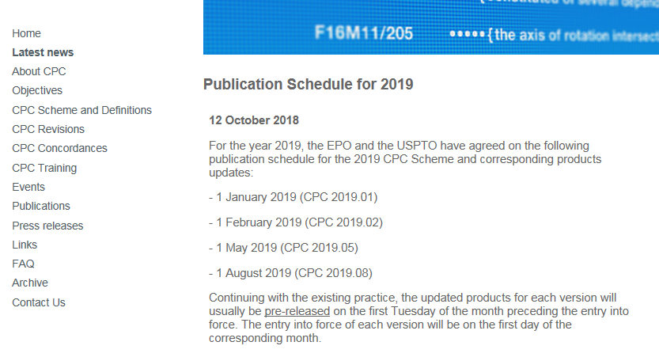
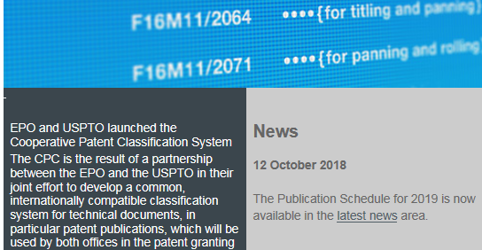
CPC Release Schedule
Four CPC releases in 2018:
              1 January 2018 - 2018.01
              1 February 2018 - 2018.02
              1 May 2018 - 2018.05
              1 August 2018 - 2018.08
See “Latest News” section on www.cpcinfo.org for the 2019 Publication Schedule
Four releases scheduled in 2019:
  1 January 2019 (2019.01)
  1 February 2019 (2019.02)
  1 May 2019 (2019.05)
  1 August 2019 (2019.08)

Slide 9
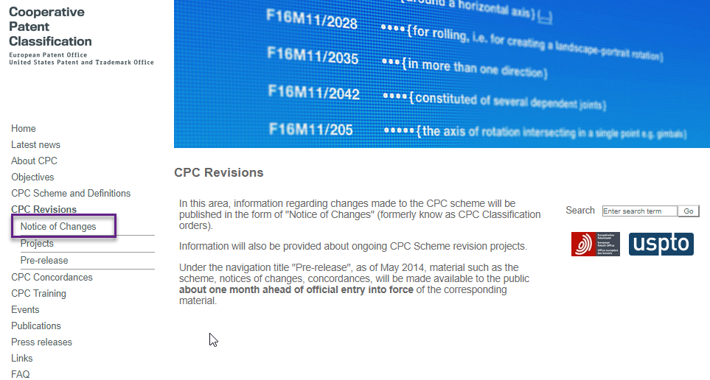
CPC Notices of Changes (NoC) Publications:
2018 NOC Publication | RP | DP | MP | TOTAL
January | 23 | 6 | 19 | 48
February | 10 | 2 | 6 | 18
May | 9 | 1 | 10 | 20
August | 24 | 2 | 13 | 39
TOTAL | 66 | 11 | 48 | 125
2019 NOC PUBLICATION | RP | DP | MP | TOTAL
JANUARY | 39 | 8 | 32 | 79
FEBRUARY | 14 | 0 | 3 | 17
TOTAL | 53 | 8 | 35 | 96
Notes:
When we account for maintenance and definition revision projects, those numbers grow to totals of 127 in 2018. These revisions resulted in the reclassification of more than 115,000 families into CPC.
By August 2018, the added symbols increased to 2,445, and those deleted were 1,474.
Reclassification work was completed for 130 revision projects, which resulted in 58,094 families reclassified in CPC.

Slide 10
Scheme Changes in 2018/2019:
Number of created new symbols
Number of deleted symbols
CPC version | Total no. symbols | Symbols deleted | Symbols added
2018.01 | 260,674 | 409 | 1,243
2018.02 | 260,741 | 253 | 320
2018.05 | 260,846 | 437 | 542
2018.08 | 260,812 | 375 | 341
TOTAL | 1,043,073 | 1,474 | 2,446
CPC version | Total no. symbols | Symbols deleted | Symbols added
2019.01 | 260,864 | 531 | 583
2019.02 | 260,890 | 631 | 657
TOTAL | 521,754 | 1162 | 1240

Slide 11
Definitions Changes in 2018/2019:
Number of published definitions
Number of deleted definitions
Number of modified definitions
CPC version | Total no. Definitions | Definitions deleted | Definitions added | Definitions modified
2018.01 | 42,811 | 36 | 77 | 302
2018.02 | 42,873 | 77 | 139 | 180
2018.05 | 42,976 | 9 | 112 | 308
2018.08 | 43,136 | 5 | 165 | 243
TOTAL | 171,796 | 127 | 493 | 1033
CPC version | Total no. Definitions | Definitions deleted | Definitions added | Definitions modified
2019.01 | 43,110 | 344 | 318 | 939
2019.02 | 43,181 | 228 | 299 | 661
TOTAL | 86,291 | 572 | 617 | 1600

Slide 12
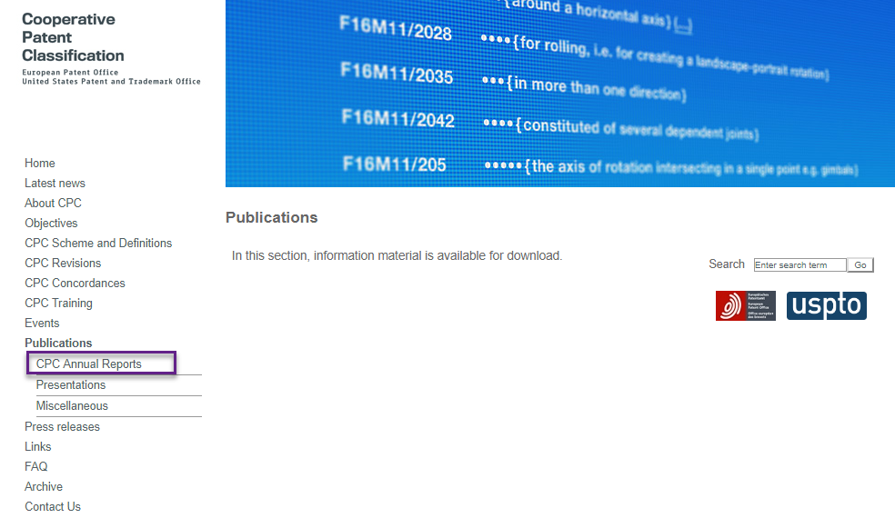
CPC Annual Report 2017/2018
Coming soon
http://www.cooperativepatentclassification.org/publications/AnnualReports
Notes:
Published 2017/2018 CPC Annual report

Slide 13
New CPC products

Slide 14
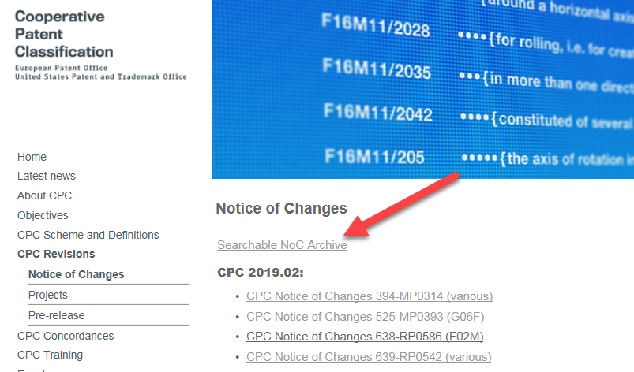
Searchable NoC archive
New!

Slide 15
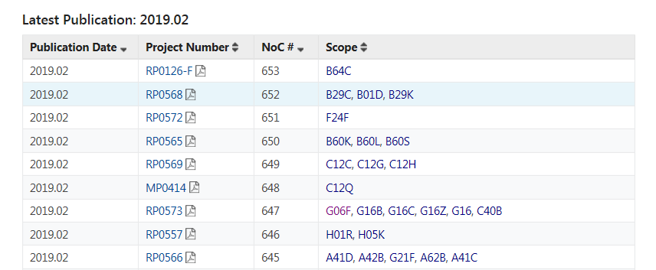
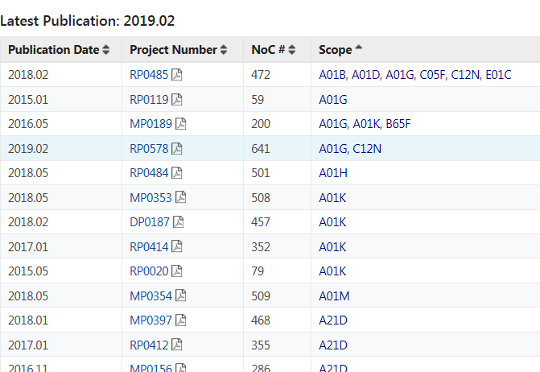
Searchable NoC archive

Slide 16
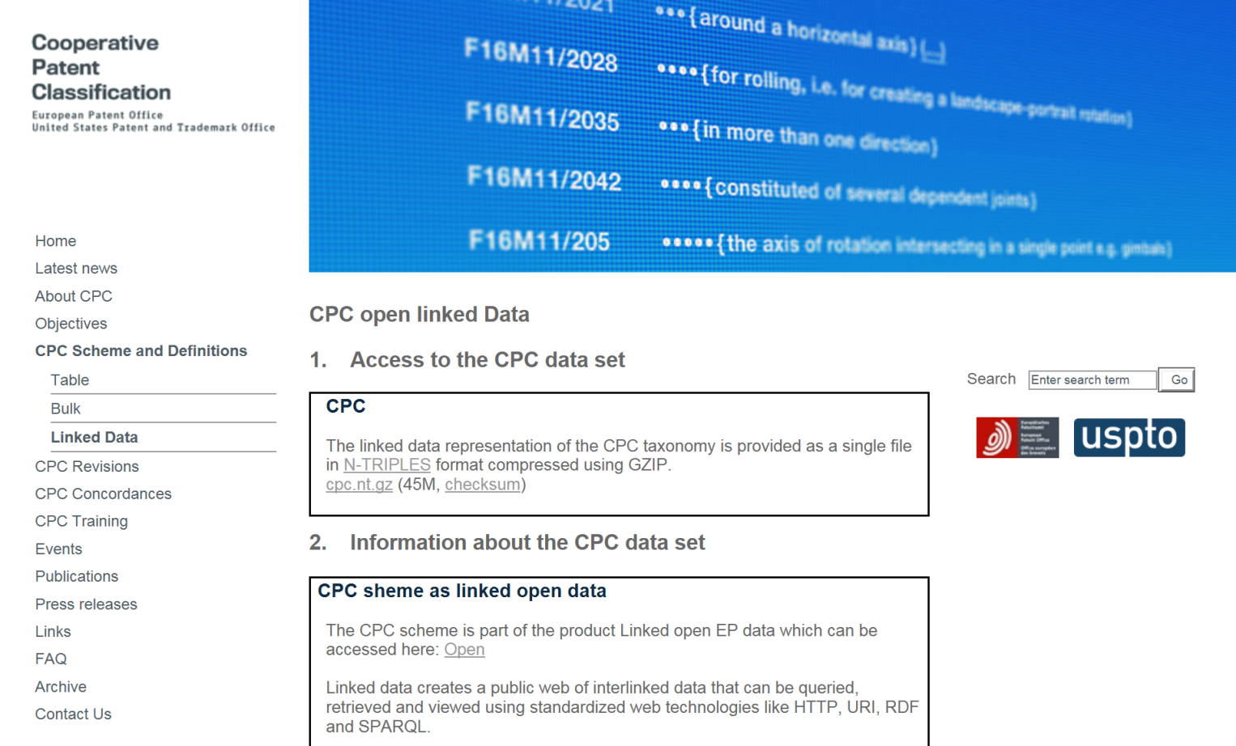
CPC as open linked data
New!

Slide 17
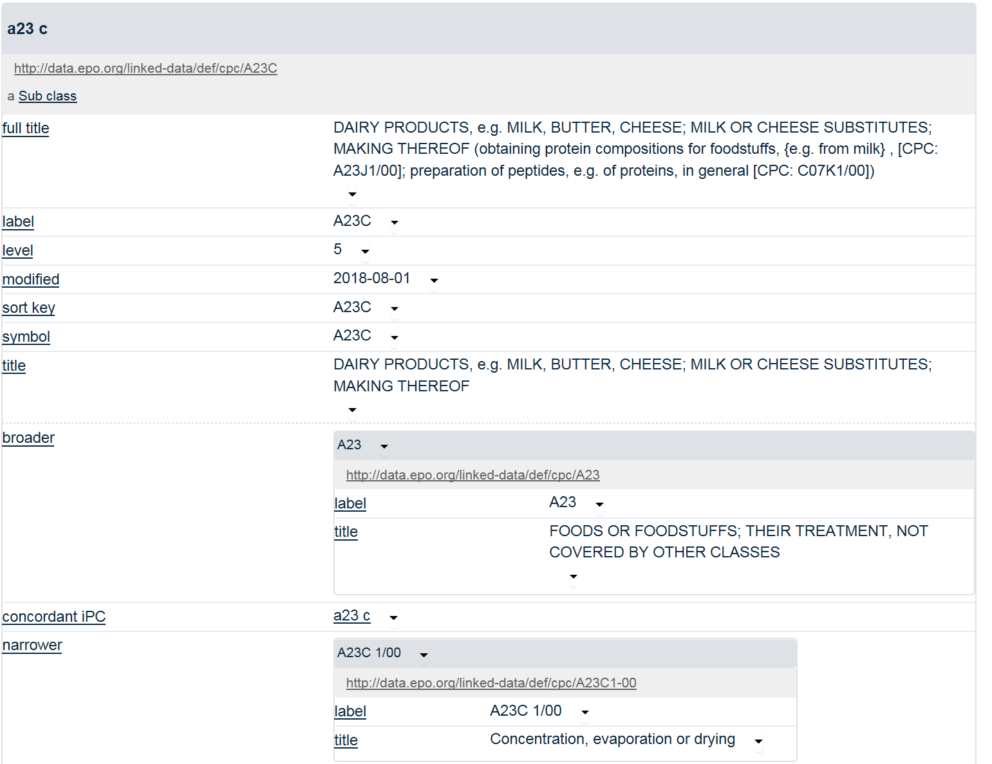

Slide 18
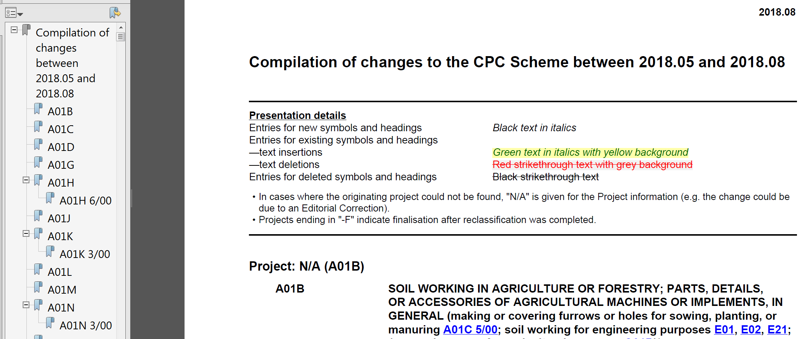
Compilation of changes
Coming soon

Slide 19
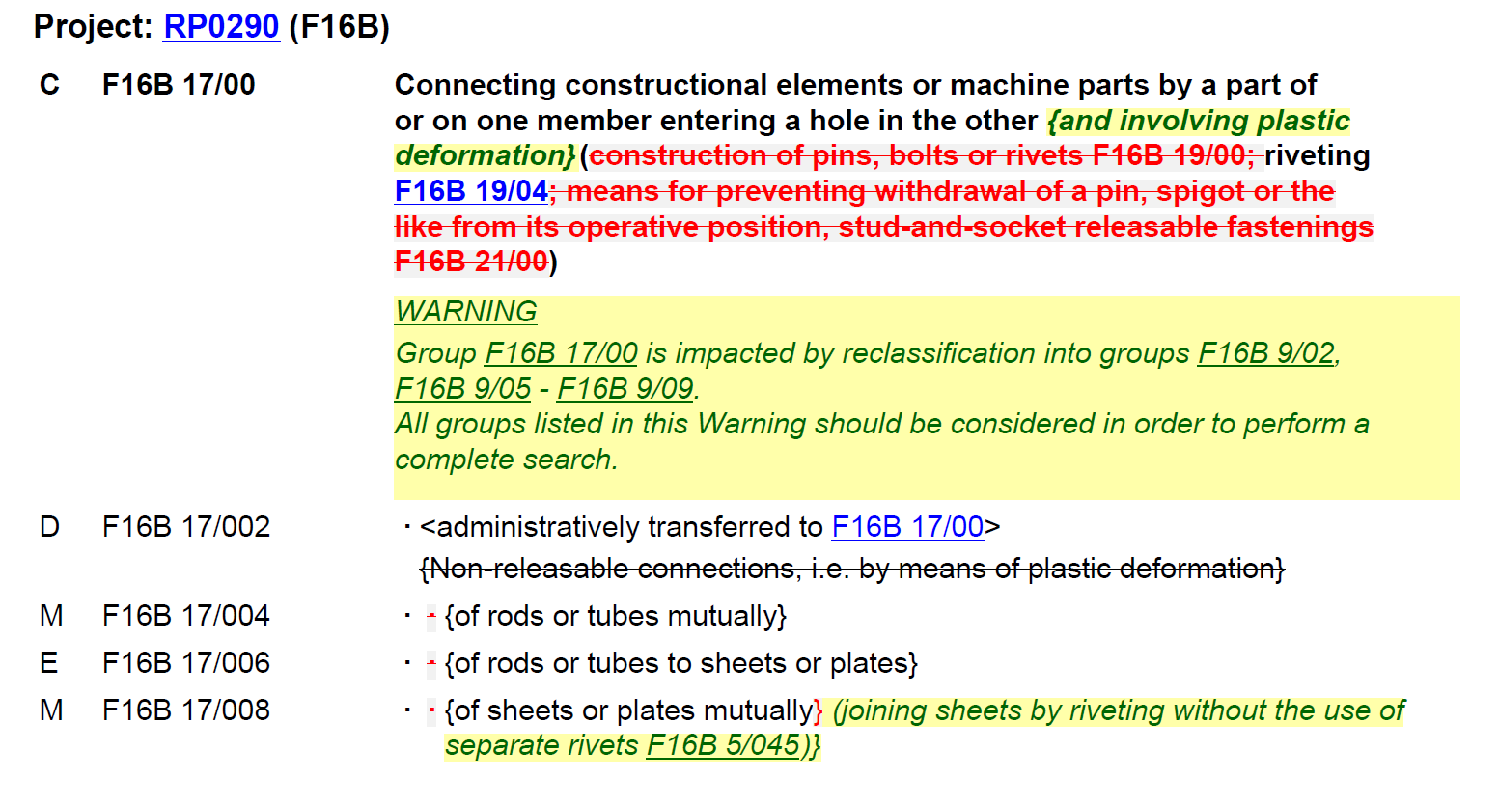
Compilation of changes

Slide 20
CPC International

Slide 21
Impact of the CPC International project on CPCNO data
CPC data from National Offices are currently stored at document level, in the C(PC)NO fields in Epodoc, i.e. CNOI, CNOA and CLC.
After launch of CPC International:
Allocations from National Offices at simple patent family level
Office(s) endorsing allocation visible and searchable
No Raise-Hand flags – Each Office manages its own allocations
Supported by a new CPCDB infrastructure
Notes:
Until April 2019, CPC allocations from National Offices were stored at document level in specific fields in Epodoc, i.e. CNOI, CNOA and CLC for C-Sets.
For a number of reasons, including the wish to treat allocations from the EPO, USPTO and other National Offices equally, as well as to simplify the synchronisation and conflict resolution mechanisms between the EPO and USPTO, the CPC International project was started between the EPO and the USPTO.
As a consequence, from April 2019 onwards, allocations from National Offices will be stored, like EPO and USPTO allocations, at simple patent family level.
The Office endorsing a particular allocation will be visible and searchable
The concept of “Raise-Hand flags” will disappear – an EPO examiner will be allowed to delete an allocation given by the USPTO and vice versa – each Office will manage its own allocations
A new CPC Database infrastructure and synchronisation mechanism has been established using state of the art cloud technology
We will keep circulating US documents to EPO examiners for classification in non-proficient technical fields: the new process does not impact the proficiency level of the USPTO in a technical field.

Slide 22
Old situation
Document level
(CPCNO)
Family level
(CPC)
INPI Brazil | BR9910073 | H01R 12/71 | H01R 12/71 H01R 13/6581
CNIPA | CN1306684 | H01R 13/65
EPO | EP1075714 | H01R 12/71 H01R 13/6581
UKIPO | GB2353908 | H01R 12/73
KIPO | KR20010071195 | H01R 13/65
PRV | SE0003892 | H01R 13/6581
USPTO | US6206729 | H01R 12/71 H01R 13/6581
Notes:
This slide will show you in a graphical way the difference between the old and new situation regarding the storage and display of CPC allocations.
Let us consider a patent family consisting of the following family members.
Each office has classified its corresponding family member as indicated.
Under the old situation, only the allocations provided by the EPO and USPTO were promoted to the simple patent family level.
The allocations provided by other CPC National Offices were stored at document level under specific “CPCNO” fields.

Slide 23
Current situation
Document level
(CPCNO)
Family level
(CPC)
INPI Brazil | BR9910073 | H01R 12/71 | H01R 12/71 H01R 13/6581
CNIPA | CN1306684 | H01R 13/65
EPO | EP1075714 | H01R 12/71 H01R 13/6581
UKIPO | GB2353908 | H01R 12/73
KIPO | KR20010071195 | H01R 13/65
PRV | SE0003892 | H01R 13/6581
USPTO | US6206729 | H01R 12/71 H01R 13/6581

Slide 24
Future situation
Document level
(CPCNO)
Family level
(CPC)
INPI Brazil | BR9910073 | H01R 12/71 | H01R 12/71 (EP, BR, US) H01R 13/65 (CN, KR) H01R 13/6581 (EP, SE, US) H01R 12/73 (GB)
CNIPA | CN1306684 | H01R 13/65
EPO | EP1075714 | H01R 12/71 H01R 13/6581
UKIPO | GB2353908 | H01R 12/73
KIPO | KR20010071195 | H01R 13/65
PRV | SE0003892 | H01R 13/6581
USPTO | US6206729 | H01R 12/71 H01R 13/6581
Notes:
Under the new situation, allocations from all CPC National Offices are promoted to the simple patent family level
There is no need for the CPCNO fields anymore – they will disappear from the EPO databases

Slide 25
Future situation
Family level
(CPC)
INPI Brazil | BR9910073 | H01R 12/71 (EP, BR, US) H01R 13/65 (CN, KR) H01R 13/6581 (EP, SE, US) H01R 12/73 (GB)
CNIPA | CN1306684
EPO | EP1075714
UKIPO | GB2353908
KIPO | KR20010071195
PRV | SE0003892
USPTO | US6206729
H01R 12/73 (GB)
Notes:
It is now possible to identify which office endorses a particular allocation. Here for instance, the allocation H01R 12/73 is endorsed by the United Kingdom Intellectual Property Office.

Slide 26
Future situation
Document level
(CPCNO)
Family level
(CPC)
INPI Brazil | BR9910073 | H01R 12/71 | H01R 12/71 (BR, EP, US) H01R 13/65 (CN, KR) H01R 13/6581 (EP, SE, US) H01R 12/73 (GB)
CNIPA | CN1306684 | H01R 13/65
EPO | EP1075714 | H01R 12/71 H01R 13/6581
UKIPO | GB2353908 | H01R 12/73
KIPO | KR20010071195 | H01R 13/65
PRV | SE0003892 | H01R 13/6581
USPTO | US6206729 | H01R 12/71 H01R 13/6581

Slide 27
CPC updates_the USPTO

Slide 28
CPC training
USPTO training
Bilateral consultation
- Examiner(s)/classifier(s) focused workshop / training
Training material
Timeline for the training
Previous training held at Brazil, Chile, Israel, Korea, and the USPTO
Specific feedback - contact the USPTO classification division
(CQIC – classification quality and international coordination division)
Notes:
CPC Scheme & Definitions
E-learning modules
See training e-learning modules on the cpcinfo.org website:
Using CPC in classification
Practical and strategical aspects of the CPC
CPC General training
CPC Advanced training
C-set training
CPC Collective Training Events
CPC Field-specific training:
FST videos

Slide 29
CPC training (con.)
Customize unique technical expert training for each
Office (at the USPTO or National Office(s) location)
General training
Master level training
Advanced training in specific technical field
C-set training
Computer based training (CBT) e-learning modules
Field-specific training (FST) on the CPC scheme/definitions
(Http://ptoweb.Uspto.Gov/patents/cpc/fst.Html)
Notes:
Other CPC modules were not released to the public in 2018, because they’re under review by the management. The management will decide when to release them internally to USPTO examiners. CPC Essentials I (classification system and cpc scheme) will be released to cpcinfo in 2019.

Slide 30
CPC Implementation
The USPTO transitioning to CPC routing from the USPC (united state patent classification) routing
CPC revisions, IP5 revisions and IPC revisions underway
Research on artificial intelligence (AI) for classification

Slide 31
CPC Update - EPO

Slide 32
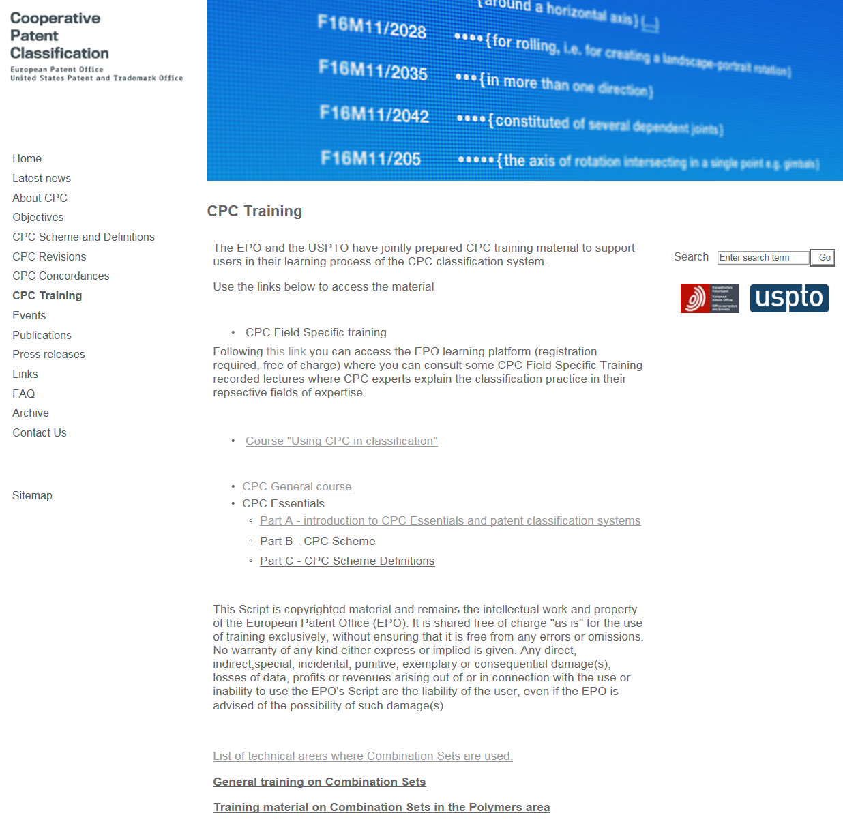
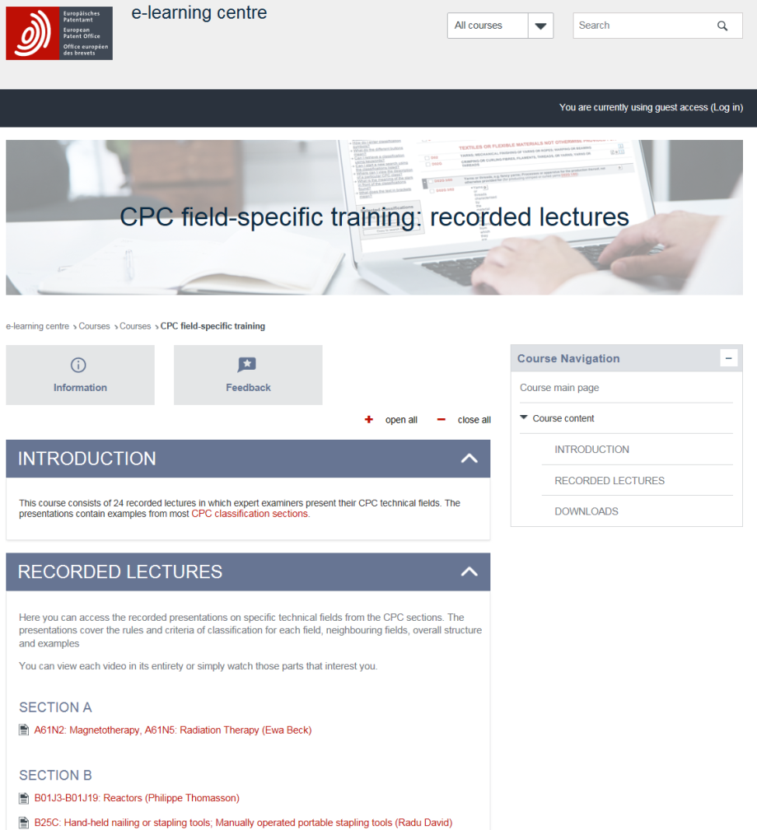
CPC Training on www.cpcinfo.org
https://www.cooperativepatentclassification.org/Training.html

Slide 33
CPC International
Impact on DocDB XML

Slide 34
Impact of CPC International on DocDB XML
From the point of view of DocDB XML, the changes related to the CPC International project are minor:
No impact on schema definition
No impact on the content of element <patent-classification>
Minor change in the content of element <classification-scheme>
  currently: value “CPC” (EPO, USPTO) or “CPCNO” (other NO)
  future: value “CPCI”
Minor change for element <generating-office>
  currently only populated when “scheme” = “CPCNO”
  future: populated in all cases

Slide 35
Impact of CPC International on DocDB XML
Notification and documentation was sent in November 2018
Included sample files
Same package also loaded on the download area under 14.7 DOCDB (notification folder)
Will be published once CPC International goes live

Slide 36
CPC International
Impact on Epoque (Net)

Slide 37
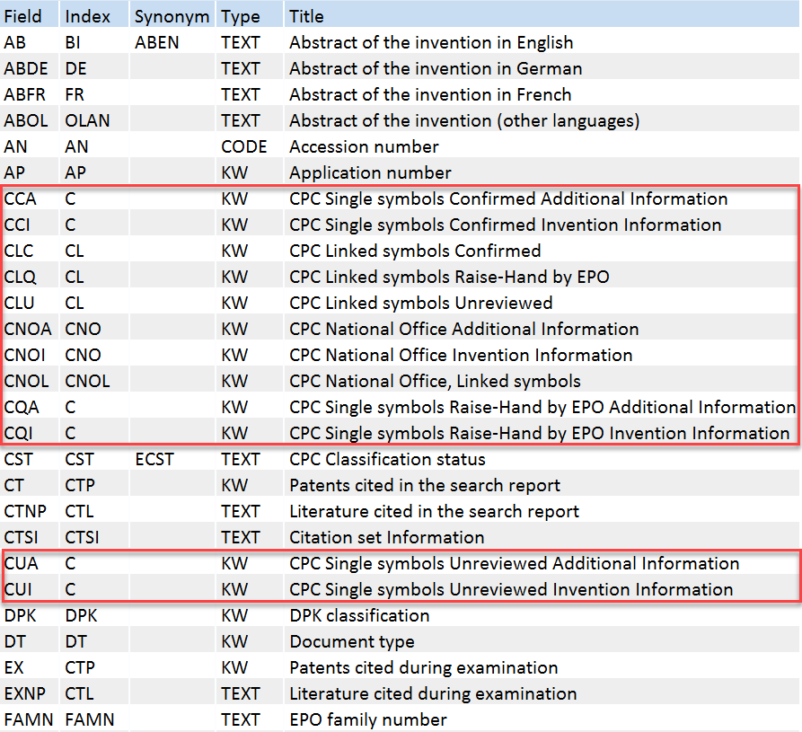
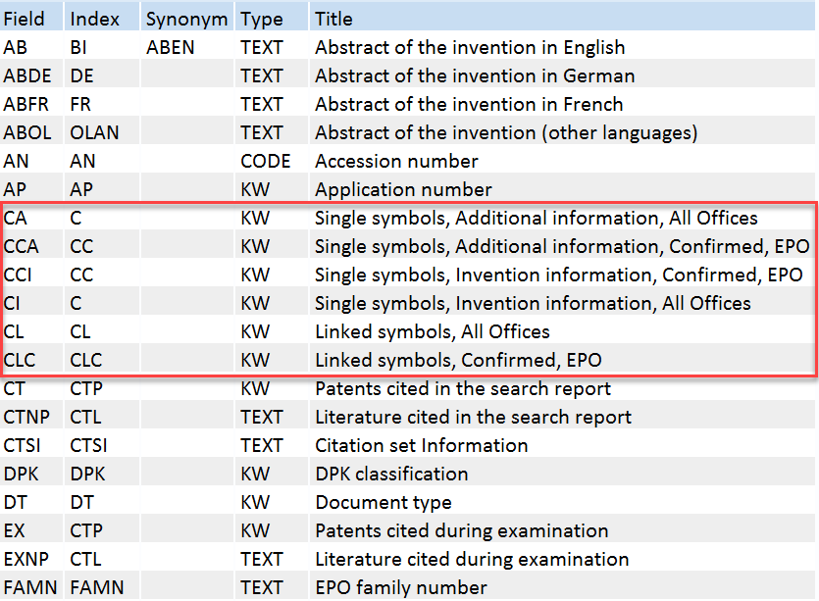
EPOQUE (Net) – old and new CPC fields in EPODOC
Old
New
Notes:
Epoque has been adapted to the new situation. In EPODOC, the number of CPC fields has changed from 12 to only 6.
There are no Raise-Hand flags anymore – therefore the fields CQI, CQA and CLQ have disappeared.
There are no specific fields for unreviewed allocations anymore, i.e. CUI, CUA and CLU: allocations provided by examiners not authorised in a technical field, e.g. when creating visits, are searchable from the /CI field
All allocations are stored at simple patent family level – there is no need for CPCNO fields anymore, i.e. CNOI, CNOA and CNOL. These fields have therefore disappeared.
This results in a substantial simplification of the CPC fields in Epodoc to 6 fields only.

Slide 38
EPODOC fields
FIELD | Content
/CI | Single symbols, Invention information, All Offices
/CA | Single symbols, Additional information, All Offices
/CCI | Single symbols, Invention information, Confirmed, EPO
/CCA | Single symbols, Additional information, Confirmed, EPO
/CL | Linked symbols, All Offices
/CLC | Linked symbols, Confirmed, EPO
Notes:
To summarise, here are the 6 Epodoc fields with their meaning:
/CI: CPC Invention information, all offices
/CA: CPC Additional information, all offices
/CCI: CPC Confirmed Invention information, i.e. confirmed by an EPO examiner authorised in the technical field
/CCA: CPC Confirmed Additional information, i.e. confirmed by an EPO examiner authorised in the technical field
/CL: CPC Linked Symbol (C-Set), all offices
/CLC: CPC Linked Symbol (C-Set), Confirmed, , i.e. confirmed by an EPO examiner authorised in the technical field

Slide 39
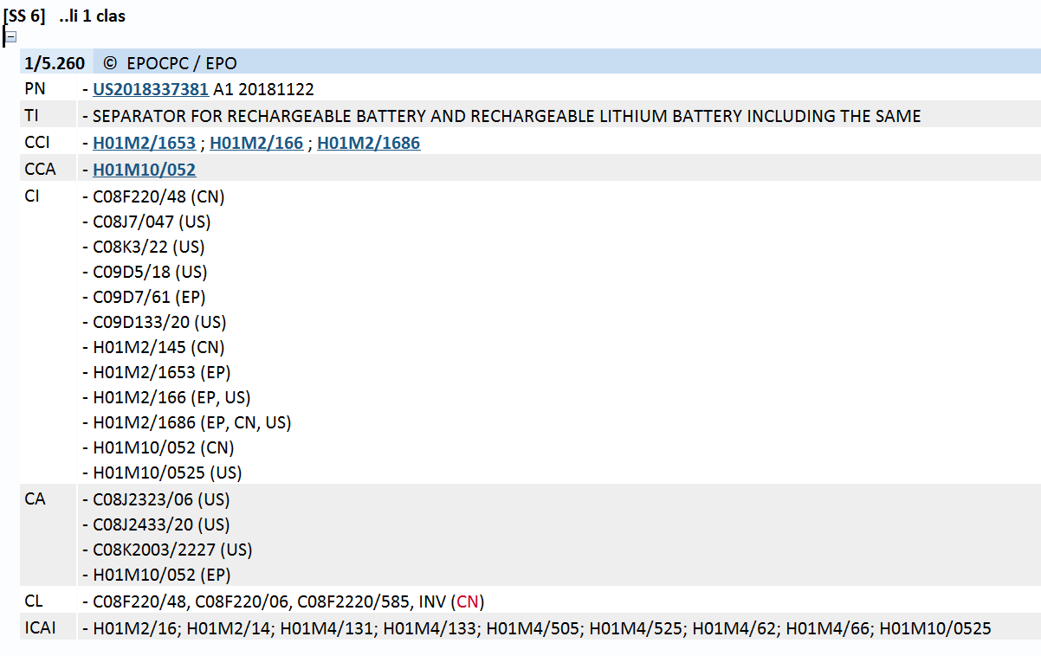
EPODOC - Display
Notes:
When displaying the classification information for a particular record with the command ..clas, as a default the classification information is provided with the confirmed information first (CCI and CCA), followed by the classification information from all offices (CI and CA).
Offices endorsing a particular allocation are listed in alphabetical order, with EP appearing first when appropriate, e.g. (EP, CN, US)
Note that when an EPO examiner creates a visit to a field where he/she is not authorised to classify, the corresponding allocation is searchable in the field /CI (or /CA). It is only when the allocation gets confirmed by an authorised classifier that it becomes available under /CCI (resp. /CCA).

Slide 40
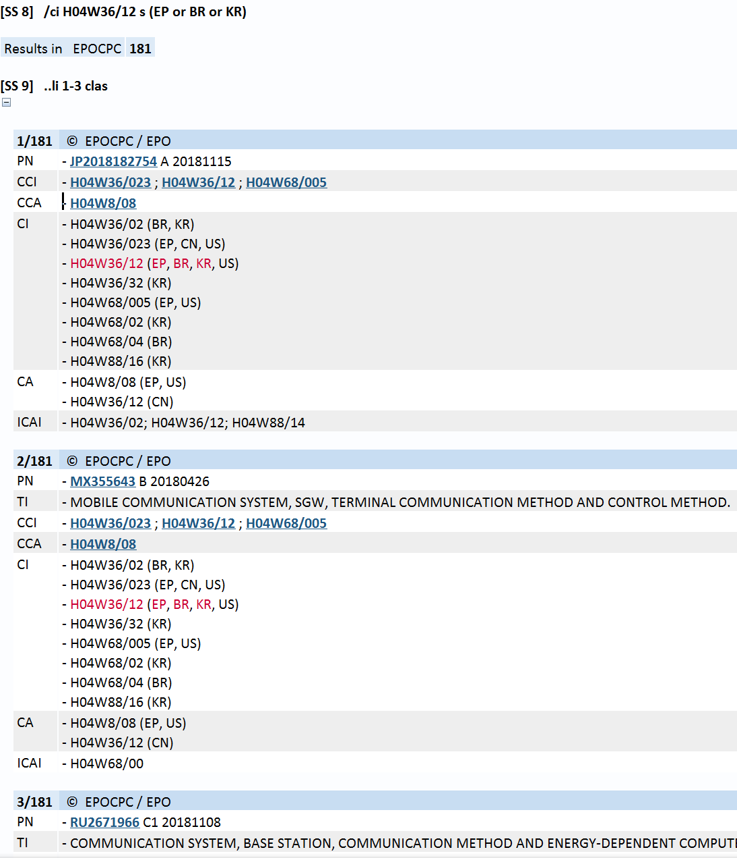
EPODOC – Search
Symbol endorsed by an office, e.g. BR
/CI H04W 36/12 S BR
Symbol potentially endorsed by
certain offices, e.g. EP or BR or KR
/CI H04W 36/12 S (EP OR BR OR KR)
Notes:
It is possible to search for a symbol endorsed by a particular office. To do so, just search in field /CI (or /CA) for the symbol and the country code using “S”, “P” or “L” as an operator. For instance, /CI H04W 36/12 S BR will retrieve all records classified by Brazil in H04W 36/12
Similarly, it is possible to search for a symbol endorsed by the EPO or Brazil or Korea by using the OR operator in a bracket, e.g. H04W 36/12 S (EP OR BR OR KR). (OR combination)

Slide 41
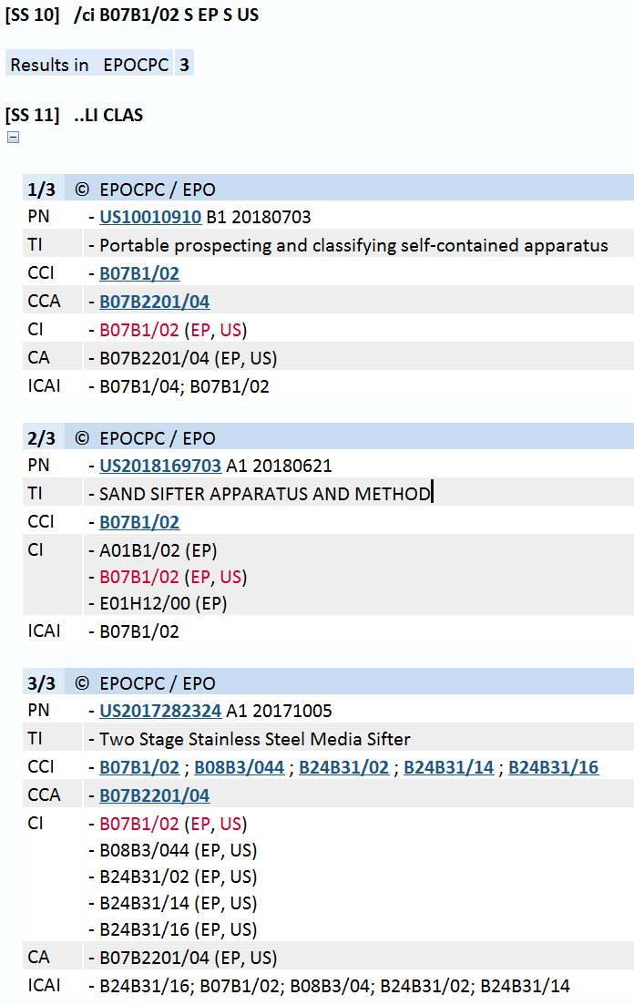
EPODOC – Search (AND)
Search for symbol endorsed by
certain offices, e.g. EP and US:
/CI B07B 1/02 S EP S US
Notes:
When one wants to search for a symbol endorsed by certain offices, e.g. the EPO and the USPTO, one needs to use the “S” or “L” or “P” operator with each office, e.g. B07B1/02 S EP S US to search for records for which both the EPO and USPTO have endorsed B07B 1/02.

Slide 42
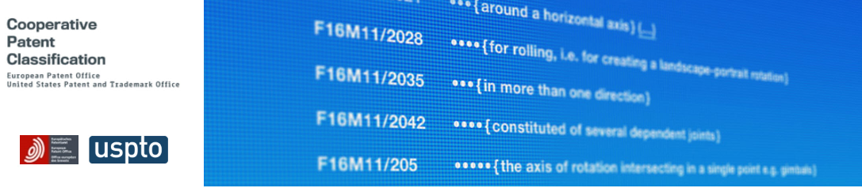
Thank you for your attention!

