Slide 1
Experience at INPI/BR on Computer-Assisted Classification
Catia Valdman
Head of the Telecommunications Division
DIRPA / INPI
Geneva, February 20th, 2019

Slide 2
Summary
Historical overview
Current situation
Future perspective

Slide 3
Historical overview
Main goal was (still is) routing the file to one of the twenty divisions;
We first applied a neural network in 2010;
We rank each division for every new file application, routing the file to the first division ranked and showing which is the second in the rank;
In April 2018 we changed the algorithm for this task;

Slide 4
Current situation
Multilayer perception applied in Application Router (AR);
AR is using title and abstract;
Process includes
Identifying tokens;
Excluding stop words;
Stemming the working words with Scikit Learn package;
Extracting features using a TFIDF (Term Frequency Inverse Document Frequency);
Ranking the twenty divisions.

Slide 5
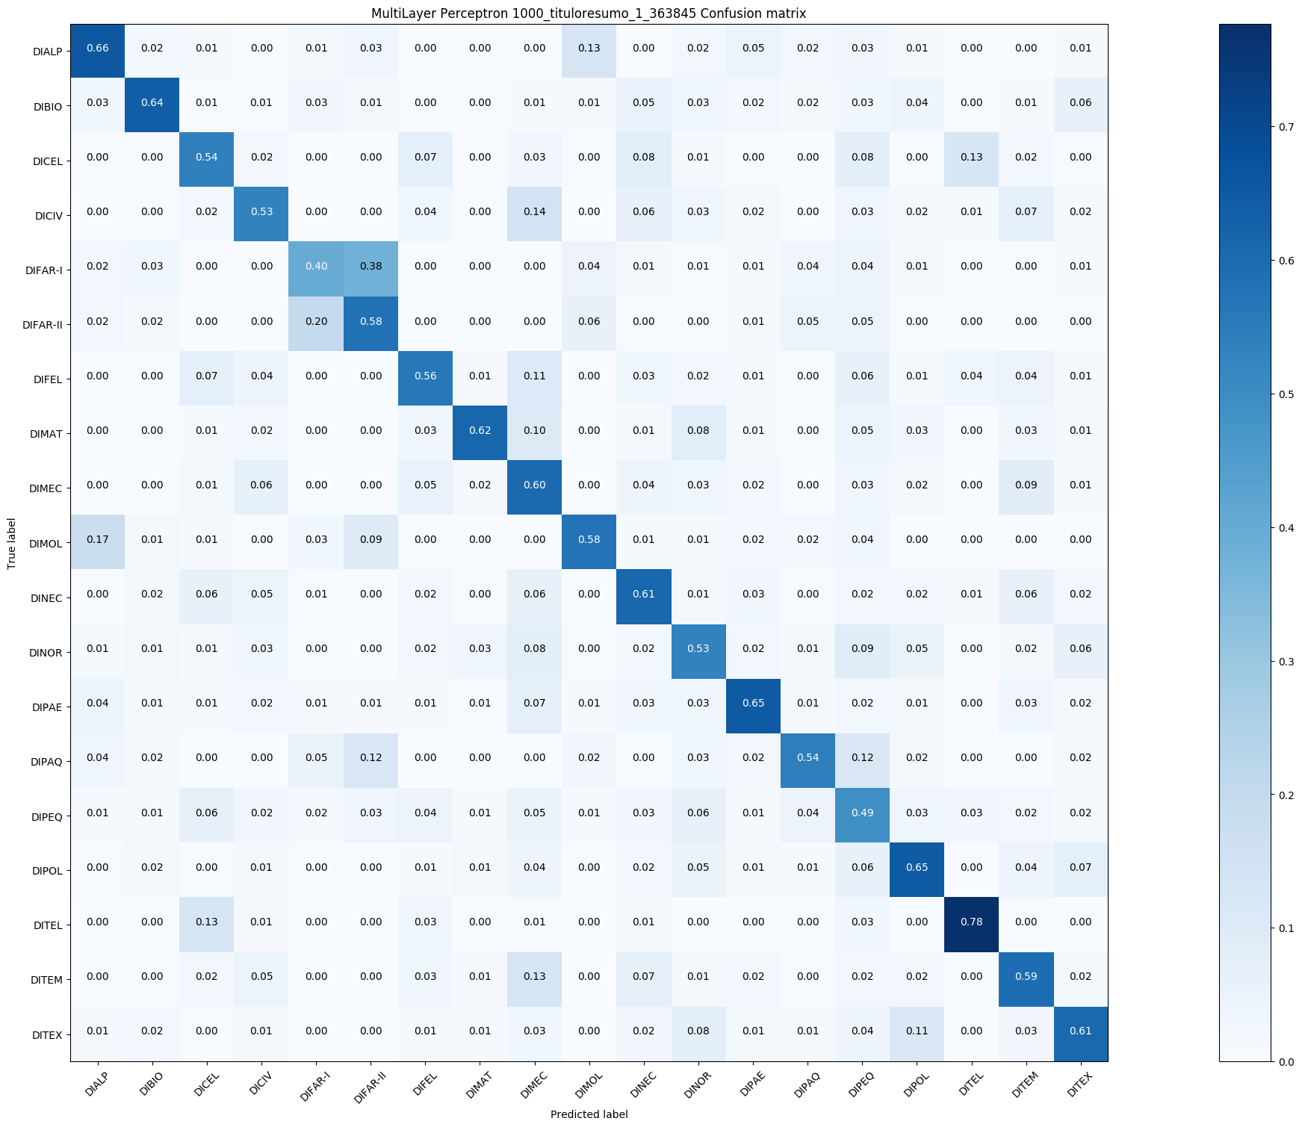
Current situation
200 features from the title;
800 features from the abstract;
Mono-gram type, although it was tested with bi-gram the time cost for processing was too high;
363.845 applications were used to train this model.

Slide 6
Future perspective
Retrain the current AR with information since April 2018;
Being able to attribute symbols up to subclass level, as it is in IPCPUB website;
Exchange information in order to improve our knowledge in this area:
Rafael Nunes rafael.nunes@inpi.gov.br
Marcus Vieira marcus.vieira@inpi.gov.br
Celso Tchao celso.tchao@inpi.gov.br

Slide 7
cvaldman@inpi.gov.br
http://ipc.inpi.gov.br/

