Slide 1
Automated Patent Preclassification at the German Patent and Trade Mark Office (DPMA)
Geneva, February 2020

Slide 2
Patents and Utility Models
2018 at a glance

Slide 3

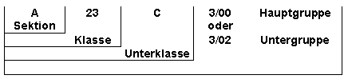

Automated Patent Preclassification
IPC
The allocation of responsibilities at DPMA is based on the IPC.
Therefore, the IPC is essential for the processing of patent applications.
Challenges
An improved new tool
for automated IPC-classification
Better Support
of the business processes at DPMA
Customizability
covering various use cases at DPMA
parameterisation, flexibility

Slide 4
Pre-classification: the business process
The automated patent classification tool is part of the internal electronic filing system for patents and utility models.
“Old” e-classifier (until 30.09.2019)
introduced in 2011
based on heuristic algorithms
black-box solution, no interfaces, few customization possibilities (input document selection), time-consuming process
The aim was and still is to allocate patent applications to individual responsible patent examiners.

Slide 5
Pre-classification: the business process
The e-classifier …
assigns IPC suggestions to the incoming patent application
(abstract, description, claims).
➔ Intellectual initial allocation – based on IPC suggestions of e-classifier
coarse classification => routing to the appropriate patent examination department based on the main (i.e. most likely) classification
➔ Fine classification in the patent examination department
and assignment of secondary classification symbols
… is the first step before patent examination by the responsible examiner.

Slide 6
Pre-classification: the business process
Quality Management System
Data analysis by the statistical department of the DPMA
Comparison between the output of the e-classifier
and the main IPC symbol assigned in intellectual initial allocation
Valid hit
when one of the three IPC-suggestions of the e-classifier matches main IPC symbol assigned in initial allocation at subclass level:
about 80%

Slide 7
The new classifier
is based on supervised machine learning (fastText library),
is trained with publications of patent applications, granted patents and utility models from 2010 to 2019.
The training collection is balanced across the IPC hierarchy
classification depth depends on the number of documents available
classification up to the IPC sub-group level (approx. 5000 categories).
IPC-revisions (concordance lists) are considered during the training.

Slide 8
The new classifier
is in production since 1.10.2019 with full integration into the unit for digitising incoming documents of the DPMA,
has probability evaluation of the classification results – “top prediction” and “three guesses”,
workflow (data preparation, training and evaluation) is flexible, transparent, modular with parameter configuration at each step and view of partial results,
is implemented as a webservice and an Interactive Classification Tool,
is no cloud service, as confidential data sets are classified.
Statistical evaluation of the new e-classifier is still under development.

Slide 9
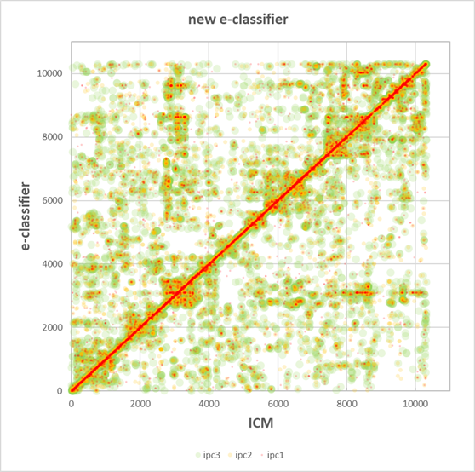
Preliminary statistical evaluation
Plot shows IPC suggestions 1,2,3 vs. IPC main class.
majority (of values) on or close to principal diagonal
symmetrical cluster formation off principal diagonal since the classification scheme is not always unambiguous

Slide 10
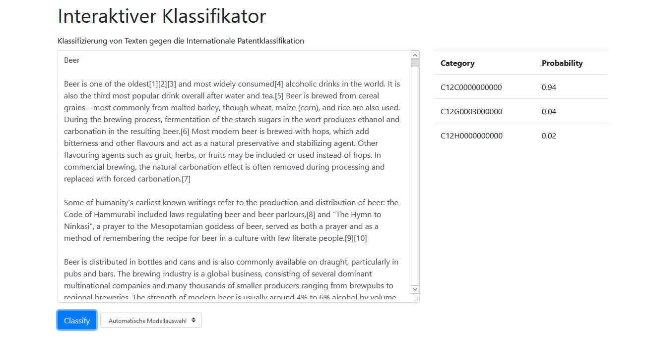
The new classifier
Interactive Classification Tool - assists the coarse classification

Slide 11
Thank you !
Questions?
ipc-de@dpma.de

