Slide 1
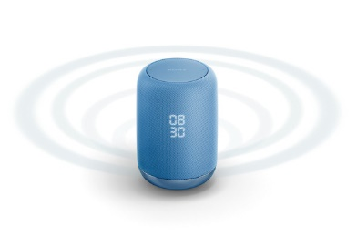
AI for Sony
Accelerated by AI
Contents
Contents
Enhanced by AI
Service
Service
Products
Empowered by AI
Products
Manufacturing
Improved by AI
Manufacturing
Components
AI Ethics
Reinforced by AI

Slide 2
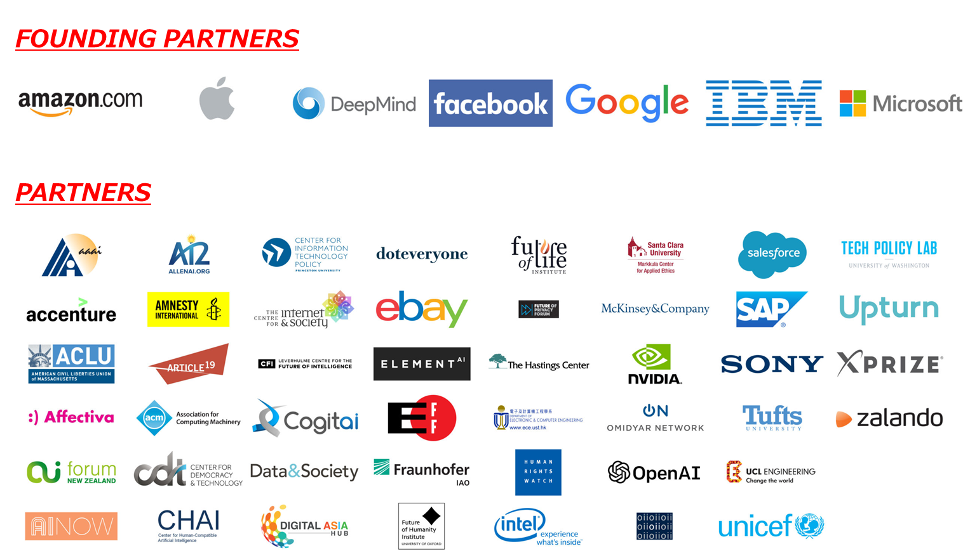
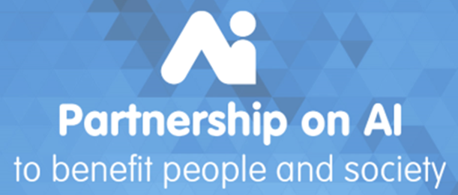
Partnership on AI
Goals
Develop and Share Best Practices
Advance Public Understanding
Provide an Open and Inclusive Platform for Discussion and Engagement
Identify and Foster Aspirational Efforts in AI for Socially Beneficial Purposes

Slide 3
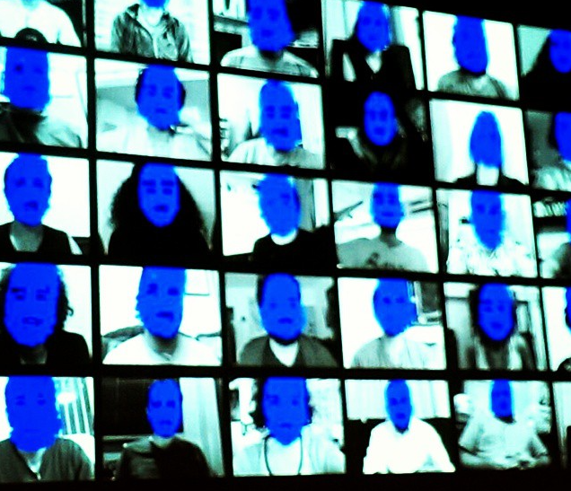
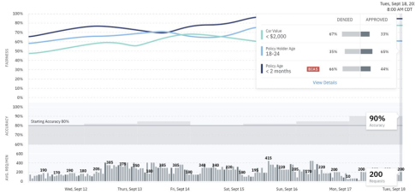
AI Ethics－FAT (Fairness, Accountability, and Transparency）
Fairness
Accountability
Transparency
Non-discriminatory AI model
based on nationality, gender,
religion, creed, etc. and
Data for AI without bias
Explainable AI, AI’s Accountability
for Human, and AI Engineer’s
Accountability for the society
Traceable & Verifiable AI for
input / output and judgement
by AI
■Fairness:
■Accountability: Explaining reason for predicted result (diagnosis) by AI
MIT pointed out that a face recognition system of a company may have a bias in recognition of gender
AI
Misrecognition rate of the company’s system:
・Misrecognition rate of 19% Woman to Man
・Misrecognition rate of 31% Woman with dark skin to Man
(See: https://arxiv.org/pdf/1602.04938.pdf)
■Transparency：
If compliance with laws and rules such as GDPR are required, below will have to be considered.
・Verifiability and traceability
・Re-examination of its accuracy
・Performance of AI model
・Bias of AI’s data, etc.
「Source] https://www.flickr.com/photos/sheilascarborough/16836491502
【IBM Open Source】

Slide 4
AI for AI – Biggest Paradigm Shift since Image Sensor Development
AI will go beyond human capability.
In the future, AIs are expected to communicate each other by Data,
which cannot be understood by human.
Human
Eyes
Image
Data
Recognize by Image
Recognize by Data

