Slide 1
Uncoventional trademarks in sport
Blanka Bułacz – trademark examiner
TRADEMARK DEPARTMENT
PATENT OFFICE OF THE REPUBLIC OF POLAND bbulacz@uprp.gov.pl

Slide 2
Uncoventional trademarks in sport

Slide 3
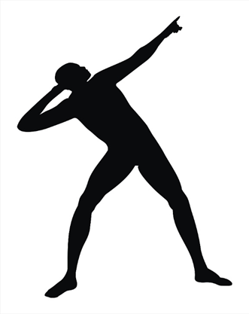
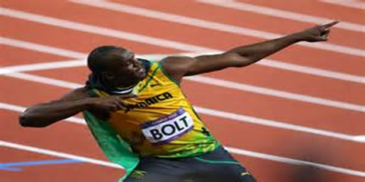
EUTM 007459027
EUTM 009787573
Notes:
http://photo.bikestats.eu

Slide 4
USAIN BOLT | EUTM 9787581
MARC GASOL | EUTM 11318318
ROGER FEDERER | EUTM 3209756
SEBASTIAN VETTEL | EUTM 8851073
ANA KOURNIKOVA | EUTM 11931052
CRISTIANO RONALDO | EUTM 16809485
Lionel MESSI | EUTM 14799928
DIEGO MARADONA | EUTM 2243947
PAUL POGBA | EUTM 12540035
PODGBA | EUTM 17039256
POGBANCE | EUTM 17060278
GRIEZMANN | 4312154 France – INPI
DISTRICT 77 | EUTM 017050626
D77 | EUTM 017060518
DB07 | EUTM 002746337
CR7 | EUTM 01276529, EUTM 01308948
 | EUTM018019298

Slide 5
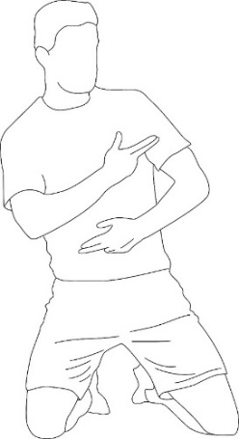
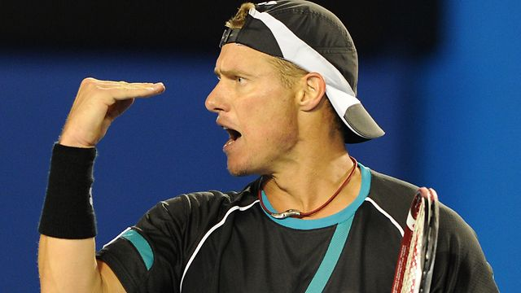
Uncoventional trademarks in sport
UK00002657917
UK00003311979
EUTM 018038054
Z.497157

Slide 6
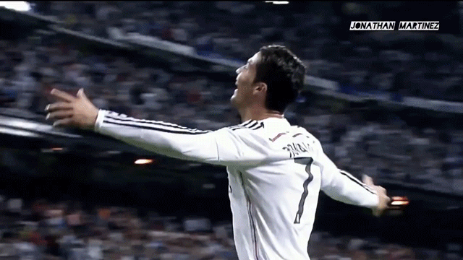

Slide 7
Thank you for your attention!
Blanka Bułacz bbulacz@uprp.gov.pl

