Slide 1
TECHNOLOGY TRANSFER in the Philippines
INTERREGIONAL EXPERT meeting
South-South and Triangular Cooperation for Access to Information and Knowledge, Innovation Support, and Technology Transfer
Harris M. Fulo R.Ch, M.Sc.
Technology Transfer Division
Documentation, Information & Technology Transfer Bureau
Intellectual Property Office of the Philippines (IPOPHL)
Republic of the Philippines
Notes:
1. the needs for the IP office to have its own expert team of patent searchers who can mentor and lead the other stakeholders;
2. the non-training aspects of building ITSOs into a network that works together as one for the country rather than rival / fragmented camps of institutions;
3. the need to rally all other development partners beside WIPO to fill in the training needs so there is monthly training for the stakeholdrs; 4. the need to create demand, and not just the supply. Without continuing work, the skills are not practiced and will be lost; and 5. the need for apprenticeship with international firms so trainees get the longer period of on-the-job exposure.

Slide 2
OUTLINE OF THE PRESENTATION
Overview of the IPOPHL’s initiative
Results achieved – Technology Transfer in PH
Next steps/outlook
Lessons learned: main challenges, achievements and opportunities for adaptation/replication
Notes:
Overview of the initiative/partnership
(rationale, main partners, objective/expected results, deliverables, implementation modalities, activities, timeframe)
Results achieved
Next steps/outlook
Lessons learned: main challenges, achievements and opportunities for adaptation/replication

Slide 3
Technology Transfers in PH
Examples of some successful Technology Transfers in the Philippines
Notes:
Disclaimer: not related to IP DEPOT

Slide 4
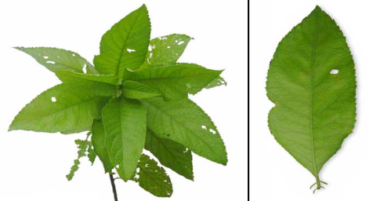
LAGUNDI & SAMBONG – UP MANILA
Going Herbal:
Innovation & Tradition
Patent No. 1-1997-57575
Sambong Tablet: Herbal Composition & Uses Thereof (diuretic and for kidney stone dissolution)
UM No. 2-1999-00164
Lagundi Pediatric Syrup, Herbal Pharmaceutical Composition in Syrup Form containing Lagundi as the Active Ingredient*

Slide 5
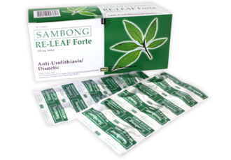
LAGUNDI & SAMBONG – UP MANILA
Trademarks:
Ascof (for Lagundi)
ReLeaf (for Sambong)
Product Variants after Licensing:
Strawberry
Banana-flavored Lagundi Pediatric Syrup
Technologies Licensed:
Lagundi Tablet,
Lagundi Pediatric Syrup
Sambong Tablet
Akapulko Lotion
First license issued in November 1995 for Lagundi & Sambong tablet and in 1999 for Lagundi Pediatric Syrup

Slide 6
LAGUNDI & SAMBONG – UP MANILA
From initial remittance of P164,018.85 for royalties and license fees on Lagundi and Sambong products in 1997 to P13,856,915.13 in 2010
Total remittance of P50,046,894.79 for royalties and license fees from 1997 to 2010

Slide 7
University of San Carlos
Innovation for the city:
Turning Waste
into Gold
Developed a bio-refinery plant that converts mango peels into useful side-products such as raw materials for cosmetic products and more.

Slide 8
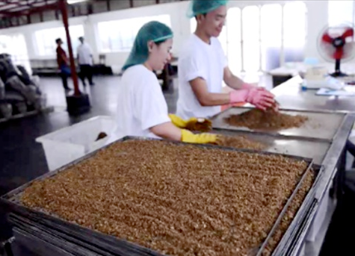
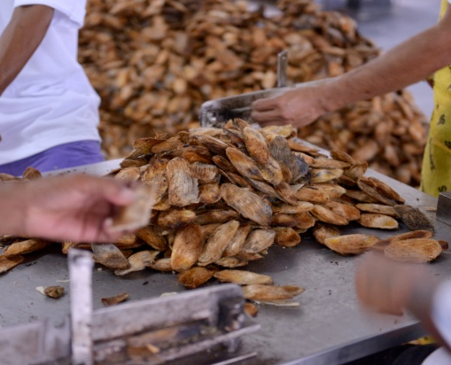
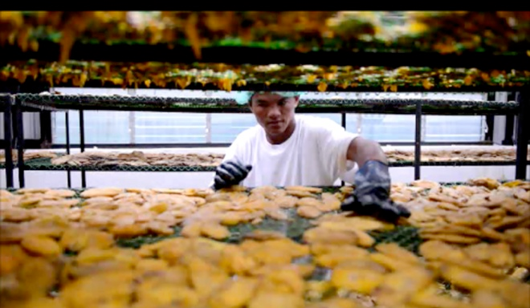
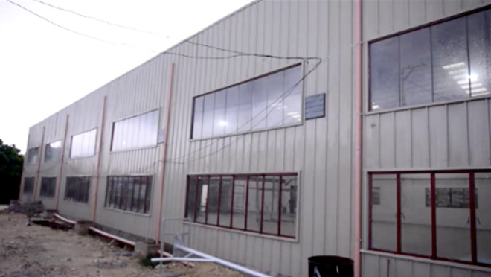
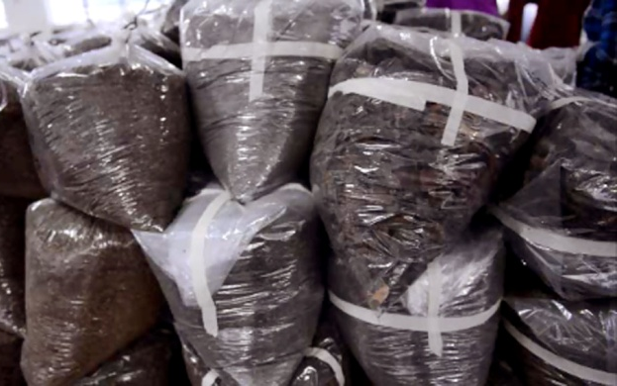
University of San Carlos
Turning Waste into Gold
USC’s BioPERC partnered with GEMS, Inc. with its patent to a technology being USC’s equity to the private company

Slide 9
Western Visayas College of S&T
Creative Minds
WVCST Generates income from their Intellectual Properties
Since 2008, the College has been able to generate a gross income of almost PhP 6 Million from instructional materials and software-developed systems.
The faculty authored twenty-eight (28) instructional materials that were published & commercialized by the College.

Slide 10
IPOPHL’s Initiative

Slide 11
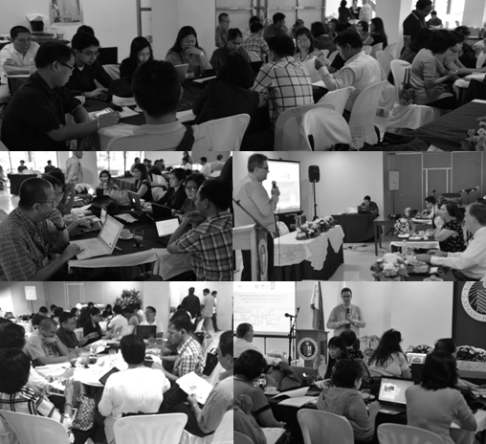
Technology Licensing Workshop
Partnership with WIPO
Simulation of deal negotiation
Team consultations
Simulation of deal negotiations
IP Valuation
Basic methods
In R&D
Exercise
Licensing Agreement drafting
Notes:
5-day comprehensive course

Slide 12
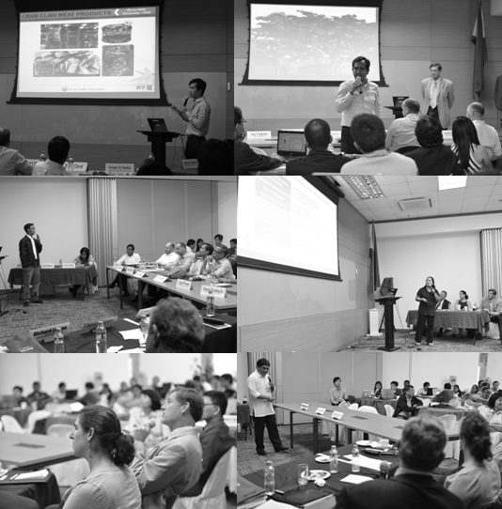
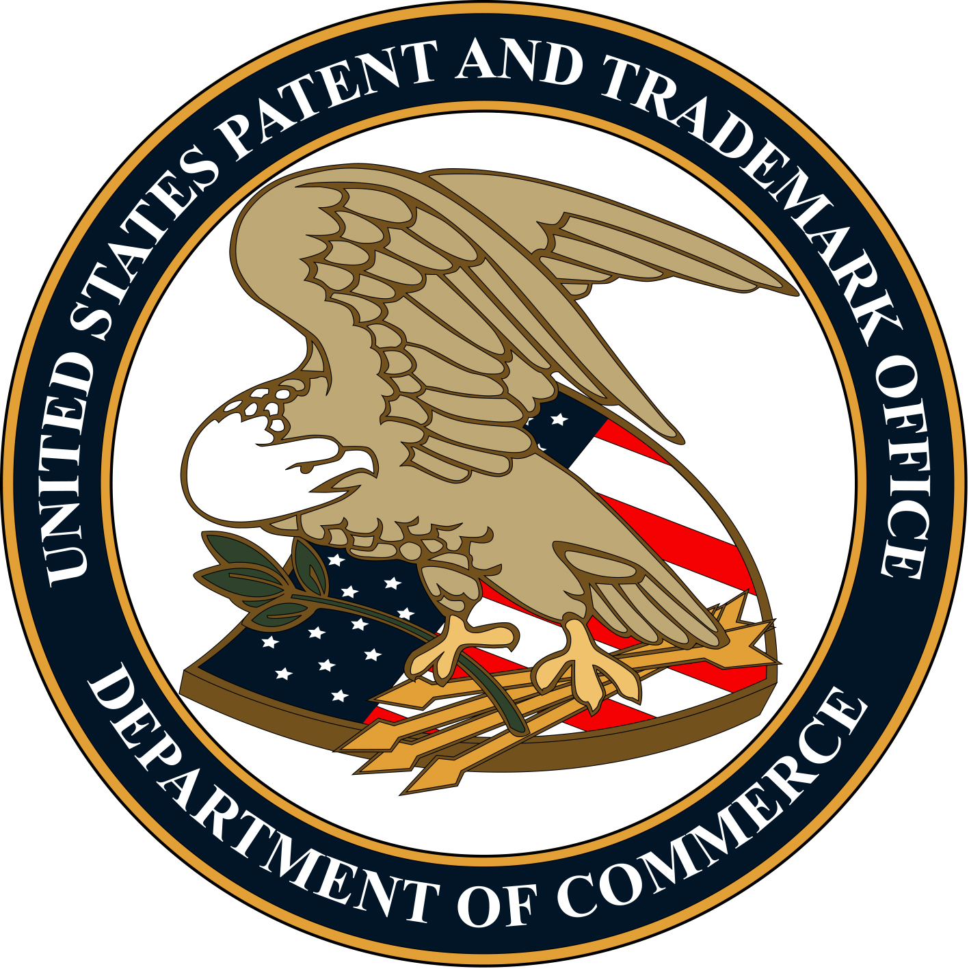
Technology Pitching Workshop
Partnership with IIPI & USPTO
Invention Triage, Technology Viability & Market Relevance
Pitch presentation to advisory group
One-on-one advisory & counsel sessions

Slide 13
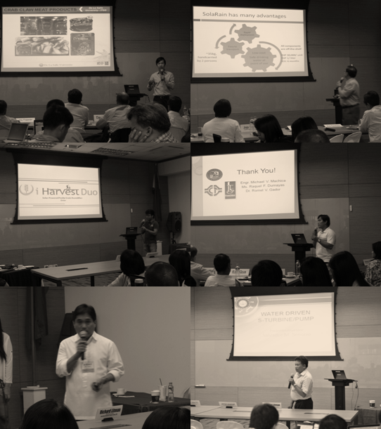
Actual Technology Pitching
Partnership with the Philippine Chamber of Commerce & Industries (PCCI)
Philippines Business Conference
Tech Pitching during a break-out session
Networking with investors & potential collaborators

Slide 14
IPOPHL’s Digital marketplace

Slide 15
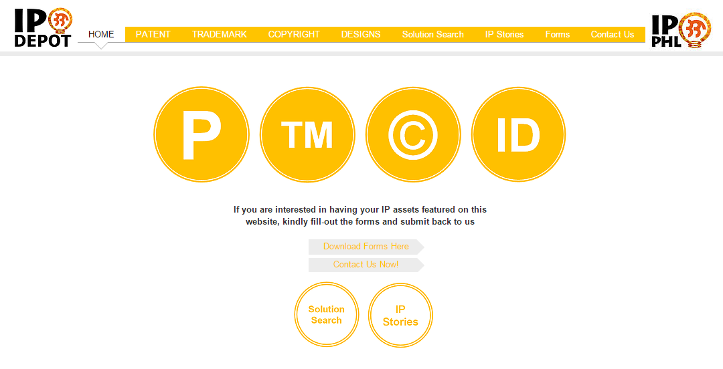

Slide 18
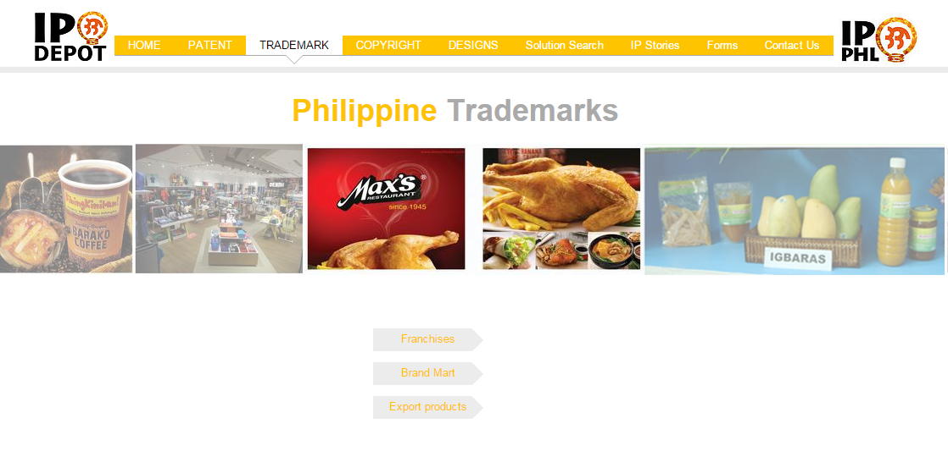

Slide 19
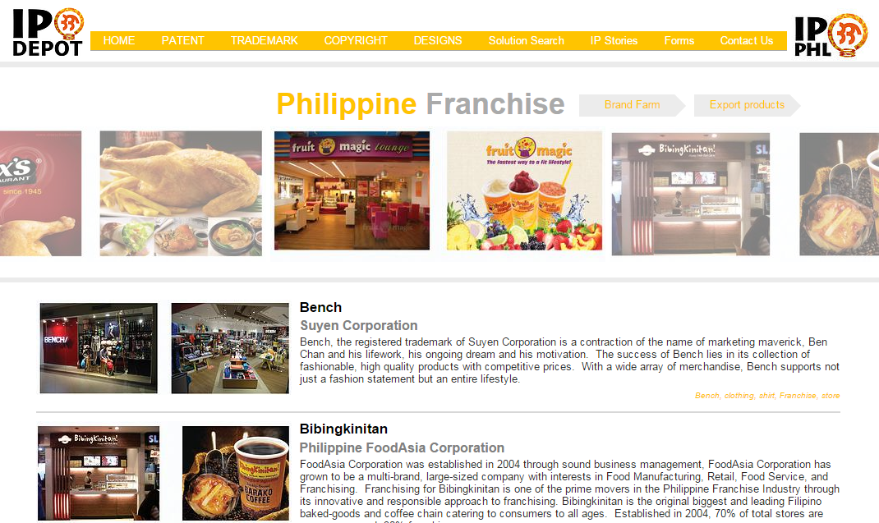

Slide 20
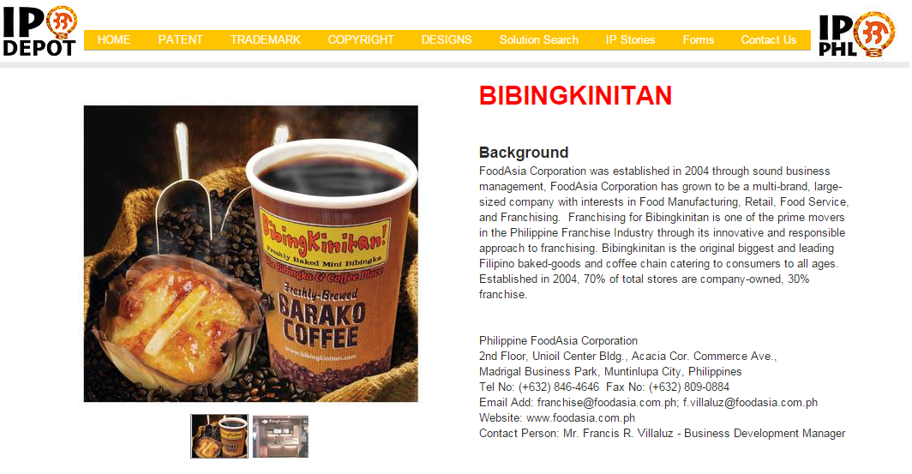

Slide 22
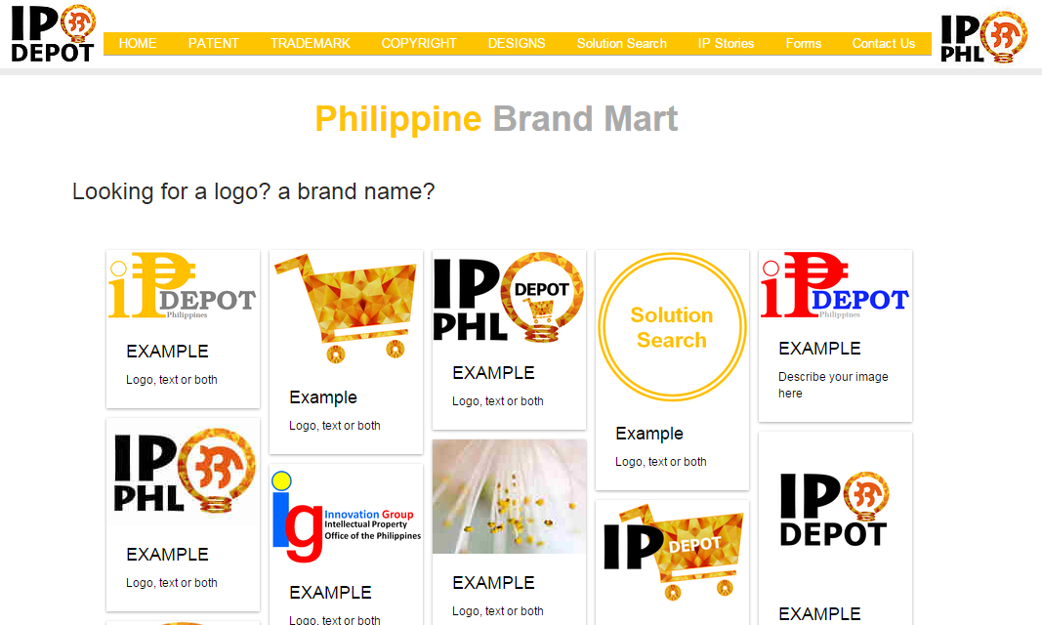
IP DEPOT

Slide 24
IP DEPOT

Slide 25
IP DEPOT

Slide 26
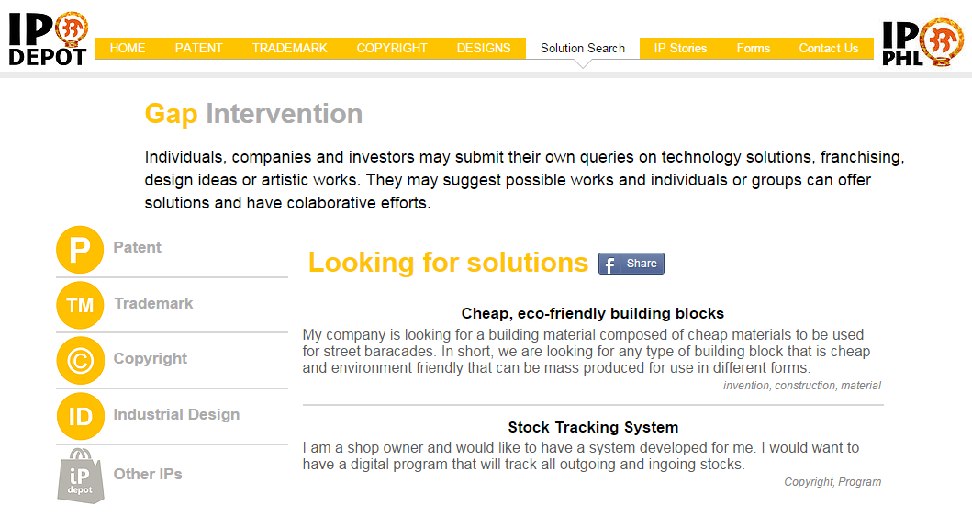
IP DEPOT

Slide 27
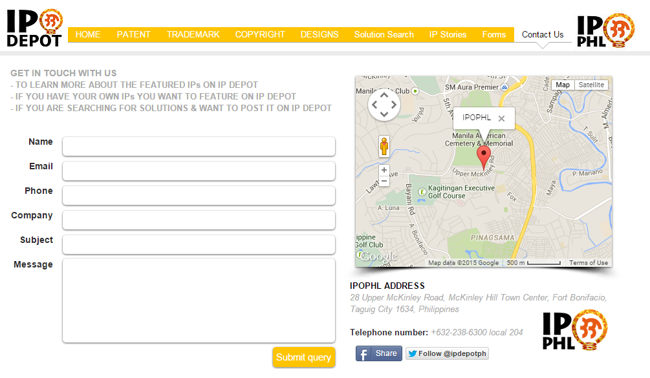

Slide 28
Partnerships
Assoc. of Filipino Franchisers, Inc.
Philippine Franchise Association
GLIPX (Singapore)
HKTDC – ASIA IPEX (Hong Kong)

Slide 29
Next Steps

Slide 30
Next steps for Tech Trans in PH
Road-mapping of innovation for RDIs and inventors
IP Commercialization & IP Financing trainings
To capacitate ITSO members with knowledge to improve their marketing skills
Exploration of IP securitization in the PH
To entice local and foreign investors to apply the IP system
New partnerships for IP DEPOT
Malaysia’s PLATCOM
Other international digital platforms

Slide 31
Lessons learned

Slide 32
Lessons learned
Technology pitching and valuation trainings will make a big difference in commercializing your IP assets.
Proper training for tech pitching will increase the marketability of your technology with in-depth business analyses of your technology
Need for Industry-Academe linkage

Slide 33
Lessons learned
Setting-up the digital marketplace
Website creation may be initiated using a free online platform and can be upgraded for a fee based on the need that arises
It is highly recommended that operations of the digital platform should be done by a team consisting of IP technical experts to easily convert the technical description into laymanized forms.
Promotion should be done extensively
Approaching or having partnerships with associations or groups will make it easier to rake in IP assets for promotion than having to talk to specific individuals

Slide 34
THANK YOU!!!

