Slide 1
Broadcasting – status quo & future implications A perspective on audiences, revenues, and digital disruption
TECHNOLOGY
Geneva, 29 June 2015
Daniel Knapp, Senior Director, IHS

Slide 2
1. The traditional broadcast landsape: consumer access & monetization

Slide 3
Television platform penetration worldwide in 2014

Slide 4
Pay TV is still growing globally, but we expect slowdown

Slide 5
Global pay TV growth is driven by operators in APAC (mainly China, India), North America reaches saturation

Slide 6
Lower ARPUs mean LATAM and APAC revenues are lower – but growth will continue to be strong
Notes:
More developed UK market is expected to start plateauing in the coming years
German online video market growth is being driven by subscription sector (arrival of Netflix in Q3 2014 and strong local presence)
In 2013 Over 80% of Spanish online video market revenues accounted for ad-funded video, while only 40% of UK market and 50% of German market revenues were generated by from ad-funded video services
Latin America region and Brazil in particular are expected to grow strongly with FTV and subscription taking the lion share in total market revenues

Slide 7
TV advertising recovers from cyclical factors; West faces structural challenges while other regions grow
Higher ad rates & better measurement drive APAC, Africa, MENA, LATAM revenues
Online pressure in North America and Western Europe
Global ad recession
US/Europe double-dip ad recession

Slide 8
National reach & suitability for brand advertising have so far prevented TV from suffering print industry’s fate

Slide 9
Distribution of funding sources varies across markets

Slide 10
2. Re-defining broadcasting: changing patterns of consumption & new revenue streams

Slide 11
Pathways to the consumer are ever-increasing globally, with greater scale yet also fragmentation every year

Slide 12
TV consumption is moving into non-linear – both time shifted and place shifted

Slide 13
Online video revenue will more than double by 2018 to $40bn globally
Sample services
Notes:
More developed UK market is expected to start plateauing in the coming years
German online video market growth is being driven by subscription sector (arrival of Netflix in Q3 2014 and strong local presence)
In 2013 Over 80% of Spanish online video market revenues accounted for ad-funded video, while only 40% of UK market and 50% of German market revenues were generated by from ad-funded video services
Latin America region and Brazil in particular are expected to grow strongly with FTV and subscription taking the lion share in total market revenues

Slide 14
3. A new competitive landscape

Slide 15
TV now covers the full spectrum from linear channels to MCNs, and broadcasters are just one of many providers
Incumbent broadcasters
The TV channels business already exists on a continuum
The lines that presently distinguish parts of the channels business will continue to blur as channels compete for:
Rights
Audience attention
Data
Technology
Consumer revenue and ad-spend
These changing dynamics affect TV channels and content, but also the role of free-to-air broadcasters themselves
Premium channels (e.g. HBO)
Traditional broadcast
‘Cable networks’ (e.g. Fox channels)
Broadcaster digital channels (e.g. BBC 3)
Online premium channel subscription (e.g. HBO Now)
Online broadcaster subscription (e.g. Hulu Plus, CBS All access)
Online broadcaster ad funded (e.g. ITV.com)
‘Over the top’ (OTT)
Online broadcaster transaction (e.g. Sky pay-per-view)
Traditional TV background
Online premium (e.g. Netflix, Amazon Prime)
Portals (e.g. Yahoo, Twitch, Facebook, AOL)
OTT and/or platform background
(YouTube) MCNs

Slide 16
Broadcasters are investing and adding services to compete within this new definition of TV
Example Europe: On Demand Audio Visual Services Operated by Broadcasters
Note: Owned and Operated include catchup and OTT services; Branded includes services hosted on iTunes, XBox and YouTube
Source: MAVISE Database

Slide 17
Broadcasters are looking to tap into YouTube’s scale via ‘Multichannel Networks’
Broadcasters are increasingly buying into YouTube Multichannel Networks (MCNs), which aggregate and monetise YouTube channels.
Broadcasters are competing in the MCN ecosystem through short-form non-TV like offers, in order to add to their traditional premium long-form content.
This is partly a diversification strategy, and ensures that bets are hedged against the success of YouTube at the expense of broadcast.
It also represents a defensive move – as major content suppliers buy into MCNs as well (Disney into Maker, Dreamworks into Awesomeness TV, Warner into Machinima), looking to create new, more direct paths to consumers.
List is exemplary, not exhaustive

Slide 18
Beyond YouTube, new creators & platforms such as Facebook and AOL capture video audiences, together dwarfing time spent on broadcasters’ online offerings
Audience reach creates content opportunity – millenial publisher MIC got 33m views for Facebook series ‘Flip the Script’.
“Facebook has changed the discovery and distribution of video […] If we were doing this three years ago, we’d have to be publishing an insane amount of video just to be discovered.” (CEO of MIC).
After ‘AOL Originals’ video content strategy (feat. Sarah Jessica Parker, James Franco), AOL ditches portal & relaunches with video-centric design.
Partner publishers bring brand & content.

Slide 19
The US has signs of ‘cord-cutting’ – and this looks set to continue

Slide 20
Netflix is the key global player in online video – it has few rivals without a history in pay TV
Hollywood VIP
Netflix Early 2015 launch
Netflix announced availability in over 200 countries by 2017

Slide 21
The ‘currency’ of measuring consumer behaviour is changing; those with large-scale data set have an edge
+43%
+100%
+84%
ID with credit cards
Monthly active users
Cumulative Android activations

Slide 22
Broadcasters compete with global players for advertising

Slide 23
New players enjoy global scale advantages that national and regional broadcasters cannot compete with
Technology
Consumers
Global
product
development
for apps and devices
Global brand
management
and audience
aggregation
Global R&D
and infrastructure
DATA
(individual,
segment,
region / nation,
global)
Audience
measurement
& insight
Ad tech
investment
Global
relationships
with Agencies
and Brands
Global
content
commissions
and licences
Brand funded
content partnerships
Advertisers
Content

Slide 24
4. Piracy

Slide 25
‘Control word’ sharing is the most common pay TV piracy method
Not new - existed in the pre-Internet era, when pirates mainly relied on non-electronic means, such as physical cloned cards for control word redistribution.
Pirates with a single authorised card can now capture control words and redistribute them to thousands of Internet-connected STBs
Highest impact on pay satellite - one-way nature of satellite transmission makes it difficult to tackle control word sharing
Software loaded on a legitimate receiver allows it to share control word over the internet to pirate set-top-boxes – they can then access the content as if they had their own subscription. Control word sharing also allows for retransmission of content itself

Slide 26
Direct File sharing – the ‘Electronic Sell-Thru’ of piracy
Users can store illegitimate content, as easily as they would on their own hard drives
Name | Unique Monthly Users (m)
DropBox | 35
MediaFire | 22.5
4Shared | 21
Google Drive | 18.5
SkyDrive | 16
iCloud | 9.5
Box | 6.75
Mega | 6.5
ZippyShare | 6.25
Uploaded | 6
DepositFiles | 4.75
HighTail | 4.5
SendSpace | 4
RapidShare | 3.25
FileCrop | 3

Slide 27
Torrent websites main venues for download-to-own piracy – especially for movies and episodic content
The more popular the content is, the easier it is to pirate via torrent sites
Name | Unique Monthly Views (m)
ThePirateBay | 50
KickAssTorrents | 30
Torrentz | 15
ExtraTorrent | 6
YifyTorrents | 3
BitSnoop | 2.75
IsoHunt | 2.65
SumoTorrent | 2.5
TorrentDownloads | 2
EZTV | 1.9
RarBG | 1.75
1337x | 1.6
TorrentHound | 1.5
Demonoid | 1.3
Fenopy | 1.25

Slide 28
The impact of piracy on operator revenues can be significant – but it varies on a case by case basis
Peak of 2.5m downloads a day, with season 2 downloaded 25m times via bittorrent
Game of Thrones – p2p downloads by country
10.5%
5.6%
5.6%
5.4%
5.3%
4.7%
4.7%
4.1%
3.8%
2.4%
USA
France
Brazil
China
Russia
UK
India
Canada
Australia
Spain
Source: TorrentFreak

Slide 29
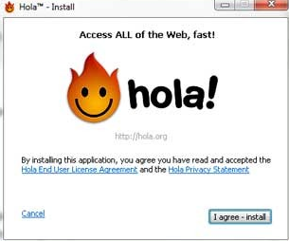
Use of VPNs and proxy servers is new – helps bypass ISP-enabled security and URL blocking
Originally intended for legitimate business use:
New user-friendly and lighter VPNs for piracy use:
Hola VPN claims 44m global users
VPNs also used to subscribe to geo-blocked services from outside ‘official’ territories

Slide 30
Online retransmission of broadcast content has become one of today’s biggest piracy threats
Higher impact on sports and popular reality shows - illegal streams simultaneous with broadcast
Combatting live streaming is technically difficult

Slide 31
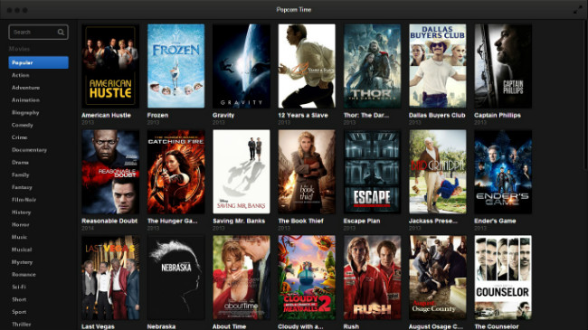
P2P streaming re-emerges, bypassing the need for website hosts
Software like Popcorn Time, allow users to stream content P2P, rather than from a single server
More reliable for the user – and harder to trace

Slide 32
Broadcast streaming from consumers is only just beginning…

Slide 33
Thank you
daniel.knapp@ihs.com
@_dknapp
technology.ihs.com

