Slide 1
Partner Ecosystems Accelerate Innovation
Theresa Kotanchek
Evolved Analytics LLC
Theresa@evolved-analytics.com

Slide 2
Purpose of innovation is to create value
Research is the transformation of money into knowledge.
Innovation is the transformation of knowledge into money.
Geoff Nicholson, 3M

Slide 3
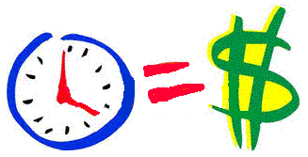
REAL
WIN
WORTH
Is the market real?
Is the product real?
Can the product be competitive?
Can your organization be competitive?
Are the forecasted returns worth the risks?
Does the offering make strategic sense?
Source: George S. Day, “Is It Real? Can We Win? Is It Worth Doing?’ HBR, December 2007, 3-13.

Slide 4
Realities
Time Value of Money
Technology Risks
Market Risks
Product Risks
Regulatory Risks
Financial Risks
Business Model Risks
Partnerships...
Mitigate Risks
Accelerate Growth
Maximize Profits

Slide 5
High
New Product into
Existing Market
New Product into
New Market
Product/
Technology
Risk
Innovation Categories
Product Extension
into
Existing Market
Product Extension
into
New Market
Low
Low
Market Risk
High

Slide 6
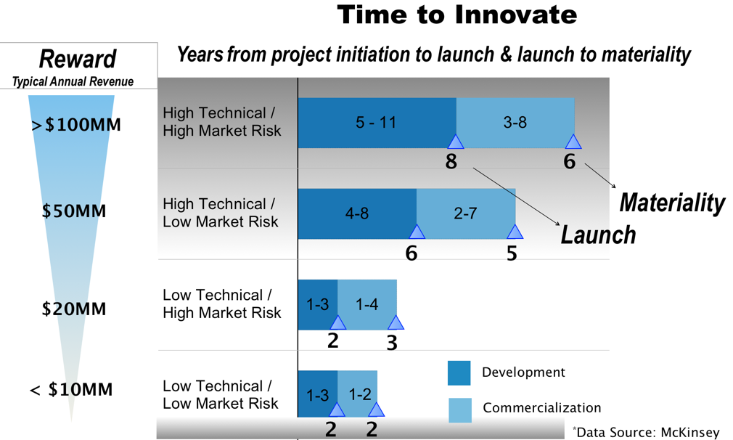
Time Line to Commercial Launch & Materiality
14 Years
11 Years
5 Years
4 Years

Slide 7
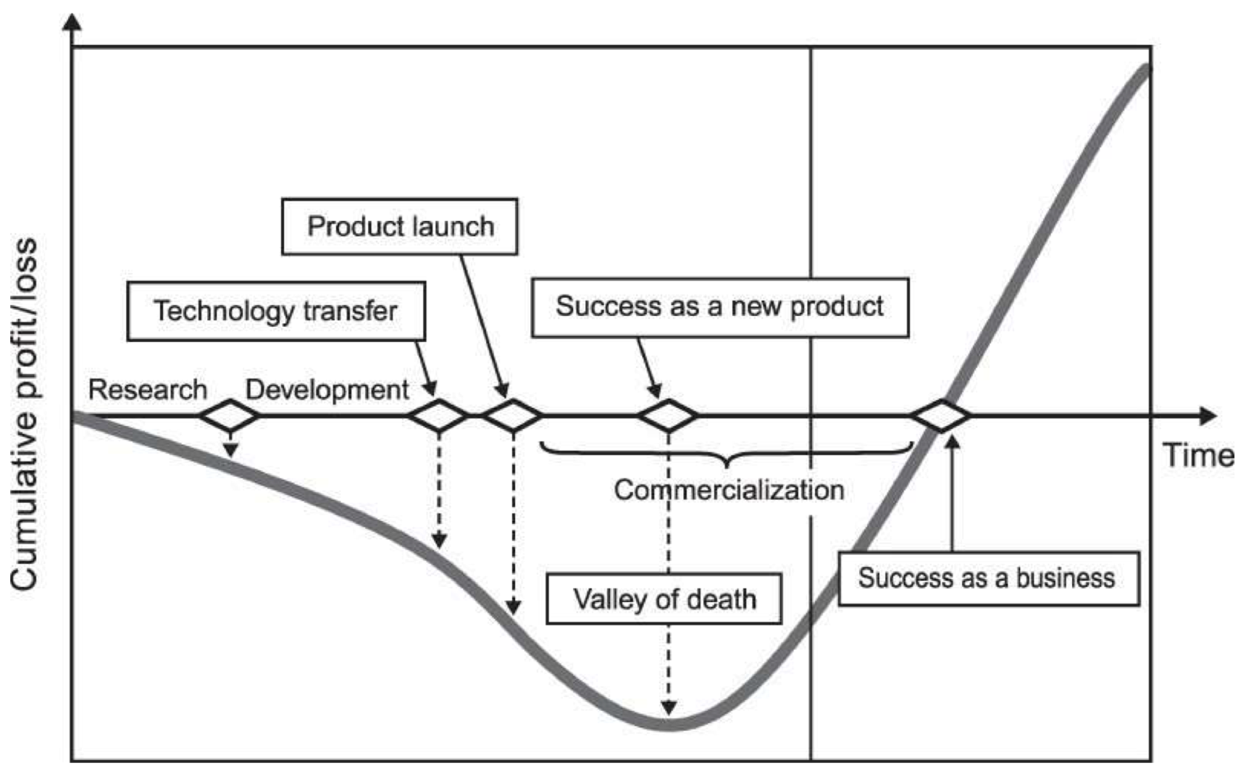
Commercialization Delays Are Costly
Research & Development
Commercialization
Successful Business
Source: Osawa and Miyazaki, 2006

Slide 8
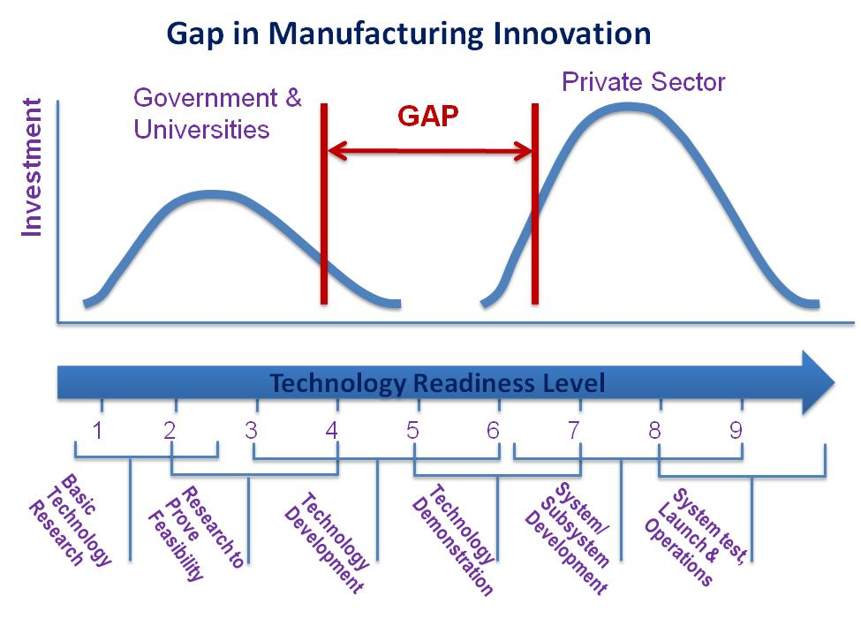
Research/ Intellectual Property
Proof of Concept
Prototyping
Capital Investment
Market Expansion

Slide 9
https://www.nist.gov/system/files/documents/2018/05/22/nist_michael_molnar.pdf

Slide 10
https://www.nist.gov/system/files/documents/2018/05/22/nist_michael_molnar.pdf

Slide 11
https://www.nap.edu/catalog/25417/strategic-long-term-participation-by-dod-in-its-manufacturing-usa-institutes

Slide 12
How Each Manufacturing USA Institute Works
Has a clear mission based on a critical industry need
Operated by industry-led consortium
Works on industry priorities & big challenges only solvable by collaboration
Creates a collaboration space for pre-competitive applied R&D
Manages a balanced portfolio of projects
Addresses education & workforce skills gaps for their technology space
Conducts topic focused workshops & applies the outcomes to real applications
Funding→ Federal start-up funding PLUS ≥ 100% co-investment
https://www.nist.gov/system/files/documents/2018/05/22/nist_michael_molnar.pdf

Slide 13
Industry Feedback on Top Ranked
Innovation Institute Offerings
Networking & Collaboration Opportunities
Technology R&D Roadmaps
Updates on State of the Art Technologies
Education & Workforce Development Roadmaps
Technology Standards Roadmaps and Coordination
Use of Institute Equipment
Data Coordination and Dissemination
Member Driven R&D Projects- Shared Cost, Risk & Results (IP)
Contracted Customer R&D Projects- No Cost Share, Own IP
Creation of Region Institutes/ HUBS and Technology Ecosystems
https://www.nap.edu/catalog/25417/strategic-long-term-participation-by-dod-in-its-manufacturing-usa-institutes

Slide 14
Public-Private Partnerships
Accelerate Successful Innovations
Accelerate Growth
Maximize Investment & Impact
Mitigate …
Market Risks
Technology Risks
Product Risks
Regulatory Risks
Supply Chain Risks
Financial Risks

Slide 15
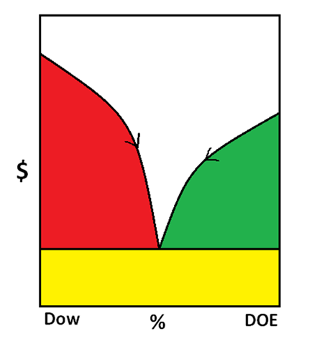
Accelerating Successful Innovation
Define → Discover → Design → Develop → Deploy
Market Knowledge
Customer Relationships
Channel Access
Available Technology/ IP
Workable Prototypes
Raw Material Sourcing
Rapid Testing & Validation
Regulatory & Standards
Engineering Design
Viable Business Model
Trained Workforce
Geographic Reach
Robust Supply Chain & Logistics
Utilize Partnerships to Overcome
What is Rate Limiting?
Identify Gaps
Partner 1
Partner 2

