Slide 1
Marrakesh and
Meaningful Access
Karen Keninger
Marrakesh Liaison
Libraries Serving Persons with Print Disabilities (LPD)
International Federation of Library Associations and Institutions (IFLA)
Kuala Lumpur, Malaysia ● 28 August 2018
Notes:
Title slide:
Marrakesh and Meaningful Access
Karen Keninger
Marrakesh Liaison
Libraries Serving Persons with Print Disabilities (LPD)
International Federation of Library Associations and Institutions
Kuala Lumpur, Malaysia / 28 August 2018

Slide 2
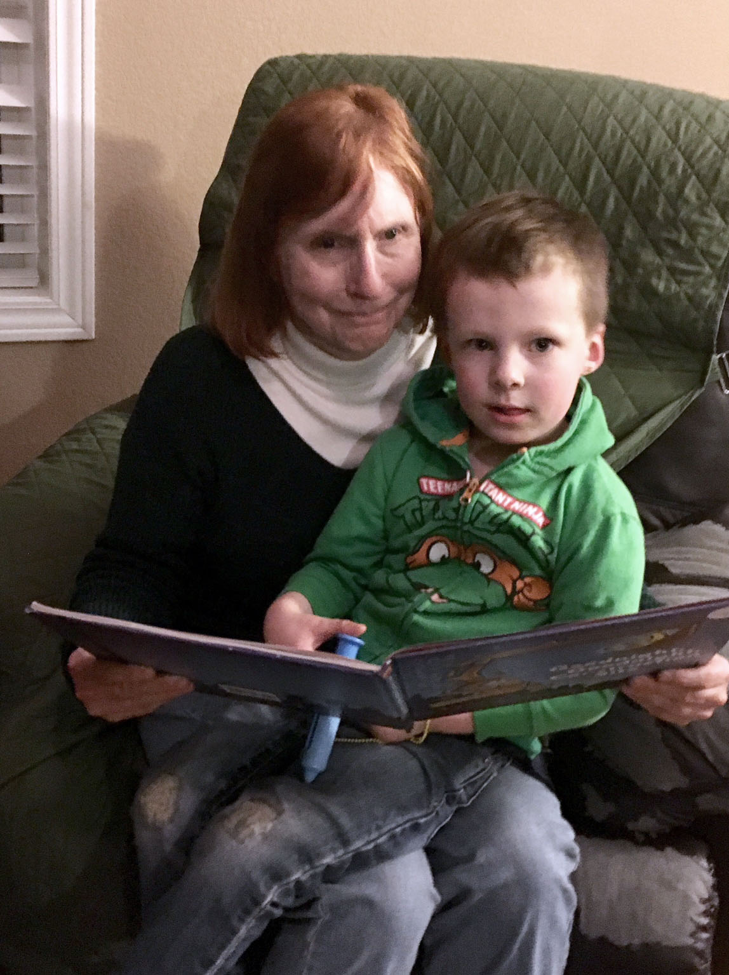
Notes:
Photo of Karen with grandson on lap with a book. No text.

Slide 3
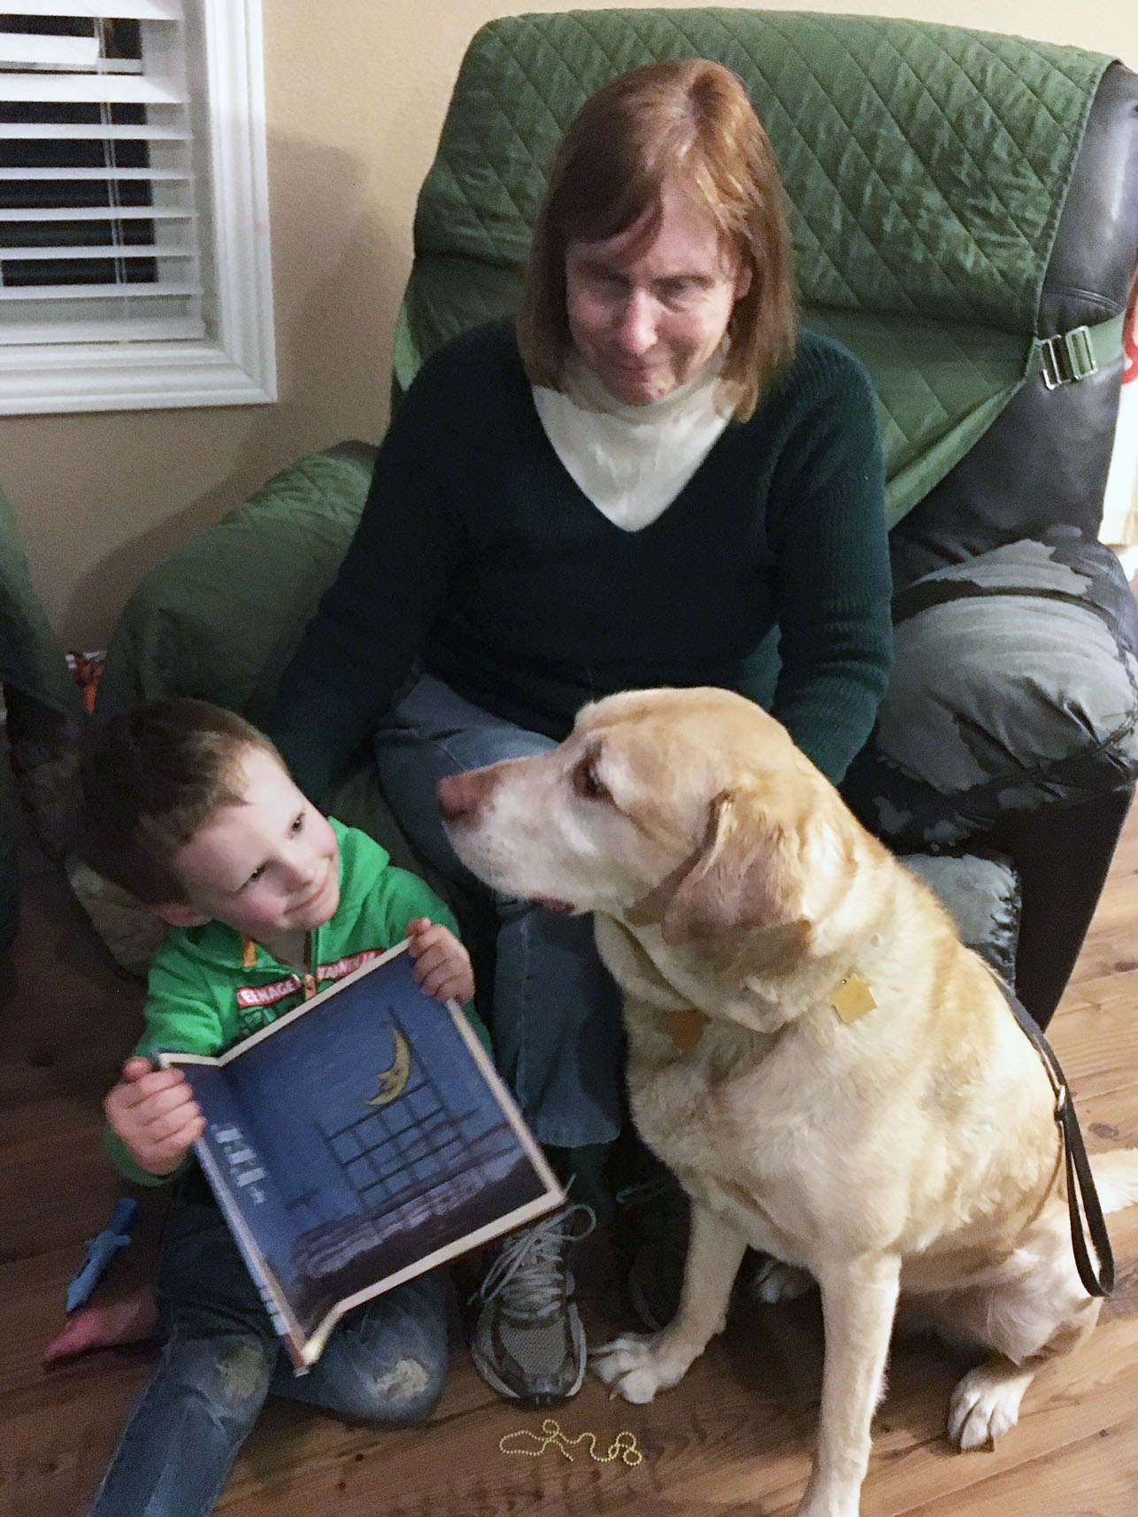
? ? ?
Notes:
Karen looks on as grandson shows Jimi the book. After one second, a thought bubble with question marks appears over Jimi’s head.

Slide 4




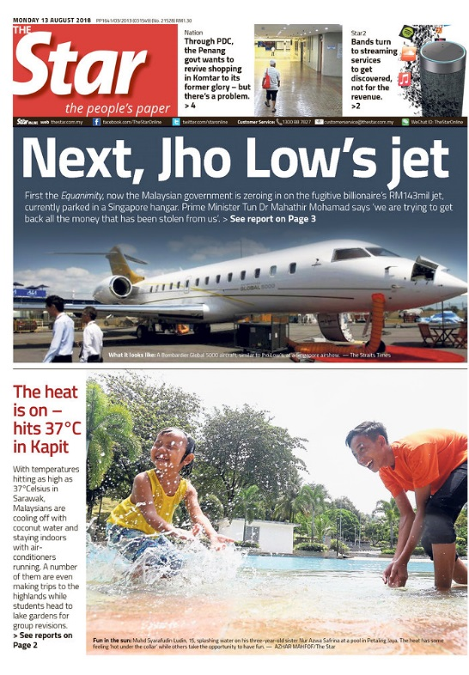

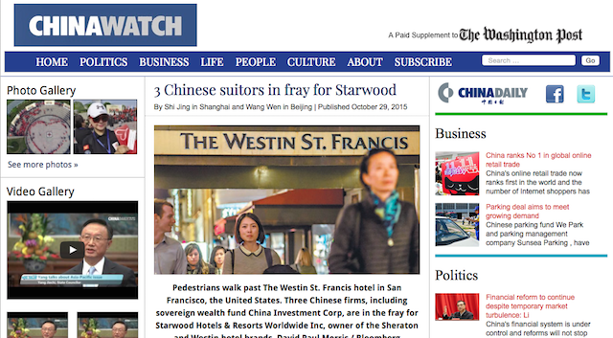
Notes:
Seven book covers appear, one after another, with a short delay between. (1) Dr. Spock’s Baby and Child Care. (2) Good Food Cookbook. (3) Current issue of British Vogue with Rihanna on the cover. (4) Aug. 13 issue of the Kuala Lumpur Star newspaper. (5) China Watch website. (6) College Chemistry textbook. (7, after slightly longer delay) Modern Spanish Prose textbook

Slide 5
The book famine
More than 300 million people have print disabilities
The cost to individuals?
Poor education
Poverty
Dependency
Can’t get a job
Notes:
Title: The book famine
More than 300 million people have print disabilities
The cost to individuals?
(Items appear one at a time in this order)
(1) Poor education. (2) Can’t get a job. (3) Dependency. (4) Poverty.

Slide 6
The book famine
The cost to society?
The skills, the creativity, the ideas,
the work, that an individual could be contributing to her family, her community, to her employer, and her society in general, have no outlet.
Notes:
Title: The book famine
The cost to society?
(The following text fades in)
The skills, the creativity, the ideas, the work, that an individual could be contributing to her family, her community, to her employer, and her society in general, have no outlet.

Slide 7
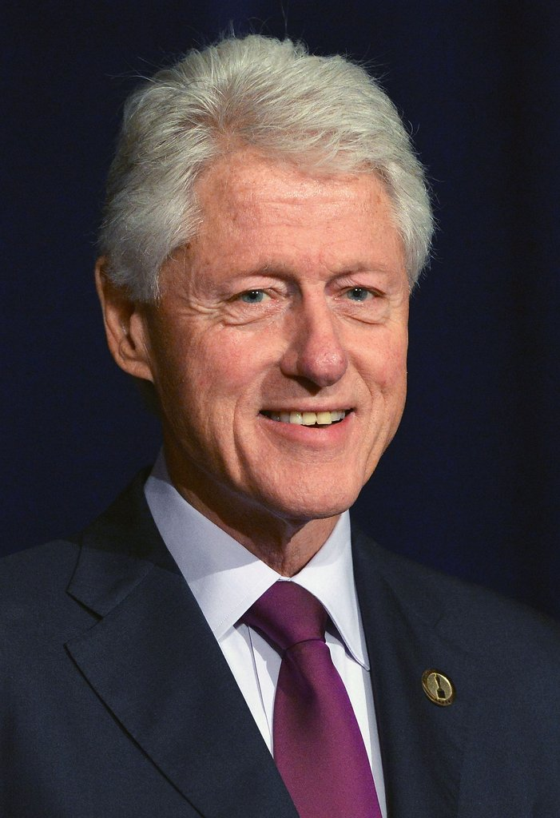
“
Literacy is not a luxury,
it is a right and a responsibility. If our world is to meet the challenges of the
twenty-first century
we must harness the energy and creativity
of all our citizens.
—President Bill Clinton
”
International Literacy Day September 8, 1994
Notes:
(Photograph of circa-2018 Bill Clinton)
“Literacy is not a luxury, it is a right and a responsibility. If our world is to meet the challenges of the twenty-first century we must harness the energy and creativity of all our citizens.”
--President Bill Clinton / International Literacy Day / September 8, 1994

Slide 8
最微弱的墨水比最強大的記憶更強大
The faintest ink
is more powerful
than the strongest memory
Notes:
(String of Chinese characters. English translation fades in below)
The faintest ink is more powerful than the strongest memory

Slide 9

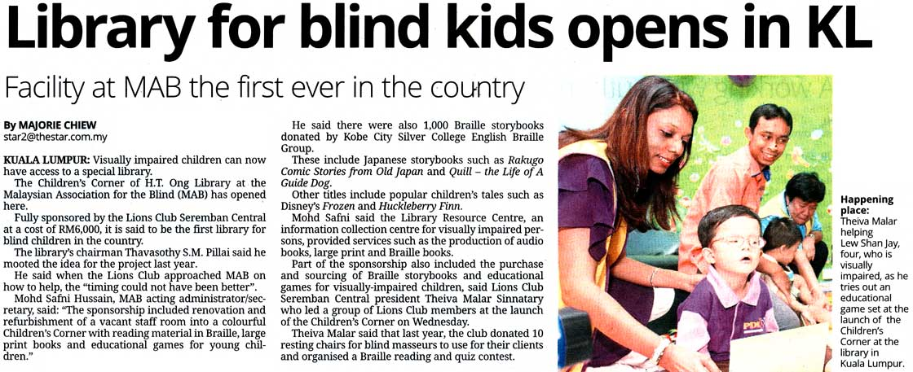
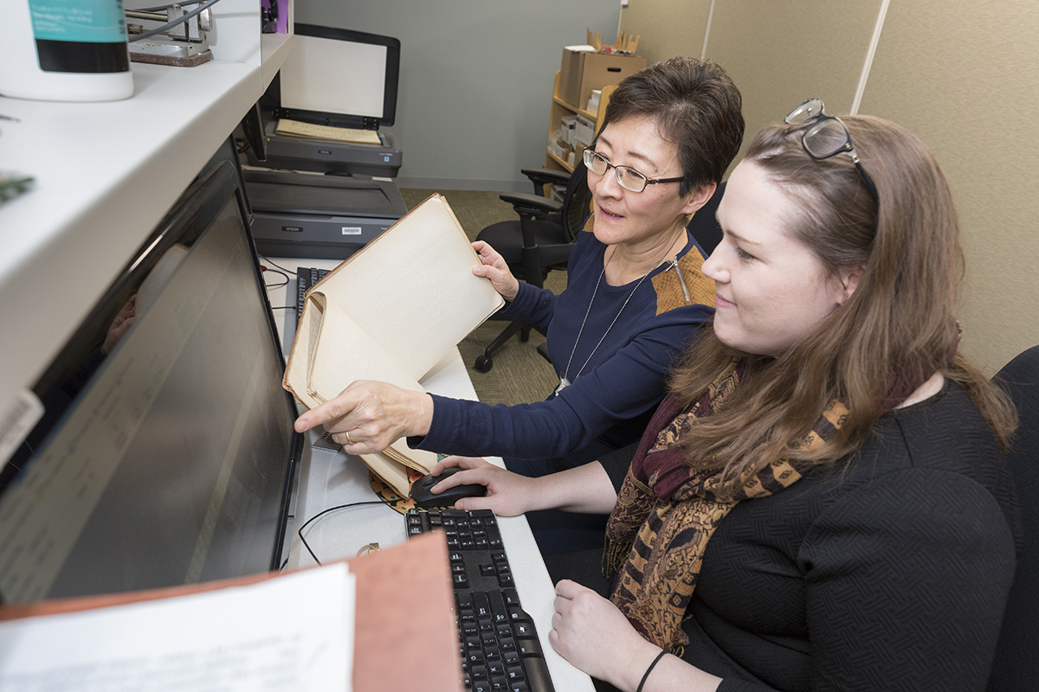
Notes:
Three photos fade in and then fade out one after the other. (1) Charles Young narrating a book in the NLS studio. (2) Donna and Katie scanning braille music. (3) Newspaper story from the Kuala Lumpur Star headlined “Library for blind kids opens in KL / Facility at MAB the first ever in the country.” (Slide takes 12 seconds to fully display.)

Slide 10



Notes:
Cover shots of “The Main Provisions and Benefits of the Marrakesh Treaty (2013)” in English, Spanish, and Chinese.

Slide 11
Implementing Marrakesh
Advocacy
Sharing knowledge
Web of resources
Cross-border standards
Notes:
Title: Implementing Marrakesh. These bullet points appear one after the other: (1) Advocacy. (2) Sharing knowledge. (3) Web of resources. (4) Cross-border standards.

Slide 12
Implementing Marrakesh
Advocacy
Sharing knowledge
Web of resources
Cross-border standards
Notes:
Same as slide 11, but “Advocacy” is in bold yellow, then grows to 150%.

Slide 13
Implementing Marrakesh
Advocacy
Sharing knowledge
Web of resources
Cross-border standards
Notes:
Same as slide 11, but “Sharing knowledge” is in bold yellow, then grows to 150%.

Slide 14
LPD
www.ifla.org/lpd
IFLA
www.ifla.org
Daisy Consortium
www.daisy.org
World Blind Union
www.worldblindunion.org
Notes:
(Names of organizations and website addresses, all appear when slide opens)
LPD www.ifla.org/lpd
IFLA www.ifla.org
Daisy Consortium www.daisy.org
World Blind Union www.worldblindunion.org

Slide 15

“
Never doubt that a small group of thoughtful, concerned citizens can change the world. Indeed it is the only thing that ever has.
—Margaret Mead
”
Notes:
Image of 1998 U.S. postage stamp with colorful drawing of a young Margaret Mead in a tropical setting. Text reads: “Never doubt that a small group of thoughtful, concerned citizens can change the world. Indeed it is the only thing that ever has.” –Margaret Mead

Slide 16
Implementing Marrakesh
Advocacy
Sharing knowledge
Web of resources
Cross-border standards
Notes:
Same as slide 11, but “Web of resources” is in bold yellow, then grows to 150%.

Slide 17


Web of resources
Stockholm
Moscow
Toronto
Tokyo
Zagreb
Beijing
Washington
Tel Aviv
Mexico City
Marrakesh
Nairobi
Kuala Lumpur
New Delhi
São Paulo
Sydney
Cape Town
Notes:
Title: Web of resources
Slide begins with graphic of a globe, with the Americas on the left, Europe and Africa on the right. One by one, names of cities appear around the globe, along the general latitude of their locations, starting with Kuala Lumpur, Washington, and Marrakesh. Other cities follow, more quickly: Toronto, Tokyo, Mexico City, Sao Paulo, Sydney, Stockholm, Moscow, Zagreb, Beijing, Tel Aviv, Nairobi, New Delhi, and Cape Town. After all the names are on the screen, a small wi-fi symbol appears in the center of the globe and expands over 2 seconds to cover the globe and visually connect the cities.

Slide 18
Implementing Marrakesh
Advocacy
Sharing knowledge
Web of resources
Cross-border standards
Notes:
Same as slide 11, but “Cross-border standards” is in bold yellow, then grows to 150%.

Slide 19

Let the journey begin!
Notes:
Let the journey begin!
(IFLA logo fades in)

Slide 20

Karen Keninger
kken@loc.gov
www.loc.gov/nls
Notes:
Final slide
Karen Keninger kken@loc.gov
www.loc.gov/nls
That All May Read flying book banner in white

