Slide 1
The Napa Valley Experience in Protecting NAPA VALLEY
Presented by:
J. Scott Gerien, Esq.
Outside Counsel, Napa Valley Vintners

Slide 2
Napa Valley
Most acclaimed, profitable, well-known wine appellation in the United States
American Viticultural Area (U.S. Appellation of Origin)
Geographical Certification Mark Registration, Napa Valley Vintners Registrant

Slide 3
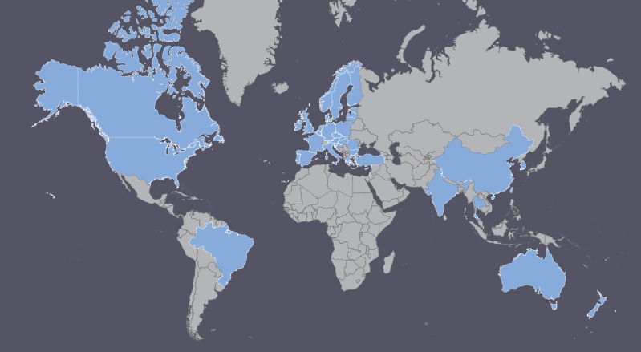
Worldwide Protection for
NAPA VALLEY

Slide 4
Jurisdictions of Protection for NAPA VALLEY
Australia (CM)
Brazil (GI)
Canada (GI)
China (GI and CM)
EU (GI)
India (GI)
Israel (CM)
New Zealand (CM)
Norway (CM)
Singapore (CM)
Taiwan (CM)
Thailand (GI)
Turkey (CM)
U.S. (CM)
GI = Geographical Indication Registration
CM = Certification Mark Registration

Slide 5
China Experience
Could not register as certification mark until U.S. certification mark registration issued
Napa Valley first foreign wine GI registered in China by AQSIQ
$100k+ in costs, travel, attorneys’ fees, expert fees
Seven years
Challenges of being first

Slide 6
Switzerland Experience
Madrid extension of certification mark to CH
Treated as equivalent to Swiss guarantee mark
Refused, geographic terms descriptive, not registerable without acquired distinctiveness evidence
Potential appeal to Federal Supreme Court
Potential path through Canton system for recognizing wine appellations

Slide 7
Chile Experience
Refusal of both GI and Certification Mark Apps
GI refused for failure to demonstrate sufficient connection between product characteristics and region, expert report required
Certification mark refused because “Napa Valley” was found to be geographically descriptive

Slide 8
Vietnam Experience
GI application filed nearly 10 years ago
Refused during TPP negotiations on basis U.S. needed to provide some equivalent concession
No action taken during pendency of TPP, NOIP said would not issue until TPP signed
Unclear what will happen now given Trump administration position on TPP

Slide 9
Russia Experience
AOC application is still pending, has been refused at examination stage and Rospatent Board of Appeal
Basis is AVA not evidence of appellation, certification mark not evidence of appellation, and two things are contradictory
NVV intends to appeal to IP Court

Slide 10
Multilateral System
NVV supports Lisbon, but it is beyond control of NVV
Multilateral system for registration of geographical indications for wine per TRIPS
Madrid-Protocol type system
INTA Proposal for Multilateral System http://www.inta.org/Advocacy/Documents/INTAProposalforMultilateralGIRegister.pdf

Slide 11
Thank you!
J. Scott Gerien
Dickenson, Peatman & Fogarty
sgerien@dpf-law.com
Outside Counsel to Napa Valley Vintners

