Slide 1
Artificial Intelligence Initiatives - IP Australia
December 2022

Slide 2
Contents
IP Australia’s Cognitive Futures Strategy
Existing tools / services
Automated Preliminary Search
Family Member Analyser (FMA)
Patent Auto Classifier (PAC)
Outcome Based Directions
Tools in development
Trade Mark Precedent Identification (TMPI)
Trade Mark International Classification Service (TMICS)
TM Checker

Slide 3
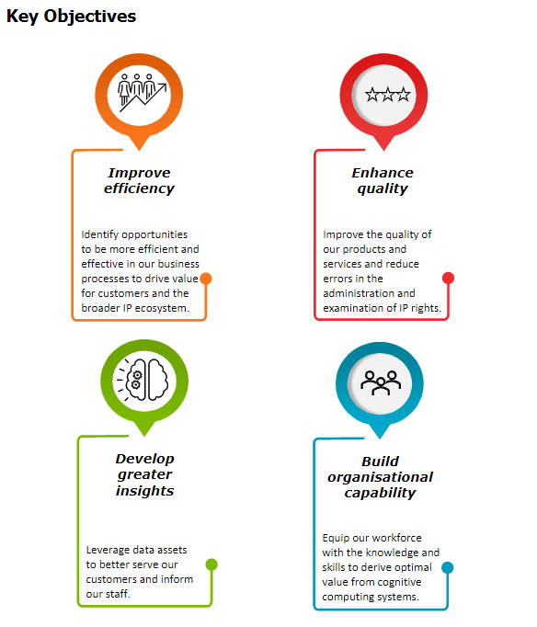
Cognitive Futures Strategy
Initially developed in 2016-2017
Cognitive Futures Strategy reviewed for 2022-2024
GOAL: Enhance customer service delivery and the way we do business by leveraging the power of cognitive technologies
Current focus on
Text analysis/search (Natural Language Processing)
Classification
Image analysis/search

Slide 4
Delivery Model
Necessary to realise the vast benefits of cognitive computing
Proven to be successful in progressing initiatives from ideation through to production
Reviewed periodically to ensure suitability

Slide 5
Cognitive Futures: Use cases
Augmented search
Free-form text or image-based searches for information within large volumes of unstructured data
Customer support
Interactive tools that assist applicants in interacting with IP Australia, including understanding, applying for and managing IP Rights.
Prioritisation and classification
Prioritisation of applicants, classification of entities, and identification of groups based on structured and unstructured information
Enhanced processing
Automatic collation of information, indexing of images/text, report generation based on structured and unstructured information.
Automated checks
Automatic validation and verification of data using internal/external data sources and known standards.

Slide 6
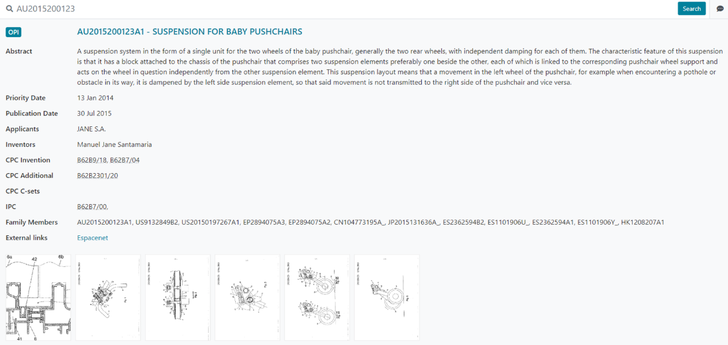
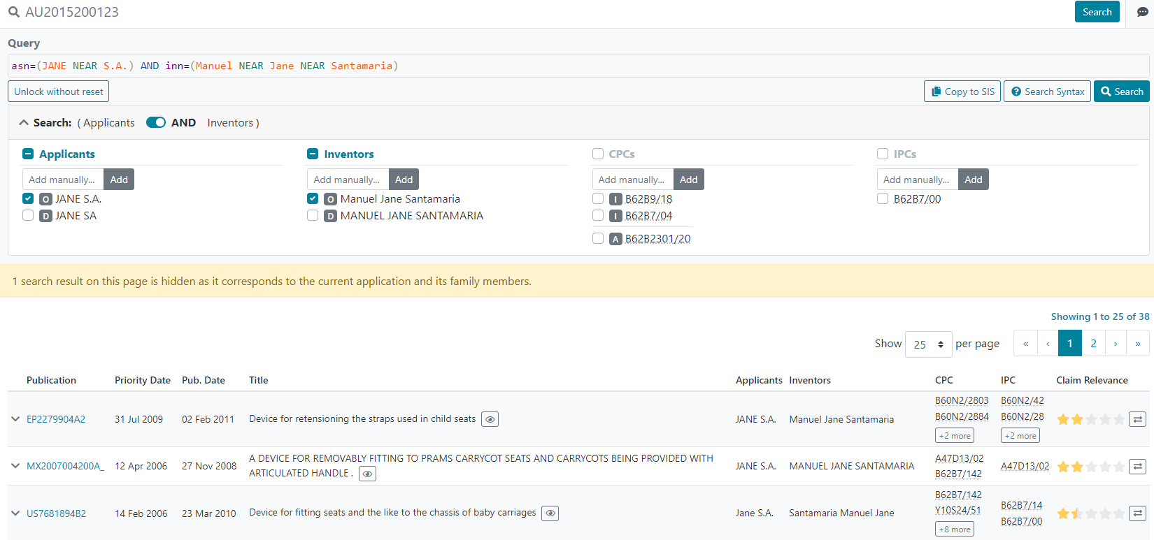
Automated Preliminary Search Tool

Slide 7
Family Member Analyser (FMA)

Slide 8
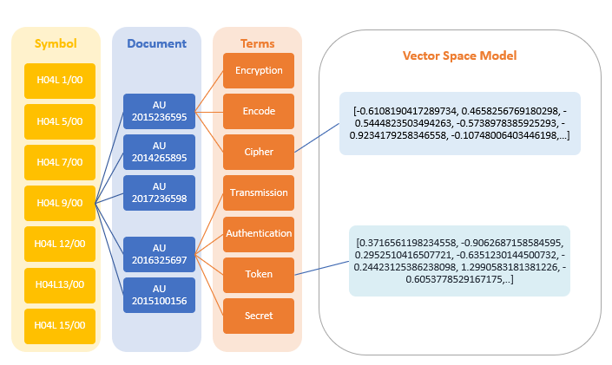
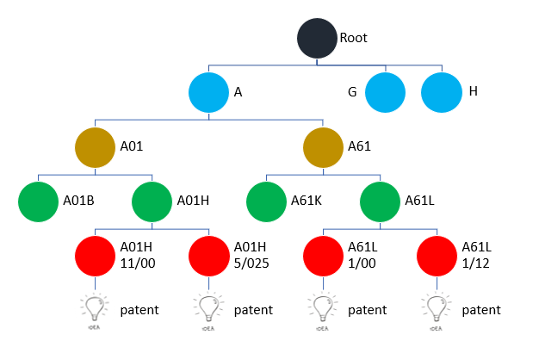
Patent Auto Classifier (PAC)
A service using NLP and ML to perform sort applications by allocating IPC main-group level information

Slide 9
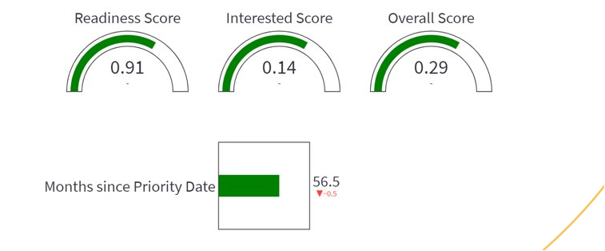
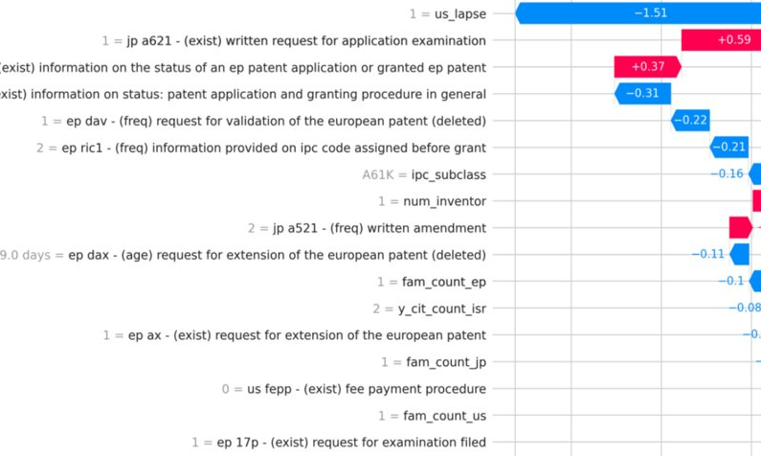
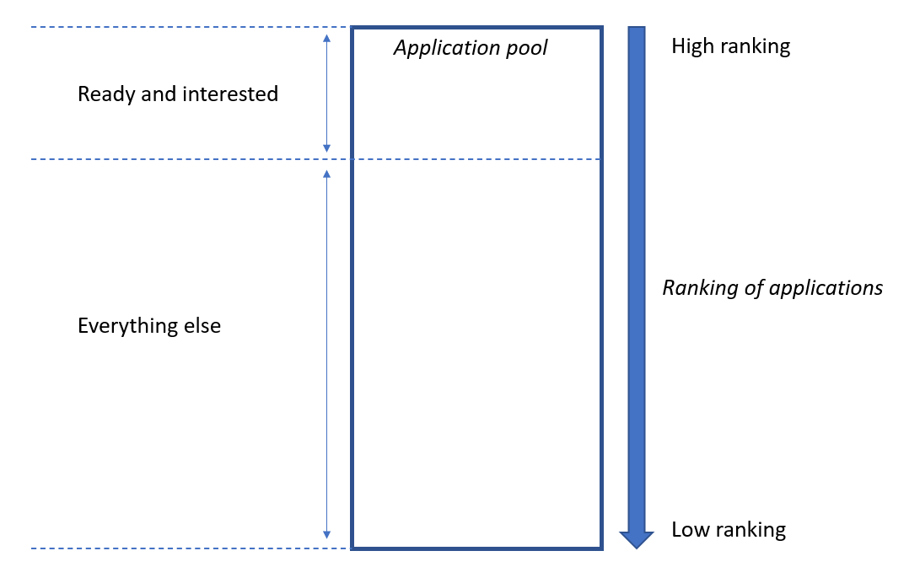
Outcome Based Directions

Slide 10
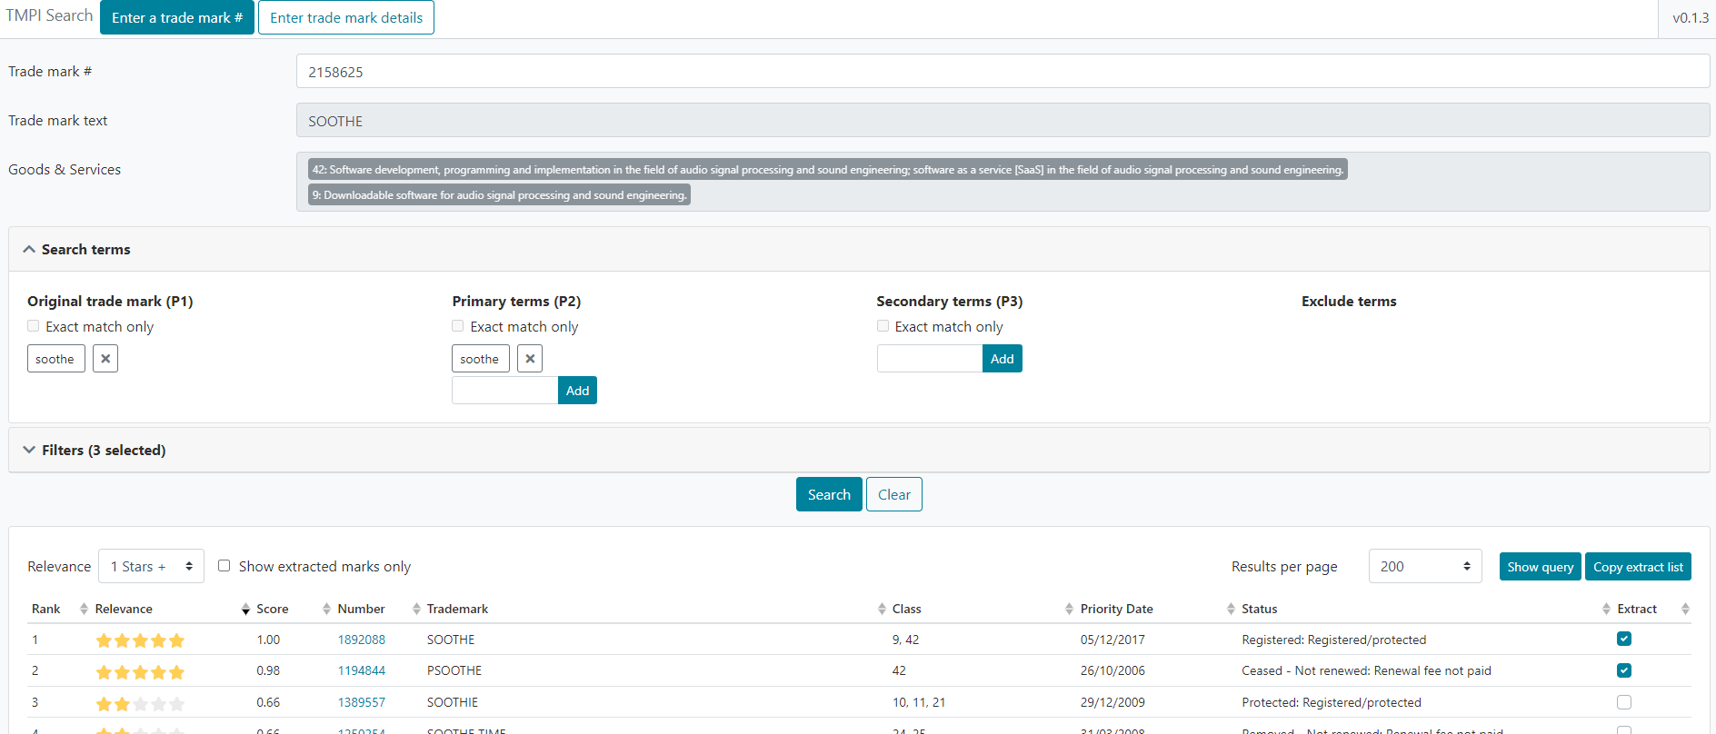
Trade Mark Precedent Identification (TMPI)

Slide 11
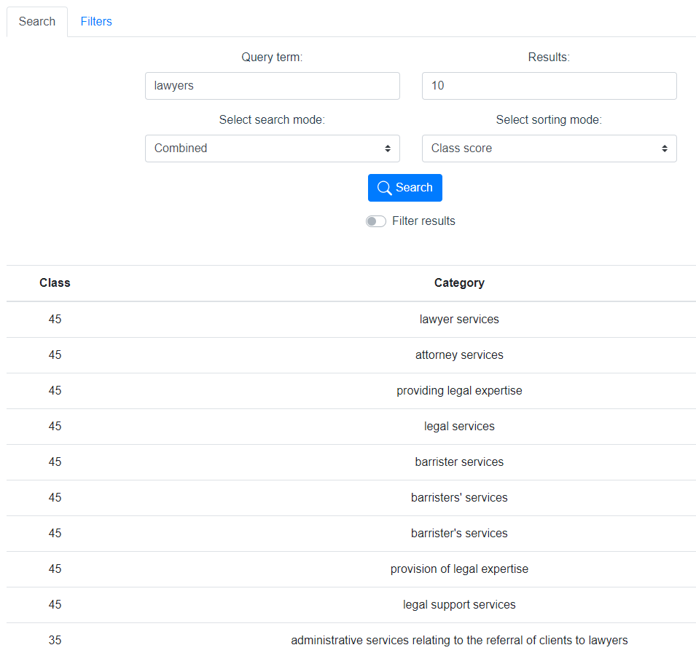
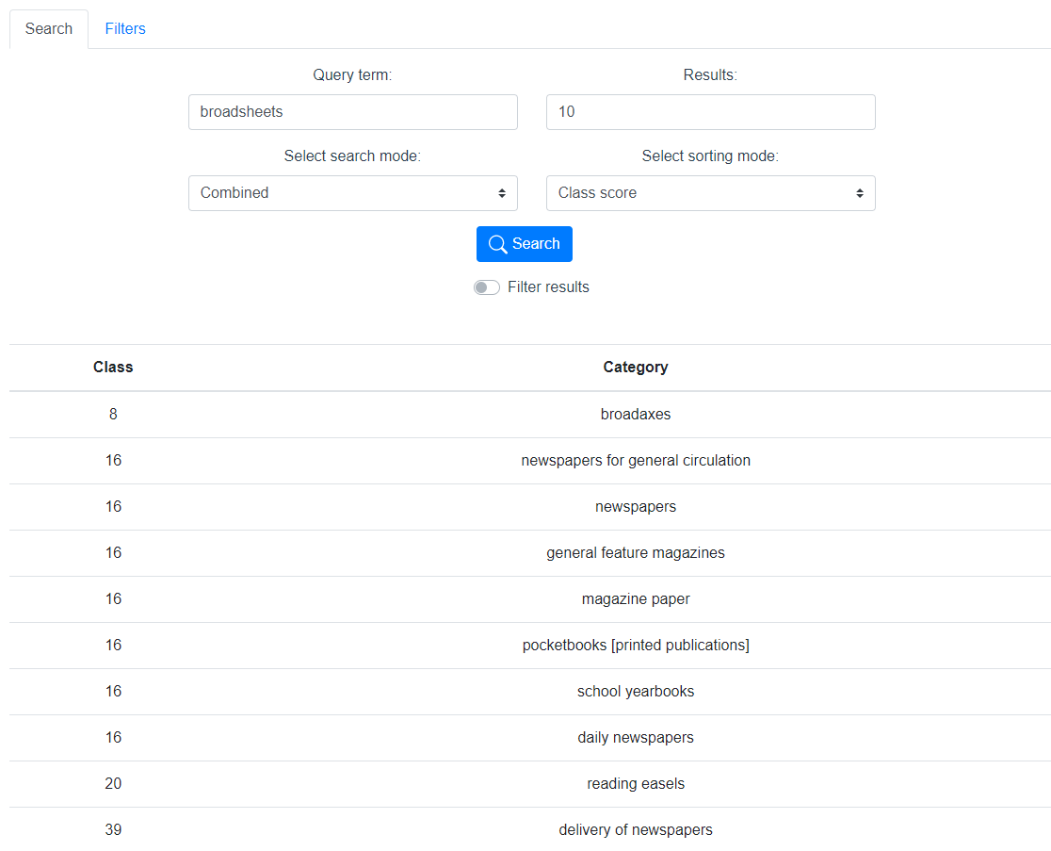
Trade Mark International Classification Service (TMICS)

Slide 12
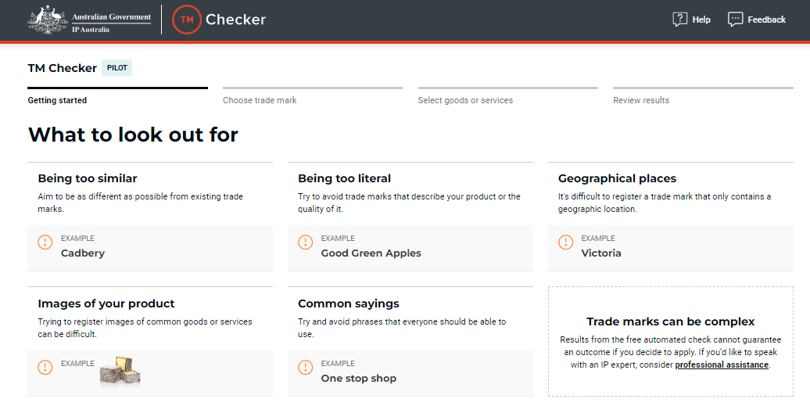
TM Checker

Slide 13
Contact us
E-mail: mdb-international-ict-cooperation@ipaustralia.gov.au
1300 65 1010 (9am-5pm)
ipaustralia.gov.au
facebook.com/ipaustralia.gov.au
twitter.com/IPAustralia
linkedin.com/company/ip-australia
youtube.com/@IPAustralia
instagram.com/ipaustraliaofficial/

