Slide 1
Image search in the Global Brand Database
Internet
April 2020
Sandrine Ammann
Marketing & Communications Officer

Slide 2
If you can hear me and see my screen, please click the raise hand button

Slide 3
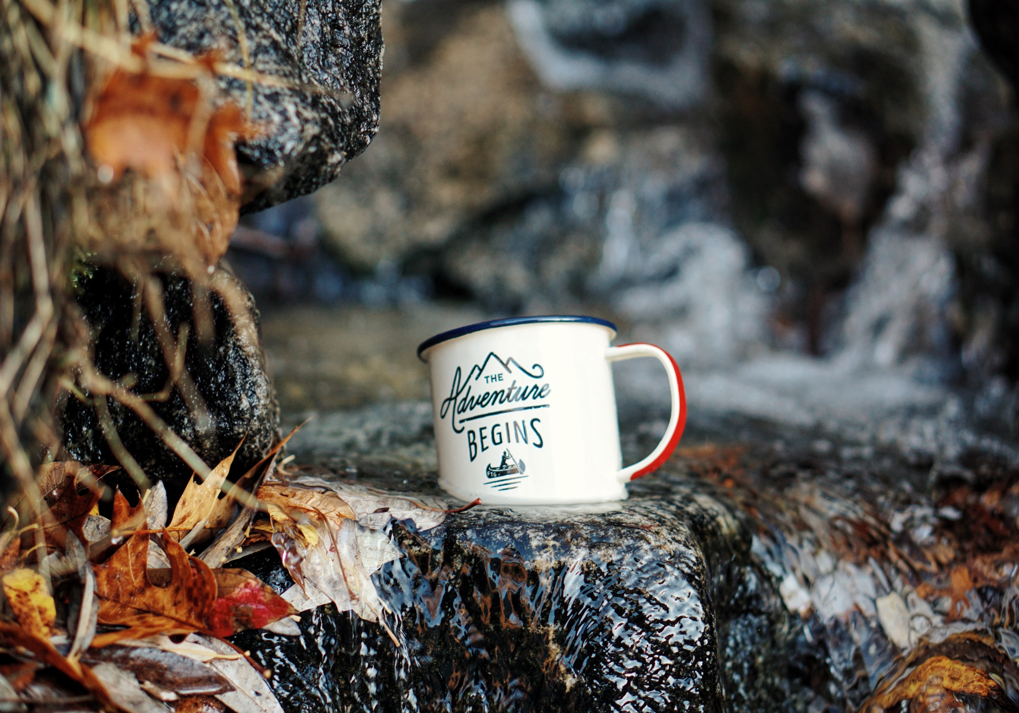

Slide 5
Questions/concerns
gbd@wipo.int

Slide 6
Agenda
Image search
As a user
History
Webinar
Q&A

Slide 7
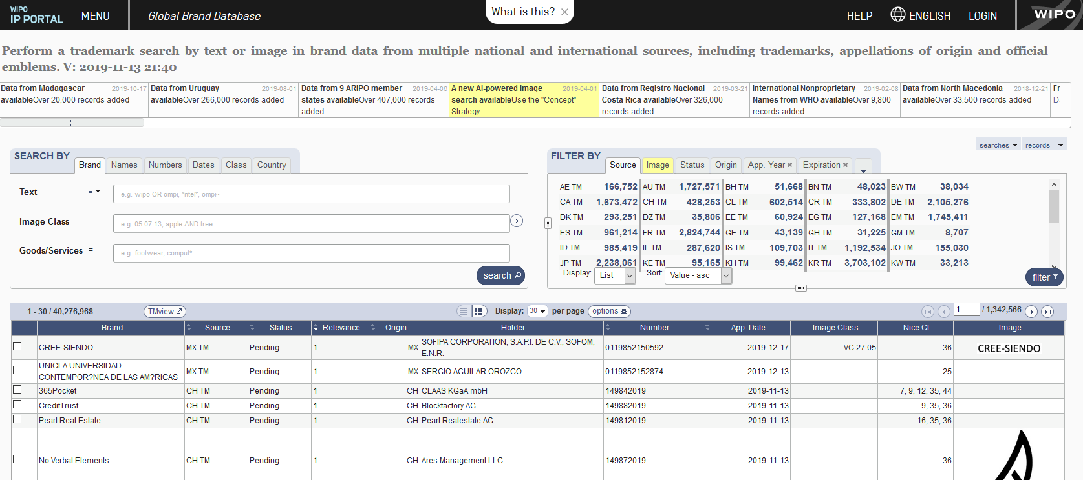
Image search

Slide 8
Image search: 2/3 steps
1. Image = unique search term
2. Rank search results by visual similarity to an image

Slide 9
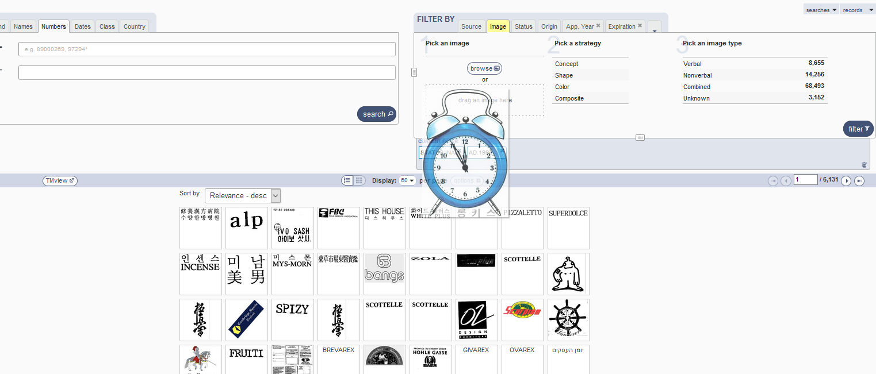
Step 1: select image

Slide 10
Step 1: image

Slide 11
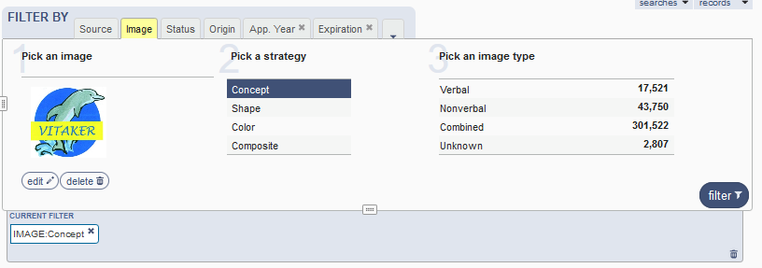
Image: edit

Slide 13
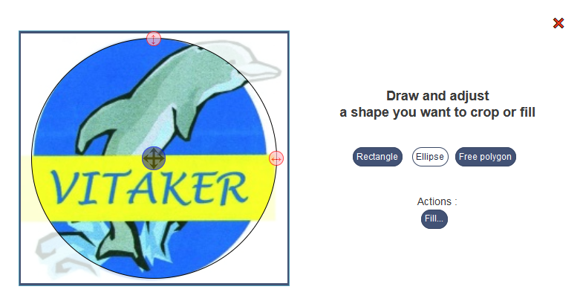

Slide 14
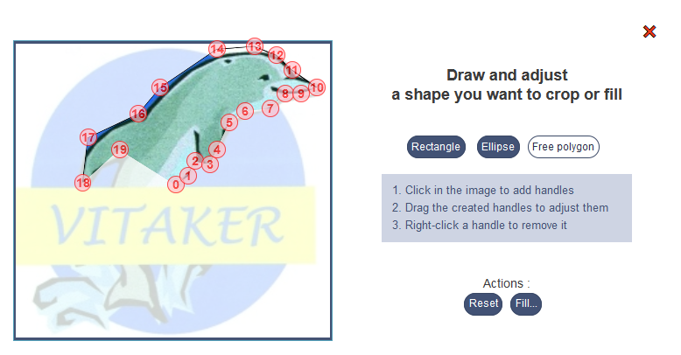

Slide 15
Step 2: strategies

Slide 16
Concept: abstract idea

Slide 17
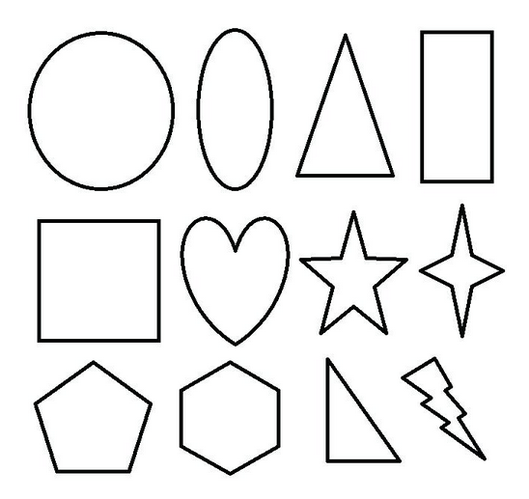
Strategy: shape
Notes:
Shape . This comparison method looks only at the distribution of lines in your source image, and looks for similar images in our collection. Color is completely ignored for this type of search.

Slide 18
Strategy: color
Notes:
Color . This comparison method looks only at the colors in the image, and how they are distributed in the image. It.s not as effective at matching shapes as the Shape or Texture methods, but is the most accurate for matching colors.

Slide 19
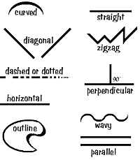
Strategy: composite
Notes:
Composite . This option uses both color and line information in it.s analysis, but since it uses both simultaneously, it.s not as accurate as other options, but you may still receive interesting results.

Slide 20
Step 3 (optional): image type

Slide 21
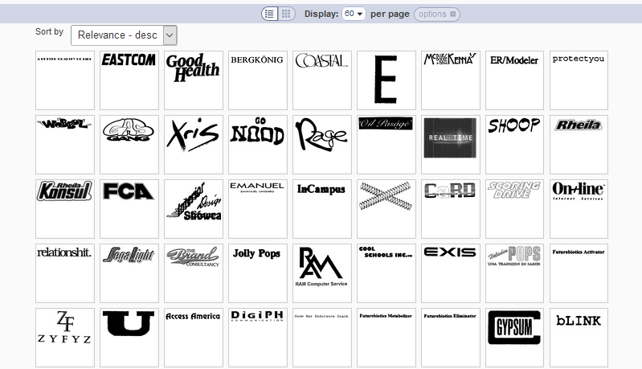
Image type: verbal
Notes:
Verbal . These are marks that are determined to have only a textual element of some form, without being noted as having a design element. You can find any of these marks by searching in the .Text. in the .Brand. tab in the Global Brand Database page. Note that these are only records which contain an image. If the brand is purely textual and doesn.t have an associated image, this filter will not match. For some countries, it is impossible to determine the type of image (see the .Unknown. option), so this filter will automatically exclude those images as they may or may not contain a device.

Slide 22
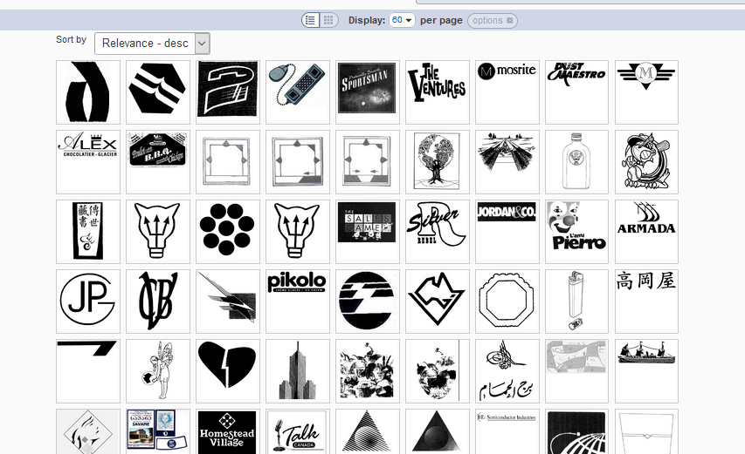
Image type: non verbal
Notes:
Nonverbal . This will match images that are determined to have no textual element at all, but only some form of device, shape, color, scent or sound.

Slide 23
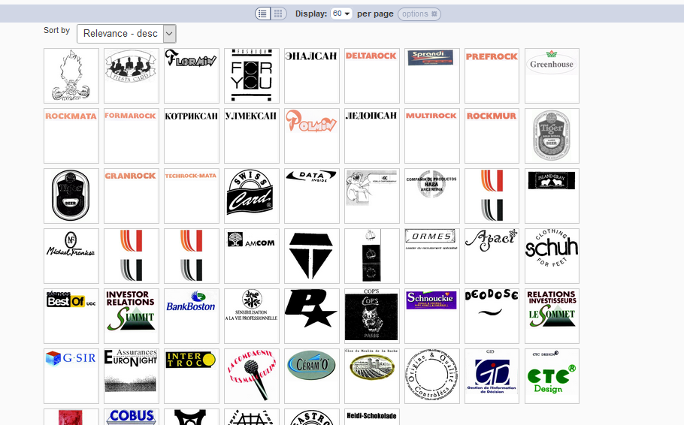
Image type: combined
Notes:
Combined . This will match images associated with records that are determined to have both a textual and non-textual element.

Slide 24
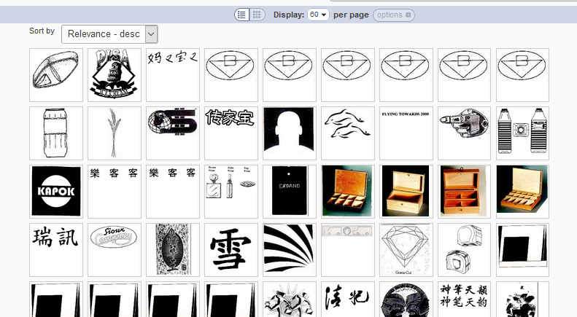
Image type: unknown
Notes:
Unfortunately, in some collections, it is impossible to determine what is comtained in the associated image, and these images are marked .Unknown.. They may be verbal, non-verbal or combined.

Slide 26
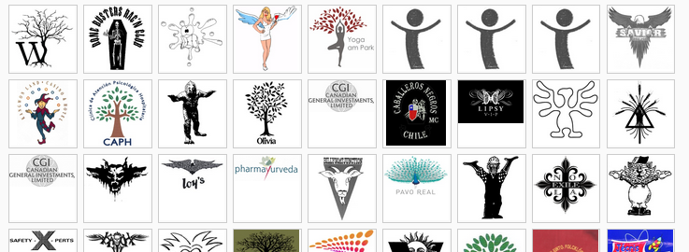
Strategy: Shape

Slide 27
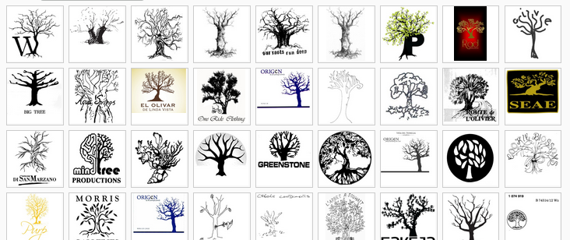
Strategy: concept

Slide 28
Strategy: Shape

Slide 29
Strategy: concept

Slide 30
Strategy: Shape

Slide 31
Strategy: Color

Slide 32
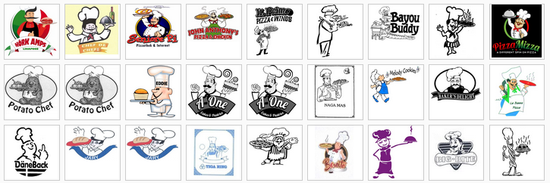
Strategy: concept

Slide 33
Filter & Combine

Slide 34
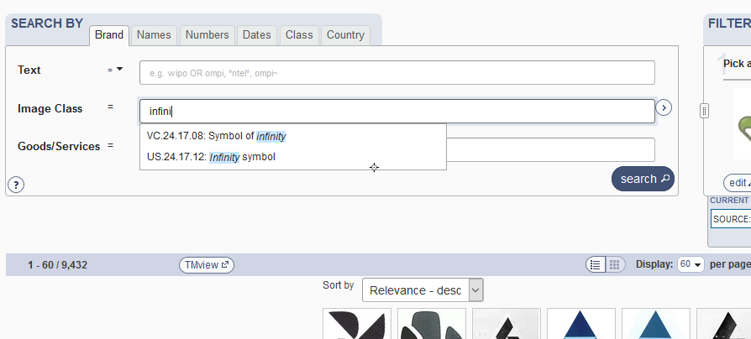
Add a classification
Notes:
Helping the system go the right direction with classes

Slide 36
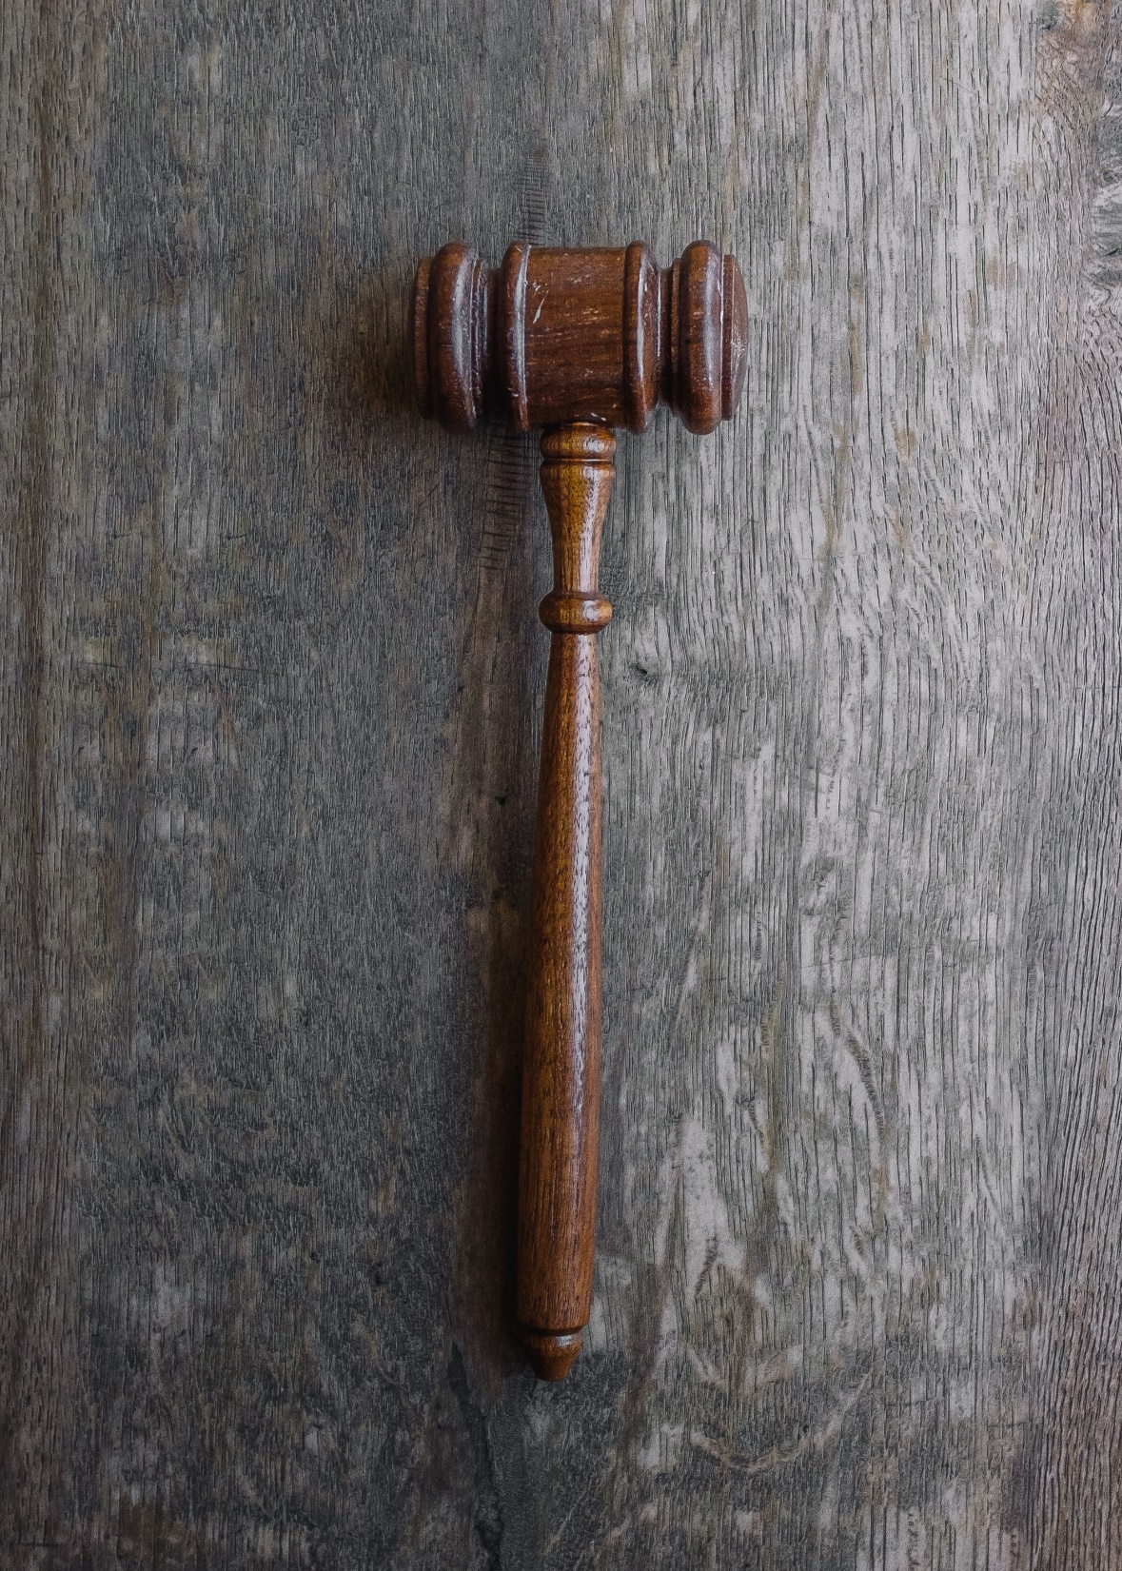

Slide 38
Image similarity: history
Released in 2014
Based on Image features:
Shape
Color
Texture
Very effective: simple geometric shapes

Slide 39
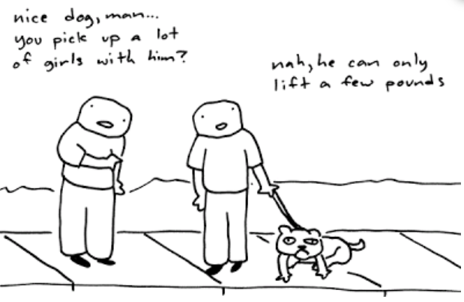
Image similarity: limitation
Semantic similarity

Slide 40
Image similarity: now
AI based search
Semantic search by definition
Automated classification of images
Release date: April 2019

Slide 41
Image classification: example
1 06.09.05 Other cultivated areas (15.1)
2 01.05.01 Sun, rising or setting (partially exposed or partially o... (13.8)
3 06.03.03 Open sea, stretches of water without shore, multiple wav... (12.9)
4 26.01.06 Semi-circles (11.8)
5 06.01.04 Mountains, mountain landscapes (10.9)
6 06.09.03 Farms (10.2)
7 01.15.01 Rainbows (10.1)
8 01.05.25-Other representations of the sun (9.9)
9 07.11.11-Roads without lines or dividers (9.5)
10 01.15.13-Single wave of water (9.4)
Notes:
Numbers on right indicate how obvious the concept is presnet in the image, arbitory, deep netowrk decide, value used to determine how how relevant the image is to the query image, simialr concept with simialr weight are ranked higher

Slide 42
Image classification: example
1 03.01.08 Dogs (14.8)
2 03.01.24 Stylized cats, dogs, wolves, foxes, bears, lions or tige... (14.5)
3 18.13.05 Yokes, collars, leashes, and harnesses for other animals (13.8)
4 03.01.07 Shadows or silhouettes of dogs (13.5)
5 03.01.04 Domestic cats (10.9)
6 03.03.24 Stylized elephants, hippopotami, rhinoceri, giraffes, al... (9.8)
7 03.03.01 Elephants, mammoths (9.7)
8 03.01.26 Costumed animals and those with human attributes in this... (9.6)
9 02.11.01 Hearts (9.2)
10 03.01.17 Cats, dogs, wolves, foxes, bears, lions or tigers with f... (8.6)

Slide 43
Image classification: example
1 02.03.22 Heads, portraits or busts of women in profile (13.2)
2 02.03.18 Women wearing ribbons or flowers in their hair (11.6)
3 02.03.24 Stylized women, including women depicted in caricature f... (10.3)
4 02.03.01 Heads, portraits, busts of women not in profile. (10.0)
5 02.03.02 Shadows or silhouettes of women (9.9)
6 05.05.25 Other flowers including daffodils and irises (8.9)
7 17.03.25 Other jewelry, including pendants, earrings and brooches (8.5)
8 02.03.25 Other women including hobos, women holding fans and wome... (8.4)
9 02.07.02 Groups of females (8.2)
10 02.03.09 Romans, Greeks or Egyptian women (ancient dress) (8.1)

Slide 44
Image classification: example
1 05.09.13 Slices or quarters of fruits, open fruits (13.0)
2 05.09.04 Lemons, limes (10.9)
3 05.09.03 Oranges, tangerines and the like; grapefruit (10.4)
4 01.15.18 More than one drop including teardrops or raindrops (10.1)
5 01.15.08 A single drop (including a single raindrop or a single t... (9.6)
6 05.05.25 Other flowers including daffodils and irises (8.4)
7 05.03.25 Other leaves (7.9)
8 01.01.04 A single star with six points (7.8)
9 02.11.01 Hearts (7.3)
10 18.03.06 Baby carriages and strollers (7.2)

Slide 45
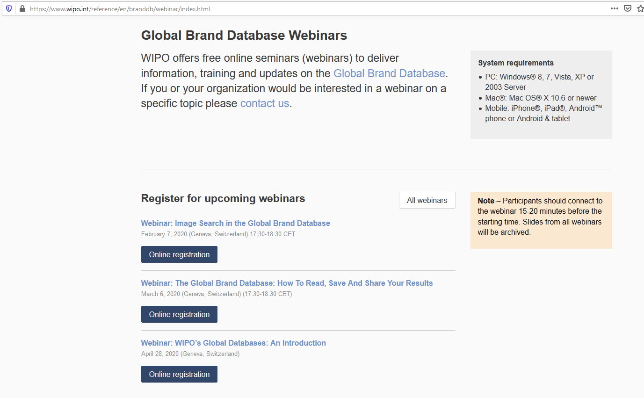
http://www.wipo.int/reference/en/branddb/webinar/index.html

Slide 46
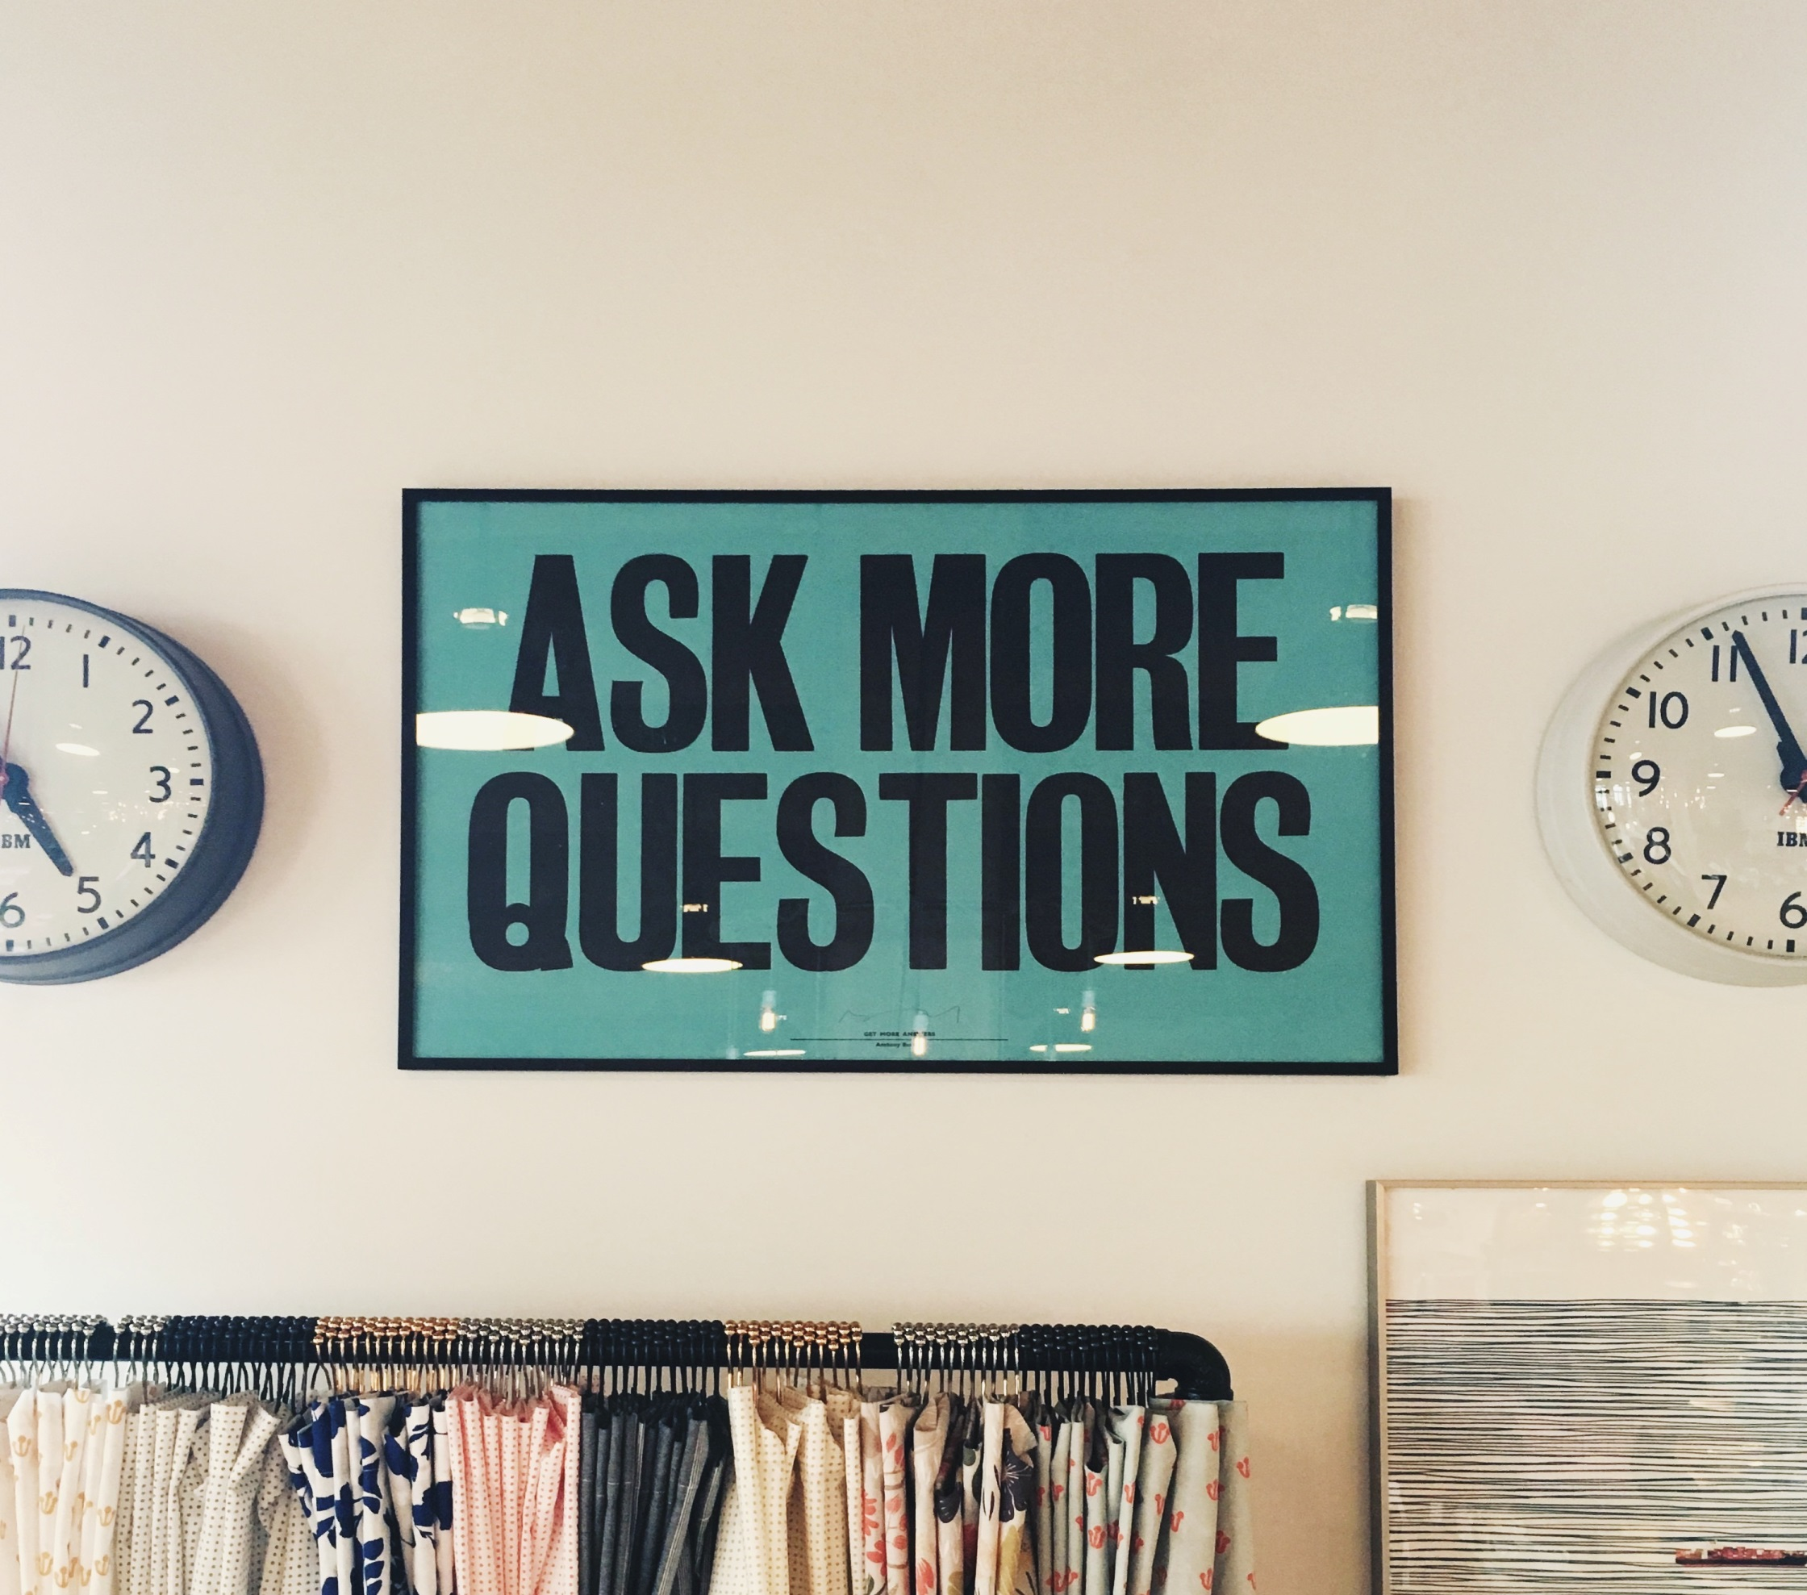

Slide 47
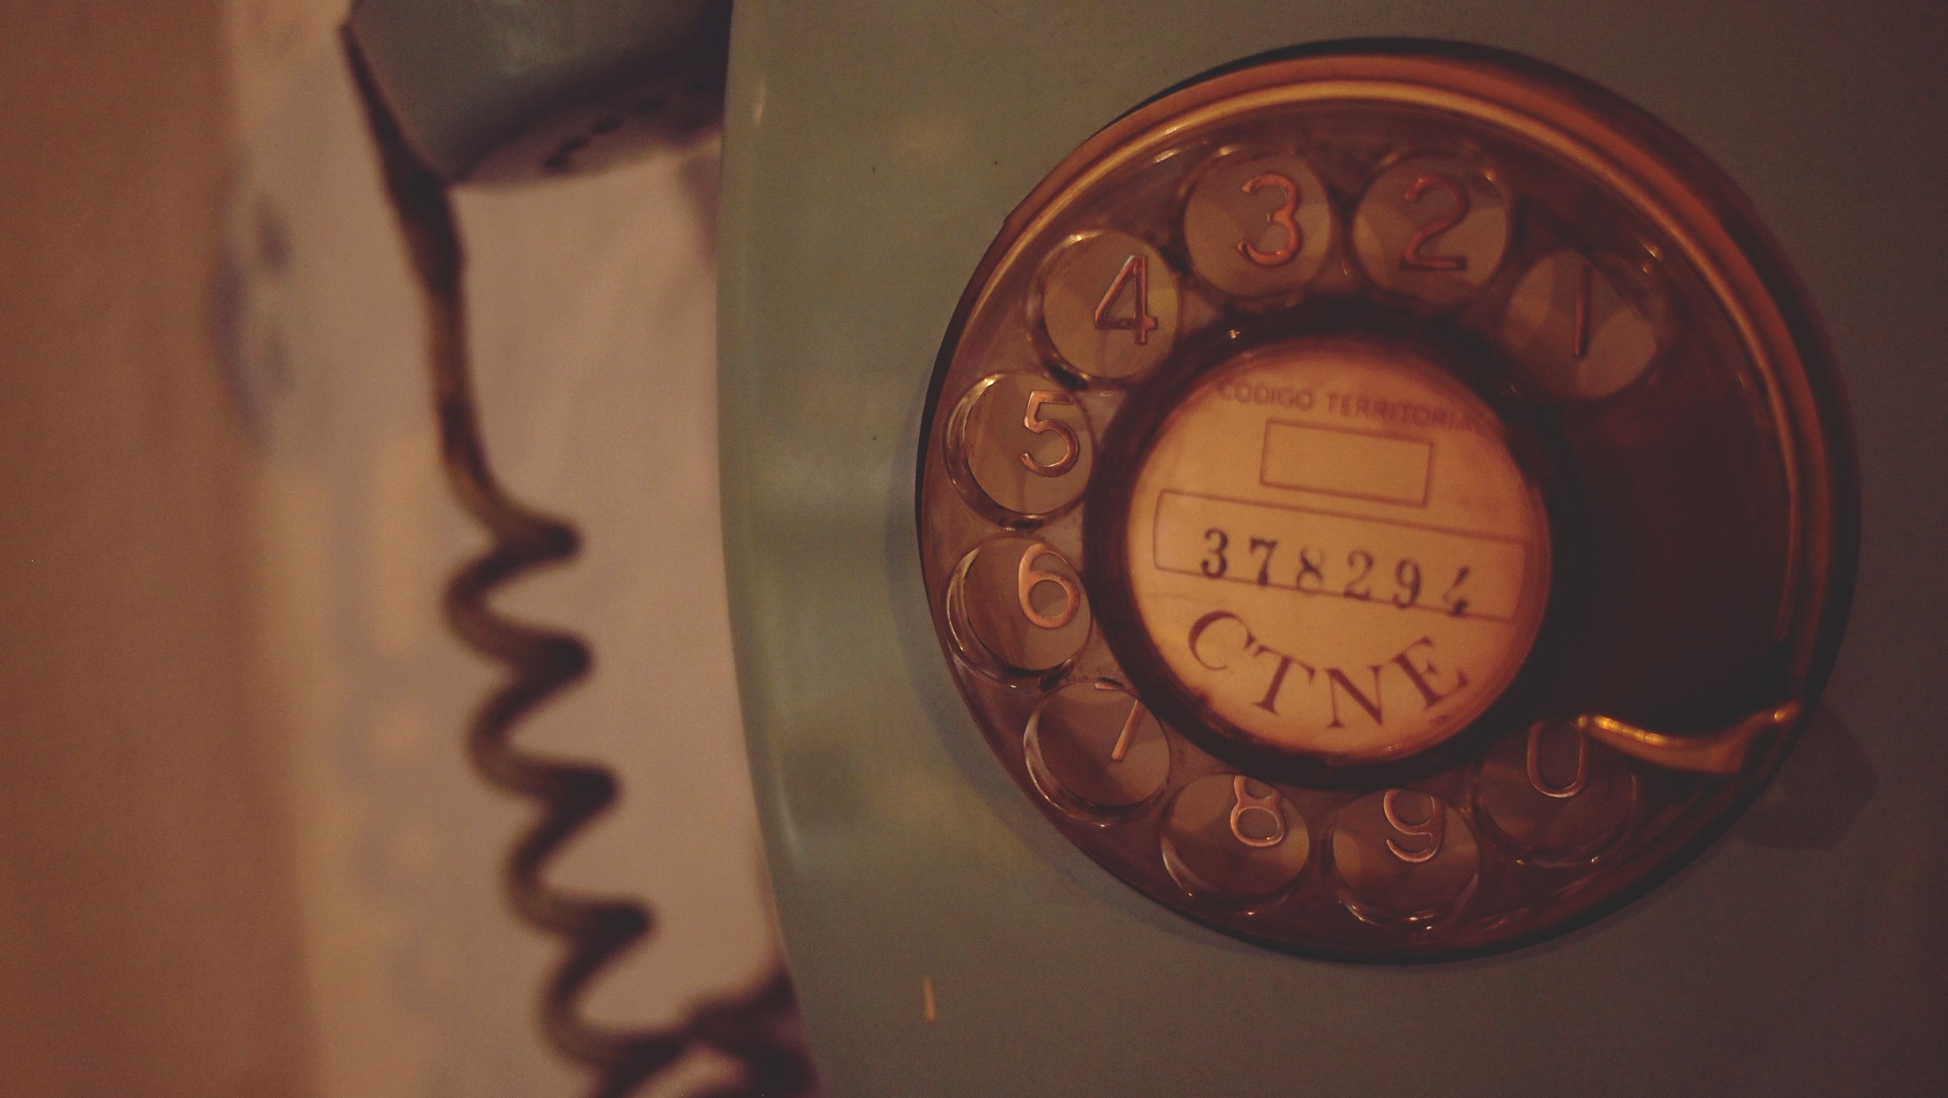
gbd@wipo.int

