Slide 1
Special COVID-19 in PATENTSCOPE
May
2020
Alex Riechel
Iustin Diaconescu
Sandrine Ammann

Slide 2
Webinar functions: audio + screen validation
If you can hear me and see my screen, please click the raise hand button
To report issues, please use the Chat box

Slide 3
Agenda
Introduction to the Index
The Index in details
Searches in PATENTSCOPE using the Index

Slide 4
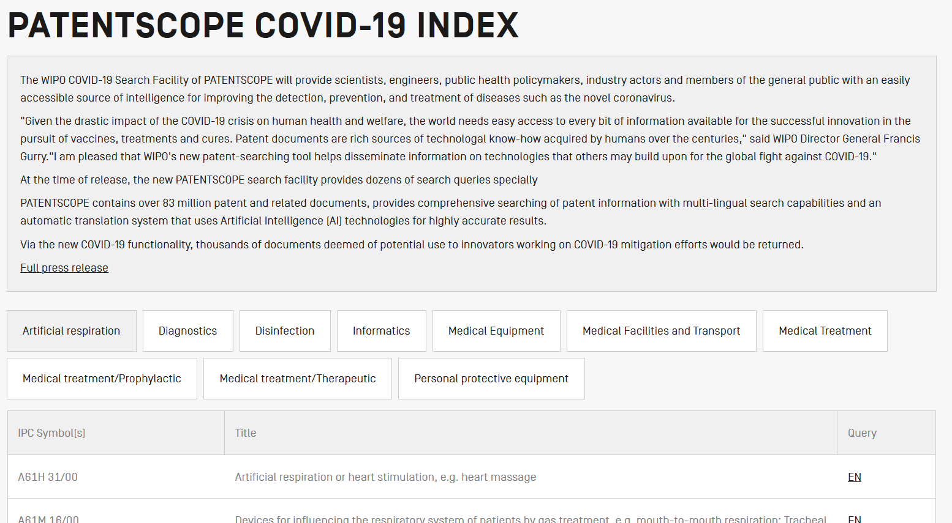
https://patentscope.wipo.int/search/en/covid19.jsf

Slide 5
“Given the drastic impact of the COVID-19 crisis […], the world needs easy access to every bit of information available for the successful innovation […] of vaccines, treatments and cures.”

Slide 6
https://patentscope.wipo.int/search/en/covid19.jsf

Slide 7
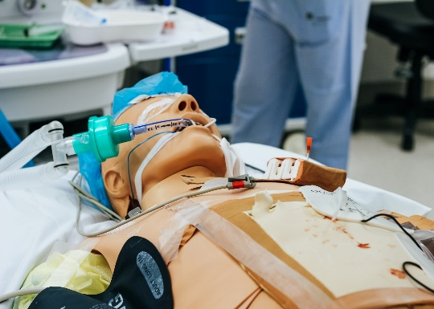
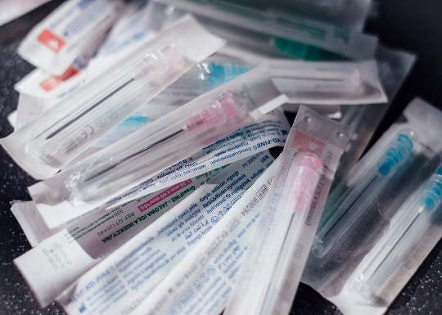
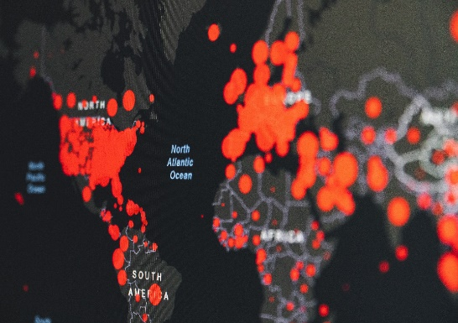
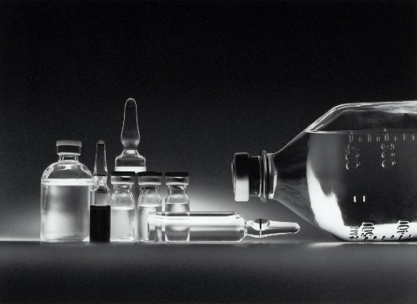
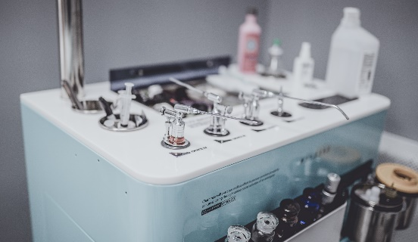
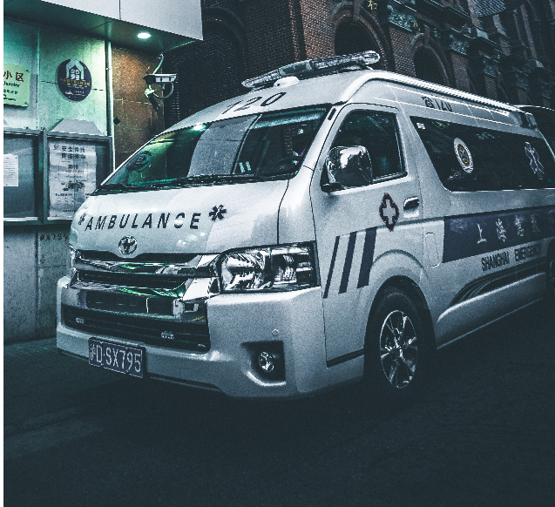
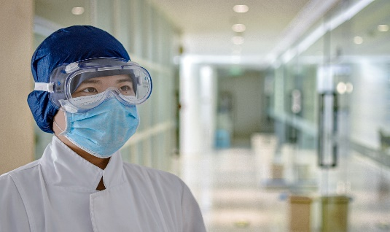
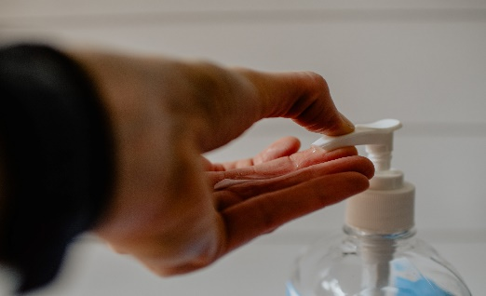
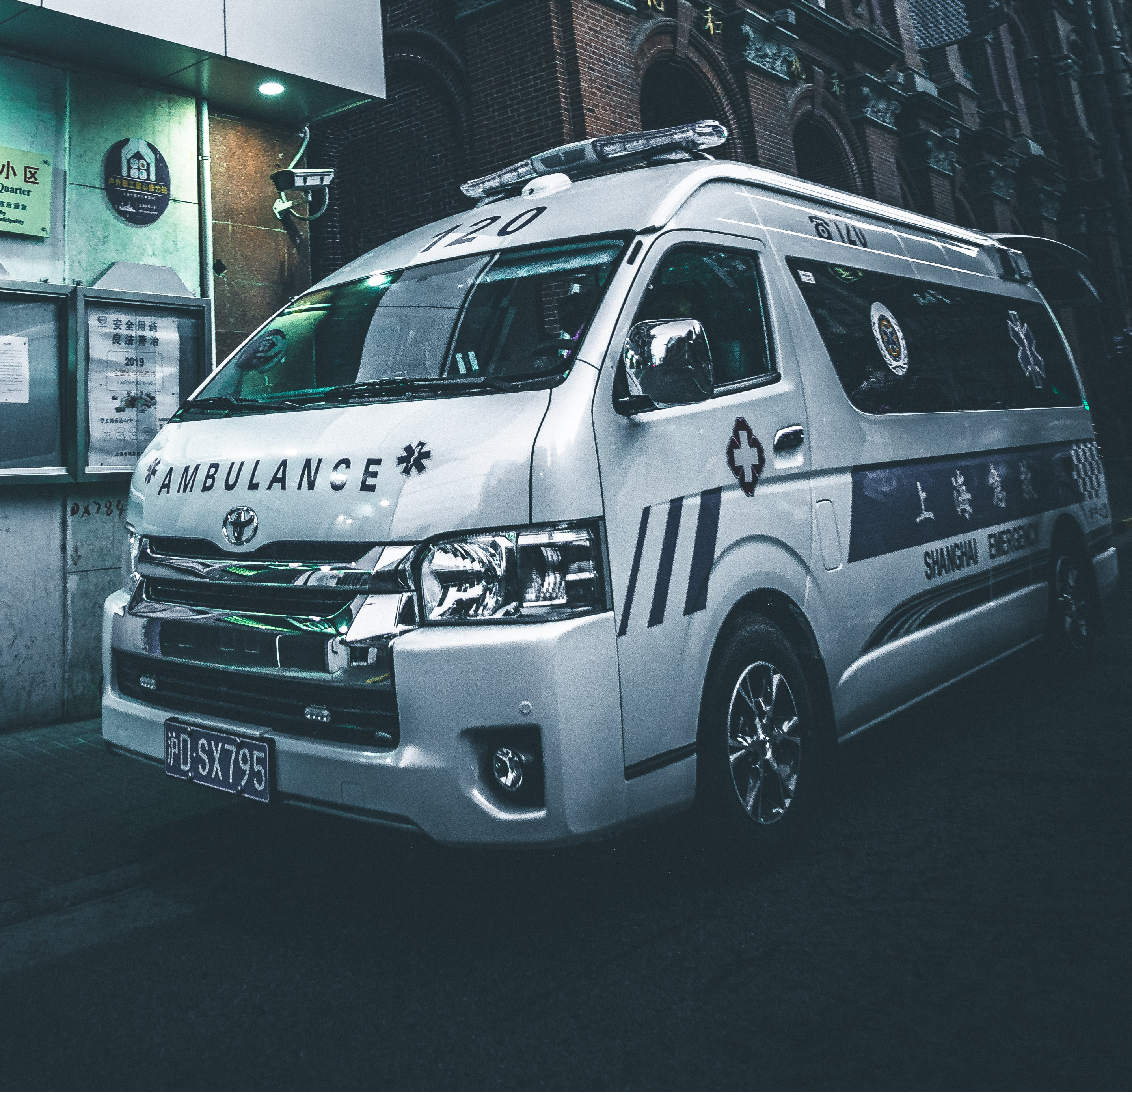
ARTIFICAL RESPIRATION | DIAGNOSTICS | INFORMATICS | MEDICAL TREATMENT
MEDICAL EQUIPMENT | MEDICAL FACILITIES/ TRANSPORT | PERSONAL PROTECTIVE EQUIPEMENT | DISINFECTION

Slide 8
Search terms

Slide 9
Search terms

Slide 10
Search terms: IPC symbols
→ “Symbols” representing (inventive) concepts

Slide 11
Classification
Image source: Skwanem (Wikimedia)

Slide 12
Classification

Slide 13
Advantages of patent classification
Independent of terminology and jargon (including changes in terms used over time)

Slide 14
Advantages of patent classification
Independent of terminology and jargon (including changes in terms used over time)
Independent of language

Slide 15
Advantages of patent classification
Independent of terminology and jargon (including changes in terms used over time)
Independent of language
Covers patent documents with limited searchable text

Slide 16
Advantages of patent classification
Independent of terminology and jargon (including changes in terms used over time)
Independent of language
Covers patent documents with limited searchable text
→ More precise and complete set of patent documents

Slide 17
Search queries: Finding innovations

Slide 18
Search queries: Finding innovations

Slide 19
Covid-19 Facility in PATENTSCOPE
Details of a query execution
Translation of query terms using WIPO PEARL
Chemical search

Slide 20
PATENTSCOPE – Query Execution

Slide 21
PATENTSCOPE – Query Execution

Slide 22
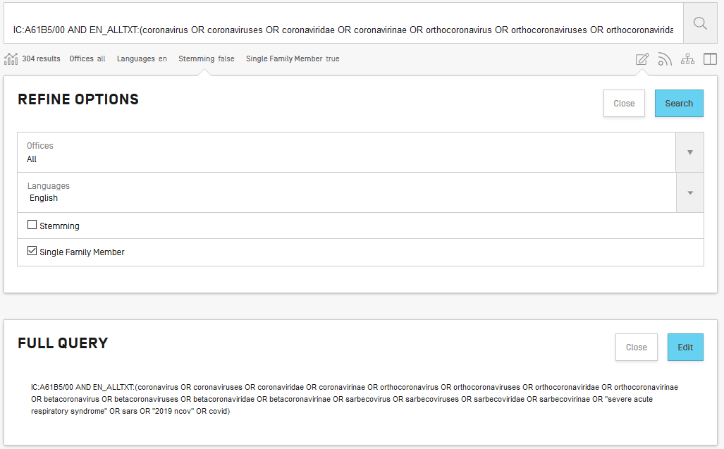
PATENTSCOPE – Query Execution
IC:A61b5/00 EN_ALLTXT: coronavirus ...

Slide 23
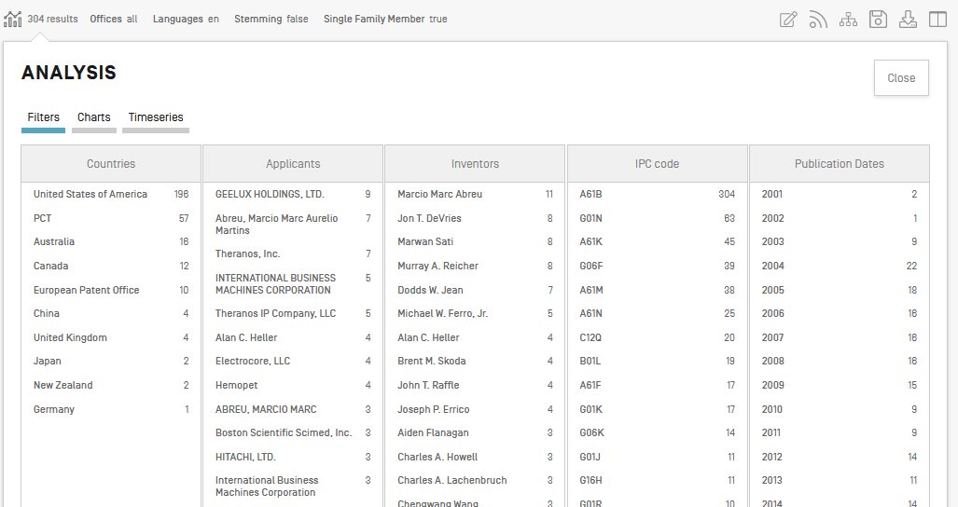
PATENTSCOPE – Query Execution

Slide 24
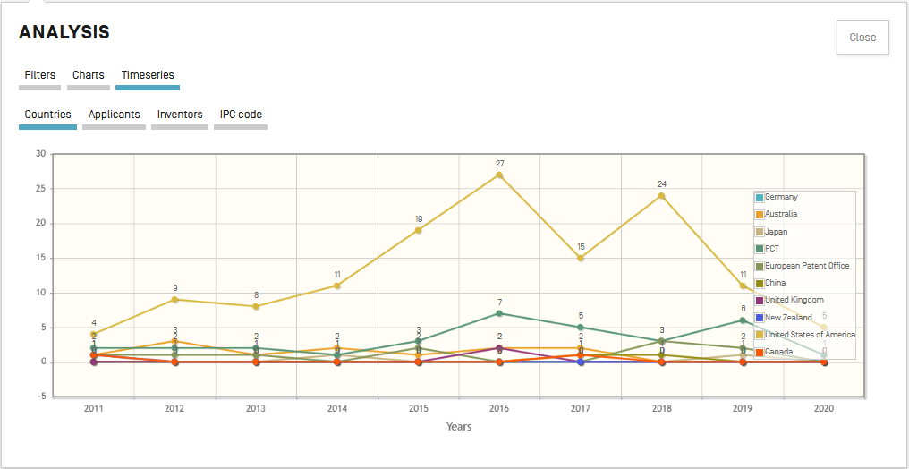
PATENTSCOPE – Query Execution

Slide 25
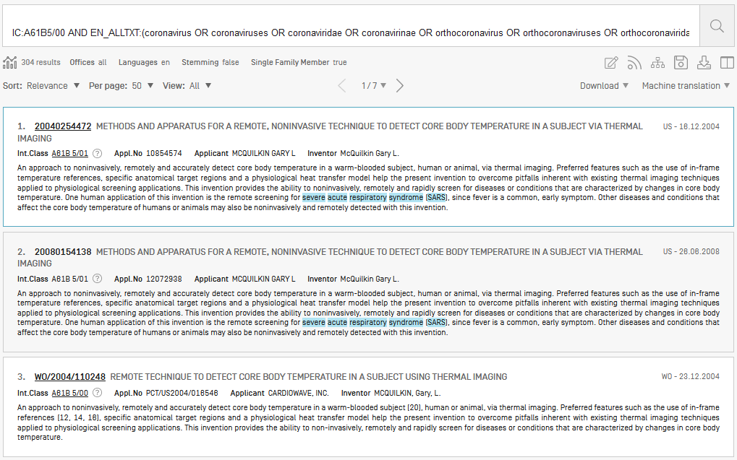
PATENTSCOPE – Query Execution

Slide 26
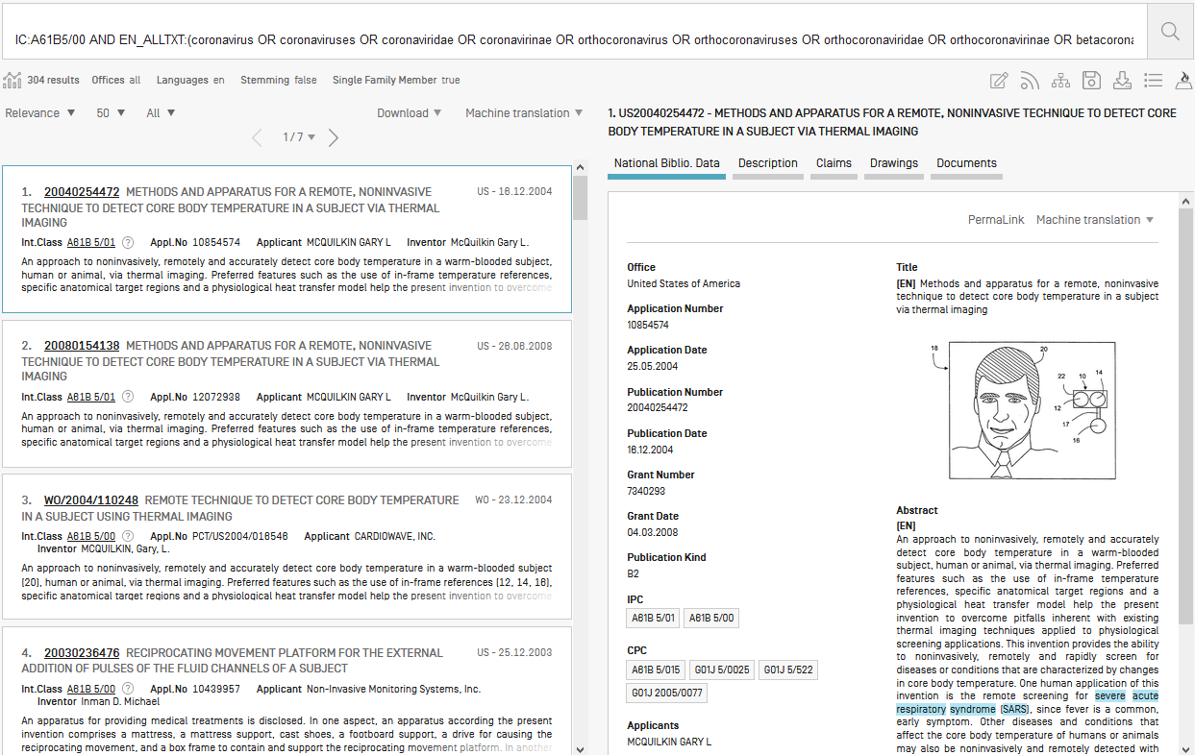
PATENTSCOPE – Query Execution

Slide 27
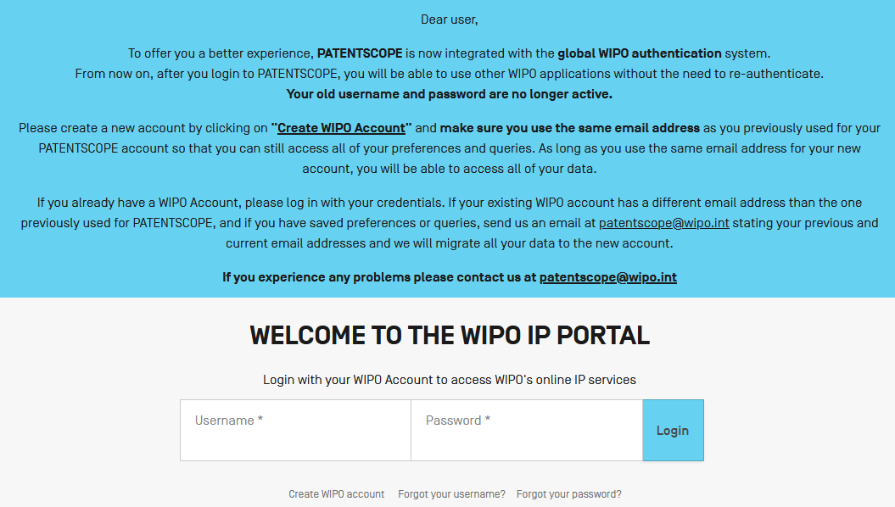
PATENTSCOPE – Query Execution

Slide 28
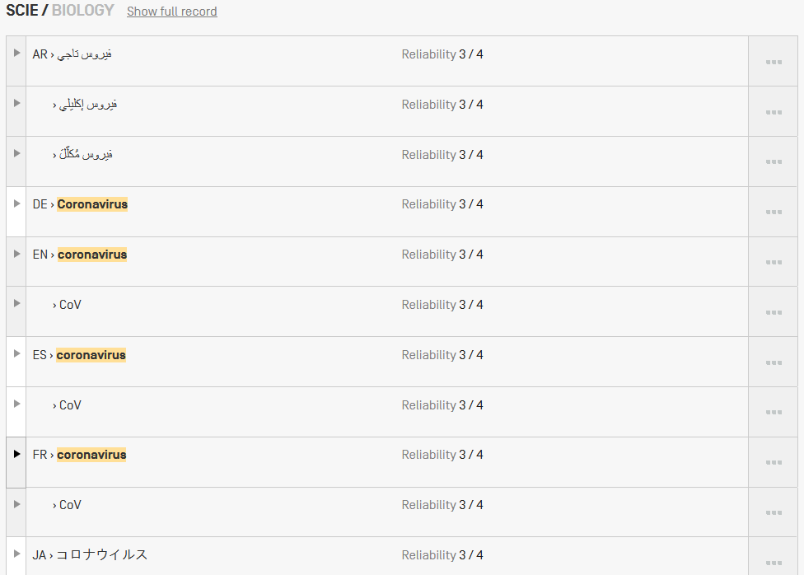
PATENTSCOPE – WIPO Pearl

Slide 29
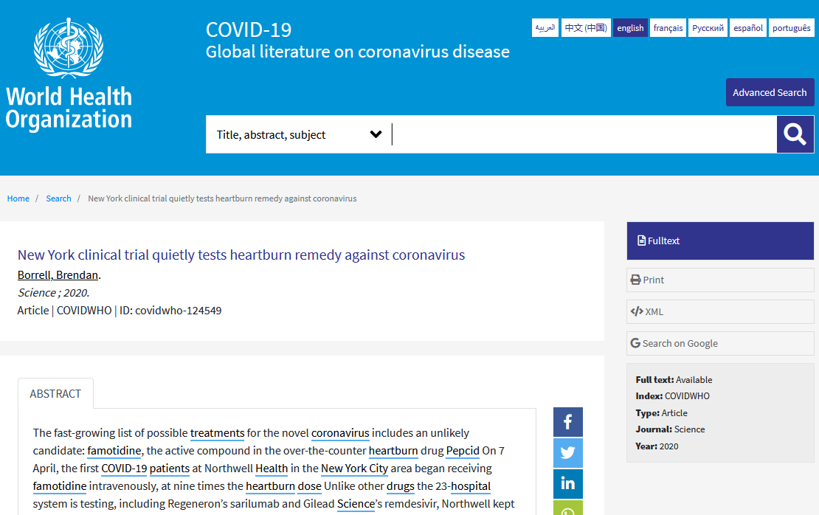

Slide 30
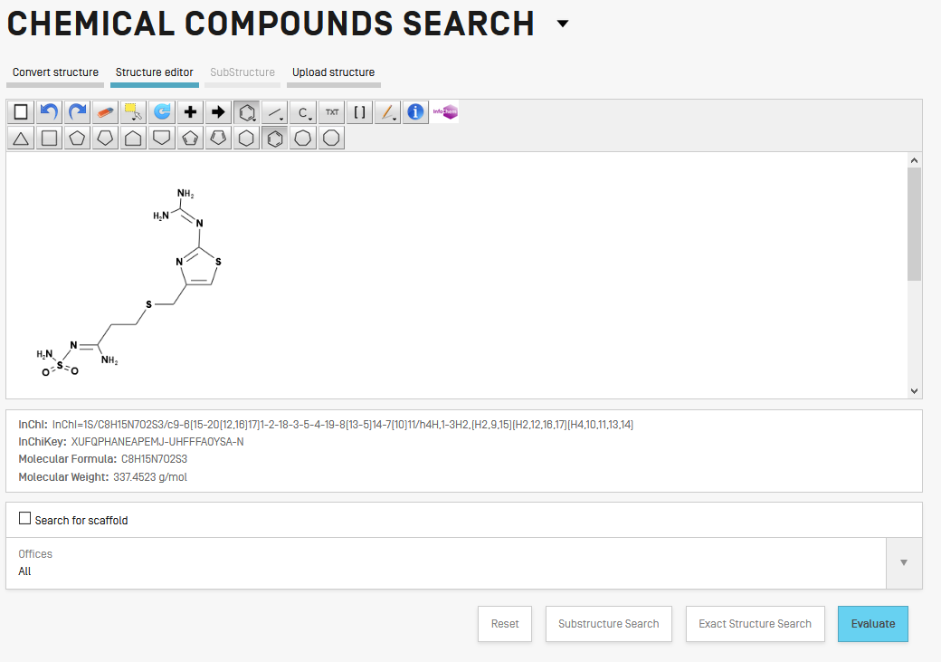
PATENTSCOPE – Chemical Search

Slide 31
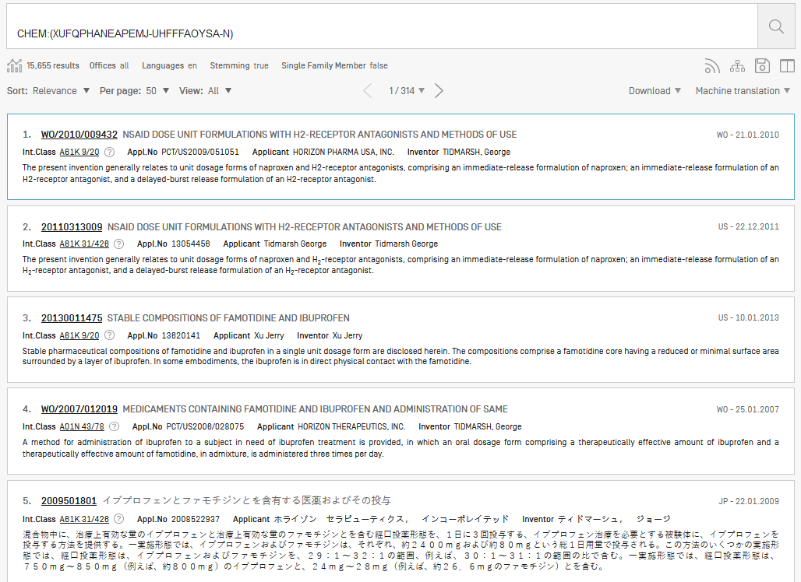
PATENTSCOPE – Chemical Search

Slide 32
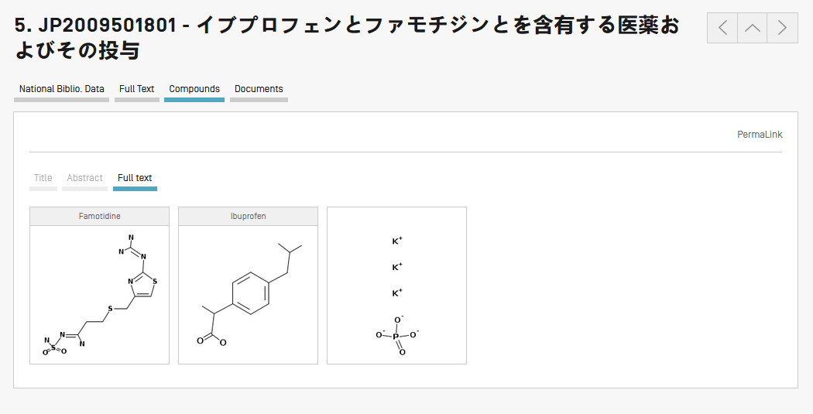
PATENTSCOPE – Chemical Search

Slide 33
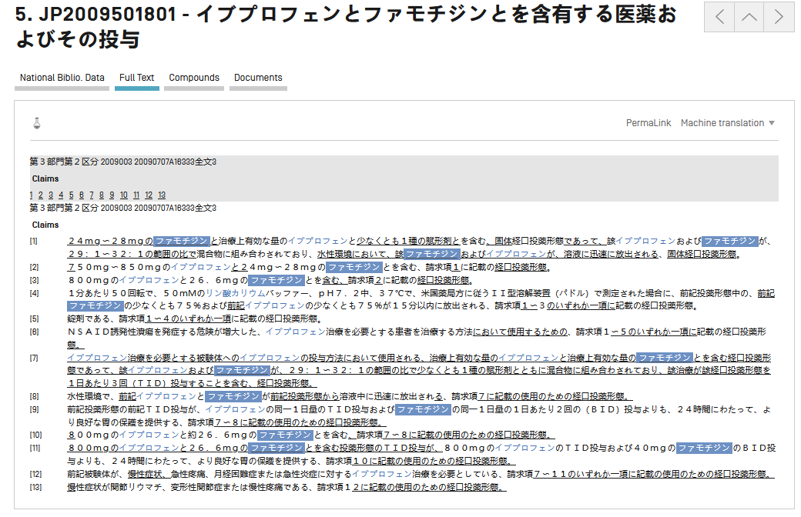
PATENTSCOPE – Chemical Search

Slide 34
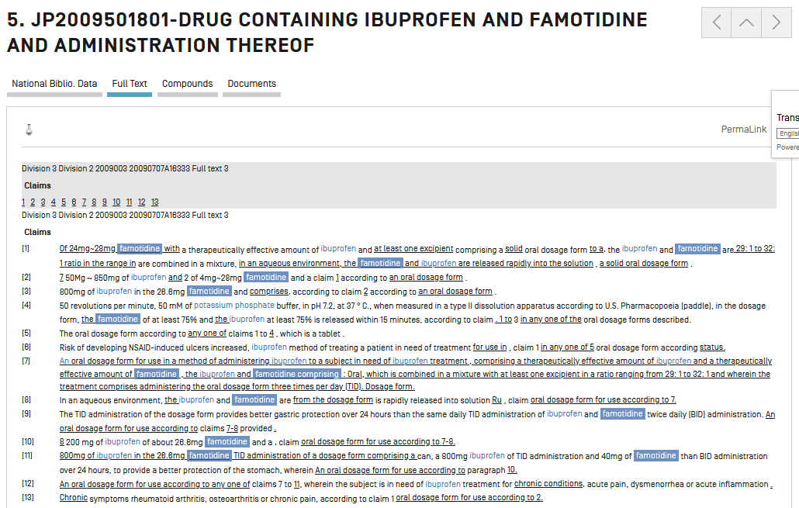
PATENTSCOPE – Chemical Search

Slide 35
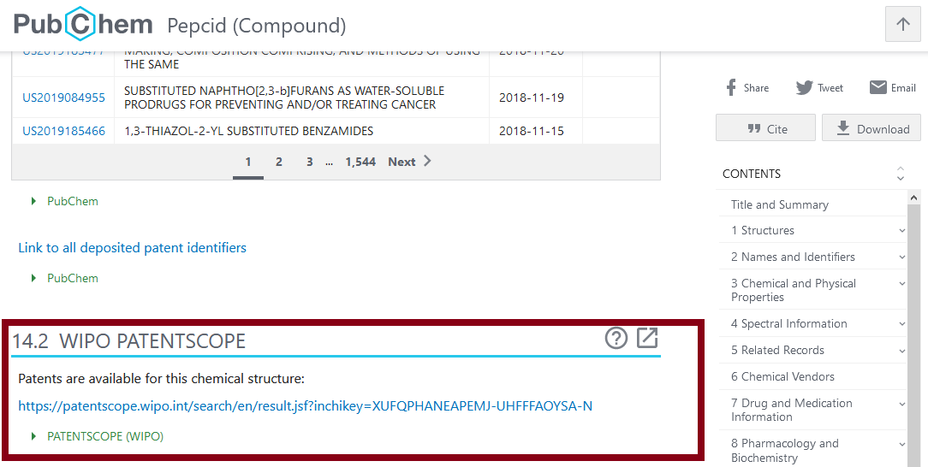
PATENTSCOPE – Chemical Search

