Slide 1
PATENTSCOPE
Translation tools
May
2020
Sandrine Ammann
Marketing & Communications Officer

Slide 2
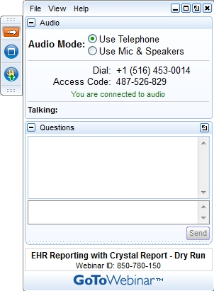
Click this button if you can hear me otherwise send me a message

Slide 3


Slide 4
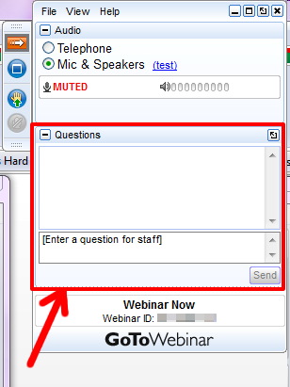

Slide 5
Questions/concerns
patentscope@wipo.int

Slide 6
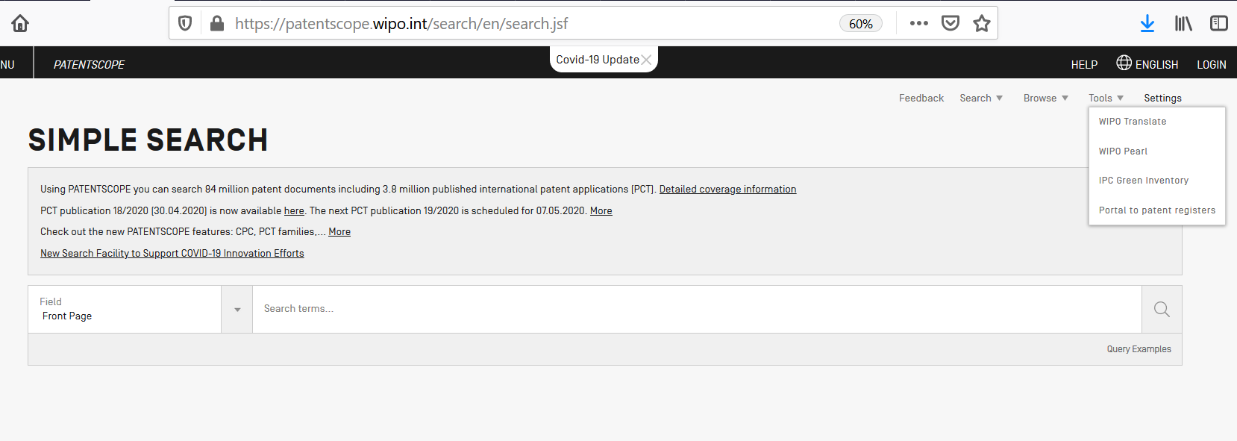
WIPO Translate

Slide 7
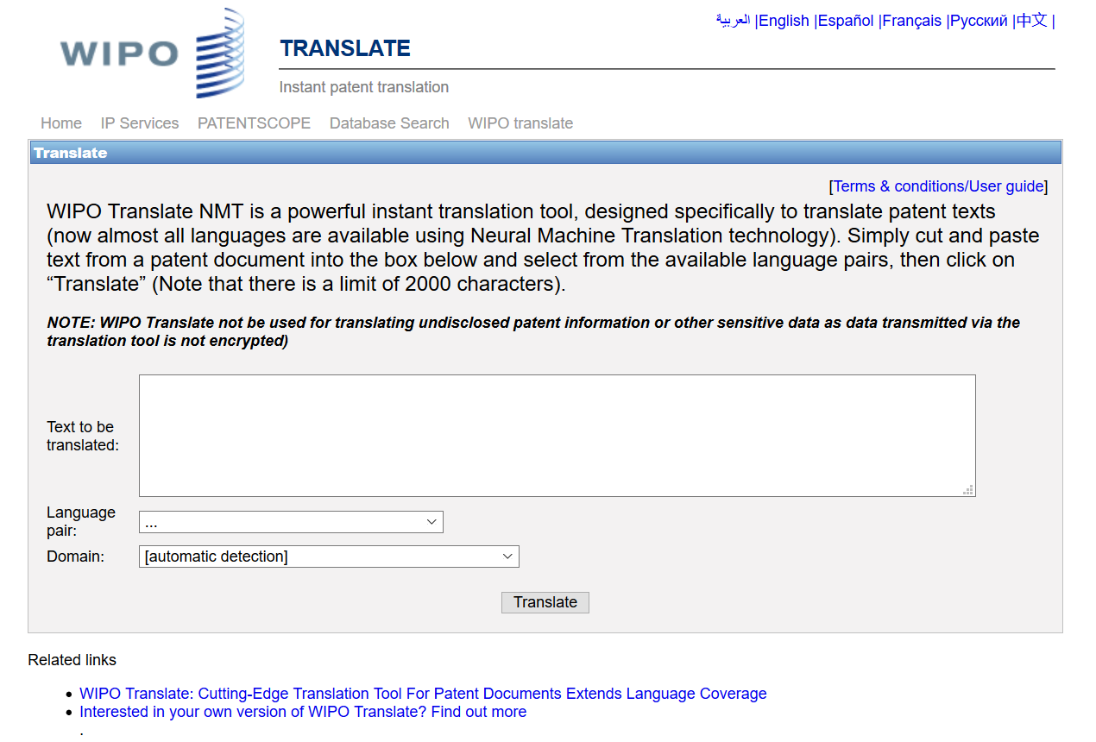

Slide 8
3 steps
Enter text
Select language pair
Select technical domain

Slide 9
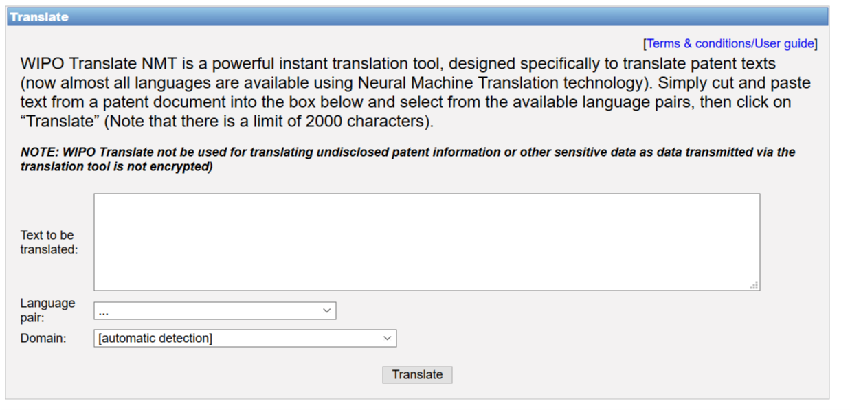
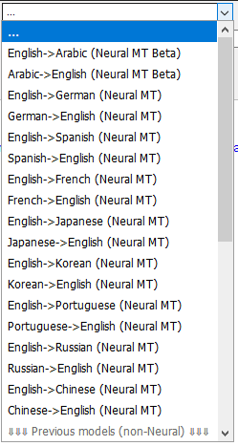

Slide 10
18 Language pairs
Arabic – English English-Arabic
Chinese – English English - Chinese
French – English English - French
German – English English - German
Japanese – English English - Japanese
Korean – English English - Korean
Portuguese – English English - Portuguese
Russian – English English - Russian
Spanish – English English - Spanish

Slide 11
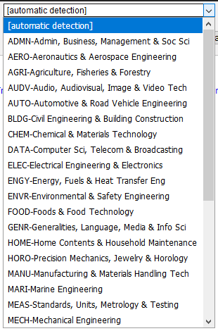

Slide 12
32 Technical domains from the IPC
[ADMN] Admin, Business, Management & Soc Sci
[AERO] Aeronautics & Aerospace Engineering
[AGRI] Agriculture, Fisheries & Forestry
[AUDV] Audio, Audiovisual, Image & Video Tech
[AUTO] Automotive & Road Vehicle Engineering
[BLDG] Civil Engineering & Building Construction
[CHEM] Chemical & Materials Technology
[DATA] Computer Sci, Telecom & Broadcasting
[ELEC] Electrical Engineering & Electronics
[ENGY] Energy, Fuels & Heat Transfer Eng
[ENVR] Environmental & Safety Engineering
[FOOD] Foods & Food Technology
[GENR] Generalities, Language, Media & Info Sci
[HOME] Home Contents & Household Maintenance
[HORO] Precision Mechanics, Jewelry & Horology
[MANU] Manufacturing & Materials Handling Tech
[MARI] Marine Engineering
[MEAS] Standards, Units, Metrology & Testing
[MECH] Mechanical Engineering
[MEDI] Medical Technology
[METL] Metallurgy
[MILI] Military Technology
[MINE] Mining, Oil & Gas Extraction & Minerals
[NANO] Nano Technology
[PACK] Packaging & Distribution of Goods
[PRNT] Printing & Paper
[RAIL] Railway Engineering
[SCIE] Optical Engineering
[SPRT] Sports, Leisure, Tourism & Hospitality
[TEXT] Textile & Clothing Industries
[TRAN] Transportation

Slide 13
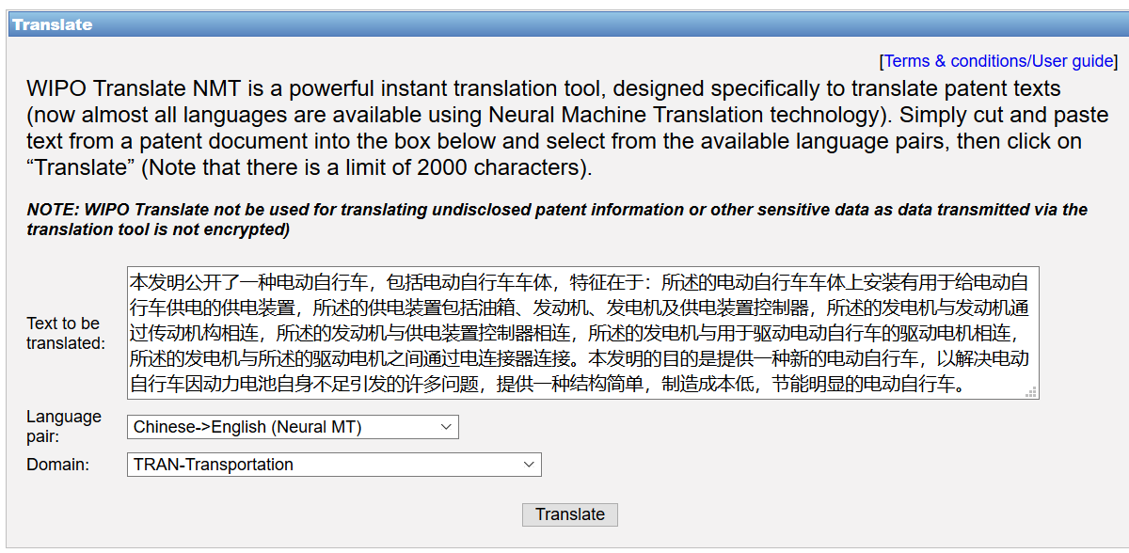
WIPO Translate: an example

Slide 14
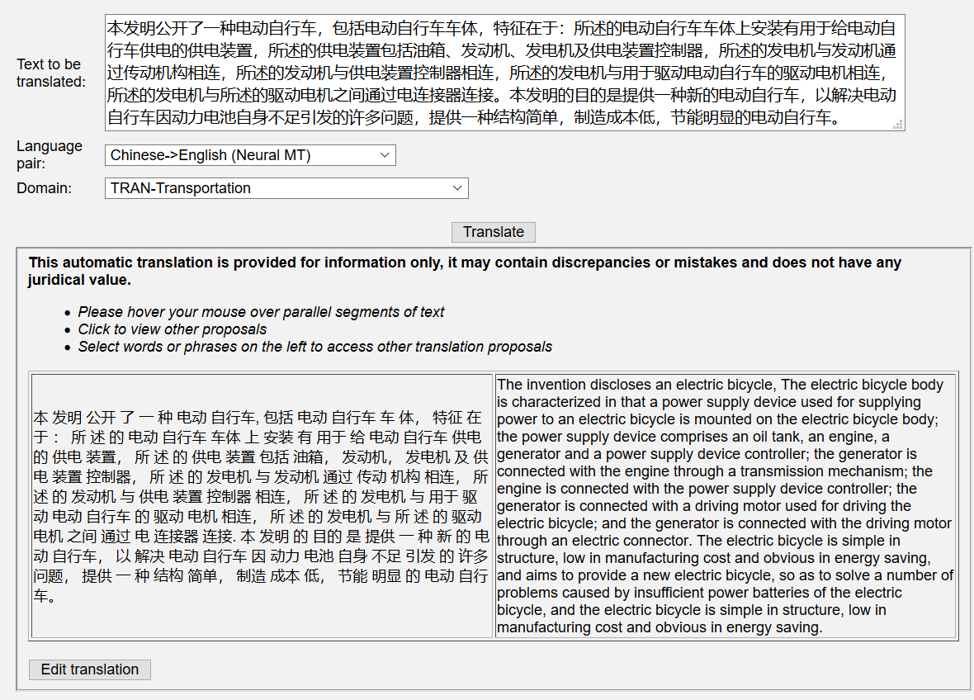

Slide 15
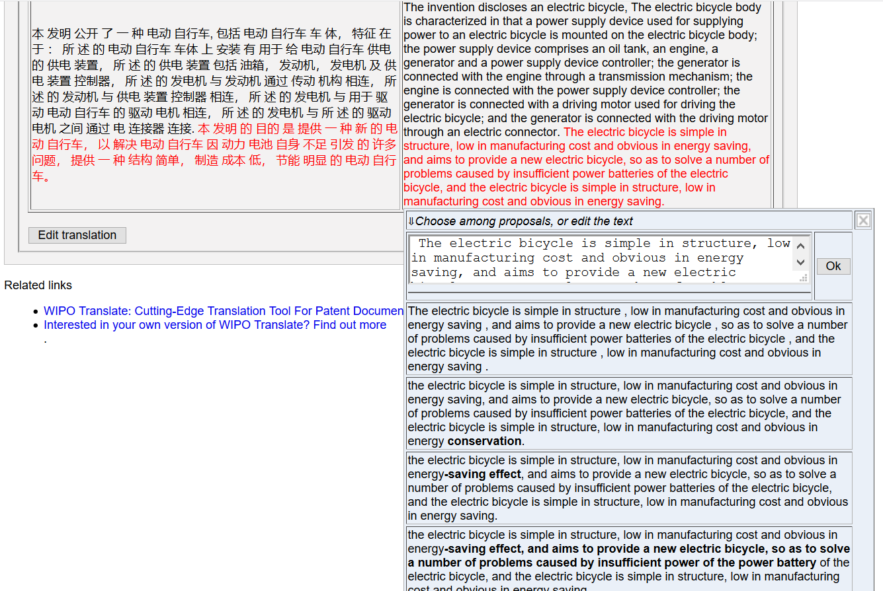

Slide 16
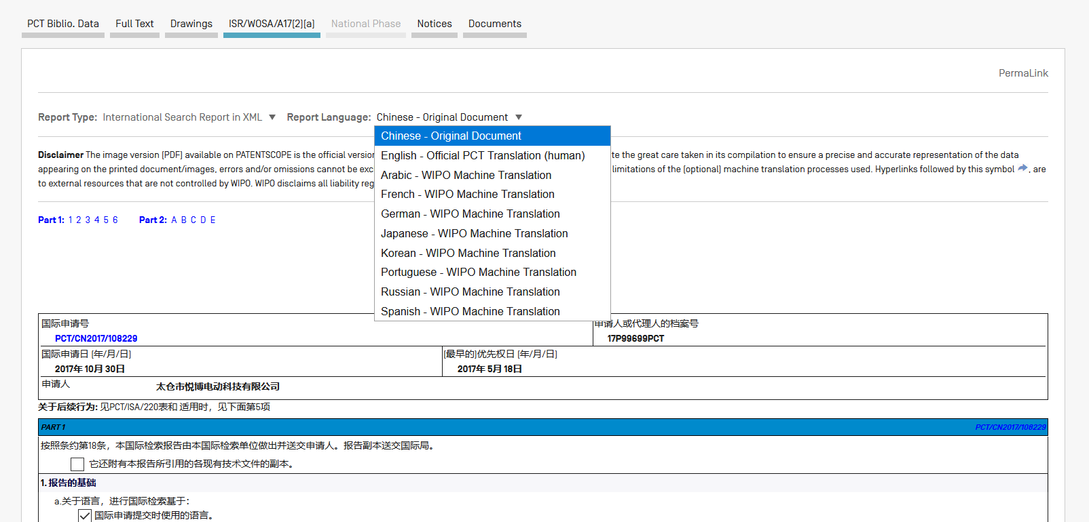
ISA/WOSA/Art172a translation

Slide 17
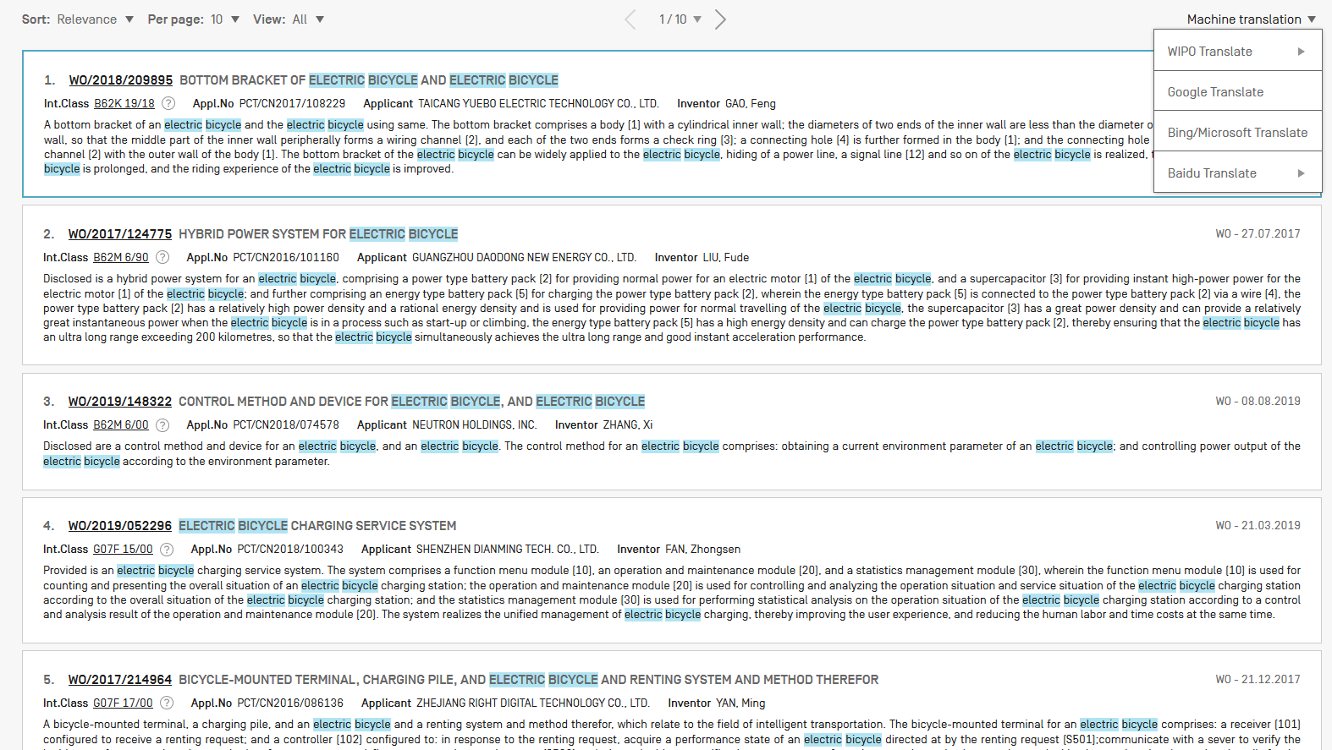
Result list translation

Slide 18
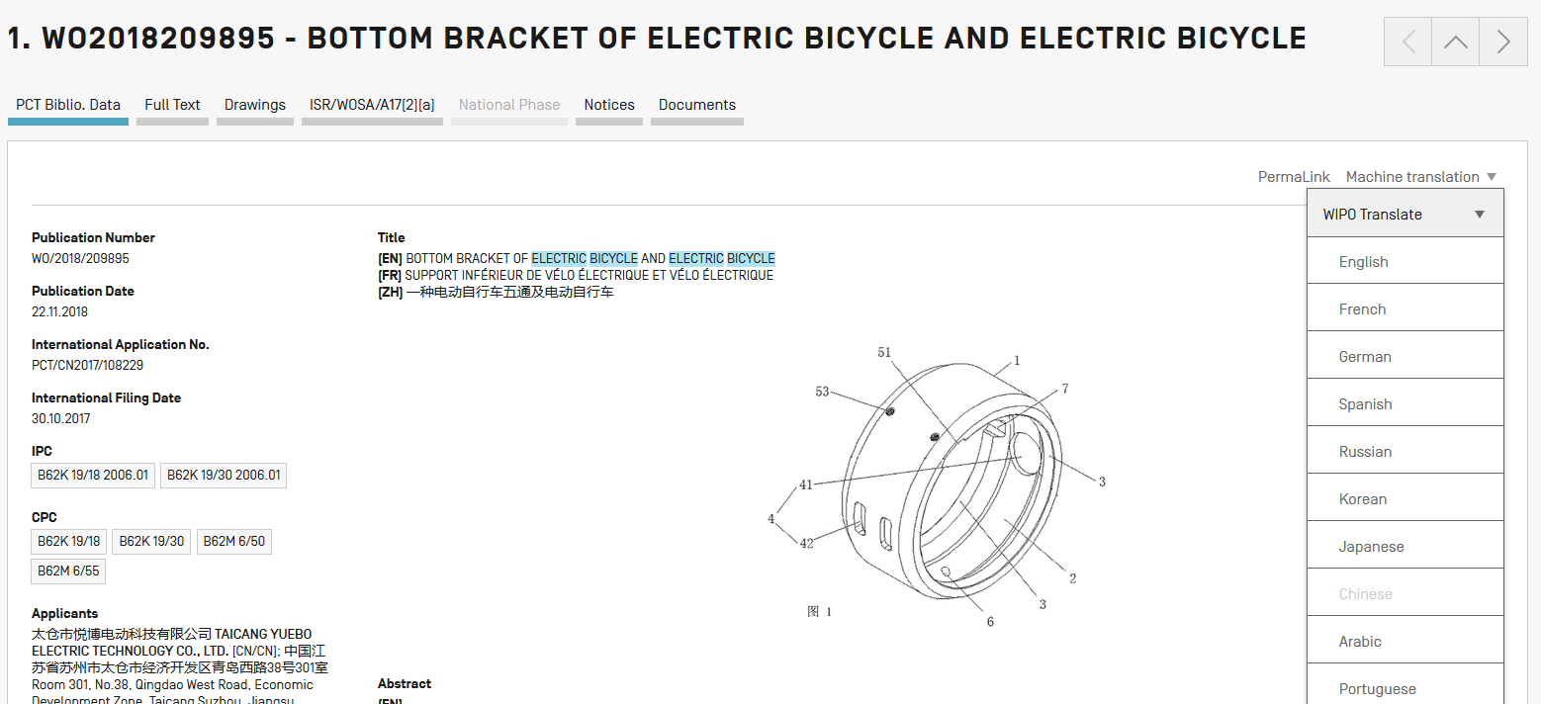
Biblio data translation

Slide 19
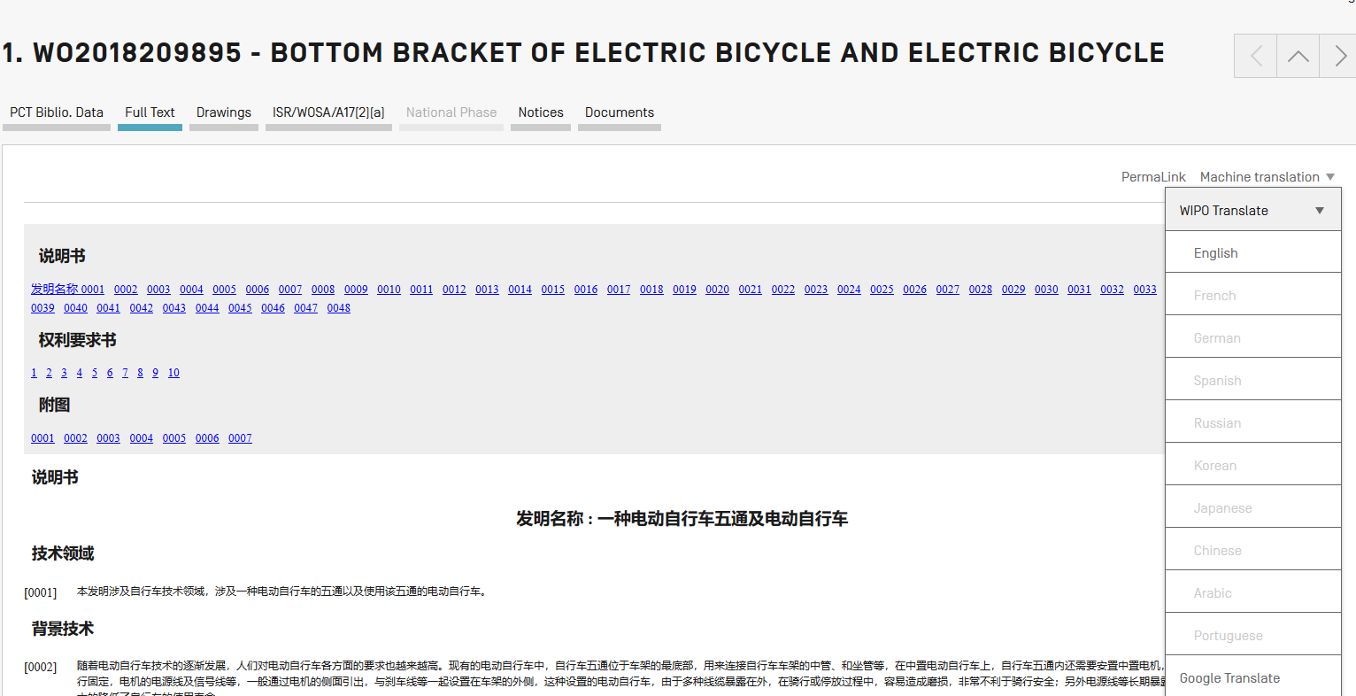
Full-text/description/claims translation

Slide 20
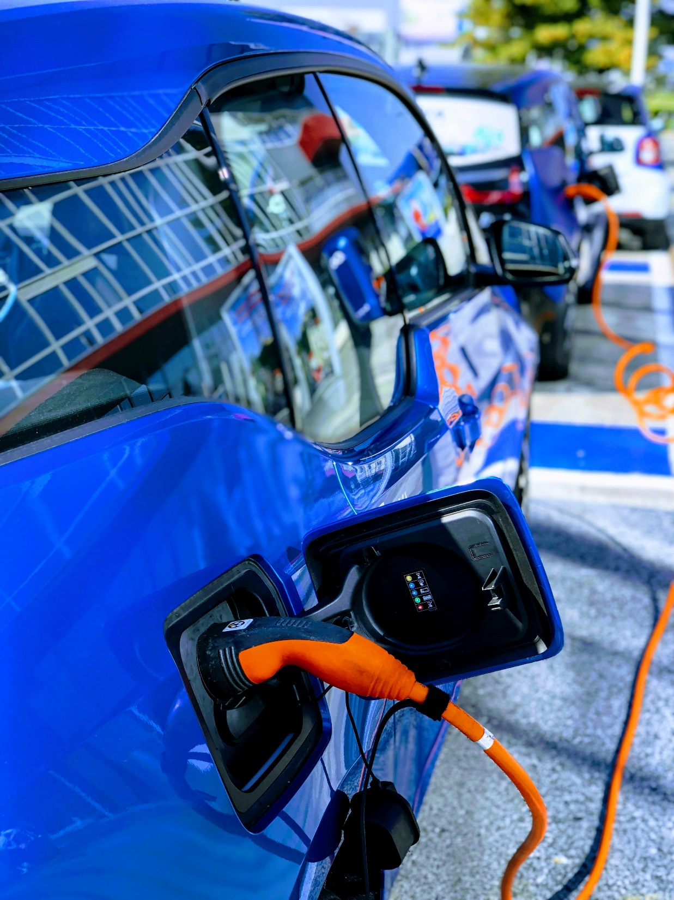

Slide 21
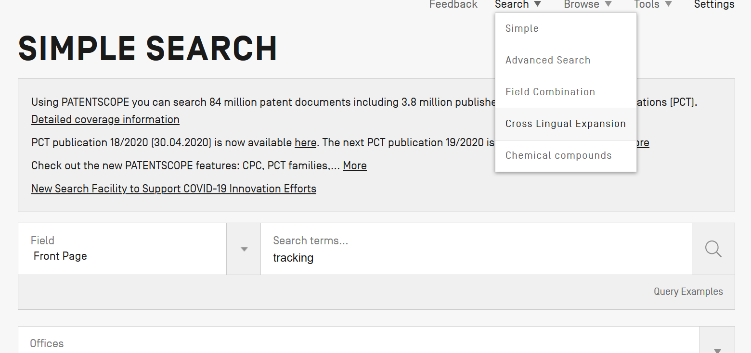
CLIR

Slide 22
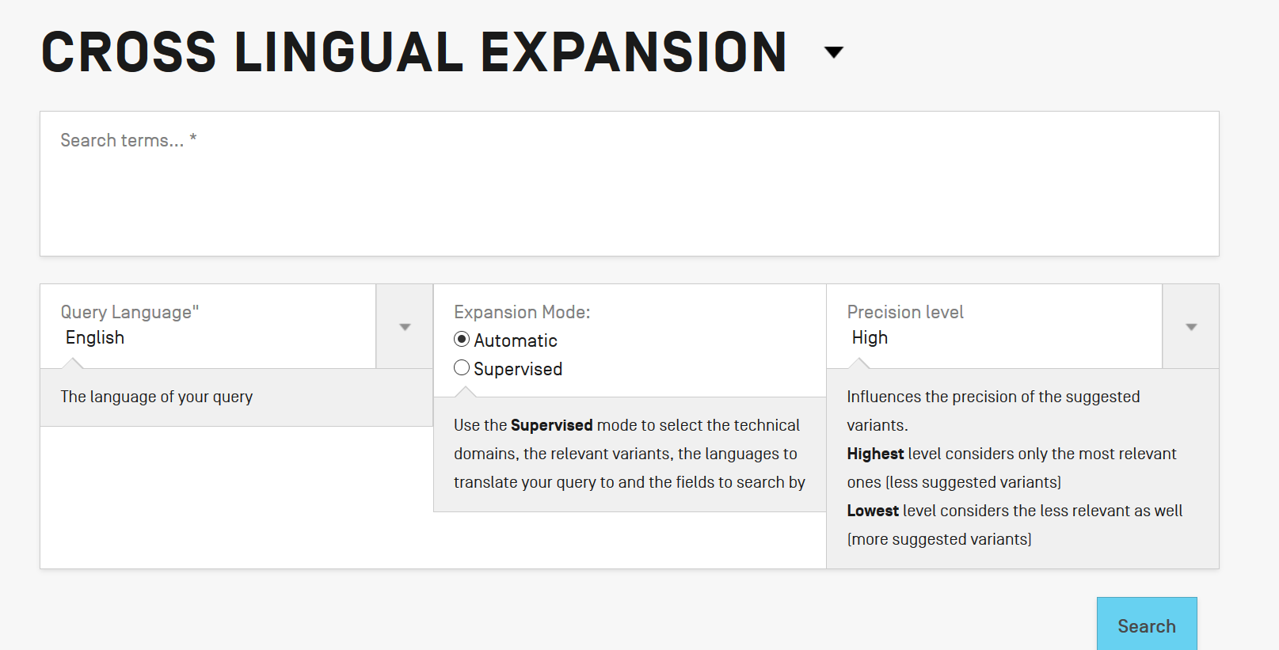
CLIR: interface

Slide 23
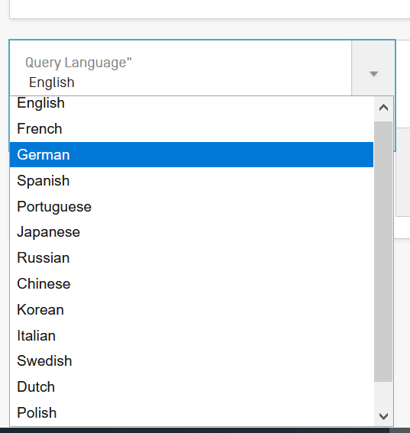
CLIR: query language

Slide 24
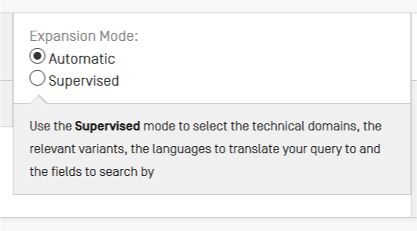
Mode: supervised or automatic

Slide 25
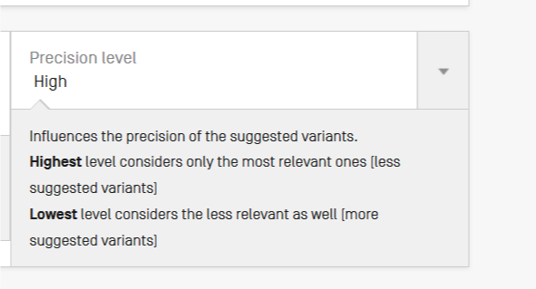
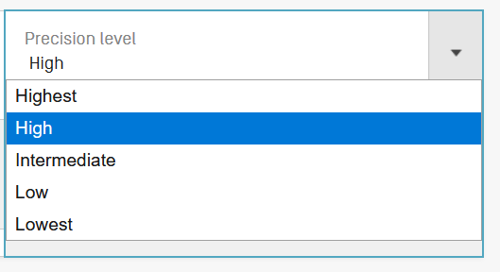
Precision level

Slide 26
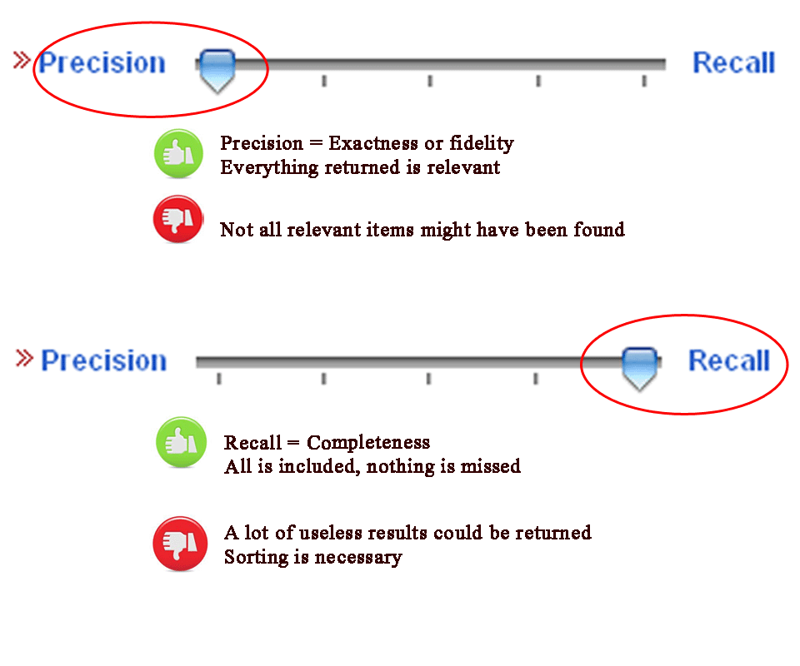
Highest precision vs lowest precision (recall)

Slide 27
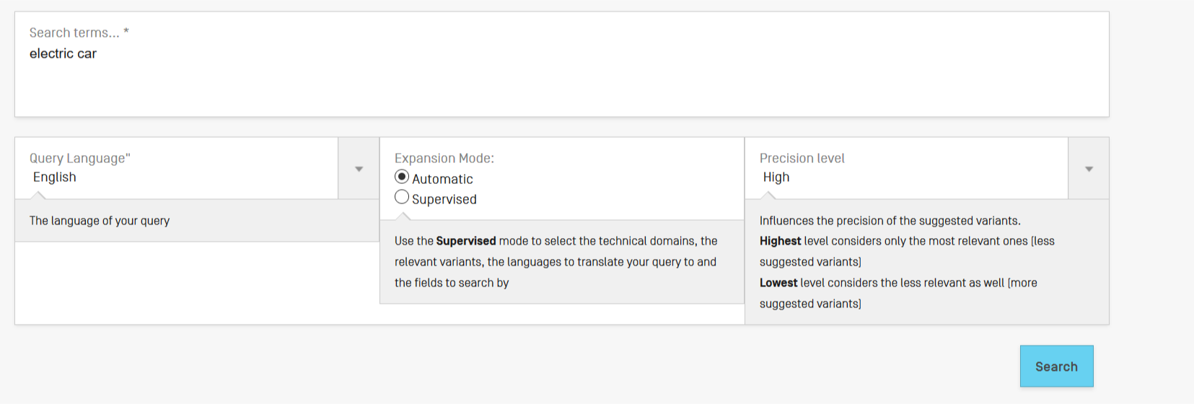
CLIR: an example

Slide 28
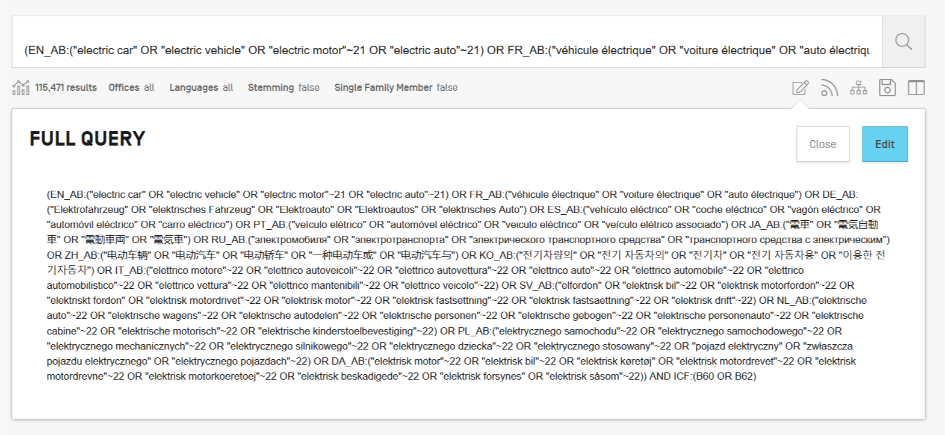

Slide 29
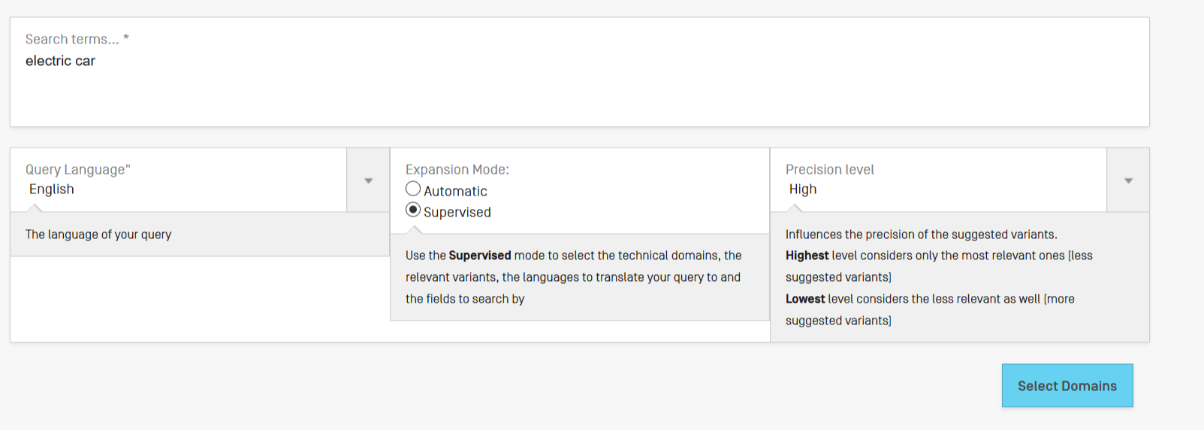
Supervised mode

Slide 30
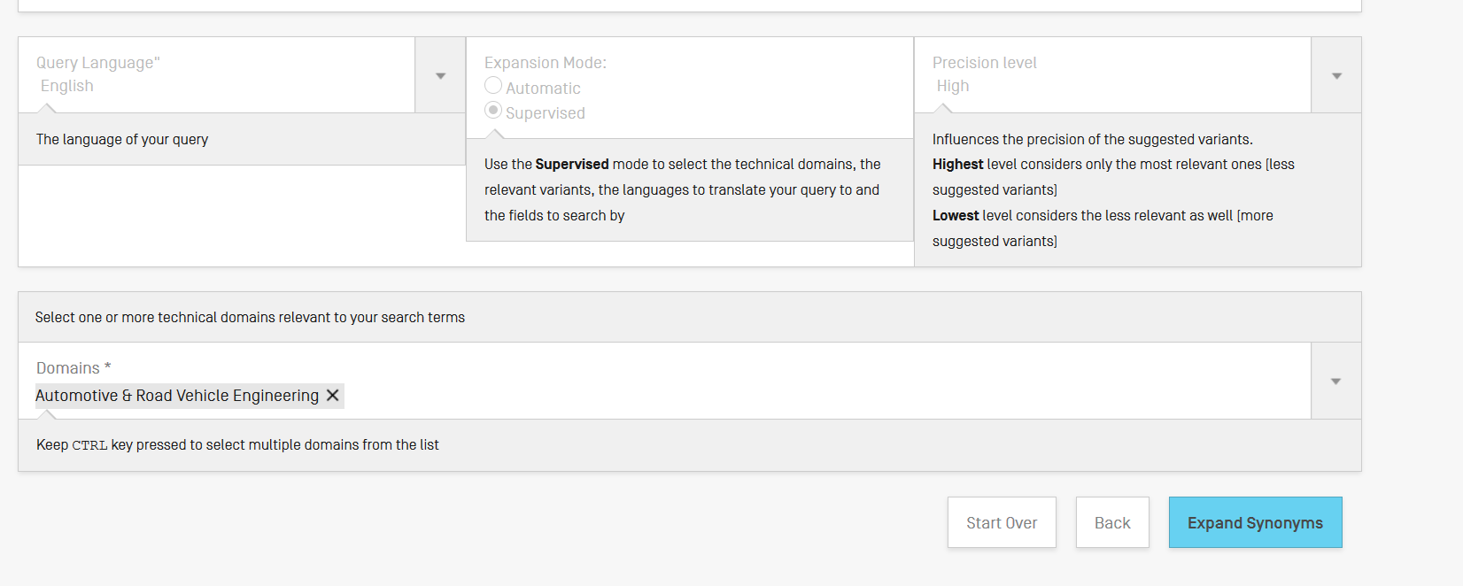
CLIR: supervised

Slide 31
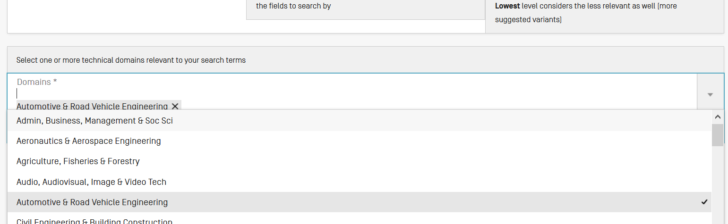
Domain selection

Slide 32
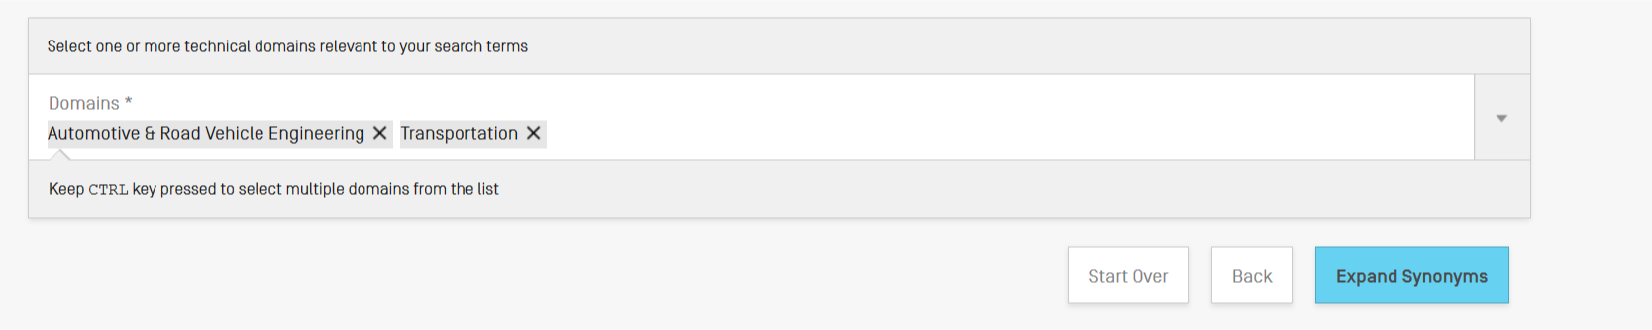
Domain selection

Slide 33
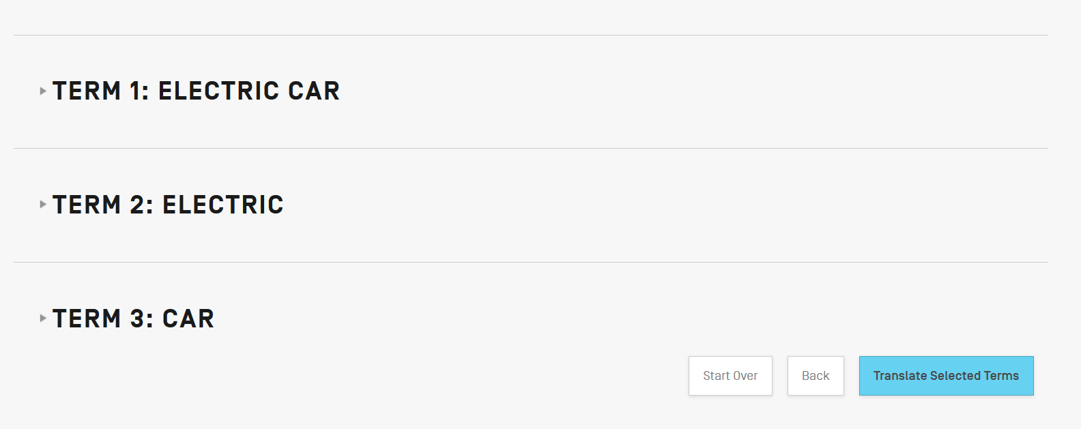
Synonyms selection

Slide 34
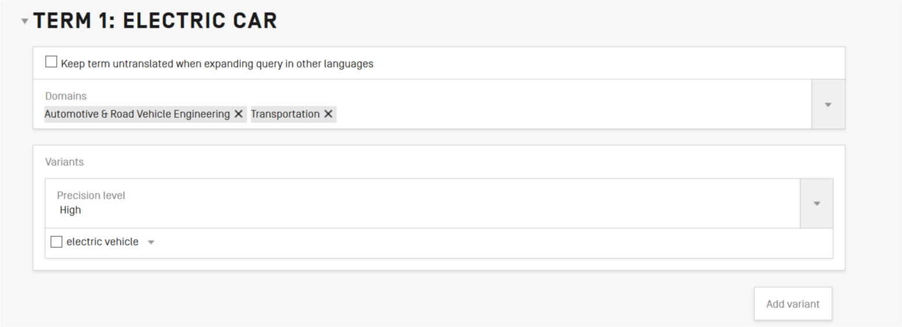
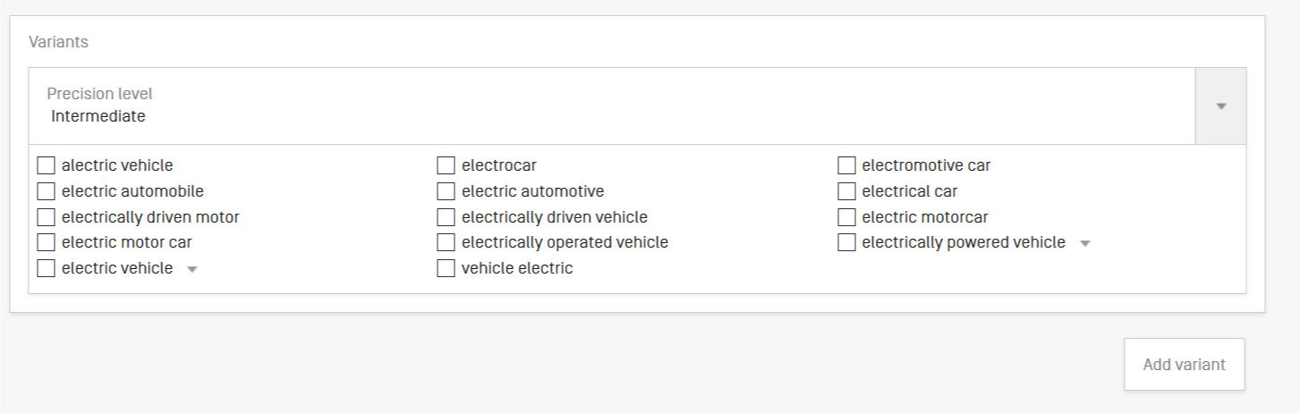

Slide 35
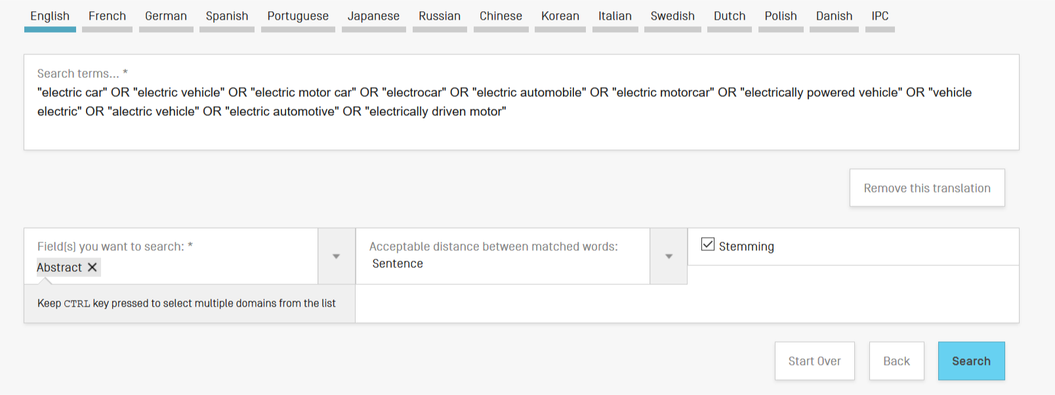
Summary of synonyms

Slide 36
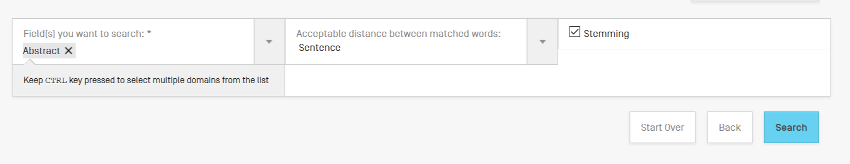
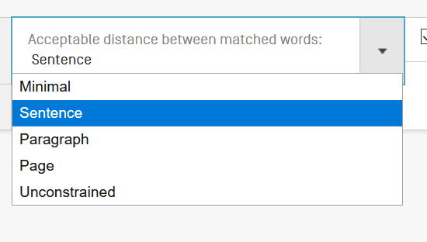
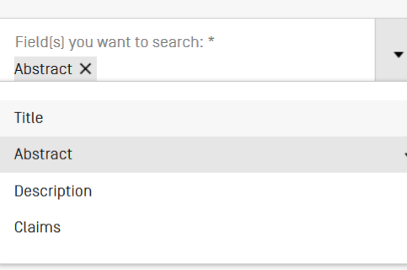

Slide 37
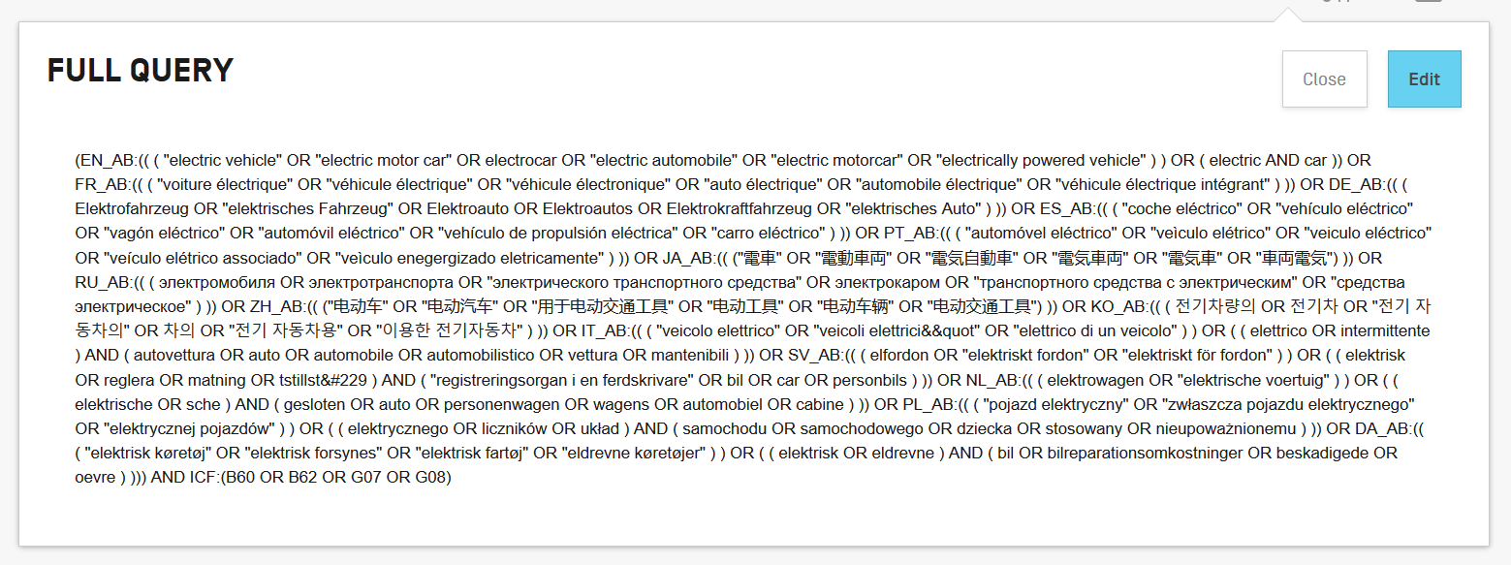
Results

Slide 38
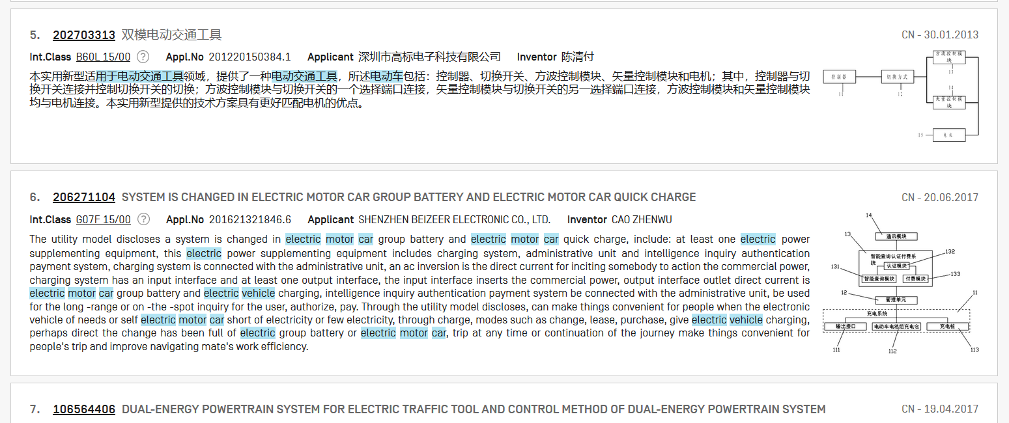

Slide 39
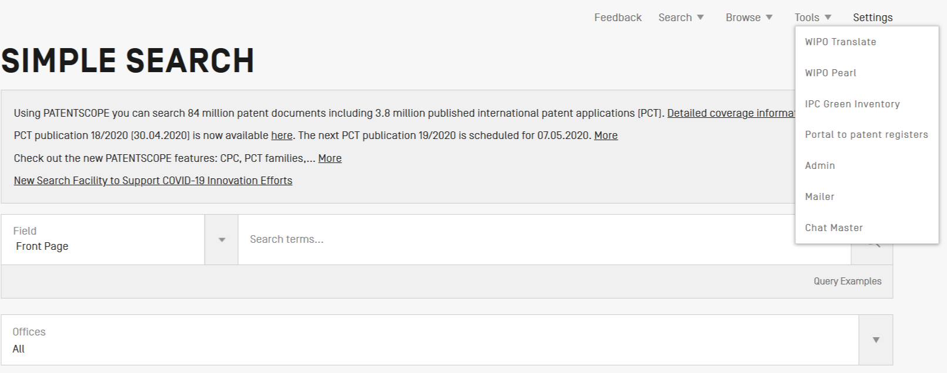
WIPO Pearl

Slide 40

WIPO Pearl
WIPO’s online terminology database
17’000 concepts, 115’000 terms
10 languages
Contents validated by WIPO language experts and terminologists

Slide 41
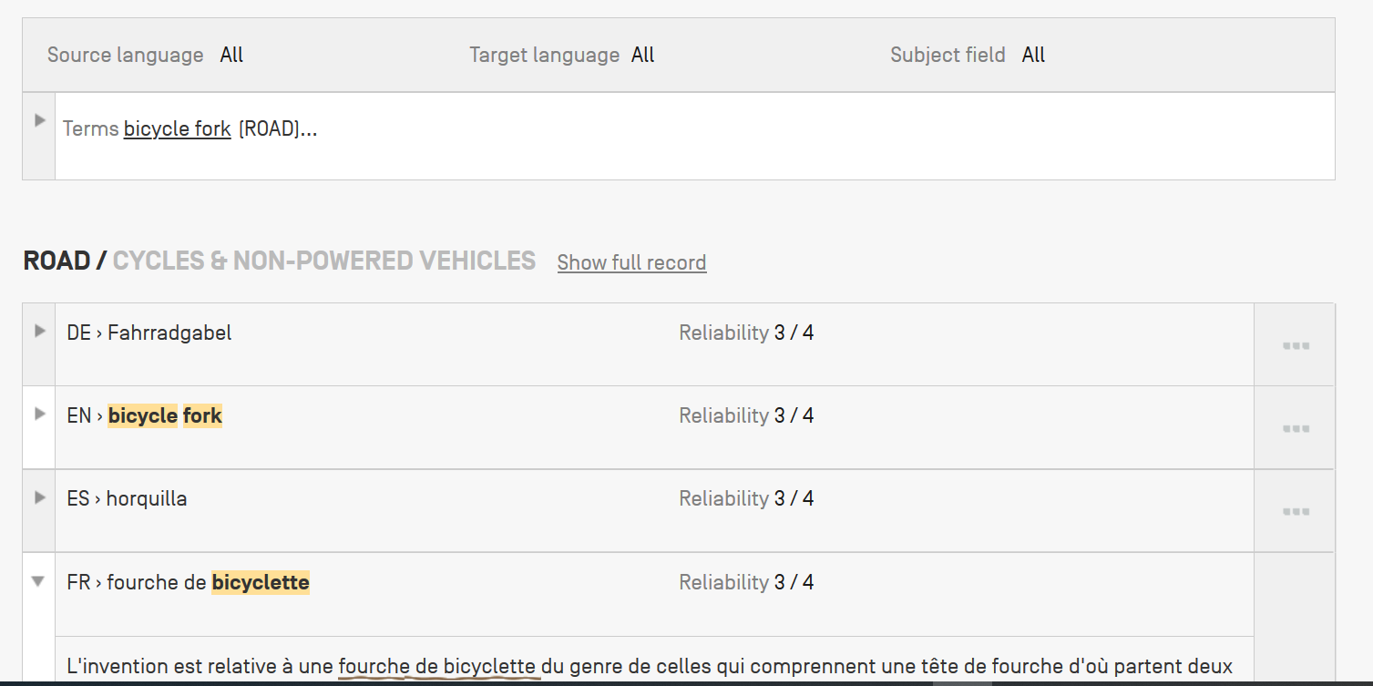
Example: bicycle fork

Slide 42


Slide 43
Q1: If in your result list, there a document in Greek, can you use WIPOTranslate to translate it?
A
No
B
Yes

Slide 44

Q1: If in your result list, there a document in Greek, can you use WIPOTranslate to translate it?
A
No
B
Yes

Slide 45
Q 2: if you would like to find synonyms and translation of your search which tool should you use?
A
CLIR
B
WIPO Translate

Slide 46
Q 2: if you would like to find synonyms and translation of your search which tool should you use?
A
CLIR
B
WIPOTranslate

Slide 47
Q3: In CLIR, which mode provides, in most cases, the longest queries?
A
supervised
B
automatic

Slide 48
Q3: In CLIR, which mode provides, in most cases, the longest queries?
A
supervised
B
automatic

Slide 49
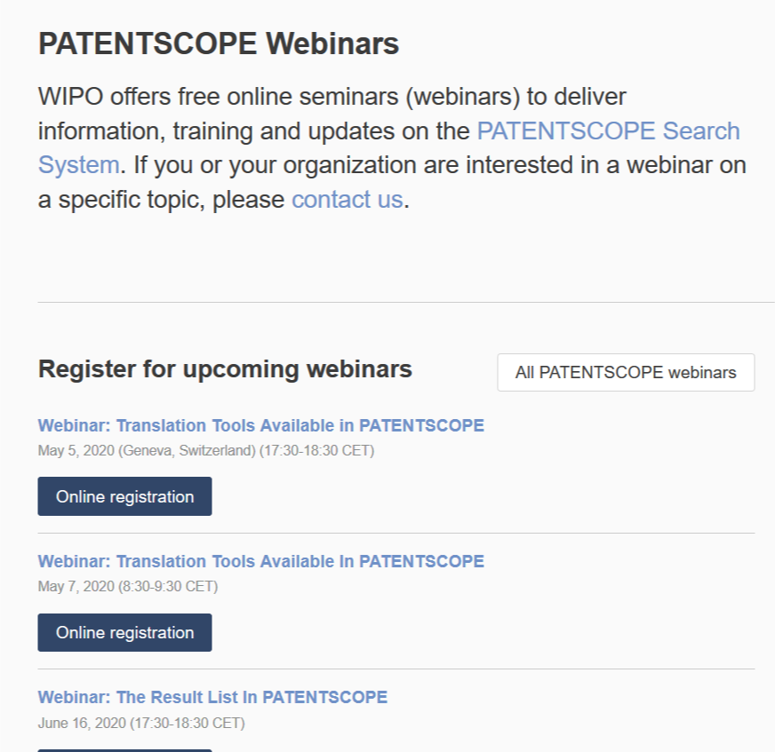
Future/past webinars:
wipo.int/patentscope/en/webinar

Slide 50
Global Brand Database, Global Design Database
Webinars:
https://www.wipo.int/reference/en/branddb/webinar/index.html
https://www.wipo.int/reference/en/designdb/webinar/index.html

Slide 51


Slide 52
Q:Will new languages be added in WIPOTranslate?
A: We hope to provide new languages in the future (candidate new languages are Italian, then maybe Polish and/or Dutch). To add new languages, as a first step, additional parallel texts (training data) have to be collected from offices. As the process is not entirely controlled by WIPO, it is difficult to provide any deadline for new language addition.
Q: Will the number of words be increased in WIPOTranslate? Will it be possible to upload a Word document or PDF?
A: A new translation on-demand (Word document) is currently under consideration rather than an increase of the number of words that can be translated.
Q: How safe is WIPOTranslate?
A:It is safe to use, what users do in PATENTSCOPE stay confidential between users and WIPO.

Slide 53

patentscope@wipo.int

