Slide 1
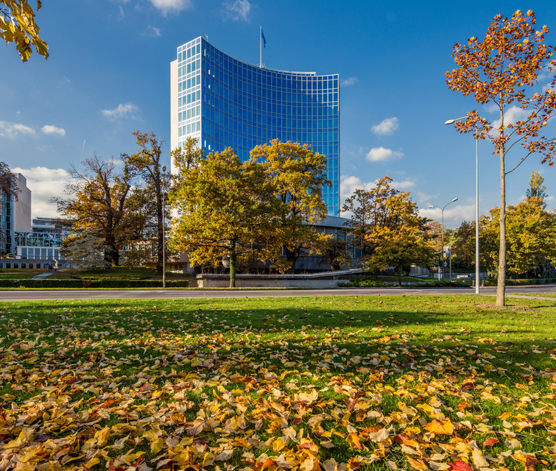
Update on Sustainability within the context of procurement
Prepared by the Secretariat
37th Session of the PBC

Slide 2
UPDATE ON SUSTAINABLE PROCUREMENT
During the 35th session of the PBC the member states requested WIPO to present an “Assessment Report on the issue of sustainability in procurement (in the context of Regulation 3.8 of the Financial Regulations and Rules (FRR))” (document WO/PBC/35/6).
During the 36th session of the PBC the member states “decided to discuss sustainability within the context of procurement and consider any potential impact of such discussion on the FRRs and take appropriate action, if necessary, at the 37th session of the PBC.”
37th session of the PBC: this presentation is provided to facilitate Members States’ discussions.

Slide 3
SUSTAINABLE PROCUREMENT IN THE CONTEXT OF THE UN AND WIPO
2009
CEB - UN HLCM: UN HLCM calls for implementation of sustainable procurement in accordance with the UN Financial Regulations and Rules, and fundamental UN procurement principles (best value for money).
2015
2018 and 2020
JIU: UN Joint Inspection Unit (JIU/REP/2018/6 & JIU/REP/2020/8) – procurement offices to incorporate specific provisions on accessibility requirements for persons with disabilities, and to integrate environment sustainability considerations into procurement procedures, manuals and guidelines.
SDG 12 aims to ensure sustainable consumption and production patterns which includes target for Member States to “Promote public procurement practices that are sustainable, in accordance with national policies and priorities”.
2022
FRR: Sustainability added to Regulation 3.8 among other dimensions and included in the revised FRRs approved by the GA in 2022 and effective 1 January 2023. Practical Guidance on how to apply Sustainable Procurement was inserted in the Procurement Manual.

Slide 4
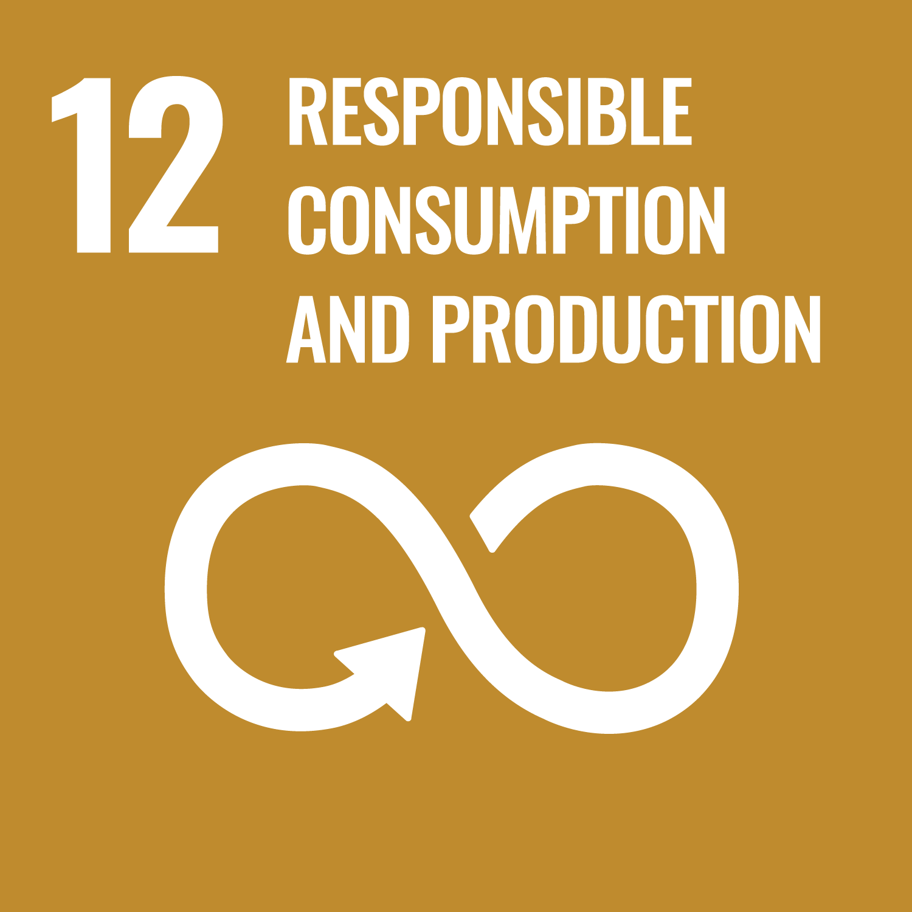
UNITED NATIONS DEFINITION OF SUSTAINABLE PROCUREMENT
In 2009, the UN High Level Committee on Management - Procurement Network defined Sustainable Procurement as procurement that:
“integrates requirements, specifications and criteria that are compatible and in favor of the protection of the environment, of social progress and in support of economic development, namely by seeking resource efficiency, improving the quality of products and services and ultimately optimizing costs”.

Slide 5
DEFINITION OF SUSTAINABLE PROCUREMENT
WIPO
Pillar: Environmental Sustainability
Pillar: Social Sustainability
Recognizing equality, diversity and respect for human rights; addressing needs of more vulnerable members of society; observing core labor standards; ensuring fair working conditions, increasing employment and skills; developing local communities and their physical infrastructure.
Including the costs of products and services over their entire life cycle, acquisition, maintenance, operations and end-of-life management costs (including waste disposal) in line with good financial management, as well as wider support for economic development.
Pillar: Economic Considerations
Addressing issues such as natural resource use and water scarcity, emissions, waste reduction and management, climate change and biodiversity over the whole product life cycle.
Source: WIPO’s Procurement Manual
WIPO’s definition is based upon the three-pillar definition of sustainable procurement (i.e. environmental, social and economic considerations) in the United Nations publication, Sustainable United Nations, Buying for a Better World: A Guide on Sustainable Procurement for the UN System, UNEP, UNOPS, ILO and ILO ITC, 2011.

Slide 6
WIPO PROCUREMENT OVERVIEW
Total procurement spend in 2023: 145 million CHF
Stability over 5 years with an increase in 2023
97% spent on Services, 3% on Goods
Top 3 purchase categories:
Information Technology Services Delivery (40%)
Written Translation Services (23%)
Facility Management Services (9%)

Slide 7
APPLICATION OF SUSTAINABLE PROCUREMENT IN WIPO TENDERS
Selection Criteria
Contractual Obligation
In more mature markets, sustainability is part of the selection process. Bidders are also evaluated on their commitment on sustainability
In case of existing national sustainability norms, relevant obligations are included in the contract.
Information
Bidders are encouraged to share any policy on sustainability, in case they have one.
3 ways of addressing sustainable procurement in tenders

Slide 8
WIPO TOOLKIT
ACCESSIBILITY OF DOCUMENTS : all procurement documents and contracts are accessible to print-disabled users
PROACTIVE SUPPLIERS require IT suppliers to offer solutions to address innovation and sustainability
TRAINING FOR PROCUREMENT STAFF both on sustainable procurement and on major categories of goods and services
ACCESSIBILITY OF E-SOURCING TOOLS : WIPO’s e-sourcing tool has been confirmed to be accessible to print-disabled users
LIFECYCLE CONTRACT REVIEW : Implementation of scorecard which includes sustainability as a Key Performance Indicator
WIPO’s General CONDITIONS OF CONTRACT require suppliers to adhere to UN Supplier Code of Conduct

Slide 9
IMPACT ASSESSMENT
SUPPLIER ENGAGEMENT : Most of them are able to demonstrate their engagement on sustainability
NO LIMITATION TO COMPETITION : no bidders were disadvantaged or disqualified
LOCAL SOURCING : 85% of procurement related to development agenda (2023)
SUSTAINABILITY OVER THE FULL CONTRACT LIFE CYCLE : e.g. KPI on gender diversity in the context of security services
Emphasis on SOCIAL SUSTAINABILITY as 97% of our spend is with services
Emphasis on ECONOMIC SUSTAINABILITY, by assessing Total Cost of Ownership (TCO), which includes end-life costs

Slide 10
PUBLIC DATA ON UN/WIPO SUSTAINABLE PROCUREMENT
Participation in the Annual Statistical Report managed by UNOPS, including sustainability reporting
Use of sustainability tag in UN Global Marketplace

Slide 11
Thank you!

