Slide 1

From Filing to Expiry:
The Lifecycle of an International Registration
Quan-Ling Sim
Head, Operations Service
The Hague Registry
Geneva,
July 19, 2018

Slide 2
Outline
Filing
Examination by the International Bureau
Maintenance of an International Registration
Changes to an International Registration

Slide 3
Filing Entitlements
Hague is a closed system governed by the 1960 and 1999 Acts
Entitlements
  Nationality
  Domicile
  Real and effective commercial or industrial establishment
  Habitual residence (1999 Act)

Slide 4
1960 and 1999 Acts (1)
1960 Act only: Belize, Morocco, and Suriname
1999 Act: all other (1960/1999) countries either individually or by virtue of membership in the European Union (EU) or OAPI
  Japan, Republic of Korea, United States
  EU: Belgium, Greece, Italy, Luxembourg, Netherlands, + other EU countries
  OAPI: Benin, Côte d’Ivoire, Gabon, Mali, Niger, Senegal
  + other countries, e.g., Russian Federation, United Kingdom

Slide 5
1960 and 1999 Acts (2)
1960/1999: Albania, Bulgaria, Croatia, DPR Korea, France, Georgia, Germany, Hungary, Kyrgyzstan, Liechtenstein, Moldova, Monaco, Mongolia, Montenegro, North Korea, Romania, Serbia, Slovenia, Switzerland, FYROM, Ukraine

Slide 6
Designations
1960 Act: 1960 Contracting Parties only
1960/1999 Acts: 1960, 1960/1999, 1999 Contracting Parties
1999 Act: 1960/1999 and 1999 Contracting Parties

Slide 7
How to file?
With the International Bureau or indirect filing (e.g. Japan, Republic of Korea, Russian Federation, United States)
File electronically!
English, French, or Spanish
No need for an earlier national application
Designation of Contracting Parties at time of filing (no subsequent designation possible)
Be aware of declarations made by Contracting Parties (e.g., creator, deferment of publication, oath/declaration, special reproductions, claim, description, etc.)

Slide 8
Mandatory contents of an application
Applicant details
Reproductions (can include up to 100 designs)
Product indication
Designation of Contracting Parties
Fees

Slide 9
Additional mandatory contents
Contracting Parties may have additional requirements
  Creator
    Romania
    National requirement: (see Box 11 of DM1)
  Description (Romania, Syria)
  Oath/declaration of the creator (United States only)
  Claim (United States only)
  Individual designation fee payable in two parts (United States only)

Slide 10
Optional contents (1)
Creator (if not required by a designated Contracting Party)
Description (if not required by a designated Contracting Party)
Legends
Priority claim
Publication (immediate/deferred instead of standard)
International exhibition
Exceptions to lack of novelty (JP and KR)
Relation with the principle design (JP and KR)

Slide 11
Optional contents (2)
Appointment of a representative
Information on eligibility for protection (Information Disclosure Statement in the United States)
Economic status and certificate where applicable
Locarno classification

Slide 12
Requirements concerning the reproductions (1)
Size
  Max: 16cm x 16 cm
  Min: One side at least 3cm
5mm left around the reproduction
Numbering
  1.1, 1.2, 1.3, 2.1, 2.2, 2.3 (first number refers to the design, second number to the reproduction)
Can submit photographs or graphic representations in black/white and/or color

Slide 13
Requirements concerning the reproductions (2)
Don’t include other objects, accessories, person or animal
No technical drawings (axes & dimension)
No explanatory text or legends in the representations

Slide 14
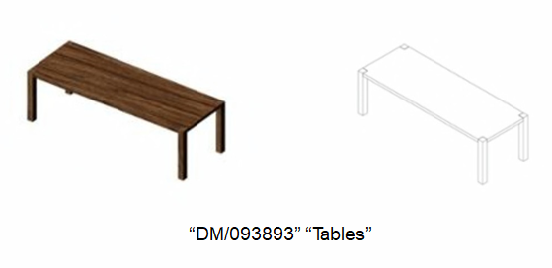
Photograph and/or graphic representation
Photograph and graphic representation can be included as one design (note: examining offices may issue objection)

Slide 15
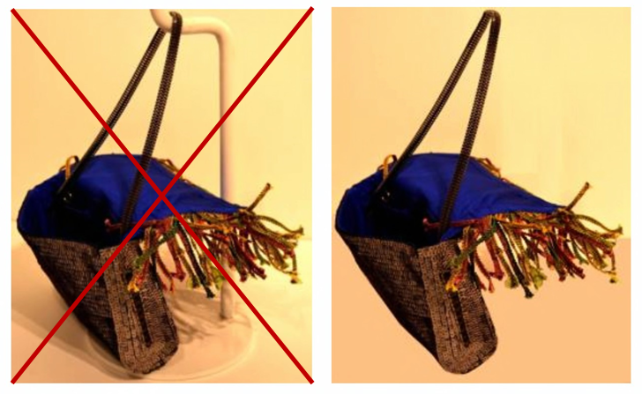
Other objects

Slide 16
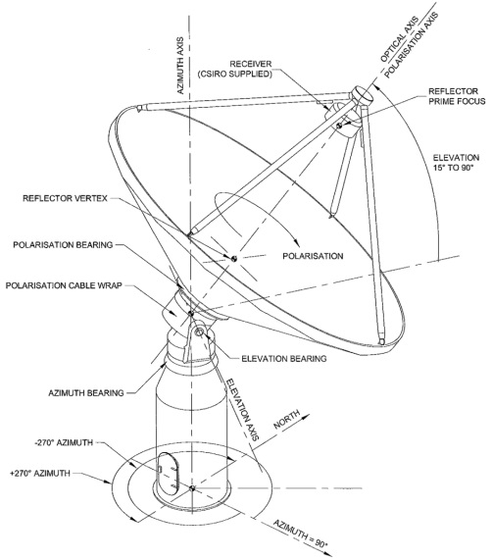
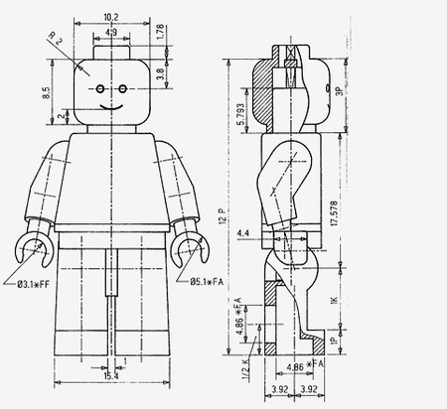
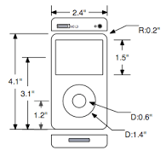
Technical drawing not permitted

Slide 17
Disclaimer
Matter which is shown in a reproduction but for which protection is not sought
  Text in the description
  Dotted or broken lines or coloring

Slide 18
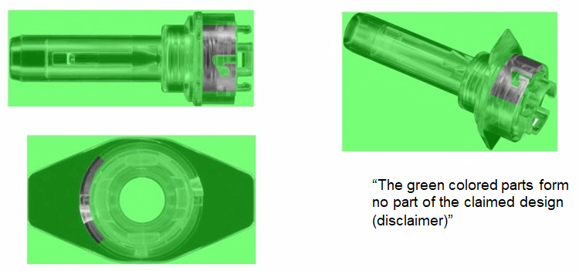
Disclaimer by coloring and description

Slide 19
Disclaimer by broken lines and description
DM/082544
“No protection is sought for the matter shown in dotted lines”

Slide 20
Description
Optional in most instances
  Appearance of the design
  Possible utilization
  Omitted views
  Disclaimer
  Legends
Brief description is compulsory for Romania and Syria

Slide 21
Legends
DM/095106, “Drive module assembly for vehicles”

Slide 22
Omitted views
DM/084264, “Watch dial”
(Right side, top and bottom views can be omitted because they are identical or mirror image of the left side view)

Slide 23
Possible utilization
DM/084820, “Heel protector”
Heel protection designed to protect the back of shoes or sandals against rubbing or damage while driving or traveling and to improve safe driving

Slide 24
Product indication (1)
Specific and usually generic name
  Be as precise as possible
Check Hague Express for examples
  Lighting device -> Table lamp
  Communication equipment -> Mobile phone
  Footwear article -> Boot
One product indication per design
  Carpets, mats or rugs -> Bathroom mat
  Footwear, socks or stockings -> Golf shoes

Slide 25
Product indication (2)
Can be the product itself or part thereof
  Chair, Chair seat
Industrial designs are classified according to the Locarno classification
  Mono class system
  Multiple designs can be included as long as they belong to the same class
  If there are multiple Locarno classes, divisional applications are to be filed

Slide 26
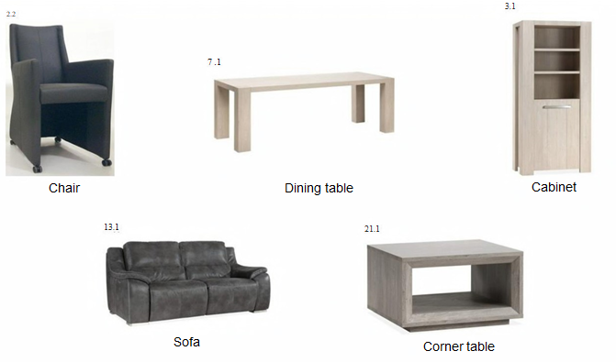
Mono class
Class 6 (Furnishing)

Slide 27
Multiple classes
Class 12
Class 6
Class 26

Slide 28
Examination by the International Bureau
Formal examination by the International Bureau
Issuance of irregularity letter in case of defect
Time limit of 3 months to file response

Slide 29
Irregularities affecting the filing date
Not in a prescribed language (English, French, or Spanish)
No express or implicit indication that an international registration is being sought
No applicant details
No contact details
No reproductions
No designation of Contracting Party

Slide 30
Irregularities affecting the registration date
Creator: Romania
Description: Romania and Syria
Claim: United States

Slide 31
Revised examination guidelines
Reference and training guide
Increased efficiency, consistency and predictability
Incorporates best practices and experience gained from reviewing refusals from Japan, Republic of Korea, and the United States
Preserve as many options as possible for Hague applicants

Slide 32
Main changes in examination practice (1)
(1) Examination of the claim required by the United States of America
  Formal check only (claim there/ not there)
(2) Late addition of priority claim
  Priority claim has to be in the application at the time of filing

Slide 33
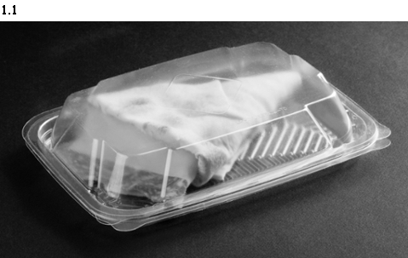
Main changes in examination practice (2)
(3) Combined product (D097264)

Slide 34
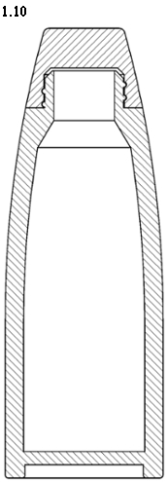
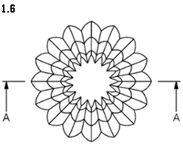
Main changes in examination practice (3)
(4) Cross-section or enlarged views (D098942)

Slide 35
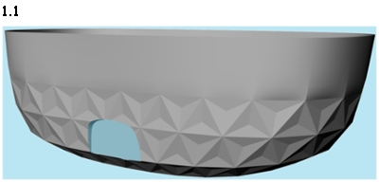
Main changes in examination practice (4)
(5) Color shown in reproductions may be disclaimed (D099926)

Slide 36
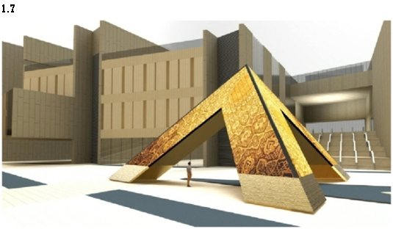
Main changes in examination practice (5)
(6) Reference views require a textual or graphical disclaimer (D098930)

Slide 37
International Registration
Registration certificate
Publication in the Gazette (immediate, standard, deferred) and availability in Hague Express
Communication to the Offices

Slide 38
Refusals
6 month refusal period for non-examining Offices
12 months for examining Offices (primarily JPO, KIPO and USPTO) or Offices with an opposition period (e.g., TURKPATENT)
If no refusal issued, grant is automatic
  Contracting Parties may provide a Statement of Grant of Protection (particularly Examining Offices such as the JPO, KIPO and USPTO)

Slide 39
Examination of refusals by the International Bureau
Reference to the number of the international registration
Grounds of refusal
Sent to the International Bureau within the time limit
If the refusal is in order, it is recorded and communicated to the holder by the International Bureau
If the refusal is out of time, Office is informed that refusal is not recorded with copy of the refusal sent to the holder

Slide 40
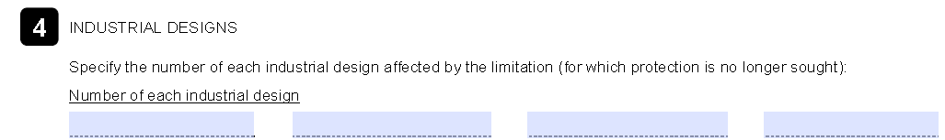
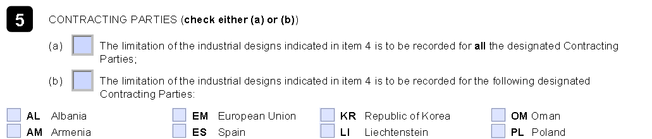
Limitation
Form DM/3
Limitation of protection for some designs in some or all Contracting Parties

Slide 41
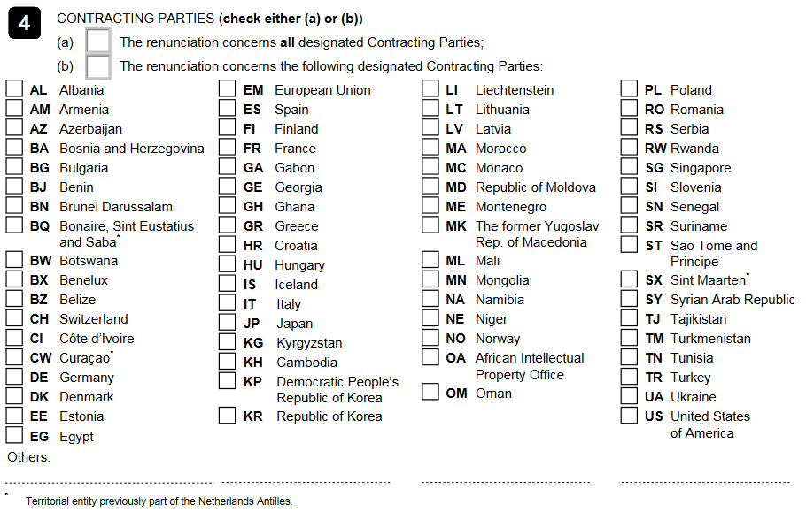
Renunciation
Form DM/5

Slide 42
Renewal
Duration of protection
  Initial term: 5 years
  Renewal period: every 5 years
  Minimum duration
    1960 Act: 10 years
    1999 Act: 15 years
  Maximum duration may be longer in each Contracting Party

Slide 43
Scope of Renewal
Total
Partial
  For some designated Contracting Parties
  For some designs

Slide 44
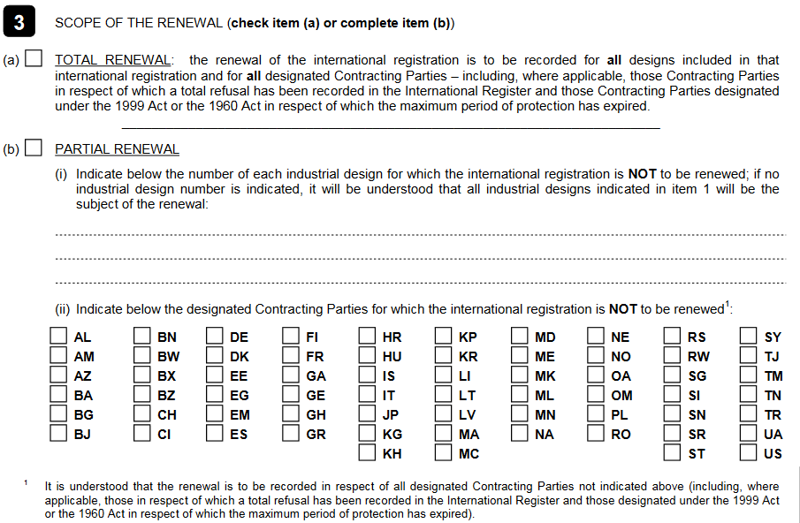
DM/4 Form

Slide 45
Renewal tips (1)
WIPO will send a reminder 6 months prior to expiry
Use E-renewal
  Pay between 0-3 months before and renewal is automatic
  Any concurrent transaction will block automatic renewal
  Payment between 3-6 months (e.g., with WIPO current account) will be deemed premature and will require manual processing

Slide 46
Renewal tips (2)
Renewals still possible even after expiry of minimum period of protection
Renewal still possible even if refusal is recorded
No renewal possible in cases of renunciation, limitation, or invalidation

Slide 47
Change of Ownership
Form DM/2
Can be presented by the current holder (recommended)
Can be presented by the new holder
  Proof of entitlement (e.g. attestation from a competent authority)
Common treaty between new owner and each Contracting Party
Transfer between 1960 and 1999 Acts is complicated
New agent can be appointed by new owner if transfer is in order

Slide 48
Other transactions
Form DM/6 (Change in name or address of the holder)
Form DM/7 (Appointment of a representative)
Form DM/8 (Change in name or address of the representative)
Form DM/9 (Cancellation of appointment of the representative)

Slide 49
Sending Forms to the International Bureau
Use Hague Contact Form upload (to be launched shortly)
Send to intdesigns@wipo.int (temporary solution)

Slide 50
Bulletin and Databases
International Designs Bulletin
  http://www.wipo.int/haguebulletin/?locale=en
Hague Express
  http://www.wipo.int/designdb/hague/en/
Global Designs Database
  http://www.wipo.int/designdb/en/index.jsp

Slide 51
Questions
Hague “Contact Us”
  http://www.wipo.int/hague/en/contact
Hague Customer Service
  Tel: +41 22 338 7575

