Slide 1
IP and Innovation: Trademark and Design Strategies for Entrepreneurs
Presentation by the Secretariat to CDIP/28
May 19, 2022

Slide 2
Globalization and technology have left their mark on branding
Brands more easily transcend national borders
Companies create and deliver a “brand experience” for the consumer; brand perception goes beyond product quality
Brands “communicate” through an increasing number of channels, in a more interactive way
Branding is no longer the purview of companies alone

Slide 3
…driven by a multitude of factors
Economic growth has come along with the creation of new companies and the introduction of new goods and services
Economies have shifted towards services
Firms seek trademark protection in more and more countries
The Internet has increased the need for trademark protection

Slide 4
Branding generally complements innovation
Branding increases demand and enhances willingness to pay
Advertising activities raise awareness about a firm’s products
Strong brand reputation makes consumers willing to accept a higher price, to avoid the search costs of switching to a competing product
Brands convey image, which is a product feature consumers are willing to pay for
A series of firm-level studies have shown that branding is one of the most important mechanisms for firms to secure returns on R&D investments

Slide 5
Why trademark and design strategies matter?
Brands and designs are key intangible assets shaping a company’s competitive edge
Examples:
WIPO study on industrial design use in Southeast Asia (2018) found industrial designs especially relevant for small companies and for entering export markets
World IP Report 2017 documented the role of origin branding for developing economy coffee producers to enter lucrative and fast growth “third-wave” coffee market

Slide 6
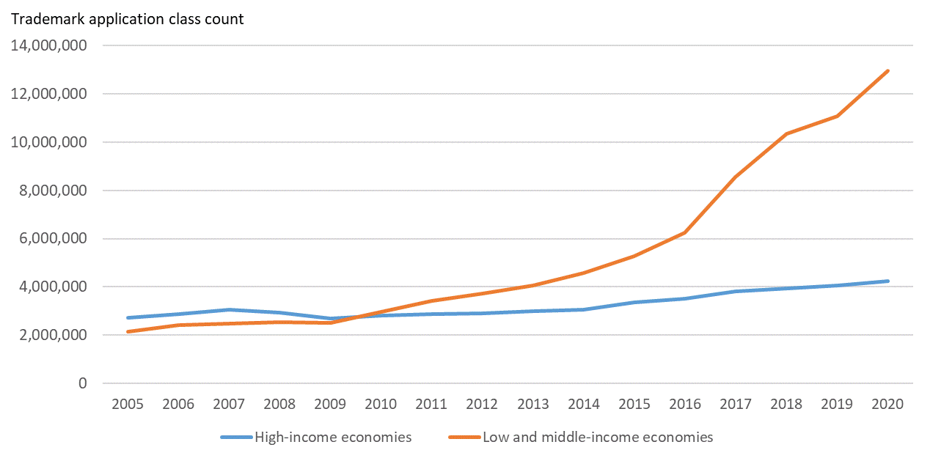
Rapidly growing demand for trademarks …
Source: WIPO IP Statistics Database

Slide 7
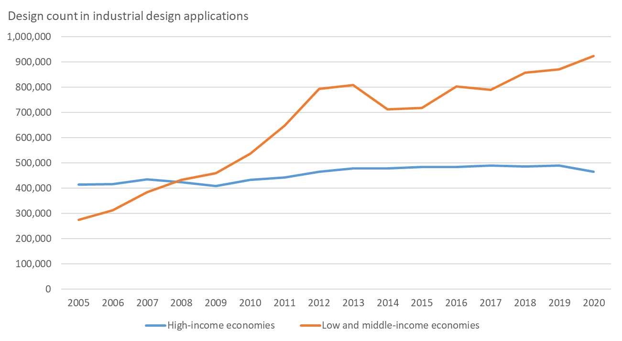
… and industrial designs
Source: WIPO IP Statistics Database

Slide 8
Supporting Trademark and Design Strategies of Entrepreneurs -The IP for Business Division
WIPO IP Diagnostics - An Online IP Self-Assessment Tool for Businesses https://www.wipo.int/ipdiagnostics/en/index.html
IP Business Moments (under development) – an introduction to the different IP issues for Entrepreneurs across their Business Journey
“Enterprising Ideas”, A Guide to Intellectual Property for Startups https://www.wipo.int/publications/en/details.jsp?id=4545&plang=EN
Programs of supporting business intermediaries integrate IP related advisory services to their menu of business services (including in the area of trademarks and designs)

Slide 9
Supporting Trademark and Design Strategies of Entrepreneurs -The IP for Business Division
IP Management Clinics for Businesses (including in the area of trademarks and designs)
Making a Mark: An Introduction to Trademarks for Small and Medium-Sized Enterprises https://www.wipo.int/publications/en/details.jsp?id=4208&plang=EN
Looking Good: An Introduction to Industrial Designs for Small and Medium-sized Enterprises https://www.wipo.int/publications/en/details.jsp?id=4388&plang=EN

Slide 10
The Madrid System for International Registration of Marks

Slide 11
The Madrid System
One-stop shop for SMEs to obtain and maintain protection of their marks in export markets
A convenient and cost-effective solution for registering and managing trademarks worldwide
File a singe application and pay one set of fees for protection in up to 128 countries
Modify, renew or expand your global trademark portfolio through one centralized system

Slide 12
Madrid Online Tools and Services
Madrid online services are available to support owners throughout the lifecycle of their marks
The Madrid Website provides information on how to search before filing, file an application, monitor and manage registrations, and how to pay fees

Slide 13
Stay informed
Website
Madrid News
Visit the Madrid System Website
Subscribe to Madrid News
Webinars
Podcast and YouTube
Access Madrid Webinars recordings and stay tuned
for new topics
Check our WIPO Madrid YouTube playlists and listen our historical podcasts
Tutorials
Questions
Play our Madrid “How-to” videos and tutorials
Contact us online or by phone

Slide 14
Supporting Entrepreneurs through the Hague System

Slide 15
Framework
Provides entrepreneurs with a simple, cost-effective, and efficient means to secure and manage design rights in over 90 countries for up to 100 designs in one application.
A unique business solution that is easily accessible to any individual or entity with nationality, domicile, residence, or commercial establishment in any of the Hague System’s 90+ members.
One set of formalities, one language, and one currency make it easy for entrepreneurs to plan their international design registration strategies and estimate costs.

Slide 16
Tools
Anyone can file an application online at their own pace directly with WIPO – no legal representation is required at the time of filing.
A one-step procedure to manage renewals, changes, representation, and other formalities makes it easy and efficient for entrepreneurs to keep their international registrations active and up to date.
Free digital resources to search, file, pay, and manage international design applications and registrations provide efficiency gains for an entrepreneur regardless of size.

Slide 17
Support
Personal support throughout the filing and registration process helps minimize any mistakes and maximize effectiveness of the Hague System’s advantages.
Customer service is available to assist new and veteran users of the Hague System throughout the lifecycle of international design applications and registrations.
Free training, webinars, and other events help entrepreneurs learn how to best take advantage of the Hague System.

Slide 18
Tools for collective branding
WIPO’s DTMIDGI provides assistance to groups of producers and entrepreneurs to develop collective branding strategies through:
Collective marks
Certification marks
Geographical indications

Slide 19
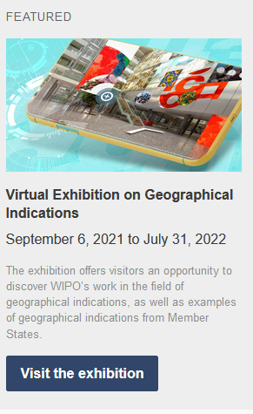
Supporting collective strategies with…
Information tools and material
Targeted projects
- IP and Gastronomic Tourism in Peru, Malaysia, Morocco
and Cameroon
- Registration of Collective Marks in Bolivia, Brazil, Tunisia
and the Philippines

Slide 20
Commercialization of Origin Products
The Lisbon Registry provides assistance to WIPO Members and producers groups of origin products (local communities) to develop an enabling ecosystem for the protection of geographical indications (GIs) to enable successful commercialization of their GI products internationally
Management of the Lisbon System: (International registration and protection system for GIs covering more than 50 countries)
Technical assistance activities:
Legislative advise
Capacity building activities
GI projects: protection and commercialization of geographical indications
https://www.wipo.int/lisbon

Slide 21
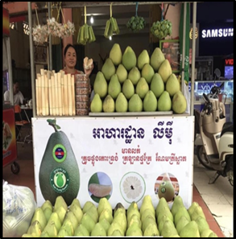
GI-Projects : Development, protection and commercialization of origin products
Koh Trung Pomelo (Cambodia)
Madd de Casamance (Senegal)
Kampot Sea Salt (Cambodia)
Riz de Kovié (Togo)
https://www.wipo.int/ipadvantage/en/details.jsp?id=11582

Slide 22
Indigenous and local community entrepreneurship
https://www.wipo.int/tk/en/entrepreneurship/index.html
WIPO’s TK Division provides assistance to indigenous peoples and local communities to make strategic and effective use of existing intellectual property tools in their businesses, including trademarks and designs.

Slide 23
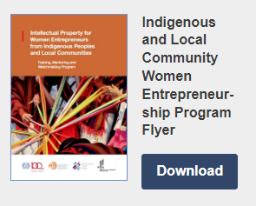
Indigenous and local community entrepreneurship
https://www.wipo.int/tk/en/entrepreneurship/index.html
WIPO Training, Mentoring and Matchmaking Program on Intellectual Property for Women Entrepreneurs from Indigenous Peoples and Local Communities (WEP) in partnership with the ILO, INTA and the ITC. The Program allows participants to:
build capacity in IP and acquire the skills necessary for an effective use of the IP system, including in the digital economy;
acquire basic knowledge of related fields useful in an entrepreneurial context, such as business modelling, marketing and digital storytelling;
benefit from the support of a mentor to further develop and implement projects and businesses based on traditional knowledge and/or traditional cultural expressions that have an IP component; and
meet other program participants, share and learn from each other's experiences, but also meet potential partners who can provide support with the implementation of their projects and businesses.

Slide 24
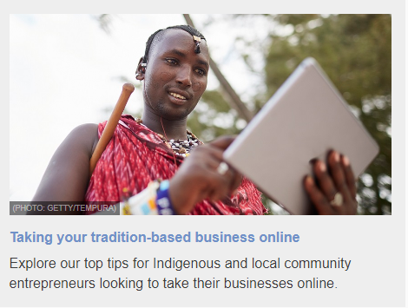
Development of tools and resources to support community entrepreneurs

Slide 25
The WIPO Academy’s skills building training – The WIPO Academy offers a broad range of training courses which include training in areas that support TM and Design Strategies for entrepreneurs. Participants come from a wide spectrum of interests and occupations, including entrepreneurs. Some examples are listed below and further details can be found on the WIPO Academy website.
Several Distance Learning Courses which are relevant to entrepreneurs seeking to build skills in TM and Design Strategy: Advanced Course on Trademarks, Industrial Designs and Geographical Indications (DL-302); Specialized Course on the Madrid System for the International Registration of Marks (DL-303). The Executive course on IP and Exports (DL-730) and the Intellectual Property Management course (DL-450) also touch on trademarks in different contexts.
Joint Master’s Degree Programs: Nine Joint Master’s Degree programs all of which cover Trademark and Design and equip participants with relevant skills in this area. Some specialize in certain areas of IP such as the WIPO-University of Ankara Master of Laws (LL.M.) in Intellectual Property (with specialization in Patent Law and Design Law).
Summer Schools: The WIPO Summer Schools are offered globally and cover all aspects of IP, including interactive sessions on brands and designs.
WIPO National IP Training Institution (IPTI) Projects: The WIPO IPTI projects aim to support Member States in building their own IP skills building capacity. At the core of these projects are a series of “train the trainer” modules which focus on respective countries priority IP areas, including TM and Design strategies. The IPTI’s provide training for a wide range of participants, but predominantly from the private sector, including entrepreneurs.

Slide 26
IP and Innovation: Trademark and Design Strategies for Entrepreneurs
Presentation by the Secretariat to CDIP/28
May 19, 2022

