Slide 1
SUSTAINABLE DEVELOPMENT AND
METAVERSE
R.ERDEM ERKUL,PHD
FOUNDER OF CEREBRUM TECH
@rerdemerkul
@ErdemErkul
@R.Erdem Erkul
1

Slide 2
METAVERSE
IN NUMBERS
In 2026, it is estimated that 25% of people worldwide will spend at least one hour a day in the metaverse for digital activities.
95% of business leaders think that metaverse will affect their industry positively
in the next 5-10 years.
Worldwide metaverse market revenue will reach almost 680 billion dollars by 2030.
Statista, 2022
Statista, 2022
McKinsey & Company, 2022
2

Slide 3
METAVERSE & SUSTAINABLE DEVELOPMENT GOALS
CLIMATE CHANGE ISSUES & METAVERSE:
CLIMATE ACTION
HEALTH ISSUES & METAVERSE:
GOOD HEALTH AND WELL-BEING
EDUCATION ISSUES & METAVERSE:
QUALITY EDUCATION
3

Slide 4
CLIMATE CHANGE ISSUES & METAVERSE:
CLIMATE ACTION
Global CO2 emissions rebound by nearly 5%, and they are rising day by day.
Global Energy Review
(2021)
4

Slide 5
HEALTH ISSUES & METAVERSE:
GOOD HEALTH AND WELL-BEING
More than 60% of consumers expect to be able to change or schedule a healthcare
appointment online.
McKinsey & Company
(2022)
5

Slide 6
57 million children of primary school age in the world cannot receive basic education.
EDUCATION ISSUES & METAVERSE:
QUALITY EDUCATION
UNDP
More than 400 million people are unconnected due to a lack of the infrastructure requirements, such as mobile broadband.
GSMA Intelligence Report (2022)
6

Slide 7
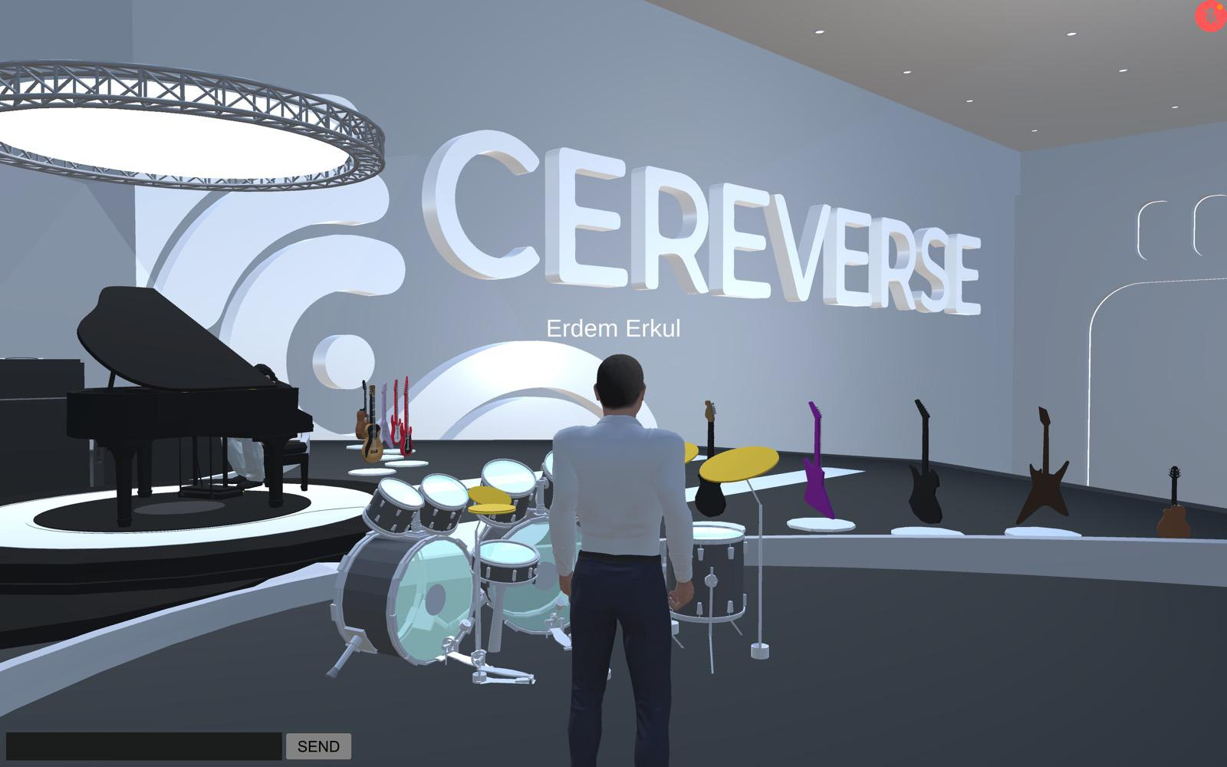
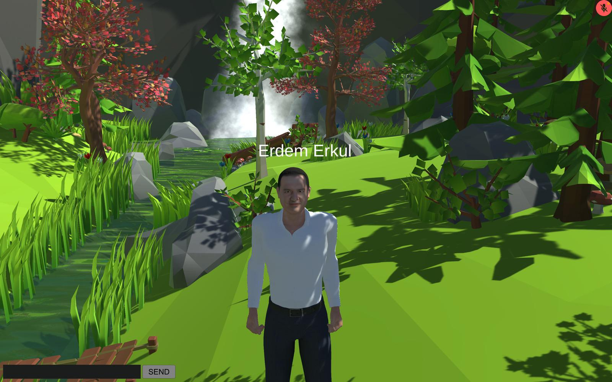
CEREVERSE
7

Slide 8
CERE THE AI
PERSONALIZED AND ENGAGING INTERACTIONS
SAVING USERS TIME & EFFORT
ALWAYS AVAILABLE
SCALABLE
8

Slide 9
WHAT DOES AN AI ''THINK'' ABOUT SUSTAINABILITY?
9

Slide 10
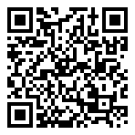
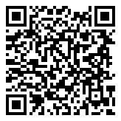
THANK YOU
R.ERDEM ERKUL,PHD
FOUNDER OF CEREBRUM TECH
@rerdemerkul
@ErdemErkul
@R.Erdem Erkul
Download Cere AI now!
10

