Slide 1
A metaverse of walled gardens?
Realising an open metaverse
Dr Jorge Soares
jorge@protocol.ai
Notes:
Hello everyone. My name is Jorge Soares and I’m a programme manager with Protocol Labs.
Before I start, I’d like to thank WIPO for the invitation. It’s a pleasure to be here before all of you, and also among people who have thought about this topic far more deeply than I have.

Slide 2
Hiro is approaching the Street. It is the Broadway, the Champs Élysées of the Metaverse … It does not really exist. But right now, millions of people are walking up and down it.
[Developers] can build buildings, parks, signs, as well as things that do not exist in Reality … In order to place these things on the Street, they have had to get approval from the Global Multimedia Protocol Group, have had to buy frontage on the Street, get zoning approval, obtain permits, bribe inspectors, the whole bit. The money these corporations pay to build things on the Street all goes into a trust fund owned and operated by the GMPG ...
Text: Neal Stephenson, “Snow Crash”
Image: Bruce Jensen, “Snow Crash”
Notes:
Where do we start? Inevitably, we must start with Snow Crash.
Yes, it’s a trope, and yes, it’s a 30-year old work of fiction that’s not meant to be a guide. But it also crafted the term around which we’re having this event.
In Snow Crash, the metaverse and "the street" have millions of simultaneous users, among the 1% wealthiest people on Earth, many of which spend a lot of waking hours in this virtual world.
A world that is controlled by one major corporation.

Slide 3
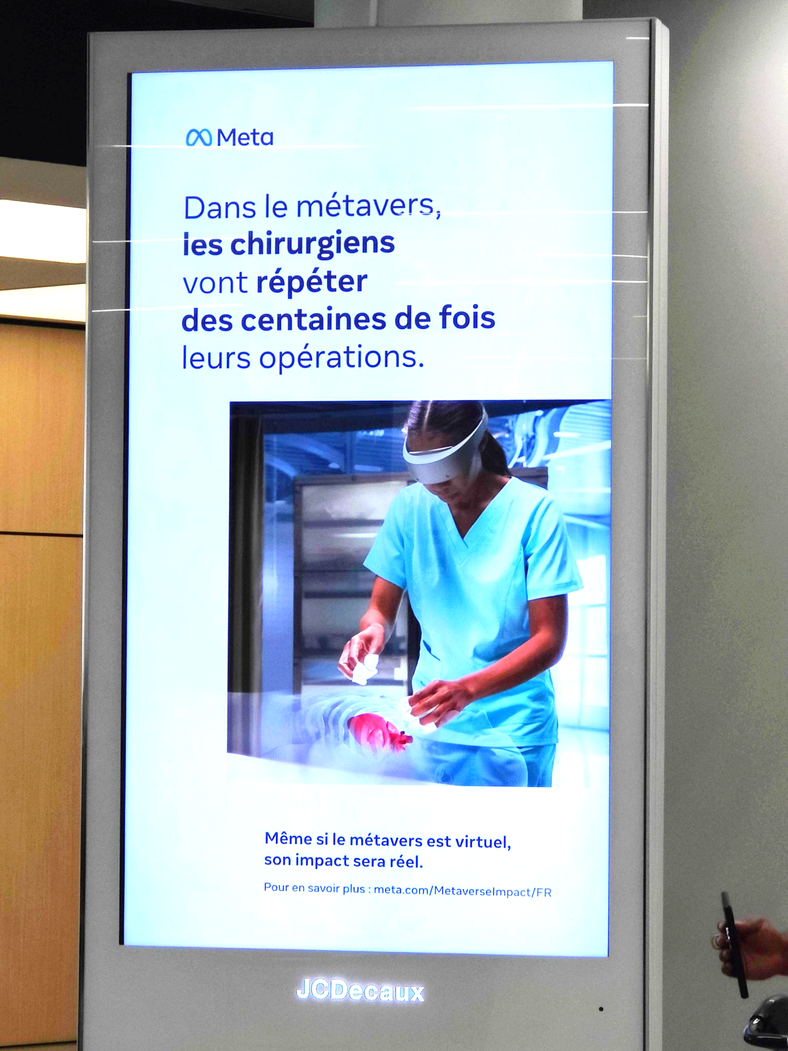
Notes:
But let’s set that aside for a moment and come back to reality. I was in Brussels recently and saw these ads about training surgeons on the metaverse.
This might be a very worthwhile application, but I think we can all agree that’s not the same metaverse as in Snow Crash — at least not now and not in the foreseeable future.
And that brings me to my first point: a lot of what we are discussing today depends significantly on what the metaverse ends up becoming. While it’s easy to discount the practical relevance of having this debate so early on, this seems like the right time to build solid foundations.
Now, is it essential for a surgical training platform to be built on open principles? Maybe not. Is that important for a virtual world in which millions of people live, work, and play? I would say the answer is yes.

Slide 4
“You have your avatar and your digital goods, and you want to be able to teleport anywhere. You don’t want to just be stuck within one company’s stuff.”
— Mark Zuckerberg
Notes:
So let’s focus on that scenario, one of a comprehensive platform for interaction among humans.
Here is the first bit of good news: that outcome seems unlikely, both due to the competitive landscape and to fundamental limits on scalability. It’s really hard for a single platform to be everything to everyone, and to do so at a planetary scale while maintaining real-time performance. So we’re probably not getting exactly that.
Instead, what we might get is a set of platforms, split across geographies, topics, cultures, philosophies, or really just ownership lines. I would claim that’s already an improvement, but this scenario still raises major questions around interoperability, inclusivity, security, privacy, and property rights – and that’s without even getting into topics like brain-computer interaction.
These concerns become more important the more central the metaverse becomes to our society and to our economy. If we believe that it will be central, then an open architecture is just a fundamental starting point.

Slide 5
Image: Bing, AI-generated
Notes:
Now, while I'm obviously in the "open" camp, I'll qualify that by saying that decentralisation isn't the holy grail.
Decentralisation -- especially trustless decentralisation -- is hard, expensive, and inefficient. You can almost always, at least on the surface, come up with a better, faster, cheaper solution by exploiting centralised control and economies of scale — and you can also capture more value.
However, interoperability and openness are also how we got the Internet instead of AOL, so that still seems like a worthy trade-off.
As an aside, I just thought it’d be appropriate to let a generative AI model dream the concept of each slide in the context of a metaverse, so there you go.

Slide 6
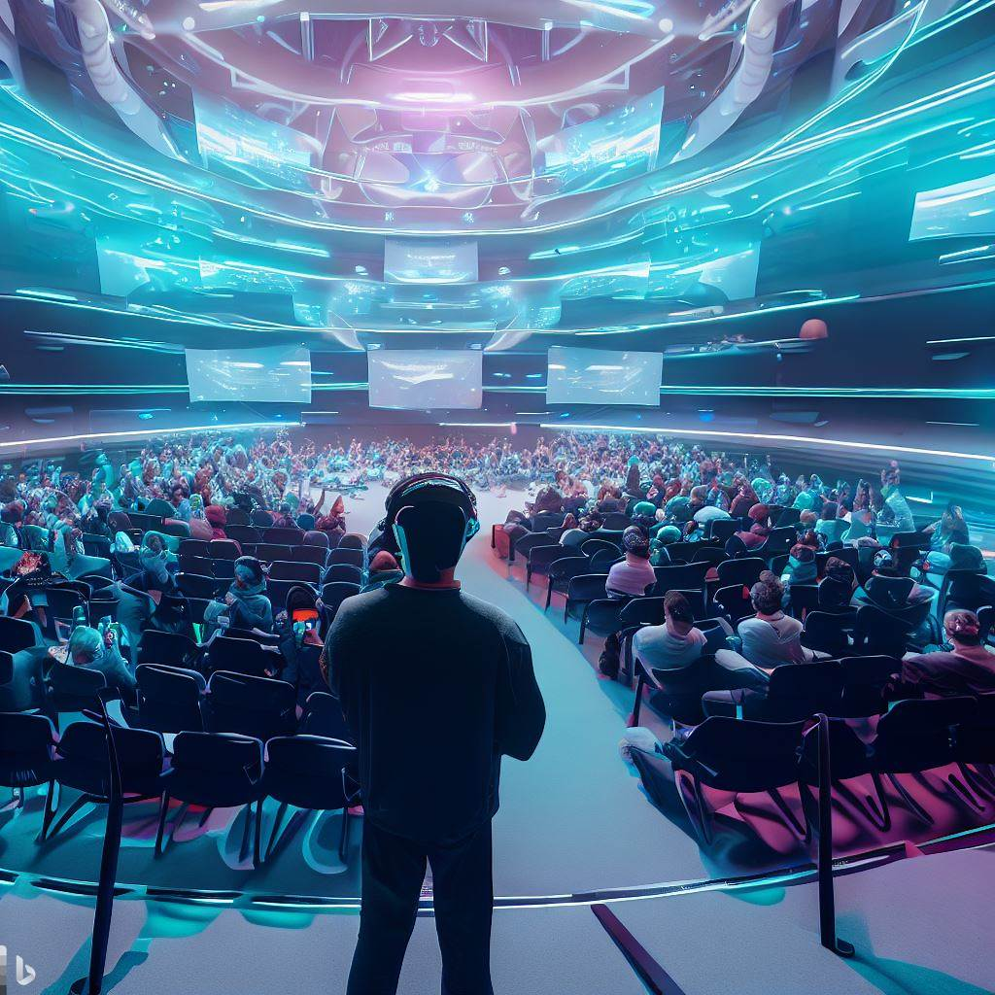
Interop
Interoperable 3D Assets
Privacy, Safety, Security, Inclusion
User Identity
Avatars and Apparel
Real/Virtual World Integration and Geospatial
Teaching and Education
Payments and Economy
XR and UI
Image: Bing, AI-generated
Notes:
So how do we get to “open”?
Standards are, of course, a good starting point. Metaverse standards are early but not a novel idea.
The Metaverse Standards Forum was created last year and now counts twenty-five hundred member organisations. It is explicitly not an standards development organisation but brings together large corporates, startups, non-profits, with interests ranging from hardware to content.
It also includes SDOs like IEEE and W3C, which are, in fact, already stewarding standards in the field.
Those items you see on the slide the priority topics, as ranked by the forum members, and it’s worth noting they’re not all technical.
But formal standard setting isn’t the only approach. There are also open-source de facto standards, which we get via shared software libraries, soft consensus, and the organic spread of open protocols.
This is a core tenet of Web3, or the decentralised web. There, soft standards are often developed by a group and end up being broadly adopted across the community. Think, for instance, of ERC-721, the Ehereum standard for NFTs.
Blockchains, by the way, face similar challenges: a single blockchain cannot scale to support everything, and the future will be diverse. So what you also see are a lot of cross-chain bridges and other efforts towards interoperability between independent distributed systems
And, then, of course, there are very interesting questions around governance of open, transnational systems lacking clear operators or even jurisdiction.
Decentraland is a great early example combining all of these things, as a web3-native proto-metaverse which is governed by a decentralised autonomous organisation (or DAO) and adopts some open standards.

Slide 7
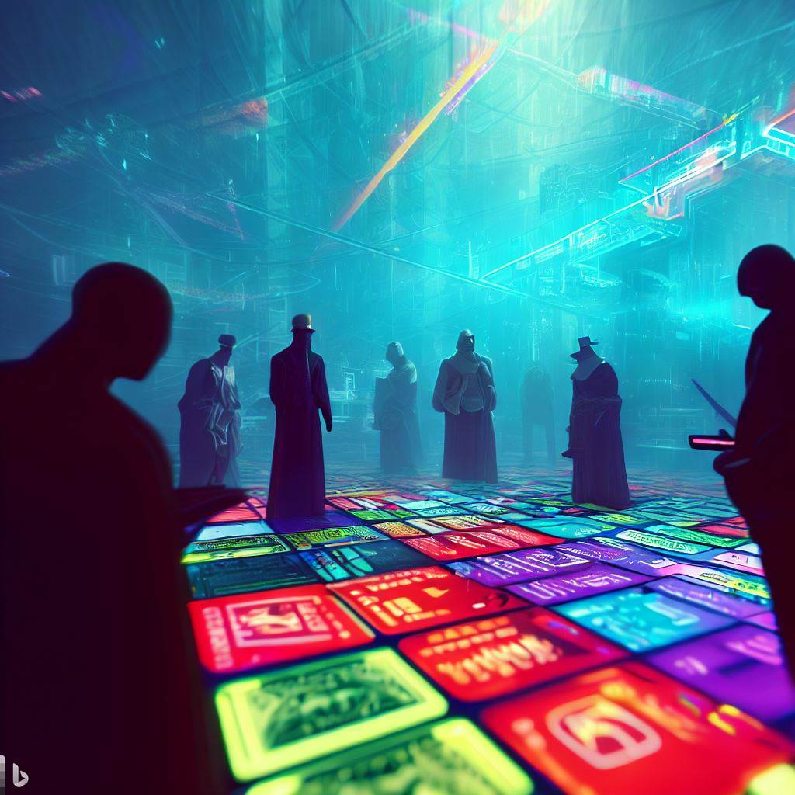
Is it enough?
Image: Bing, AI-generated
Notes:
I’m already at time and, inevitably, I have more questions than answers. I guess a good question on which to close is just “is this enough?””
It’s not enough. Openness is a base requirement. The internet is built on open standards and, despite all the good that came out of it, that hasn’t stopped a mere handful of companies from acquiring near complete control over it – and, in the process, over both our attention and our privacy.
Effective regulation is also fundamental. Governments and international organisations have a role to play in enforcing basic rules beyond the technical aspects, ranging from IP to antitrust.

Slide 8
Thank you
jorge@protocol.ai
Notes:
But that’s a topic that Chin Chin can definitely explore much better than I could, and, lucky for us, she’s going up right next.
Thank you again for your attention.

