Slide 1
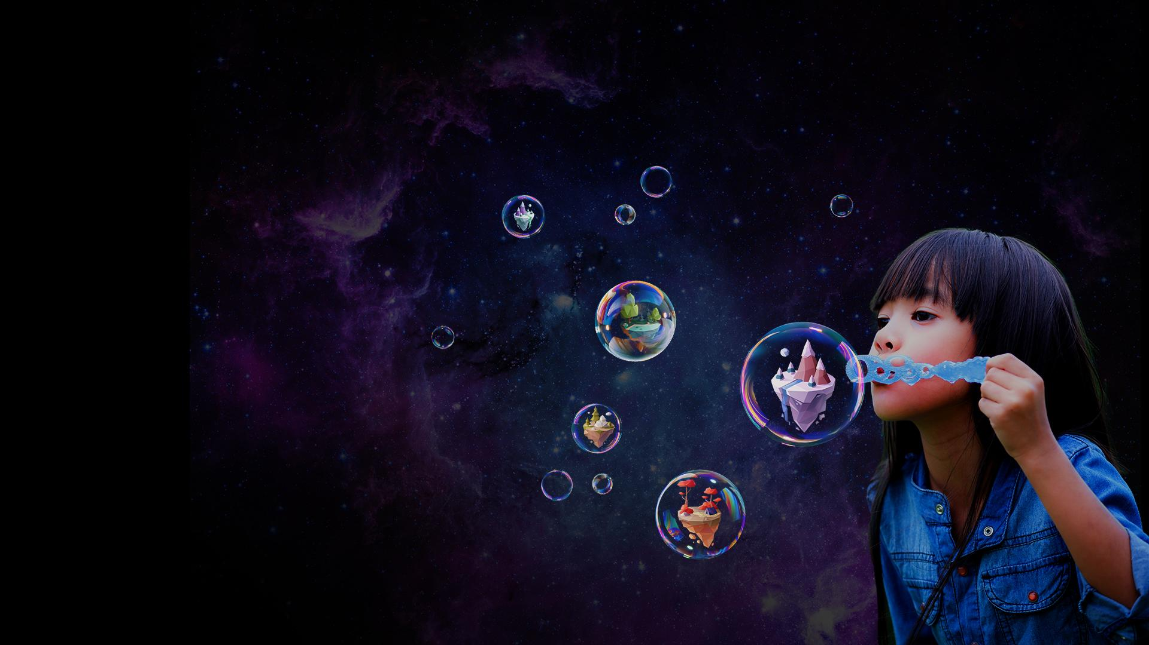

Slide 2
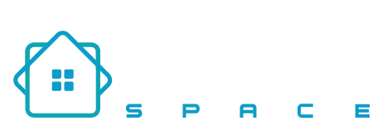
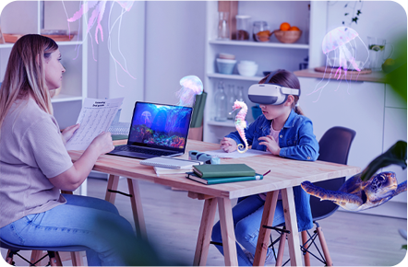
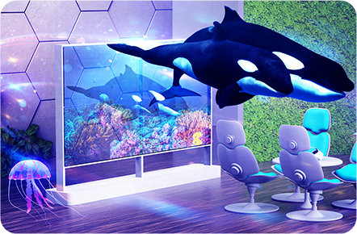
Kabuni UNIVERSITY Immersive content, micro credentials, enhancing curriculum and the future of work.
Kabuni CAMPUS
A global school designed for homeschooling and hybrid learning support.
Kabuni SPACE Transform your building into a hub of immersive education and training.
Access 50,000 educators across 50 countries in supporting hybrid immersive learning at school, home, or work.
Drive purposeful education with a blend of academic and experiential learning, grounded in the future of work.
Elevate the outcomes of each learner through evidence-based improvements in retention, engagement, speed, and health.
Immerse your learning environment with awe and wonder through our custom-built spaces.

Slide 3
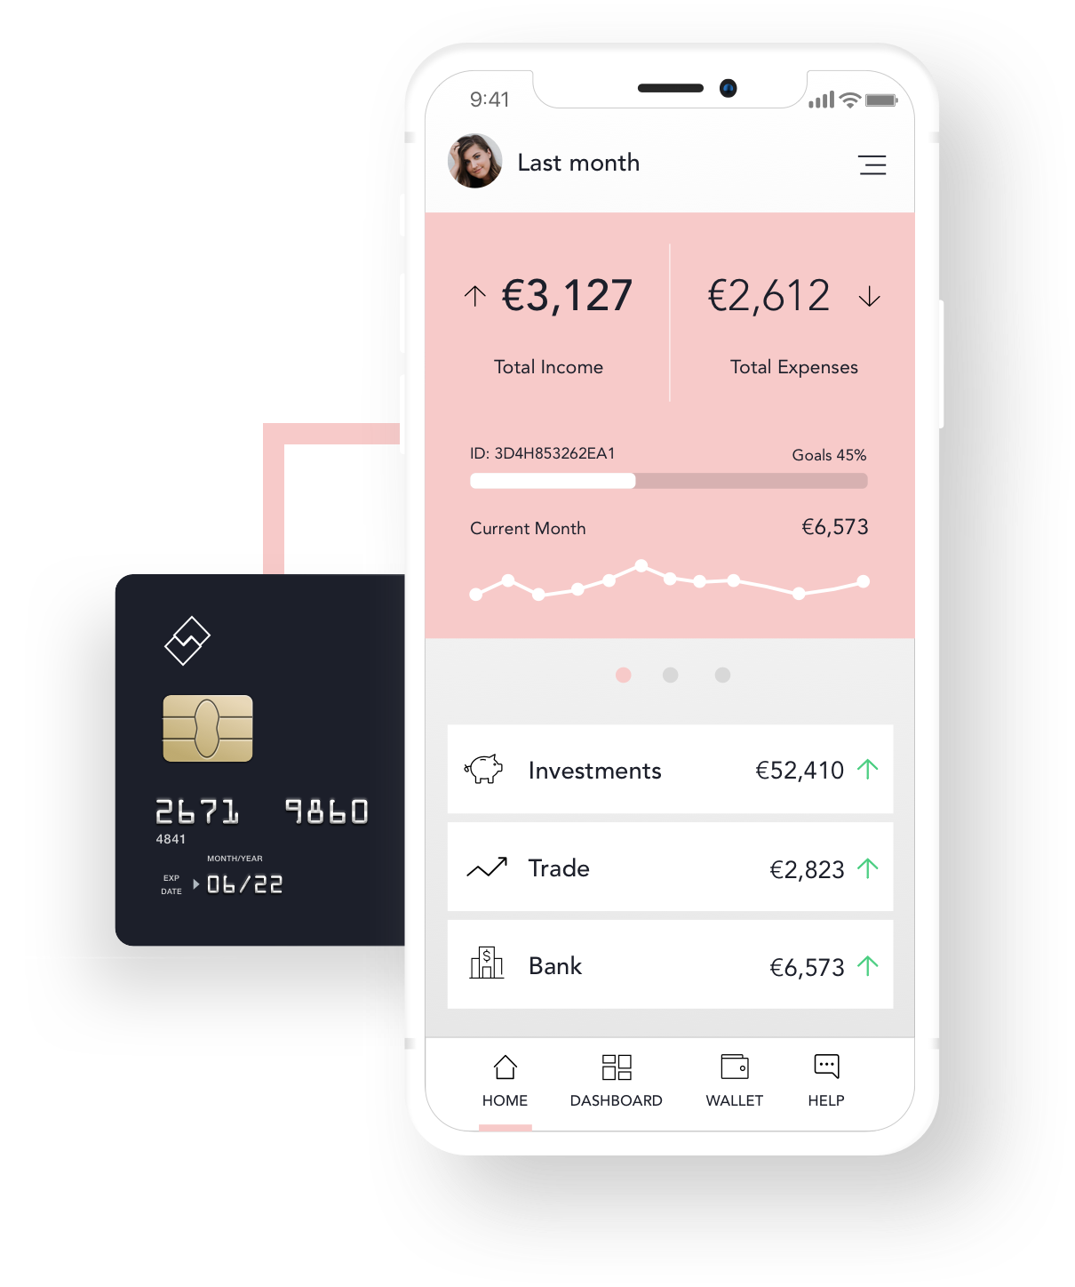
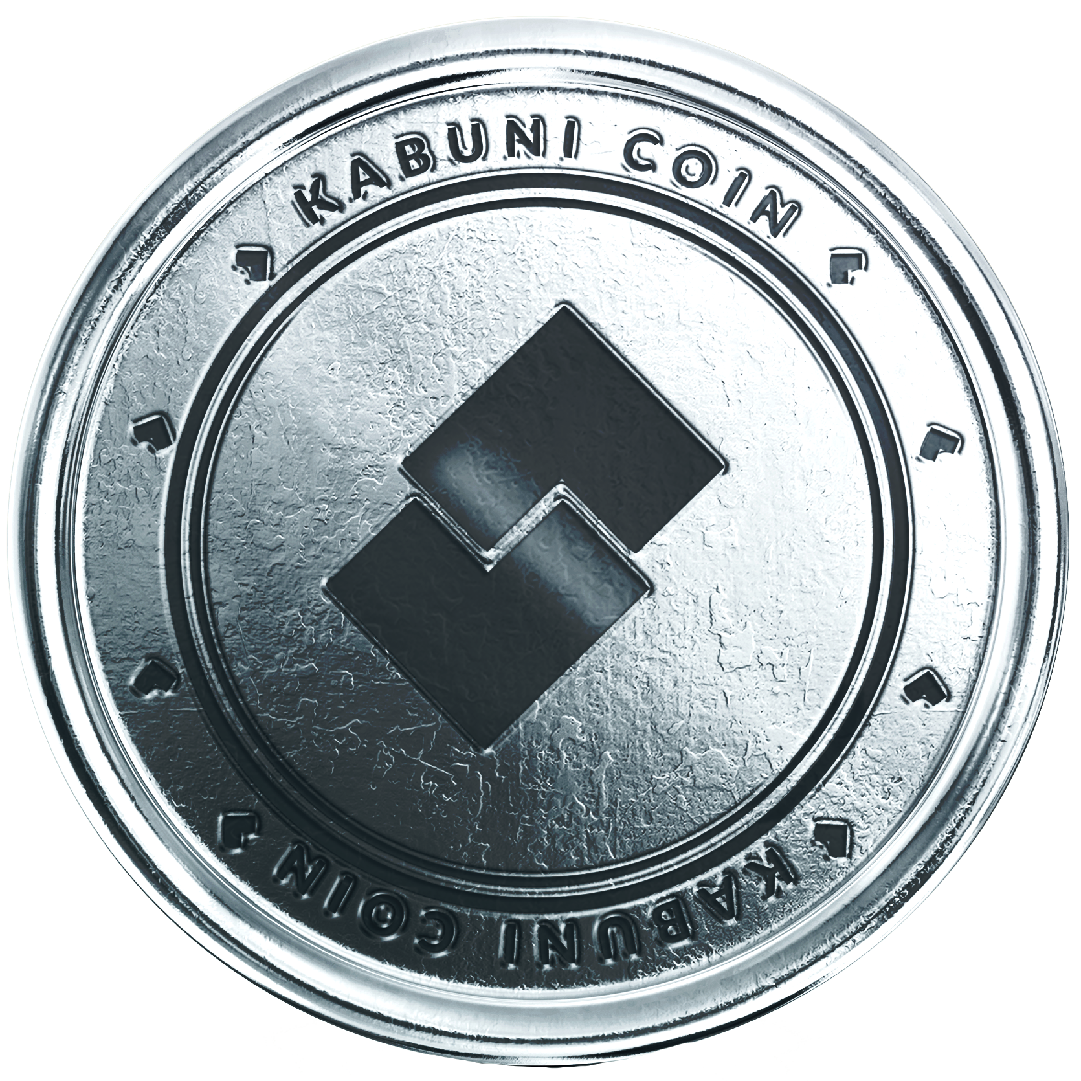
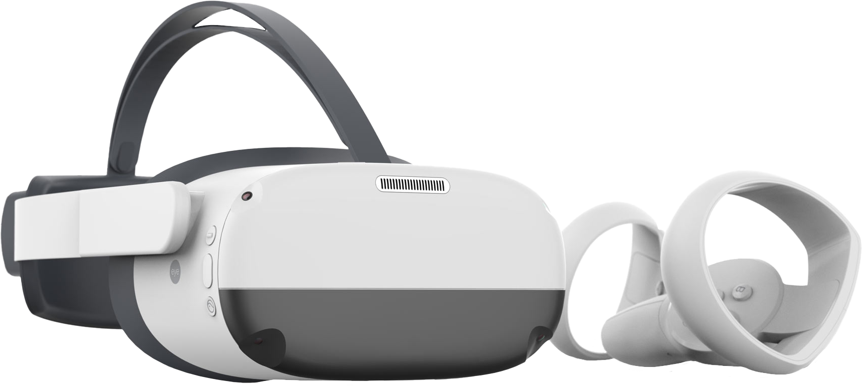
Learn and Earn Safely in the Metaverse with the World's First Integrated Crypto Card
With Kabuni CARD, learners can easily earn rewards for their achievements, from completing courses to participating in community events. These rewards can be redeemed for valuable items, experiences, or even real-world currency. This not only incentivizes learners to stay motivated and engaged, but also helps them build a portfolio of skills and experiences that can boost their career prospects.
Kabuni CARD is powered by brands to unlock the design potential of every human being and elevate life.

Slide 4
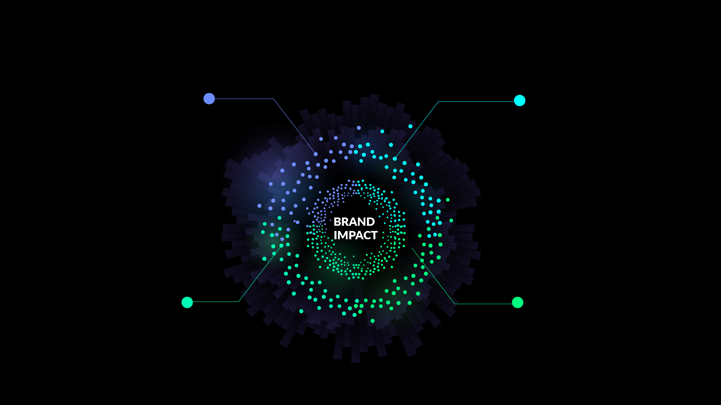
ADDING VALUE: HOW EACH STAKEHOLDER CONTRIBUTES TO THE KABUNI COIN ECOSYSTEM
LEARNERS:
Learners are a key stakeholder in the Kabuni COIN ecosystem, as they are the ones who take the micro immersive learning sessions and earn micro credentials. The more learners there are on the platform, the more valuable the coin becomes, as demand for coins will increase as more people seek to earn and spend them.
EDUCATORS:
Educators are another important stakeholder in the Kabuni COIN ecosystem, as they are the ones who create and deliver the micro immersive learning sessions. The quality of the content that educators provide can have a significant impact on the value of the coin. If educators are providing high-quality content that learners find valuable, demand for coins will increase, which in turn will increase the value of the coin.
BRANDS: Brands are the third major stakeholder in the Kabuni COIN ecosystem, as they are the ones that learners can spend their coins with. The more brands that are part of the platform, the more valuable the coin becomes, as there will be a greater variety of products and services that learners can spend their coins on.
CREATORS:
Creators can add value by developing high-quality content that educators can use to deliver Kabuni CONCEPTS. By doing so, they can earn Kabuni COINS that they can spend with the brands. They can also benefit from the feedback loop, which rewards them for developing better content that improves the learning experience for learners.

Slide 5
WEB3 FEATURES
A child creates and mints their unique digital avatar on blockchain which then represents them in the Metaverse as they explore, learn and grow.
The world's first Metacurrency designed to motivate users to learn, earn and donate encouraging academic and experiential learning.
An immersive playground of experience to create an unimaginable learning environment for educators to unlock the potential of every child they teach.
Unleash your creativity and create immersive content to teach, present or to just have fun, you will never use powerpoint again.
Build, design, educate and learn. All your content and accomplishments are owned by you in the form of an NFT.
Notes:
A unique digital avatar represents your kid in the Metaverse as they explore, learn and grow. Removing any risk of your child's personal data being exposed.
represents your kid in the Metaverse as they explore, learn and grow. Removing any risk of your child's personal data being exposed.

Slide 6
COMMUNITY
THE FUTURE OF WORK MICRO-CREDENTIALS MODEL FOR EDUCATORS AND LEARNERS POWERED BY BRANDS
BRANDS
Our Learn-to-Earn model is designed to help brands deliver micro-credentials to their target audience. With Kabuni SPACES, brands can choose to reach a local, regional, national, or international audience. Simply select the industry category that you want to upskill your talent in, and begin providing valuable education to your target market. This will help future-proof their skills and improve their career prospects.
PARTNERS
In partnership with schools, universities, and retail sites, Kabuni SPACES will provide customized and immersive learning experiences to upskill learners in academic and industry settings. Our spaces will be tailored to meet the needs of each partner, and will be measured based on the number of micro-credentials they deliver in collaboration with brands. By working together, we can help individuals gain the skills and knowledge they need to thrive in today's rapidly-evolving job market.

Slide 7
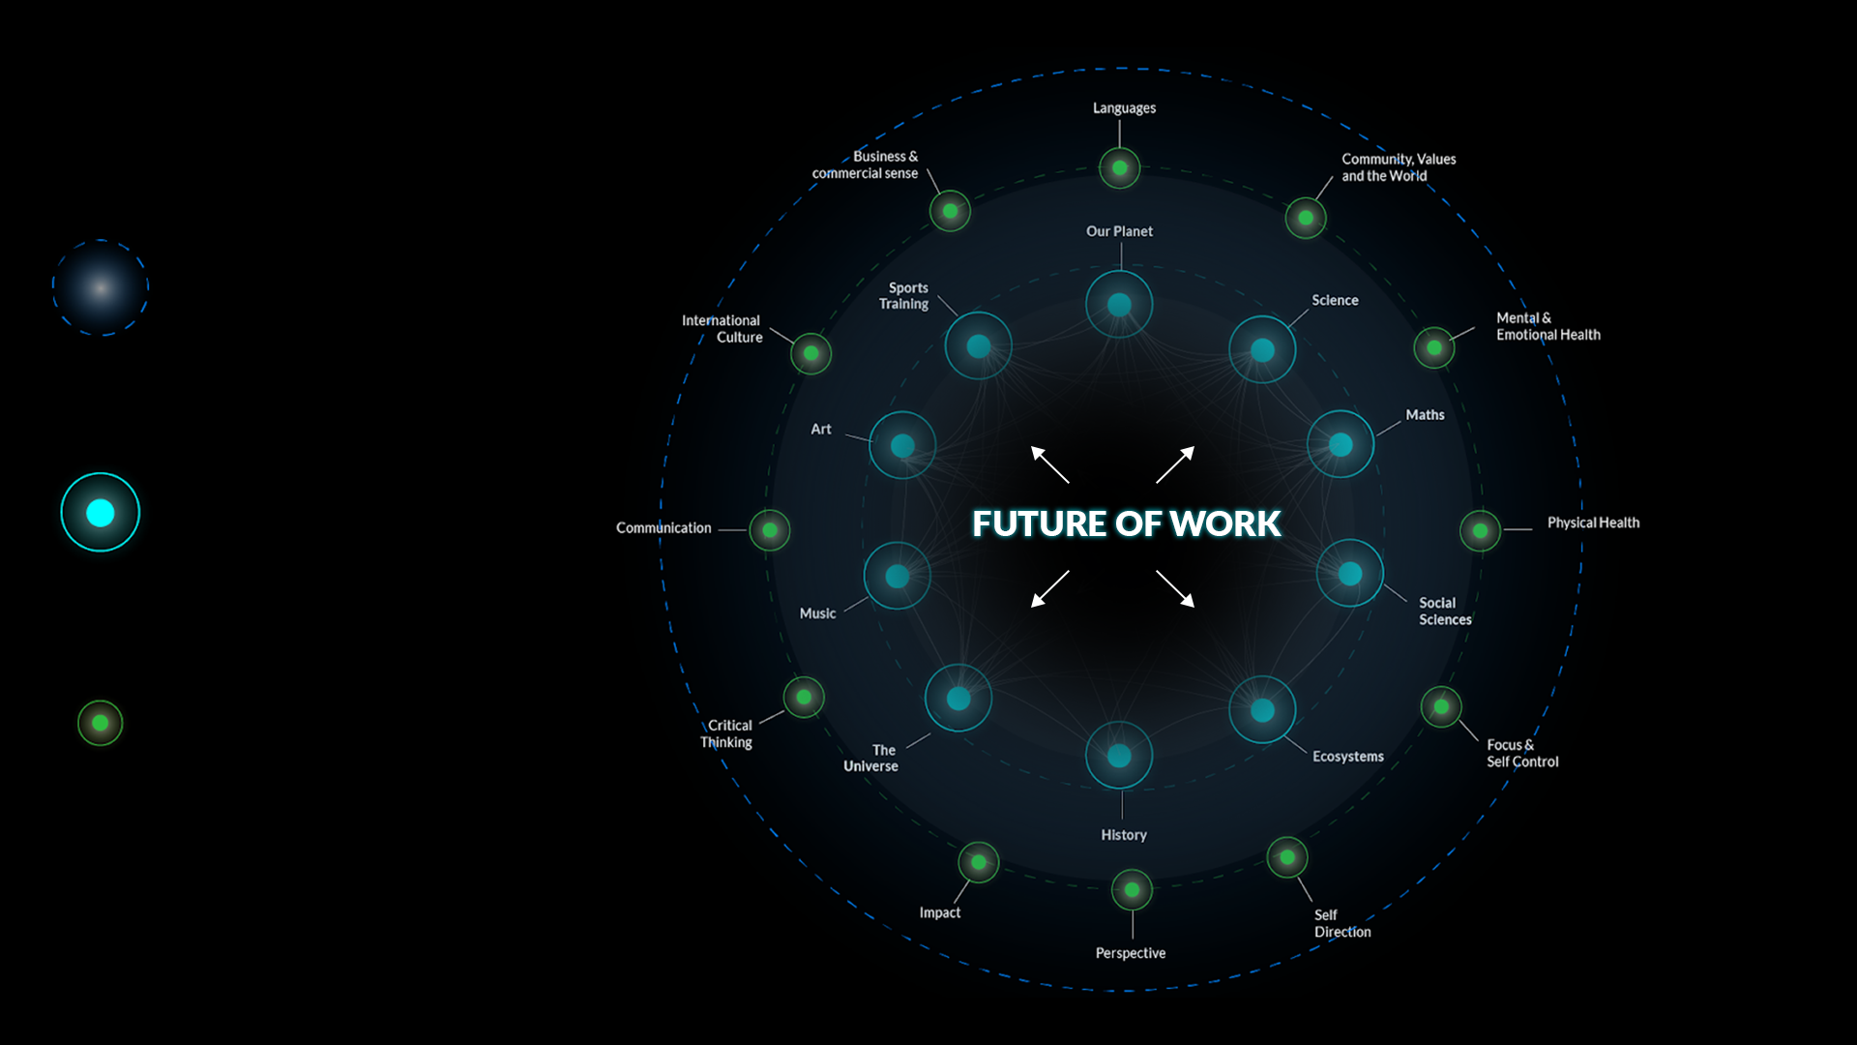
IMMERSIVE LEARNING METHOD
HOW YOU’LL LEARN
Every learner will be able to explore educational content across Kabuni WORLD
IMMERSIVE LEARNING
HOW YOU’LL GROW
Learning anything, anytime safely with friends, classmates or one on one has never been more fun
EVIDENCE BASED
HOW YOU’LL EXPLORE
Learners will be more engaged, retain more, learn faster and be healthier and happier

Slide 8
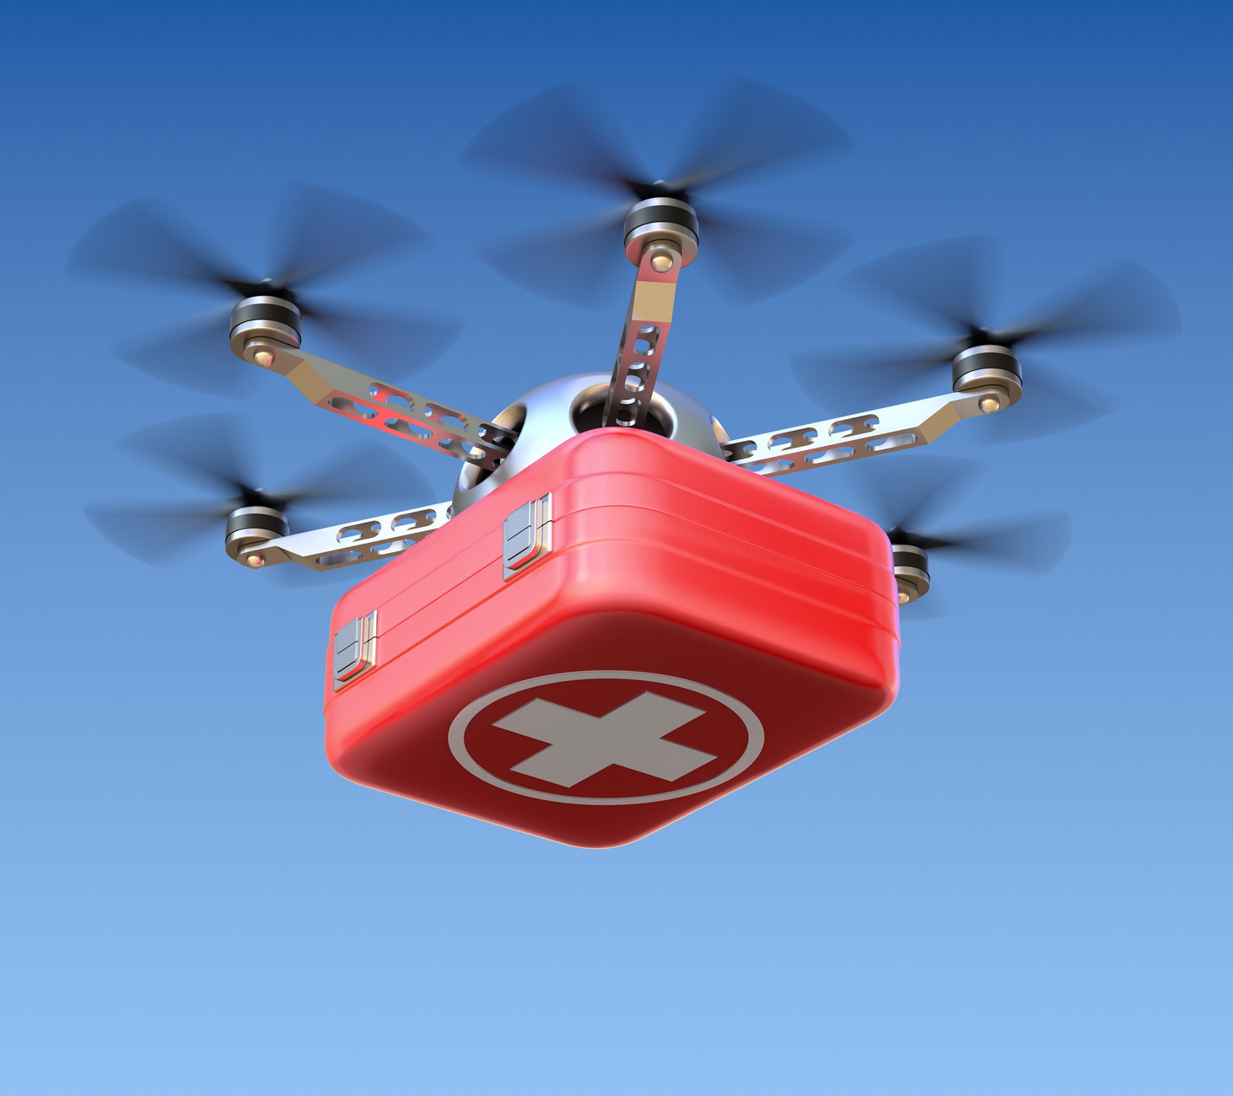
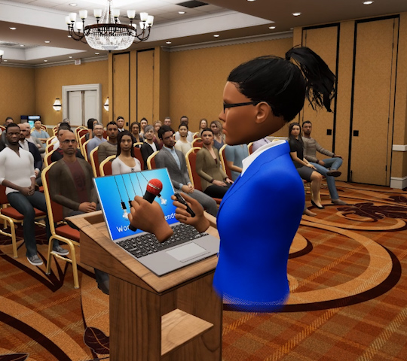
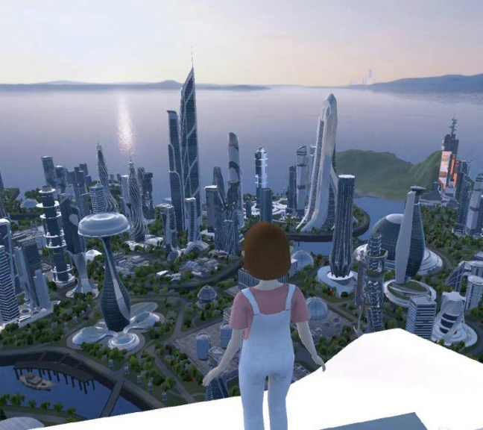
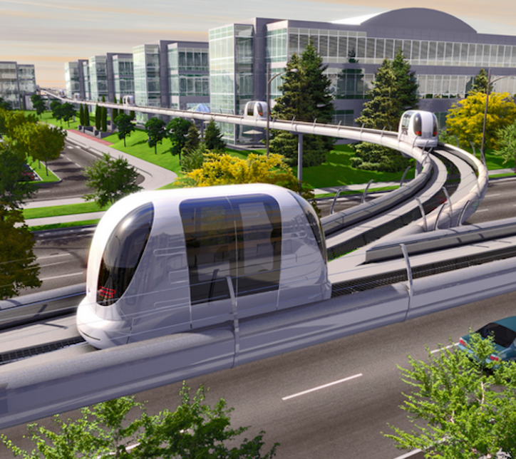
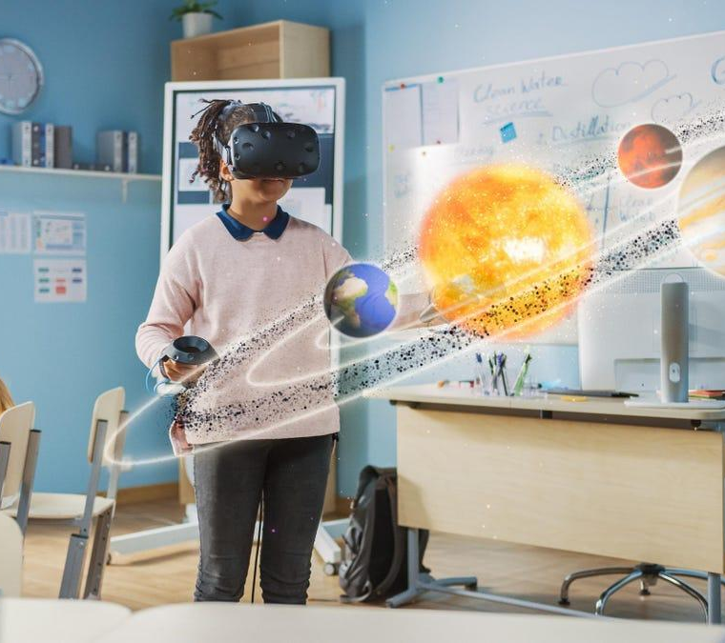
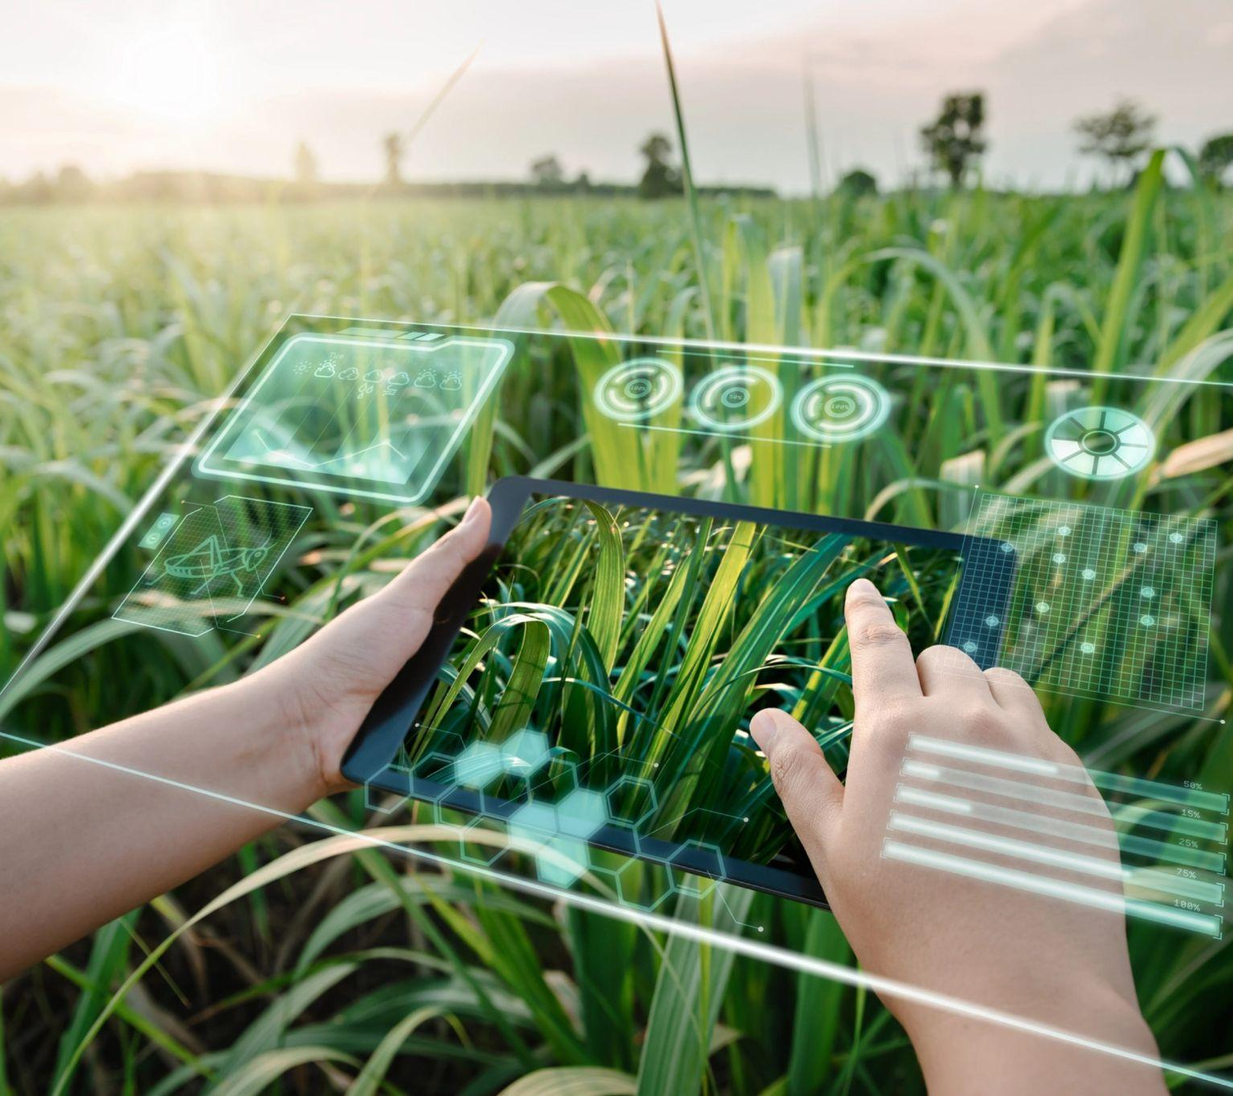
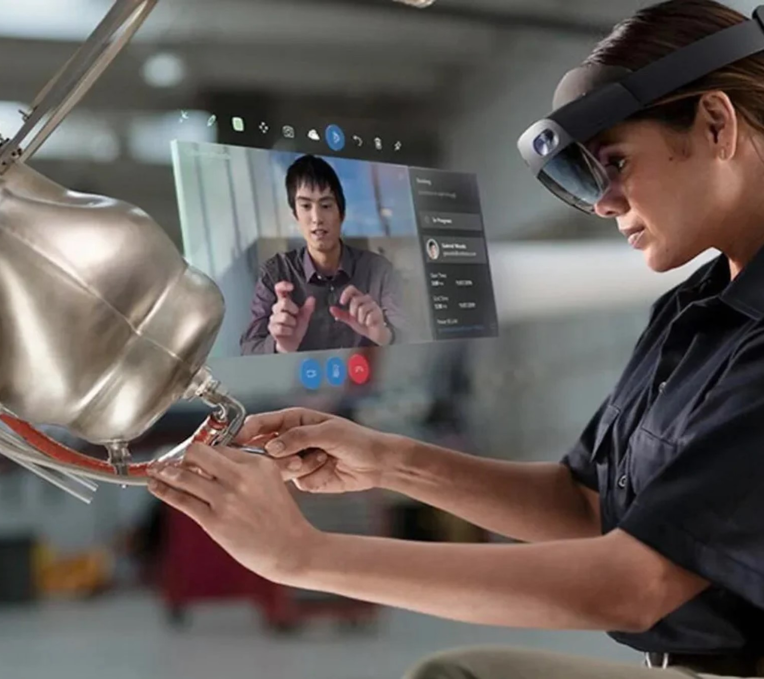
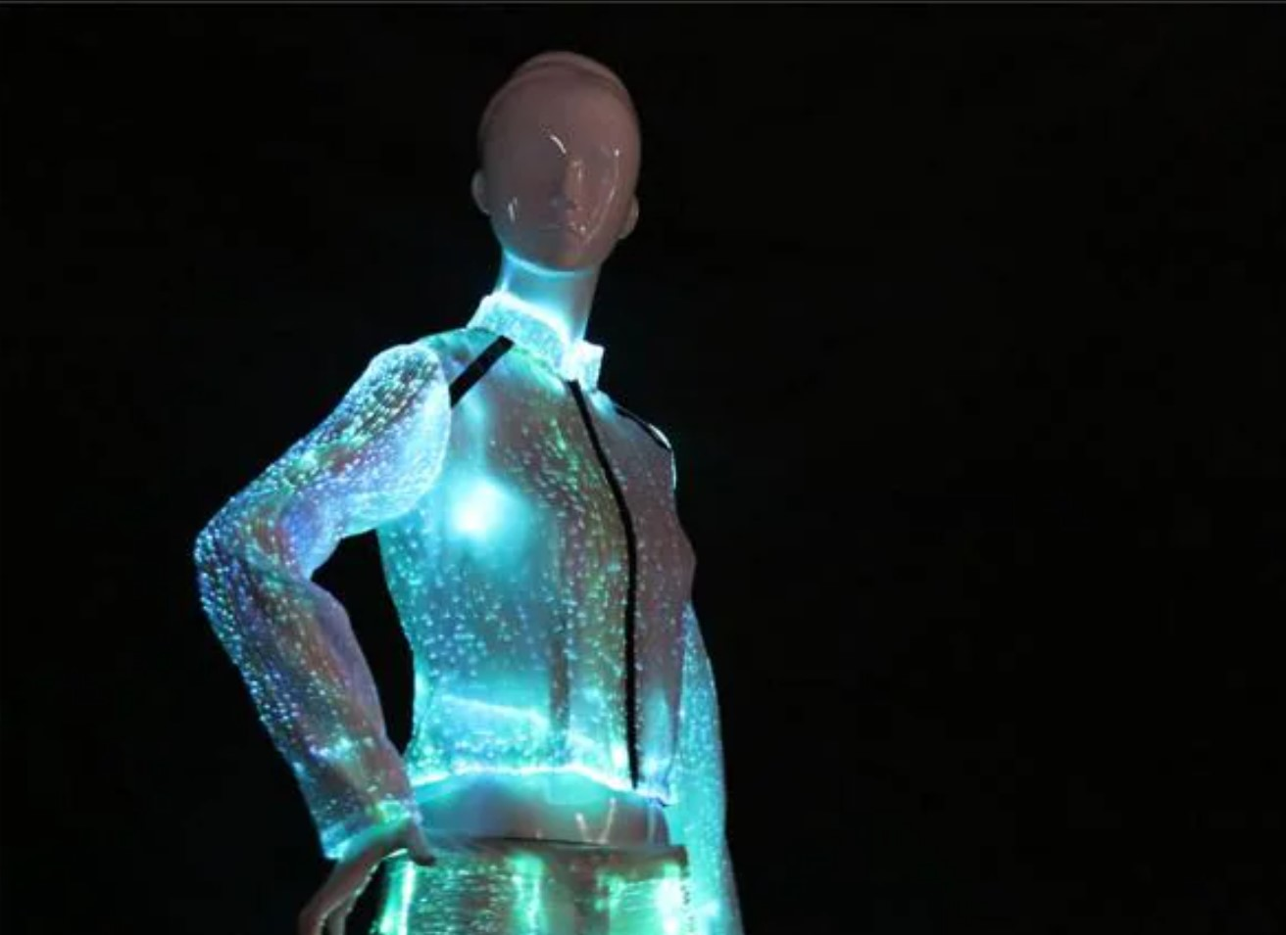
FUTURE OF WORK
Paramedic drone programmer
an AI expert with medical knowledge to 'teach' drones to help emergency rescue teams
Smart-assisted sports coach
data and AI skills will help coaches measure player performance and welfare, predict outcomes, and adjust tactics
AI speech coach
help voice assistants and visual avatars become more realistic
Metaverse architect
create environments and activities to entertain people in the virtual world
Zero carbon transport planner
design and programme driverless public transport networks
Augmented learning technician
use AI and augmented reality to create state-of-the-art tools for teachers and
their lessons
Agricultural AI engineer
help farm sustainable foods like synthetic meats and insects at faster and
grander scales
AI creative skills producer
help creators enhance their music and art by learning popular trends
Community care technician
use AI to detect loneliness in the community, alerting care workers to who needs their help the most
Tech fashion designer
create the next-generation of sustainable smart clothing and wearables, like garments that can react and respond to the weather

Slide 9
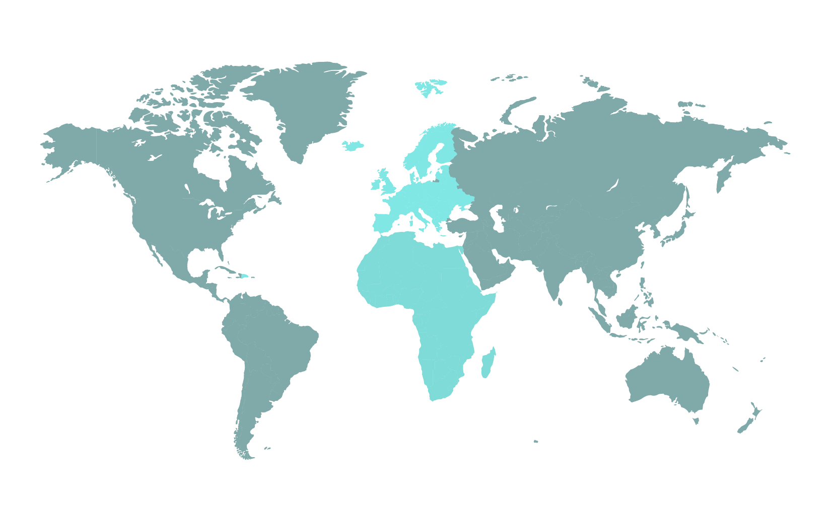
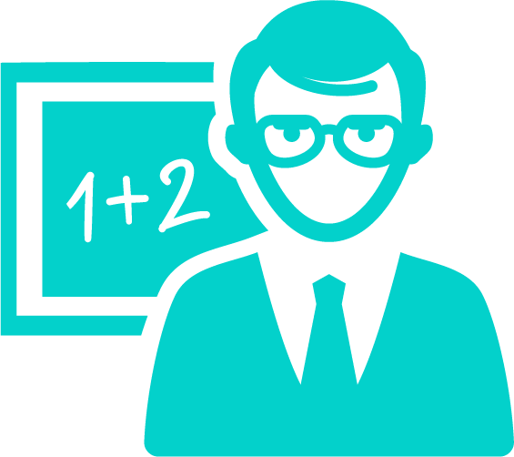
Global Research Study
Kabuni will provide a scientific approach to immersive learning with our large scale, international school program. Grounded in current curriculum to deliver specific and targeted immersive experiences to elevate key areas of learning. The research will generate robust and rigorous research to develop Kabuni’s evidence based methodology to integrate immersive experiences into the classroom and at home - defining the Kabuni Toothpaste Moment - use Kabuni 2x per day to see improvements in 4 key areas:
Nina Jane Patel
Co-founder + VP of Metaverse Research
Retention
Metaverse learning research shows that students both made more progress and scored higher when using virtual learning; their self-reported confidence levels also showed great improvement and the highest overall score.
Engagement
With Metaverse learning, students will be captivated and excited by the medium of learning and will, in turn, be much more likely to engage in further conversation about their experience and the different elements of experiential, embodied learning.
Speed
Learning efficiency will be improved for specific content objectives. Students will be able to understand key concepts more quickly with the embodied cognitive learning within the Metaverse.
Health
Kabuni will enhance opportunities for open-ended, imaginative, risk-taking and diverse play that promotes health and wellbeing.
Pilot Program
3 Continents
10 Schools
5,000 Students
400 Educators
5

