Slide 1
Preserving heritage from the impact of leading technologies

Slide 2
The Egyptian national strategy for the intellectual property
On 21 September 2022, Egypt officially launched its first-ever National Intellectual Property Strategy (NIPS)

Slide 3
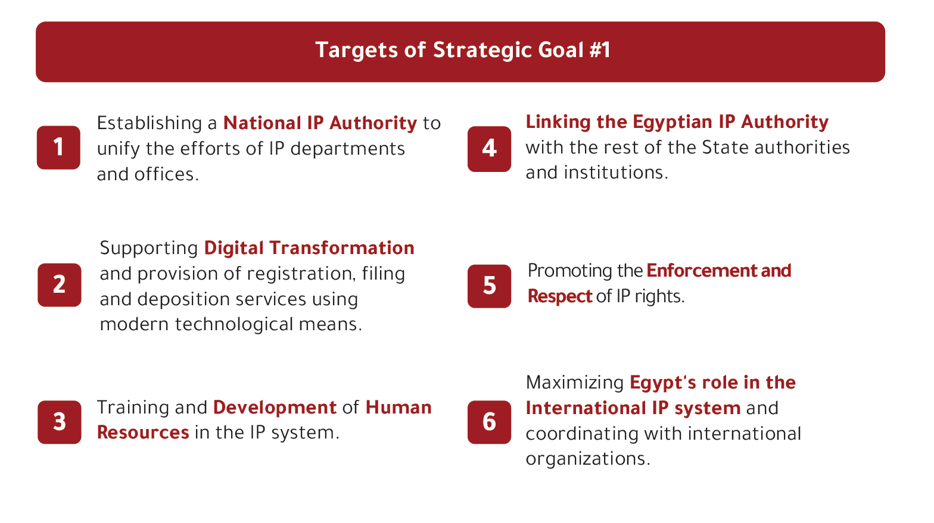

Slide 4
The principle role of the Egyptian ministry of tourism and antiquities
the Egyptian ministry of tourism and antiquities is open for all new frontier technologies as well as it adopted many projects that rely on frontier technologies especially in the time of the covid pandemic

Slide 5
It also encourages technology producers to collaborate with local communities and organizations to create digital projects that accurately represent the history and heritage of a civilization.

Slide 6
The ministry also provides facilities, grants licenses, and plays a key role in scientific review, as it provides guarantees that the information is documented

Slide 7
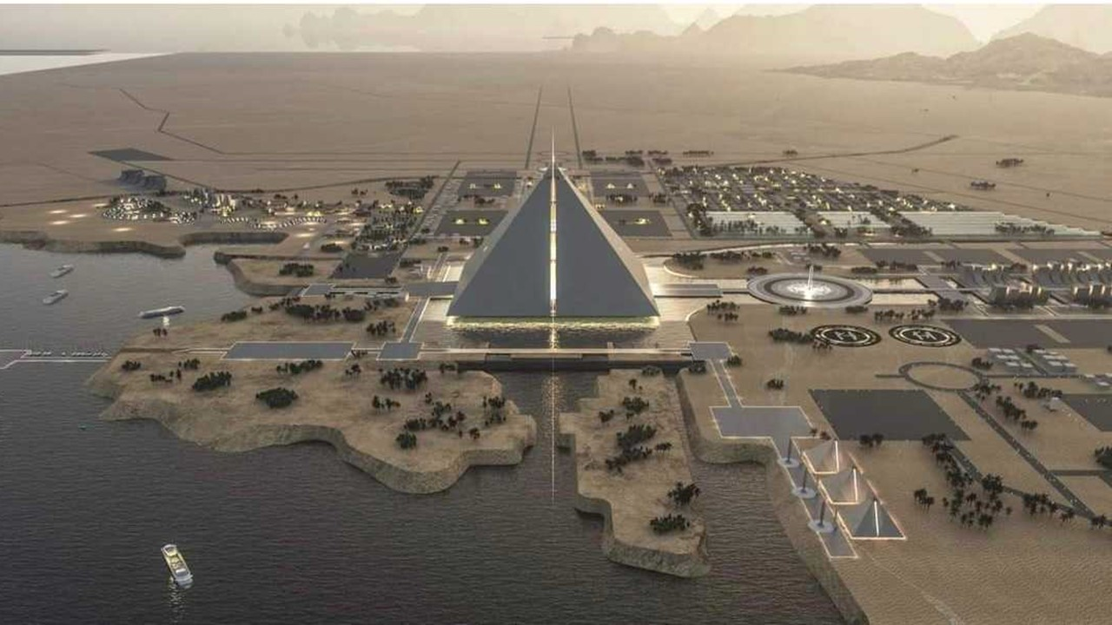
Tuteara is one of the most pioneering metaverse projects and it is a purely original Egyptian project that works according to the vision of the Ministry of Tourism and Antiquities to cooperate with technology producers to protect intellectual property and the rights of the Ministry in granting licenses.

Slide 8
WIPO recommendations
Finally, we are looking forward to know more about your recommendations regarding discussion and knowledge building among Member States and other stakeholders to the intellectual property for Preserving heritage from the impact of leading technologies

Slide 9
Thank you

