Slide 1
Digital twins in virtual worlds
hybrid objects in search of IP protection
Jean-Marc Deltorn
Centre for International Intellectual Property Studies (CEIPI)
University of Strasbourg
WIPO Conversation on intellectual property (ip) and frontier technologies
Seventh Session
Geneva, March 29 2023

Slide 2
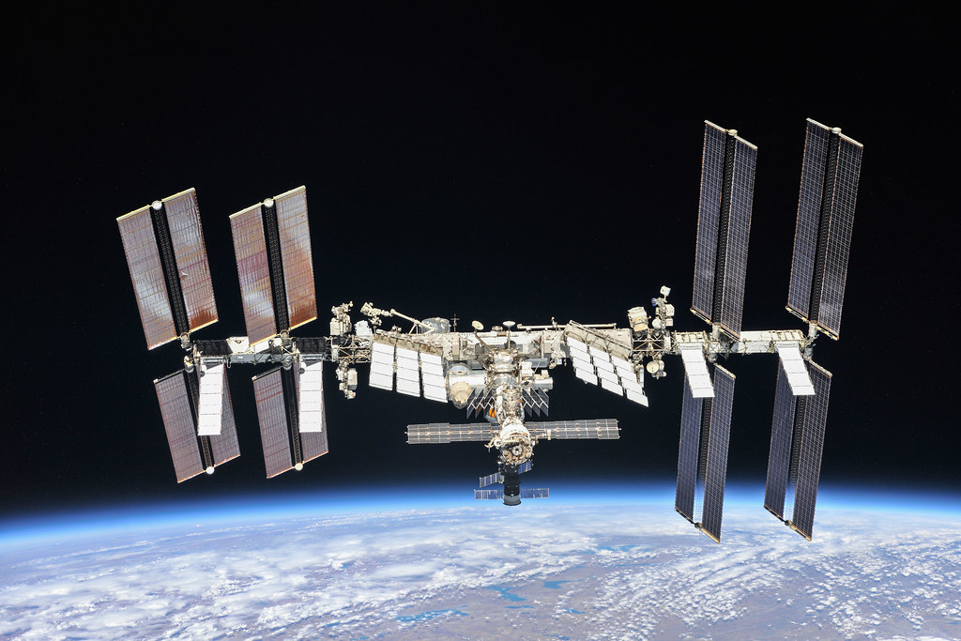
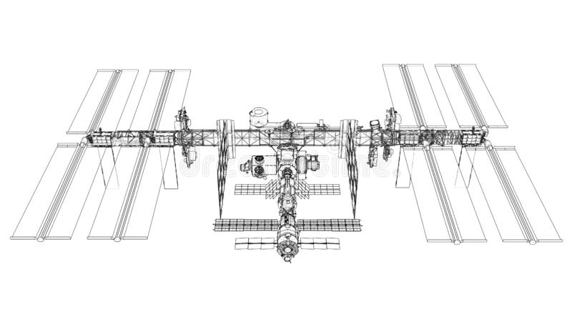
What is a digital twin?
A digital twin is a virtual replica of a physical object, process, or system.
The digital twin is informed by data from sensors, that feed computer simulations.
They can be used to monitor, analyse, and optimise the performance of the real-world object.
Aerospace: NASA's digital twin of a spacecraft (e.g. the ISS) can be used to monitor and predict its behaviour.
operational
history
maintenance
history
state of the ISS
&
predictions
real time
data
model
(design, physics, etc.)
space
environment
feedback

Slide 3
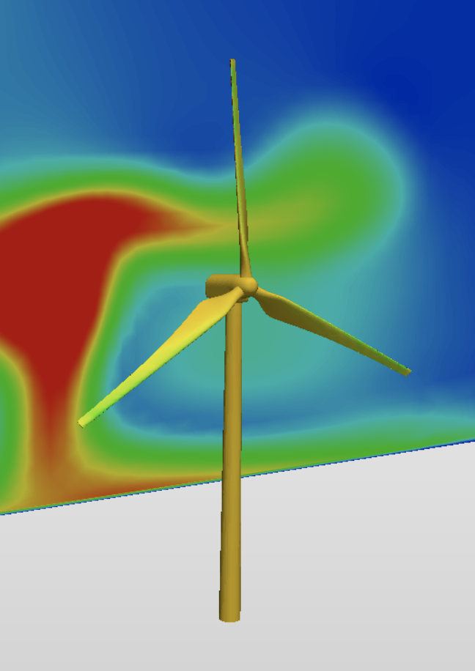
What is a digital twin?
A digital twin is a virtual replica of a physical object, process, or system.
The digital twin is informed by data from sensors, that feed computer simulations.
They can be used to monitor, analyse, and optimise the performance of the real-world object.
Design & Manufacturing: prototype, test and improve the performance of products and industrial processes, predict maintenance needs, help in training.
Smart cities: Digital twins can be used to create virtual models of cities to help planners manage traffic flow, energy or water consumption, etc.
Healthcare: Digital twins can be used to create personalized simulations of patients to help clinicians diagnose pathologies and tailor treatments to an individual's unique physiology and genetic makeup.
data

Slide 4
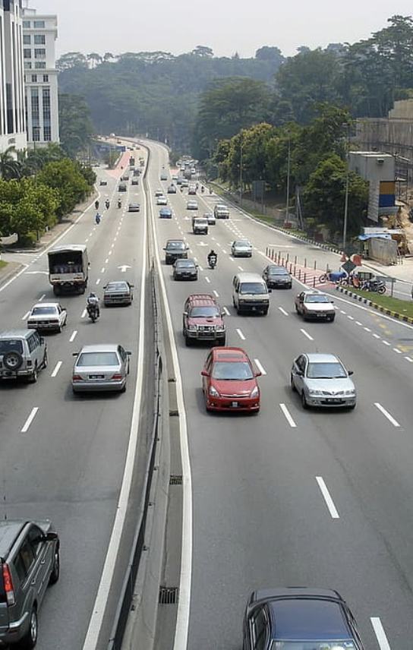
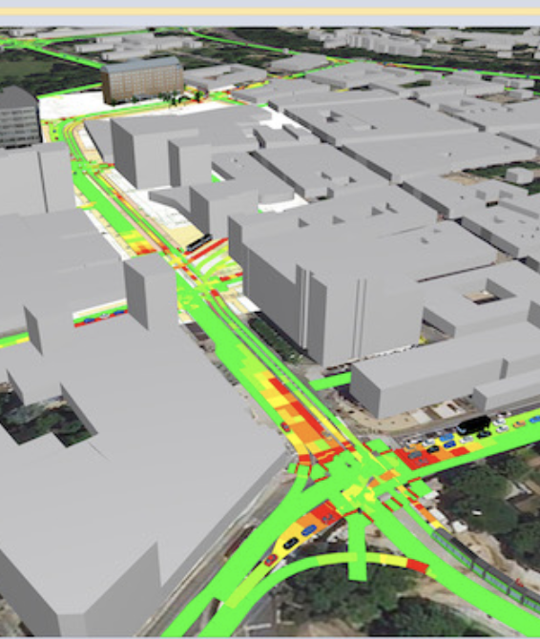
What is a digital twin?
A digital twin is a virtual replica of a physical object, process, or system.
The digital twin is informed by data from sensors, that feed computer simulations.
They can be used to monitor, analyse, and optimise the performance of the real-world object.
Design & Manufacturing: prototype, test and improve the performance of products and industrial processes, predict maintenance needs, help in training.
Smart cities: Digital twins can be used to create virtual models of cities to help planners manage traffic flow, energy or water consumption, etc.
Healthcare: Digital twins can be used to create personalized simulations of patients to help clinicians diagnose pathologies and tailor treatments to an individual's unique physiology and genetic makeup.
data

Slide 5
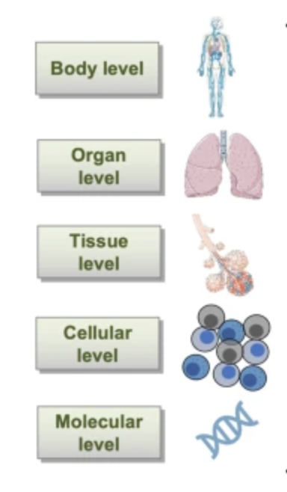
What is a digital twin?
A digital twin is a virtual replica of a physical object, process, or system.
The digital twin is informed by data from sensors, that feed computer simulations.
They can be used to monitor, analyse, and optimise the performance of the real-world object.
Design & Manufacturing: prototype, test and improve the performance of products and industrial processes, predict maintenance needs, help in training.
Smart cities: Digital twins can be used to create virtual models of cities to help planners manage traffic flow, energy or water consumption, etc.
Healthcare: Digital twins can be used to create personalized simulations of patients to help clinicians diagnose pathologies and tailor treatments to an individual's unique physiology and genetic makeup.
data
Laubenbacher, R., Niarakis, A., Helikar, T. et al. Building digital twins of the human immune system: toward a roadmap. npj Digit. Med. 5, 64 (2022)

Slide 6
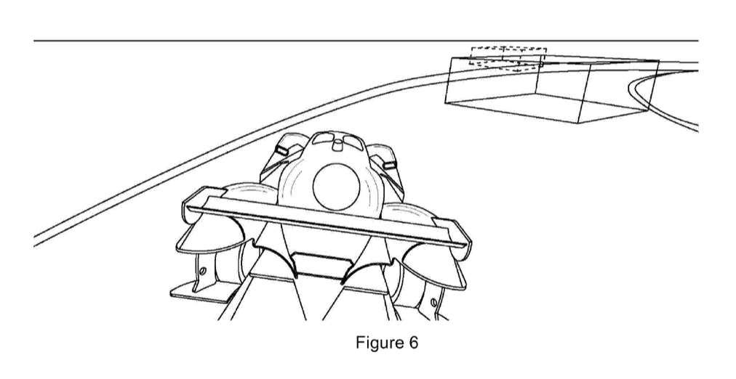
Digital twins in the metaverse
Self-driving vehicle + real-world "edge cases" in a virtual environment (metaverse)
Digital twins can play a significant role in the development of the metaverse.
Virtual products and services: e.g. a gaming / fashion: virtual goods associated with a digital twin can be exchanged in the metaverse.
Virtual training and simulation.
Virtual environments: virtual representation of real-world spaces (buildings, factories, cities), modelled using digital twins → allow to explore different scenarios and test the impact of different policies and decisions on the virtual system.
Problem: virtual agents developed in strictly simulated environments are likely to fail when used to control real-world devices operating in the real world, especially in edge or extreme cases.
So we address that problem by adding a metaverse-based phase: the metaverse combines virtual reality and the real-world into a unified representation of a hybrid reality.
WO2022106829A1 Method of developing or training software-implemented agents or systems

Slide 7
The composite nature (and protection) of digital twins
Digital twins can be protected using various forms of IP rights:
Copyright
Patents
Designs
Sui generis database rights
Trademarks
Trade secrets
software
hardware
input data
output data
digital
twin
simulation &
models
application
7
business
models
What can be protected? By which IP right? What are the limitations?

Slide 8
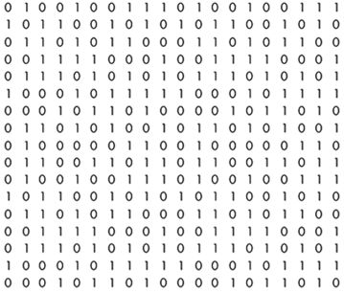
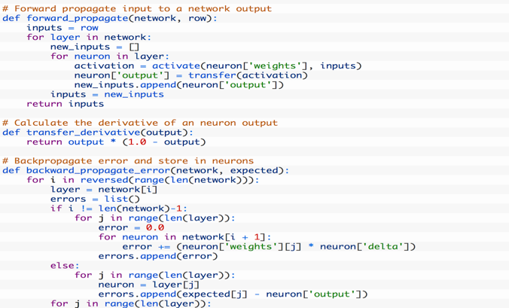
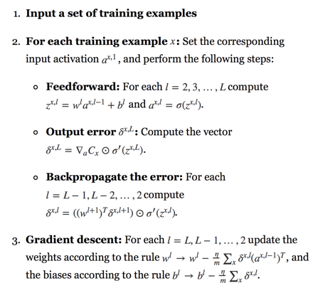
The composite nature (and protection) of digital twins
Copyright & software:
Directive 2009/24/EC (art 1.2):
copyright protection applies to the expression of a computer program
However, underlying ideas and principles are not protected
software
hardware
input data
output data
digital
twin
simulation &
models
application
8
business
models
✗
code only: OK
algorithm:
not protected

Slide 9
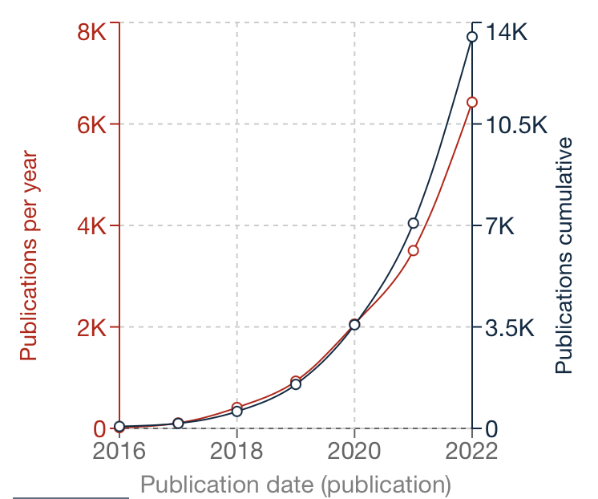
The composite nature (and protection) of digital twins
Patents
2022: 13500
software
"(digital OR virtual) twin"
hardware
input data
output data
digital
twin
simulation &
models
application
9
2016: 60
business
models
source: espacenet.com

Slide 10
The composite nature (and protection) of digital twins
Sui generis database rights:
Art. 7 Directive 96/9/EC:
Member States shall provide for a right for the maker of a database which shows that there has been qualitatively and/or quantitatively a substantial investment in either the obtaining, verification or presentation of the contents to prevent extraction and/or re-utilization
software
hardware
input data
output data
digital
twin
simulation &
models
application
10
business
models

Slide 11
The composite nature (and protection) of digital twins
Sui generis database rights:
BUT: database contents, which evidence a substantial investment in the creation of data rather than in its obtainment, are excluded from protection
CJUE: British Horseracing Board Ltd and Others v. William Hill Organization Ltd, ECJ case C-203/02, 9 Nov. 2004
software
hardware
input data
output data
digital
twin
simulation &
models
application
11
business
models

Slide 12
The composite nature (and protection) of digital twins
Trade secrets:
Directive 2016/943 (harmonized the treatment of trade secrets in Europe) – TRIPS Art. 39:
(1) Information
(2) Secret
(3) Commercial value due to secrecy
(4) Measures to keep it secret
BUT: does not prevent independent discovery (non exclusive right) and (safely) does not protect against reverse engineering
software
hardware
input data
output data
digital
twin
simulation &
models
application
12
business
models

Slide 13
The composite IP protection of digital twins
As with many emerging technologies digital twins are characterized by a composite technical nature → require in practice a multiplicity of existing IP rights to protect all their components
Copyright & computer program:
yes but only the expression (not the underlying algorithm)
Patents & technical functionalities:
yes but only if there is an inventive technical contribution over the prior art
Sui generis database rights & data:
yes but only for investments related to data "obtained, verified, or presented" (note "created")
Trade secrets:
yes but only if maintained secret... (risks of reverse engineering, leaks, etc.)
Protecting digital twins is indeed possible, but require a careful assessment of the risks/benefits associated with each IP regime!

Slide 14
Thank-you!

