Slide 1

China National Intellectual Property Administration
Discussion about Patentability
of Algorithm-related Inventions
WIPO 7th IP & Frontier Technologies Conversation | March 30th, 2023
Presented by SU Dan

Slide 2

Supporting Technologies of Metaverse
AI
Modeling & simulation
A
Augmented Reality
Big Data
Game
3D rendering
B
G
Natural Language Processing
Algorithm
Metaverse
Game Engine
I
T
Non-Fungible Token
Interactivity
N
Image Recognition
Internet of Things
Digital Twin
Avatars
Network

Slide 3
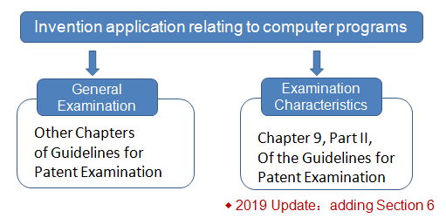
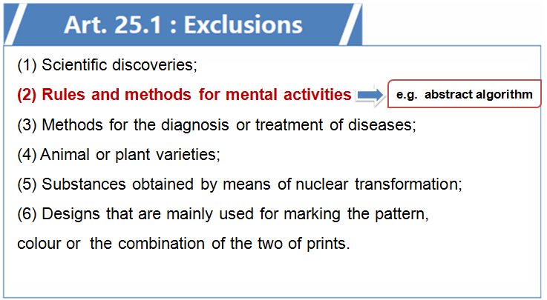
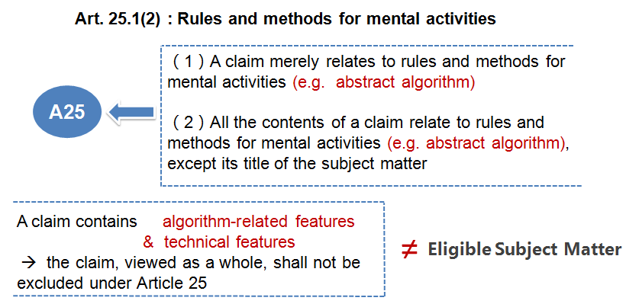
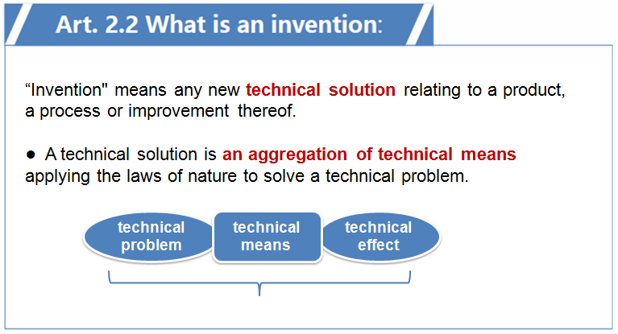
Examination Criteria and Principles

Slide 4

Examination Criteria and Principles
For example, if each step refer to an algorithm involved in a claim is closely related to the technical problem to be solved, for example, the data processed by the algorithm is the data with exact technical meanings in a technical field, and the execution of the algorithm can directly reflect the process of solving a technical problem by applying the laws of nature and obtain technical effects, the solution defined in the claim generally is the technical solution as provided for in Article 2.2 Chinese Patent Law.
applied algorithm
general algorithm
basic algorithm
image
text
video
audio
posture
gesture
motion path
...

Slide 5
Examination Practices & Examples
CASE 1
A method for establishing a mathematical model, which is characterized by comprising the following steps:
-- training the initial feature extraction model according to the feature values in the training samples of the first classification task and the feature values in the training samples of at least one second classification task to obtain the target feature extraction model; wherein the second classification task is other classification task related to the first classification task;
-- according to the target feature extraction model, processing the feature values in each training sample of the first classification task to obtain the extracted feature values corresponding to each training sample;
-- combining the extracted feature values and label values corresponding to each training sample to extracted training samples, and training the initial classification model to obtain the target classification model;
-- combining the target classification model and the target feature extraction model to form a mathematical model of the first classification task.
Abstract Algorithm → A25

Slide 6
Examination Practices & Examples
CASE 2
A method for mining a block comprising a block header, as a function of a selected hash function applied on the block header, the selected hash function comprising an expansion operation and a compression operation, the method comprising the steps of:
-- developing a plurality, m, of mid-states, each as a function of selectively varying a selected first portion of the block header;
-- performing the expansion operation on a selected second portion of the block header to produce a message schedule; and
-- for each of the m mid-states, performing the compression operation on the mid-state and the message schedule, to produce a respective one of m results.
Not Technical Solution

Slide 7
Examination Practices & Examples
CASE 3
A method for detecting a fall state of a humanoid robot based on multi-sensor information, characterized by comprising the following steps:
(1) Establish a hierarchical sensor information fusion model by fusing the posture sensor information, zero-moment point ZMP sensor information and robot walking stage information;
(2) Use the front and rear fuzzy decision-making system and the left-right fuzzy decision-making system to determine the stability of the robot in the front and rear directions and the left and right directions. The specificsteps are as follows:
-- Determine the walking stage of the robot according to the contactsituation between the supporting feet of the robot and the ground andoffline gait planning;
-- Using fuzzy inference algorithm to fuzzify the position information of ZMP points;
-- Using fuzzy inference algorithm to fuzzify the pitch angle or roll angle of the robot;
-- Determine the output membership function;
-- Determine fuzzy inference rules according to steps 1~step4.
Eligible Subject Matter

Slide 8
Examination Practices
Following the development of frontier technologies
Guidelines
Guiding Cases
Adjusting examination rules if necessary

Slide 9
China National Intellectual Property Administration
Thanks !

