Slide 1
From Creation to Caution: Data Risks of Generative AI and How to Deal with it
Marc Stampfli, September 2023
E-Mail: mstampfli@nvidia.com
Linkedin: https://www.linkedin.com/in/marcstampfli

Slide 2
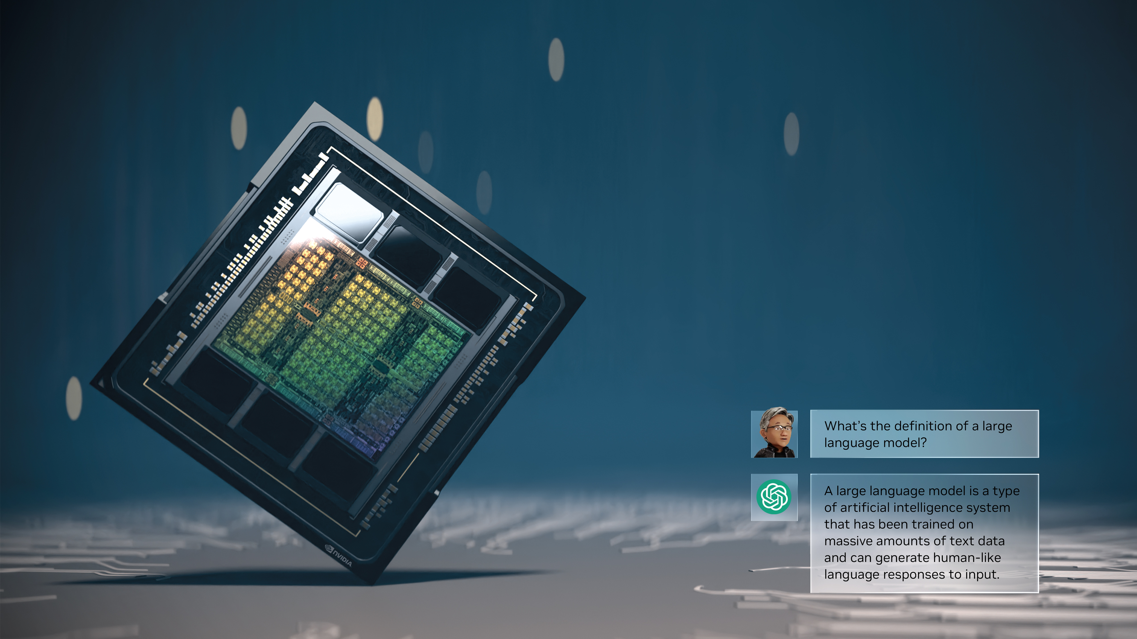
Sparking the iPhone Moment of AI
The acceleration of deep learning ignited
the big bang of AI. ChatGPT, a large language model powered by an NVIDIA DGX™ AI supercomputer, reached 100 million users in just two months. Its magical capabilities have captured the world’s imagination. Generative AI is a new computing platform, like the PC, internet, and mobile-cloud. Accelerated computing and AI have fully arrived.

Slide 3
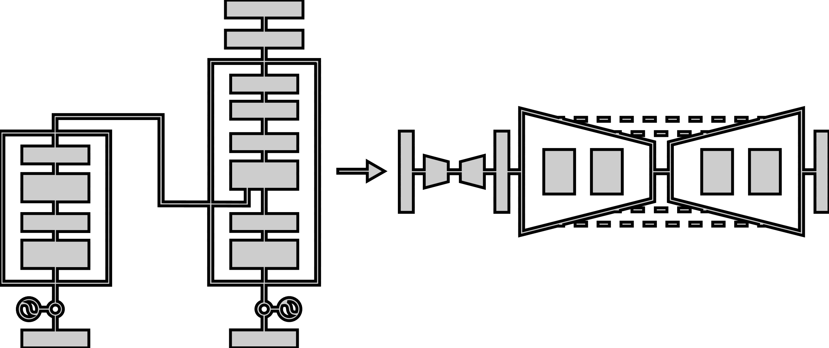
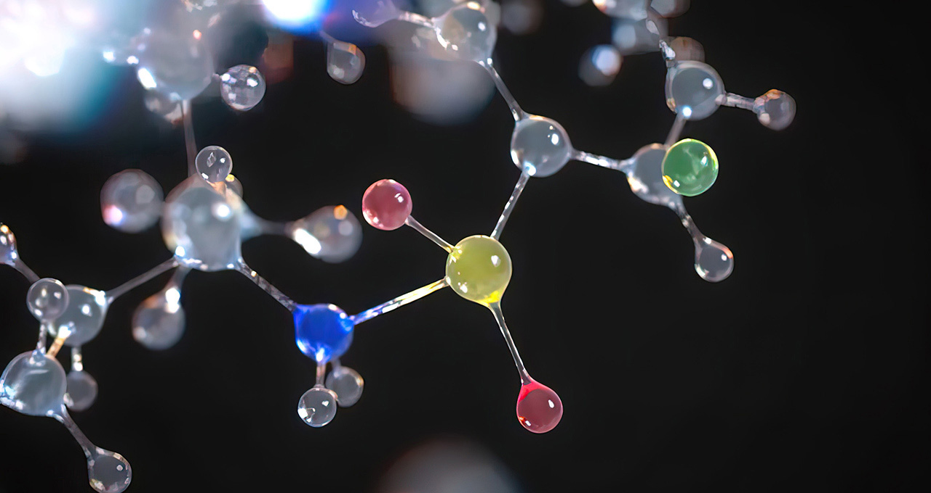
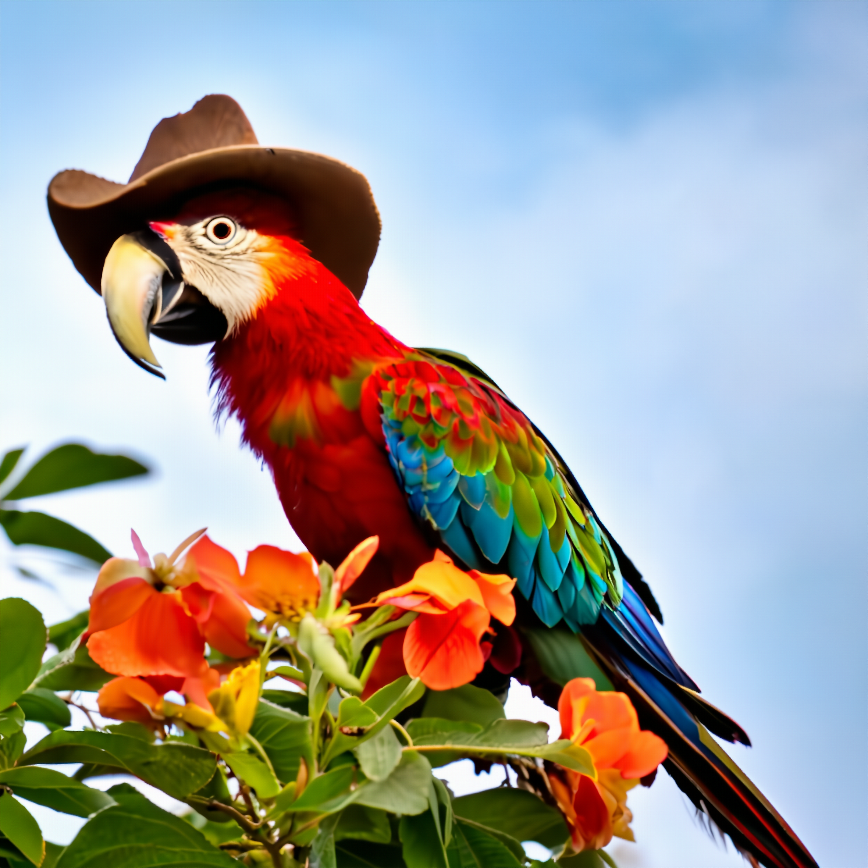
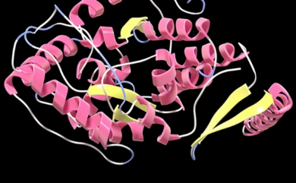
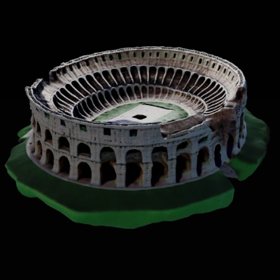
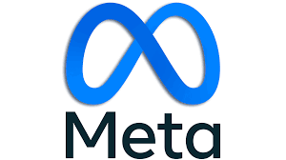
What’s the Hype!
Generative AI is here
Key Players
Generative AI Possibilities
ChatGPT
110 million users in 2 months
TEXT
ANIMATION
Reinvent search with Generative AI
Generative AI computing power & platform of the world
MOLECULE
AUDIO
IMAGE
PROTEIN
3D
DNA
Business group focused on Generative AI
VIDEO
VIDEO
Enterprises
&
Startups
Generative AI changing the main products
DNA
3D
PROTEIN
Language is more than text
e.g. Genome, Molecule, Music Notes, Computer Code
IMAGE
1600+
MOLECULE
AUDIO
ANIMATION
TEXT
Generative AI is Having a Moment!
Captivating World’s Attention | Happening Fast | Solving Problems in a Way Never Done Before

Slide 4
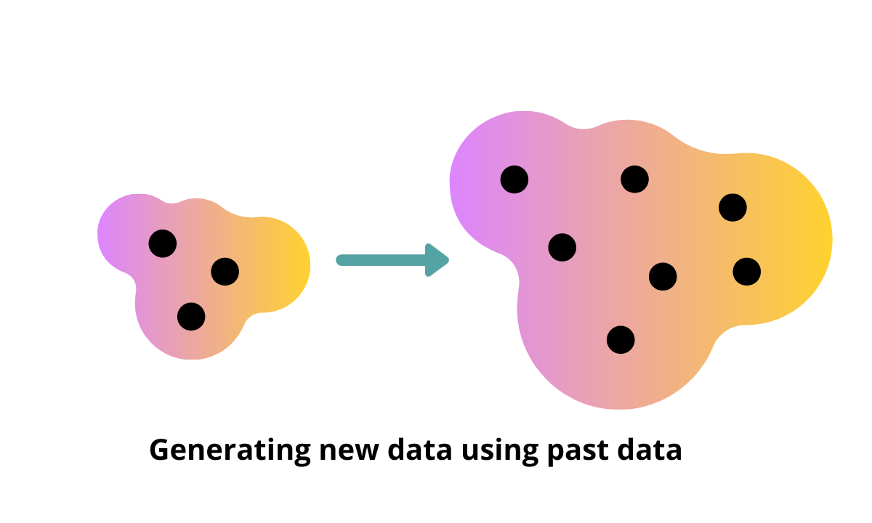
What is Generative AI?
Generation of new content
Generative AI refers to machine learning algorithms that enable computers to use existing or past content like text, audio and video files, images, and even code to generate new possible content.
The main idea is to generate completely original artifacts that would look like the real deal.
Original, Augmented or Artificial?

Slide 5
Generative AI Risks
Challenges/Limitations of Generative AI
Data Privacy
&
Security
IP Rights
&
Copyright
Biases,
Errors,
&
Limitations
Ethical
Implication
Malevolent
Activities

Slide 6
How Enterprises are Using Generative AI and implication to proprietary data and how to deal
Gen AI as a Service – p-tuning.inference
Fine-tuning/customization –
Custom/building models from scratch -
Less Customization
Using Generative AI as a Service - ChatGPT, Google Bard, Amazon Bedrock, Midjourney etc. - Existing Services
- Consumption model, $ per inference
- Fastest time to market
- Mostly external public data
Moderate Customization
Fine tuning of pre-trained model
- $M+ for infrastructure and resources
- Weeks to months for development - Adding internal data to external data
# of Adopters, Time to Market
Extensive Customization or own Model
Custom foundation models or extensive finetuning
- $10M+ for infrastructure and resources
- 6+ months for development - Mainly own data
Higher Risk
Generative AI Customization
Less Risk

