Slide 1
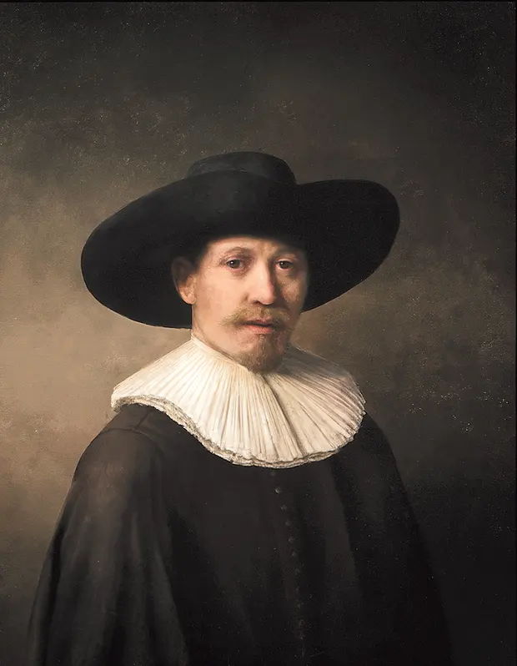
Generative AI: Navigating EU Copyright Law Challenges
Exploring the Intersection of Text and Data Mining Exceptions, Generative AI, and EU Copyright
Kristina Christensen

Slide 2
Generative AI and EU copyright
Text and Data Mining (TDM) – ‘automated computational analysis of large amounts of digital information to identify patterns, trends and correlations’
Extraction of value form data with TDM to generate valuable dataset for training of generative AI
Low threshold for originality – ’11 consecutive words’, C-5/08 Infopaq
Mandatory exception in article 5 (1) InfoSoc Directive with cumulative condition; ‘transient or incidental’, ‘lawful use of a work’ and ‘no independent economic significance’
1
2
3

Slide 3
National implementations
Directive need to be transposed into national law within 2 years and have no direct effect
Transposition of the non-mandatory research exception under article 5(3)(a) InfoSoc Directive:
Text and Data Mining for non-commercial research: Section 29A Copyright, Designs and Patents Act 1998
Text and Data Mining for public research purposes: Article L122-5, 10° Code de la Propriété Intellectuelle
Text and Data Mining for scientific research: Section 60d Urheberrechtsgesetz
1
2
3
4

Slide 4
1
Text and Data Mining exceptions
Divergent national implementations results in patchwork approach in EU
Introduction of mandatory TDM exceptions in articles 3 & 4 Digital Single Market Directive
Article 3 – scientific research by research organizations and cultural heritage institutions with lawful access to works
Article 4 – general exception for lawfully accessed works, unless copyright owner ‘opt-out’ (reserves its exclusive right)
Lawful access – real challenge for generative AI, due to huge training datasets needed
2
3
4
5

Slide 5
Generative AI and AI Act
Increased inquire for transparency in order to make use of the ‘opt-out’ mechanism
New requirement introduced in the proposal – ‘make available summaries of the copyrighted material that was used to train their systems’
Difficulties for generative AI, because of the (1) Low threshold for originality
(2) Diverging national copyright law
(3) Lack of registration requirement within the EU copyright law
Different formulation or interpretation would provide a more balanced approach for generative AI and copyright law
2
3
4
5

Slide 6
Ways to balance it out
Practical solutions to consider:
Creative Commons (CC) licensing
Use of public domain works, which are not copyright protected
Data augmentation on public works to enlarge training datasets
Creation of a database with no possibility of copyright infringement
Risk Management Integration into organization’s governance structure
Training and awareness, both generative AI developers and copyright owners
3
4
5

Slide 7
Thank you!

