Slide 1
ACCESS TO TRAINING DATA: EXPLORING TEXT AND DATA MINING (TDM) EXCEPTIONS, FAIR USE AND MORAL RIGHTS
Prof. Dr Ida Madieha bt Abd Ghani Azmi
Ahmad Ibrahim Kulliyyah of Laws
International Islamic University Malaysia

Slide 2
OUTLINE
Digital divide, legislative divide and jurisprudential divide?
Fair dealing and fair use jurisprudence
Way forward
ACCESS TO TRAINING DATA: EXPLORING TEXT AND DATA MINING (TDM) EXCEPTIONS, FAIR USE AND MORAL RIGHTS

Slide 3
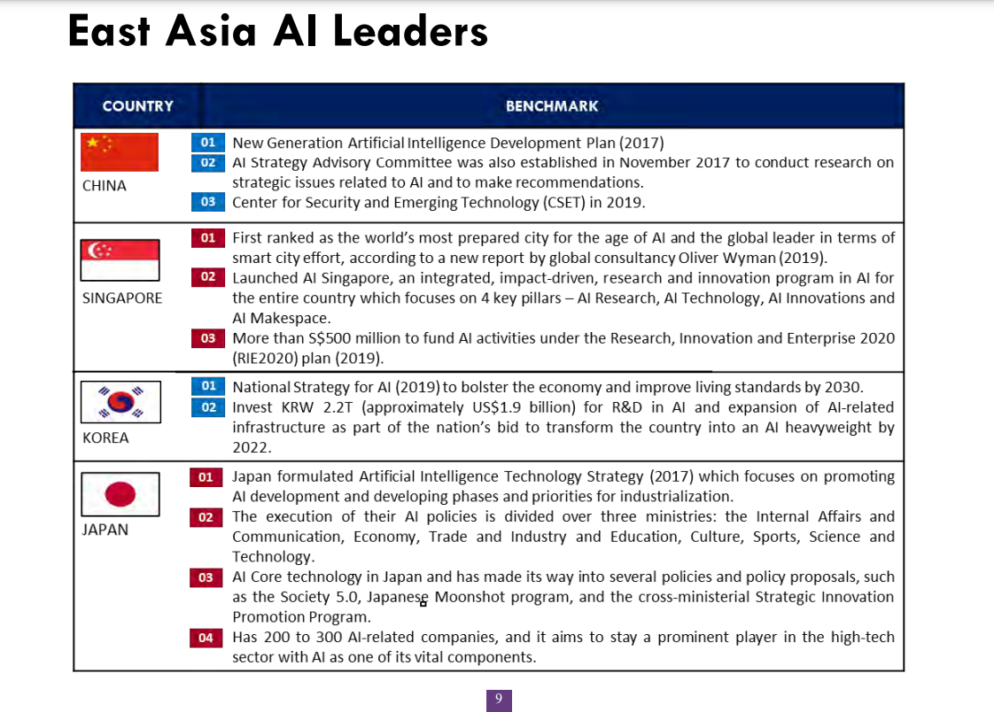
The race in AI deployment
ACCESS TO TRAINING DATA: EXPLORING TEXT AND DATA MINING (TDM) EXCEPTIONS, FAIR USE AND MORAL RIGHTS

Slide 4
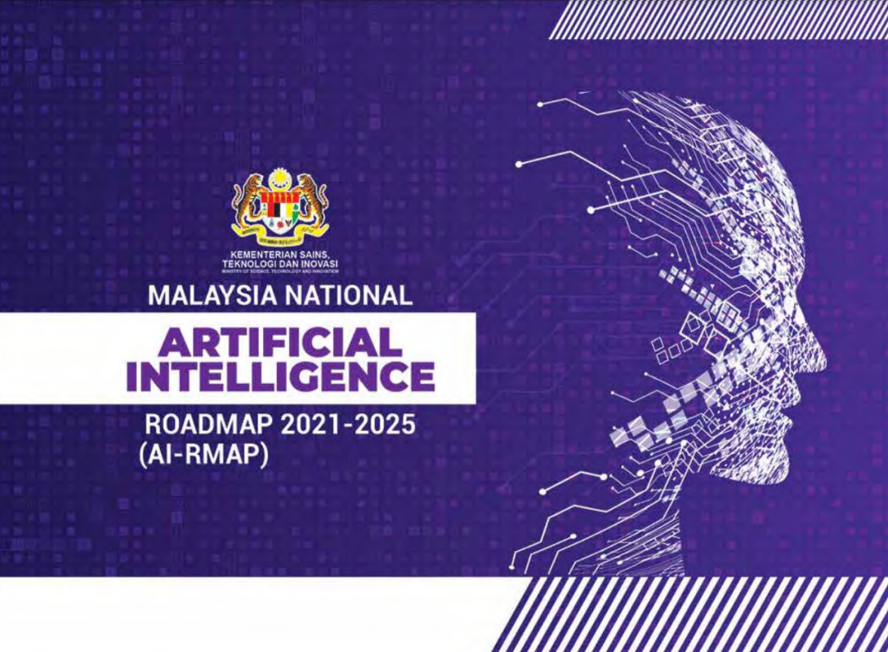
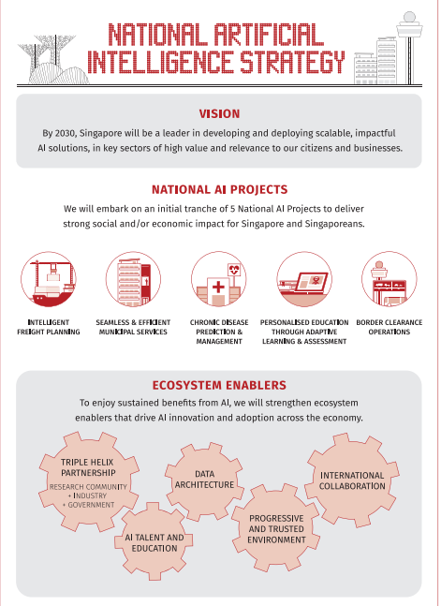
National policies on AI
ACCESS TO TRAINING DATA: EXPLORING TEXT AND DATA MINING (TDM) EXCEPTIONS, FAIR USE AND MORAL RIGHTS

Slide 5
India | Fair dealing? Blackwood AIR 1959 Mad 410.; SK (substantial copying would negate fairness) Dutt v Law Book Co and Ors AIR 1954 All 570 Para 45 (quotation – whether substantial taking)
China | Draft Regulation for Generative Artificial Intelligence Services
Indonesia | Art 43: Acts not considered as infringement: (d) The production and distribution of the Copyrighted content through information technology and communication media that are not commercial and/or lucrative for the Author or related parties, or the Author expresses no objection to the manufacture and dissemination in question Art 44 Use, retrieval, reproduction and/or change of Works and/or Related Rights products in whole or substantial part are not regarded as a copyright infringement if the source is mentioned or cited in full for the purpose of: (a) education, research, scientific writing, report writing, writing of critique or review of a problem without prejudicing the reasonable interests of the Author of the Copyright Holder.
Philippines | Fair use …criticism, comment, news reporting, teaching including limited number of copies for classroom use, scholarship, research and similar purposes..
South Korea | Forthcoming legislative proposal?
Malaysia | S 13(2)(i)(ii) and (2A) Mediabanc [2010] forthcoming law on AI?
Singapore | S 243 &244 – make a copy or a work or a recording of a protected performance for the purpose of computational data analysis
Japan | Allows all for exploitation of work in a text-data mining for the purpose of extraction, comparison, classification, or other analysis of language, sound, or image data, or other elements of which a large number of works or a large volume of data is composed…) Under this provision, TDM is permissible even for commercial purpose. The sharing of such data is permissible even if for non-computational purposes. There is no provision allowing reservation (opt out) of right-holders making the range of datasets available for use on a broad basis. One important limitation set is that the exploitation is not for enjoying the ideas or emotions expressed in such work, would not unreasonably prejudice the interests of the copyright owner.
TDM Exceptions (Asia)

Slide 6
Fair Dealing
Lord Denning in Hubbard v Vosper:
“It is impossible to define what is “fair dealing”. It must be a question of degree. You must first consider the number and extent of the quotations and extracts. Are they altogether too many and too long to be fair? Then you must consider the use of made of them. If they are used as a basis for comment, criticism or review, that may be fair dealing. If they are used to convey the same information as the author, for a rival purpose, that may be unfair.
Next, you must consider the proportions. To take long extracts and attach short comments may be unfair. But abstracts and long comments may be fair. Other considerations may come to mind also. But, after all is said and done, it must be a matter of impression.”
Fairness is a question of degree and impression.
ACCESS TO TRAINING DATA: EXPLORING TEXT AND DATA MINING (TDM) EXCEPTIONS, FAIR USE AND MORAL RIGHTS

Slide 7
Carve out new exception?
Fair dealing and fair use – ex post and not ex ante; determination by court
Fair dealing and fair use – broad guidelines but does not give clear and detailed guidance to users
If do not fit the fair dealing nor the fair use exception – then perhaps carve out new exception
Need to comply with Berne 3 step test?
ACCESS TO TRAINING DATA: EXPLORING TEXT AND DATA MINING (TDM) EXCEPTIONS, FAIR USE AND MORAL RIGHTS

Slide 8
Endgame?
The creation of useful products for humans
Will it deprive the creation of better AI apps without access to copyright material?
Only to train the AI but not to create materials using copyright work – transformative use but if the outcome is to compete or ride over the author’s interest
The limitations and exceptions cannot be overridden by a contract
ACCESS TO TRAINING DATA: EXPLORING TEXT AND DATA MINING (TDM) EXCEPTIONS, FAIR USE AND MORAL RIGHTS

Slide 9
WAY FORWARD?
Statutory licence
Compulsory licence
Mandatory collective management
Compromise between authors and users – use does not unduly harm authors’ interests and is bound to appropriate remuneration to users.
Market failure consideration: difficulties emerging from the advancement of technology and the effect on the financial interests of the authors.
Use without authorization
Art 11 bis. (2) and Art 13 of the Berne Convention concerning the broadcasting of literary and artistic works as well as the recording of musical works.
Eg s 118 of the US Copyright Act (Title 17 of the USC – contains a compulsory licence for the use of published nondramatic musical works and published pictorial, graphic and sculptural works in connection with non-commercial broadcasting
Terms and rates for the CL – can be privately negotiated licences
Does not provide for limitations on authors’ rights but forces authors and right holders to exercise economic rights in a certain predetermined way.
Appropriate remuneration in these circumstances is fixed in so called bulk licence agreements that are negotiated among collecting societies and user organisations.
ACCESS TO TRAINING DATA: EXPLORING TEXT AND DATA MINING (TDM) EXCEPTIONS, FAIR USE AND MORAL RIGHTS

Slide 10
Thank you.
Any inquiries could be made to
imadieha@iium.edu.my
ACCESS TO TRAINING DATA: EXPLORING TEXT AND DATA MINING (TDM) EXCEPTIONS, FAIR USE AND MORAL RIGHTS

