Slide 1
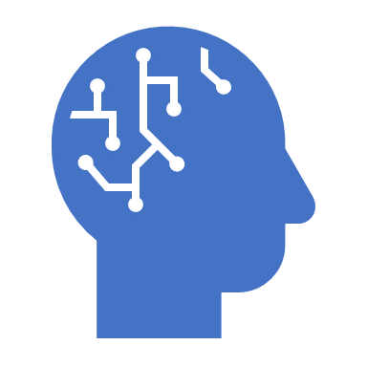
Using copyrighted materials to train AI
Dr. Lital Helman
Ministry of Justice, Israel

Slide 3
The problem
Good AI requires massive datasets
GIGO
Massive datasets implies using materials others produced
Others’ materials are typically copyrighted
Where is the balance point between copyright and AI?

Slide 4
How can creating a dataset be infringing?
Copying
Derivative work
Moral right? Credit?

Slide 5
Potential exceptions under Israeli Law
Fair use
Incidental copies
Temporary copying

Slide 6
Fair use
First prong – purpose of use
Second prong – 4 factors:
1. The purpose and character of the use
2. The nature of the copyrighted work
3. The amount and substantiality of the portion taken
4. The effect of the use upon the potential market

Slide 7
Conclusion
In most cases, creating the dataset will be PERMITTED
SOMETIMES not. We can define some of those cases
SOMETIMES you can share your dataset with others
Terms of use of third-party websites CANNOT impede right

Slide 8
rather than statute?
Why opinion

Slide 9
Around the world…

Slide 10
Thank you! litalhe@justice.gov.il

