Slide 1
Generative AI Discovery Sprints by IP Australia
21 September 2023
IPAVentures

Slide 2
Gen AI: an opportunity or a threat?

Slide 3
What we did
6 intensive sprints
40+ Interviews
9 Workshops
204 businesses surveyed
14 Blogs
Set of provocations
9 co-designed experiments
10 custom chatbots
Notes:
Whistle stop tour

Slide 4
High level observations
Generative AI is a step-change over previous forms of AI. It changes the context for the IP system.
Gen AI lowers the barriers to entry to the IP system, which will change how the system needs to work. By virtue of more actors in the system, it will be a different system.
As a likely general purpose technology, generative AI will clearly affect and be relevant to every aspect of our business.
This is the beginning of the story, rather than the end. The existing limitations of generative AI should not be taken as inherent.
The responsible use of generative AI will likely be dependent more on individual and collective capability and maturity than specific controls. Norms will need to evolve quickly.
The impacts on the business will continue and evolve over time, rather than being a one-time transformation.

Slide 5
Provocations
For each of the rights we explored the possible ramifications and implications of generative AI through a series of provocations or scenario pieces that sought to bring the issues to life.
These are available at https://www.ipaustralia.gov.au/temp/Generative-AI-and-the-IP-System.html

Slide 6
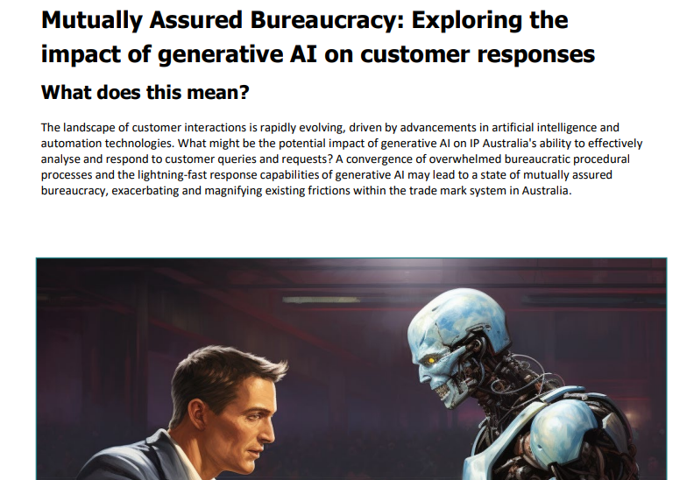

Slide 7
Paradigm shift #1
Humans have always used their tools to create new tools – what might it mean when these new tools create the outputs instead?
Humans have always used tools to create and invent – paintbrushes, machines and computers.
These have been considered an extension of the human rather than separate or independent.
These new generative AI tools challenge this tradition.
The tools themselves can now create, and are likely to get better at it, if only because the guardrails to help them do so are improving at a rapid rate – i.e. helping them identify the whitespace, giving them constraints, etc.
This challenges the precepts of the IP system. Who and what are we incentivising and why?
The tool is moving to the fore – we are moving from inventing with tools, to tools inventing.

Slide 8
Paradigm shift #2
The IP system is based on a scarcity perspective – what might it look like through one of abundance?
The current IP system incentivizes innovation in return for disclosing it.
Innovation = implementing novel to context and impact.
It presupposes that novelty is a scarce quality that will not happen to the socially and economically beneficial level without intervention.
A generative AI world intimates a world where novelty may no longer be the limiting factor.
While it may take time, the directionality of generative AI is that it will be able to make a significant impact, if only by identifying white space and dramatically accelerating the diffusion of, and access to, existing IP.
What might a system suited for abundance need to look like?
The core reality of the IP system may be transforming and flipping – from scarcity to abundance.

Slide 9
Revisiting our purpose
These two shifts raise big questions about what IP Australia’s purpose is.
Ensuring Australians benefit from great ideas
If novel ideas become less scarce and are more easily and quickly diffused because of generative AI, what does our role look like?
If the risk reward relationship for creation is substantially altered by generative AI, what economic rents should government be granting?
IP Australia will need to continue to explore how it can be fit for purpose and its purpose fit for the context.

Slide 10
Thank you

