Slide 1

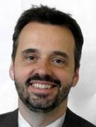


Seminar on WIPO Services and Initiatives
Munich, Germany
July 01, 2014, and
Berlin, Germany
July 02, 2014

Slide 2

INTRODUCTION TO WIPO
Speaker: Mr. Christian Wichard, Deputy Director General, Global Issues Sector (GIS), WIPO
Notes:
Welcome ….
Today, we are going to explain to you, in very general terms,
what this Organization does and why?

Slide 3
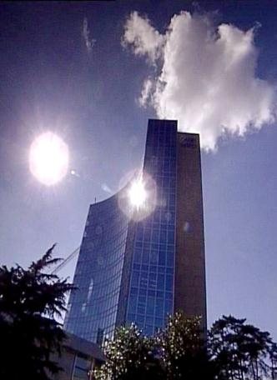
FACTS ABOUT WIPO
MISSION: Promote the protection of IP rights worldwide and extend the benefits of the international IP system to all member states.
MEMBER STATES: 186
OBSERVERS: + 390
STAFF: 950 FROM 101 COUNTRIES
ADMINISTERED TREATIES: 26
MAIN BODIES: GA, CC, WIPO CONFERENCE

Slide 4
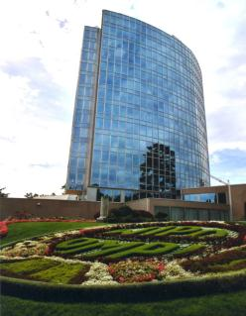
MILESTONES: 1883 - 2013
2013
MARRAKESH TREATY
2012
2006
BEIJING TREATY
2000
STLT
1996
PATENT LAW TREATY
INTERNET TREATIES
1989
MADRID PROTOCOL
1970
PCT ESTABLISHED
1967
1960
WIPO CONVENTION
1925
BIRPI MOVES TO GENEVA
1893
HAGUE AGREEMENT
1891
BIRPI
1886
1883
MADRID AGREEMENT
BERNE CONVENTION
PARIS CONVENTION

Slide 5
INTELLECTUAL PROPERTY OUTREACH
PUBLIC SECTOR & POLICY MAKERS
BUILDING AWARENESS
INTELLECTUAL PROPERTY OFFICES
GENERAL PUBLIC & CIVIL SOCIETY

Slide 6

Economic Development
Norm Setting
Services to Industry
Global Infrastructure

Slide 7
PROVIDER OF PREMIER
GLOBAL IP SERVICES
Core business areas:
  Patent Cooperation Treaty (Patents)
  Madrid System (Trademarks)
  Hague System (Industrial Designs)
  Lisbon System (Geographical Indications)
  WIPO Arbitration and Mediation Center
Notes:
Patent law differs from country to country. It can be a costly, complex and lengthy process to obtain patent protection in multiple countries. WIPO’s global protection services offer a swift, reliable cost-effective and user-friendly option. Principle objective of PCT is operational excellence and provision of high quality services to benefit users of patent system, patent administrations and general public by streamlining the filing and processing of patent applications in multiple countries (through reduced duplication of work of national filing and processing) to make the grant of patents more economical (ie less diversion of public resources for patent admin.)
Emphasis on ensuing PCT beneficiaries receive adequate knowledge of system and that the system responds satisfactorily to their needs.
TRADEMARKS: In constantly changing business environment, TMs, etc. are important tools for promotion of domestic commerce and int’l. trade which, in turn, contribute to sustainable national economic growth. Indispensable in designing marketing strategies to identify and promote goods in market place and distinguish these goods from those of competitors. To be effective, need adequate legal protection at national & int’l. levels. WIPO’s registration systems facilitate the acquisition and maintenance of these IPRs in different countries
A company in Morocco requesting TMP in 12 countries - application in 3 classes would pay over 6.5 times more if it didn't use MS but opted to apply to each national office separately -Madrid = 2,162 CHF; vs. 14,245 CHF using national route). Renewal of same app. = 5+ times cheaper and cost of registering a change in ownership is 20+ times cheaper, costing 177 Swiss francs as opposed to 3,697 Swiss francs under the national route.

Slide 8
BUDGET 2014 – 2015: CHF 713.3 MILLION
Notes:
Why are you important to us?

Slide 9

Photo: Thomas Hawk / Flickr
Notes:
“Just as participation in the physical economy requires access to roads, bridges, and vehicles to transport goods,
similar infrastructure is needed in the virtual and knowledge economy.
However, here
the highway is the Internet and other networks,
the bridges are interoperable data standards,
and the vehicles are computers and databases.”

Slide 10
GLOBAL IP INFRASTRUCTURE
  Databases
  Common platform for e-data exchange among IPOs
  Other platforms
  Tools
  Standards & technical agreements
  Services
  Capacity building & networking by Technology Innovation Support Centers (TISCs)
Notes:
Databases: PATENTSCOPE, Global Brand DB & access to aRDI and ASPI
Common platform: WIPO Case for Global Dossier, the Digital Access Service
Other platforms: WIPO Green; WIPO Research.
Tools: international classifications in TMs/design; IPC, Green inventory, Nice classification
Services: International Cooperation for Patent Examination (ICE), Patent Information Services, including Legal Status of Patents

Slide 11
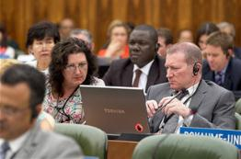

NORM SETTING
Development of international IP law that is:
  balanced
  responsive
  effective
  flexible

Slide 12
STANDING COMMITTEES
PATENTS (SCP)
COPYRIGHT & RELATED RIGHTS (SCCR)
TRADEMARKS, DESIGNS & GEOGRAPHICAL INDICATIONS (SCT)
  AIM:
      Build consensus on topical issues
      Consider interests of stakeholders for a balanced, efficient, user-friendly, cost-effective system
      N.B. Enforcement issues are discussed in the Advisory Committee on Enforcement
Notes:
PATENTS: (patent quality, E&Ls, patents & health, client-patent adviser privilege, tech transfer)
COPYRIGHT & RELATED RIGHTS: (AV performances- E&Ls VIPs/libraries/archives, broadcasting)
TRADEMARKS: (Design Law Treaty/protection of country names against registration and use as TMs)
WIPO’s work in this area is designed to reduce complexity, cost and time involved in obtaining patent protection in multiple countries and to address workload crisis facing many office because of rising number of patent applications, changing nature of applications (biotech) and duplication of work. Various activities support this endeavor, namely:
- Substantive and procedural harmonization of patent law.
- Development and adoption of reforms of PCT System.
PCT Reform: began in Oct. 2000. General objectives to simplify the system, streamline procedures, reduce costs for applicants, maintains quality of services to facilitate greater use, ensure system works to advantage of all offices irrespective of size.

Slide 13
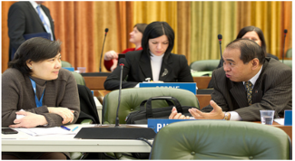
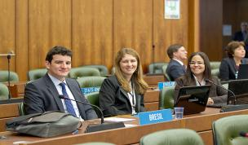
STANDING COMMITTEE ON LAW OF PATENTS
Established in 1998
Member States’ Committee
IGOs and NGOs are observers
Facilitate coordination and provide guidance on development of international patent law

Slide 14
THE STANDING COMMITTEE ON LAW OF PATENTS
The last SCP took place from the 27th to the 31st of January 2014:
Quality of patents: the secretariat will prepare a compilation of work-sharing programs among patent offices and use of external information for search and examination
A document compiling laws and practices on confidentiality of communications between clients and their patent advisors
The Secretariat will prepare a document on how 5 different exceptions/limitations are implemented by member states and a half day seminar will also be organized on the above. A sharing session on countries’ use of health-related patent flexibilities will also be organized
The Secretariat will revise the existing document on transfer of technology by adding practical examples and experiences regarding patent-related incentives and impediments
Notes:
private and/or non-commercial use; experimental
use and/or scientific research; preparation of medicines; prior use; use of
articles on foreign vessels, aircrafts and land vehicles. The document should
also cover practical challenges encountered by Member States in
implementing them.

Slide 15
WORK OF THE SCT
Member States are working to protect country names against registration or use of trademarks
This work relates to the overlap between private trademark rights and the interests of States to control the use and appropriation of their names

Slide 16
NEXT SCT SESSION (JUNE 2014)
Decision on technical assistance and capacity building.
  Some Member States prefer a Treaty Article
  Some Member States prefer to convene a diplomatic conference without agreement for such an article

Slide 17
BEYOND THE SCT
GA September 2013 decided to convene a diplomatic conference for the adoption of a revised Lisbon Agreement on Appellations or Origins and Geographical Indications in 2015

Slide 18
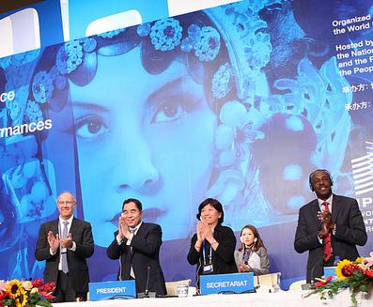
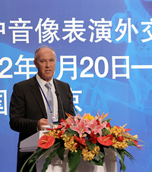
BEIJING TREATY ON AUDIOVISUAL PERFORMANCES, 26 JUNE 2012

Slide 19


BEIJING TREATY
Adopted on June 2012
Strengthen the position of performers, giving them moral and economic rights for the international use of their performances
Parties will pay for the use of foreign audiovisual performances. Some or all of this money will go to performers
“The conclusion of the Beijing Treaty is an important milestone toward closing the gap in the international rights system for audiovisual performers”
- WIPO Director General, Francis Gurry
Notes:
The treaty will enter into force upon 30 ratifications.

Slide 20
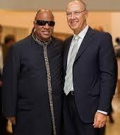
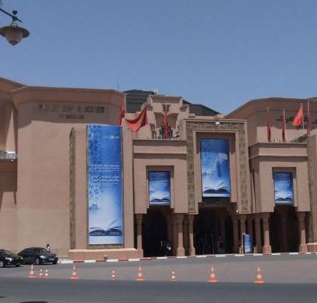
MARRAKESH TREATY TO FACILITATE ACCESS TO PUBLISHED WORKS FOR PERSONS WHO ARE BLIND, VISUALLY IMPAIRED OR OTHERWISE PRINT DISABLED
Notes:
The Diplomatic Conference took place in Marrakesh from June 18 to 28, 2013 (600 negotiators from WIPO’s 186 member states).

Slide 21

MARRAKESH TREATY
314 million blind and visually impaired persons
90% live in developing countries
Only 5% of books published are available in braille or other accessible formats
Requires parties to adopt limitations for the benefit the people who are blind, visually impaired, and print disabled
Provides for exchange of accessible format works across borders

Slide 22
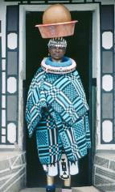
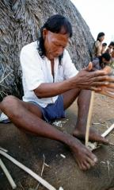
INTELLECTUAL PROPERTY AND TRADITIONAL
KNOWLEDGE, ACCESS TO GENETIC RESOURCES AND FOLKORE
Objective: Agree on international legal instruments that protect traditional knowledge (TK), traditional cultural expressions (TCEs) and genetics resources (GRs).
Draft articles on TK and TCEs and a Consolidated Document Related to IP and GRs have been prepared.
  KEY ISSUES TO BE NEGOCIATED
  Objectives
  Definitions of TK/TCEs
  Options on protection
  Scope
  Beneficiaries
  Duration
Notes:
Created in 2000

Slide 23

MAJOR ECONOMIC STUDIES ON IP
A NEW WIPO UNIT – THE ECONOMICS AND STATISTICS DIVISION- REFLECTS THE GROWING CONSENSUS ON THE IMPORTANCE OF THE ECONOMIC DIMENSION OF IP.
THE DIVISION APPLIES STATISTIC AND ECONOMIC ANALYSIS TO THE USE OF WIPO SERVICES.
THIS NEW STRUCTURE ALSO IMPROVES WIPO ECONOMIC INSIGHT ON IP DEVELOPMENT.

Slide 24
STRATEGIC REALIGNMENT WITHIN WIPO
Economics and Statistics Division
WIPO Chief Economist
IP Statistics
Section
Data Development
Section
Economics
Section

Slide 25
DEMAND FOR IP RIGHTS HAS GROWN
Source: WIPO Statistics Database, October 2011

Slide 26
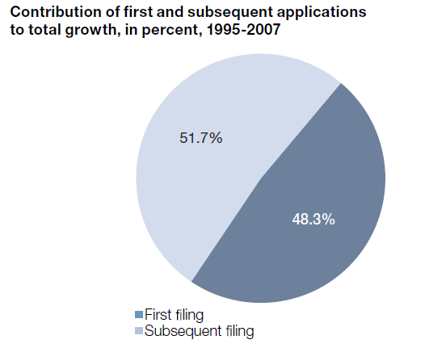
MORE INVENTIONS AND GREATER INTERNATIONALIZATION
Source: WIPO (2011)

Slide 27
STUDIES AND REPORTS
World Intellectual Property Indicators (WIPI): This is our flagship IP statistics publication. It provides an overview of latest trend in IP filings and registrations covering more than 100 offices : http://www.wipo.int/ipstats/en/wipi/index.html
The PCT Yearly Review provides an overview of the performance and development of the PCT system. It includes a comprehensive set of statistics for the latest available year See: http://www.wipo.int/ipstats/en/statistics/pct/
Madrid Yearly Review: http://www.wipo.int/ipstats/en/
Hague Yearly Review: http://www.wipo.int/ipstats/en/
The WIPO IP Facts and Figures provides an overview of intellectual property (IP) activity based on the latest available year of statistics. It serves as a quick reference guide for statistics: http://www.wipo.int/ipstats/en/
WIPO IP Statistics Data Center is an on-line service enabling access to WIPO’s statistical data. Users can select from a wide range of indicators and view or download data according to their needs: http://ipstatsdb.wipo.org/ipstatv2/ipstats/patentsSearch

Slide 28

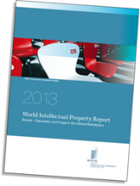
STUDIES AND REPORTS
II
New report « Brands – Reputation and Image in the Global Marketplace»
The report looks at how branding behavior and trademark use have evolved in recent history, how they differ across countries, what is behind markets for brands, what lessons economic research holds for trademark policy and how branding strategies influence companies’ innovation activities
For further information and the full report :
http://www.wipo.int/econ_stat/en/economics/wipr

Slide 29
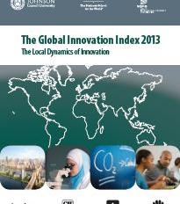
THE GLOBAL INNOVATION INDEX 2013
Annual publication that provides the latest trends in innovation activities across the world. It is co-published by INSEAD, Cornell Univ. and WIPO http://www.wipo.int/econ_stat/en/economics/gii/index.html
Its results are useful:
  To benchmark countries against their peers
  To study countries profiles over time
  Identify countries strengths and weaknesses

Slide 30
THE GLOBAL INNOVATION INDEX 2013
The framework is revised and adjusted every year in a transparent exercise
This year, out of 84 indicators, 64 are identical to GII 2012, and a total of 20 indicators were modified
10 indicators were deleted/replaced
10 indicators underwent changes such as the computation methodology at the source, change of scaling factor, change of classification etc.
The year per year comparison has to be carefully taken into consideration

Slide 31
GLOBAL INNOVATION INDEX FRAMEWORK
OUTPUT SUB INDEX
INPUT SUB INDEX
SCIENTIFIC OUTPUT
CREATIVE OUTPUT
HUMAN CAPITAL AND RESEARCH
INFRASTRUCTURE
MARKET SOPHISTICATION
BUSINESS SOPHISTICATION

Slide 32

GERMANY PROFILE
PHOTO AND CREDIT NEEDED

Slide 33
THE GLOBAL INNOVATION INDEX
RANKING 2012
RANKING 2013
1. SWITZERLAND
2. SWEDEN
3. SINGAPORE
4. FINLAND
5. UNITED KINGDOM
6. NETHERLANDS
7. DENMARK
8. HONG KONG (CHINA)
9. IRELAND
10. UNITED STATES OF AMERICA
11. LUXEMBOURG
12. CANADA
13. NEW ZEALAND
14. NORWAY
15. GERMANY
1. SWITZERLAND
2. SWEDEN
3. UNITED KINGDOM
4. NETHERLANDS
5. UNITED STATES OF AMERICA
6. FINLAND
7. HONG KONG (CHINA)
8. SINGAPORE
9. DENMARK
10. IRELAND
11. CANADA
12. LUXEMBOURG
13. ICELAND
14. ISRAEL
15. GERMANY

Slide 34
GERMANY PROFILE
  Germany is ranked 15th in the Global Innovation Index
  Germany ranks higher in the output sub-index category (10th) than the input sub-index category (20th) due principally to strong Knowledge & technology outputs, which rank 10th out of the 142 countries. Here, Germany has especially strong outputs in Knowledge creation (6th). Germany also scores strongly in areas of Creative outputs, in particular Online creativity (12th)
  Within the input sub-index, Germany scores highest under Infrastructure (14th), and in particular Information and Communication Technologies (ICTs) (7th). Germany also scores highly in areas of Human capital & research, being ranked 12th in Research and Development (R&D), and Institutions, being ranked 16th in Political environment
  Germany’s relative weaknesses are drawn primarily from Business sophistication, where Germany is ranked 26 overall; including Knowledge absorption (37th) and Knowledge workers (32nd)

Slide 35
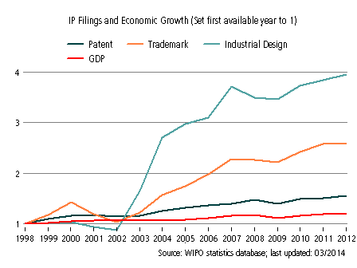
Germany’s evolution with respect to IP filings and
Economic Growth from 1998 to 2012
Filings for industrial designs and trademarks have increased strongly since 2000 despite slow-downs in the periods 2001-2002 and 2008-2009. In 2012 there were 116,405 industrial designs filings and 667,596 trademark filings (including resident, abroad and regional filings)
Filings for patent have grown more steadily since 2000. In 2012 there were 181,959 patent filings (including resident, abroad and regional filings)
Overall, GDP figures appear to show that filings of each of patents, trademarks and industrial designs are sensitive to fluctuations in GDP as is demonstrated by falls in filing numbers in 2009.
Notes:
GDP : GROSS DOMESTIC PRODUCT

Slide 36
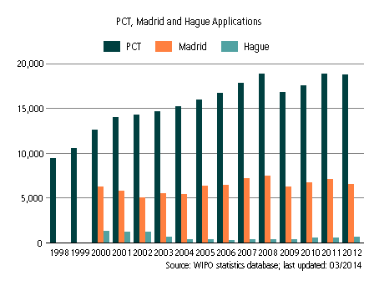
INTERNATIONAL APPLICATIONS
VIA WIPO ADMINISTERED TREATIES

Slide 37
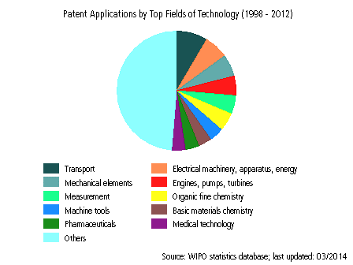
PATENT APPLICATIONS (1998-2012)

Slide 38
THANK YOU!
Mr. Christian Wichard
Deputy Director General , Global Issues Sector (GIS)
World Intellectual Property Organization (WIPO)
34 chemin des Colombettes, 1211 Geneva 20, Switzerland
JohannesChristian.Wichard@wipo.int;
Notes:
Welcome ….
Today, we are going to explain to you, in very general terms,
what this Organization does and why?

Slide 39
Der Patentzusammenarbeitsvertrag (PCT)
Einführung und zukünftige Entwicklungen
Matthias Reischle, Stellvertretender Direktor der PCT-Rechtsabteilung, WIPO
Juli 2014

Slide 40

DAS TRADITIONELLE VERFAHREN
(Monate) 0
12
Auslandsanmeldungen
Nationale
Anmeldung
Nationale Anmeldung, gefolgt – innerhalb des Prioritätsjahres gemäß der Pariser Verbandsübereinkunft - von einer Vielzahl einzelner Auslandsanmeldungen:
    unterschiedliche Formvorschriften
    unterschiedliche Recherchen
    unterschiedliche Prüfungsverfahren und unterschiedliche Bearbeitung der Anmeldung
    Übersetzungen und nationale Gebühren bereits 12 Monate nach Einreichung der nationalen Anmeldung fällig
Zum Teil Rationalisierung durch regionale
Übereinkommen (ARIPO, EAPÜ, EPÜ, OAPI)

Slide 41
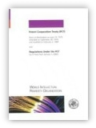
DER PCT – 1970
Grundidee: Vereinfachung des Verfahrens, um Patentschutz in mehreren Staaten zu erlangen, und es zugleich effezienter und wirtschaftlicher zu machen für:
  Benutzer des Patentsystems: Zurverfügungstellung eines Werkzeuges, um Patentanmelduungen im Ausland zu erleichtern; und
  Patentämter: Zurverfügungstellung eines Werkzeuges, das es Patentämtern, die es nutzen wollen, ermöglicht, auf der Arbeit anderer Patentämter aufzubauen und damit das Patenterteilungsverfahren effezienter zu gestalten

Slide 42
GRUNDZÜGE DES PCT
Nationale Anmeldung, gefolgt - innerhalb des Prioritätsjahres gemäß der Pariser Verbandsübereinkunft - von einer internationalen Anmeldung nach dem PCT, Eintritt in die “nationale Phase” nach Ablauf von 30 Monaten*:
  einheitliche Formvorschriften
  internationale Recherche
  internationale Veröffentlichung
  internationale vorläufige Prüfung
  Verbesserung der Anmeldung vor dem Eintritt in die nationale Phase
  Übersetzungen und nationale Gebühren erst 30 Monate* ab Prioritätsdatum fällig und nur, wenn der Anmelder entscheidet, die Anmeldung weiterzuverfolgen
* Für Ausnahmen, siehe http://www.wipo.int/pct/en/texts/reservations/res_incomp.html

Slide 43
GRUNDZÜGE DES PCT
Werkzeug zur Arbeitsteilung für Patentämter:
  Zentrale Prüfung der Formalitäten
  Zentrale internationale Veröffentlichung
  Internationaler Recherchenbericht (ISR)
  Internationaler vorläufiger Prüfungsbericht (vorläufiges, unverbindliches Gutachten bzgl. Neuheit, erfinderische Tätigkeit (Nichtoffensichtlichkeit) und gewerbliche Anwendbarkeit
    Kapitel I
    Kapitel II

Slide 44
VERGLEICH: PARISER VERBANDSÜRBEREINKUNFT/PCT
Anfallende Kosten:
- Übersetzungen
- Amtsgebühren
- Patentanwälte
Auslands-
anmeldungen
(Monate)
0
12
Anfallende Kosten:
- Übersetzungen
- Amtsgebühren
- Patentanwälte
Paris
Nationale
Anmeldung
Eintritt
nationale
Phase
(Monate)
Internationale
Veröffentlichung
PCT
0
12
16
18
22
28
30
Nationale
Anmeldung
PCT-
Anmeldung
Internationaler Recherchenbericht & schriftlicher
Bescheid
(wahlweise)
Einreichung eines
Antrags auf
internationale
vorläufige Prüfung
(wahlweise)
Internationaler vorläufiger Prüfungsbericht
(IPRP Kapitel II)

Slide 45
ALLGEMEINE ANMERKUNGEN
Das PCT-System ist ein Patent-“Anmelde”-System, kein Patent-“Erteilungs”-System; es gibt kein “PCT-Patent”
Das PCT-System ist gegliedert in eine
  internationale Phase, bestehend aus
    Einreichung der internationalen Anmeldung
    internationaler Recherche und schriftlichem Bescheid der ISA
    internationaler Veröffentlichung und
    internationaler vorläufiger Prüfung
  nationale/regionale Phase vor den Bestimmungsämtern
Die Entscheidung über die Erteilung eines Patents wird ausschließlich von den nationalen oder regionalen Ämtern in der nationalen Phase getroffen

Slide 46
DAS PCT – SYSTEM
Kapitel I
20
30
Eintritt
in die
Nationale
Phase
Internationale
Veröffentlichung
(Monate)
0
12
16
18
19
Nationale
Anmeldung
PCT
Anmeldung
Internationaler Recherchenbericht und schriftlicher
Bescheid
der ISA
SIS-Antrag
(ggf.)
oder wahlweise
Antrag nach Kapitel II
Internationale
vorläufige
Prüfung
30
Eintritt
in die
Nationale
Phase
Kapitel II

Slide 47
DIE INTERNATIONALE ANMELDUNG
Nur EINE Anmeldung, die standardmäßig die Bestimmung aller
Staaten für jede erhältliche Schutzrechtsart und die üblichen Prioritätsansprüche enthält
Die internationale Anmeldung hat in jedem Bestimmungsstaat die Wirkung einer vorschriftsmäßigen nationalen Anmeldung einschließlich der Feststellung eines Prioritätsdatums: das internationale Anmeldedatum gilt als Anmeldedatum in jedem Bestimmungsstaat
Einreichung in EINER Sprache
Einreichung bei EINEM Anmeldeamt
Einheitliche Formvorschriften
Aufschiebung der nationalen Phase bis 30 Monate ab Prioritätsdatum (für Ausnahmen, siehe www.wipo.int/pct/en/texts/reservations/res_incomp.pdf)

Slide 48
DAS PCT – SYSTEM
Kapitel I
20
30
Eintritt
in die
Nationale
Phase
Internationale
Veröffentlichung
(Monate)
0
12
16
18
19
Nationale
Anmeldung
PCT
Anmeldung
Internationaler Recherchenbericht und schriftlicher
Bescheid
der ISA
SIS-Antrag
(ggf.)
oder wahlweise
Antrag nach Kapitel II
Internationale
vorläufige
Prüfung
30
Eintritt
in die
Nationale
Phase
Kapitel II

Slide 49
PCT INTERNATIONALE RECHERCHENBEHÖRDEN
Die “ISAs” sind die folgenden 19 Patentämter:
  Ägypten
  Australien
  Brasilien
  Chile (Arbeit noch nicht aufgenommen)
  China
  Finland
  Indien
  Israel
  Japan
  Kanada
  Őstereich
  Republik Korea
  Russische Föderation
  Spanien
  Schweden
  Ukraine (Arbeit noch nicht aufgenommen)
  Vereinigte Staaten von America
  Europäisches Patentamt
  Nordisches Patentinstitut

Slide 50
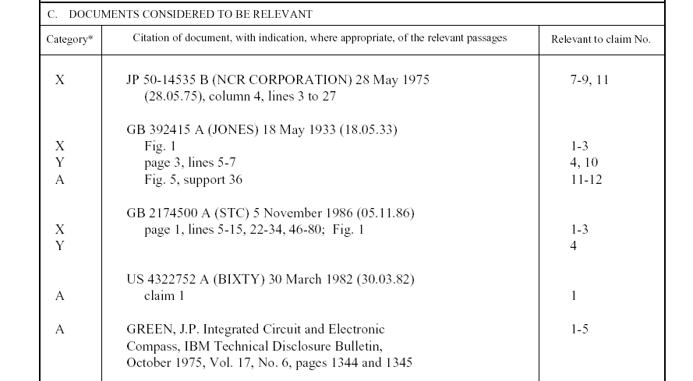
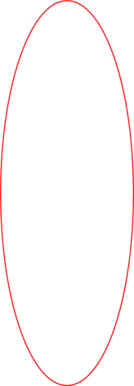
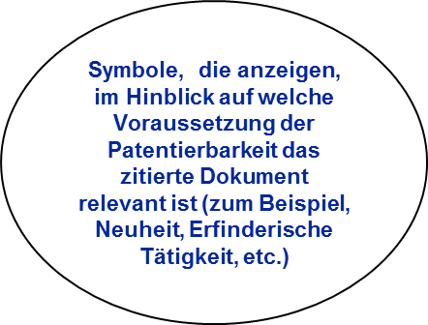

BEISPIEL: INTERNATIONALER RECHERCHENBERICHT
Dokumente, die für die Frage der Patentierbarkeit der Erfindung relevant sind

Slide 51
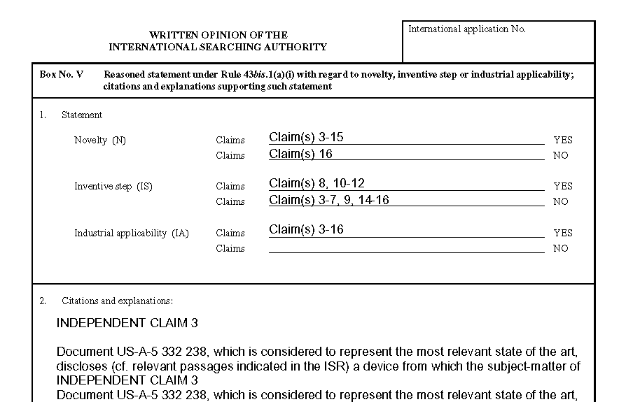
BEISPIEL: SCHRIFTLICHER BESCHEID DER ISA
Begründung der Beurteilung
Beurteilung der Patentierbarkeit der Ansprüche

Slide 52
DAS PCT-SYSTEM
Kapitel I
20
30
Eintritt
in die
Nationale
Phase
Internationale
Veröffentlichung
(Monate)
0
12
16
18
19
Nationale
Anmeldung
PCT
Anmeldung
Internationaler Recherchenbericht und schriftlicher
Bescheid
der ISA
SIS-Antrag
(ggf.)
oder wahlweise
Antrag nach Kapitel II
Internationale
vorläufige
Prüfung
30
Eintritt
in die
Nationale
Phase
Kapitel II

Slide 53
DAS PCT-SYSTEM
Kapitel I
20
30
Eintritt
in die
Nationale
Phase
Internationale
Veröffentlichung
(Monate)
0
12
16
18
19
Nationale
Anmeldung
PCT
Anmeldung
Internationaler Recherchenbericht und schriftlicher
Bescheid
der ISA
SIS-Antrag
(ggf.)
oder wahlweise
Antrag nach Kapitel II
Internationale
vorläufige
Prüfung
30
Eintritt
in die
Nationale
Phase
Kapitel II

Slide 54
GRUNDZÜGE DER INTERNATIONALEN
VORLÄUFIGEN PRÜFUNG
Fakultatives Verfahren
Es besteht die Möglichkeit, die gesamte internationale Anmeldung vor Eintritt in die nationale Phase zu ändern
Der Prüfungsbericht ist
  ein vorläufiges, nicht-bindendes Gutachten der mit der internationalen vorläufigen Prüfung beauftragten Behörde über die Neuheit, erfinderische Tätigkeit und gewerbliche Anwendbarkeit
  kein Gutachten über die Patentierbarkeit nach den nationalen Gesetzen der ausgewählten Staaten

Slide 55
DAS PCT-SYSTEM
Kapitel I
20
30
Eintritt
in die
Nationale
Phase
Internationale
Veröffentlichung
(Monate)
0
12
16
18
19
Nationale
Anmeldung
PCT
Anmeldung
Internationaler Recherchenbericht und schriftlicher
Bescheid
der ISA
SIS-Antrag
(ggf.)
oder wahlweise
Antrag nach Kapitel II
Internationale
vorläufige
Prüfung
30
Eintritt
in die
Nationale
Phase
Kapitel II

Slide 56
DER ANMELDER MUß ENTSCHEIDEN
Ob: die internationale Anmeldung weiterverfolgt oder aufgegeben werden soll
Wann: vor Ablauf von 30 Monaten (in manchen Fällen 31 Monate oder mehr)
    am Ende des Verfahrens nach Kapitel I?
    am Ende des Verfahrens nach Kapitel II?
  frühzeitiger Eintritt?
Wo: bei welchen nationalen Ämtern/bei welchen regionalen Ämtern

Slide 57
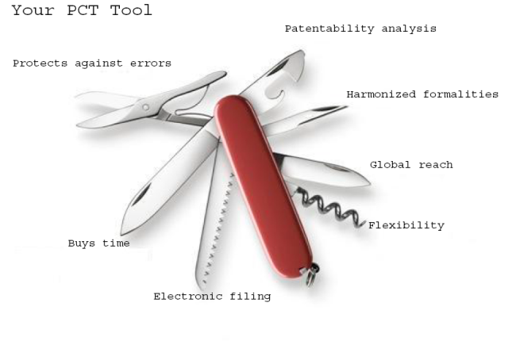
DER PCT

Slide 58
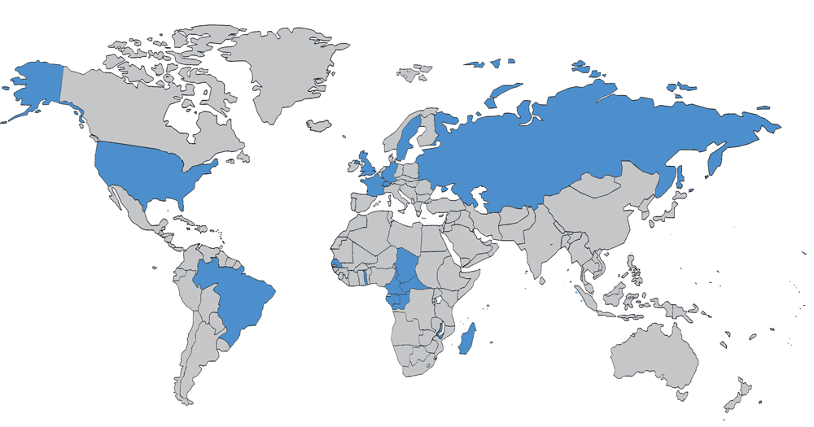
DER PCT 1978

Slide 59
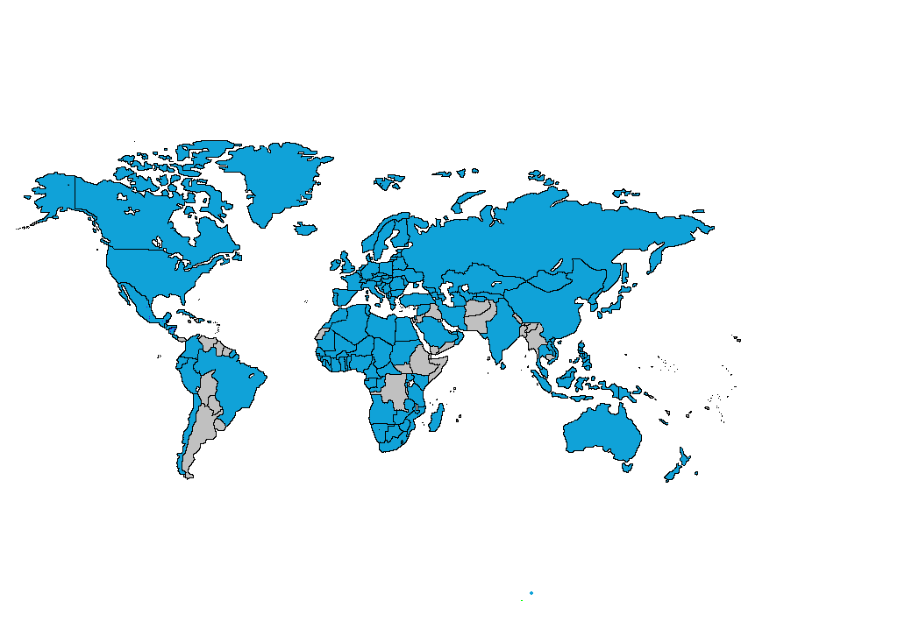
DER PCT HEUTE

Slide 60

148 PCT MITGLIEDSTAATEN
=PCT
Albania
Algeria
Angola
Antigua and Barbuda
Armenia
Australia
Austria
Azerbaijan
Bahrain
Barbados
Belarus
Belgium
Belize
Benin
Bosnia and Herzegovina
Botswana
Brazil
Brunei Darussalam
Bulgaria
Burkina Faso
Cameroon
Canada
Central African Republic
Chad
Chile
China
Colombia
Comoros
Congo
Costa Rica
Côte d'Ivoire
Croatia
Cuba
Cyprus
Czech Republic
Democratic People's
Republic of Korea
Denmark
Dominica
Dominican Republic
Ecuador
Egypt
El Salvador
Equatorial Guinea
Estonia
Finland
France,
Gabon
Gambia
Georgia
Germany
Ghana
Greece
Grenada
Guatemala
Guinea
Malawi
Malaysia
Mali
Malta
Mauritania
Mexico
Monaco
Mongolia
Montenegro
Morocco
Mozambique
Namibia
Netherlands
New Zealand
Nicaragua
Niger
Nigeria
Norway
Oman
Panama
Papua New Guinea
Peru
Philippines
Poland
Portugal
Qatar
Republic of Korea
Republic of Moldova
Romania
Rwanda
Russian Federation
Saint Lucia
Saint Vincent and
the Grenadines
San Marino
Sao Tomé e Principe
Saudi Arabia
Senegal
Serbia
Seychelles
Sierra Leone
Singapore
Slovakia
Slovenia
South Africa
Spain
Sri Lanka
Sudan
Swaziland
Guinea-Bissau
Honduras
Hungary
Iceland
India
Indonesia
Iran
Ireland
Israel
Italy
Japan
Kazakhstan
Kenya
Kyrgyzstan
Lao People’s Dem Rep.
Latvia
Lesotho
Liberia
Libyan Arab Jamahiriya
Liechtenstein
Lithuania
Luxembourg
Madagascar
St. Kitts and Nevis
Sweden
Switzerland
Syrian Arab Republic
Tajikistan
Thailand
The former Yugoslav
Republic of Macedonia
Togo
Trinidad and Tobago
Tunisia
Turkey
Turkmenistan
Uganda
Ukraine
United Arab Emirates
United Kingdom
  United Republic of Tanzania
  United States of America
Uzbekistan
Viet Nam
Zambia
Zimbabwe
Notes:
60

Slide 61

PCT STAATEN, DIE DEM PCT NOCH
NICHT BEIGETRETEN SIND (45)
Afghanistan
Andorra
Argentinien
Äthiopien
Bahamas
Bangladesch
Bhutan
Bolivien
Burundi
Dschibuti
Eritrea
Fidschi
Guyana
Haiti
Irak
Jamaika
Jemen
Jordanien
Kambodscha
Kap Verde
Kiribati
Kongo (Demokratische Republik)
Kuwait
Libanon
Malediven
Marshallinseln
Mauritius
Mikronesien
Myanmar
Nauru
Nepal
Pakistan
Palau
Paraguay
Samoa
Salomonen
Somalia
Südsudan
Suriname
Osttimor
Tonga
Tuvalu
Uruguay
Vanuatu
Venezuela

Slide 62

PCT Anmeldungen 2013
2013: 205,300 PCT Anmeldungen (+5.1%)

Slide 63
IN 2013 EINGEREICHTE INTERNATIONALE ANMELDUNG NACH HERKUNFTSLAND
CN: +15.6%
US: +10.8%
SE: +10.4%

Slide 64
Pariser Verbandsübereinkunft im Vergleich zu PCT Nationale Phase Eintritte
*

Slide 65
PCT EINTRITT IN DIE NATIONALE PHASE 2011— ZIEL-STAATEN (1)

Slide 66
PCT EINTRITT IN DIE NATIONALE PHASE 2011— ZIEL-STAATEN (2)

Slide 67
Top PCT Anmelder 2013
Panasonic—JP (2881)*
ZTE—CN (2309)
Huawei—CN (2094)
Qualcomm—US (2036)
Intel—US (1852)
Sharp—JP (1840)
Bosch—DE (1786)
Toyota—JP (1696)
Ericsson—SE (1467)
Philips—NL (1423)
Siemens—DE (1323)
Mitsubishi Electric—JP (1312)
Samsung Electronics—KR (1193)
NEC—JP (1190)
LG Electronics—KR (1170)
Fujifilm Corporation (1008)
Shenzhen China Star Optoelectronics—CN (916)
Sony—JP (915)
Hitachi—JP (841)
Nokia—FI (807)
*(…) veröffentlichte
PCT Anmeldungen

Slide 68
Top Universitäts PCT Anmelder 2013
University of California (US)
MIT (US)
Columbia University (US)
University of Texas (US)
Harvard University (US)
Johns Hopkins (US)
Korea Advanced Institute of Science and Technology (KR)
Leland Stanford University (US)
Cornell University (US)
Cal Tech (US)
University of Florida (US)
Postech Foundation (KR)
Seoul National University (KR)
Peking University (CN)
Nanyang Technical University (CN)
University of Tokyo (JP)
Isis Innovation Limited (GB)
University of Pennsylvania (US)
University of Michigan (US)
National University of Singapore (SG)

Slide 69
PCT VORTEILE
Der PCT, das „Rückrat“ des internationalen Patentsystems, ist ein weltweites System für die Einreichung und Bearbeitung von Patentanmeldungen, welches:
  die grössten mit der Internationalisierung einer Patentanmeldung verbundenen Kosten aufschiebt
  eine starke Basis für Entscheidungen über die Patentierung bietet
  Formalitäten vereinheitlicht
  den Anmelder vor unbeabsichtigten Fehlern schützt
  sich ständig weiterentwickelt mit dem Ziel, den Nutzern zu dienen
  von den weltgrössten Unternehmen, Universitäten und Forschungseinrichtungen benutzt wird

Slide 70
HERAUSFORDERUNGEN FÜR DEN PCT
Verbesserung der Qualität der während der internationalen Phase erstellten Recherchen- und Prüfungsberichts
Schaffung von Vertrauen zwischen den Patentämtern, so dass Ueberschneidungen/Doppelarbeit in der internationalen und der nationalen Phase vermieden oder zumindest verringert werden kann
Sprachen: 33% der Anmeldungen werden auf Chinesisch, Japanisch und Koreanisch eingereicht
Wie Können Entwicklungsländer verstärkt vom PCT profitieren:
15 Länder sind verantwortlich für 92.1% aller in 2011 verföffentlichten Anmeldungen
Zugang zum PCT für alle Arten von Anmeldern aus allen Vertragesstaaten (zum Beispiel: KMU)

Slide 71
DER PCT ─ 1970 BIS HEUTE
PCT sehr erfolgreich als Anmeldewerkzeug
Harmonisierung von Formalitäten und Verfahren (über den PCT hinaus)
  Nationale und regionale Systeme und Gesetze
  Patent Law Treaty (PLT)

Slide 72
DER PCT ─ 1970 BIS HEUTE
Allerdings: PCT in der Praxis nicht so erfolgreich als Werkzeug zur Arbeitsteilung, um Qualität der nationalen Prüfung zu steigern und Rückstände in Patentämtern abzubauen
Erwartung war: Nutzung der PCT Recherchen- und Prüfungsberichte PCT steigert die Qualität oder veringert zumindestet den Arbeitsaufwand in der nationalen Phase (bei gleichbleibender Qualität)
  “fliegender Start” für Patentämter; vervollständigen, prüfen und kritisieren der Arbeit anderer, nicht von Vorne beginnen

Slide 73
ePCT
WIPO Online-Dienst, der sicheren Zugriff auf PCT Anmeldungen in der vom Internationalen Büro geführten elektronischen Datenbank erlaubt
Sicherer Zugang zum “geschützten Teil” von ePCT (“private services”) erfordert ein WIPO Benutzerkonto und ein digitales Zertifikat (nutzbar für alle PCT Anmeldungen, die ab dem 1. Januar 2009 eingereicht wurden)
Zugang zum “öffentlichen Teil” von ePCT (“public services”), welcher das elektronische Einreichen von Dokumenten erlaubt, erfordert nur ein einfaches WIPO Benutzerkonto (keine Authentifizierung nötig) (nutzbar für alle PCT Anmeldungen)
Weitere Informationen:
  https://pct.wipo.int/ePCT

Slide 74
Regeländerungen mit Wirkung vom
1. Juli 2014
Verfügbarkeit des schriftlichen Bescheids der ISA ab dem Datum der internationalen Veröffentlichung in der eingereichten Sprache auf PATENTSCOPE
Die IPEA muss eine zusätzliche Recherche (“Top-up search”) durchführen (Regel 66.1ter)
Die Änderungen finden Anwendung auf Anmeldungen, deren Anmeldedatum der 1. Juli 2014 oder ein späteres Datum ist, bzw. für Anträge nach Kapitel II, die an oder nach diesem Datum eingereicht werden

Slide 75
PCT Working Group 2014
(Auswahl an besprochener Themen)
Integration von PPH in den PCT
Bestellung von Internationalen Recherchenbehörden
Collaborative international search
Farbige Bilder und Zeichnungen
PCT-EASY Gebührenermässigung soll gestrichen werden
Anwendbarkeit der Gebührenermässigung um 90% für bestimmte Anmelder
Änderungen hinsichtlich Einwendungen Dritter (längere Stellungnahmen zulässlich)

Slide 76
PCT TRAINING
PCT-Fernlehrgang (Grundkurs) in den 10 Veröffentlichungssprachen (für Fortgeschrittene in Vorbereitung)
29 PCT Schulungsvideos auf WIPOs Youtube Kanal und auf WIPOs Internetseite
PCT-Webinars als weiterer Service an die Nutzer des PCT-Systems, zusätzlich zu Schulungskursen und Seminaren
  Möglichkeit kostenloser Updates zum PCT
  können auch speziell für einzelne Unternehmen und Kanzleien angeboten werden
PCT-Seminare und Schulungen
Weitere Informationen auf der Internetseite für Anmelder:
www.wipo.int/pct/de

Slide 77
PCT Informationstelle
Für weitere Informationen zum PCT, siehe
http://www.wipo.int/pct/en/
Für allgemeine Fragen zum PCT steht der PCT Information Service zur Verfügung:
      Telephon: (+41-22) 338 83 38
      Fax: (+41-22) 338 83 39
      E-mail: pct.infoline@wipo.int

Slide 78
THANK YOU!
Notes:
Welcome ….
Today, we are going to explain to you, in very general terms,
what this Organization does and why?

Slide 79
Global IP Systems:
The Madrid System
The Hague System
The Lisbon System
Debbie Roenning
Director, Legal Division
Madrid Registry
Germany, July 2014
Notes:
79

Slide 80





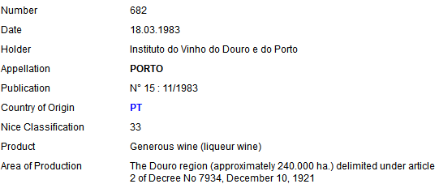

Trademarks
IRN 957947
Designs
DM/069670
Appellations
of Origin
The International System of Appellations of Origin

Slide 81












No international procedure
NATIONAL OFFICES
APPLICANT

Slide 82



















International procedure
INTERNATIONAL PROCEDURE
MADRID
NATIONAL OFFICE
WIPO
WIPO
MAINTENANCE
Basic
HAGUE
NATIONAL OFFICE
WIPO
Basic
WIPO
MAINTENANCE
USER
LISBON
WIPO
LISBON
REGISTRY
GOVERNMENT
ALL MEMBERS
Registered AO

Slide 83
The Madrid System:
The International Trademark System

Slide 84
Trademarks
"A brand incarnates an enterprise's reputation and image and so is one of an enterprise's most valuable assets” (Director General, Francis Gurry)
Trademarks are the most widely used form of registered intellectual property (IP) throughout the world
Trademark demand quadrupled between 1985 and 2011, from just under 1 million applications per year in 1985 to 4.2 million by 2011

Slide 85
Routes for protecting a trademark
The national route: Filing trademark application with the Trademark Office of each country in which protection of the mark is sought
The regional route: Apply for protection in countries which are members of a regional trademarks registration system with effect in the territories of all Member States (ARIPO, Benelux Trademark Office, OHIM and OAPI)
The international route: The Madrid System

Slide 86
The Madrid System
A centralized filing and management procedure
A one-stop shop for trademark holders to obtain and maintain trademark protection in export markets
An alternative to the national route
The domestic legislations of the designated Contracting Parties set the conditions for protecting a trademark and determine the rights which result from protection

Slide 87
Madrid System – June 2014
1 Agreement only
91 Protocol (including EU)
92 Members

Slide 88
Accessions
2012: Colombia, Mexico, New Zealand and Philippines
2013: India, Rwanda and Tunisia
Future accessions?
  Algeria to the Protocol
  OAPI
  Canada
  Latin American countries
  ASEAN countries by 2015
  Caribbean countries
  African countries

Slide 89
Key features – I
A registration system for 92 Contracting Parties
One application – one language – one set of fees
Entitlement and basic application or registration
Three main stages
  Basic mark > International application
  Formal examination by WIPO
  Substantive examination by the Offices of the designated Contracting Parties

Slide 90
Key features – II
One registration covering multiple territories
Fixed time limit for refusal – 12 or 18 months
Manage a portfolio of trademarks via a single centralized procedure
Renew for all designated Contracting Parties with one request
Expand protection to new Contracting Parties

Slide 91
Fees under the Madrid System
Fees payable to WIPO in Swiss francs
Basic fee includes three classes of goods and services
  653 Swiss francs - b/w reproduction of mark
  903 Swiss francs - color reproduction of mark
Standard fees:
  Complementary: 100 Swiss francs per DCP
  Supplementary: 100 Swiss francs per class beyond three
  OR
Individual fees where this is declared

Slide 92
Fees under the Madrid System (2)
Fees can easily be paid by:
  Credit card using E-payment / E-subsequent designation / E-renewal
  WIPO current account
  Bank transfer
More information about the payment of fees is available at: http://www.wipo.int/about-wipo/en/finance/madrid.html
You can calculate the cost of an application, subsequent designation or a renewal at: http://www.wipo.int/madrid/en/fees/calculator.jsp

Slide 93
The international procedure
Office of Origin
Designated Contracting Party
Designated Contracting Party
Designated Contracting Party
WIPO
Applicant
Certifies the application and forwards it to WIPO
Conducts the formal examination; records the mark in the International Registry and publishes the international registration in the Gazette. Issues a certificate of registration and notifies the designated Contracting Parties
Entitlement
Basic Mark
Scope of protection of the international registration will be determined by the substantive examination under domestic law, within 12/18 months

Slide 94
The Madrid System – Facts and figures
Worldwide trademark filings + 9.3% from 2008 to 2011
2012 + 4.1% growth in applications
2013 + 6.4% growth in applications
Received 46,829 international applications
Over 578,320 international registrations in force
5.61 million designations in force
191,759 holders of international registrations

Slide 95
Top Offices of origin – 2013
Contracting Parties | Number of IA | Change from 2012
European Union | 7,444 | 15.3%
United States of America | 6,084 | 4.8%
Germany | 4,514 | 6.1%
France | 3,755 | 0.7%
Switzerland | 2,976 | 10.7%
China | 2,273 | 10.9%
Italy | 2,254 | -1.2%
Benelux | 1,916 | 0.1%
Japan | 1,845 | -9.3%
United Kingdom | 1,562 | 17.2%

Slide 96
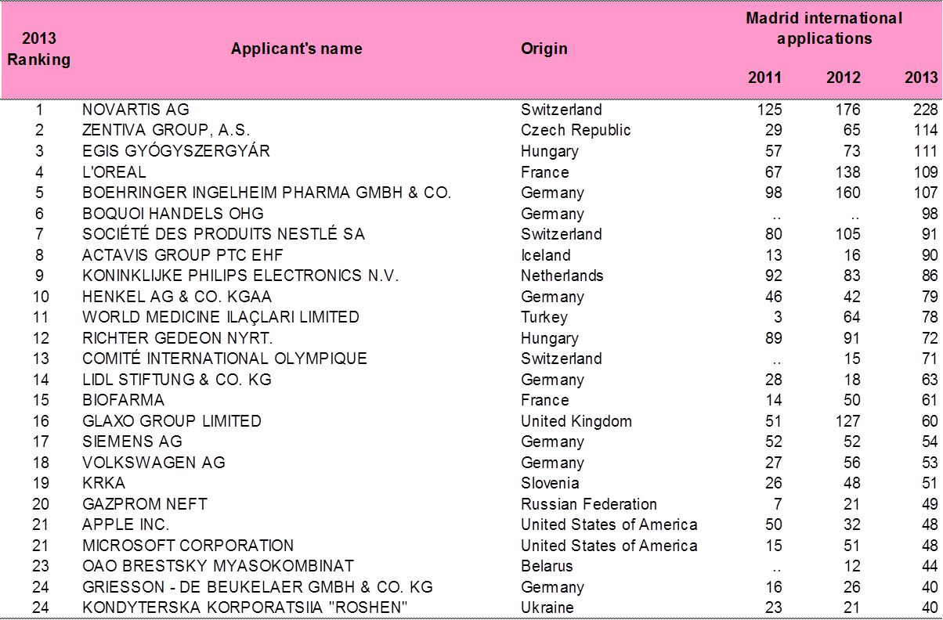
Top applicants

Slide 97
Top designations – 2013
Contracting Parties | Number of designations | Change from 2012
China | 20,275 | 18.1%
Russian Federation | 18,239 | 24.4%
European Union | 17,598 | 23.7%
United States of America | 17,322 | 23.2%
Switzerland | 13,215 | 9.3%
Japan | 13,179 | 25.5%
Australia | 11,675 | 32.6%
Republic of Korea | 10,967 | 30.4%
Turkey | 9,838 | 10.9%
Ukraine | 9,589 | 11.6%

Slide 98
General Profile 2013
44,414 International Registrations
Average Number of Designations | 6.9
Average Number of Classes | 2.5
Average Fee | CHF 2,926
All Fees | 70% < 3,000 CHF
Notes:
98

Slide 99
International Applications from Germany and the EU

Slide 100
Designations in IRs and subsequently of Germany and the EU

Slide 101
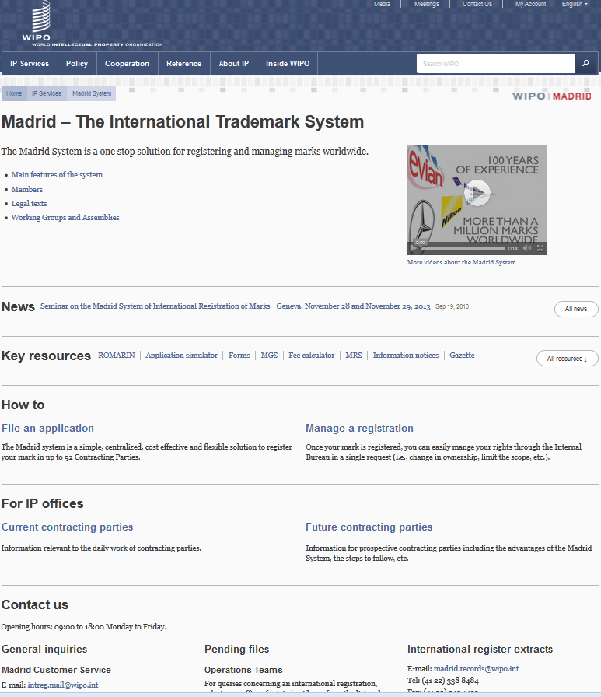

Slide 102
Online information services
Legal texts, Guide and Information Notices
WIPO Gazette of International Marks
New publication: Making the Most of the Madrid System
  Practical tips on how to use specific forms
E-Renewal Tool
Fee Calculator: Costing service
ROMARIN: On-line search database
Dynamic Madrid Statistics
free access at http://www.wipo.int/madrid/en/
Notes:
102

Slide 103
Online tools
Madrid Goods and Services Manager (MGS): To use correct specifications of goods and services
Madrid Real-Time Status (MRS): To inform of the status of an international application/registration
Madrid Portfolio Manager (MPM): To allow the holders and representatives to view and modify their portfolio
Madrid Electronic Alerts (MEA): To allow users to submit a list of IRs to monitor and to be informed by email when any of them change
Image-based search tool http://www.wipo.int/branddb/en/
E-subsequent designation is now available

Slide 104
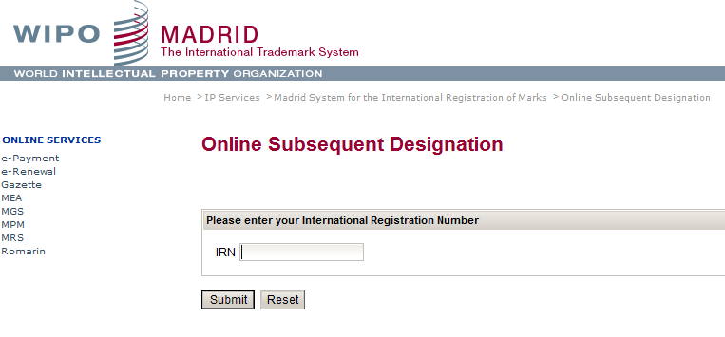
E - Subsequent Designation

Slide 105
Benefits for trademark owners
Simple and economical procedure
  A single set of simple formalities
  A single filing Office
  Low registration fees
  No need to pay foreign agents for filings
  No need to pay translation of the paperwork into several languages
Effective procedure
  A single international application produces the same legal effect in various countries
  A fixed deadline for the confirmation or refusal of the legal effects in each designated country
Notes:
105
105

Slide 106
Contact details
For general questions about the Madrid System
  Madrid Customer Service intreg.mail@wipo.int
  Telephone: + 41 22 338 8686
For questions regarding specific international applications or international registrations
  Madrid Team 2: madrid.team2@wipo.int
  Telephone: + 41 22 338 750 2

Slide 107
The Hague System:
The International Design System

Slide 108

In a nutshell
“The Hague Agreement provides creators and holders of designs with a simple, rapid and economical procedure to secure and maintain the protection of industrial designs, through a single international registration"

Slide 109
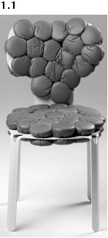
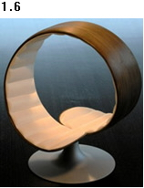
WIPO Director General Francis Gurry:
“Design is one of the principal means of differentiating a range of mass produced household and consumer items, such as chairs and tables, for which the technological possibilities for development have been exhausted.”
DM/075065 DM/076022
« Chair » « Chair »

Slide 110
The Hague System
A centralized filing mechanism
A closed system
A one-stop shop to obtain and maintain design protection in export markets
An option to the national route
A purely procedural treaty
The domestic legislations of the designated Contracting Parties set the conditions for protecting the design and determine the rights which result from protection
Notes:
110

Slide 111
Members of the Hague System
47 Geneva Act (1999) (including EU and OAPI)
15 Hague Act (1960)
62 Contracting Parties

Slide 112
Accessions
2012: Montenegro, Tajikistan, Tunisia
2013: Brunei Darussalam
2014. Republic of Korea
Future accessions?
  China, Japan and USA
  Russian Federation and Belarus
  ASEAN countries by 2015
  Barbados and Trinidad & Tobago
  Madagascar and Morocco
Notes:
112

Slide 113
Foreseen Expansion
Coming Soon!

Slide 114
Key features – I
Entitlement:
To use the Hague system, you need a connection with a Contracting Party (CP), like establishment, domicile, nationality or habitual residence
One to many relationship:
File a single international application for a single international registration (IR) in which one or more Contracting Parties (CP) are designated (“self-designation“ is possible)
Renewal:
Duration: 5 years renewable. 15 years for the 1999 Act or possibly longer if allowed by designated CP

Slide 115
Key features – II
Possible deferment of up to 12 months:
Counted from date of filing or priority date
Fixed time limit for refusal:
Any refusal must be notified to the International Bureau within 6 or 12 months from the publication of the international registration on the WIPO website, otherwise the design will be deemed protected
“Bundle of rights”:
If no refusal is issued, the resulting IR has the effect of a grant of protection in each designated CP

Slide 116
The use of the Hague System in 2013
2,990 international applications filed (13,172 designs)
2,734 international registrations recorded (12,806 designs)
Largest filers: Swatch AG, The Proctor and Gamble Company; Daimler AG, Volkswagen Aktiengesellschaft; Koninklijke Philips Electronics
Approximately 26,877 international registrations in force,
  Equivalent to over 134,385 designations in force
  Involving 8,204 holders
  80% SMEs?
Notes:
116

Slide 117
General profile 2013
2,734 International Registrations
Average Number of Designations | 3 to 5
Average Number of Designs | 4.68
Average Fee | Less than 1,000 CHF
All Fees | 79.2% < 2,000 CHF
Notes:
117

Slide 118
Top Filing Contracting Parties
Contracting Party of entitlement
1. European Union (5168 designs, 41.5%)
2. Switzerland (2855 designs, 22.9%)
3. Germany (1630 designs, 13.1%)
4. France (1265 designs, 10.2%)
5. Turkey (278 designs, 2.2%)
6. Norway (186 designs, 1.5%)
7. Spain (101 designs, 0.8%)
8. Poland (86 designs, 0.7%)
9. Croatia (76 designs, 0.6%)
10. Liechtenstein (73 designs, 0.6%)

Slide 119
Most Designated Contracting Parties
Number of designs recorded:
1. European Union (8961 designs, 74.9%)
2. Switzerland (8802 designs, 73.5%)
3. Turkey (5110 designs, 42.7%)
4. Ukraine (2853 designs, 23.8%)
5. Singapore (2531 designs, 21.1%)
6. Norway (2389 designs, 20%)
7. Croatia (2376 designs, 19.8%)
8. Morocco (1853 designs, 15.5%)
9. Liechtenstein (1499 designs, 12.5%)
10. Serbia (1494 designs, 12.5%)

Slide 120
The registration procedure
Only formal examination in the International Bureau
  Recording in the International Register
  Publication in the International Designs Bulletin
  Notification to designated CPs through the publication
Substantive examination by the designated Contracting Parties only
Refusal must be received by the International Bureau within a set time limit after publication: 6 or 12 months

Slide 121
Online services / tools
http://www.wipo.int/hague/en/
  E-Filing Portfolio Manager
  E-Renewal
  E-Payment
  Hague Express Database
  Fee calculator

Slide 122
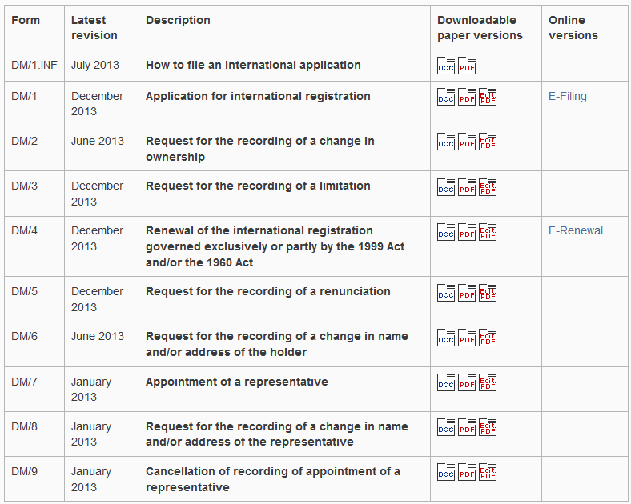
E-filing/Forms (http://www.wipo.int/hague/en/forms/)

Slide 123
Advantages
The Hague System is cost-effective and efficient, thereby creating opportunities that would not otherwise exist for any enterprise with a limited legal budget
It is flexible affording right holders great flexibility in targeting national, regional or global markets for particular goods
The centralized acquisition and maintenance of industrial design rights by filing a single international application for a single international registration with effect in one or more designated Contracting Parties

Slide 124
The Lisbon System
Notes:
124

Slide 125
Appellations of origin and geographical indications
An appellation of origin is a special kind of geographical indication
It generally consists of a geographical name or a traditional designation used on products which have a specific quality or characteristics that are essentially due to the geographical environment in which they are produced
Examples: Champagne, Cognac, Roquefort, Chianti, Porto, Tequila, Darjeeling
Geographical indications are protected in accordance with international treaties and national laws under a wide range of concepts

Slide 126
The Lisbon System
An international system that facilitates the protection of “appellations of origin”, in countries other than the country of origin
Protection of national economic interests, in many countries, for goods bearing an appellation of origin represents substantial share of exports

Slide 127
Lisbon Union: 28 Member States
  Africa (6)
  Algeria
  Burkina Faso
  Congo
  Gabon
  Togo
  Tunisia
  Asia (3)
  Iran (Islamic Rep. of)
  Israel
  Korea (DPR of)
  Europe (13)
  Bosnia and Herzegovina
  Bulgaria
  Czech Rep.
  France
  Georgia
  Hungary
  Italy
  Moldova
  Montenegro
  Portugal
  Serbia
  Slovakia
  The FYR of Macedonia
  America (6)
  Costa Rica
  Cuba
  Haiti
  Mexico
  Nicaragua
  Peru
Countries in red are post TRIPS accessions
Notes:
127

Slide 128
Why protect Appellations of origin (AO)?
AO are a collective tool for producers to promote the products of their territory and preserve their quality and reputation acquired over time
The use of the protected AO is reserved to those producers that are able to meet a number of specifications, including geographical area of production
Producers: Help obtain good prices - compensation for maintaining high and constant levels of quality
Consumers: AO provides guarantees with respect to production methods and quality
Tools for economic development and promotion of regions and countries

Slide 129
Protection through the Lisbon System
Application for international registration is requested by the country of origin, on behalf of the holders of protected AO
The International Bureau notifies the Offices of the Contracting States
Term of protection: The international registration of an AO ensures the protection of that AO without renewal for as long as it is protected in the country of origin
Scope of protection: As long as the AO is protected in the country of origin, the Contracting States are obliged to provide means of defense against usurpation or imitation
Application fees: 500 Swiss francs

Slide 130
Protection through the Lisbon System (2)
Territorial effect: In principle, protected in all Contracting States
Refusal: Contracting States have the right to refuse
  If no refusal received within 1 year, protection is granted
Appeal against refusal: The International Bureau notifies the country of origin of a refusal
The interested party (holder) may resort to all the judicial and administrative remedies open to nationals of that country (refusing Contracting State)

Slide 131
Online services
Search appellations of origin in the Lisbon Express http://www.wipo.int/ipdl/en/search/lisbon/search-struct.jsp
The Bulletin “Appellations of origin” is the official publication of the Lisbon system for the publication of recordings in the International Register and information concerning changes in the legal framework http://www.wipo.int/lisbon/en/bulletin/
Forms available on the web site (application, refusal, withdrawal of refusal, declaration of invalidation) http://www.wipo.int/lisbon/en/forms/

Slide 132

Tequila (Reg. No. 669)
Product: Spirit
Holder: Government of Mexico
Area of Production: Territory of the area of Jalisco
Legal Basis: Law on inventions and trademarks of February 10, 1976; Ministry of Heritage and Industrial Development declaration of October 13, 1977

Slide 133

Parmigiano-Reggiano (No. 513)
Product: Cheese
Holder: Consorzio del formaggio Parmigiano-Reggiano, 4, piazza della Vittoria, Reggio Emilia
Area of production:
Territory of the Provinces of Bologna (left bank of the Reno), Mantova (right bank of the Po), Modena, Parma and Reggio Emilia
Legal basis: Executive Order N° 1269 of the President of the Italian Republic, of October 30, 1955

Slide 134

Chulucanas (No. 869)
Product: Ceramics
Holder: The Peruvian State
Area of production: District of Chulucanas, in the province of Morropón, department of Piura.
Legal basis: Office of Distinctive Signs of the National Institute for Defence of Competition and Protection of Intellectual Property (INDECOPI), Resolution No. 011517-2006/OSD-INDECOPI

Slide 135
On-going Multilateral Negotiations
WTO:
  Establish a GI registry
  Wine and spirits only or not ?
WIPO:
  Mandate for the Lisbon Working Group to look for improvements of the Lisbon system, so that it might attract a wider membership, while preserving the principles and objectives of the Lisbon Agreement

Slide 136
Draft revised Lisbon Agreement
Definitions for GIs and AOs
Procedures for international applications, refusals, invalidations, modifications, etc.
Scope of protection
How to deal with prior rights and prior use
Option for registration of trans-border GIs and AOs
Option for direct filings by beneficiaries
Accession criteria for Intergovernmental Organizations (e.g., EU, OAPI)

Slide 137
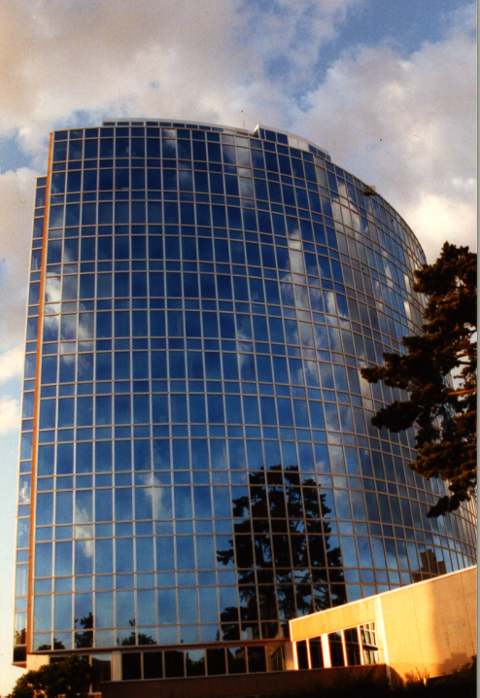
Thank you
for your attention
debbie.roenning@wipo.int

Slide 138
WIPO Alternative Streitbeilegungsverfahren
WIPO Arbitration and Mediation Center

Slide 139
Bedarfsgerechte Beilegung von IP Streitigkeiten
International – Parteien, Rechte
Neutrale Expertise – Recht, Technischer Bereich
Effizienz – Kosten, Zeit, Durchsetzbarkeit
Vertraulichkeit – Reputation, Know-how
Parteibeziehungen – Geschäftsbeziehungen bewahren
Notes:
139

Slide 140

WIPO Arbitration and Mediation Center
140
Büros in Genf und Singapur
Förderung der effizienten Streitbeilegung im Bereich des geistigen Eigentums durch “ADR”
  WIPO Mediationen
  WIPO (beschleunigte)
  Schiedsgerichtsverfahren
  WIPO Sachverständigenverfahren
Fortbildungen zu ADR/IP
Spezielle Verfahrensregeln
Not-for-profit

Slide 141
WIPO Center - Fallbetreuung
  Prämisse:
    Zeit- und kosteneffiziente Verfahren
    Durchsetzbares Qualitätsresultat für die Parteien
  Unterstützung u.a. bei:
    Verfahrenseinleitung und Durchführung
    Auswahl und Bestellung von Mediator/ Schiedsrichter(n)
    Finanzmanagement
    Verfahrensfragen Mediator/Schiedsrichter/Parteien
    Treffen/Anhörungen

Slide 142
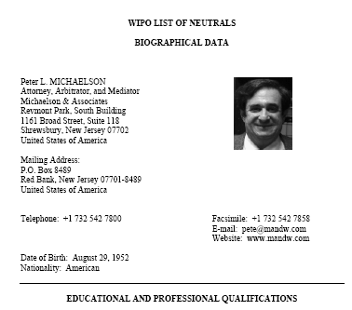
WIPO Schiedsrichter, Mediatoren, Experten
Unterstützung bei Auswahl/Bestellung von Schiedsrichtern, Mediatoren
Datenbank mit 1500 Schiedsrichtern, Mediatoren, Experten aus über 70 Ländern

Slide 143
WIPO ADR Optionen

Slide 144
Alternative Dispute Resolution (ADR)
144
Mediation: Nicht bindendes neutrales Verfahren, in dem ein unabhängiger Dritter (Mediator) den Parteien hilft, ihre Streitigkeit einvernehmlich zu lösen. Keine Entscheidungsbefugnis.
Schiedsgerichtsverfahren: Neutrales Verfahren, in dem ein unabhängiger Dritter (Schiedsrichter) einen für die Parteien bindenden und rechtskräftigen Schiedsspruch erlässt.
Sachverständigengutachten: Neutrales Verfahren, in dem eine spezifische Frage (oft technischer Natur) einem unabhängigen Sachverständigen unterbreitet wird, der ein für die Parteien bindendes/nicht bindendes Gutachten erlässt.

Slide 145
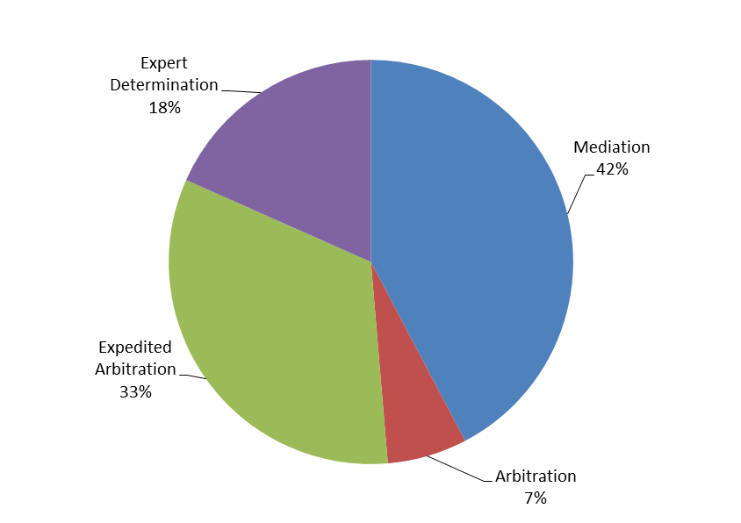
WIPO Verfahrensarten

Slide 146
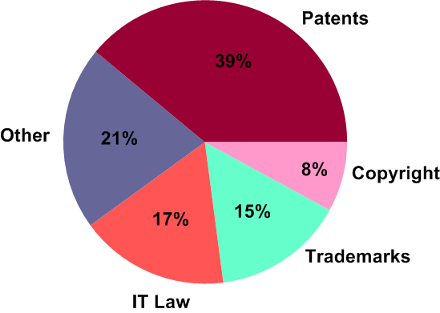
WIPO Verfahren: Rechtsgebiete

Slide 147
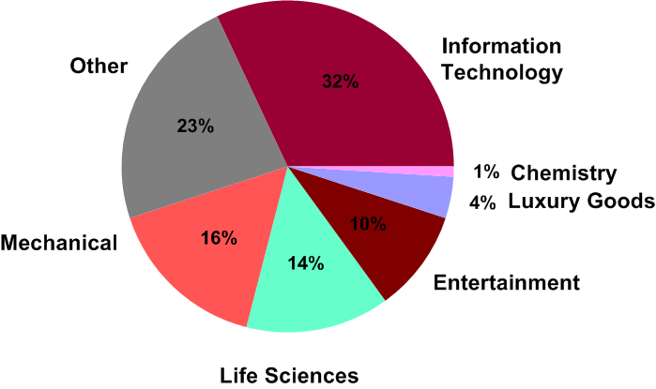
WIPO Verfahren - Wirtschaftszweige
147

Slide 148
Neue WIPO Mediation und (beschleunigte) Schiedsverfahrensregeln
In Kraft seit 1. Juni 2014
Berücksichtigung einzelner jüngerer Entwicklungen im internationalen Scheidsverfahrensrecht, einschliesslich der 2010 Revision der UNICITRAL Schiedsregeln
Berücksichtigung von Fallpraxis des WIPO Zentrums
Unterstreichen der Bedeutsamkeit von Zeit- und Kosteneffizienz von WIPO ADR Verfahren
Wesentliche Neuerungen:
  «List procedure» in allen WIPO ADR Verfahren verfügbar
  Schiedsverfahren mit mehr als zwei Parteien: Einbeziehung Dritter ins Verfahren («Joinder») und Verbindung von Verfahren («Consolidation»)
  Dringlicher Rechtsschutz («Emergency Arbitrator»)

Slide 149
Rechtsgrundlage ADR
Parteivereinbarung
Streitbeilegungsklauseln
Unterwerfungsvereinbarungen
Verweisungen durch Gerichte
  z.B. Deutschland : § 278a ZPO - Mediation, aussergerichtliche Konfliktbeilegung:
  Gericht kann den Parteien eine Mediation oder ein anderes Verfahren der aussergerichtlichen Konfliktbeilegung vorschlagen
  Entscheiden sich die Parteien zur Durchführung einer Mediation oder eines anderen Verfahrens der außergerichtlichen Konfliktbeilegung, ordnet das Gericht das Ruhen des Verfahrens an

Slide 150
Vertragliche Rechtsgrundlage - Empfohlene WIPO Mediations- und Schiedsklauseln
150
Mediation mit für den Fall mangelnder Streitbeilegung nachfolgendem Schiedsgerichtsverfahren
Mediation vor Schiedsgerichts-verfahren,
  Ablauf einer festgesetzten Frist
  Beendigung der Mediation
Kombination von Verfahrensvorteilen
  Schieds-gerichts-verfahren gut vorbereitet
„Alle Streitigkeiten, die sich aufgrund dieses Vertrags oder späterer Änderungen dieses Vertrags ergeben oder sich auf diesen beziehen, einschliesslich (ohne Einschränkung hierauf) dessen Entstehung, Gültigkeit, bindende Wirkung, Auslegung, Durchführung, Verletzung oder Beendigung, Durchführung, Verletzung oder Beendigung, sowie ausservertragliche Ansprüche sind gemäss den Regeln für das Mediationsverfahren der WIPO dem Mediationsverfahren zu unterwerfen. Der Ort des Mediationsverfahrens soll .... sein. In dem Mediationsverfahren soll die .... Sprache verwendet werden.”
”Falls und insoweit als solche Streitigkeiten nicht innerhalb von [60] [90] Tagen seit Beginn des Mediationsverfahrens aufgrund des Mediationsverfahrens beigelegt werden, sind sie nach Einreichung eines Schiedsantrags einer Partei gemäss den Regeln für das Schiedsgerichtsverfahren der WIPO dem Schiedsgerichtsverfahren zu unterwerfen und endgültig im Schiedsgerichtsverfahren zu entscheiden. Alternativ soll, wenn vor Ablauf der genannten Frist von [60] [90] Tagen eine Partei versäumt, sich an dem Mediationsverfahrens zu beteiligen oder nicht mehr an dem Mediationsverfahrens teilnimmt, die Streitigkeit nach Einreichung eines Schiedsantrags durch die andere Partei gemäss den Regeln für das Schiedsgerichtsverfahren der WIPO dem Schiedsgerichtsverfahren unterworfen und endgültig im Schiedsgerichtsverfahren entschieden werden. Das Schiedsgericht soll aus [drei Schiedsrichtern] [einem Einzelschiedsrichter] bestehen. Der Ort des Schiedsgerichtsverfahrens soll .... sein. In dem Schiedsgerichtsverfahren soll die .... Sprache verwendet werden. Die Streitigkeit soll unter Anwendung des Rechts von .... entschieden werden.”
Notes:
150

Slide 151
WIPO Mediation – Verfahrensschritte
151
Notes:
151

Slide 152
WIPO (beschleunigte) Schiedsgerichtsverfahren
152
WIPO Schiedsgerichtsverfahren
WIPO beschleunigtes Schiedsgerichtsverfahren
Schiedsantrag
Schiedsantrag und Klageschrift
30 Tage
20 Tage
Erwiderung auf Schiedsantrag
Erwiderung und Klageerwiderung
Schiedsrichterbestellung
Schiedsrichterbestellung
30 Tage
30 Tage
3 Monate
Klageschrift
Mündliche Verhandlung
30 Tage
Klageerwiderung
Beendigung des Verfahrens
30 Tage
1 Monat
Ggf. weitere Schriftsätze
Schiedsspruch
9 Monate
Ein Austausch von Schriftsätzen
Einzelschiedsrichter
Kürzere Fristen
Mündliche Verhandlung grds. max.
drei Tage
Niedrigere Gebühren
Mündliche Verhandlung(en)
Beendigung des Verfahrens
3 Monate
Schiedsspruch

Slide 153
WIPO Schiedsgerichtsverfahren
153
Parteiautonomie hinsichtlich der Bestellung der Schiedsrichter (Art. 16-17)
Vertraulichkeit (Art. 52, 73-76)
Einstweiliger Rechtsschutz (Art. 46a-c)
Technische Beweise (Art. 49-51)
Schiedsfähigkeit von geistigem Eigentum – inter partes
Keine Berufung
International vollstreckbar: New York Übereinkommen 1958

Slide 154
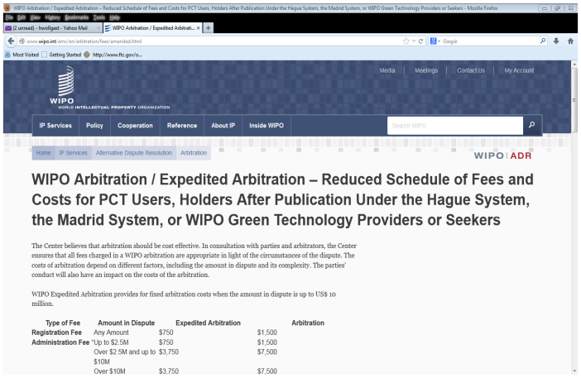
Kosten – Reduzierung für Nutzer der PCT/Madrid/Hague Systeme

Slide 155
WIPO Verfahren - Vergleich
Mediation
Schiedsgerichtsverfahren

Slide 156
WIPO ADR Services für bestimmte Bereiche
Angepasste Klauseln, Verfahrensregelen, Kostenregeln
Gesonderte Listen mit spezialisierten Mediatoren, Schiedsrichtern und Experten
Beispiele (www.wipo.int/amc/en/center/specific-sectors/ )
  R&D (DESCA, IPAG)
  Patent- und Markenämter: WIPO ADR Optionen für Parteien in Verfahren vor den Aemtern in Singapur, Brasilien, Kolumbien, Philippinen
  Kunst und kulturelles Erbe: ICOM-WIPO Mediation
  Patente in Standards («FRAND Streitigkeiten»)

Slide 157
Weitere Informationen
Modellvertragsklauseln: http://www.wipo.int/amc/en/clauses/
Information zu Verfahren, Mediatoren, Schiedsrichtern, Fallbeispielen: http://www.wipo.int/amc/en
Kontakt: arbiter.mail@wipo.int

Slide 158
THANK YOU!
Notes:
Welcome ….
Today, we are going to explain to you, in very general terms,
what this Organization does and why?

Slide 159
Global Databases for IP Platforms and
Tools for the Connected Knowledge Economy
Speaker: Christophe Mazenc, Head, Global Databases Service, Global Infrastructure Sector

Slide 160
Strategic Goals of Global Databases and Tools
2 related goals:
  “Coordination and Development of Global IP Infrastructure”
  “World Reference Source for IP Information and Analysis”

Slide 161
Benefits to Stakeholders
For Business/Research:
  Providing search facilities for IP collections (patents, trademarks, industrial designs)
  Simplifying application procedures to multiple IP authorities
  Providing IP related matchmaking services
For IP offices:
  Assisting automation, IP information dissemination to the public, and exchange of IP documents with other offices

Slide 162

GLOBAL DATABASES, TOOLS, AND PLATFORMS FOR IP BUSINESS (FREE)
PATENTSCOPE
Global Brand Database
WIPO Lex
WIPO IPAS, WIPO DAS
WIPO CASE
WIPO RE:SEARCH
WIPO GREEN

Slide 163
PATENTSCOPE
2.4 million published PCT applications (first publish every week, high quality full text)
36 million patent applications from 38 countries or regions
Full text data from 18 countries or regions
15,000 pageviews per hour
Analyze results by graphs and charts
Search and read in your language

Slide 164
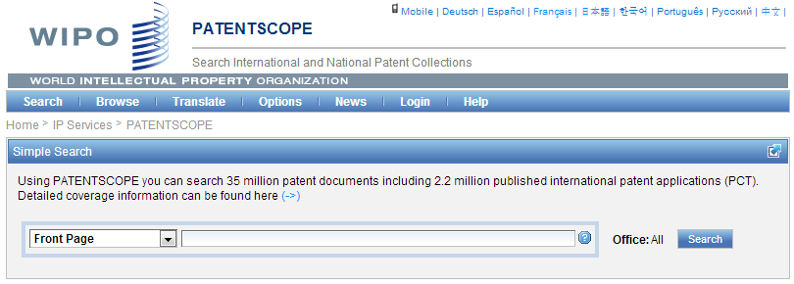
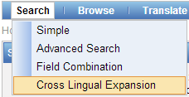

Slide 165
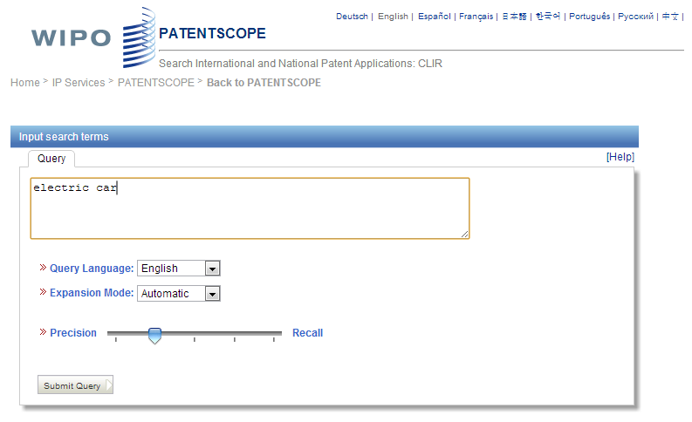


Slide 166
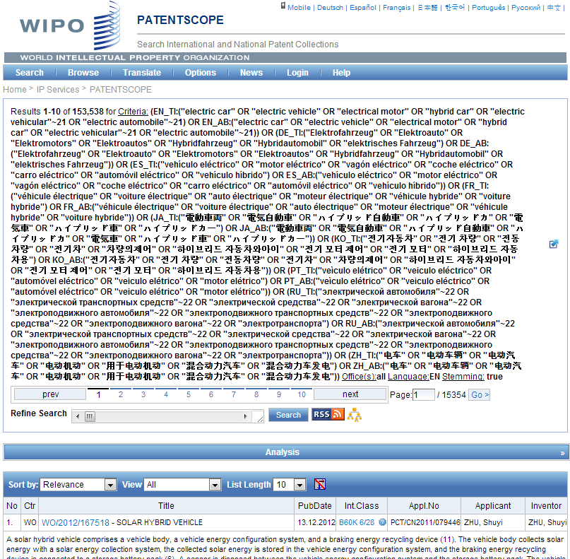

Electric car - only 16,000 hits
Search Query
(synonyms & technologically related terms)

Slide 167
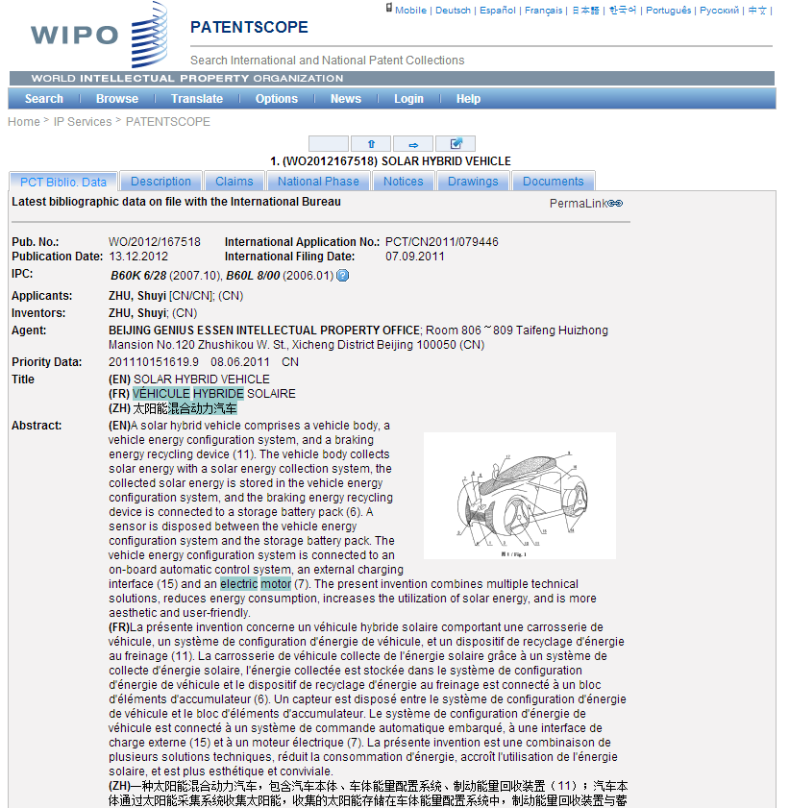

Slide 168
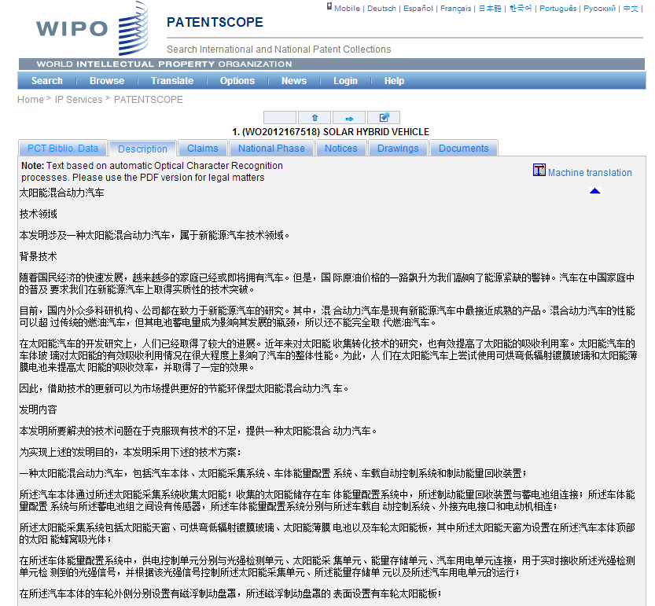
???

Slide 169
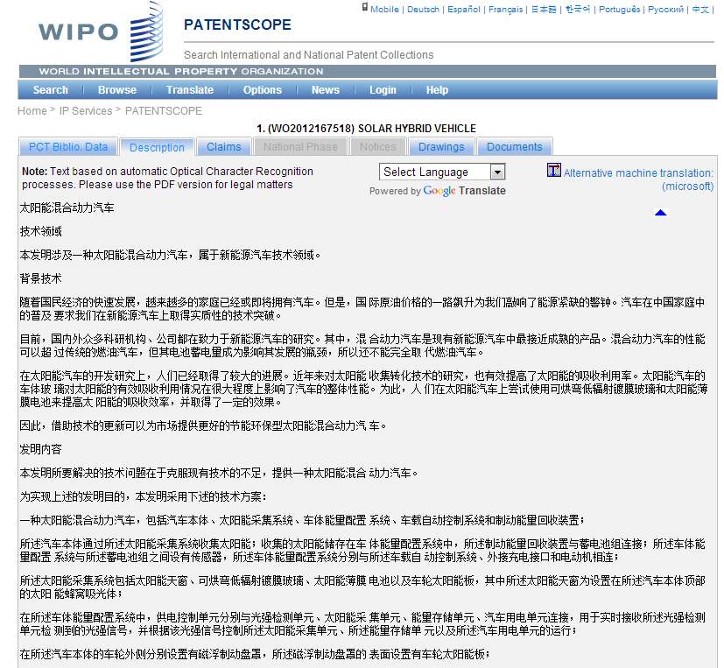

Slide 170
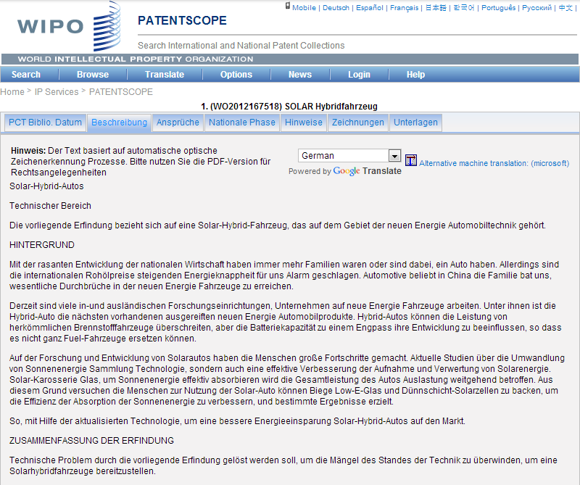

Slide 171
German Full text in PATENTSCOPE?
Currently a bit more than 700'000 descriptions and claims:
  From the EPO: 425'000 applications
  From the PCT: 300'000 applications
Expected for Q4 2014
  Inclusion in PATENTSCOPE of the complete full text of the national patent applications and grants from DPMA (more than 5'000'000 full text records)

Slide 172
Searching German Full text in PATENTSCOPE
Separate searchable fields for titles, abstracts, descriptions and claims
Stemming: very important for German as it is inflected language with different variations for ends of words
When Searching for “Robot” , documents containing the following words will also be returned:
Roboter, Roboters, Robotern
medizinisch => medizinisches, medizinischen, medizinischer, medizinische, medizinischem,
Gerät => Gerätes, Geräten, Geräte, Geräts, Geraet, Geraetes, Geraeten, Geraete, Geraets

Slide 173
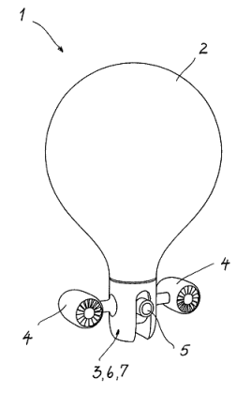
German decompounder
Special care has been taken to index efficiently compound words in German language
Example: WO2014/00729
Gasballongetragener Flugroboter
With decompounding, any of the following queries will match the WO2014/00729 document:
  “gasballon” AND “roboter”
  “gasballon” AND “flugroboter”
  “gasballongetragener “ AND “roboter”
  “getragener” AND “roboter”
Notes:
173

Slide 174
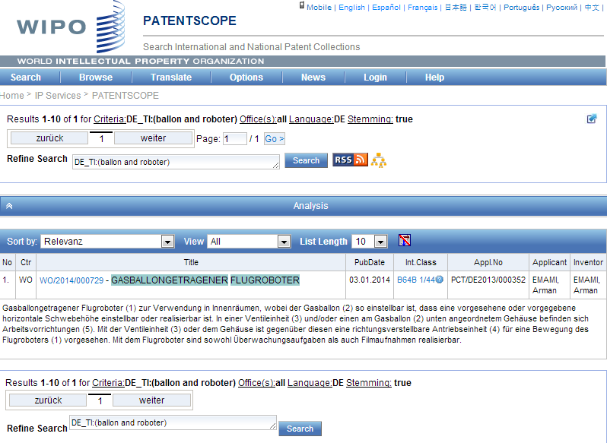
German decompounder

Slide 175
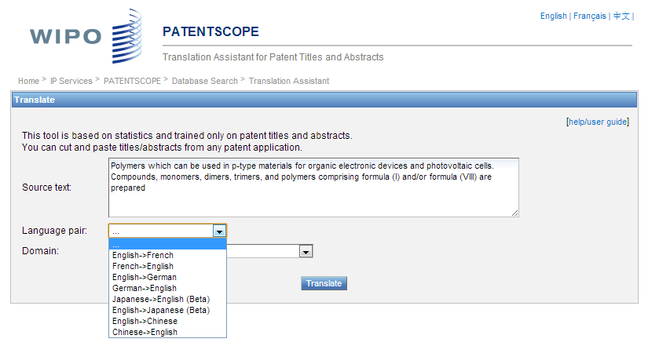
TAPTA

Slide 176


Slide 177



Slide 178
TAPTA: German <=> English
A difficult language pair
Some recent progress: usage of decompounding and of linguistic word reordering
As a result, TAPTA is competitive with Google*Translate for translating patent abstracts between German and English
EAMT 2014, June 18, 2014: Martin Junczys-Dowmunt, Bruno Pouliquen, SMT of German Patents at WIPO, Decompounding and Verb Structure Pre-reordering

Slide 179

Survey in 2013

Slide 180


Who are using PATENTSCOPE ?
Notes:
We see that PATENTSCOPE is mostly used in Asia, Europe and North America
And by
Patent information professionals
Patent office employees
Patent attorneys,
inventors
And then academic researchers

Slide 181

71% : interface is good

Slide 182

Monthly webinar

Slide 183
GLOBAL DATABASES, TOOLS, AND PLATFORMS FOR IP BUSINESS (FREE)
PATENTSCOPE
Global Brand Database
WIPO Lex
WIPO IPAS, WIPO DAS
WIPO CASE
WIPO RE:SEARCH
WIPO GREEN

Slide 184
GLOBAL BRAND DATABASE
Over 13 million records relating to internationally-protected trademarks, etc.
Free of charge simultaneous brand-related searches across multiple collections, including:
  Trademarks registered under Madrid System
  Appellations of Origin registered under Lisbon System
  Emblems protected under the Paris Convention 6ter
  Algeria, Australia, Canada, Egypt, Estonia, Israel, Morocco, New Zealand, Oman, Singapore, Switzerland, UAE, US
  Upcoming: Mexico, Denmark

Slide 185
Global Brand Database
Video demo:
http://www.wipo.int/pressroom/en/articles/2014/article_0007.html

Slide 186




Global Brand Database – Features
Single intuitive interface to search 15 data collections
Image Search by example
Interactive & dynamic search with immediate feedback
Fuzzy, phonetic and word-stem matches
Automatic term suggestion
Easy search of US or Vienna image class
Full Boolean, proximity and range options
Unlimited, customizable results browsing
Saved searches and record sets
Instant, graphical data analysis

Slide 187



Slide 188


Slide 189





Slide 190


Slide 191




Slide 192


Slide 193





Slide 194
GLOBAL DATABASES, TOOLS, AND PLATFORM FOR IP BUSINESS (FREE)
PATENTSCOPE
Global Brand Database
WIPO Lex
WIPO IPAS, WIPO DAS
WIPO CASE
WIPO RE:SEARCH
WIPO GREEN

Slide 195


Slide 196


Slide 197


Slide 198


Slide 199
GLOBAL DATABASES, TOOLS AND PLATFORMS FOR IP BUSINESS (FREE)
PATENTSCOPE
Global Brand Database
WIPO Lex
WIPO IPAS, WIPO DAS
WIPO CASE
WIPO RE:SEARCH
WIPO GREEN

Slide 200
IPAS AND DAS
IPAS (IP office Administration System) used by 60 IPOs
A WIPO software enabling small IPOs to electronically process patent, trademark, design applications
DAS (Digital Access System) used by 11 IPOs
A System that allows IPOs and applicants to securely exchange or submit a digital copy of priority documents to multiple IPOs
Notes:
Those are software systems developed and maintained by WIPO for IP offices of its member states.
The first one IPAS, which is an acronym for IP Office Administration System) is used by 60 small IP offices and enable them to electronically process patent, trademark and design applications.
The second one is named DAS, which stands for Digital Access System, is used by 11 IP offices and allows them and their applicants to securely exchange certified digital copies of priority documents among themselves.

Slide 201
GLOBAL DATABASES, TOOLS, AND PLATFORM FOR IP BUSINESS (FREE)
PATENTSCOPE
Global Brand Database
WIPO Lex
WIPO IPAS, WIPO DAS
WIPO CASE
WIPO RE:SEARCH
WIPO GREEN
Notes:
The next system I wish to present to you is called WIPO CASE.

Slide 202
WIPO CASE
“Centralized Access to Search and Examination Reports”
Started with an initiative of IP Australia and the Vancouver Group (AU, CA, UK)
Online patent work-sharing platform for patent examiners worldwide—secure sharing search and examination documentation
IPOs can enhance quality and efficiency of patent examination
CASE will be linked to Open Portal Dossier of IP5 to become the Global Portal Dossier
How will it work?

Slide 203
WIPO CASE (CONTINUED)
The System will notably allow examiners to:
  search by patent number and retrieve simple results or a list of patent family members.
  view bibliographic data, citation data (if available) and lists of documents available for each patent record.
  view and/or download the available documents.
  subscribe to notifications of updates to a given patent record.

Slide 204


Slide 205




GLOBAL DOSSIER PLATFORM (WIPO-CASE, OPD AND PATENTSCOPE)
Public Users
(including IP office users)
Examiner of IP5 Office not participating in WPO/CASE
OPD
Feed dossier information that OPD/CASE Offices agree to publish
Public Domain
OPD
WIPO CASE
Not accessible to the public and for PTO official use only
IPAS+
CASE depositary
System
Examiner of CASE participating office
Examiner of IP5 Office participating in WPO/CASE
CASE depositary Office using IPAS
CASE depositary Office using own EDMS
E.g. Australia

Slide 206
GLOBAL DATABASES, TOOLS, AND PLATFORMS FOR IP BUSINESS (FREE)
PATENTSCOPE
Global Brand Database
WIPO Lex
WIPO IPAS, WIPO DAS
WIPO CASE
WIPO RE:SEARCH
WIPO GREEN

Slide 207


Broad aims:
  Match-making for technology transfer and collaborations
  Reduce transaction costs
  Build on comparative advantages of multi-stakeholder approaches
  Demonstrate practical means for the global policy issues
Based on the recognition that:
    Users want access to technologies, not just patent rights
    Collaboration (e.g. training) is crucial to tech transfer

Slide 208
WIPO RE: SEARCH
A Global Database and Platform to bridge partners to use IP (including know-how and data) to facilitate R&D on neglected tropical diseases, tuberculosis, and malaria.
Royalty-free for R&D, manufacture and sale in LDCs
Over 60 partners (pharmaceutical industry, research institutes such as NIH, Universities)
As of January 2014, 44 collaborations

Slide 209

www.wipo.int/research

Slide 210













WIPO RE:SEARCH
Sharing Innovation in the Fight Against Neglected Tropical Diseases
Get involved:
As a user
As a provider
As a supporter
(Adhere to Guiding principles, contact email: re_search@wipo.int)
…

Slide 211
WIPO GREEN
A global database allowing users to make green technologies available for licensing or partnership, enter technology needs, search for technologies and needs
Started a pilot with Japan Intellectual Property Association in 2011
Launched in November 2013
as of January 2014, over 800 offers
Green tech providing companies in Germany, Japan, US etc.
Partners include companies, universities, UN agencies, governments, IPOs, NGOs, etc.

Slide 212





























Partners of WIPO GREEN

Slide 213

www.wipo.int/green

Slide 214

Six Areas of Green Technology Markets

Slide 215

The Challenge
International Transfer of wind power technology, 1988-2007,
OECD 2010

Slide 216
Get Involved
Become a Partner and shape the further development of WIPO GREEN
Register to:
    communicate your green innovation and technology needs
    advertise your inventions, technologies, products and services
    connect with the innovation and business communities globally

Slide 217
THANK YOU!
Notes:
Welcome ….
Today, we are going to explain to you, in very general terms,
what this Organization does and why?

