Slide 1
Main Challenges of Global Knowledge Governance in the Field of Intellectual Property
Civil Society and Various Stakeholders
WIPO - INTERREGIONAL MEETING
Brazil – August – 2012

Slide 2
Confederação Nacional da Indústria

Slide 3
Brazil: Facts & Figures
6th
Largest economy
2nd
Food producer
5th
Population
44th
Innovation
4th
FDI destiny
53rd
Competitiveness
10th
Internal market
Development transition stage
1st
Megabiodiverse Country
Efficienty
driven
Innovation
driven

Slide 4
INTELLECTUAL PROPERTY
Powerful economic tool for the generation of global knowledge “proprietary” platforms for companies and nations
Confederação Nacional da Indústria

Slide 5
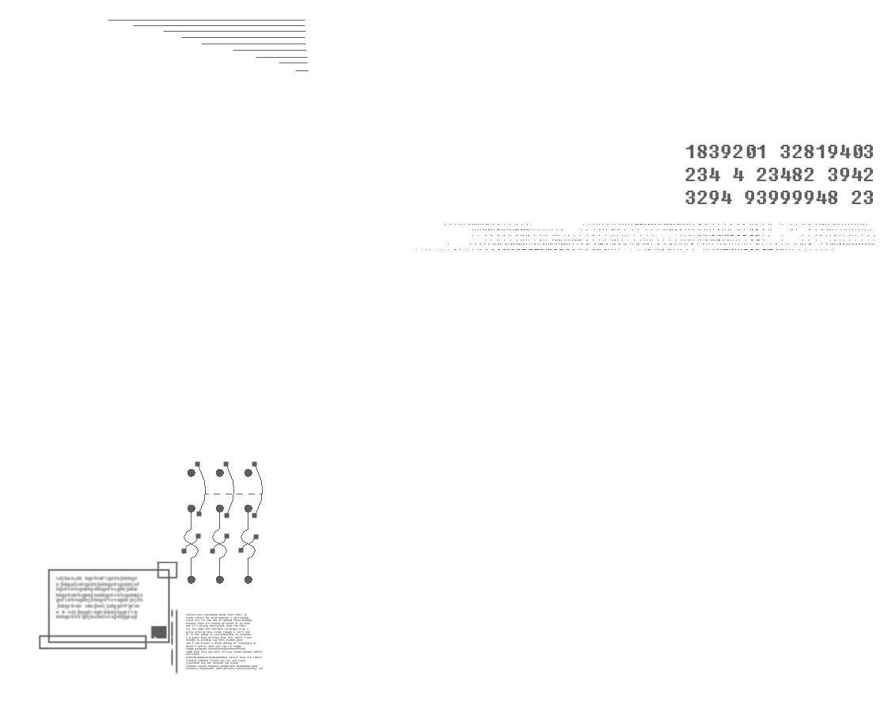
INNOVATION AND COMPETITIVENESS
The future of global competitiveness is strongly connected to the commercial exploitation of the rights over proprietary innovations

Slide 6
INGREDIENTS FOR TECHNOLOGICAL INNOVATION
Brains +
Information +
Capital
=
Protected Inventions +
New products + New markets

Slide 7
Intellectual property transforms knowledge into assets of economic
value generating wealth to the countries.

Slide 8
Brazil must learn how to protect
and exploit the rights over its innovations

Slide 9
INTELLECTUAL PROPERTY PROGRAM LAUNCHED
2010
Biggest awareness and capacity building program in Latin America

Slide 10
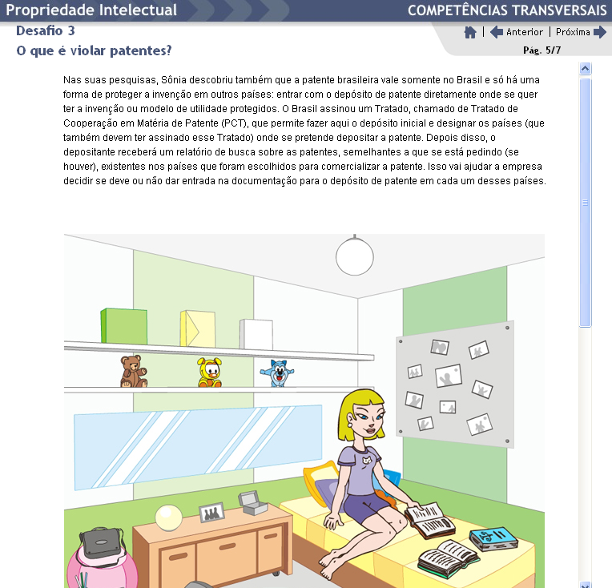
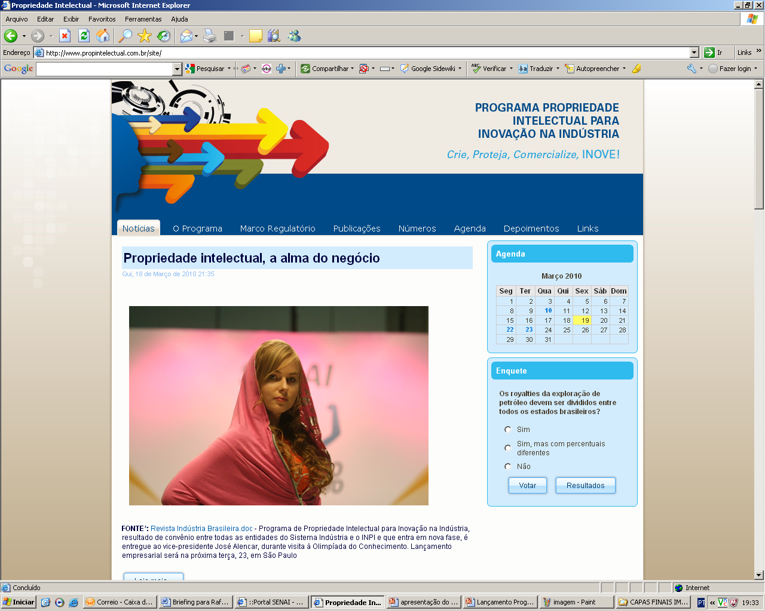
!
Businessman
Teacher
Teen # 118.107 in 24months
Journalist
Employee-CNI
Institutional
Web User

Slide 11
CORPORATE MOBILIZATION
FOR INNOVATION (MEI)
AN INITIATIVE OF

Slide 12
INTELLECTUAL PROPERTY AT MEI’S AGENDA
2011
First strategic topic in Brazil’s Innovation Agenda

Slide 13
Rights over protected intellectual assets
BRAZIL NEEDS:
MODERN INTELLECTUAL PROPERTY POLICY
Legal safety environment for business

Slide 14
BRAZIL NEEDS:
UPGRADING OF THE INDUSTRIAL PROPERTY LAW
New regulation system for the genetic resources
Speed in the access to our biodiversity

Slide 15
BRAZIL NEEDS:
INTELLECTUAL PROPERTY FOR BIOTECHNOLOGY
Patent protection for inventions related to living and genetically modified organisms

Slide 16
BRAZIL NEEDS:
BRAZIL NEEDS:
INTELLECTUAL PROPERTY FOR BIOTECHNOLOGY
Patent protection for inventions related to living and genetically modified organisms
+ PROTECTION OF CULTIVARS
Improving of the legal framework
Greater protection for the development of agribusiness

Slide 17
BRAZIL NEEDS:
IMPROVEMENT IN INPI’S PERFORMANCE
Reduction of the excessive delay in the analysis and grant of patents

Slide 18
BRAZIL NEEDS:
INCENTIVE TO THE USE OF
BRAZIL NEEDS:
PATENT DATABASE
Source of information for business intelligence
More innovation
More competitiveness

Slide 19
BRAZIL NEEDS:
Fine tuning for the digital economy
COPYRIGHT LAW MODERNIZATION

Slide 20
INTELECTUAL PROPERTY GOVERNMENT PRIORITY
2012
Highlights of President Dilma Roussseff speech at CNI @13/04/12

Slide 22
Trade
Intellectual property = innovation + legal safety + economic value

Slide 23
KNOW MORE
MEI’s Innovation Agenda
Intellectual Property Program
www.propintelectual.com.br
Thank you!
Diana Jungmann, MSc. PhD.
IP Coordinator – CNI – Brazil
diana@cni.org.br

