Slide 1
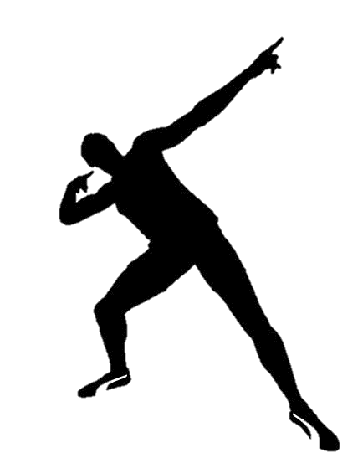
Registering the name of athletes as trade marks
CELIA SUEIRAS VILLALOBOS
May 28, 2018

Slide 2
REGISTERING THE NAME OF ATHLETES AS TRADE MARKS:
SPORTS AND BRAND VALUE
“By failing to take the proper steps necessary to protect his or her brand, an athlete, amateur or professional, could potentially lose out on millions of dollars”
https://www.forbes.com/sites/darrenheitner/2013/12/09/should-current-ncaa-student-athletes-file-for-federal-trademark-protection/#b4f15a04975e

Slide 3
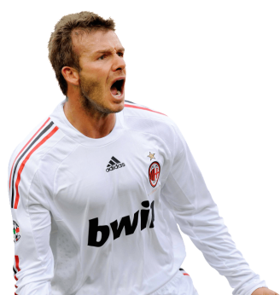
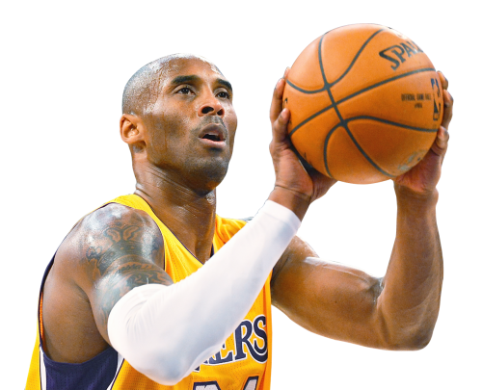
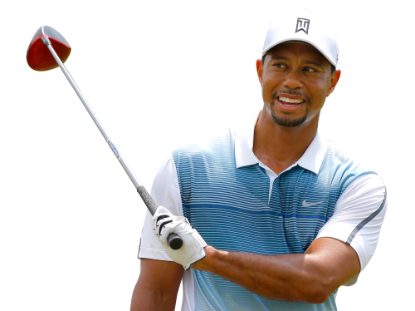
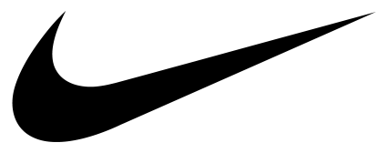
REGISTERING THE NAME OF ATHLETES AS TRADE MARKS:
SPORTS AND BRAND VALUE
TRADEMARKS ASSOCIATED WITH
INDIVIDUAL ATHLETES’ NAME AND LIKENESS:
$26 billion $361 Million $38 million $26 million $18 million
NIKE BRAND
NEW YORK YANKEES BRAND
TIGER WOODS
DAVID BECKHAM
KOBE
BRYANT
Notes:
Brand value: amount by which the brand contributes to the value of the athlete, business, event or team.
Athletes’ brand value: their earnings (excluding salary and bonus from their sport and all investment income), minus the average income of the top 10 athletes in the same sport.
Team brand value: measure the portion of the team's enterprise value attributable to local revenue streams like television, advertising, merchandise and tickets, that exceeds what a typical team in the same sport generates.

Slide 4
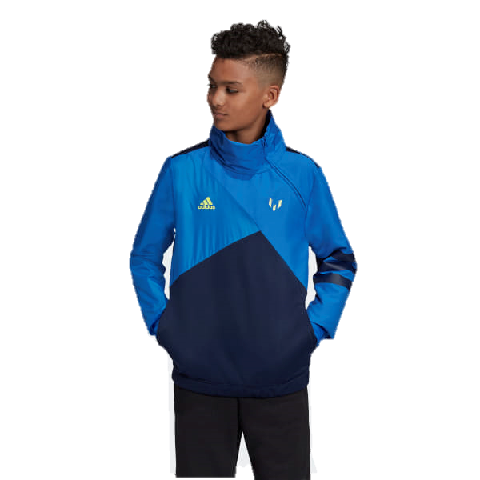
REGISTERING THE NAME OF ATHLETES AS TRADE MARKS:
TRADE MARK RIGHTS
“Having a clean plate with rights in place makes it a lot easier to negotiate licenses and endorsements deals”- NBA basketball player Jeremy Lin’s lawyer.
Ex: Messi’s mark on his Adidas clothing line. (Messi owns 74 registered marks, forming one of the biggest portfolios in the sport industry).

Slide 5
REGISTERING THE NAME OF ATHLETES AS TRADE MARKS:
TRADE MARK RIGHTS
STRATEGY: Why register a trade mark?
Athletes at all stages of their careers are increasingly attempting to register their names as trade marks (and nicknames, poses, catchphrases, fan slogans…)
Trade marks might be used to safeguard an athlete’s image and their rights to exploit it:
WITHOUT A TRADE MARK, ATHLETES WOULD NEED TO RELY ON UNREGISTERED RIGHTS, WHICH CAN BE MORE DIFFICULT TO ESTABLISH AND ENFORCE.

Slide 6
REGISTERING THE NAME OF ATHLETES AS TRADE MARKS:
STRATEGY: WHY REGISTER A TRADE MARK?
Image rights
The right to one’s own image is the ability to decide when, how and by whom our physically recognizable features can be captured, reproduced or published.
(IMAGE VOICE NAME)
Even without a registered trade mark, athletes’ image rights may have the capacity to prevent unauthorized use of their name.
Some jurisdictions, like the UK, do not have specific regulation to protect against such unauthorized use of one’s image, name or likeness by a third party. (Passing off – false endorsement).
!
+
+

Slide 7
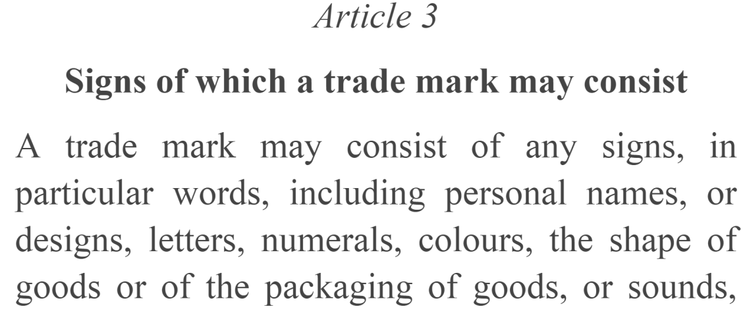
REGISTERING THE NAME OF ATHLETES AS TRADE MARKS:
STRATEGY: WHY REGISTER A TRADE MARK?
Trade mark rights
Trade marks might be used to safeguard an athlete’s image and their rights to exploit it:
By registering their names as trade marks, athletes gain a monopoly right to the use of their name for certain goods and services in the territory where it is registered. This can prevent anyone from subsequently using the same or a confusingly similar mark.

Slide 8
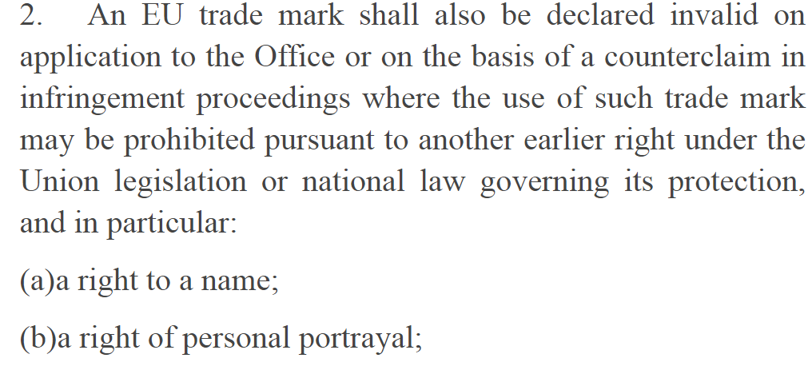
REGISTERING THE NAME OF ATHLETES AS TRADE MARKS:
STRATEGY: WHY REGISTER A TRADE MARK?
Trade mark rights
GROUNDS FOR INVALIDITY AND GROUNDS FOR OPPOSITION:
IS ONE’S PERSONAL NAME AN EARLIER RIGHT?

Slide 9
REGISTERING THE NAME OF ATHLETES AS TRADE MARKS:
STRATEGY: WHY REGISTER A TRADE MARK?
Is athletes’ purpose in filing trade mark applications that of the traditional purpose of trademark law?
The types of use that athletes are currently making of marks differ from the types of use theoretically required for protection.
PERSONAL NAMES AND TRADE MARKS ARE NOT SYNONYMOUS

Slide 10
REGISTERING THE NAME OF ATHLETES AS TRADE MARKS:
STRATEGY: FOR WHICH CLASSES REGISTER A TRADE MARK?
STRATEGY: FOR WHICH CLASSES register a trade mark?
To qualify as a trade mark, a sign must be distinctive, and it must be used to indicate the source of goods or services or distinguish its owner’s products from those of competitors.
Effective use: if athletes are to register their names as trade marks, they are bound to use them in commerce as trade marks, not just as personal names:
A LARGE NUMBER OF TRADE MARKS ARE VULNERABLE TO BE ATTACKED ON GROUNDS OF NON-USE

Slide 11
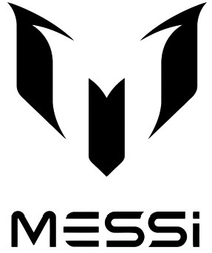
REGISTERING THE NAME OF ATHLETES AS TRADE MARKS:
LIMITATIONS FOR TRADE MARK PROTECTION
To obtain registration for a trade mark, athletes must specify the goods or services for which their name serve as a mark. Ex:
For what goods or services (if any) are the words “DAVID BECKHAM” a trade mark?
The word NIKE and the “swoosh” symbol are trade marks for sneakers and athletic apparel.
:
Are marks like these
being used in commerce
as trade marks,
or merely as references
to well-known athletes?

Slide 12
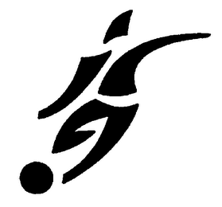
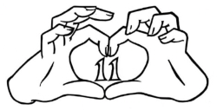
REGISTERING THE NAME OF ATHLETES AS TRADE MARKS:
TRADE MARK RIGHTS AND SOCCER PLAYERS
Pretty much every big name soccer player has their own registered trade mark.
Many soccer players use their trade marks to sell merchandise and be in a better position to license their marks to third parties.
JESSE LINGARD
HARRY KANE
GARETH BALE
DAVID BECKHAM

Slide 13
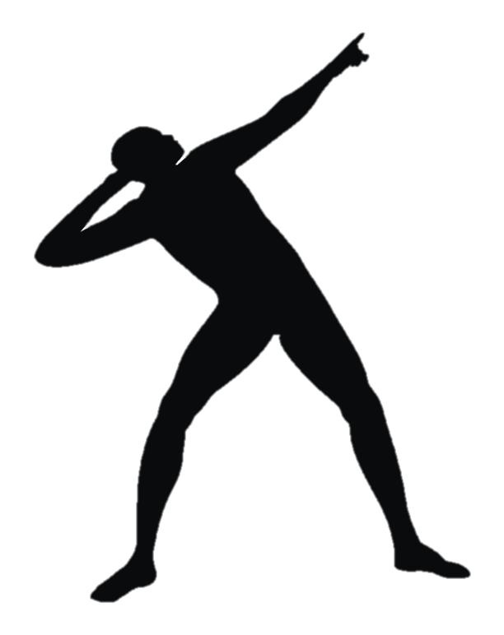
REGISTERING THE NAME OF ATHLETES AS TRADE MARKS:
TRADE MARK RIGHTS
Which signs can be registered?
Athletes and sporting celebrities not only register their own names as trade marks, but also register nicknames, poses, slogans, catchphrases, signatures, or other insignia for which they are well known.
Usain Bolt’s “Lightening Bolt” pose and the “to the world” slogan are registered trade marks.

Slide 14
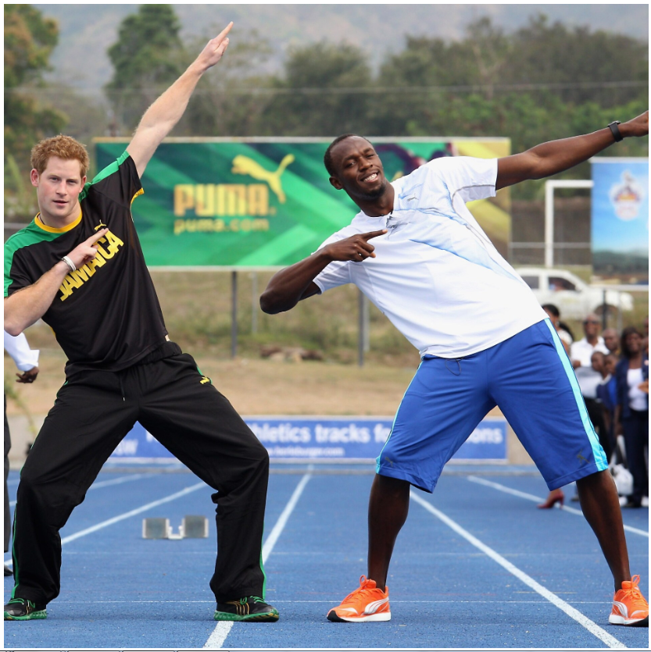
REGISTERING THE NAME OF ATHLETES AS TRADE MARKS:
TRADE MARK RIGHTS
For what
goods or services
is this pose
a trade mark?
https://www.telegraph.co.uk/usain-bolt-worlds-fastest-man/0/bolting-a-closer-look-at-athletics-most-famous-celebration/bolt-and-prince-harry-strike-bolts-trademark-pose-during-harrys/

Slide 15
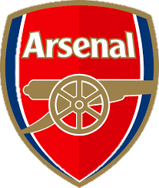
REGISTERING THE NAME OF ATHLETES AS TRADE MARKS:
TRADE MARK RIGHTS
JUDGMENT OF THE GENERAL COURT 12 November 2002
Arsenal Football Club Plc v Matthew Reed
1989: Arsenal FC had the words “Arsenal” and “Arsenal Gunners” and the clubs’ emblems registered as trade marks for a wide class of goods. The club supplied products as articles of clothing and footwear.
Mr. Reed had since 1970 sold football souvenirs marked with Arsenal FC signs from several stalls situated outside the club's stadium.
The proprietor of a trade mark must be able to prevent its use by a third party if that use is liable to affect the guarantee of origin of the goods:
The fact that the use may be perceived as a badge of support for or loyalty or affiliation to the proprietor of the trade mark does not affect that principle.

Slide 16
REGISTERING THE NAME OF ATHLETES AS TRADE MARKS:
STRATEGY: WHERE REGISTER A TRADE MARK?
STRATEGY: where register a trade mark?
TERRITORIALITY
The scope of a trade mark right is limited to the territory of the state granting it. The exclusive right can only ﻿cover activities occurring within the respective territory.
Trade mark owners may encounter some enforcement problems in certain territories such as developing countries.

Slide 17
REGISTERING THE NAME OF ATHLETES AS TRADE MARKS:
TRADE MARK PROTECTION
Are athletes using the registration system to protect marks that are not effectively used in commerce?
“Some athletes who apply to register their name do so not because they want to capitalize on their celebrity by selling particular products or services, but because they feel pressure to protect their names and control how it's used”.
Use of the trade mark registration system to prevent others from capitalizing on their reputations, rather than affirmatively to protect trademarks they use in connection with goods or services.
Athlete Trademarks: Names, Nickname - The Oxford Handbook of American Sports Law (2018)
DEFENSIVE USE OF TRADE MARK REGISTRATION

Slide 18
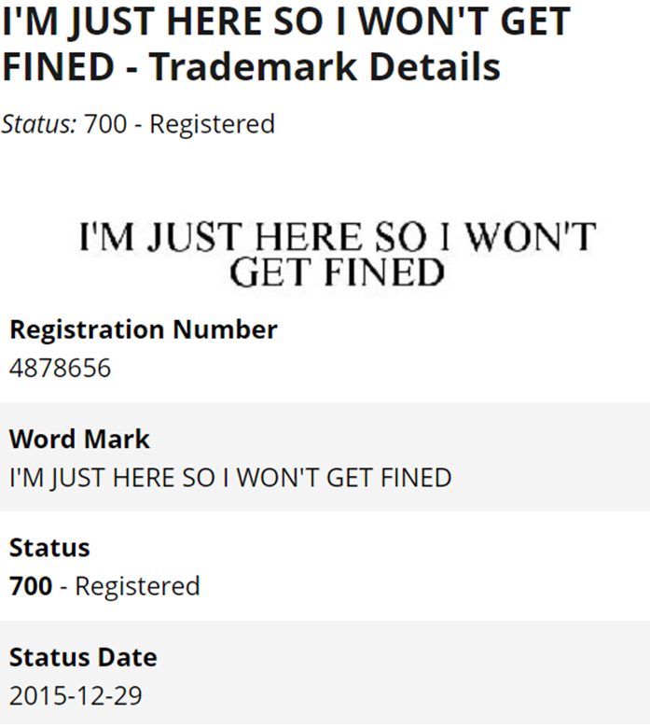
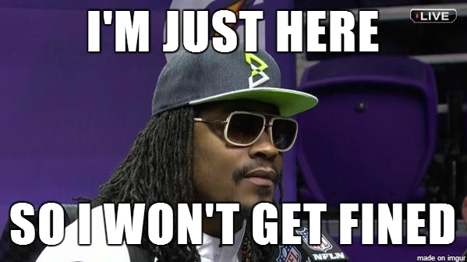
REGISTERING THE NAME OF ATHLETES AS TRADE MARKS:
TRADE MARK PROTECTION
https://imgur.com/gallery/BvKQELs

Slide 19
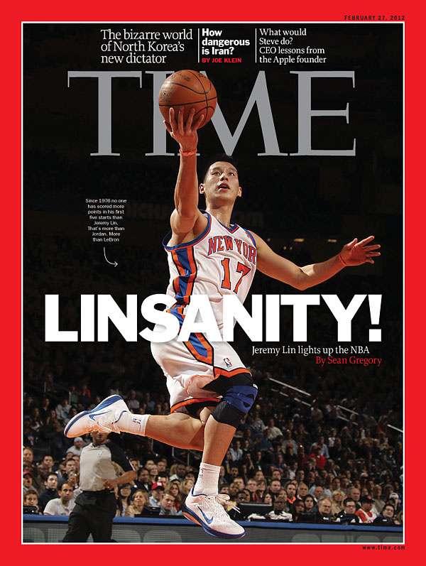
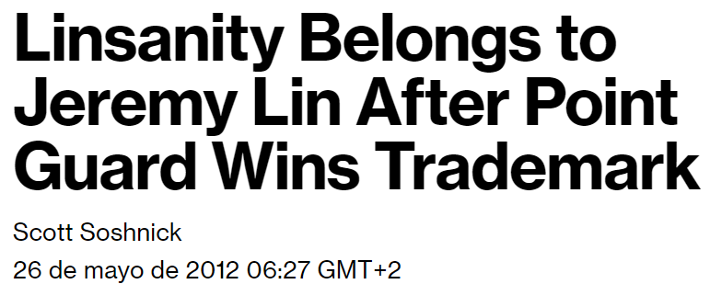
REGISTERING THE NAME OF ATHLETES AS TRADE MARKS:
TRADE MARK PROTECTION
REGISTER NOW OR HOLD YOUR PEACE FOREVER

Slide 20
REGISTERING THE NAME OF ATHLETES AS TRADE MARKS:
TRADE MARK RIGHTS
STRATEGY: wheN IS IT WORTH TO INITIATE LEGAL ACTIONS?
Is the intention of the applicant to block or prevent the registration of a the athlete’s personal name as a trade mark?

Slide 21
REGISTERING THE NAME OF ATHLETES AS TRADE MARKS:
TRADE MARK PROTECTION

Slide 22
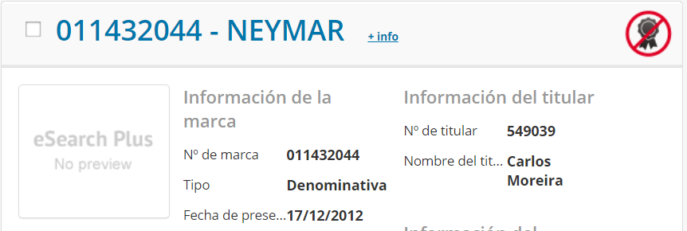
REGISTERING THE NAME OF ATHLETES AS TRADE MARKS:
TRADE MARK PROTECTION
JUDGMENT OF THE GENERAL COURT 14 May 2019
DECEMBER 2012
FEBRUARY 2016
Mr. Carlos Moreira, residing in Portugal, files an application for registration for the word sign ‘NEYMAR’, in respect of ‘clothing, footwear, and headgear’ (Class 25 Nice Classification).
That year, Neymar was ranked South America’s best football player.
Mr. Neymar Da Silva Santos Júnior files a declaration of invalidity against the mark under Article 59(1)(b) of Regulation 2017/1001, alleging bad faith registration.

Slide 23
REGISTERING THE NAME OF ATHLETES AS TRADE MARKS:
TRADE MARK PROTECTION
JUDGMENT OF THE GENERAL COURT 14 May 2019
What was the applicant’s argument?
He was aware of Neymar’s existence when he filed the application, but did not know the Brazilian footballer was a rising star.
The decision to seek registration of the word sign ‘NEYMAR’ was a mere coincidence.
The timing of the application should be taken into account - the following factors are considered relevant:
IDENTICAL SIGNS OR CONFUSING SIMILARITY OF THE SIGNS;
KNOWLEDGE OF THE USE OF AN IDENTICAL/CONFUSINGLY SIMILAR SIGN; AND
DISHONEST INTENTION ON THE PART OF THE EUTM OWNER.
The mark consists only of the word element ‘NEYMAR’, which is identical to the name under which the footballer acquired international renown.
The applicant also sought registration of the name of Iker Casillas as a mark (which proves the applicant possessed more than a little knowledge of the world of football).

Slide 24
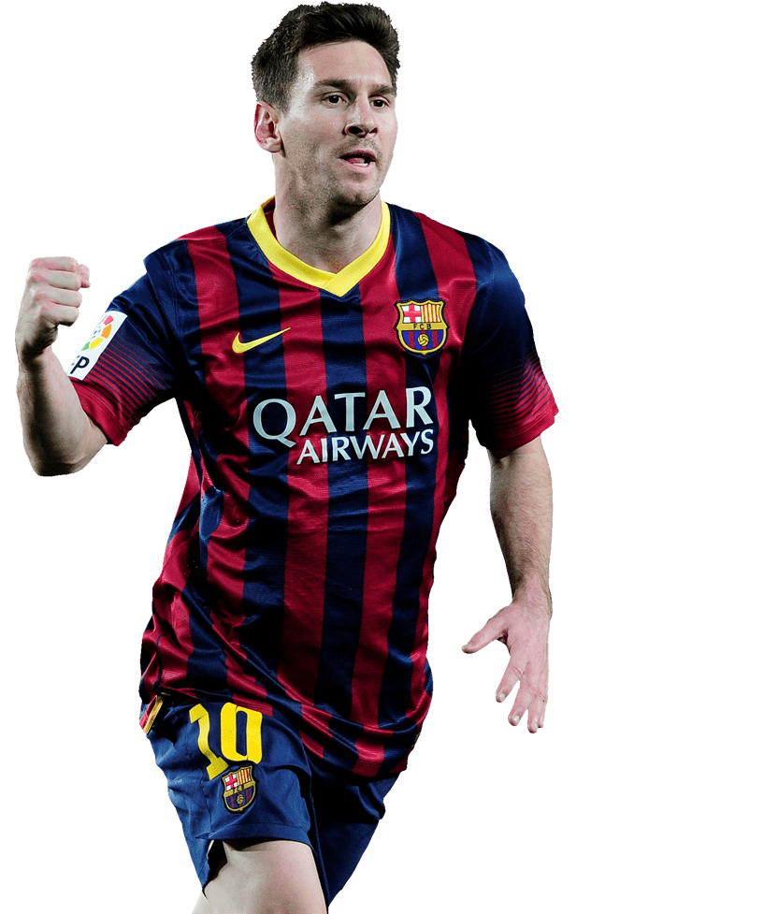
REGISTERING THE NAME OF ATHLETES AS TRADE MARKS:
TRADE MARK PROTECTION
http://www.stickpng.com/es/img/celebridades/deportistas-celebres/messi/barcelona-lionel-messi

Slide 25
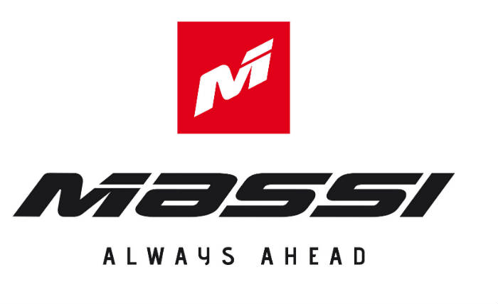
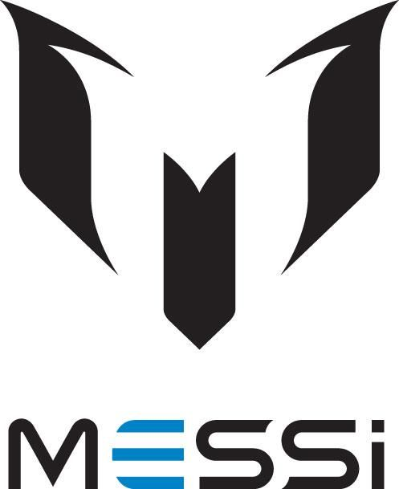
REGISTERING THE NAME OF ATHLETES AS TRADE MARKS:
TRADE MARK PROTECTION
JUDGMENT OF THE GENERAL COURT 26 April 2018
SEVEN-YEAR TRADE MARK FIGHT
August 2011: Lionel Andrés Messi requests to register an EUTM for sports and gymnastics clothing, footwear and equipment.
November 2011: Mr. Jaime Masferrer Coma files an opposition claiming likelihood of confusion. The ‘MASSI’ EU word marks is registered, inter alia, for clothing, shoes, bicycle helmets…
The signs are similar overall, but the conceptual differences between them are such as to counteract the visual and phonetic similarities identified.
A significant part of the relevant public will associate the term ‘Messi’ with the football player and therefore perceive the term ‘Massi’ as conceptually different.
Degree of similarity: not sufficiently high to accept that the relevant public may believe that the goods at issue come from economically-linked undertakings.

Slide 26
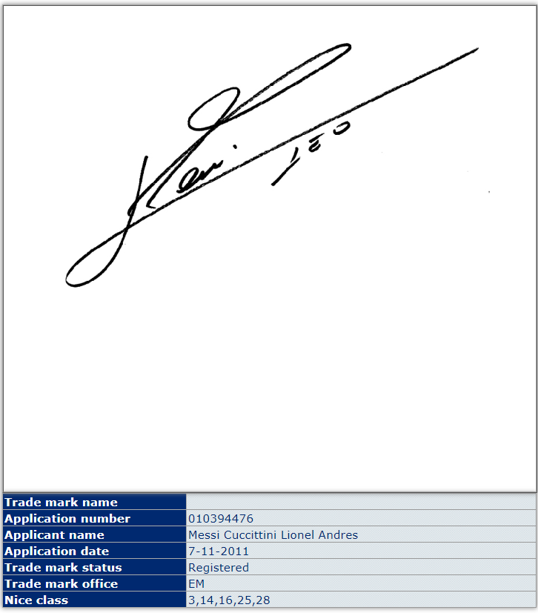
REGISTERING THE NAME OF ATHLETES AS TRADE MARKS:
TRADE MARK PROTECTION

Slide 27
Thank you!
CELIA SUEIRAS VILLALOBOS
May 28, 2018

