Slide 1
Intellectual Property rights Enforcement
CELIA SUEIRAS VILLALOBOS
May 28, 2018

Slide 2
IPR ENFORCEMENT:
IP AND THE SPORTS INDUSTRY
Virtually each sport - and related sports industries - need the protection of some form of IP rights, and an environment that enforces those rights.
In an enabling environment of robust IP rights, a chain reaction occurs benefiting multiple sectors of the economy— representing 1% of global GDP.
Patent-protected inventions drive improvement in sporting equipment, including sportswear and footwear.
Broadcasting rights are the foundation for investment in transmitting tournaments to fans and sports enthusiasts.
Trade marks protect the goodwill of events, leagues, teams, and manufacturers of sporting goods.
Licensing and merchandising agreements generate the revenues needed to take sports to higher levels of productivity.

Slide 3
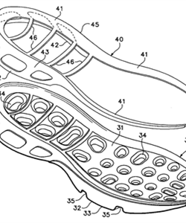
IPR ENFORCEMENT:
IP AND THE SPORTS INDUSTRY
The modern sports industry:
2019: WHERE ARE WE TODAY?
Nike has 19,500 patents and patent applications
Its patents have nearly doubled since 2009
Nike Air® sole. Nike describes this feature as “tough but flexible bags” filled with gas or fluid in a sole which absorbs shock.

Slide 4
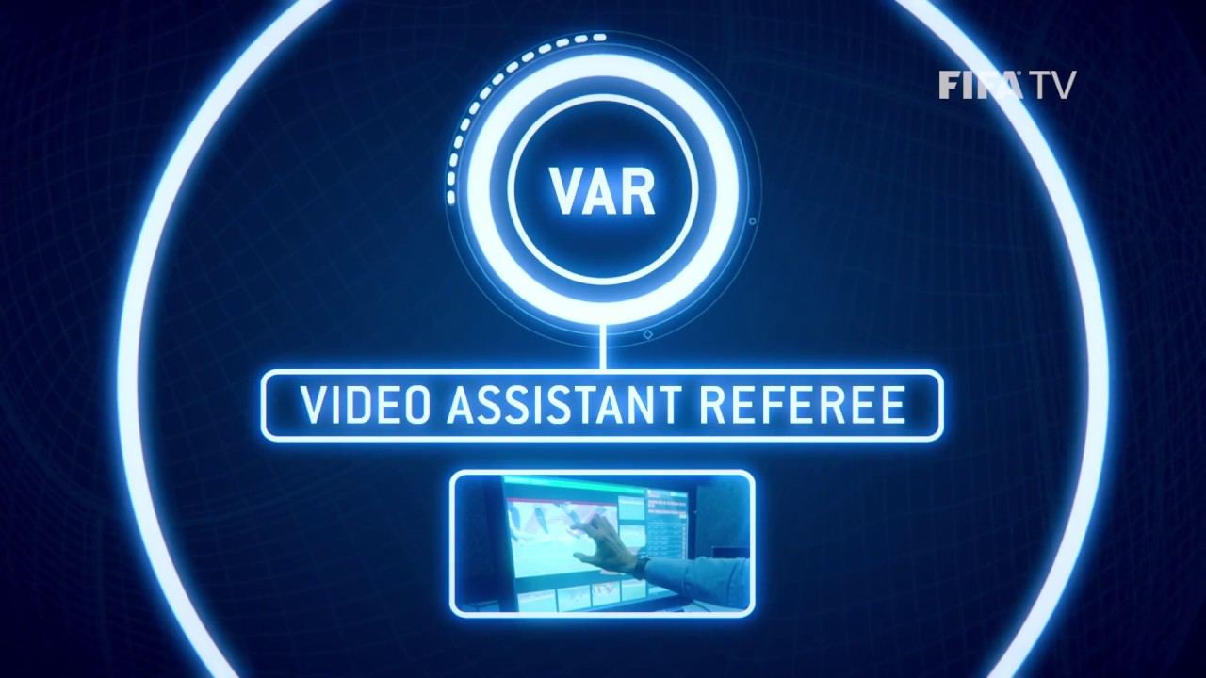
IPR ENFORCEMENT:
IP AND THE SPORTS INDUSTRY
The modern sports industry:
2019: WHERE ARE WE TODAY?
Traditionally, sports has been associated with two main IP rights: copyright and trademarks.
Innovation in the sports industry makes copyright and trademark protection look insufficient, offering a very narrow view of how sports benefit from IP rights.
For example: the rise of enhanced technologies yields more research-driven innovative sporting products. In turn, these products require strong patent protection.

Slide 5
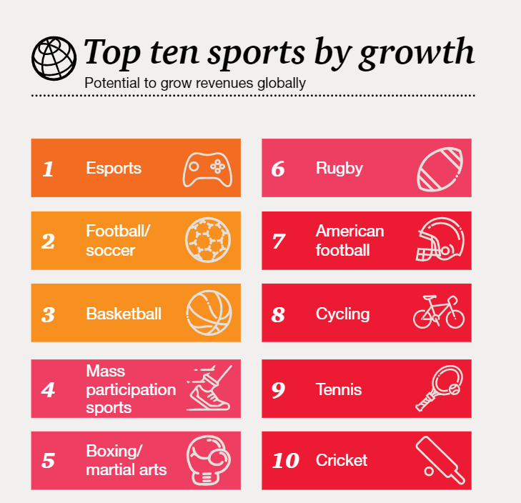
IPR ENFORCEMENT:
CHALLENGES
FUTURE CHALLENGES FOR IPR
ESPORTS
COUNTERFETING
SOCIAL MEDIA
BROADCASTING PIRACY
Source: PwC's Sports Survey 2018

Slide 6
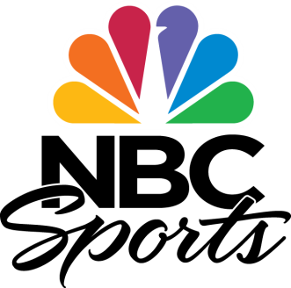
IPR ENFORCEMENT:
CHALLENGES
FUTURE CHALLENGES: ESPORTS

Slide 7
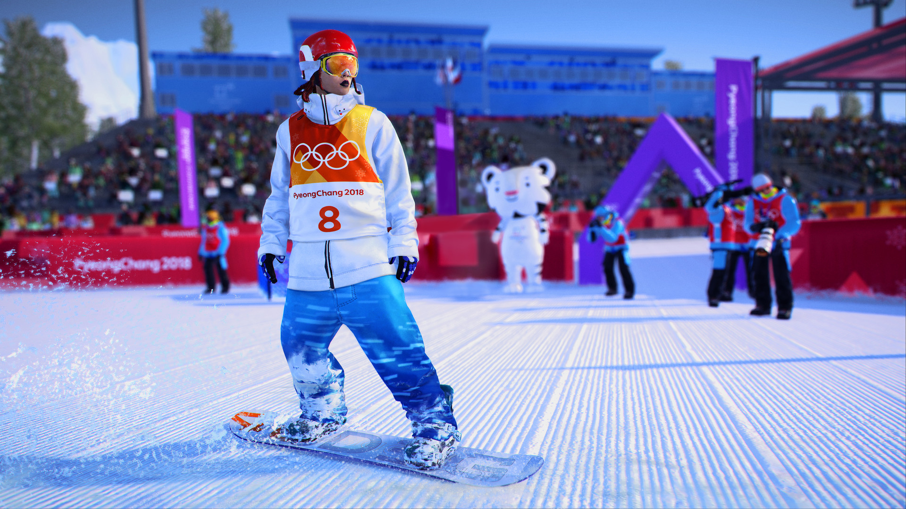

Slide 8
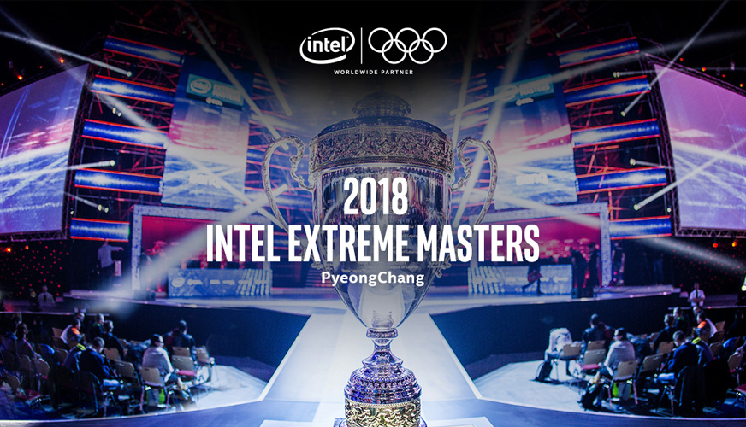

Slide 9
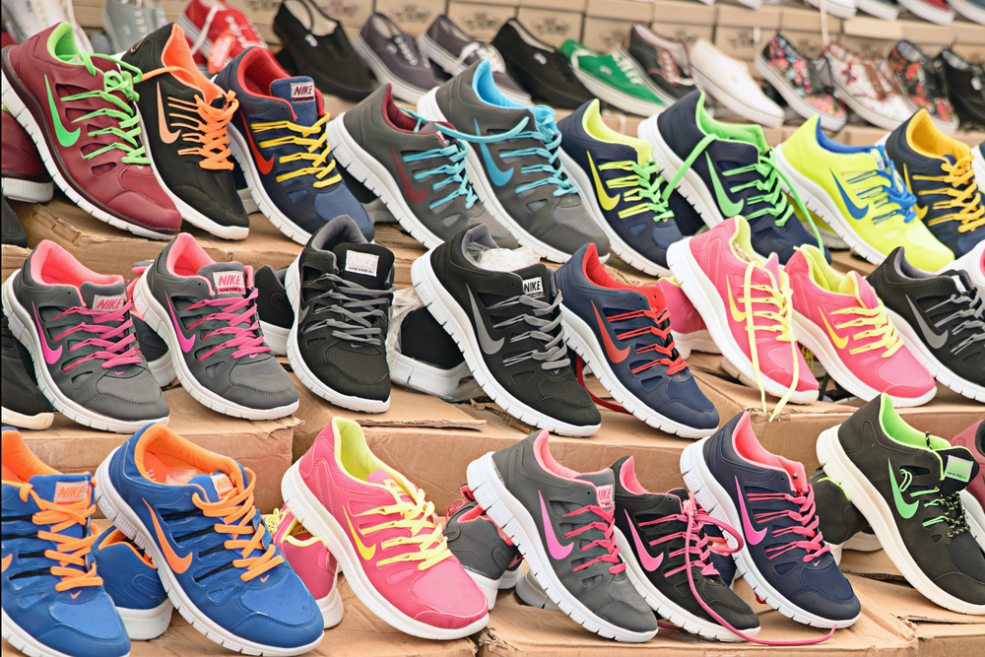
IPR ENFORCEMENT:
CHALLENGES
As online shopping becomes more popular and widespread, so does the proliferation and sale of counterfeit goods.
WHAT’S THE MAGNITUDE OF COUNTERFEITING IN THE SPORTING GOODS MARKET?
A 2015 study carried out by the EUIPO revealed that in 2012, counterfeiting of sporting goods resulted in the loss of nearly €500 million in sales of sporting goods within the EU.
(NOT SO) FUTURE CHALLENGES: ONLINE MARKETS: THE NEXT COUNTERFEITING FRONTIER?

Slide 10
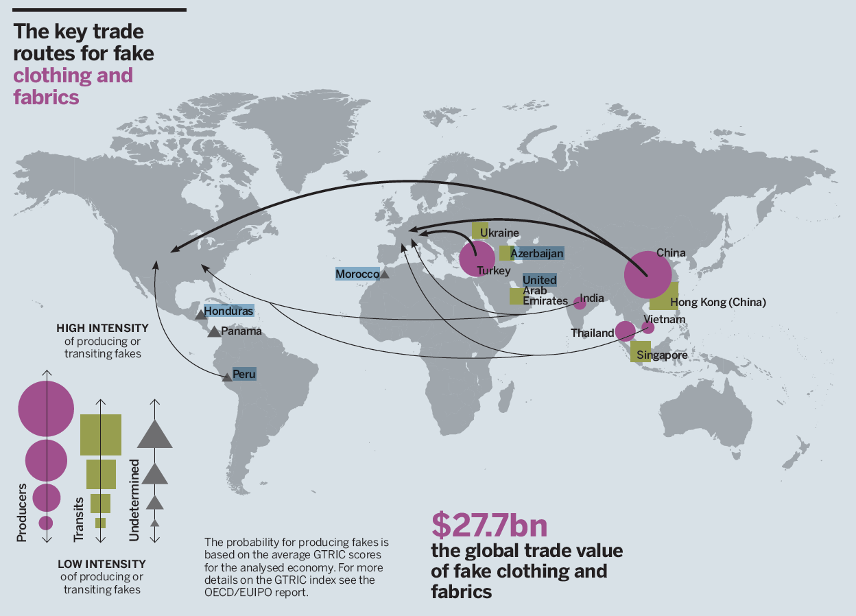
IPR ENFORCEMENT:
CHALLENGES
CUSTOMS PROTECTION: THE KEY TRADE ROUTES FOR FAKE CLOTHING AND FABRICS
Regulation (EU) No 608/2013 of the European Parliament and of the Council of 12 June 2013 concerning customs enforcement of intellectual property rights and repealing Council Regulation (EC) No 1383/2003.
OECD/EUIPO (2017) Mapping the Real Routes of Trade in Fake Goods

Slide 11
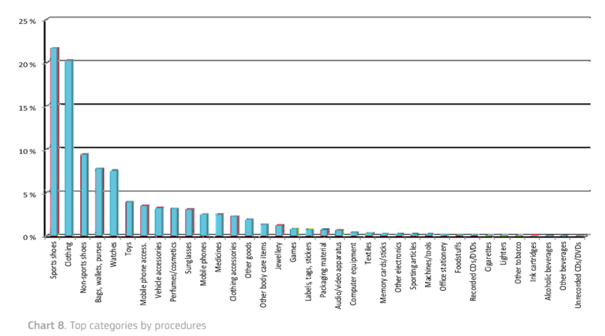
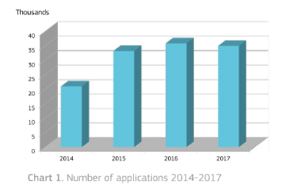
IPR ENFORCEMENT:
CHALLENGES
CUSTOMS PROTECTION: THE IMPORTANCE OF CUSTOMS ENFORCEMENT
Report on EU customs enforcement of intellectual property rights. Results at the EU border. (2017)

Slide 12
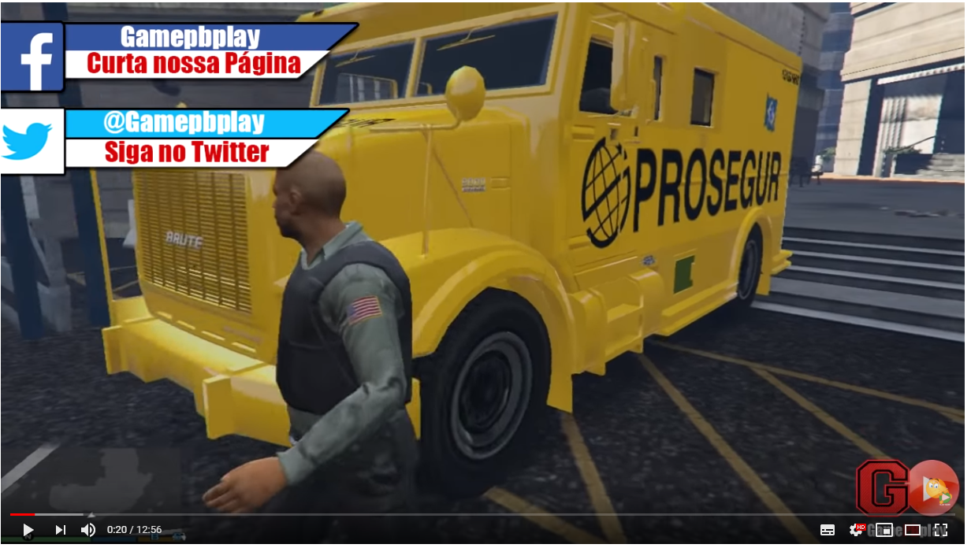
IPR ENFORCEMENT:
CHALLENGES
FUTURE CHALLENGES: SOCIAL MEDIA AND USER GENERATED CONTENT

Slide 13
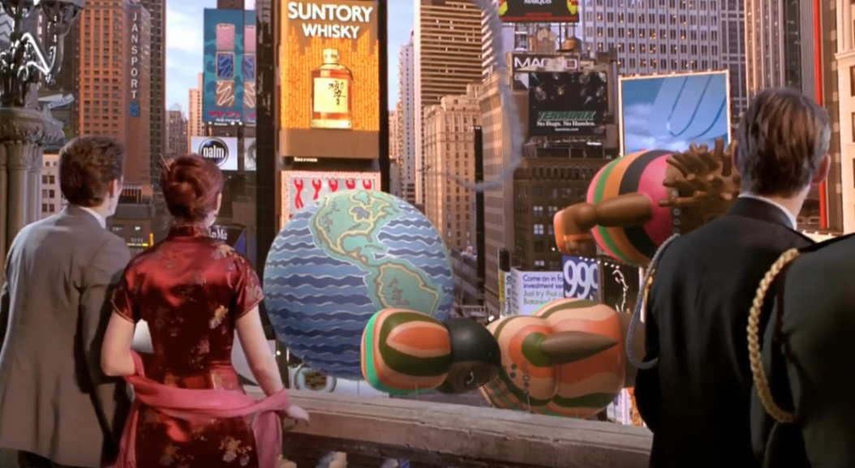
IPR ENFORCEMENT:
IP AND THE SPORTS INDUSTRY
2002: HOW DID IT START OUT?
A federal judge in New York upheld the rights of filmmakers to superimpose digital images on real-life buildings in their movies.
Spider Man 2002. Time square battle scene

Slide 14
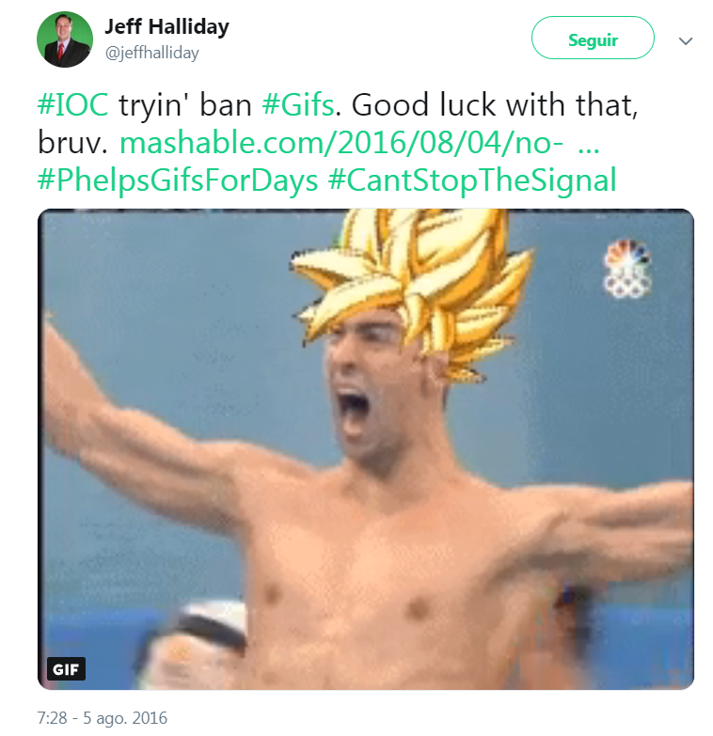
IPR ENFORCEMENT:
CHALLENGES
(NOT SO) FUTURE CHALLENGES: SOCIAL MEDIA AND USER GENERATED CONTENT

Slide 15
IPR ENFORCEMENT:
CHALLENGES
(NOT SO) FUTURE CHALLENGES: PIRACY OF LIVE SPORTS BROADCASTING

Slide 16
IPR ENFORCEMENT:
CHALLENGES
(NOT SO) FUTURE CHALLENGES: PIRACY OF LIVE SPORTS BROADCASTING
Identifying and fighting piracy of live broadcasts of sports events is not an easy task.
Example: multimillion-dollar site LiveTV.sx, which streams pirated sports events complete with banners and pop-up ads.
The site is administered in Panama with a domain name registered in the Caribbean by a Kazakh national.

Slide 17
IPR ENFORCEMENT:
CHALLENGES
(NOT SO) FUTURE CHALLENGES: PIRACY OF LIVE SPORTS BROADCASTING
Audiovisual rights: major sports events organizers usually hold “audiovisual rights” to the sport event – Radio/ TV rights.
SPAIN: football clubs hold audiovisual rights – La Liga (sport event organizer) and the Spanish Football Federation are the only entities entitled to market A/V rights (depending on the competition, football league or key matches) – revenues are then distributed among football clubs.
La Liga licenses (on an exclusive/ non exclusive basis) A/V rights to broadcasters who bid for the different competitions and formats.
FOOTBALL CLUBS
La Liga
RFEF
TV BROADCASTERS

Slide 18
IPR ENFORCEMENT:
CHALLENGES
(NOT SO) FUTURE CHALLENGES: PIRACY OF LIVE SPORTS BROADCASTING
Enforcement of A/V rights:
TV broadcasters and Sport events organizers need to address piracy (illegal distribution of the matches and TV signal).
CJEU judgements, inter alia (Premier League, 2011) (ITV broadcasting, 2013) (Sociedade Portuguesa, 2015) (TV catchup, 2017) have concluded that distributing football matches via webpages or in TV monitors located in restaurants/ pubs without a license is a communication to the public.
Pursuant to the 2001/29 Directive (Copyright Directive), communication to the public is an exclusive right which can be exercised by the A/V rights holder (Sport event organized/ TV broadcaster).

Slide 19
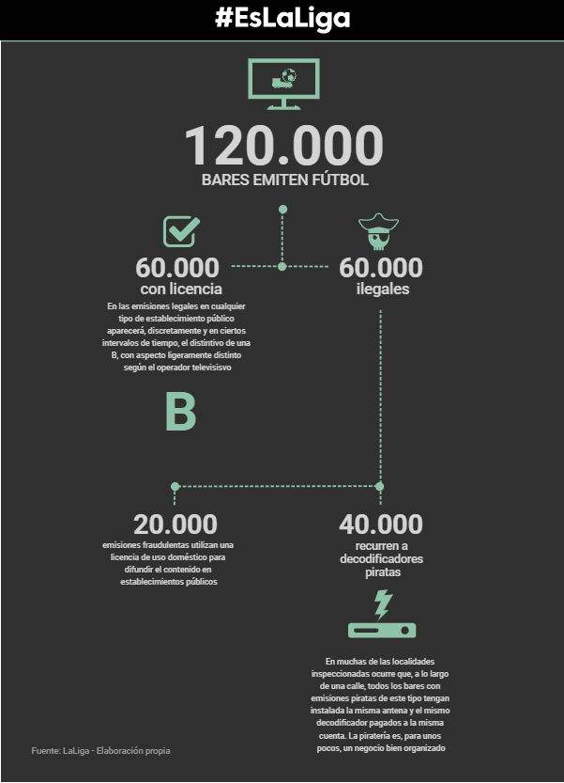
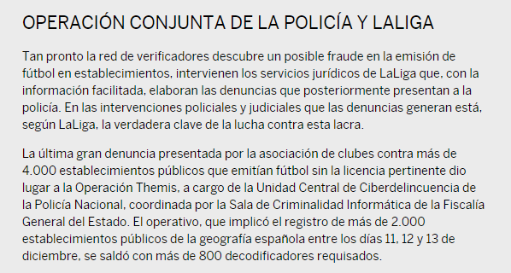
IPR ENFORCEMENT:
CHALLENGES
(NOT SO) FUTURE CHALLENGES: PIRACY OF LIVE SPORTS BROADCASTING
SPAIN: La Liga has developed a complex sytem to target broadcasting piracy in pubs and webpages.
Source: El País

Slide 20
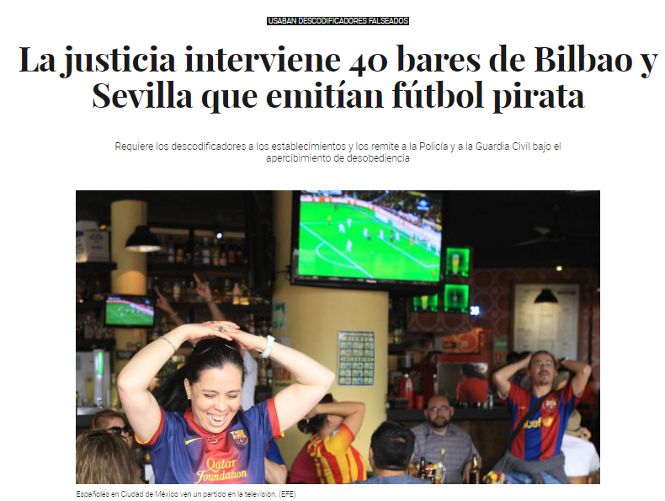
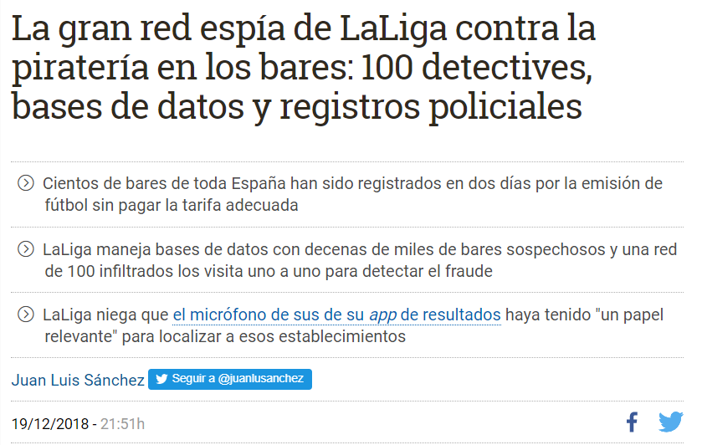
IPR ENFORCEMENT:
CHALLENGES
SPAIN: Once A/V right infringers are identified, the software provides evidence of the infringement, which is also verified by La Liga representatives in the pub/restaurant.
La Liga has initiated several criminal proceedings against infringers of A/V rights directly enforcing its rights before ES Criminal Courts. For the time being the strategy seems successful and it is helping to reduce piracy.

Slide 21
Thank you!
CELIA SUEIRAS VILLALOBOS
May 28, 2018

