Slide 1
Ambush Marketing and Olympics Czechia
Michal Havlík
Attorney at Law

Slide 2
Protection of Olympic properties
the Olympic Charter
the Nairobi Treaty on the Protection of the Olympic Symbol
signed by Czechoslovakia on 22 December 1982
never formally ratified in the Parliament
the Act No. 60/2000 Coll, on Protection of Olympic Properties
defines the Olympic properties
prohibits any use of Olympic properties for commercial, advertising or other similar purposes without prior written authorization by the Czech Olympic Committee
prohibition relates to any sign consisting of or containing the Olympic properties

Slide 3
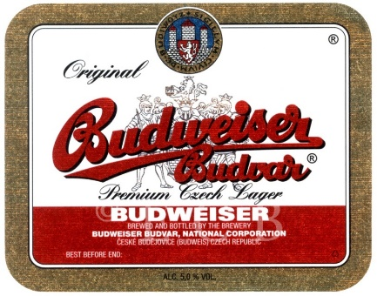
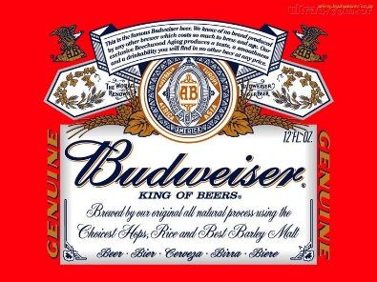
Background
Ice Hockey
since 1908
Gold Olympic Medal from Nagano 1998
No. 1 spectator sport in Czechia
Budějovický Budvar
state owned brewery
1495 foundation of brewery in Budějovice/Budweis
1876 Anheuser Busch first uses Budweiser Bier in USA
pending trademark litigation in over 100 cases around the world

Slide 4
Czech Olympic Committee vs Budějovický Budvar
Winter Olympics in Torino 2006
competing brewery Pilsner Urquell official sponsor of the Czech Olympic Team
advertising campaign of brewery Budějovický Budvar
expression „Hokejiáda“ evoking Czech word „Olympiáda“
characters Bob and Dave in Czech ice-hockey jerseys
torch consisting of ice-hockey sticks
medals and phrase „we gonna be smuggling precious metals“
tagline „Official Beer of Czech Hockey“
broadcast during Olympic Games

Slide 5
Czech Olympic Committee vs Budějovický Budvar

Slide 6
Czech Olympic Committee vs Budějovický Budvar
complaint to self-regulatory advertising council rejected
law suit filed in 2006 seeking EUR 560,000
first instance judgement in February 2009
appellate judgement in December 2010
resolution of Czech Supreme Court in November 2012
infringement of Olympic properties and unfair competition
express reference to ambush marketing
public apology
damages of EUR 90,000 and legal costs

Slide 7
Thank you!
Michal Havlík
havlik@sak-alo.cz

