Slide 1
Ministry of Economy of Montenegro Department for intellectual property Intellectual Property and Sports
Ljubljana, 29. May 2019.

Slide 2
Intellectual property and sports
Intellectual property encourages many business relationships in the world of sports and it can be a strog factor in the economic development of a country ̉s economy;
Sport can be a source of profit, a potencial for creating new jobs and thus contributing to the development of the country;
Raising awarness of the opportunities that sports and intellectual property can offer together in the economic development of the country is one of the most important thing;

Slide 3
Intellectual property and sports
The awareness of necesity of protection intellectual property in all segments of the society in Montenegro is growing (an increase of 30% where domestic natural and legal persons appear as applicants for trademarks)
Considering the geographical position of Montenegro, the development of sports, the promotion and development of tourism and science, it is clear that for further progress is necessary support of the Government and public institutions which will integrate intellectual property and sport through national development plans, national and regional sports organizations , etc.
All this is possible through adequate activities related to the protection of trademarks, designs and other intellectual property rights, enforcing IP rights, and combating counterfeiting and piracy, etc.
The Ministry of Economy is involved in the development of a large number of national strategies in which intellectual property is recognized as an important factor of economic development;

Slide 4
Intellectual property and sports in Montenegro
Each country has its famous sports clubs recognizable by its logo (trademark);
There is a growing commercialization of trademark related for sports clubs in Montenegro;
Sport society „Budućnost“ is a sports club from Podgorica and was founded in 1925. First, it was only a football club within the club, so women's handball, men's handball, basketball, volleyball, athletics, shooting, judo, boxing and tennis were later introduced;

Slide 5
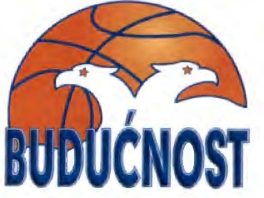
Intellectual property and sports in Montenegro
Trademarks which are registered or for which is made an application in Montenegro refer to sports clubs „Budućnost“
FC „Budućnost“- not a registered trademark
(a well-known trdaemark/logo for the territory of
Montenegro, a club founded in 1925)

Slide 6
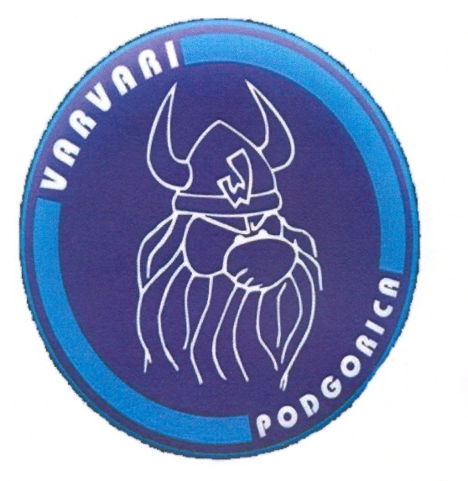
Intellectual property and sports in Montenegro
The fans of the club "Buducnost" are called "Varvari".
„Varvari“ are founded in 1987 as the only sporting fan group and has a registered trademark since 2008 - The well-known Montenegrin brand

Slide 7
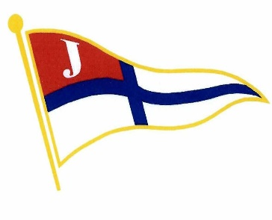
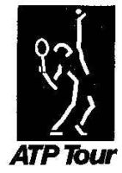
Intellectual property and sports in Montenegro
Registered national trademarks related to the sports:
PLIVAČKI VATERPOLO KLUB JADRAN

Slide 8
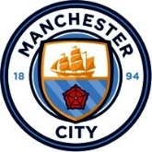
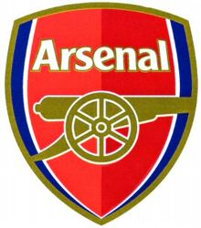
Intellectual property and sports in Montenegro
World famous sports clubs have internationally registered trademarks on the territory of Montenegro

Slide 9
Intellectual property and sports in Montenegro
Nairoby Treaty on the protection of the Olipmpic Symbol
(ME- 03. june 2006.)
At the moment uder the Ministry of economy are opposition procedure where is the Interantional Olympic Committee made an opposition
OLIMP vs OLIMPIC and OLIMPIAN
(Comité International Olimpique)
OLIMPBET vs OLIMPIC and OLIMPIAN
(Comité International Olimpique
Pierre de Coubertin- the procedure is before the Commercial Court of Montenegro for the cancellation of the trademark

Slide 10
Enforcing the intellectual property rights
The Ministry of Economy on 29.03.2017. established the Coordination Team for the enforcement of intellectual property rights, primary goal of which is to ensure the effective protection of intellectual property rights.
The Coordination team consists of the representatives of the Ministry of Economy, the Commercial Court, the State Prosecutor's Office, Market inspection, the Police Directorate and the Customs Administration

Slide 11
Enforcing the intellectual property rights
The Coordination Team for the implementation of rights established a Working group with the task of organizing and conducting joint actions aimed at preventing and combating the infridgements of intellectual property rights;
The Working group consists of the representatives of the Intellectual Property Office, Market inspection, the Police Directorate and the Customs Administration;
In 2018. Working group had 7 joint action;
The Working group adopted the Workig plan for 2019.

Slide 12
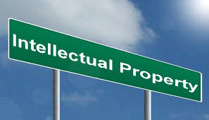
Intellectual property and sports
Bearing in mind that Montenegro is a country that strives for EU membership and the achievement of European standards, the importance of strengthening intellectual property in all aspects of society has been recognized, and the necesity of strengthening of institutions that will contribute to this.

Slide 13
Intellectual property and sports
Thank you for your attention
Ministry of Economy of Montenegro Department for intellectual property
Lidija Martić, Head of division for trademarks, industrial designs and geographical indications
lidija.martic@mek.gov.me

