Slide 1
THE GENERAL DIRECTORATE OF INDUSTRIAL PROPERTY OF THE REPUBLIC OF ALBANIA (GDIP) Regional Seminar – IP and Sports – Slovenia 28-29, 2019

Slide 2
IP system in Republic of Albania
The Intellectual Property system in Albania is organized as below: General Directory of Industrial Property (GDIP) is the institution responsible for Industrial Property rights (patents, trademarks, industrial design, geographic indications, appellation of origin, semiconductors) under the supervision of the Ministry of Finance and Economy; Ministry of Culture /Copyright Directory is responsible for the respecting of copyright and related rights in Republic of Albania.
The GDIP represents Albania in the European Patent Organisation (EPO) the World Intellectual Property Organisation (WIPO) and of the European Union of the Intellectual Property Office (EUIPO).

Slide 3
GDIP is an institution under the supervision of the Ministry of Finance and Economy, and acts as an Autonomous Agency that registers, administers and promotes IP objects.
GDIP offers services to users all over the country about industrial property issues, increasing the awareness about the importance of the industrial property system, through organization of seminars, publishing information, distribution of leaflets and materials related to IP items.
The administrative capacities of GDIP have been strengthened; with the new structure the number of staff has increased to 39 employees and currently GDIP is in process of recruiting new employees. The leading organs of the General Directorate of Industrial Property are the Supervisory Council and the General Director.

Slide 4
National Strategy on IP (2016-2020)
On July 2016, is approved by a decision of Council of Minister, the “National Strategy on Enforcement of IP Rights 2016-2020”
The mission of the strategy is to stimulate economic growth and cultural and scientific development in the Republic of Albania by strengthening the influence of the IP system in the country’s economic development.

Slide 5
Legislative development on industrial property field
On 25 March 2017, the institution with the entry into force of the amendments to Law no. 9947 "On Industrial Property" changed its name from the General Directorate of Patents and Trademarks to General Directorate of Industrial Property.
This change was made in order to better represent the GDIP’s functions for the registration of all IP objects such as trademarks and service marks, industrial design, patents and utility models, geographical indicators and appellation of origin, semiconductors etc.
This law reflects all the recommendations assigned by the European Commission reports for the Industrial Property field.

Slide 6
Statistics
During 2018, the GDIP received 1294 applications for trademarks compared to 1161 applications in 2017, showing an increase of 10.3%.

Slide 7
Statistics
During 2018, GDIP received 921 applications for patents compared to 813 applications received in 2017; this marked an 11.7% increase on the number of patent applications. Moreover, from 921 applications filed in 2018, three of these applications are PCT applications, 15 applications are national patent applications, and 903 are European patents who requested validation or extension in Albania.

Slide 8
Statistics on IP objects- Albanian experience
During 2018 GDIP received 72 applications for trademark registration/examination procedure, as regard the sports industry,
concretely:
Sportive information;
Organization of sportive competition;
Sportive activities;
Gymnastics;
Organizing motor events;
Equipments;
Sports training.
Republic of Albania is not part of Nairobi Treaty on the Protection of the Olympic Symbol.

Slide 9
National Conference on “IP and sports – Reach for gold” organized by GDIP in cooperation with EPO

Slide 13
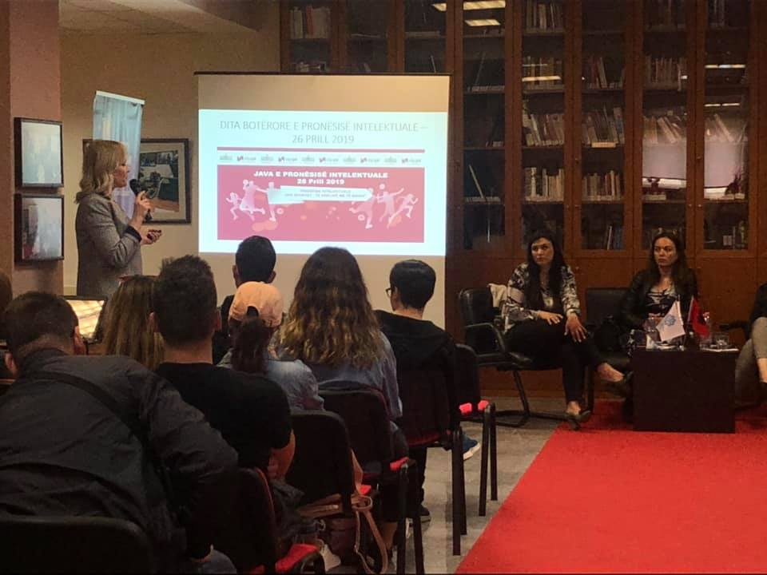

Slide 15
From 2015– till now, GDIP have played an important role in disseminating knowledge in terms of lectures and seminars in educational institutions with the aim of raising awareness and also organizing competitions among high schools to encourage the innovation creativity through new generation.

Slide 16
Technical sponsor – Macron General Sponsor – VODAFONE National Football Team (Albania)

Slide 17
Thank you for your attention!
You can find us:
Webste: www.dppm.gov.al
Instagram @dppi
Facebook –Drejtoria e Përgjithshme e Pronësisë Industriale
For GDIP: MS. SONILA MEKA
Head of Unit
Email: sonila.meka@dppm.gov.al

