Slide 2
International Sports Disputes The Role of Mediation and Arbitration
Intellectual Property and Sports
Ljubljana, Slovenia
May 29, 2019
Andrzej Gadkowski
WIPO Arbitration and Mediation Center

Slide 3
WIPO Arbitration and Mediation Center
Facilitates the resolution of commercial disputes between private parties involving IP, through procedures other than court litigation, including mediation and arbitration
Offices in Geneva and Singapore
Users around the world
ADR provider specialized in IP disputes, including sports-related disputes
WIPO mediators, arbitrators and experts experienced in IP - able to deliver informed results efficiently
International neutrality

Slide 4
Mediation
Informal consensual process
Neutral intermediary – mediator
assists parties in reaching settlement of their dispute
based on parties’ respective interests
cannot impose a decision
Settlement agreement has force of a contract
Leaves open court or arbitration options

Slide 5
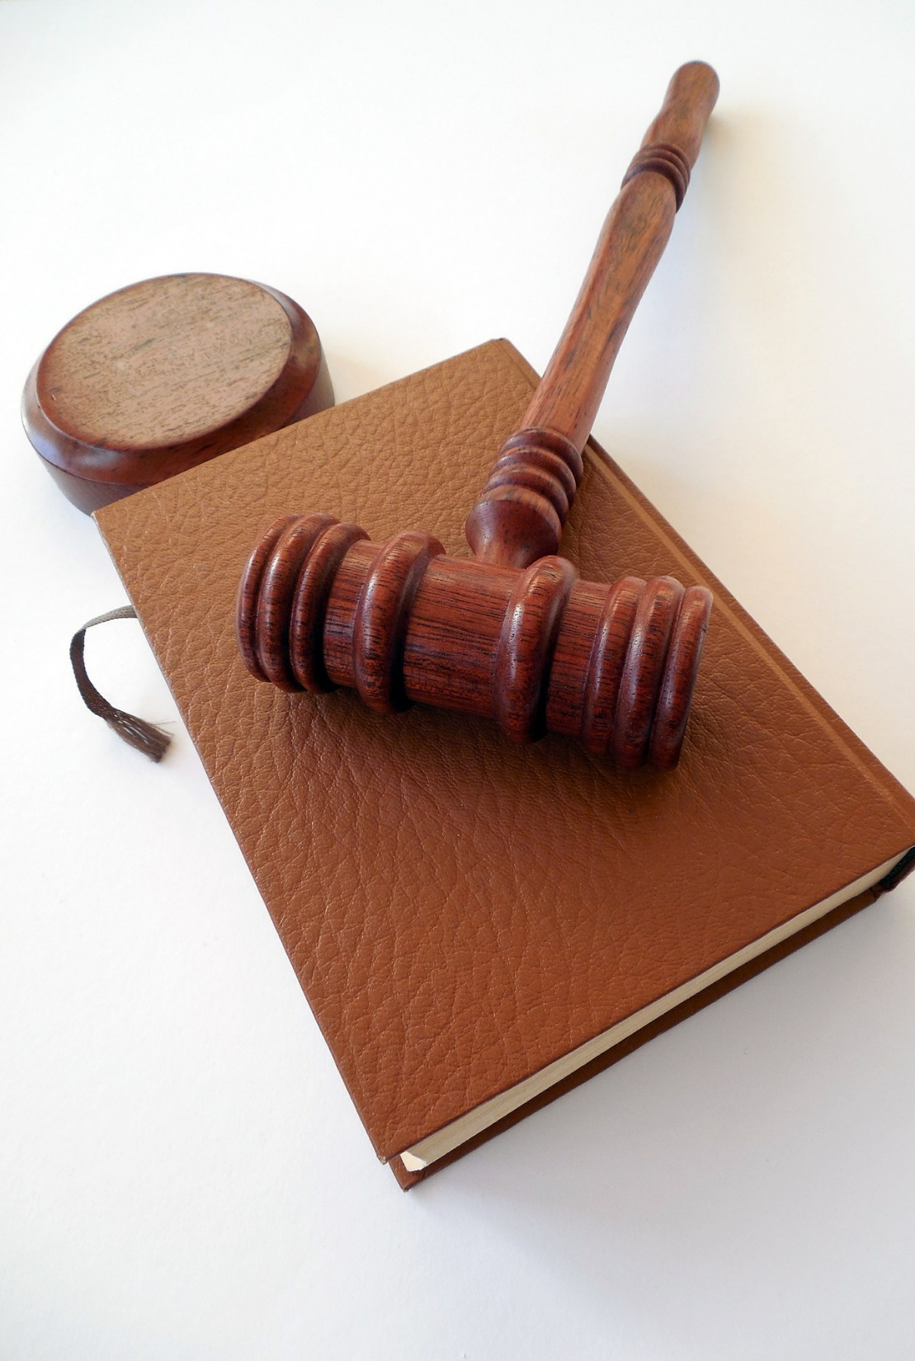
Arbitration
Consensual procedure
Parties submit dispute to one or more chosen arbitrators
Binding and final decision (award)
based on parties’ rights and obligations
enforceable internationally
Normally forecloses court options

Slide 6
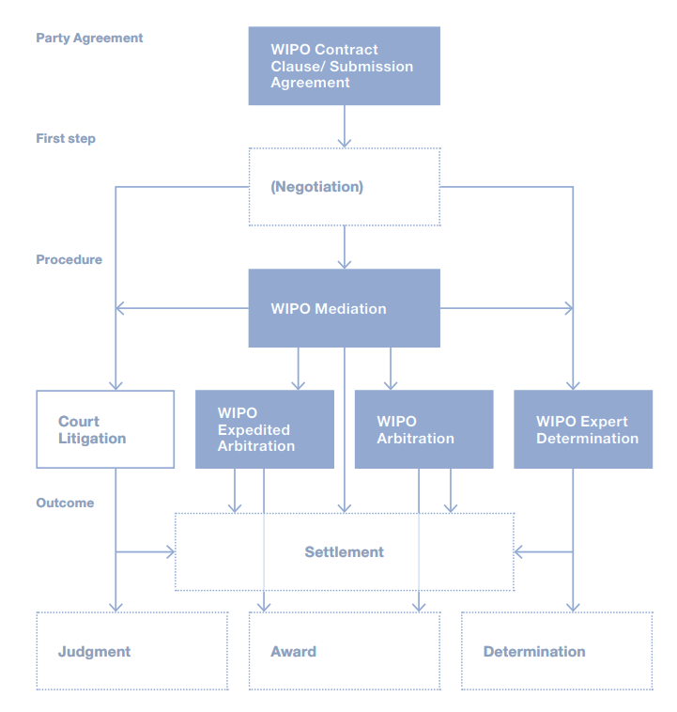
WIPO ADR options

Slide 7
Clause example for your contract: mediation followed by expedited arbitration
Any dispute, controversy or claim arising under, out of or relating to this contract and any subsequent amendments of this contract, including, without limitation, its formation, validity, binding effect, interpretation, performance, breach or termination, as well as non-contractual claims, shall be submitted to mediation in accordance with the WIPO Mediation Rules. The place of mediation shall be [specify place]. The language to be used in the mediation shall be [specify language].
If, and to the extent that, any such dispute, controversy or claim has not been settled pursuant to the mediation within [60][90] days of the commencement of the mediation, it shall, upon the filing of a Request for Arbitration by either party, be referred to and finally determined by arbitration in accordance with the WIPO Expedited Arbitration Rules. Alternatively, if, before the expiration of the said period of [60][90] days, either party fails to participate or to continue to participate in the mediation, the dispute, controversy or claim shall, upon the filing of a Request for Arbitration by the other party, be referred to and finally determined by arbitration in accordance with the WIPO Expedited Arbitration Rules. The place of arbitration shall be [specify place]. The language to be used in the arbitral proceedings shall be [specify language]. The dispute, controversy or claim referred to arbitration shall be decided in accordance with [specify jurisdiction] law.
www.wipo.int/amc/en/clauses

Slide 8
WIPO ADR Rules
IP-specific elements
e.g., confidentiality, technical evidence, interim relief
Applicable to all commercial disputes
Flexibility
Pre-structure entire proceeding
For most part can be modified by arrangement between mediator or arbitrator and parties
For domestic and international disputes
Accommodating different legal/procedural traditions

Slide 9
Principal steps in a WIPO Mediation
Filling of Request for WIPO Mediation
Mediation Agreement (Article 3 of the WIPO Mediation Rules)
Unilateral Request
(Article 4 of the WIPO Mediation Rules)
Parties conclude Mediation Agreement
Parties do not conclude Mediation Agreement
Appointment of Mediator
Initial contacts between Mediator and parties
Set up mediation meeting
Agree on preliminary exchange of documents, if any
Mediation meeting
Agree on ground rules of the process
Gather information and identify issues
Explore the interests of the parties
Develop options for settlement
Evaluate options
Conclusion of Mediation
Settlement Agreement
Termination of Mediation

Slide 10
Principal steps in a WIPO Arbitration
WIPO Arbitration
WIPO Expedited Arbitration
Request for Arbitration
Request for Arbitration and Statement of Claim
Answer to Request for Arbitration
Answer to Request for Arbitration
and Statement of Defense
Appointment of Arbitrator(s)
Appointment of Arbitrator
Statement of Claim
Hearing
Statement of Defense
Closure of Proceedings
Further Written Statements and Witness Statements
Final Award
Hearing
One exchange of pleadings
Shorter time limits
Sole arbitrator
Shorter hearings
Fixed fees
Closure of Proceedings
Final Award

Slide 11
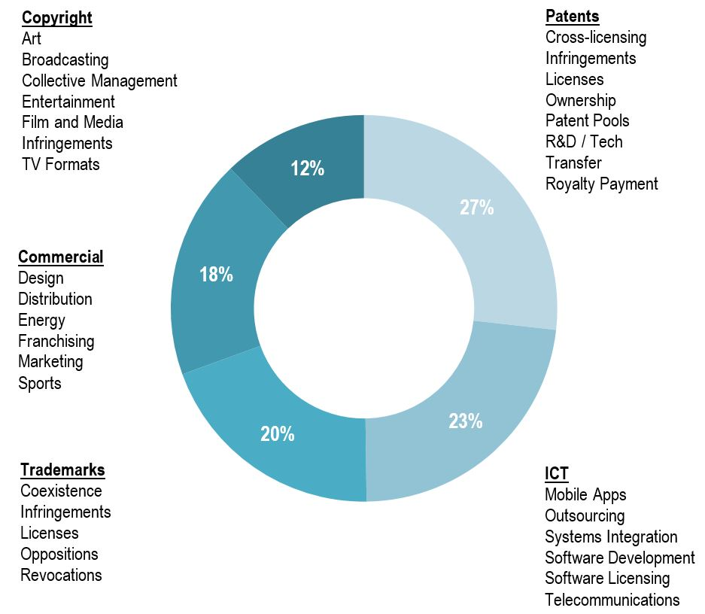
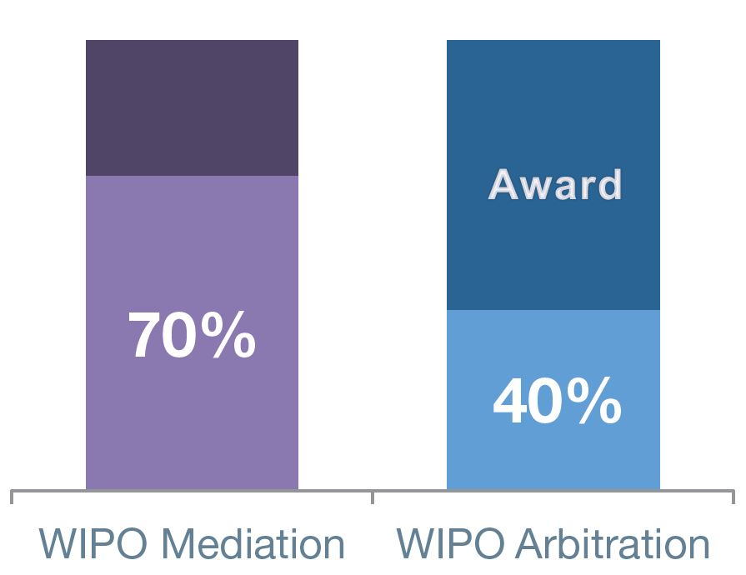
WIPO Center’s ADR cases
Areas of disputes
Settlement rates

Slide 12
WIPO ADR for sports-related disputes
Areas of dispute
advertising
broadcasting rights
copyright and related rights
event management
image rights
industrial design rights
marketing transactions
merchandising agreements
patents relating to sports equipment
product development
publishing
software
sponsorship agreements
sports betting and gaming
sports business contracts
sports online streaming

Slide 13
WIPO ADR for sports-related disputes
Parties involved
agents
athletes
broadcasters
clubs
coaches
event organizers
inventors
non-profit foundations
service providers
software developers
sponsors
sports goods manufacturers
sports organizations and federations
telecommunication providers
television and media companies

Slide 14
Case example: Broadcasting dispute
WIPO Arbitration
TV distribution company and international sports federation
Broadcast rights distribution agreement
Exclusive broadcast of sports competition to TV audiences in Asia-Pacific
Damages for breach of contract

Slide 15
Case example: Patent dispute
WIPO Expedited Arbitration
Asian inventor and US manufacturer
Exclusive licensing agreement
US and European patents for sports goods
Payment of royalties
Protection of business secrets

Slide 16
Case example: Trademark and copyright dispute
WIPO Mediation
European companies
Exclusive trademark and copyright licensing agreement for club sponsorship
Breach of contract
Lack of commercial use of the licensed trademark
Payment of royalties

Slide 17
WIPO eADR for America’s Cup
36th edition of the America’s Cup sailing race series
America’s Cup Arbitration Panel (ACAP)
Tailored version of WIPO eADR case administration platform

Slide 18
Tackling cybersquatting: the Uniform Domain Name Dispute Resolution Policy (UDRP)
1999: WIPO-created international ADR procedure
Allows trademark owners to resolve "clear-cut" cases of abusive domain name registration and use ("cybersquatting")
Operates outside the courts, but preserves court option
Applies via mandatory domain name registration conditions
Applies to all international domains "old" (.com, .net) and "new" (.bike, .shop)
Also available for over 75 country-code domains

Slide 19
Why do brand owners choose the UDRP?
Significantly quicker and cheaper than court litigation
Two-month average; fixed fees (USD 1,500)
Predictable criteria and results
Decision (transfer) implemented directly by registrar

Slide 20
WIPO domain name cases at a glance
20 years’ experience as global leader
43,000+ cases covering 80,000+ domain names
2018 total: 3,447 cases
Parties based in 177 countries
Cases in 21 languages to date
Paperless filing through WIPO eUDRP

Slide 21
Sports-related WIPO domain name cases
International Olympic Committee, FIFA, UEFA, NBA, FIBA, NFL, NCAA, PGA, Roland Garros, Wimbledon, Ryder Cup, Formula One, Wembley Stadium, London Marathon
Barcelona FC, Real Madrid, Juventus, Manchester United, Liverpool, Bayern Munich, Benfica
New York Knicks, Houston Rockets, Arizona Cardinals, Green Bay Packers, Kansas City Chiefs, Carolina Panthers
Lionel Messi, Ronaldinho, Pele, Wayne Rooney, Serena and Venus Williams, Mika Häkkinen
Adidas, Columbia, Mizuno, Nike, Rebook, Salomon

Slide 22
Key WIPO UDRP resources
WIPO Guide to the UDRP
Model pleadings (complaint and response)
Legal Index of UDRP Decisions
WIPO Jurisprudential Overview of Selected UDRP Questions

Slide 23
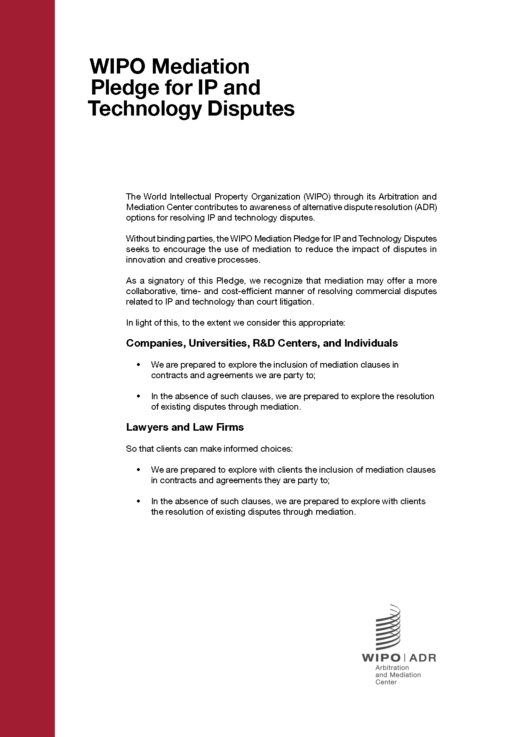
300+ signatories from over
80 countries
Join the Pledge!

Slide 24
Further Information
Queries and case filing: arbiter.mail@wipo.int
Model clauses: www.wipo.int/amc/en/clauses
Domain names: www.wipo.int/amc/en/domains
Info on procedures, neutrals and case examples: www.wipo.int/amc

