Slide 1
Topic 14:
Web Resources on Patent Landscape Reports (PLR)
Manila
6 December 2013
Irene Kitsara, Project Officer
Patent Information Section,
Access to Information and Knowledge Division

Slide 2
Outline
Introduction
Web Resources for PLR….
Terminology
Methodology
Tools
Content
Collections
Similar analyses
Providers

Slide 3
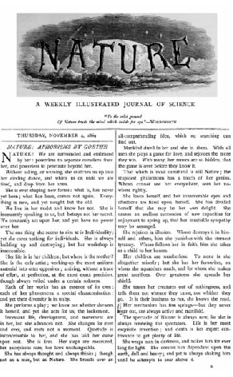
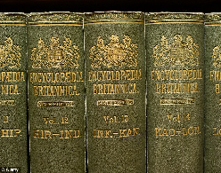
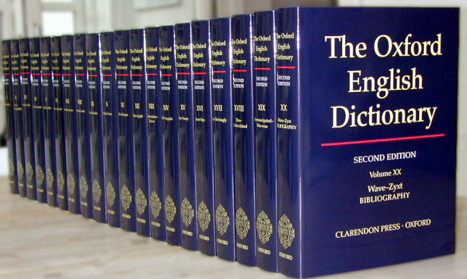
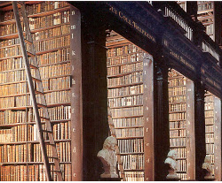
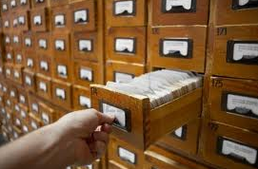
Introduction
Reference sources → research work
Traditionally → Encyclopedias, dictionaries, handbooks, journals in hard-copies
Location → Libraries

Slide 4
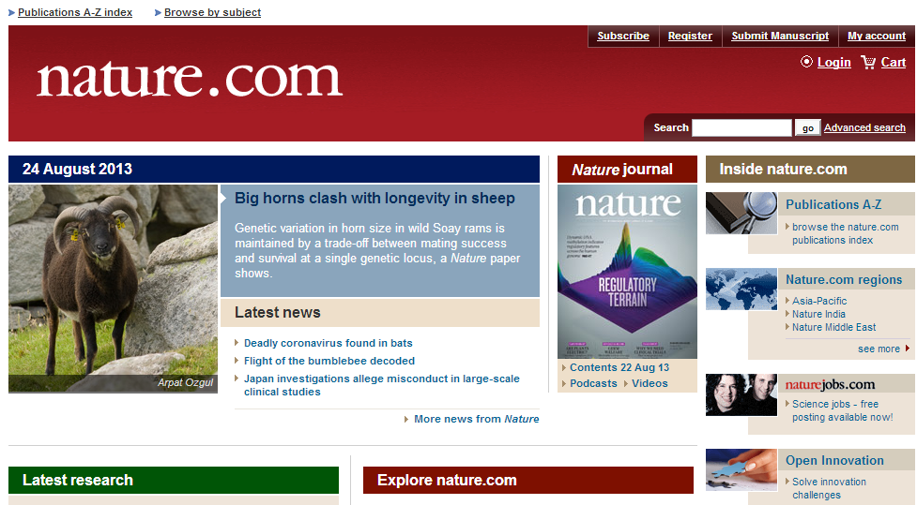
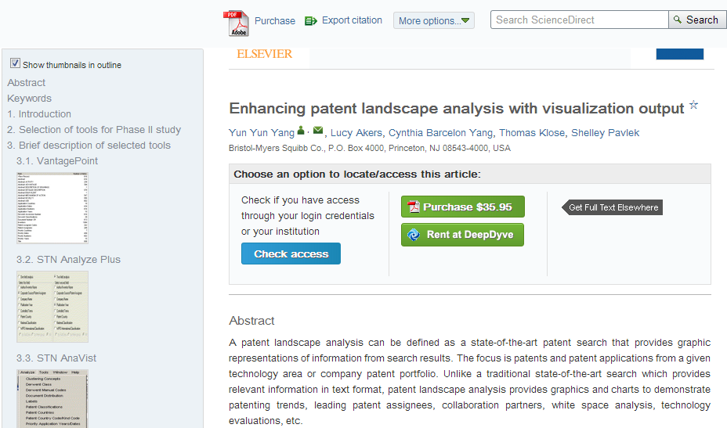
Traditional Reference Sources → Online

Slide 5
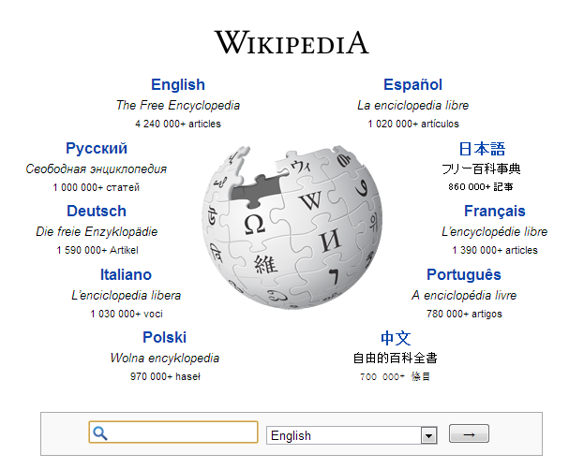
Search tools and depositories of information

Slide 6
New Web Resources
Exclusively online content (online journals…)
Online slideshows
Webinars
Videos (youtube etc…)
Social Media
Blogs

Slide 7
Patent Landscapes Web Resources
PLR: standardized practice in the industry
Online availability of PLR and related info →limited
Due to confidentiality, business intelligence issues→ disclosure problematic
Available PLR Resources:
IPOs as a service to the interested public and the patent information users
Private companies promoting their patent landscaping services through landscaping examples

Slide 8
Patent Landscaping Web Resources
Information relevant to PLR:
Terminology
Methodology
Tools for PLR preparation
Best practices
Patent Landscape Reports collections/compilations
Content – specific Patent Landscape Reports
Similar to PLR analysis types

Slide 9
Where is the information available?
General information repositories → Wikipedia, youtube…
Online journals and books
Social Media → LinkedIn etc.
Websites of IP Offices and other public sector institutions
Public sector service providers
Blogs, Fora
Information:
Free of charge or
Fee-based

Slide 10
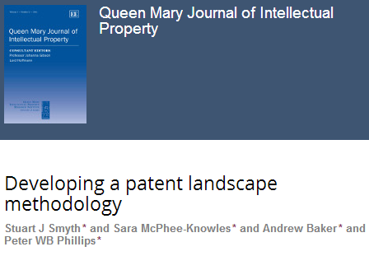
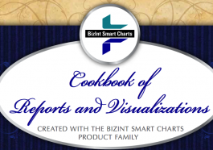
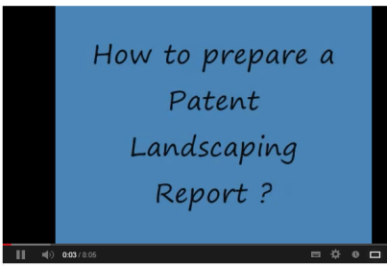
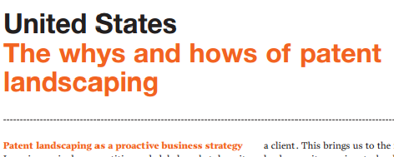
Web Resources for PLR Terminology and Methodology

Slide 11
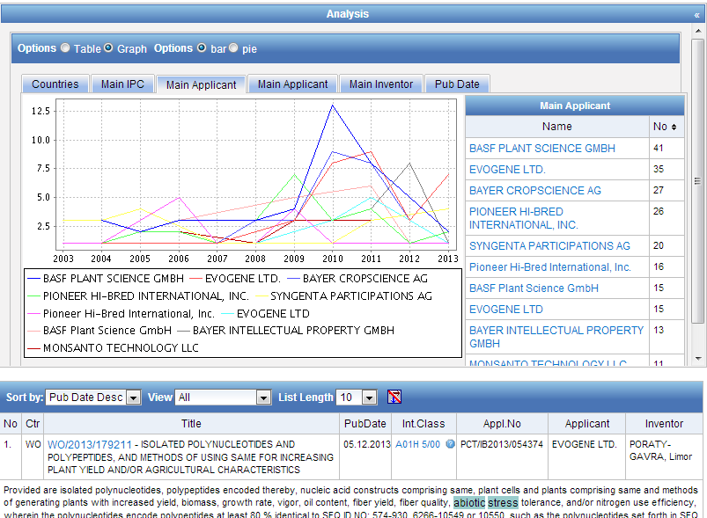
Tools for PLR preparation
Online tools used in the course of preparation of a PLR: addressed in another presentation. Nevertheless…
Source: PATENTSCOPE www.wipo.int/patentscope

Slide 12
Tools for PLR Preparation
Efforts to create online semi-automated tools for the preparation of (semi-) automated PLR, e.g.
http://patent-landscape-analysis-report.com

Slide 13
Tools for PLR preparation (2)

Slide 14
Content Web Resources – specific Patent Landscape Reports
A. National Patent Offices Websites:
INPI Brazil → PLR on nanobiotechnology, stem cells, nanotextiles and biofuel
Cuban IPO → Ethanol Production from Lignocellulosic Residues
UK IPO → Stem cells, graphene, nanotechnology, recycling and separation technologies, energy from waste, 3DTV
Colombia → Use of IP by big pharmaceutical companies in the area of major antiretrovirals
Austrian Institute of technology → Environmental technologies

Slide 15
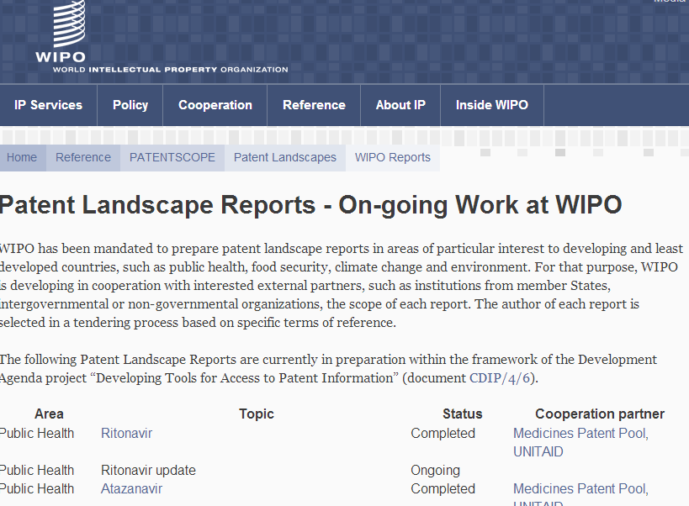
Content Web Resources – specific Patent Landscape Reports (2)
B. WIPO and EPO:
EPO: Patents and clean energy, patents and clean energy in Africa
WIPO: website on WIPO PLR and compilation of published PLR
http://www.wipo.int/patentscope/en/programs/patent_landscapes/reports

Slide 16
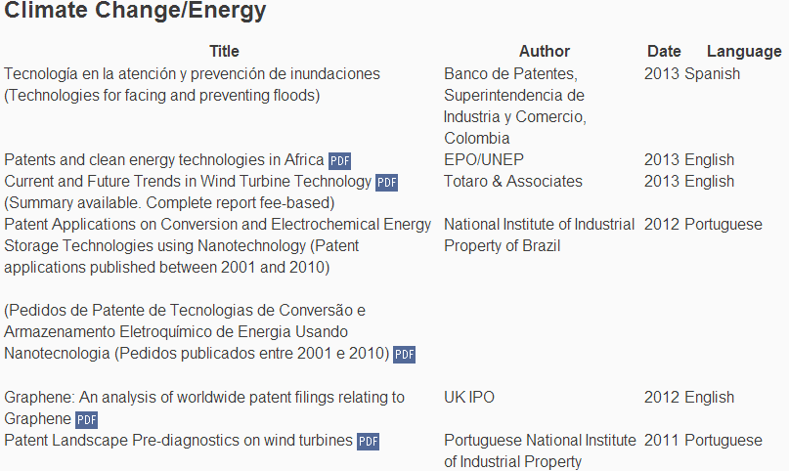
Web Resources for PLR collections
http://www.wipo.int/patentscope/en/programs/patent_landscapes/reports

Slide 17
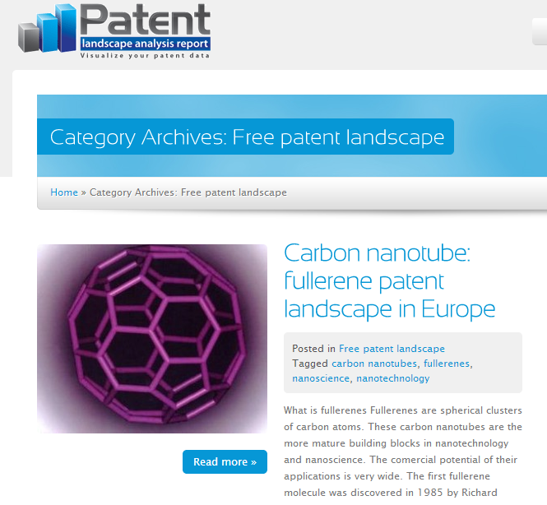
Web Resources for PLR collections (2)
http://patent-landscape-analysis-report.com/en/category/free-patent-landscape/

Slide 18
Social Media – Linkedin Groups on landscaping
Patent Searching and Landscaping - http://www.linkedin.com/groups?home=&gid=110874&trk=anet_ug_hm
IP Intelligence - http://www.linkedin.com/groups?gid=124885&trk=myg_ugrp_ovr
Patinformatics - http://www.linkedin.com/groups?gid=2391676&trk=myg_ugrp_ovr
Patent Landscaping Innovations - http://www.linkedin.com/groups/Patent-Landscaping-Innovations-1883637?trk=myg_ugrp_ovr
Patent Analysis & Landscaping - http://www.linkedin.com/groups/Patent-Analysis-Landscaping-1794428?trk=myg_ugrp_ovr
Patent Informatics Group - http://www.linkedin.com/groups?gid=76745&trk=myg_ugrp_ovr
Patent Landscapes - http://www.linkedin.com/groups?gid=2846540&trk=myg_ugrp_ovr
Competitive Intelligence from Patent Analytics - http://www.linkedin.com/groups/Competitive-intelligence-from-patent-analytics-3891330?trk=myg_ugrp_ovr

Slide 19
Blogs/Wiki/Online Fora on Patent Landscaping
www.patinformatics.com
http://wiki.piug.org

Slide 20
Similar analyses to PLR
Patent Watch
Technology Alerts
Technology Bulletins
Patent Map Bulletin

Slide 21
Web Resources for Similar to PLR Analyses

Slide 22
Web Resources on Providers of PLR services
Individual websites of:
IP Offices
Other Public Sector entities
Private sector providers
Envisaged → add to WIPO PLR website a list of patent landscaping providers

Slide 23
Coming up next….
Guidelines for the Preparation of Patent Landscape Reports – by the end of 2013
with a dedicated Chapter 11 on Web Ressources on Patent Landscaping Reports
Stay tuned….!
http://www.wipo.int/patentscope/en/programs/patent_landscapes

Slide 24
Thank you!
Irene.Kitsara@wipo.int

