Slide 1

WIPO Green
The Market Place for Sustainable Technology
Indonesia
Ir. Rudy Abdul Rahman
+62811 220 1011

Slide 2
Unit sector And distribution case
River, 11 big contaminate rivers
Domestic Waste Water Treatment Plant, every city in Indonesia
Sanitary Landfill Leacheate, every city in Indonesia
Palm Oil Refinery, 600 mills
Rubber Refinery, 400 mills
Comunal Cow Farm/livestock, 25 farms
Hotel
Shopping Center
Elevated Domitory Building
Oil Trap Workshop
Tofu and Tempeh Industry
Steel Industry Waste Water

Slide 3
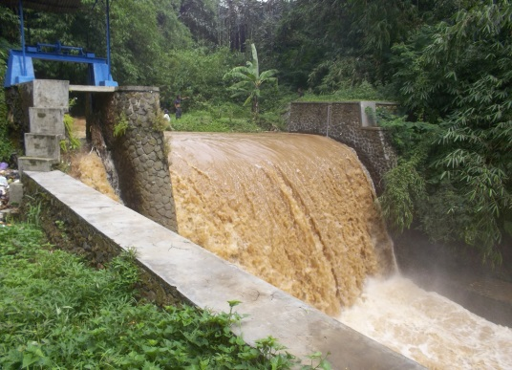
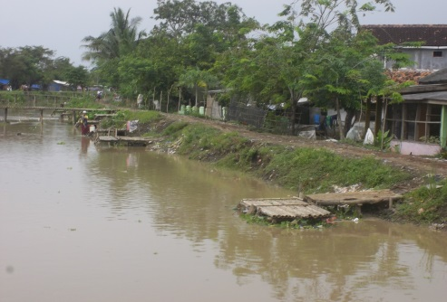
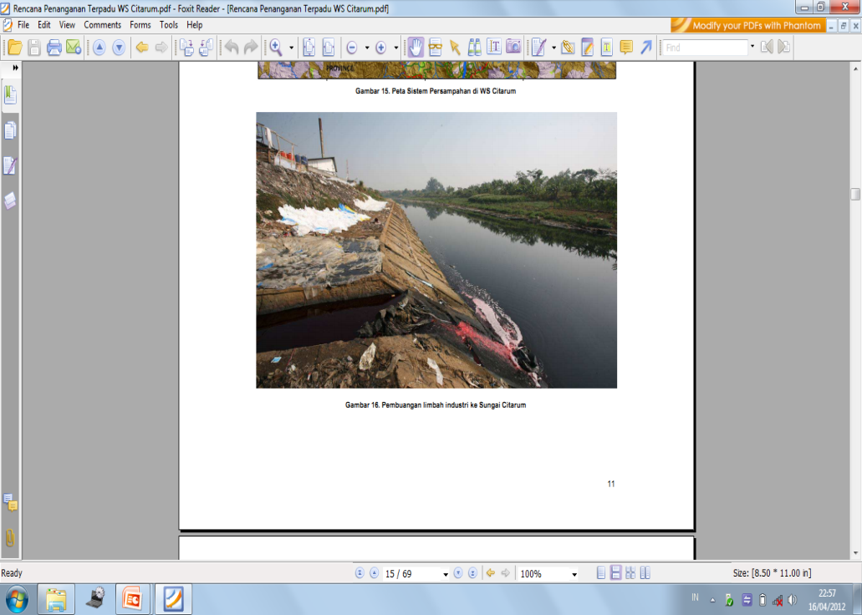
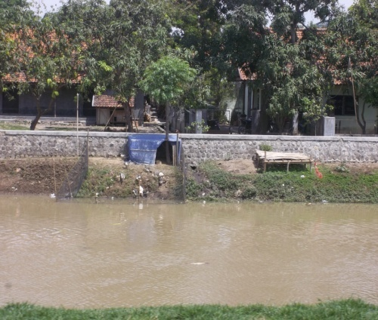
Citarum river
Row water for city water treatment plant
Contaminate resource
  Industrial
  Domestic
  Farm
  Agriculture
Technology seeker: Goverment
Need features
  Technical assistance
  Design aspects
  Waste management
  Grant
Special Need: Biologcal Patent Technology

Slide 4
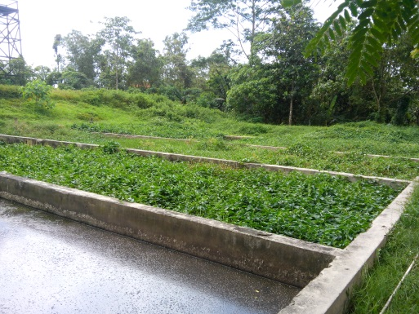
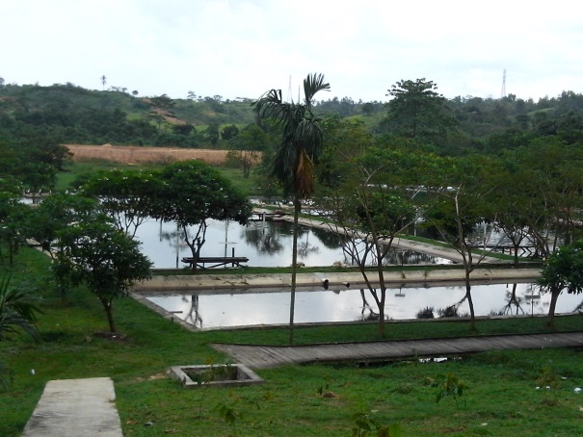
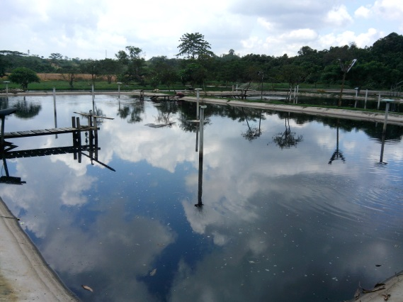
Balikpapan Domestic Waste Water Treatment Plant
Every city requires
Existing plant
  Biological
  Lagoons with aerobic, anaerobic and biofiltersystem
  The result has not been satisfied
Technology seeker: Goverment
Need features
  Technical assistance
  Design aspects
  Waste management
  Grant
Special Need:
    Biologcal Patent Technology
    Provides usable output such as liquid fertilizer
    Minimize energy, time and space

Slide 5
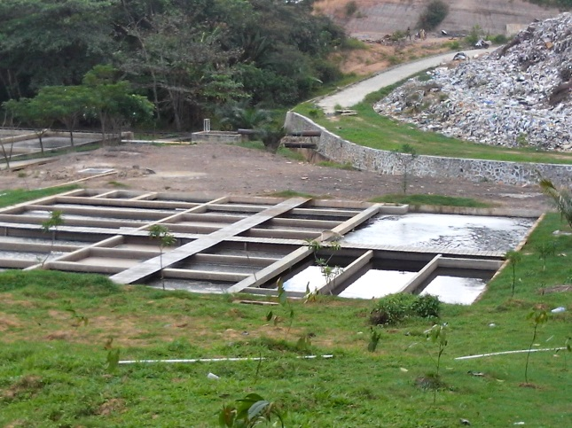
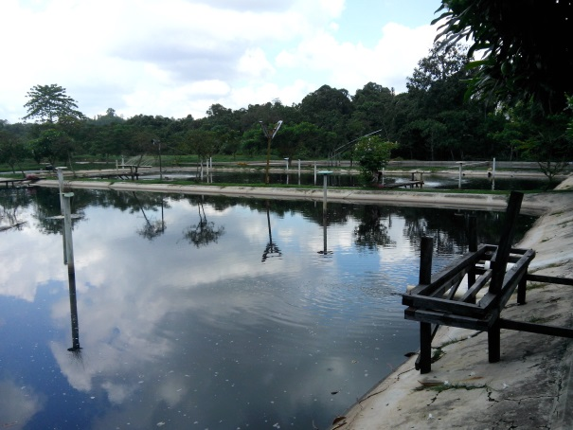
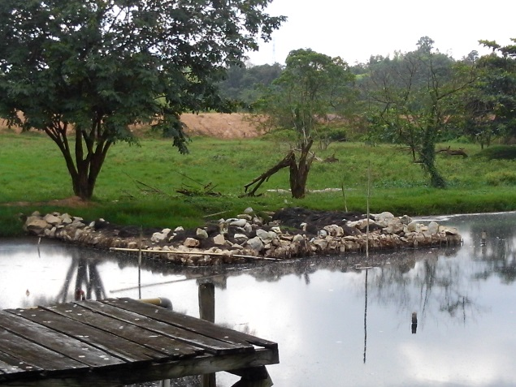
Balikpapan Sanitary Landfill Leachate
Every city requires
Existing plant
  Biological
  Lagoons with aerobic, anaerobic and biofiltersystem
  The result has not been satisfied
Technology seeker: Goverment
Need features
  Technical assistance
  Design aspects
  Waste management
  Grant
Special Need:
  Biologcal Patent Technology
  Minimize energy, time and space

Slide 6
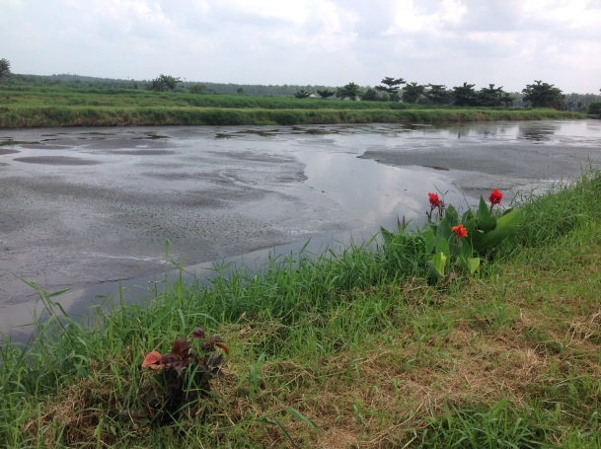
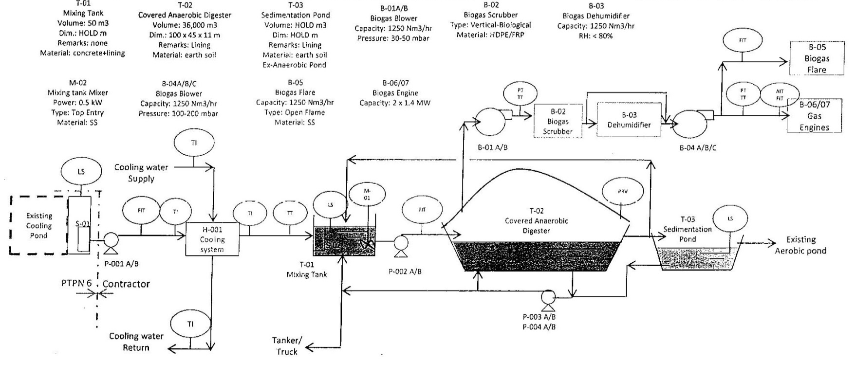
Jambi Palm Oil Refinery
Every the same plant requires
Special Need
  Palm Oil Mill Effluent (POME) to electricity
Need features
  Technical assistance
  Design aspects
  Waste management
  Partners
Special Need:
  Biologcal Patent Technology
  Reduce energy, time and space

Slide 7
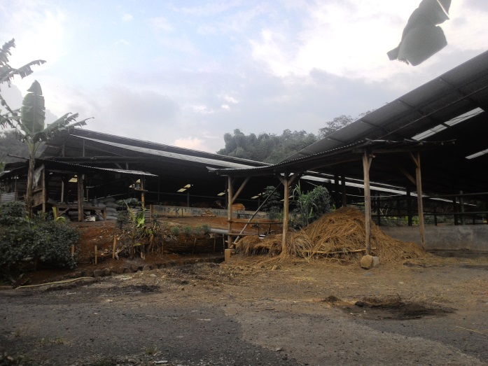
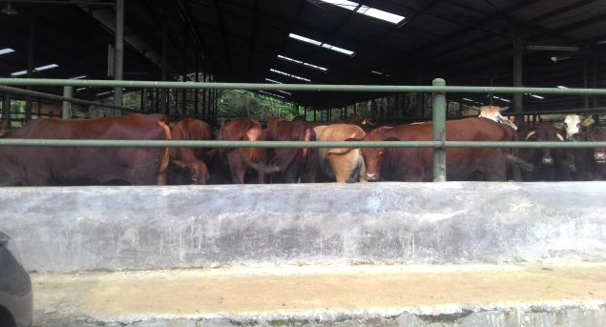
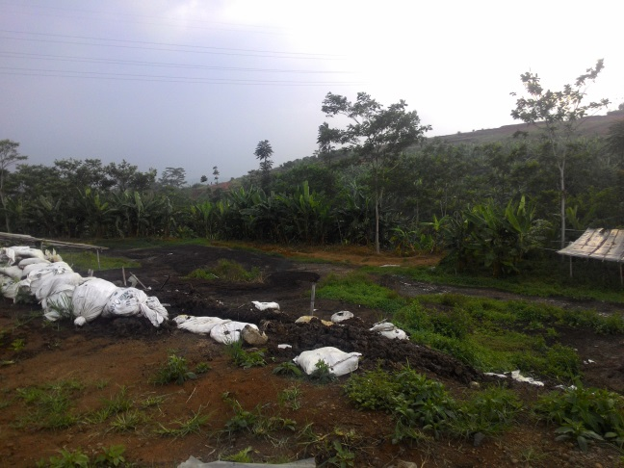
Purwakarta Comunal Cow Farm/livestock
Every the same farm/livestock requires
Special Need
  Reform energy to electricity
  Biologcal Patent Technology
  Minimize energy, time and space
Need features
  Technical assistance
  Design aspects
  Waste management
  Partners

Slide 8
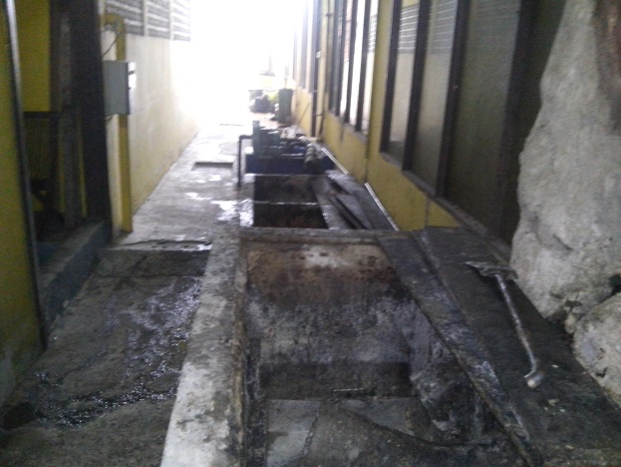
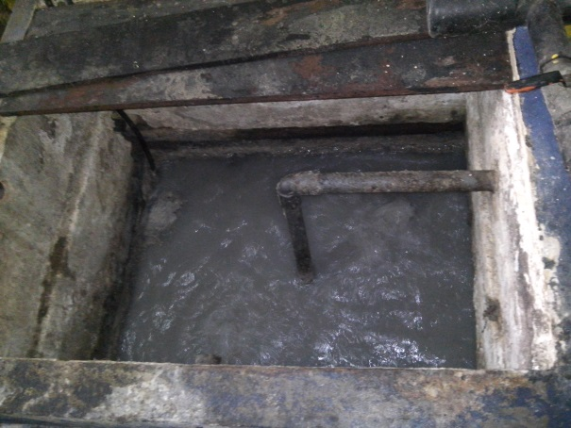
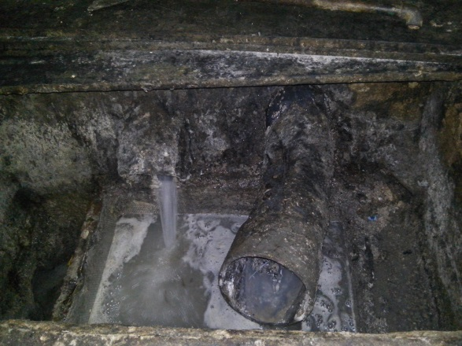
Balikpapan hotel
Every Hotel requires
Contaminate resource
  Floor drain, untreated
  Toilet, septic tank
  Kitchen, oil trap
  Laundry, untreated
Existing plant: The result has not been satisfied
Need features
  Technical assistance
  Design aspects
  Waste management
Special Need:
  Biologcal Patent Technology for oil trap
  Minimize energy, time and space

Slide 9
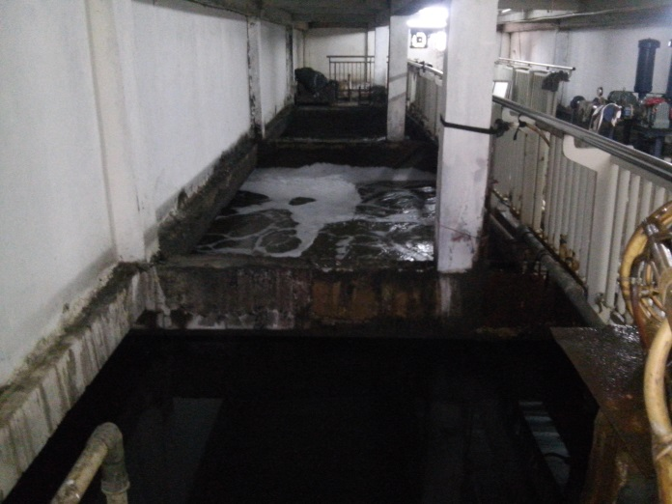
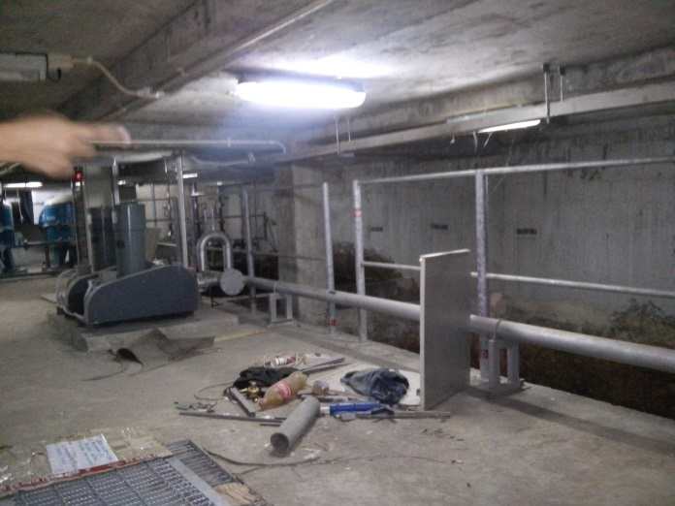
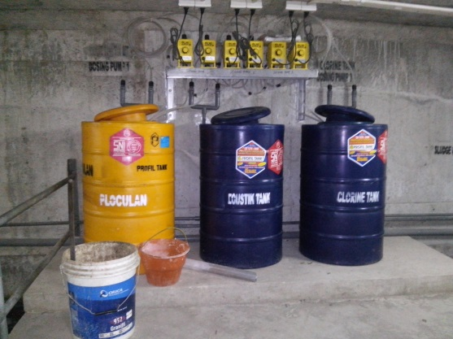
Balikpapan shopping center
Every Shopping Center requires
Contaminate resource
  Wastafel
  Toilet
  Kitchen/food court
Existing plant: The result has not been satisfied
Need features
  Technical assistance
  Design aspects
  Waste management
Special Need:
  Biologcal Patent Technology
  Minimize energy, time and space

Slide 10
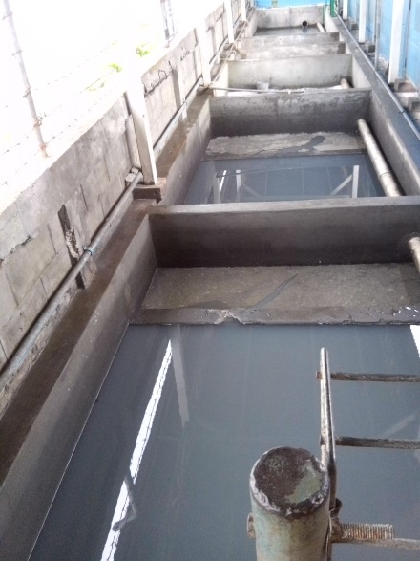
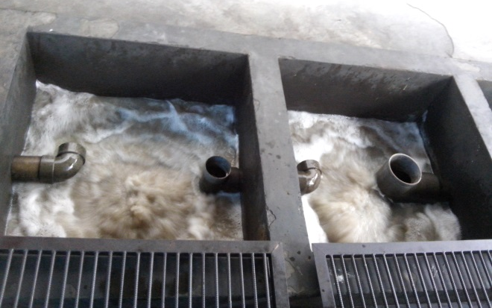
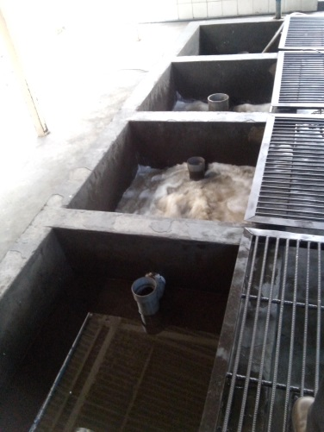
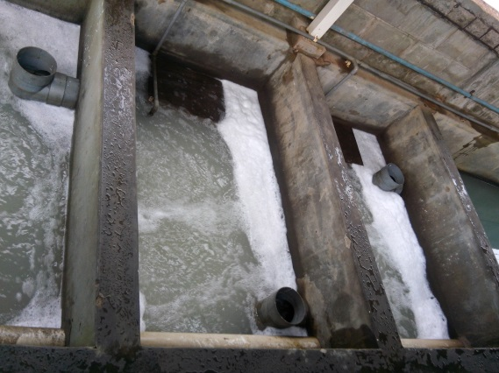
Balikpapan work shop
Every Work Shop requires
Contaminate resource
  Oil from Washing machine
  Oil from over flow activities area
Existing plant: The result has not been satisfied
Need features
  Technical assistance
  Design aspects
  Waste management
Special Need:
  Revitalization teatment plant
  Biologcal Patent Technology
  Minimize energy, chemical, time and space

Slide 11
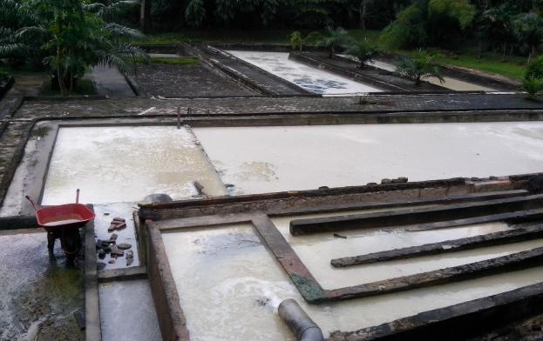
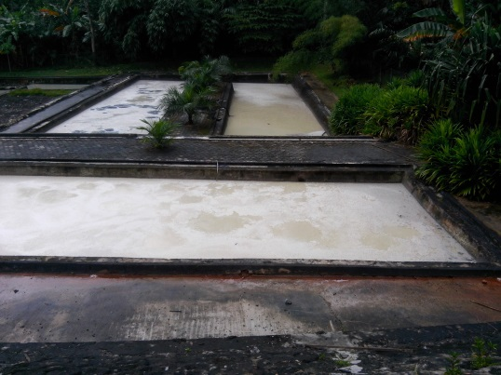
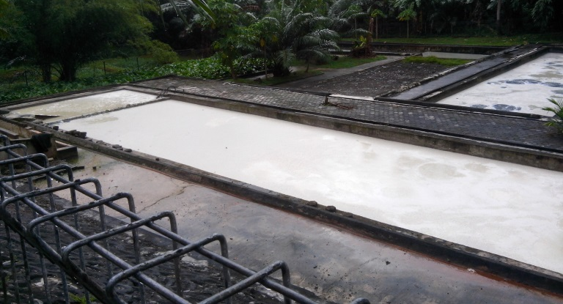
Balikpapan Tofu and Tempeh Industry
Every the activities requires
Contaminate resource
  Waste water from making of Tofu
  Waste water from making of Tempeh
Existing plant: The result has not been satisfied
Need features
  Technical assistance
  Design aspects
  Waste management
Special Need:
  Biologcal Patent Technology
  Minimize energy, time and space

Slide 12
General Result need
Safety to remove
Recovery
Recycle
Reform to Energy or something useful
Revitalization treatment to minimize energy, chemical, time and space

Slide 13
Huge market in indonesia
11 big contaminate rivers
514 cities in Indonesia
Domestic Waste Water Treatment Plant
Sanitary Landfill Leacheate, every city in Indonesia
Hotel
Shopping Center
Workshop
Apartment
Office building
Palm Oil Refinery, 600 mills
Rubber Refinery, 400 mills
Comunal Cow Farm/livestock, 25 big farms
Elevated Domitory Building, 100
Tofu and Tempeh Industry, 100
Metal Industry Waste Water, 10

Slide 14
Ir. Rudy Abdul Rahman
Environmental Technology Expert
+62 811 220 1011
rudy.abdul.rahman@gmail.com
Ms Yesim Baykal
Senior Programme Officer, Global Challenges Division, WIPO
+41 22 3387289
yesim.baykal@wipo.int

Slide 15

thank you

