Slide 1
Seminar on WIPO Services and Initiatives
Topic 5; Global Databases for Intellectual Property, Platform and Tools for Connected Knowledge Economy
Oslo
October 2013
Yo Takagi
Assistant Director General

Slide 2
Global Databases, Tools, and Platform
For IP Businesses:
  Providing search facilities for IP collections
  Simplifying application procedures to multiple IP authorities
  Providing IP related matchmaking services
For IP offices:
  Assisting automation, IP information dissemination and exchange of IP documents with other offices

Slide 3
Global Databases, Tools, and Platform for IP business (free)
PATENTSCOPE
Global Brand Database
WIPO Lex
WIPO IPAS, WIPO DAS
WIPO CASE
WIPO RE:SEARCH
WIPO GREEN

Slide 4
PATENTSCOPE
2.2 million PCT data (first publish, high quality full text)
30 million records (from 30 countries or regions)
Full text search
Cross Lingual Information Retrieval (CLIR)
Machine translation tools (Google, Microsoft, WIPO’s TAPTA)
Analysis and graphical presentation
Over 6,000 Vistors per day

Slide 5
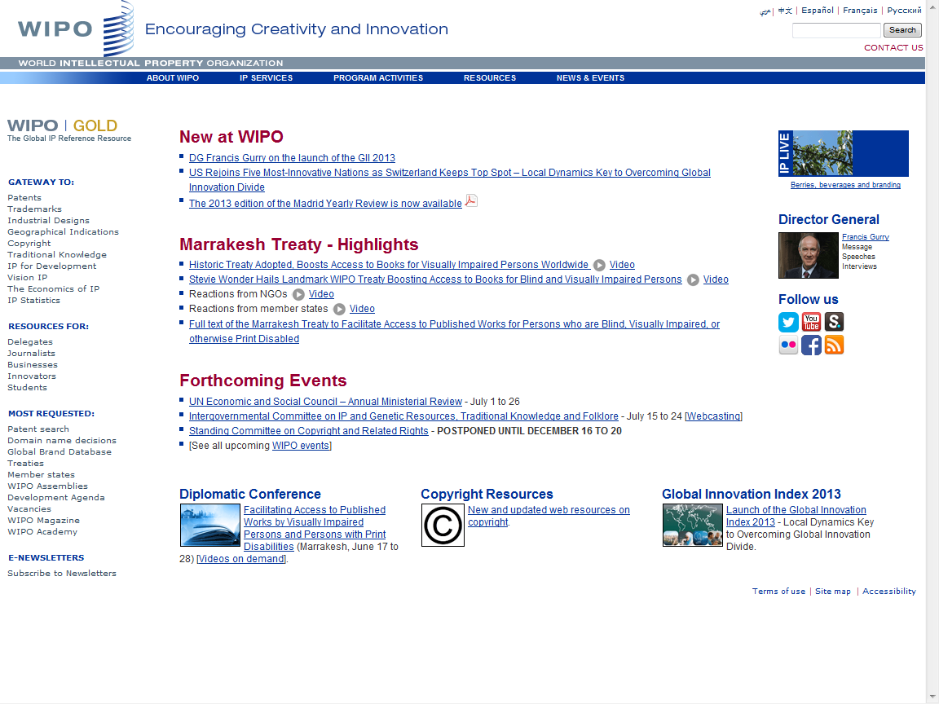

Slide 6
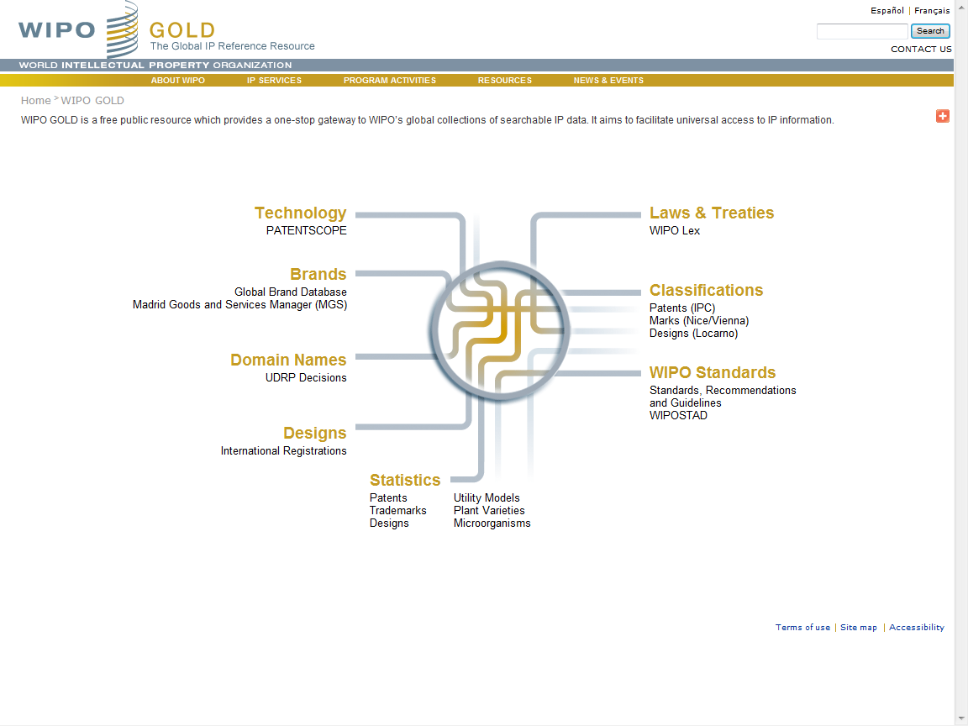

Slide 7
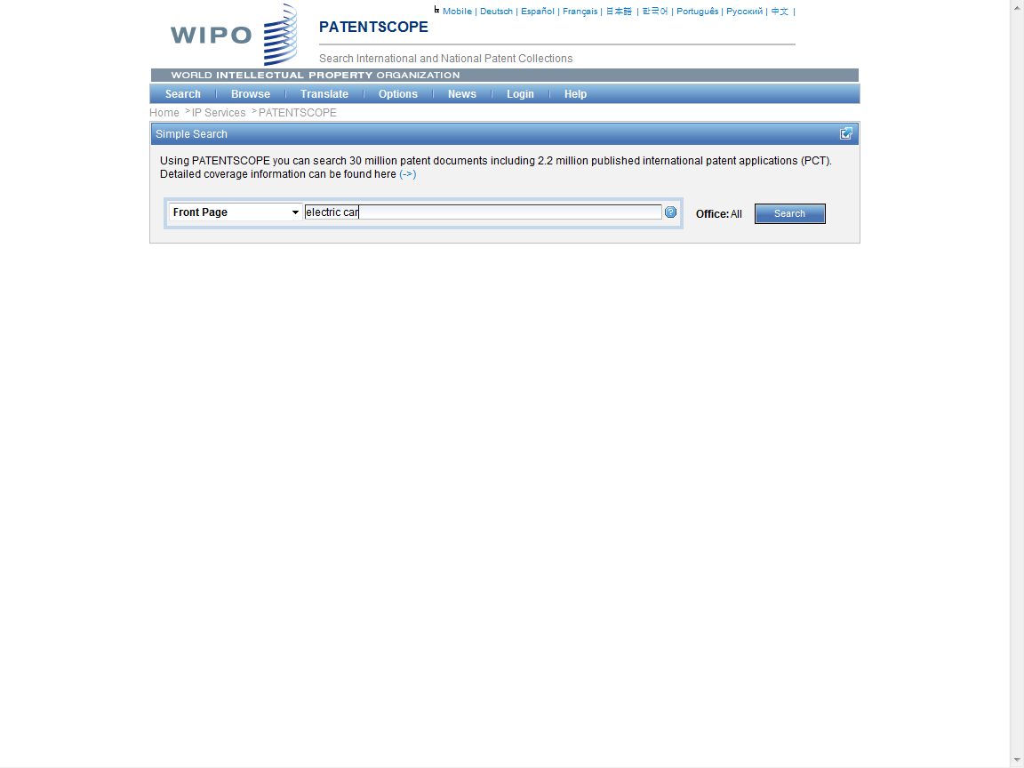

Slide 8
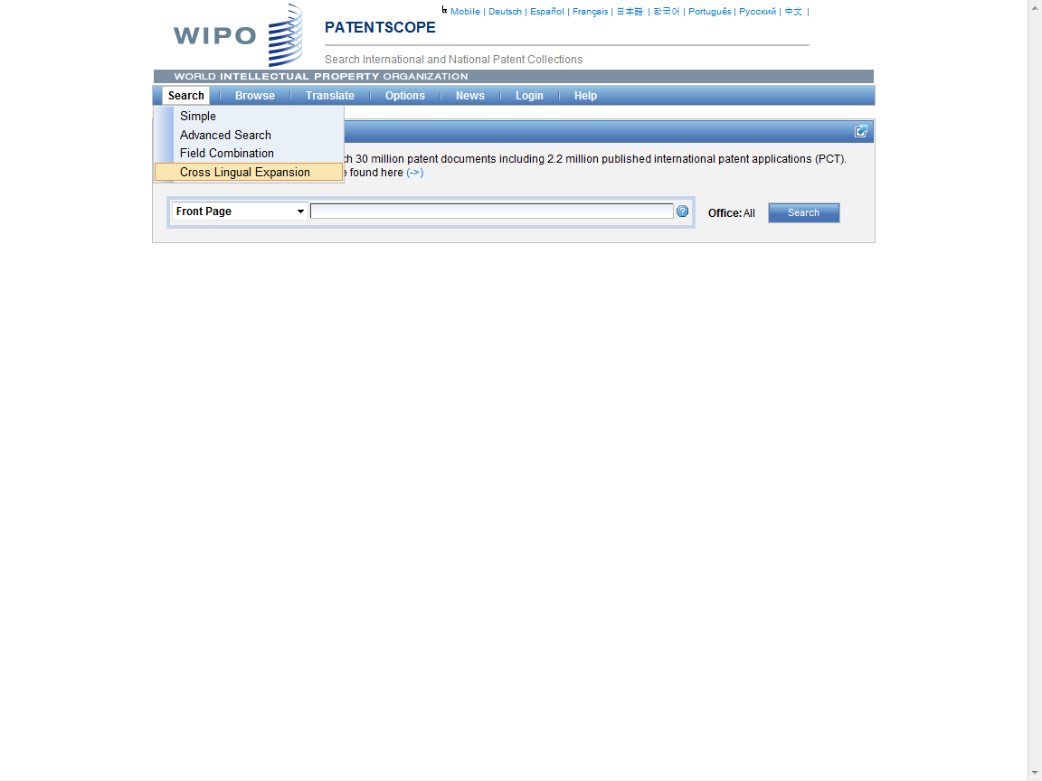

Slide 9
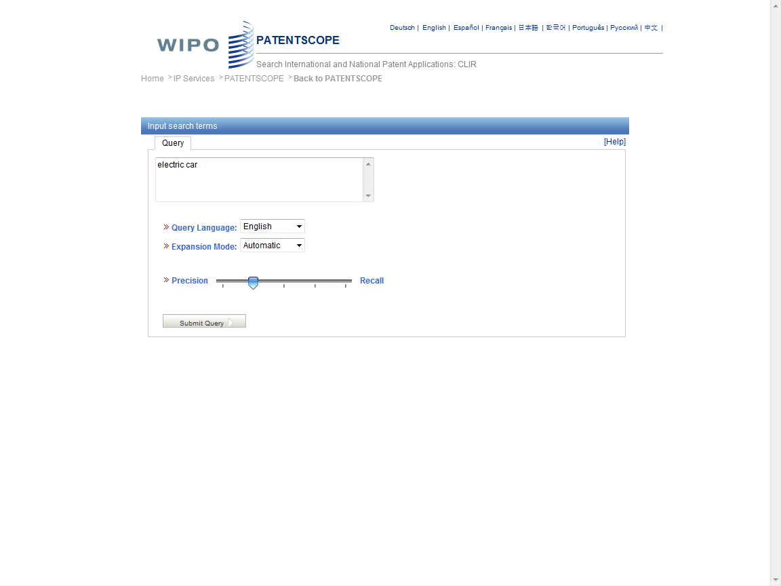

Slide 10
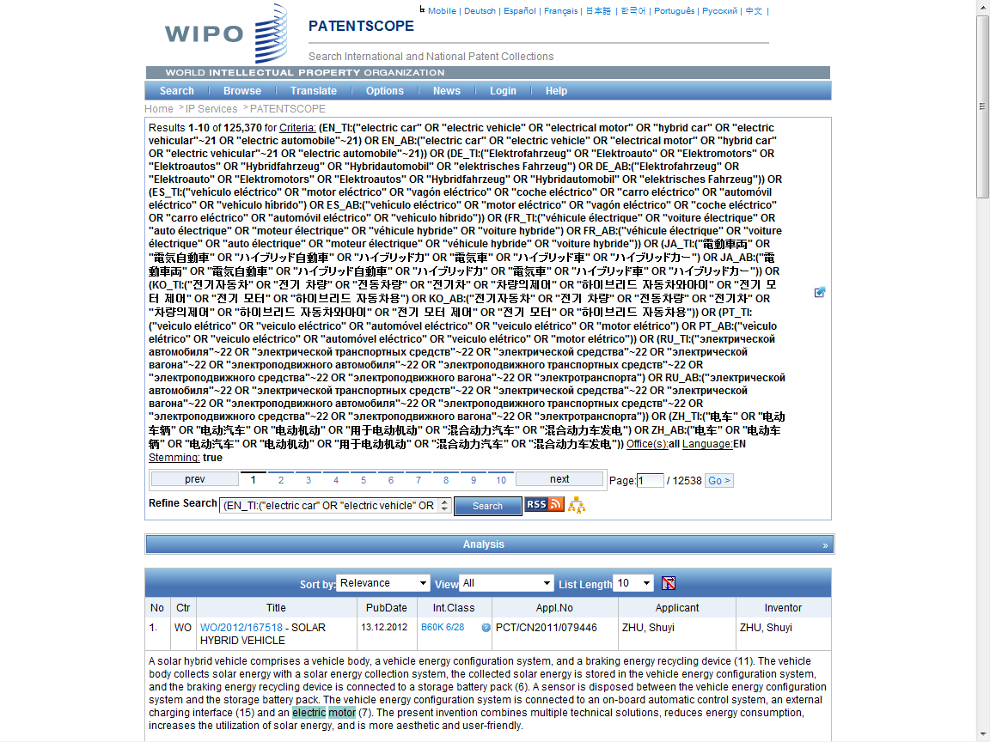
Search Query

Slide 11
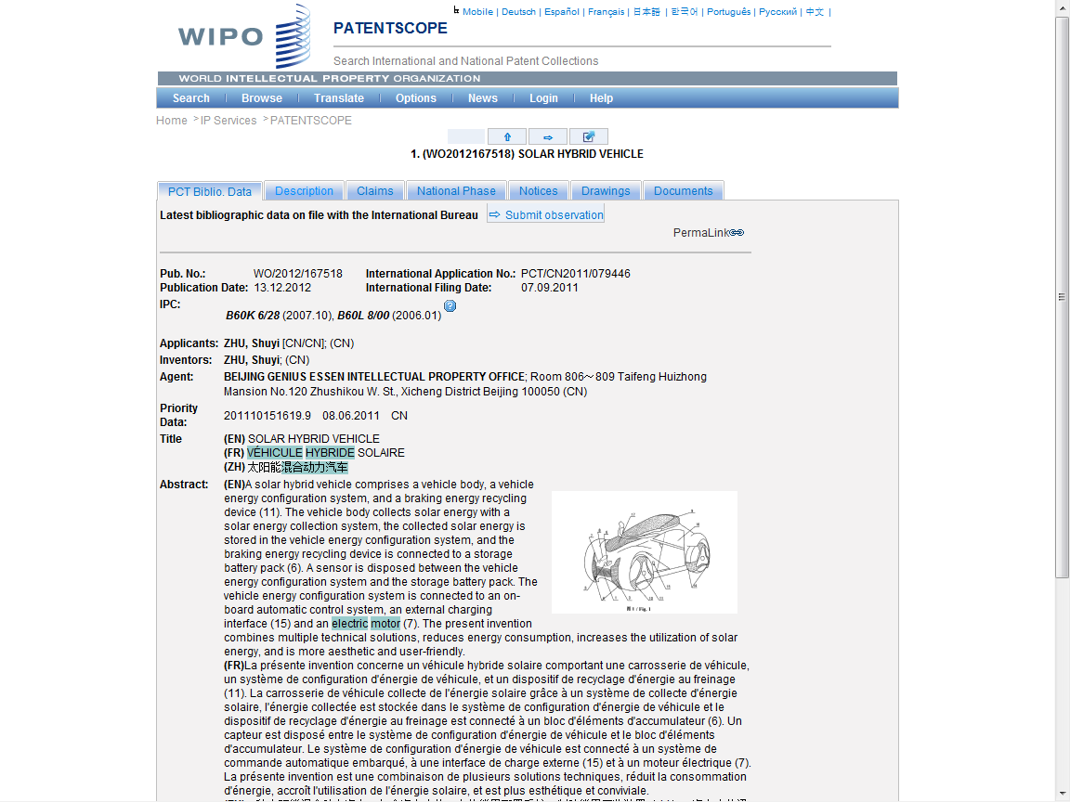

Slide 12
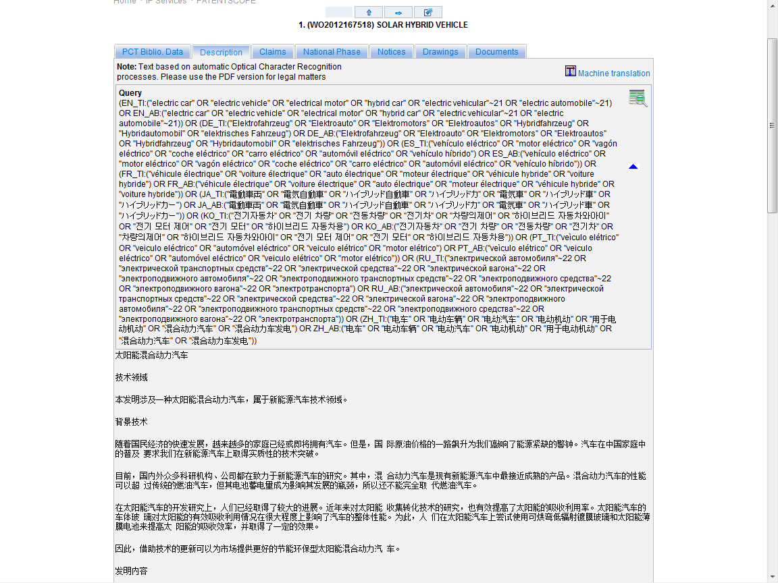
??

Slide 13
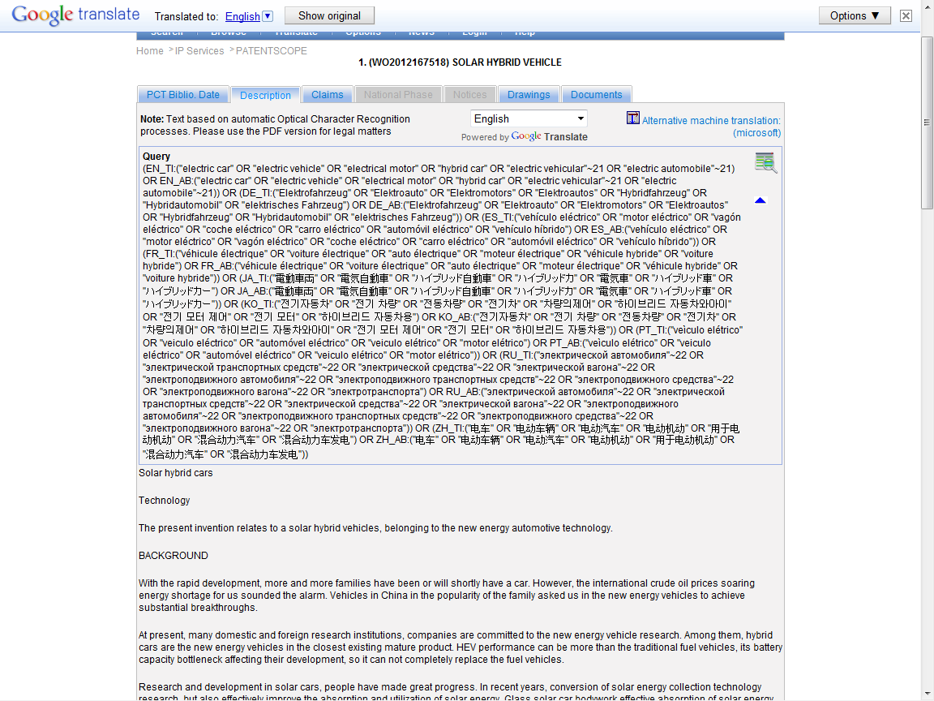

Slide 14
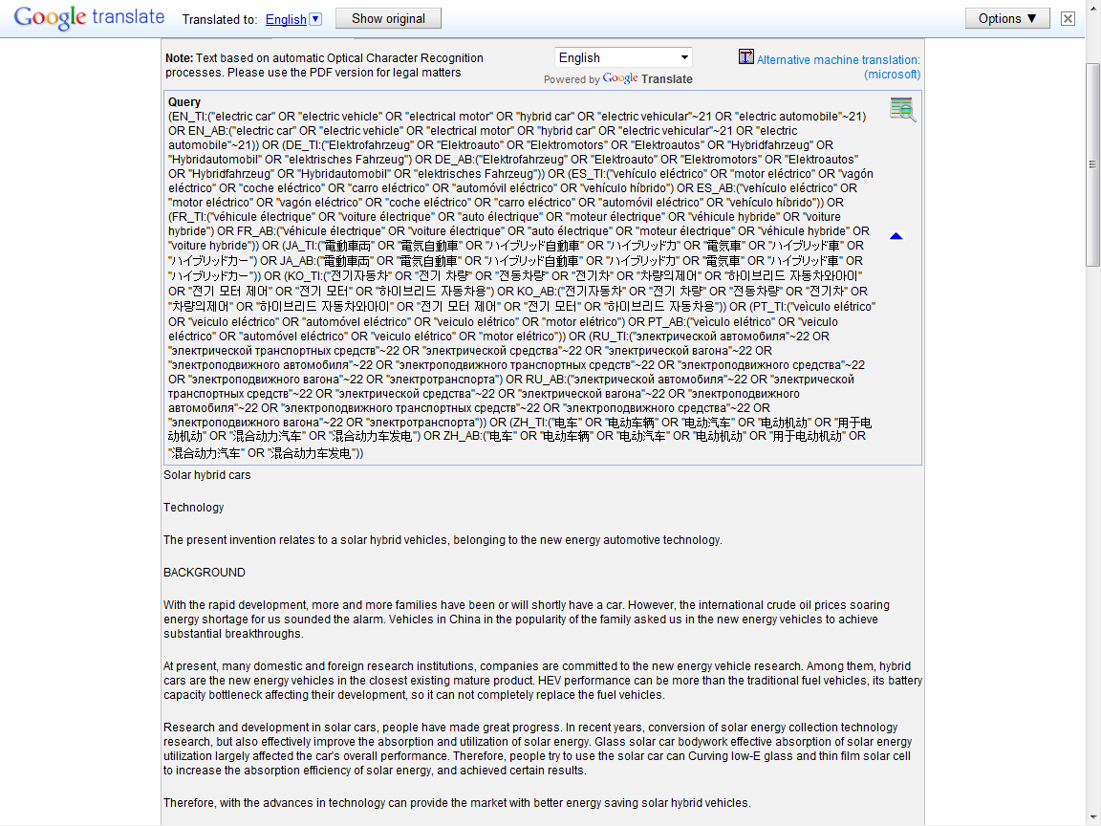

Slide 15
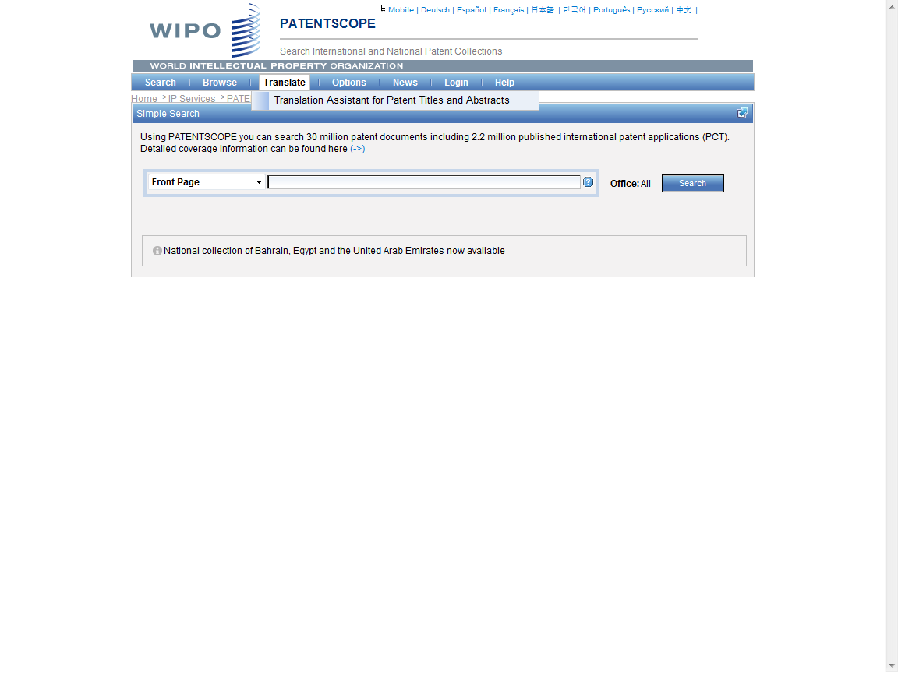

Slide 16
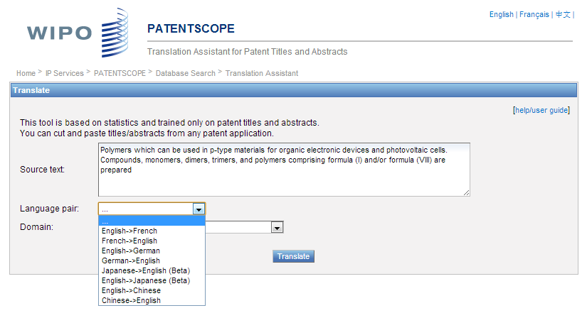
TAPTA

Slide 17
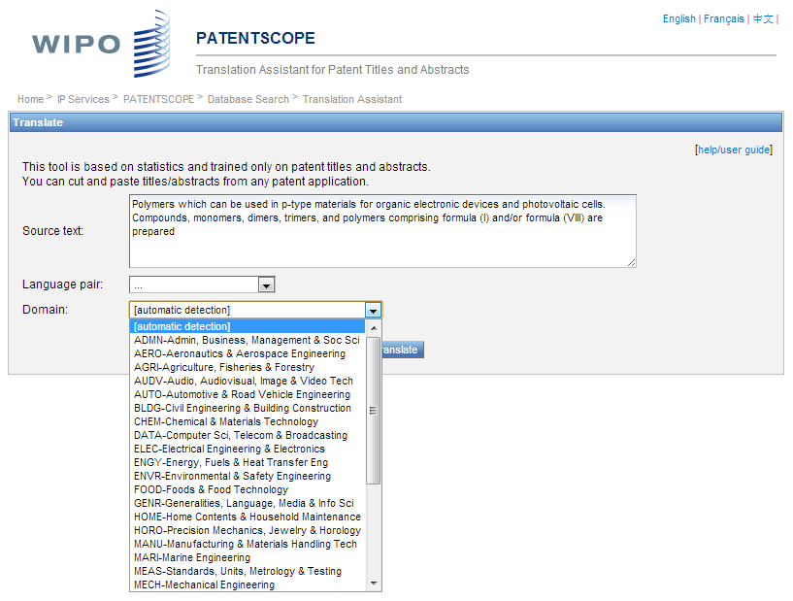

Slide 18
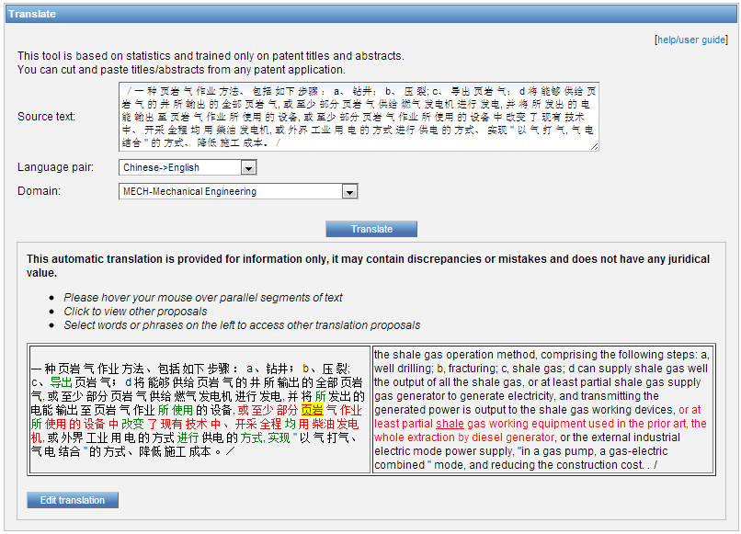

Slide 19
Global Databases, Tools, and Platform for IP business (free)
PATENTSCOPE
Global Brand Database
WIPO Lex
WIPO IPAS, WIPO DAS
WIPO CASE
WIPO RE:SEARCH
WIPO GREEN

Slide 20
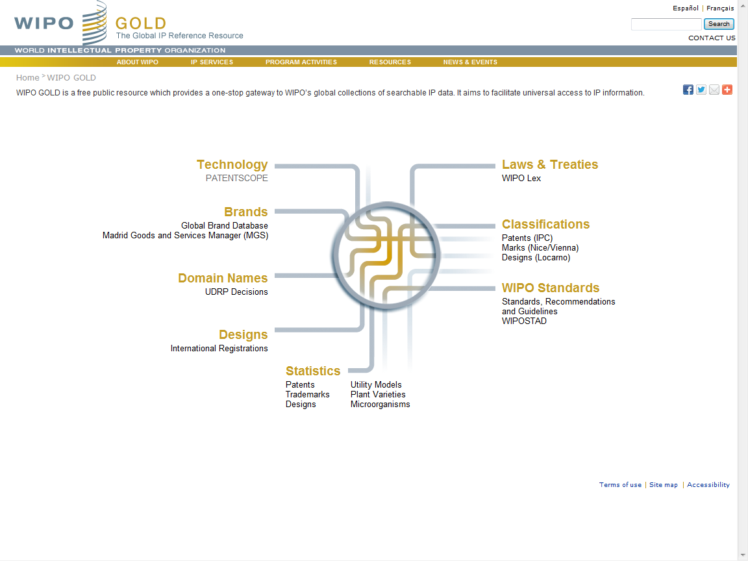

Slide 21
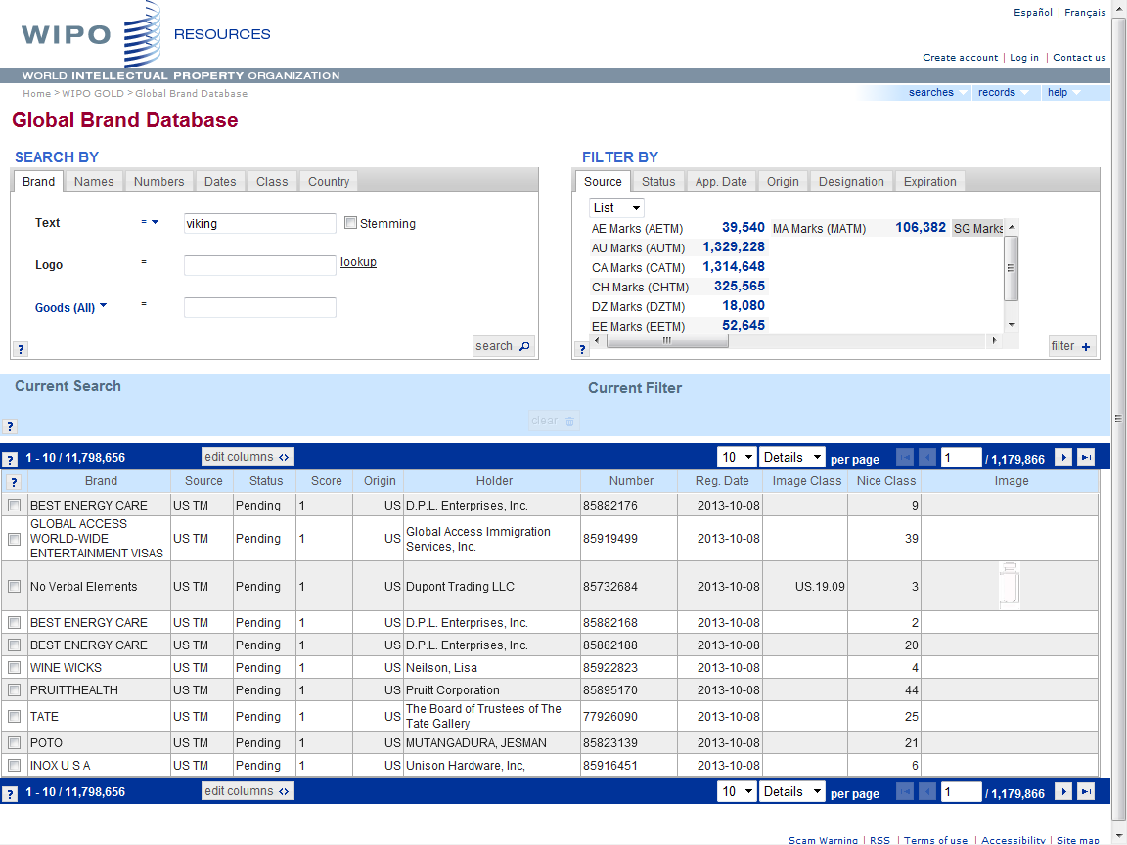

Slide 22
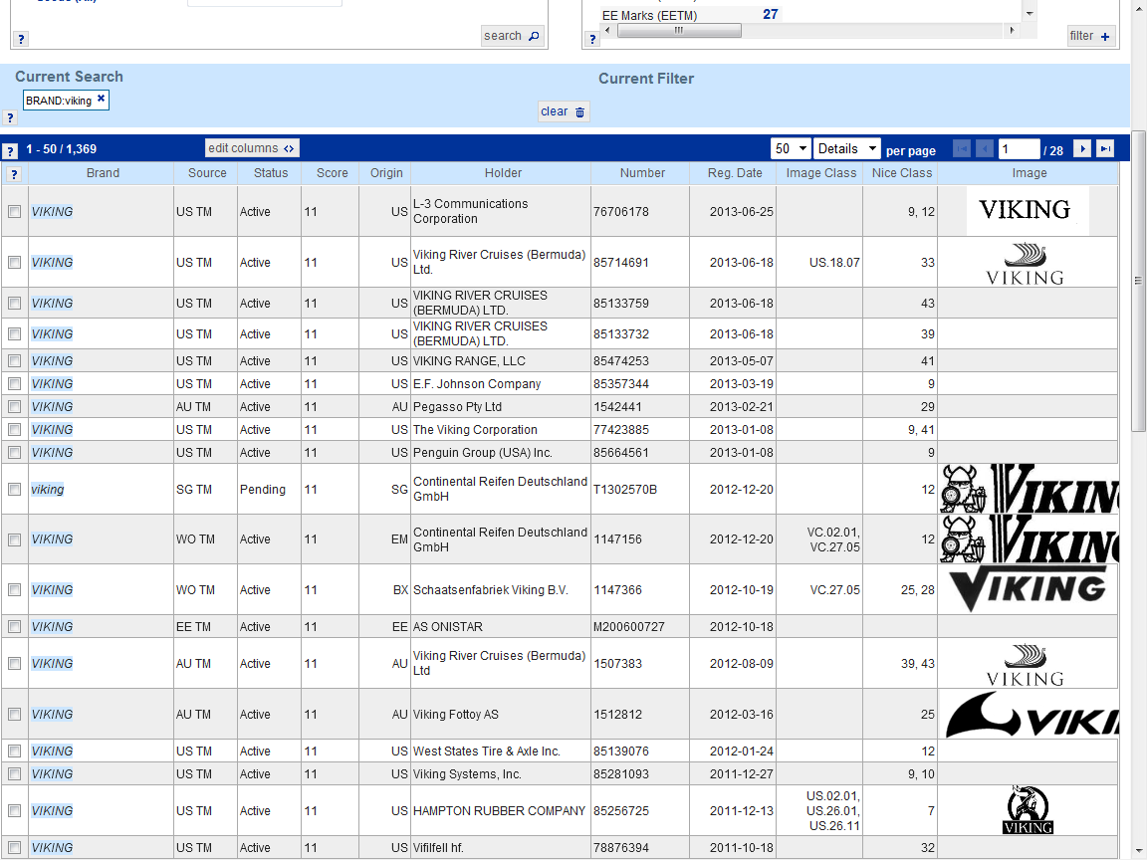

Slide 23
Global Databases, Tools, and Platform for IP business (free)
PATENTSCOPE
Global Brand Database
WIPO Lex
WIPO IPAS, WIPO DAS
WIPO CASE
WIPO RE:SEARCH
WIPO GREEN

Slide 24
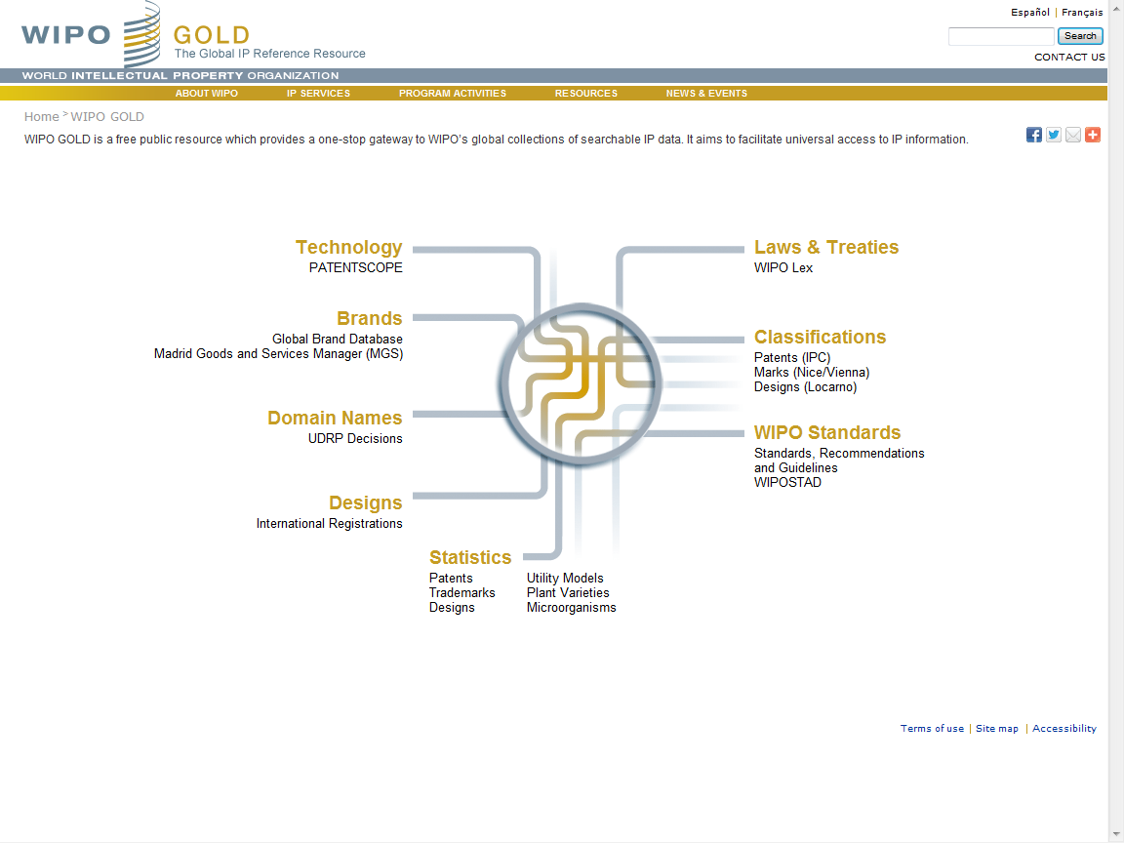

Slide 25
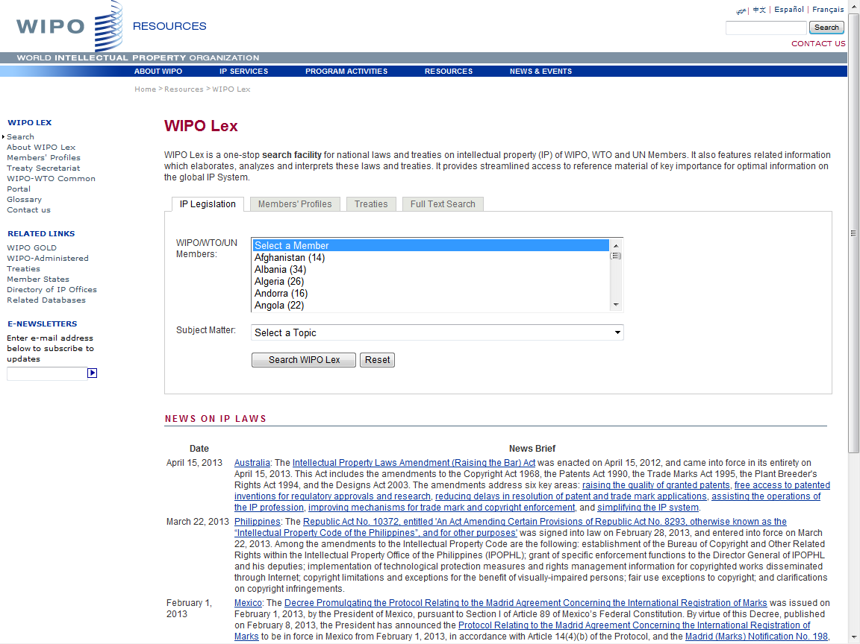

Slide 26
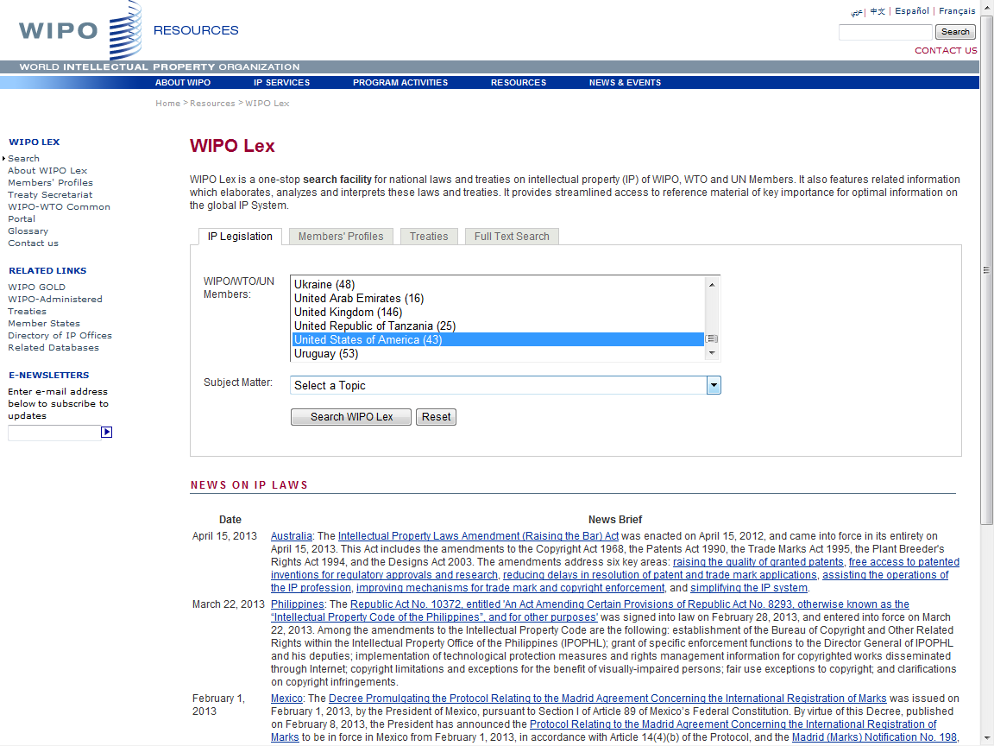

Slide 27
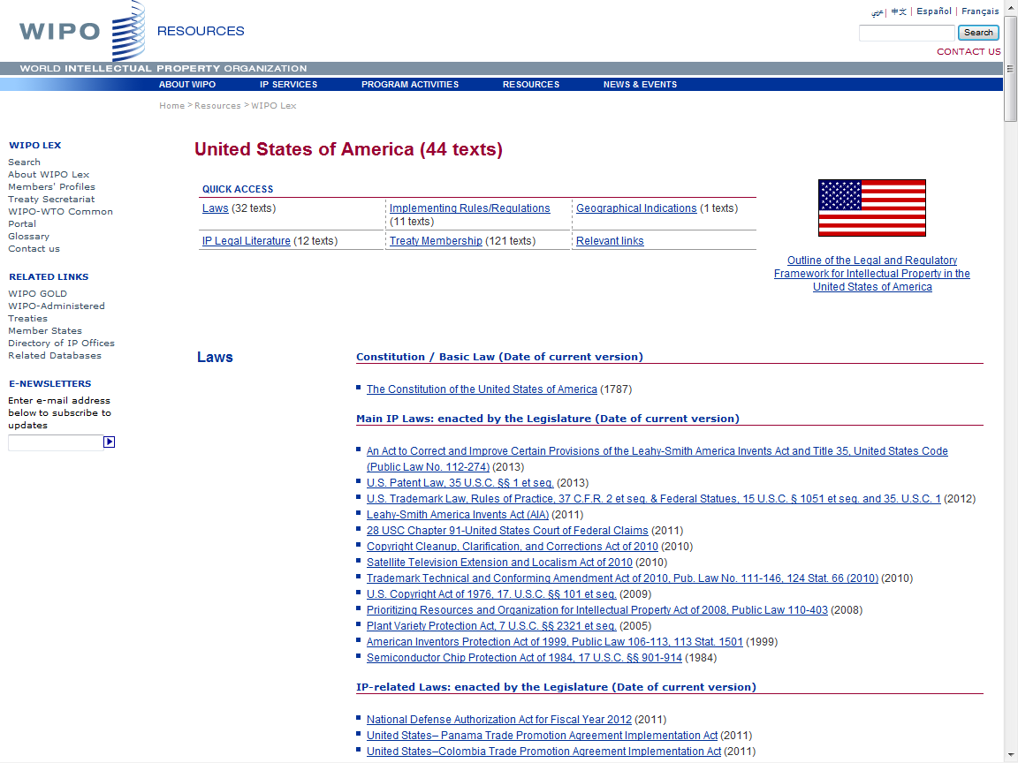

Slide 28
Global Databases, Tools, and Platform for IP business (free)
PATENTSCOPE
Global Brand Database
WIPO Lex
WIPO IPAS, WIPO DAS
WIPO CASE
WIPO RE:SEARCH
WIPO GREEN

Slide 29
IPAS and DAS
IPAS (IP Office Administration System) used by 55 IPOs
A WIPO software enabling small IPOs to electronically process patent, trademark, design applications
DAS (Digital Access System) used by 11 IPOs
- A System that allows IPOs and applicants to securely exchange or submit a digital copy of priority documents to multiple IPOs

Slide 30
Global Databases, Tools, and Platform for IP business (free)
PATENTSCOPE
Global Brand Database
WIPO Lex
WIPO IPAS, WIPO DAS
WIPO CASE
WIPO RE:SEARCH
WIPO GREEN

Slide 31
WIPO-CASE
“Centralized Access to Search and Examination Reports”
Started with an initiative of IP Australia and the Vancouver Group (AU, CA, UK)
Online patent work-sharing platform for patent examiners worldwide
IPOs can enhance quality and efficiency of patent examination
CASE will be linked to Open Portal Dossier of IP5 to become the Global Portal Dossier
How will it work?

Slide 32
WIPO-CASE (continued)
The System functions to:
Search by patent number and retrieve simple results or a list of patent family members.
View bibliographic data, citation data (if available) and lists of documents available for each patent record.
View and/or download the available documents.
Subscribe to notifications of updates to a given patent record.
-> will be linked to OPD of IP5 -> “Global Dossier”

Slide 33
“World Patent Office” on Global Dossier Platform
(WIPO-CASE, OPD and PATENTSCOPE)
PATENT
SCOPE
Public Users
(including IP office users)
Examiner of IP5 Office not participating in WPO/CASE
OPD
Feed dossier information that
OPD/CASE Offices agree to publish
Public Domain
OPD
Not accessible to the public and for PTO official use only
WIPO CASE
IPAS+
CASE depositary
System
Examiner of CASE participating office
Examiner of IP5 Office participating in WPO/CASE
CASE depositary Office using IPAS
CASE depositary Office using own EDMS
E.g. Australia

Slide 34
Global Databases, Tools, and Platform for IP business (free)
PATENTSCOPE
Global Brand Database
WIPO Lex
WIPO IPAS, WIPO DAS
WIPO CASE
WIPO RE:SEARCH
WIPO GREEN

Slide 35
WIPO RE:SEARCH
A Global Database and Platform to bridge partners to use IP (including know-how and data) to facilitate R&D on neglected tropical diseases, tuberculosis, and malaria.
Over 60 partners (pharmaceutical industry, research institutes such as NIH, Universities)
As of July 2013, 25 license agreements concluded

Slide 36
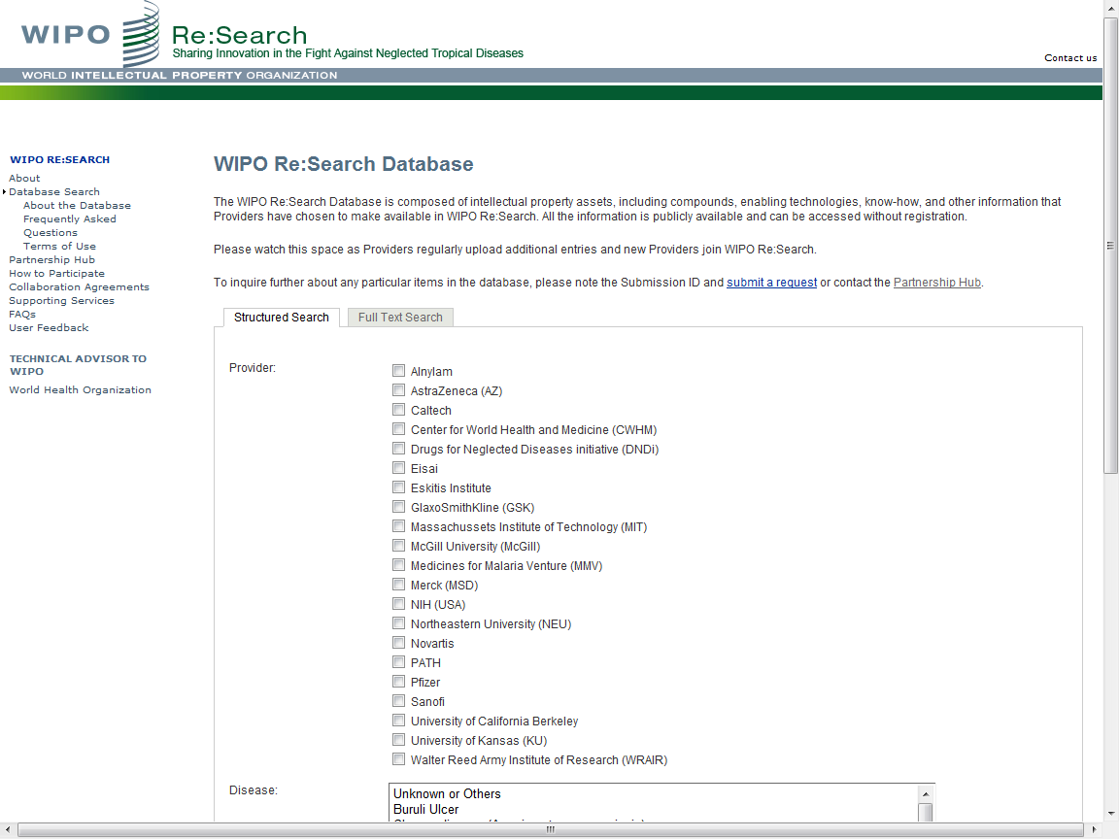

Slide 37
Global Databases, Tools, and Platform for IP business (free)
PATENTSCOPE
Global Brand Database
WIPO Lex
WIPO IPAS, WIPO DAS
WIPO CASE
WIPO RE:SEARCH
WIPO GREEN

Slide 38
WIPO GREEN
A Global Database to bridge providers of green tech and commercial partners
To be launched in November 2013

Slide 39
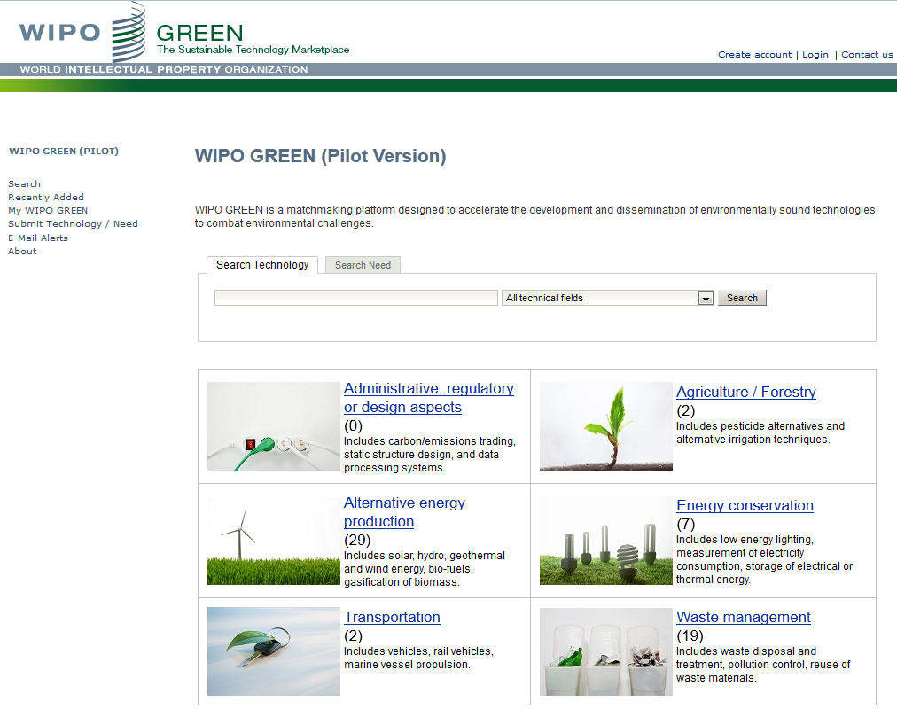

Slide 40
Vision
WIPO Global Databases and Platforms will promote global partnerships among multiple stakeholders
DB, Tools, Platforms need to be easy to search, most updated, interactive/dynamic, multilingual, and robust

Slide 41
Thank You!
www.wipo.int
“CONTACT US” Web Site at
http://www.wipo.int/contact/en/

