Slide 1
Federal state-funded institution of higher professional education
“Russian State Academy of Intellectual Property” (RSAIP)
Federal Service for Intellectual Property
ROSPATENT
Economic Development and the Role of Intellectual Property
Rector of RSAIP - Ivan Anatolievich BLIZNETS
- state Councilor of the 3rd class, Doctor of Law, professor
-Head of Intellectual Property Committee of the Chamber of Commerce and Industry of the Russian Federation
- Member of the Council on intellectual property issues under the Chairman of the Federation Council of the Federal Assembly of the Russian Federation
h.55a, Miklukho-Maklaya St., 117279 Moscow

Slide 2
Intellectual property – the basis for the development of the national innovation system
Innovative processes in economy and society are closely connected with the functioning of the IP Institution
Mechanisms of Intellectual Property comprise objects, sources and results of innovative activities

Slide 3
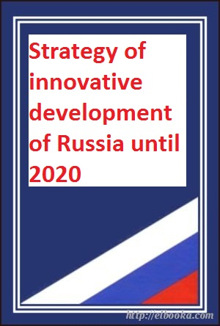
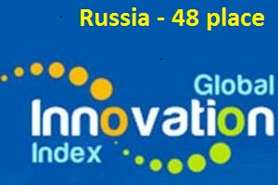
Building a national innovation system
Stage 1: until 2014
creation of the basic elements of innovative infrastructure
development of professional competencies of participants in the system
fostering development of new prospective markets
support of innovative projects
restructuring scientific sphere and drafting state programs aimed at the development of high-tech sectors in the economy

Slide 4
Main problem areas
MARKETS
Low level of innovative activities
Barriers to the development and implementation of innovations
INSTITUTIONS
Gap between research, development and commercial
FUNDING
Lack of funds for science and research (1.7% of GDP in 2015)
CULTURE
Low prestige of the scientist
Distorted attitude towards entrepreneurship
Primary development projects
Improving the efficiency of government bodies
Strategy of innovative development of Russia until 2020
Increase of the activity in the system of development institutions
Promoting development of state-supported companies and private sector
Active participation of IP in international trade
National strategy in the field of IP

Slide 5
goals
State strategy of intellectual property
significant increase in the intellectual component of the Russian economy
creation of a culture and raising awareness in respect to intellectual property
stimulating growth of creative activity of citizens and organizations
establishment of effective intellectual property institutional environment
provision of government guarantees for intellectual property rights protection,
improvement of judicial and law enforcement practice
establishment of the system for training highly qualified personnel in the field of intellectual property

Slide 6
Key indicators of the Russian Federation
Main innovation index
48
16-position growth from 2010
According to WIPO
Rating of patent activity
6th place
out of 103 countries in 2013
According to WIPO
Level of R&D personnel employed
12 out of 1000 people
830 thousand people in 2013
According to Russian Federation
Contribution of copyright
7,2% of GDP
increase of 20% from 2004 to 2013
According to WIPO,
Russian Federation
Rating of IP rights
81th place
out of 129 countries in 2015
According to IPRI

Slide 7
Intellectual property and the economy of Russia
In 2015 Rospatent granted 27 thousand patents to Russian inventors:
Technological exchange between organizations

Slide 8
Intellectual property and the economy of Russia
development of many industries
providing employment
development of foreign trade
growth of added value
In 2013 this figure rose to around 20%
7,2% GDP
The contribution of the sector of the economy, copyright in Russia in 2005 amounted to 6,06% of GDP

Slide 9
Intellectual property and the economy of Russia
Volume of GDP produced by
individual industries of
Russian economy
Diagram of turnover of industries
directly related to copyright

Slide 10
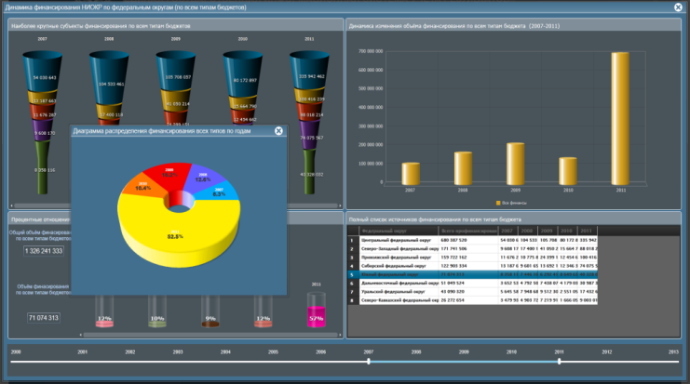
Improvement
of intellectual property regulation
Development of proposals on improvement of out-of-court dispute resolution in the sphere of intellectual property rights infringement
Development of measures on the legal system improvement in the field of intellectual property protection
Development of proposals on the legal framework improvement in the field of accounting and tax accounting of intangible assets, tax system related to intellectual property and IP transactions
Appraisal of proposed by public customers procedures of making decisions on the possibility of concluding contracts for gratuitous alienation of the exclusive right to the result of intellectual activity and/or contracts for granting a free ordinary (non-exclusive) license to use the RIA
Transition to the international principle of exhaustion of exclusive trademark rights
Creation of legal framework for IP within the bounds of CEA

Slide 11
Development of intellectual property infrastructure
Special economic technological development zones
“Skolkovo” innovation center
business incubators (50)
science and technology parks (70)
Centers for technology transfer (in 67 regions)
Development institutions
More than 200 organizations, which, based on the functions performed, can be classified as development institutions
Science Towns (14)

Slide 12
State support of SMEs
2009
2010
Law No. 217-FZ "On amendments to certain legislative acts of the Russian Federation concerning creation by state-funded scientific and educational institutions of economic societies (companies) for practical application (implementation) of intellectual activity results" - allowed the universities and research institutes to set up small innovative enterprises (SIE)
road map "Expanding access of small and medium businesses to infrastructure monopolies and state-supported companies purchase"
Tracking, analysis and statistics of small innovative enterprises and their methodological support are carried out
2013
at present
tax concessions to small innovative enterprises in universities and research institutes, simplified system of taxation, reduced rent rate, reduced rates of insurance fees
“Strategy of development of small and medium businesses in the Russian Federation for the period till 2030"
There removed restrictions on the transfer of non-exclusive rights from SIE to third parties and restrictions on shares in authorized capitals of economic societies and SIE partners
Work on elimination of administrative barriers in the activities of SIEs is performed

Slide 13
Creation and distribution of SMEs

Slide 14
Authors, performers, producers of phonograms can exercise their rights to RIA and control IP exploitation
Information on inventions and trademarks
Fostering intellectual property commercialization
Solution to the problem of illegal content use in the network by means of monitoring
Openness
Accessibility
private initiative

Slide 15
awareness of intellectual property issues
technological and innovation potential of the country
education level of the population

Slide 16
training in the field of intellectual property
Russian state Academy
of intellectual property

Slide 17
Education system
intellectual property
law – legal protection and IP protection
Economics and management – innovation management and IP commercialization
preparatory department
education clusters
Open doors days, open lessons and lectures in schools
pre-University training
(14-18 years)
higher education
(17-26 years)
additional education (>22 years)
Вaccalaureate ((Bachelor course))
Magistracy (Master course)
Postgraduate course
Professional retraining
Advanced training
Doctor of science (PhD program)

Slide 18
INTERNATIONAL INTELLECTUAL PROPERTY OLYMPIAD
FOR HIGH SCHOOL STUDENTS
8-th International Intellectual Property OLympiad
2016
“Inventive and research activity of the youth –
formation of the new intellectual elite of the world"
7-th International Intellectual Property OLympiad
2015
6-th International Intellectual Property OLympiad
2014
5-th International Intellectual Property OLympiad
2013
4-th International Intellectual Property OLympiad
2012
2011
3-d All-Russia Intellectual Property OLympiad
2010
2-nd All-Russia Intellectual Property OLympiad
2009
1-st All-Russia National Intellectual Property Quiz
Olympics history

Slide 19
www.rgiis.ru
inst@rgiis.ru
bliznets@mail.ru
+74953301083

