Slide 1
WIPO International Conference on Intellectual Property and Development
Geneva, April 7 and 8, 2016
Octavian APOSTOL
Director General
State Agency on Intellectual
Property of the Republic of Moldova

Slide 2
Case Study on the role of IP on social and economic development
“From ♥ Brands of Moldova”
A success story on how a branding project impacted the light industry of Moldova for the benefit of the local fashion industry and the society as a whole…

Slide 3
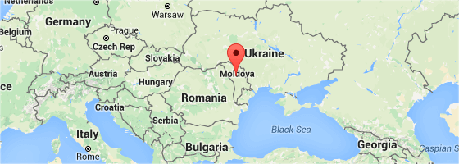
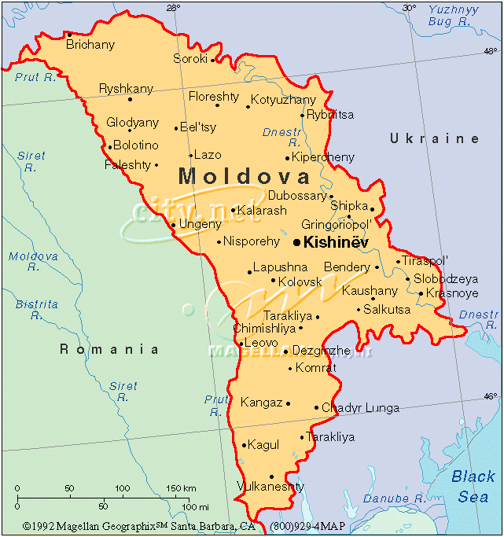
Republic of Moldova
Basic facts:
Area 33, 843 sq. Km
Pop.(2012). 3,559.500 inh.
Capital: Chişinău
Declaration of Independence: August 27, 1991
Official Language: Romanian
Memberships:
WIPO: December 25, 1991
United Nation: March 2, 1992
WTO: July 26, 2001
Council of Europe: July 13, 1995
GDP (2015)
- total: $6.188 billion
- per capita $4.177 (PPP)

Slide 4
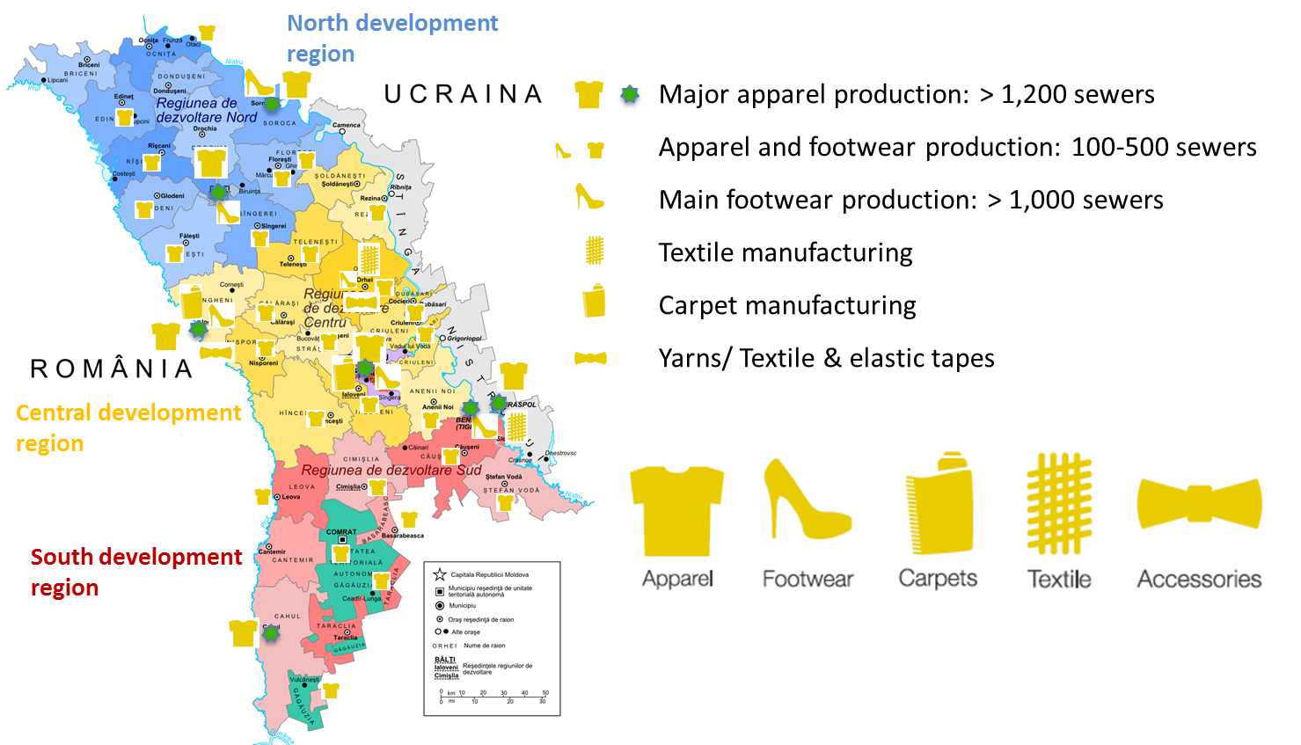
TAFL Industry Map
f

Slide 5
TAFL Industry Overview
Textile, Apparel, Footwear and Leather goods Industry (TAFL) Industry in figures (year 2014):
20.4% of positive growth, comparing with 2013;
14.3% of GDP;
7.3% increase in industry production;
20 % of export volumes, of which 86% in EU;
26.000 employees, of which 90% women;
Over 600 enterprises activating in the sector;

Slide 6
Key Challenges
Limited access to financial resources;
High share (90%) of low-value manufacturing;
Outdated technologies;
Week marketing and sales capacities;
Lack of visibility;
Insufficient skilled human resources;
Underuse of IP tools;

Slide 7
From the Heart. Brands of Moldova
The project „From the Heart - Brands of Moldova" was launched in 2012
Main goal: Increase the competitiveness and prestige of Moldovan brands in the field of apparel, footwear and accessories
Objectives:
To train entrepreneurs on how to sell more successfully the product under the local trademarks;
To develop a consumer oriented campaign for promoting domestic products, improving the consumer perception and knowledge for local brand, educating the sentiments of pride for national assets;
To stimulate the manufactures to implement high value production scheme, moving from low-cost “LOHN” model to high-value own brand production.

Slide 8
“From the Heart- Brands of Moldova”
A public-private partnership:
Employers' Association of Light Industry Enterprises (Association APIUS),
public sector represented by Ministry of Economy, Ministry of Culture and Moldova Investment and Export Promotion Organization, and
USAID - as the main donor-partner through the Competitiveness Enhancement and Enterprise Development (CEED II) Project.

Slide 9
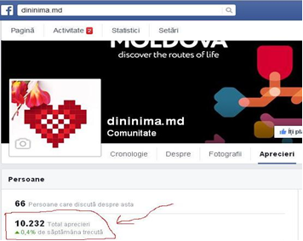
Advertising campaigns
Billboard
Mass-media
TV-shows
Radio ads
Internet

Slide 10
From the Heart…
♥ sell not just products to the consumer, but
a certain satisfaction,
good emotions,
pride for domestic goods,
feeling of being part of a community,
recognition of contributing to the common welfare,
and much more…

Slide 11
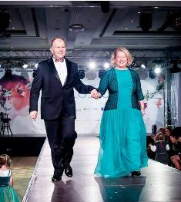
Moldova Spring Fashion Walk
In 2012, 7 designers participated in the first campaign aimed to promote apparel, footwear, and fashion accessories “made in Moldova”.
The 1st edition of Moldova Spring Fashion Walk
was organized, supported by USAID and
hosted by H.E. Ambassador of United
States in Moldova, Mr. William H. Moser
and his wife.
In 2015, at its 7th edition – 35 fashion brands
demonstrated their “made in Moldova”
Collections
Photo:
H.E. Ambassador Moser and his wife climbed the podium in a gesture of support for local designers

Slide 12
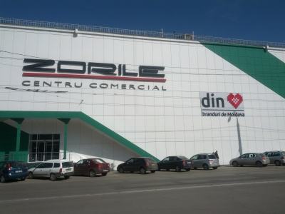
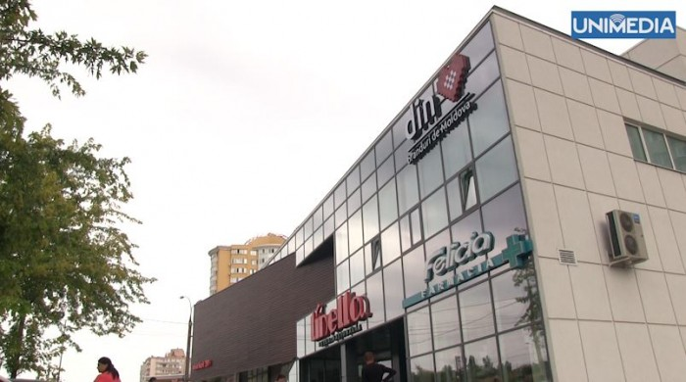
Marketing and selling tools
Commercial Platform “From the Heart - the Common House for Brands of Moldova”
+ 65 new shops selling Moldovan brands opened
+ dedicated space in national retail supermarket chains

Slide 13
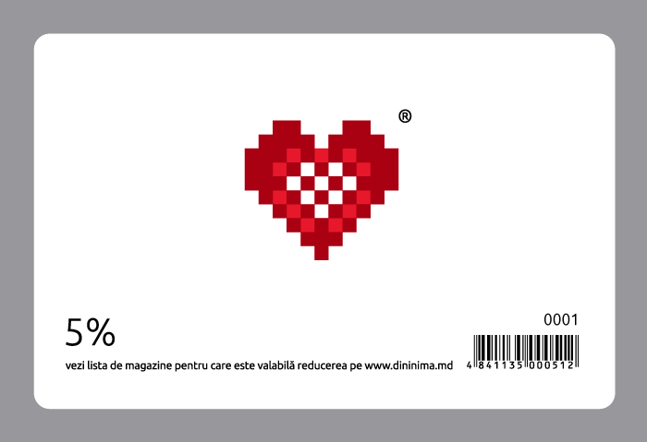
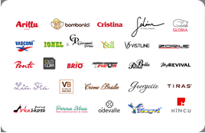
Discount card
to reward the customers’ loyalty, a discount card was introduced for all the partner- companies.

Slide 14
Trademark Identity
Umbrella brand
Individual trademarks:

Slide 15
APIUS IP Portfolio
83 companies - 49 companies have registered IP rights;
126 registered national trademarks in total,
of which
31 new trademarks registered in the period 2012-2015 with the “Brands of Moldova” project support;
5 trademarks application filled;
6 companies registered their trademarks through the Madrid system: Zorile, Steaua Reds, Tirotex, Portavita, Artizana;
2 companies registered their design.

Slide 16
Ranking of companies by trademarks
1st place - Ponti SA
with 65 national trademarks,
and 1 international :

Slide 17
Ranking of companies by trademarks
2nd place
with 6 trademarks, including 2 international registration and 3 applications
3rd place and
with 3 national trademarks each

Slide 18
Project Achievements in figures
Low-value, Cut & Make services decreased from 95 to 80 %;
Assisted brands brought in $ 7.4 million in new sales on the MD Market;
Companies registered an increase of 34% in net sales over three years;
More than 30 companies have increased productivity by 15-20%;
70 domestic brands emerged, 31 new trademarks registered;
The export geography increased to 10 foreign markets;
More than 65 new shops opened in Moldova selling local brands;
Over 60 companies assisted by the project;
Over 20 trainings organized, over 700 attendees – 81 % of them women;
Every $1 invested in the promotion campaign generates sales growth of $65!!!

Slide 19
First 100 exporters in Moldova
3 companies party to “Brands of Moldova” Project are among top 100 exporters (2014)
position 39
position 52
position 79

Slide 20
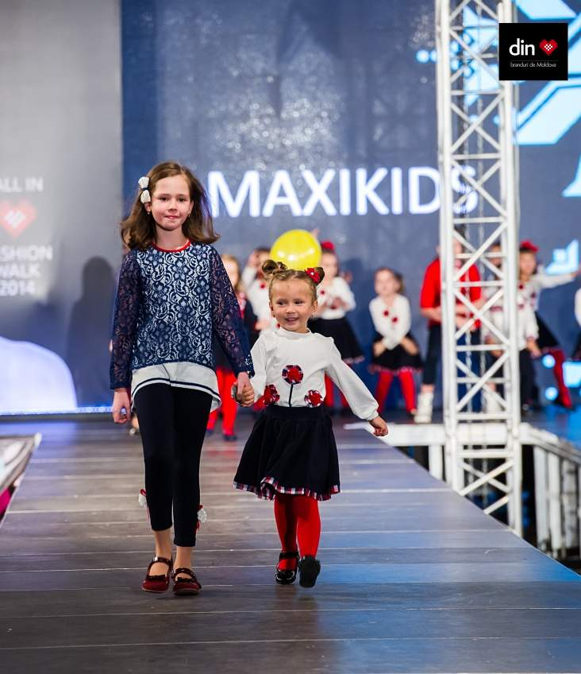
Guaranteed loans, rebranding and promotion campaigns help Moldovan small business to grow
Zivazi Maxi – a small family owned company- after benefiting in 2014 of a guaranteed loan and assistance for branding development, have managed to turn in profits, more than tripling sales in nine months.
In 2014, the company participated under its brand “Maxikids” within the Fall Fashion Show 2014.

Slide 21
Sustainability and Exploitation Strategy
consolidation of the light industry environment and of the APIUS Association:
APIUS increased its capacity and doubled its membership throughout the project running;
APIUS became a strong industry voice, representing the interests of the TAFL industry in communication with the state authorities, development partners, investors, etc.
The industry acquired a strategic development vision, embraced by both private sector and the government

Slide 22
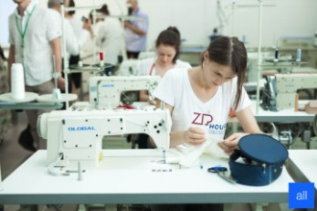
Current perspectives and future developments
In September 2015 – a Center of Excellence and Acceleration in Design and Technology was established - “ZipHouse”
An innovation hub equipped with modern
manufacturing machines, IT communication
and media, design and projecting equipment,
library, and training facilities ;
Public-private partnership: APIUS + TUM + USAID
Project budget: 325000 $ US, of which 225000 $ US provided by USAID and 100000 $ US in-kind contribution from Moldovan partners

Slide 23
“ZipHouse” - a start-up platform for students and young professionals

Slide 24
Key economic impact
Boosted the shift from low to high-value added manufacturing;
Enhanced exports and revived Moldovan Market;
Upgraded product quality and productivity;
Consolidated industry environment and vision;

Slide 25
Key social impact
Job creation – employment of rural based women;
Reduction of emigration – less women migrates for work;
Improved education - more highly skilled workers;
Salary increase - improved household wellbeing;
Young professionals work-life integration- better perspective for young entrepreneurs and designers;
Change in consumer behavior - recognition and consumer pride for local brands.

Slide 26
From ♥ Brands of Moldova – part of everyday life
♥ accompanies us on the turn of seasons,
♥ enriches our holidays and anniversaries,
♥ fills our life with joy and originality
♥ makes us special…
…it became the Moldovan TAFL Industry Visit Card

Slide 27
With compliments from Moldova…

