Slide 1
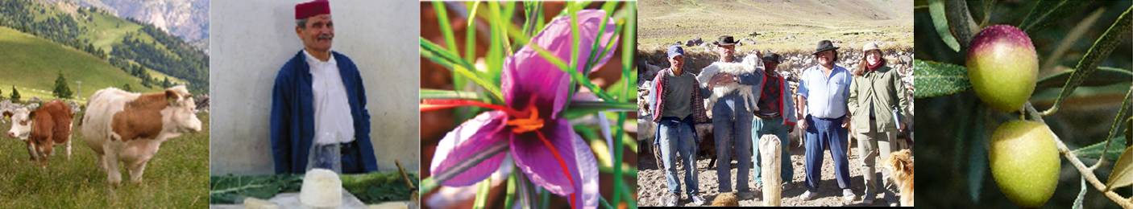
Geographical indications, an IP tool for sustainable
agri-food systems
Florence Tartanac, Senior officer, Food and Nutrition Division, FAO
WIPO international conference, 24 April 2023
Notes:
Thank you….
Good afternoon to all.
It is a real pleasure to be here today to provide this key note address on how Geographical indications, as an IP tool, could help the transition towards sustainable agri-food systems.

Slide 2
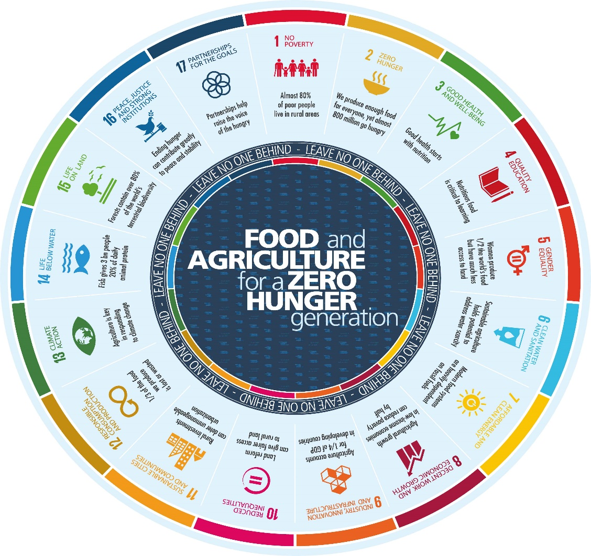
Food and Agriculture in the 2030 Agenda
Food and agriculture relate to all 17 SDGs
A food systems approach is needed to achieve SDGs
Importance of game changing solutions in the food systems to contribute to rural transformations towards SDGs
Notes:
Because our focus today is on food and agriculture, let’s start with Agenda 2030 and how it offers a vision for food and agriculture as enablers of sustainable development.
Targets relating to food and agriculture go far beyond SDG2 (Zero Hunger) and influence all 17 goals.
Food − the way it is grown, produced, traded, transported, processed, stored and marketed − is the fundamental connection between people and the planet, and the path to inclusive social and economic growth. Innovation is critical with practically only 8 years left until 2030 so we can catalyse addressing old problems in new ways.
Consequently, a food system approach is needed to achieve SDGs.

Slide 3







How GI can contribute to sustainable agri-food systems and SDGs
Territorial approach
Link with origin that is formalized into the specifications
Collective and participatory approach, smallholders to joint forces, economies of scale and VC efficiency
Economic impacts and territorial strategy, job creation, perspectives for young people
Inclusive value chain and food system
Local producers as main actors – redistribution of benefits locally and more balanced power distribution along the VC
Smallholders and women empowerment
Market tool combined to public goods
Public – private coordination, policy dialogue
Coordination between levels: local, national and international
Consumers interest
Food diversity: cultural aspects, impact on nutrition
Guarantees on quality and origin for consumers

Slide 4
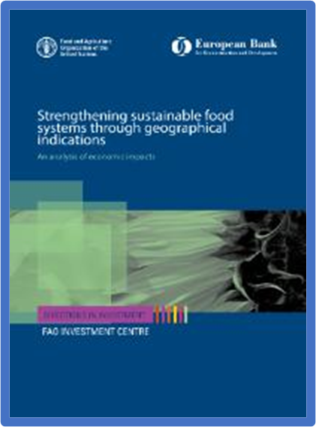
Main economic impacts
Robust impact of GIs on final products prices - from 20 to 50% increase
Better income redistribution to primary producers
Increase of production, especially in the long term after possible initial decrease
Market access enhanced, new markets or growing markets
More economic resilience, especially through diversification and decreasing dependency to global market price
Positive externalities
Notes:
Based on a FAO-EBRD analysis of economic impact published in 2018.
FAO-EBRD, 2018, Strengthening food systems through geographical indications. An analysis of economic impact. Rome.

Slide 5
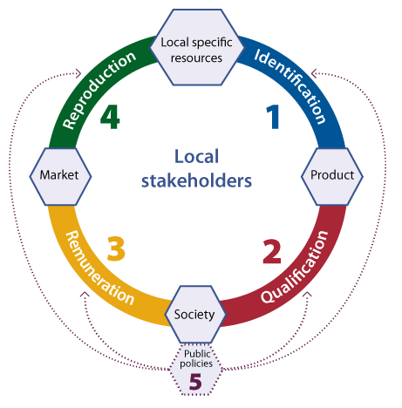


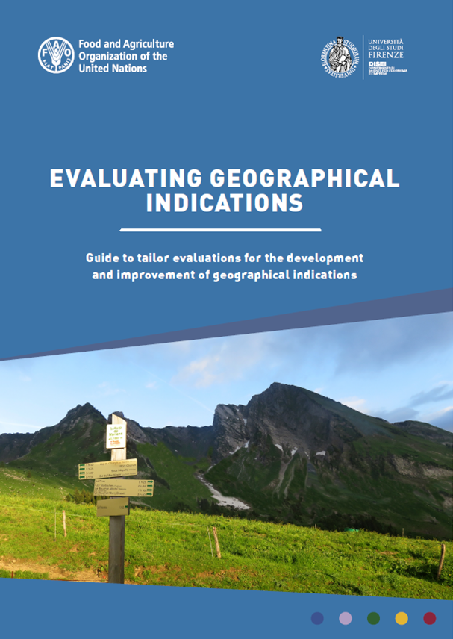

How to address sustainability for GI?
Using FAO “virtuous origin-linked quality circle”
Monitoring impacts and adjusting the GI system
Supporting GI organizations in the development of a sustainability roadmap (forthcoming guide and toolkit)
Role of public authorities

Slide 6

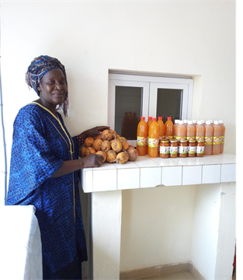
Example– Madd de Casamance, Senegal
GI project started in 2017 with support from FAO, WIPO and now CIRAD/AFD and OAPI
GI registration in the process of being finalized
Biodiversity preserved
Positive economic impacts for producers, in particular for women and youth
Notes:
Let me give a practical example --- the case of Penja Pepper in Cameroun
This case illustrates well how the GI has permitted the dissemination of innovations to help small-scale producers to improve their productivity and generic quality (that is its minimum standard on quality and safety)
The specifications incorporated an improved technical itinerary, including requirements for the nursery, labor-intensive operations in trimming, vine pruning, weeding, and with particular attention sanitary rules including hygiene rules for harvest, packaging of finished products, clean storage facilities, etc..
Thanks to the GI processes the Penja pepper, not only preserved its specific quality and tradition, but also met higher standard on food safety. And knowing that diets can’t be healthy if they aren’t safe – this higher safety standards thus contributes enabling healthy diets.

Slide 7
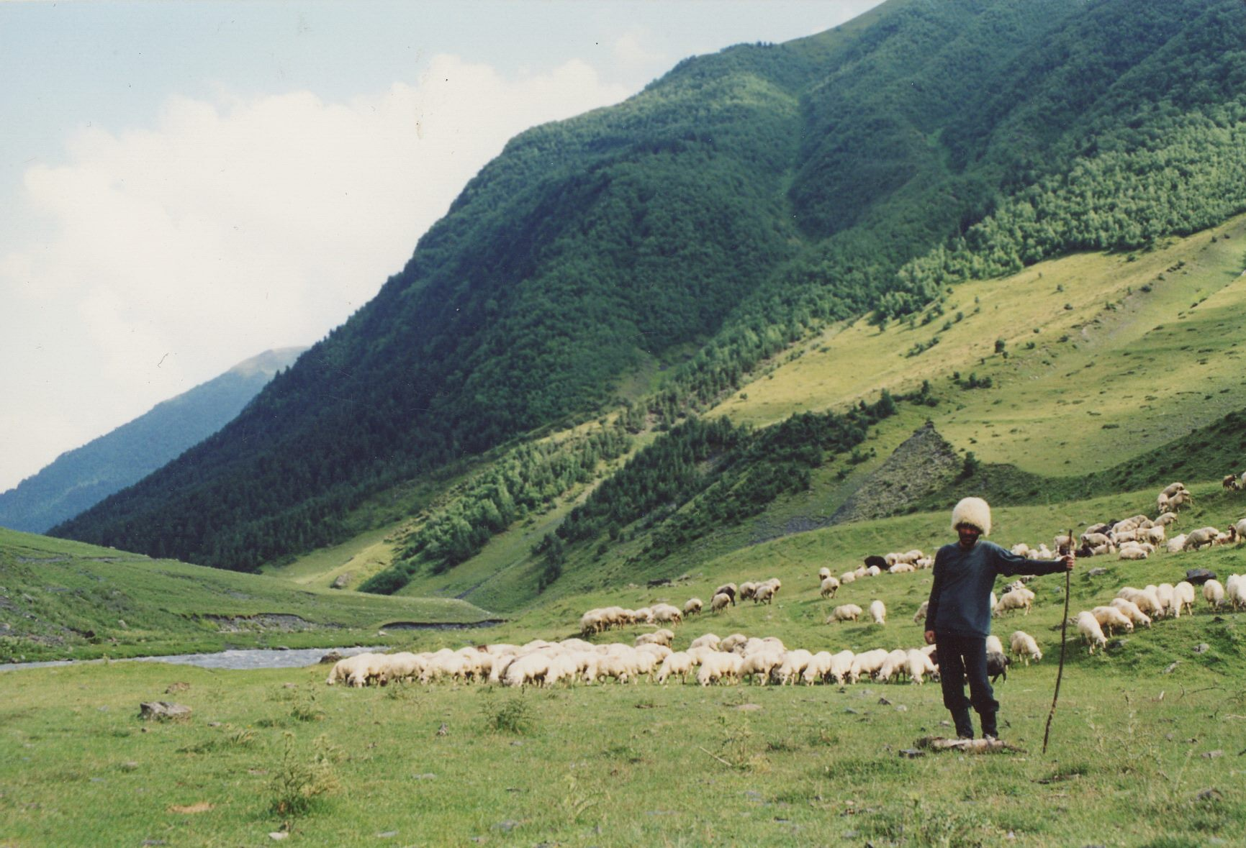
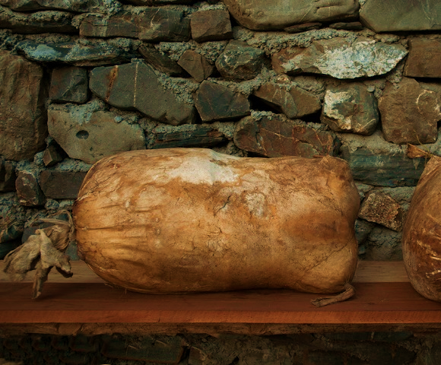
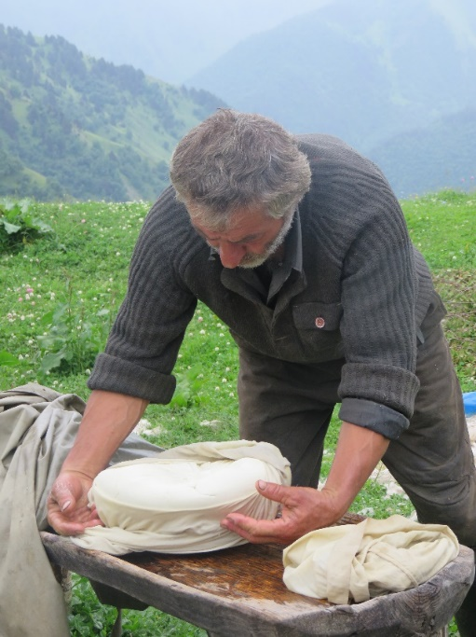

Example– Tushuri Guda, Georgia
Specifications developed by producers, especially the young shepherds :
Tushetian landraces, sheep and cow species
Pasture peculiar species
Maturation on lamb skin (microbiota)
Reduction of salt level
Biodiversity preserved
Taste, nutrition and health (salt, fermentation processes)
Enable Healthy diets
GI project started in 2017, Protected GI in 2019
Notes:
Another very interesting illustration of such innovations can be seen in the GI project we have implemented in Georgia in collaboration with the European Bank Reconstruction and Development (EBRD):
This is the example of the Tushuri Guda cheese produced in the in the high mountains of Tusheti, Georgia. Young producers of Tushuri guda cheese have finally decided to reduce the level of salt of their cheese in the specifications compared to the average level analyzed in the cheeses during the project.
This represents an important innovation that impacts the processing methods, but this decision was made to restore the original taste (less salty) of the cheese. I like particularly this case, as it represents also an innovation that directly enables healthier diets, a crucial aspect of sustainability.

Slide 8

Key messages
GI process relies on a comprehensive approach to address many development issues with many technical dimensions to consider (good agricultural practices, food safety and technology, value-chain structuration, governance and marketing): need for comprehensive technical assistance projects with time and resources
GI often developed with an external top down approach: need for empowerment of local small-scale producers
Specifications are a powerful tool but with no minimum requirements to ensure sustainability: need for technical support and comprehensive guidelines as well as regular monitoring and adaptation
Public authorities have a key role (assessment, support and protection/control): need for adequate policies and sufficient resources
Notes:
GI process relies on a comprehensive approach to address many issues - Quality and food safety, value chain coordination, standard development, territorial approach, public-private coordination, need for comprehensive development project with time and resources.

Slide 9
Website
www.fao.org/geographical-indications
More information
Florence Tartanac
florence.tartanac@fao.org
Emilie Vandecandelaere
emilie.vandecandelaere@fao.org
Valérie Pieprzownik
Valerie.pieprzownik@fao.org

