Slide 1
Intellectual property rights and CGIAR research for development of global public goods
Namukolo Covic
CGIAR Regional Director East and Southern Africa & Convenor for Ethiopia
Director General’s Representative to Ethiopia for International Livestock Research Institute
WIPO Conference: Intellectual Property (IP) and Development – IP & Innovation for Sustainable Agriculture
24 April 2023

Slide 2
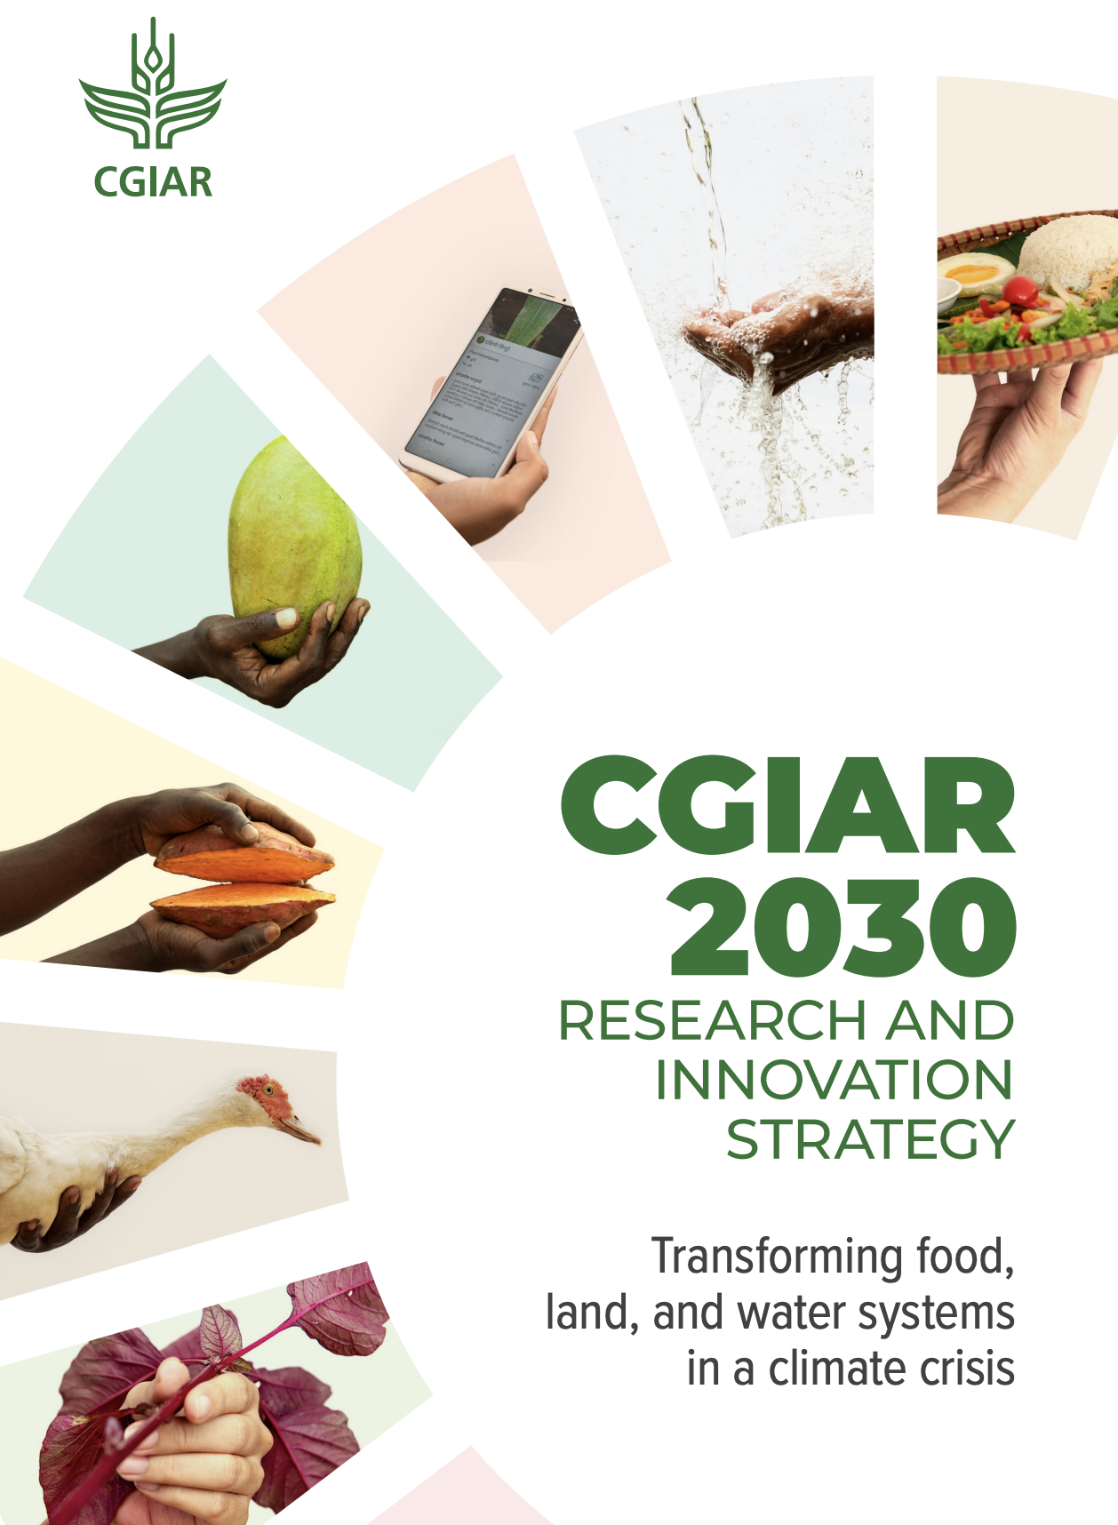
CGIAR’s 2030 Research and Innovation Strategy
Vision
A world with sustainable and resilient food, land and water systems that deliver diverse, healthy, safe, sufficient and affordable diets, and ensure improved livelihoods and greater social equality, within planetary and regional environmental boundaries.
Mission
To deliver science and innovation that advance transformation of food, land and water systems in
a climate crisis.
Impact
CGIAR is targeting multiple SDG benefits across five Impact Areas, with collective global targets for transformation of food, land and water systems across local, regional and global levels.
Notes:
CGIAR’s mission as defined in our 2030 Research and Innovation Strategy is therefore to deliver science and innovation that advance transformation of food, land and water systems in a climate crisis

Slide 3
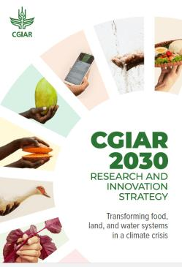
The five impact areas of the CGIAR 2030 research and innovation strategy are strongly aligned to challenges faced by LMIC settings
Nutrition, Health, and Food Security
Poverty Reduction, Livelihoods, and Jobs
Gender Equality, Youth, and Social Inclusion
Climate Adaptation and Mitigation
Environmental Health and Biodiversity

Slide 4
Selected examples of products
relevant to intellectual property rights

Slide 5

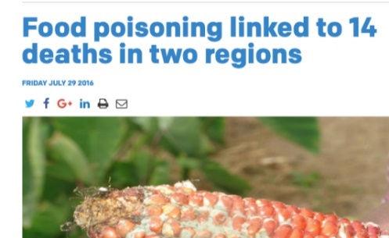
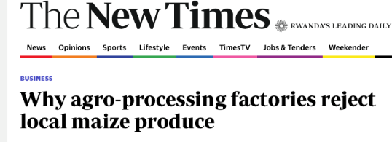
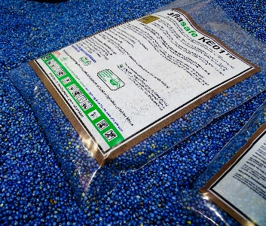
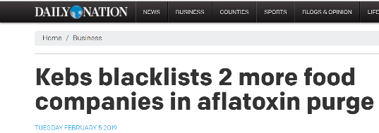
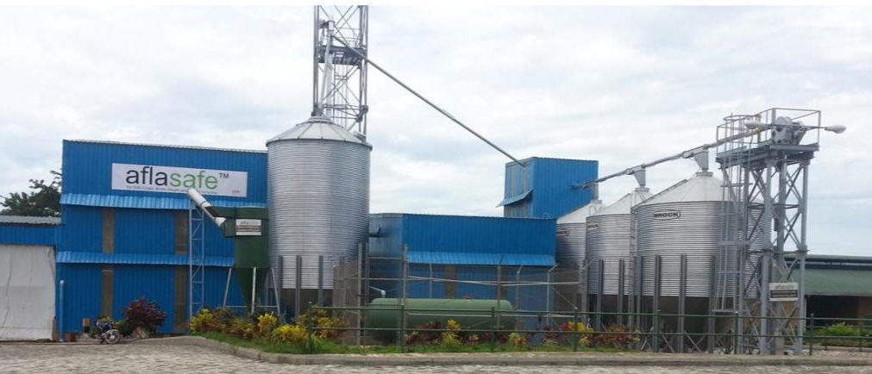

A safe and natural biocontrol product to reduce aflatoxin in food/feed crops
Aflatoxins contaminate food during production affecting health and blocking market access
The Impact
Unpleasant News
Innovative product
Scaling the solution building factories to produce Aflasafe®
Nigeria
4 manufacturers in 4 countries
2 more approved in 2 countries
8 distributors in 7 countries
More than 100 retail points
Inclusion in 6 countries’ National Agriculture Invest Plans

Slide 6
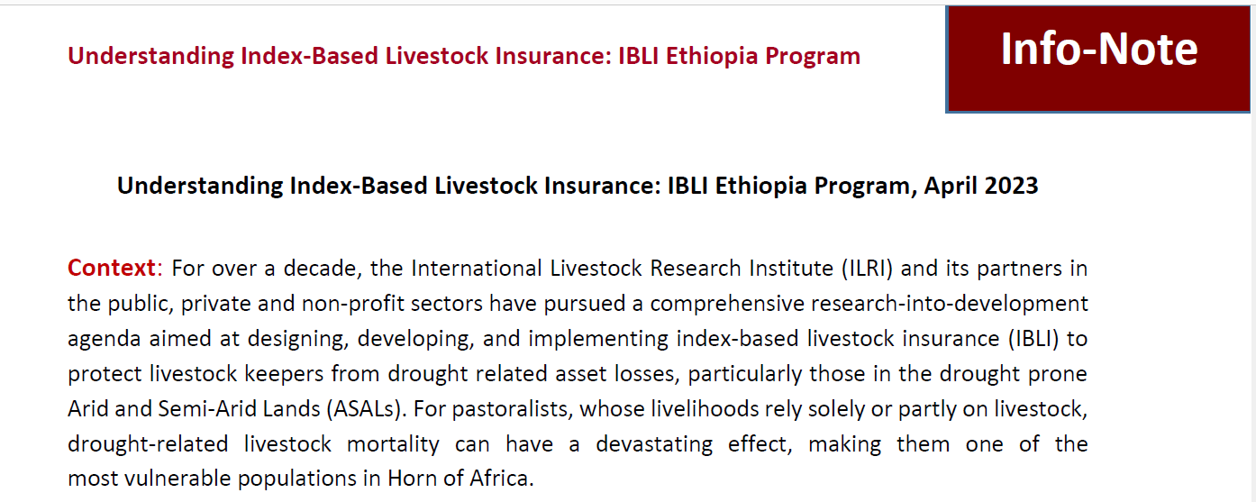
Products to limit impacts of climate challenges
to preserve livestock production capacity

Slide 7
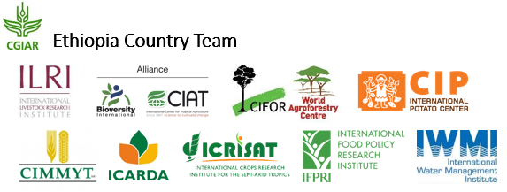
Covid Hub Project Activities in Ethiopia accelerating progress from COVID-19 lessons
Digitalized seed system platform
Digital mobile phone app for nutrition and public health messaging

Slide 8
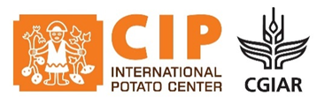
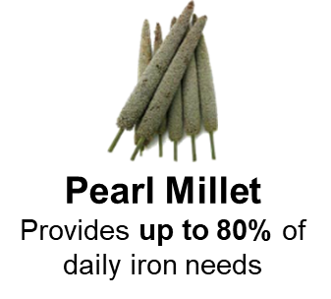
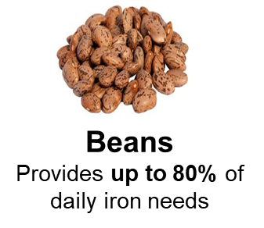
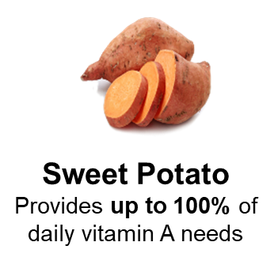

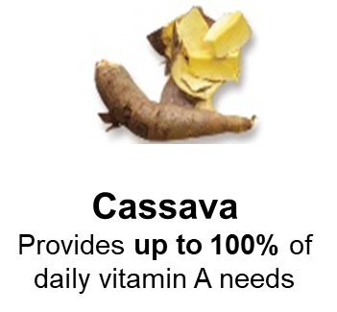
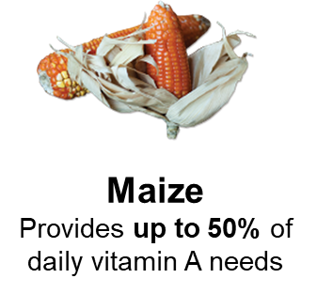



Biofortification and product development
Breeding for high nutrient density in staples
based on food crops that are already grown and eaten by resource-poor farm household who are not typically reached by food fortification and supplementation programs
readily available to all members of the household, including high-risk groups who benefit most from these crops: women, young children, and adolescent girls
shown in scientific evidence to reduce micronutrient deficiency and
improve health. Farmers are also willing to grow them, and both farmers and consumers are willing to eat them
cost-effective. It’s an up-front investment with lasting impact,
harvest after harvest, at no additional cost to farmers

Slide 9
Animal herd health products in LMIC
Product lines:
Models that improve herd health and livestock productivity
Development of packages of methods, institutional arrangements and technologies to improve food safety in informal markets
Tools for zoonoses/pandemic surveillance, prevention, and progressive control
Vaccines for priority diseases
Challenges
Small market size for neglected diseases = neglected research investment
R&D is not optimized for market challenges unique to livestock producers
Animal health companies and research institutes in the global North are either unable or cannot afford to conduct experimental infection studies with LMIC exotic pathogens.
Companies lack market and regulatory information for LMICs

Slide 10
Selected examples of impacts
of CGIAR global public goods

Slide 11





CGIAR: Global impact provided as global public goods
Almost
half
the world’s wheat land is sown to varieties that come directly or indirectly from research by CGIAR scientists.
Global economic benefits of improved rice varieties developed by CGIAR, amount to
$10.8 billion annually.
Nutrient-enriched biofortified crops have reached 50 million people across 40 countries
CGIAR’s work on modern crop varieties has reduced infant mortality by a third across the developing world – averting between 3 and 6 million infant deaths each year.
A SPIA assessment
demonstrated that CGIAR innovations in Ethiopia have potentially reached 11 million rural Ethiopian households — nearly 80 % of all rural households — with substantial adoption among poor smallholders, women and youth.

Slide 12
Conclusion
CGIAR produces global public goods that are important to support development and innovation for sustainable agriculture and food systems in LMICs.
Licensing focuses more on sustaining the quality of the products and traceability to CGIAR innovation and not royalty income.
Animal disease prevention development has received only limited investment, yet this is an important investment area in the context of the high costs associated with failed disease prevention and zoonotic spill overs. The COVID-19 pandemic is an important lesson.
CGIAR products support developments in LMICs where the traditional intellectual property rights instruments could present limitations to accessibility by the targeted audience.
It is therefore to ensure a continued pipeline of public and grant funding for CGIAR efforts.

