Slide 1


Notes:
My name is Nailya, I am managing the company that developed an e-farm managing system for Kazakhstan farmers.
The technology is giving us an opportunity to collect the data and transform the information received into the knowledge.

Slide 2

KAZAKHSTAN
2 725 000 km2
Notes:
Let me introduce you to my country, which is 2,7 mln sq.m

Slide 3

AREA
2 725 000 km2
41 285 km2
23 mln ha
Notes:
To realize the size let’s compare with the host country of this event which is 41 thousand

Slide 4
Notes:
May be like that will be better

Slide 5
PRODUCTIVITY
12
60
Notes:
Despite the size the wheat production is 12 per center per ha compare to Switzerland

Slide 6
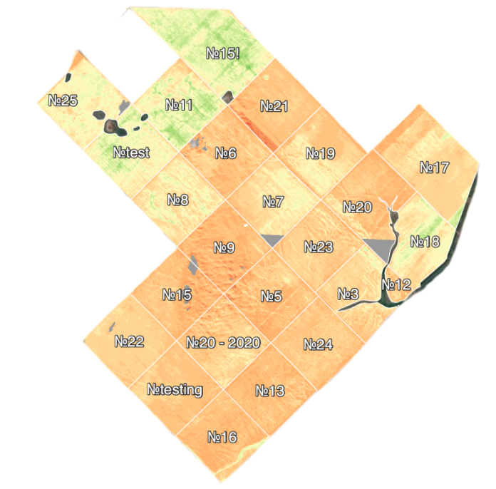
AVERAGE FARM
5 000 hectar
Notes:
The avarege farm is about 5 -10 thousand ha

Slide 7
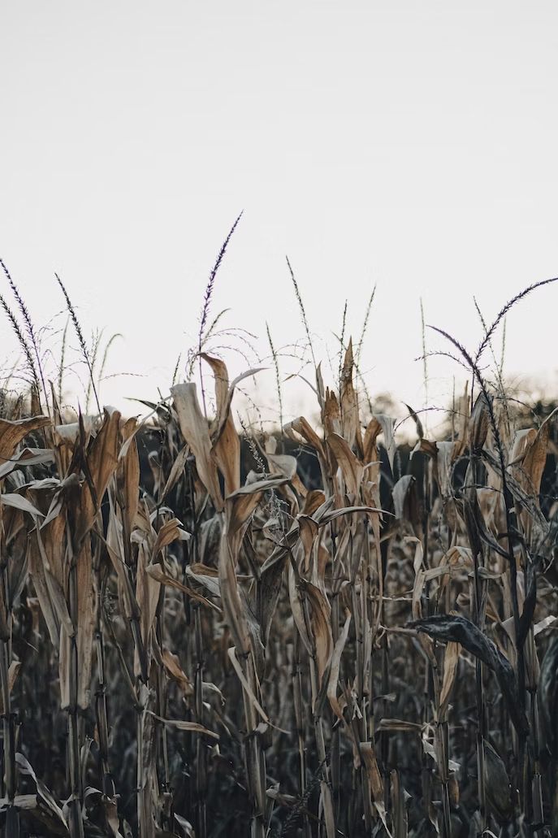

Low productivity as a result of specific farming in Kazakhstan
Notes:
There are many problems but I will highlight the main.

Slide 8


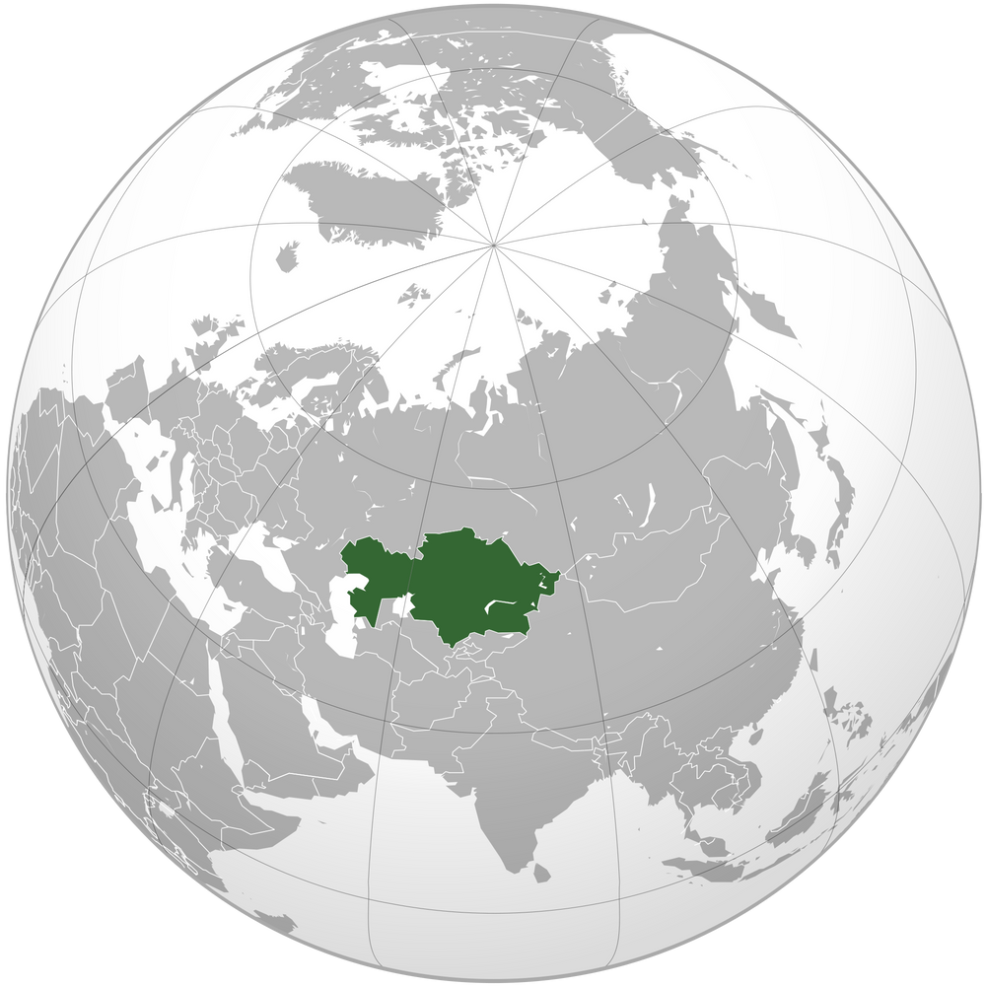

EXTREME CLIMATE
Risk farming zone
Far from the sea
Notes:
Kz is a land locked country with extreme continental climate

Slide 9
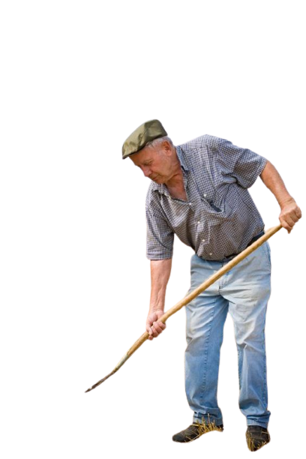
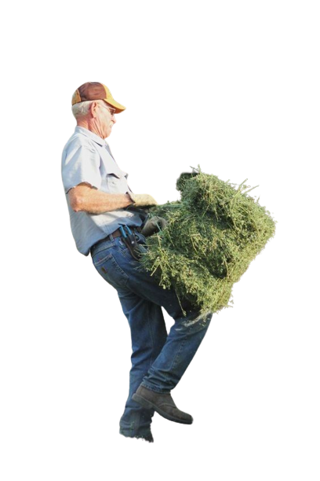
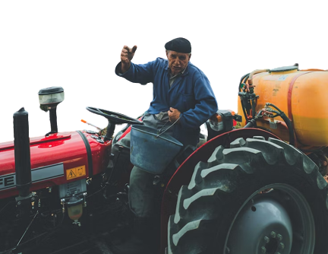
CONSERVATIVE MINDSET
do not use fertilizers and technology
Notes:
The most of the farmers has a conservative mindset regarding usage of fertilizers and technologies.

Slide 10

GOVERNMENT REGULATIONS AND INTERFERENCE
in agriculture affect the motivation for high results
Notes:
There are many studies that show that the Government regulations and interference in agriculture affect the motivation for farmers to rich high results, the //////

Slide 11


YOUNG PEOPLE REFUSE TO WORK IN AGRICULTURE
The problem of qualified personnel
Notes:
Last but not least young people refuse to go back to work in the villages after they receive an education. The younger generation do not want to work in the place where there is no technology and automatization

Slide 12
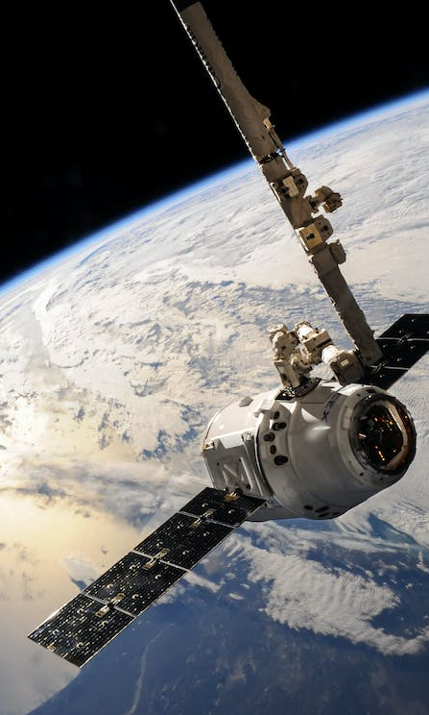
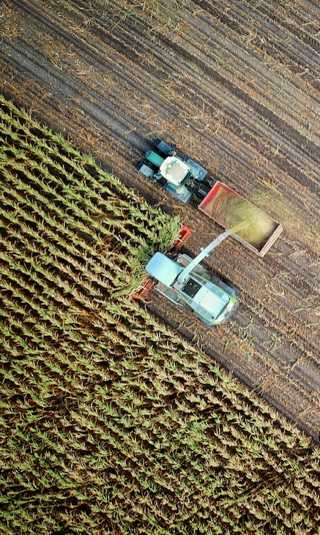

AGTECH
Notes:
We believe that the use of innovative technology such as precision agriculture techniques, mobile app providing the data can make agriculture to more predictable and depend less on the weather, the mindset is changing as the new generation is coming and information is more available.

Slide 13

IP and innovation can contribute to sustainable agriculture in Kazakhstan by
promoting the development and adoption of new technologies,
supporting knowledge transfer and collaboration,
facilitating the creation of technologies that are tailored to the needs of local farmers.

Slide 14
Satellite images

Slide 15
IoT

Slide 16
Precision agriculture tools

Slide 17
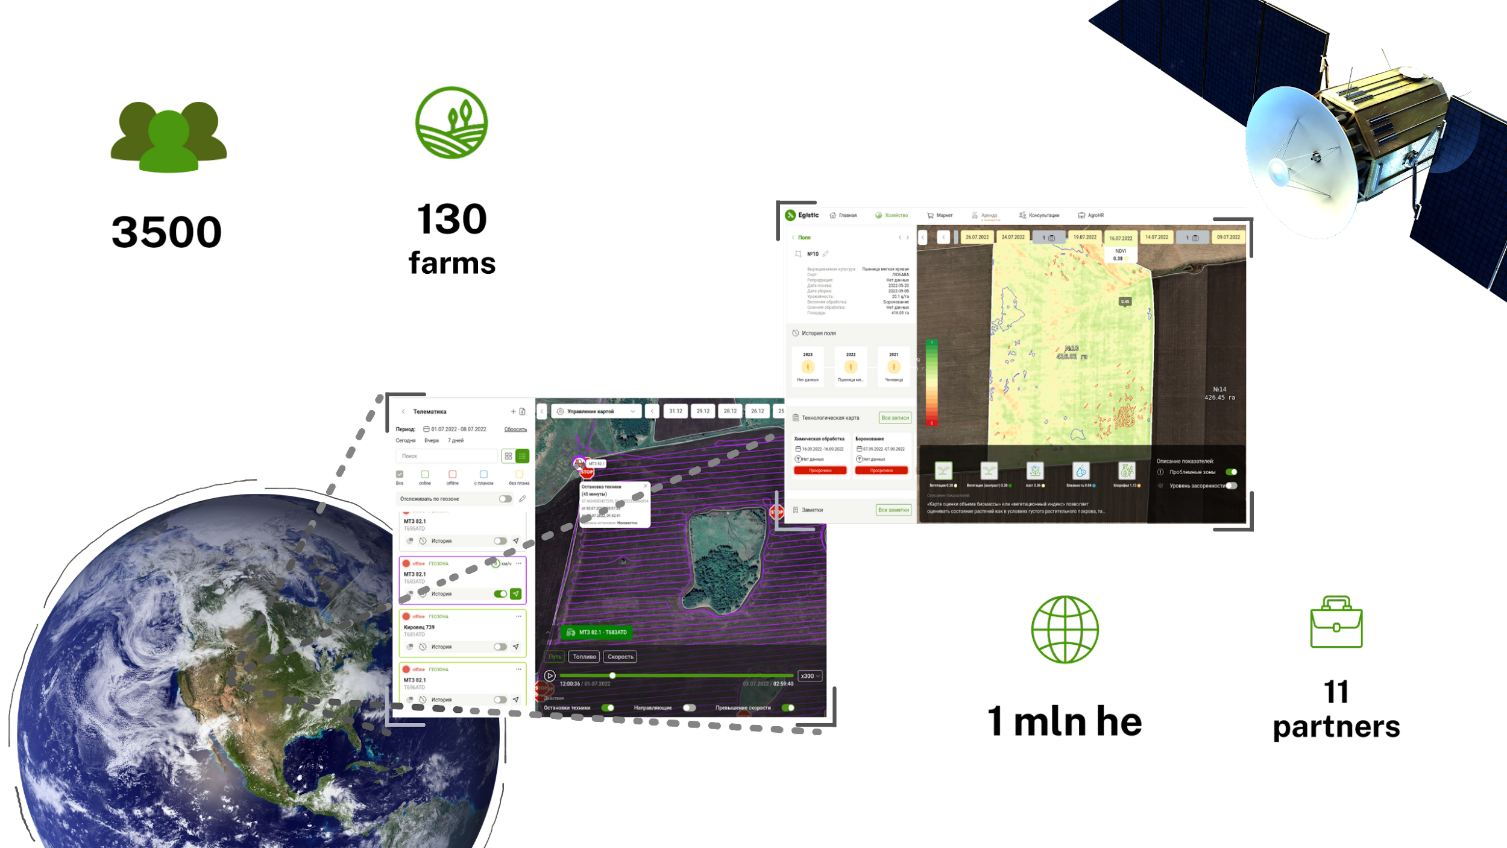

Slide 18
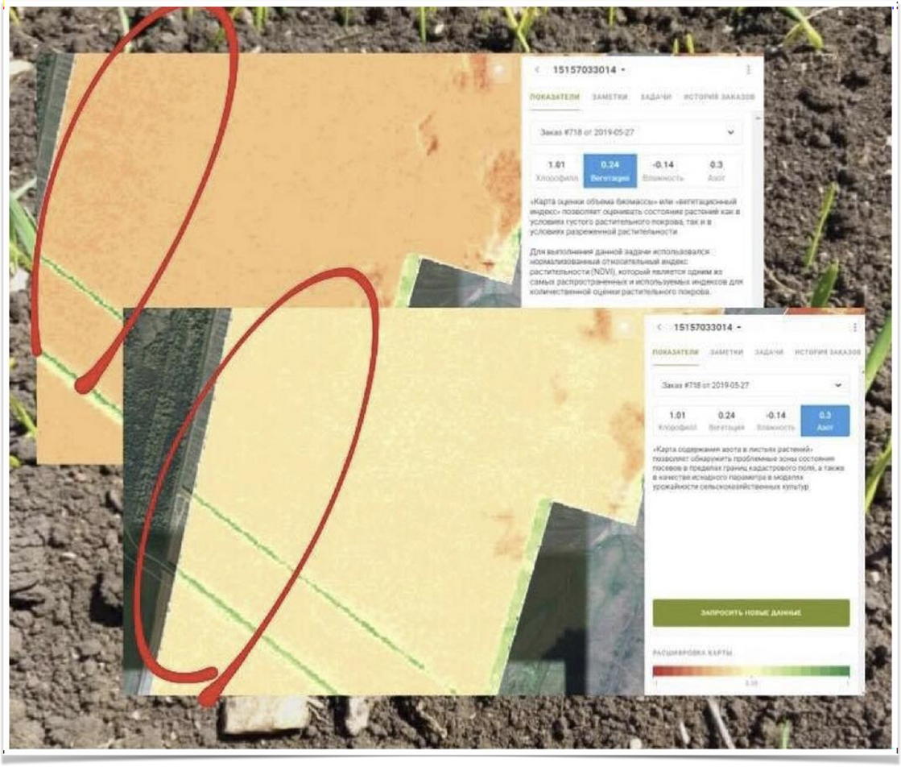

How did satellite imageries help to detect weeds and pests and avoid losses in yields
USE CASES
Ordinary farmer
Request: seedling evaluation
Goal: During the analysis, the agronomist concluded that fleas are the main cause of the lack of nitrogen in the images.
Thanks to EGISTIC, the agronomist took appropriate measures to eliminate fleas before they could spread to the remaining field.

Slide 19
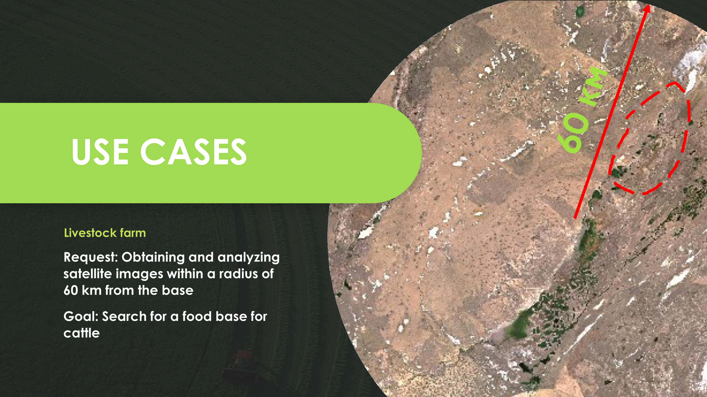

Slide 20
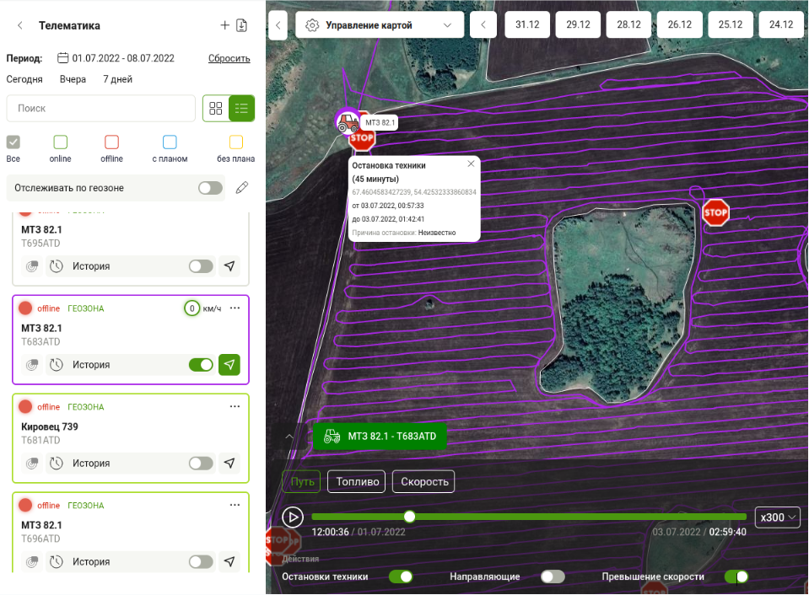
CASE
ECONOMIC EFFECT
SOCIAL EFFECT
HIGH PRODUCTION

Slide 21
How do we implement the knowledge and practice of spreading the technology?
Cooperation with Private sector
Creating the demonstration farms

Slide 22
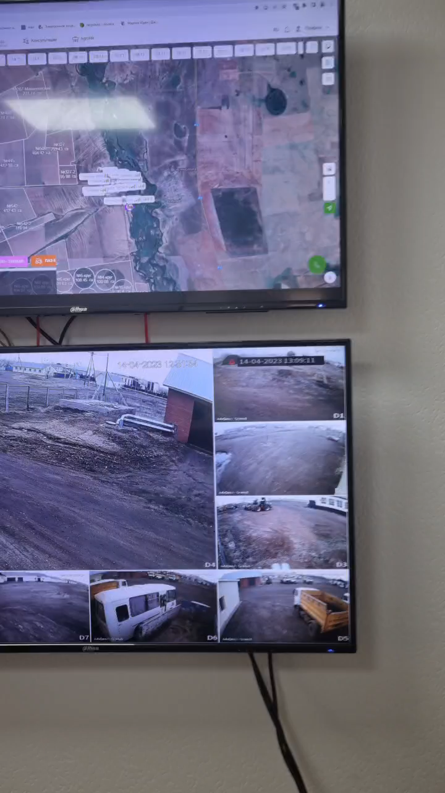
Demonstrating the benefits of technology in agriculture through model farms can be an effective strategy to encourage adoption.
These farms can showcase how technology can improve yields, reduce costs, and increase profits.
They can also allow farmers to see the technology in action and ask questions about how it can be implemented on their own farms.

Slide 23
From separate AGTECH tools to
SUPERAPP

Slide 24


Slide 25
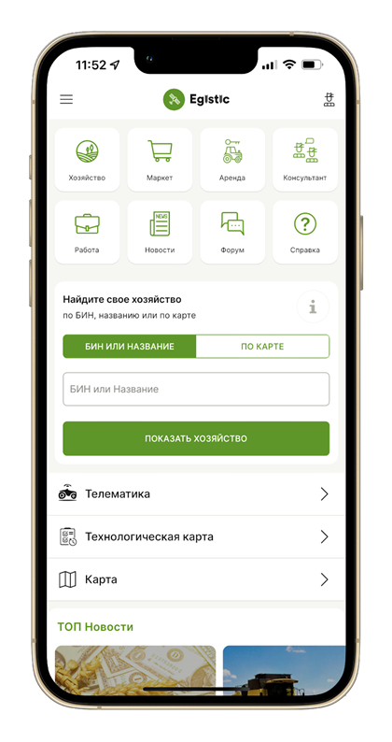

  DANKE
  RAKHMET
  THANK YOU
  WhatsApp: +7 747 227 50 81
  E-mail: info@egistic.kz
  Website: https://egistic.kz
  Social media: /egistic.kz

