Slide 1
Plant Breeder’s Rights in Kenya
Bas Smit
Kordes Roses

Slide 2
Facts Kenya-2008/2009
Population (2008): 38.5 million
Area: 562,000 Km²
Area under Agricultural production: 12.1%
Agricultural contribution to GDP: 26%
Contribution Agriculture to Export earnings: 60%

Slide 3
Basic Challenges Kenya
High population growth
Decreasing natural resources (primarily Land and Water), with corresponding increased pressure from population
High unemployment rate: 40%
Unpredictable weather pattern causing unpredictable yields

Slide 4
Horticultural facts Kenya
Approximately 3.5 million people are dependent in some way in horticultural activities in Kenya
Export makes up 4% of total Horticultural production (4.8 million tons in 2008) in Kenya
Total value Horticultural exports go from US$ 197.4 million in 1999 to US$ 772.8 million in 2008
Flowers become more important: 39% in 1999 to 53% in 2008 of total Horticultural Exports
Horticulture becomes # 2 foreign exchange earner for Kenya in 2008, after tourism

Slide 5
Kordes Roses
Started in 1887 in Northern Germany
Is a family owned company. Currently the 4th generation are managing the company.
Involved in breeding of all types of roses

Slide 6
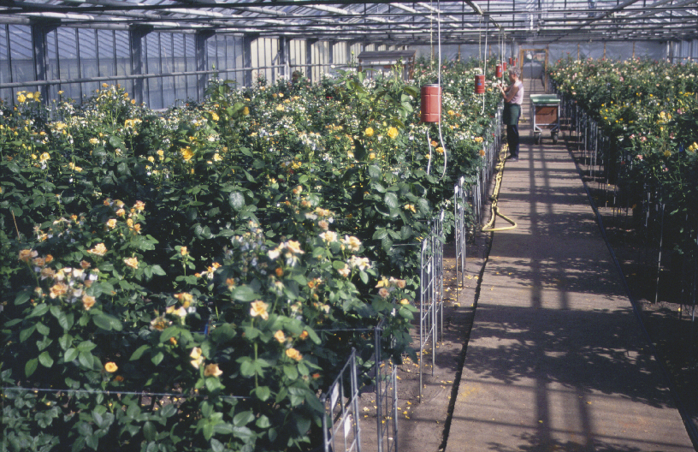
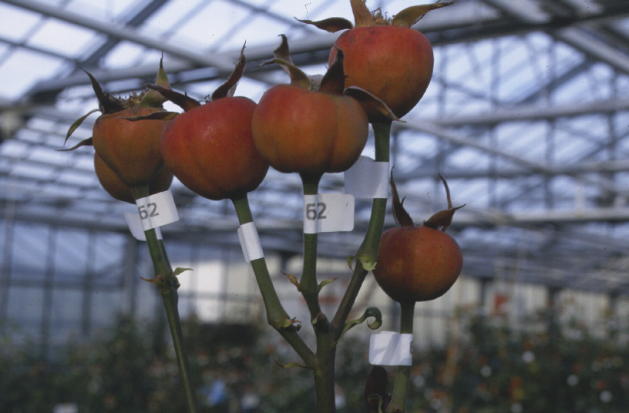
Basic steps of breeding at Kordes Roses
3,000 mother-plants are used per year
6,000 combinations are made
100,000 flowers are pollinated per year
this results in 80,000 hips ready for harvest

Slide 7
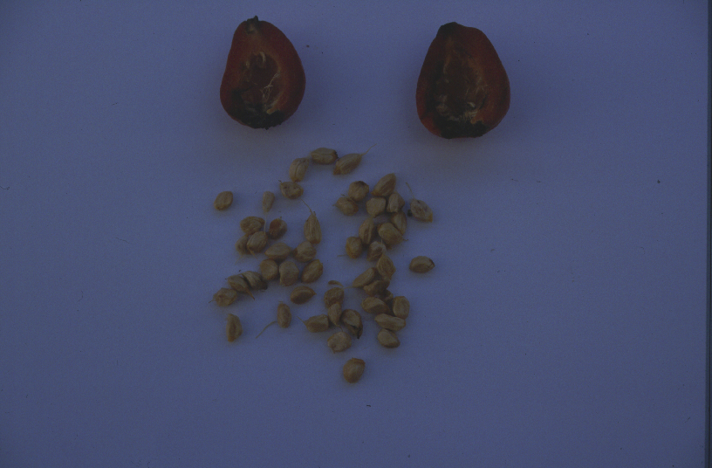
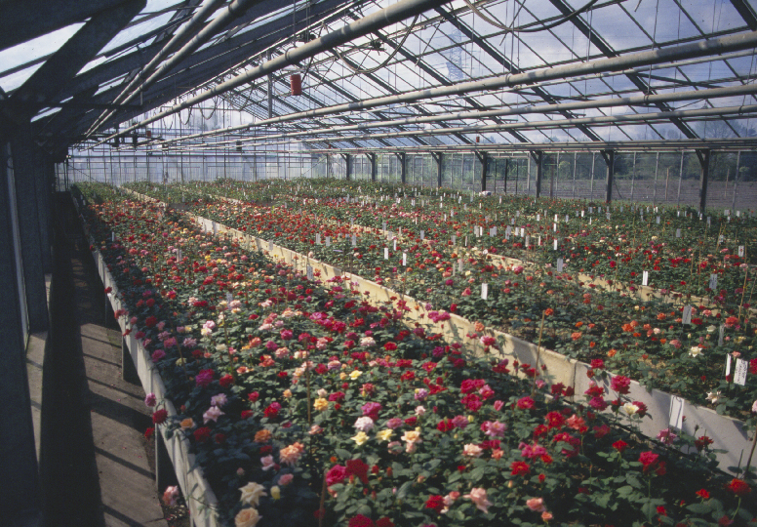
500,000 seeds are harvested
This results in 250,000 seedlings germinating the following year after winter
Selection of seedlings results in 6,000 candidates going to next phase

Slide 8
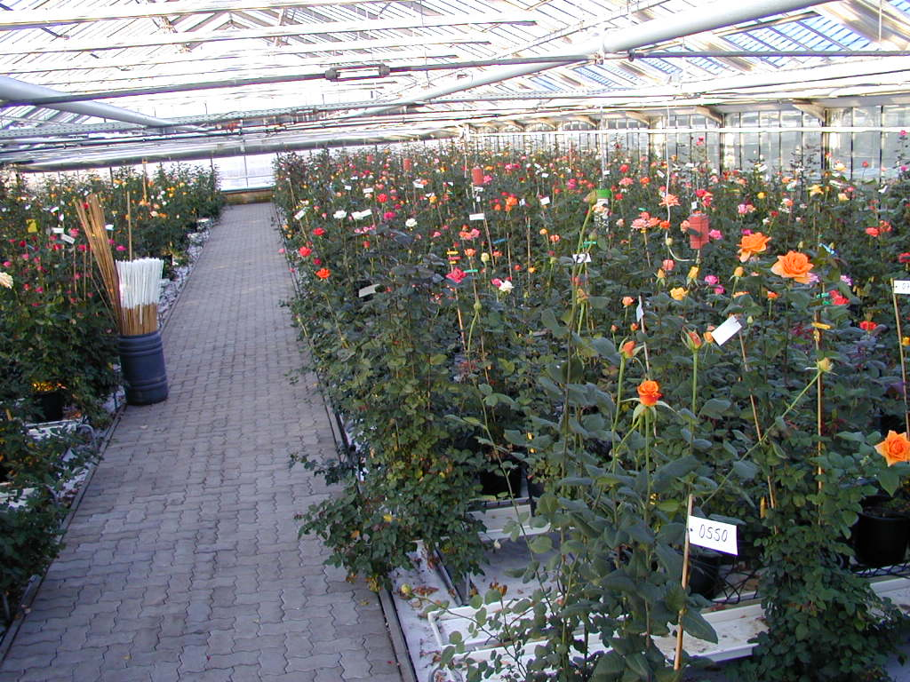
Selection process takes 3 to 4 years.
This includes selection at testing sites in;
Germany
Netherlands
Ecuador
Kenya
The complete process takes between 5 to 7 years and results in possibly 5 commercial varieties to be released to growers.
Success rate of 0.001%

Slide 9
Intellectual Property in Kenya
3 Intellectual Property Organizations-
Kenya Industrial Property Institute;
for industrial and manufacturing patents
Kenya Copyright Board;
for Print, Books and Music
Kenya Plant Health Inspectorate (KEPHIS);
for protection of plant varieties.
Local Plant Variety Protection Law in 1997
Member of UPOV since 1999

Slide 10
Plant Variety Protection
Globally governed by UPOV conventions
New Varieties have to pass DUS tests, these being;
Distinct
Uniform
Stable
Allows breeders of improved plant varieties to collect royalty as a result of innovation.
Leads to availability of improved varieties to all countries world wide.
Provides protection to all varietal innovations in ALL countries for ALL people.

Slide 11
PBR applications in Kenya 1997 to 2008 (KEPHIS)
Year | Domestic | Foreign | Total
1997 | 11 | 128 | 139
1998 | 42 | 33 | 75
1999 | 16 | 45 | 61
2000 | 24 | 45 | 69
2001 | 164 | 33 | 197
2002 | 11 | 27 | 38
2003 | 7 | 25 | 32
2004 | 16 | 44 | 60
2005 | 53 | 44 | 97
2006 | 0 | 54 | 54
2007 | 28 | 64 | 92
2008 | 4 | 62 | 66
TOTAL | 376 | 604 | 980

Slide 12
38% of the applications are Kenyan

Slide 13
PBR Application Kenya July 2007-June 2008 (KEPHIS)
Species | Number | Country of Origin
Pea | 1 | United Kingdom
Rose | 52 | Netherlands, Germany and France
Maize | 22 | Kenya and Zimbabwe
Soya Bean | 1 | Zimbabwe
Wheat | 2 | Kenya
Statice | 1 | Netherlands
Chrysantemum | 4 | Netherlands
Alstroemeria | 2 | Netherlands
TOTAL | 85
29% of above applications are from developing countries

Slide 14
Results of introduction PBR in Kenya
Newer more valuable varieties available for farmers leading to better yields, more disease resistance.
Increased investment in Horticulture by both local and international production companies, leading to more employment
Has increased competitive advantage of Kenya in global market place.
1 in 3 roses bought in Europe comes from Kenya
Increased investment by breeders (FDI);
Estimated to be between EUR 15 and 20 million over the past 5 years

Slide 15
Results-continued
Increased value of export produce:
Value of produce has increased 209% per Kg from 1997 to 2008
Transfer of know-how
Allows local breeders to compete in local, regional and international markets

Slide 16
Volume and Value development following introduction of variety protection (HCDA)

Slide 17
Kenya authorities attitude to PBR
Positive results of PPP. In this case the players are:
KEPHIS
UPOV
BREEDERS
GROWERS
KEPHIS has made applications easy through;
Acceptance of DUS results from other institutes
“Protection Direction” which allows temporary protection through Application procedure

Slide 18
Challenges of PBR protection in Kenya
Legal Institutions need to be strengthened in order to have quick, expedient resolutions to disputes, this can only be achieved through investment in capacity building.

Slide 19
Anecdotes
Small scale Cabbage farmers prefer to buy new hybrid seed (as the yields are superior) than saving seed
Newer varieties available to small scale flower exporters, leading to improved income to rural areas (Nature Grown)
Commercial rose growers acknowledge that varieties is the #1 commercial consideration for a successful business

Slide 20
Creativity drives innovation, drives development!
Thank You

