Slide 1
Impact of
Plant Variety Protection in Korea
WIPO Donor Conference
Yoon, Jin Young
Advisor, Nonwoobio Co. Ltd.
Republic of Korea
November 5, 2009

Slide 2
Contents
Ⅰ. Korean Agriculture and Breeding in Brief
II. PVP system in Korea
III . Impact of PVP system
  Increase the number of new varieties
  Diversification & improvement of varieties
  Encouragement of breeding activity
  Utilization of protected varieties for breeding new variety
  Benefiting growers and export
IV. Another advantage
V. Summary

Slide 3
I. Korean agriculture and breeding in brief

Slide 4
Korean Agriculture – some major points
Small scale (average land holding – 1.45ha)
Aged farm managers (63.3% over 60 years old)
High dependency on imports of food/feed crops (74% of total consumption)
- rice: 96% (+ 5.6% of MMA) : over supply causes price dropping
- wheat 0.4%, corn 0.9%, soybean 7.1%: little domestic market
Import increase in most horticultural crops since 1995
Therefore, opportunities are sought in
- high value specialty and functional crops/varieties
- export to Asia and to the world

Slide 5
Crops breeding
– at the time of PVP adoption
Rice and food/feed crops
– government programs only.
Vegetables
– private-led.
– advanced in unique traditional crops(radish, pepper & Chinese cabbage).
Ornamentals and fruit trees
– almost totally dependent on foreign varieties.

Slide 6
II. PVP in Korea

Slide 7
History of PVP System and Implementing Organizations
Brief history
O Dec. 1995 Consolidation of Seed Industry Law
- Article 27.3(b) of WTO/TRIPS
O Dec. 1997 Implementation of PVP system
from December 31
O Jan. 2002 Joining as a UPOV’s 50th member
Offices implementing PVP
O Korea Seed & Variety Service (KSVS) : Agricultural species
O Korea Forest Seed & Variety Center : Forestry species

Slide 8
Genera and species eligible for PVP
All
All Except
For 6
Exclusions : strawberry, raspberry, blueberry, mandarin, cherry, sea weeds

Slide 9
(1998-2008)
Application ratio by plant category

Slide 10
Application ratio of Residents/Non residents

Slide 11
Applications by non-residents by country

Slide 12
Impact of PVP System
Increase the number of new varieties
Diversification & improvement of varieties
Encouragement of breeding activity
Utilization of protected varieties for breeding new variety
Benefiting growers and export

Slide 13
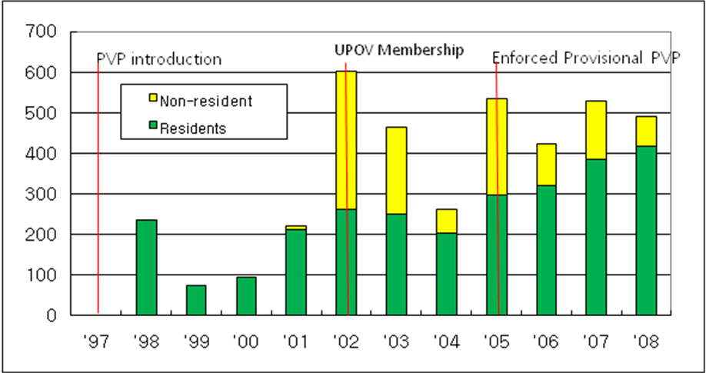

Number of Application by year
The reason behind two conspicuous peaks
- 2002 : UPOV membership & Entitlement of rose, chrysanthemum
as PVP subject
- 2005 : Entitlement of gerbera as PVP subject

Slide 14
in terms of No. of PVP titles granted
Top 10 crops
Notes:
This graph shows top 10 plants in terms of number of PVP title granted.
Rose ranks first with 470 and chrysanthemums is the second with 260 and the third is rice with 200.

Slide 15
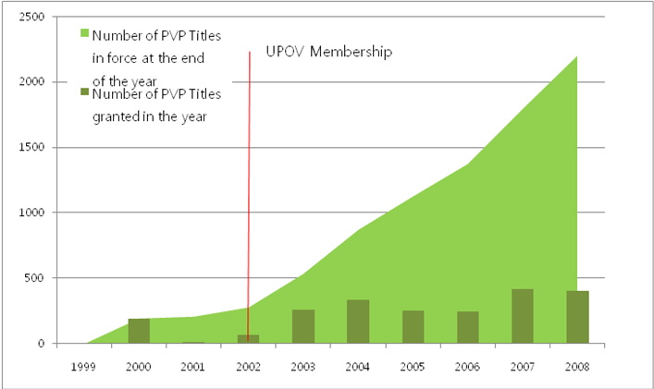
No. of PVP Titles Granted and in Force

Slide 16
Impact of PVP System
Increase the number of new varieties
Diversification & improvement of varieties
Encouragement of breeding activity
Utilization of protected varieties for breeding new variety
Benefiting growers and export

Slide 17


Rice
Breeding objectives
Productivity
  Quality
  Resistance to
  (a)biotic stress
  Functional
  food use
Productivity
+ steamed quality

Slide 18
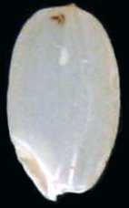

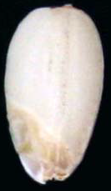
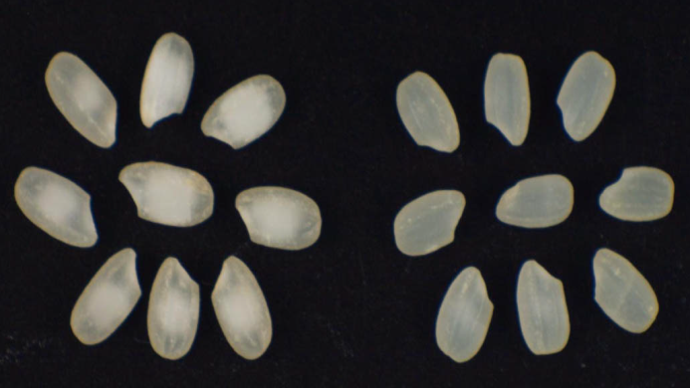
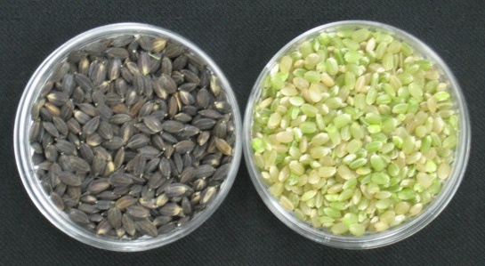
Example of rice varieties
<L> Ordinary variety
<M> Giant embryo variety
<R> Waxy variety with giant embryo
<L> Variety with white core
<R> Variety with transparent milled rice
Green kerneled variety
<L> Unhulled, <R> Dehulled
Notes:
18

Slide 19
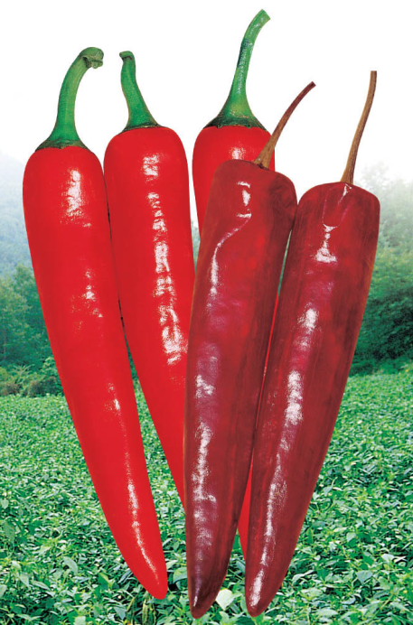
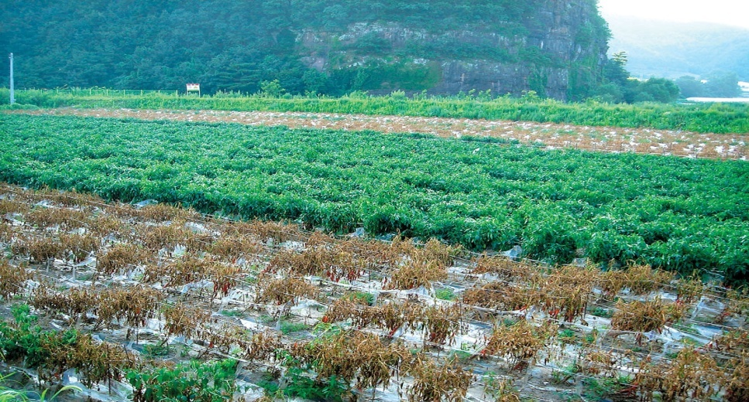
Hot pepper
Characteristics of newly developed varieties
  Resistant to Phytophthora blight/virus
  Strong to flooding damage
  High yield
  Good quality of dried pepper
  shape, color, proper degree of pungency
Above : Resistant variety to Phytophthora
blight (a fungal disease)
Bottom : Susceptible variety
Notes:
독야청청

Slide 20




Rose
Diversification in variety spectrum
  Standard type ⇒ standard + spray + pot type
  Color: Red, White, Pink ⇒ bi-colors, pastel (orange) and green
  are added.
Standard type
Bi-colors
Pastel (orange)
color
Spray type
Green color

Slide 21
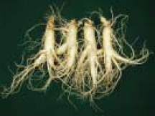

Ginseng
Current status
  Eight varieties was bred and PBR granted since PVP introduction
Improved features
  Enhanced production ratio of red ginseng
  15 % (landrace, past) ⇒ 20~38%
  High yield of root
※ Red ginseng
The six year old ginseng roots which is
steamed for preserving vital nutrients
and flavors.
Recently released variety “Chun-poong”

Slide 22
Impact of PVP System
Increase the number of new varieties
Diversification & improvement of varieties
Encouragement of breeding activity
Utilization of protected varieties for breeding new variety
Benefiting growers and export

Slide 23
Changes of breeding activity
- Private sector -
Changes of breeding activity in terms of no. of application
Notes:
In spite of variation by year, applications from both individual breeders and seed companies have increased since the introduction of PVP system.

Slide 24
Changes in number of individual breeders and their application
N.A
N.A
Notes:
This graph shows changes of accumulated numbers of individual breeders and their application by year.

Slide 25
Changes of breeding activity
- Public sector -
Changes of breeding activity in terms of no. of application
Notes:
This graph shows changes of breeding activity in public sector.

Slide 26
Governmental investment in breeding
R&D Matching fund trend in Plant Breeding
Notes:
26

Slide 27
Impact of PVP System
Increase the number of new varieties
Diversification & improvement of varieties
Encouragement of breeding activity
Utilization of protected varieties for breeding new variety
Benefiting growers and export

Slide 28
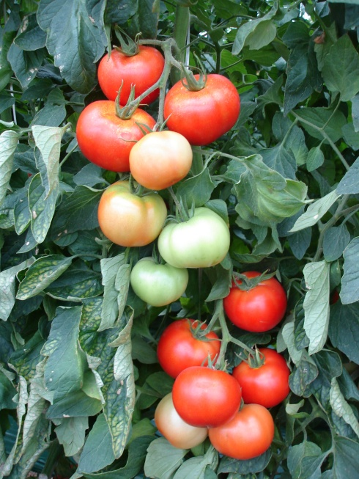
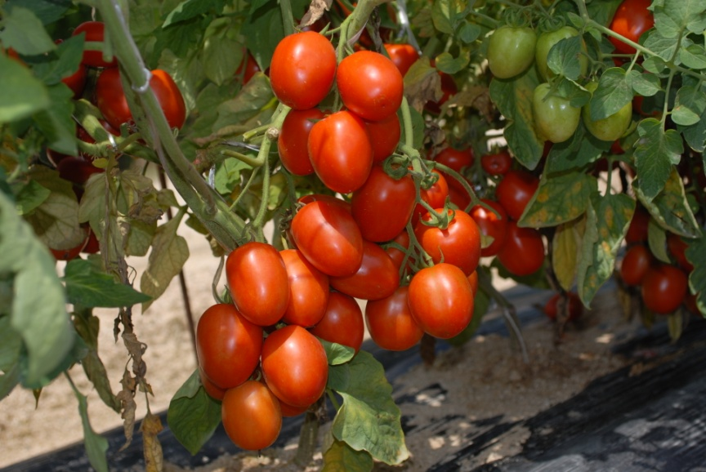
Utilizing protected varieties for breeding new varieties
Case of a private company; ‘Daniela’ tomato
Segregation and selection
Hybridization and
selection
Long shelf life
Long shelf life + more uniform fruits
Daniela (ES ’93, IL, ’94
NL ‘96, PL ‘94, ZA ‘98 )
F₁ Duesshra

Slide 29
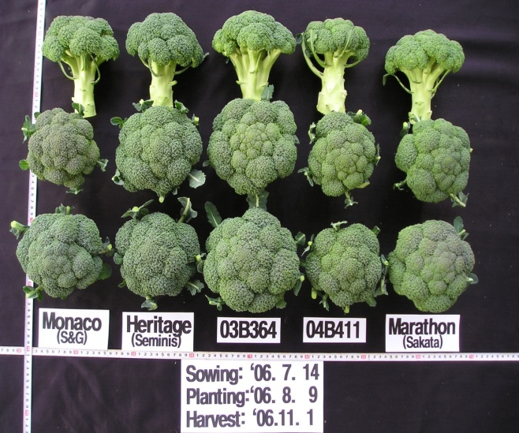
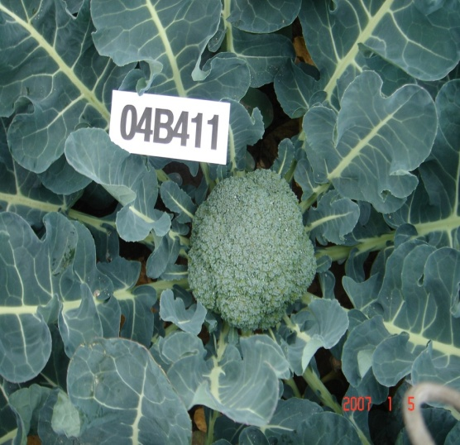
Utilizing protected varieties for breeding new varieties
Case of a private company; ‘Marathon’ broccoli
Marathon (DE ‘86,
HU ‘98 NO ‘95)
Anther culture and selection
F₁ 04B411
Combined with another parent
More uniform heads
Less side shoots
Long time market leader

Slide 30
Utilizing protected varieties for breeding new varieties
Protected varieties entered in crossing block
of a government-funded Paprika program
Variety | Protection (country, year) | Characteristics
Special | NL, 2006 | Stress tolerance, Long shelf life, Earliness
Plenty | NL, 2006 | Stress tolerance
Ferrari | NL, 2006 | Stress tolerance, Good fruit setting
Fantasy | NL, Applied | TMV-Res., Good storability
Balstar | NL, 2009 | TMV and TSWV-Res.
Derbi | RU, 2005 | High yield, Heat tolerance, Long shelf life
Maseriti | NL, 2007 | TMV-Res., High yield
Fiasta | NL, 2006 | Uniform fruit, TMV-Res.
Kelly | NL, 2006 | Heat tolerance, TMV-Res.
President | NL, 2006 | TMV-Res., Good vigor

Slide 31
Utilizing protected varieties for breeding new varieties
Protected varieties entered in crossing block
of a government-funded Paprika program
Crop | Variety bred | Protected variety utilized (country, year)
Apple | Honggeum | Hongro x Shenshu (JP ’80, expired)
 | Hongso | Hongro x Yoko(JP, 1981, expired)
 | Summer Dream | Tsugaru x Natsumidori (JP ‘83, WDRI in 1993)
 | Picnic | Fuji x Sansa (DE ‘90, JP ‘88, NL’90 , US ‘89)
Peach | Mihong | Yumeong x Chiyomaru(JP, 1989, expired)
 | Miss Hong | Yumeong x Chiyomaru(JP, 1989, expired)
 | Sumi | Yumeong x Chiyomaru(JP, 1989, expired)
 | Yumi | Yumeong x Chiyomaru(JP, 1989, expired)

Slide 32


Utilizing protected varieties
for breeding new varieties
○ ‘Pearl Red’ Rose
- Bred by : NHRI
- Year : 2004
- Cross : Red Sandra(IL, ’82 trade name)
× Baroness
○ ‘Little Sun’ Rose
- Bred by : Gyeonggi PRDA
- Year : 2006
- Cross : Nikida x
Ruigerdan(NL, ’87, KR, 04, JP ‘93)

Slide 33
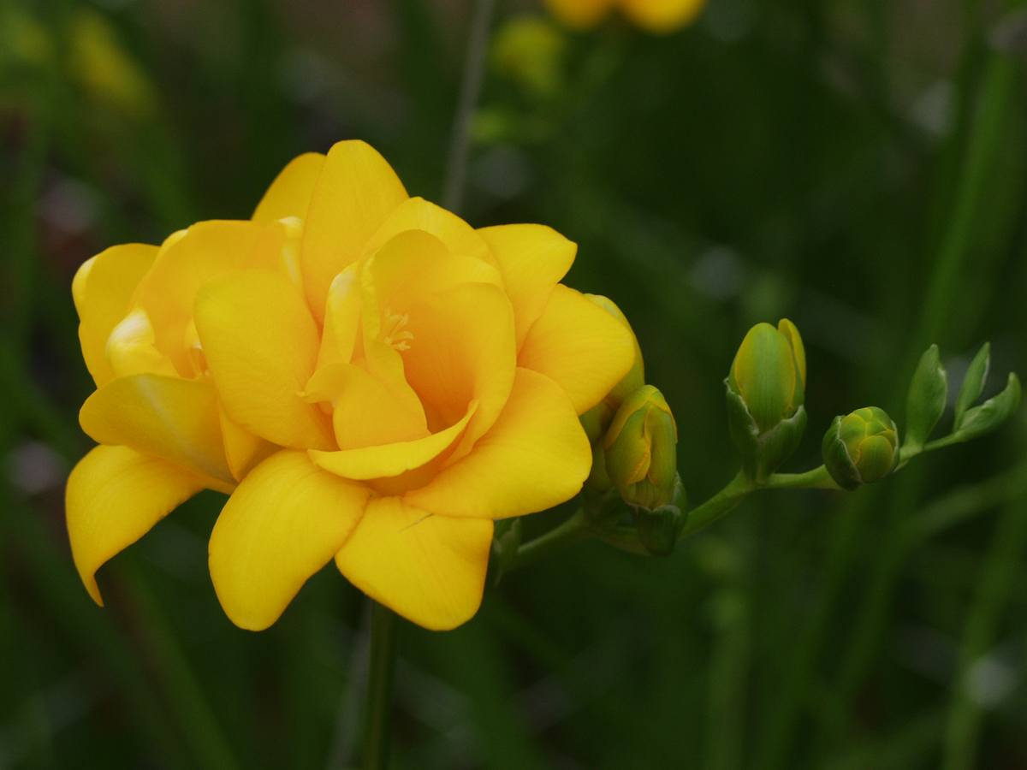
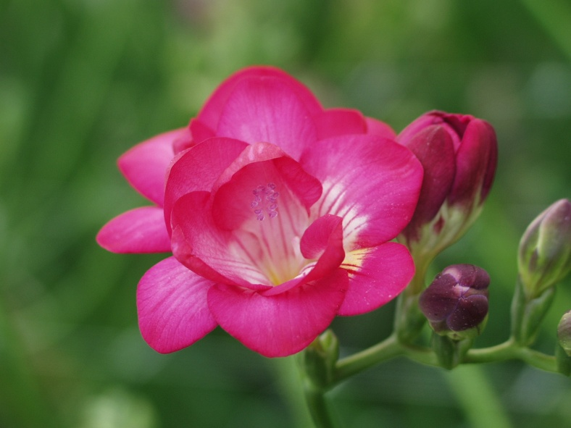
Utilizing protected varieties for breeding new varieties
○ ‘Shiny Gold ’ Freesia
- Bred by: NHRI
- Year : 2003
- Cross : Arizona (NL, ’93) x
Yvonne (NL, ’89)
○ ‘Pink Jewel’ Freesia
- Bred by: NHRI
- Year : 2003
- Cross : Michelle x Rossini (NL, ’87)

Slide 34
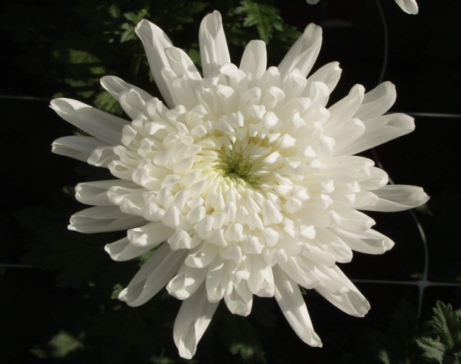
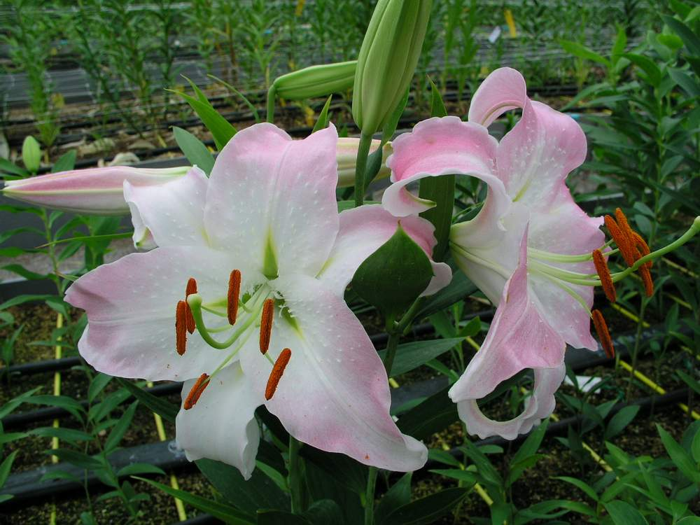
Utilizing protected varieties
for breeding new varieties
○ ‘Baegma’ Chrysanthemam
- Breeder : NHRI
- Year released : 2004
- Cross : Iwanohakusen (’95, JP)x Jinma
○ ‘Saerona ‘ Lily
- Bred by : NHRI
- Year : 2004
- Cross : Lilium Oriental 'Casa Blanca' (NL, ’81)
× Almeria (AU, ‘’04)

Slide 35
Impact of PVP System
Increase the number of new varieties
Diversification & improvement of varieties
Encouragement of breeding activity
Utilization of protected varieties for breeding new variety
Benefiting growers and export

Slide 36
화훼 신품종 육성 발전방향
○ Auction price comparison
Domestic varieties
Foreign varieties
Courtesy of Y. J. Kim

Slide 37
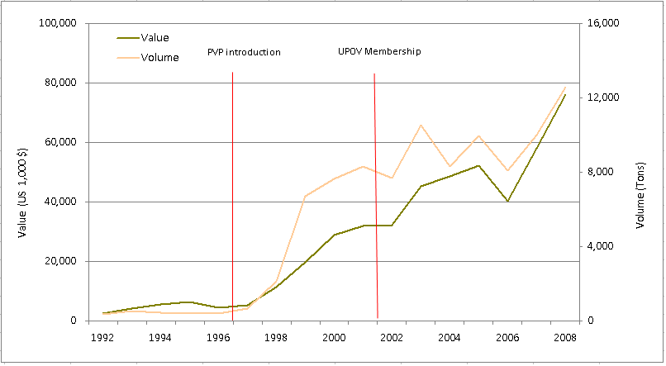
Changes of export of ornamentals

Slide 38
Changes share of domestic varieties (2000 to 2008)
Grafted cactus: 100% maintained
Rose: nil 8%
spray rose: nil to 40%
Freesia: nil 8%
Chrysanthemum: nil 10%
‘Baegma’: good acceptance in Japan
Lily and some other crops: coming up
Courtesy of Y. J. Kim

Slide 39
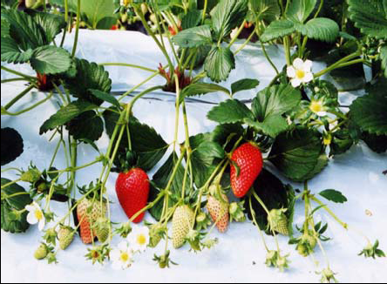
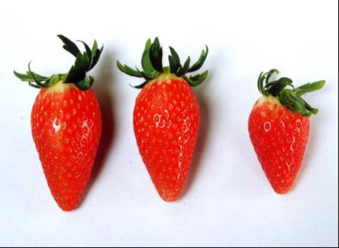
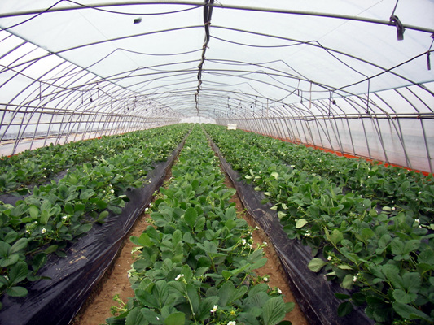
Strawberry ‘Maehyang’
Cross: Tochinomine(JP, ’93) x Akihime(JP, ’ 92)
Net income increase by 34% due to higher yield and higher selling price
* As royalty for foreign strawberry varieties had become an political issue since PVP adoption, public funding for breeding this crop was intensified to prepare for PVP entitlement of this crop.

Slide 40
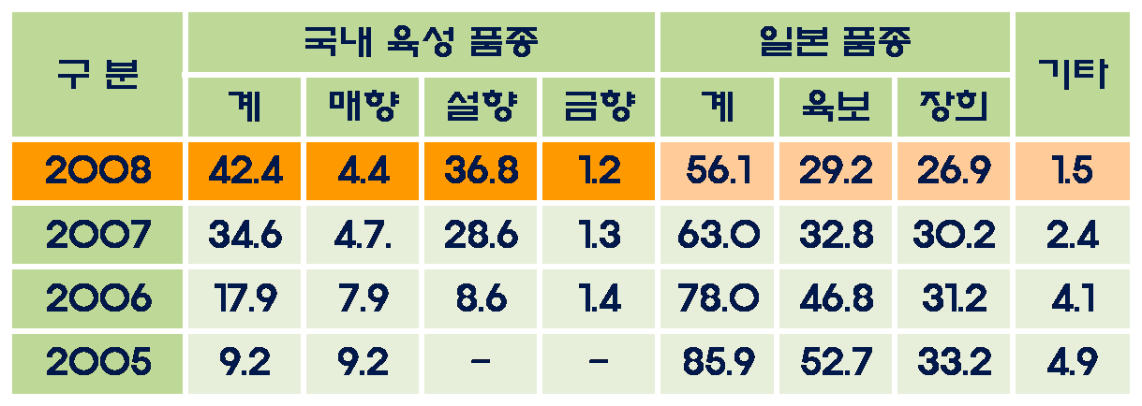
Acreage share of domestic varieties of strawberry
42.4
34.6
17.9
9.2
4.1
7.4
2003
2004
2005
2006
2007
2008
(%)
Courtesy of NHRI

Slide 41
IV. Another advantage – preferred location
Considerations in choosing research locations of seed firms
- For efficiency: climate, infrastructure, manpower, cost, proximity to target markets, breeding and related science and technology level, etc.
- For germplasm security:
a) government policy regarding PVP and IP in general
b) social environment for and tradition of IP protection
Similar factors are also considered in choosing country of seed production sites

Slide 42
V. Summary
PVP boosts breeding and benefits growers.
Increase of PVP application
  Especially soon after PVP entitlement of a given crop
Diversification of varieties and/or genetic resources
  Utilization of foreign varieties for breeding new varieties – virtue of breeder’s exemption
Encouragement of breeding activities
  especially in private sector and local governments
Benefiting growers
  More choices, higher valued products and increased export
Necessary to attract breeding and seed production
  By ensuring germplasm security

Slide 43
Acknowledgment
A great large part of this presentation was taken from Mr. CH Kim, Director General of Korea Seed & Variety Service, who reported PVP impact study in Korea in the 2nd world seed conference.
Acknowledgment also goes to Drs. YJ Kim and YU Shin of NHRI, Ms MH Yang and Mr. CU Park of KSVS, Dr. BS Lee of RDA , Dr. SG Yang of Nongwoobio, and Dr. YK Kwon of NACF’s Seed Business Center for their help in tracing records and collecting data.
Thank you for kind attention

