Slide 1
November 5 and 6, 2009
Accessing Patented Knowledge for Innovation
A global project supported by
IDRC’s Innovation, Technology and Society Program
WIPO Conference on Building Partnerships for Mobilizing Resources for Development
Geneva, Switzerland

Slide 2
What is IDRC
A Canadian Crown Corporation
Mandate – “to initiate, encourage, support and conduct research into the problems of the developing regions of the world and into the means for applying and adapting scientific, technical and other knowledge to the economic and social advancement of those regions”
IDRC Act
  Enlist scientists in Canada and abroad
  Build skills and institutions
  Coordinate development research
  Foster cooperation for mutual benefit
  Funds others to do research, not performed in-house

Slide 3
IDRC
Goals
  Strengthen and mobilize local research capacity
  Change the lives of poor people
Partnerships
  Scope and impact of investments
  Capacity and influence of researchers
  Coordinate efforts
Budget CAD $200M, 450 staff, Ottawa + 6 regional offices

Slide 4
IDRC’s Guiding Principles
Peoples of developing regions must be able to control their own knowledge-based development
IDRC takes its lead from Southern researchers
Development research grant-making is the core of our activities

Slide 5
Grants + Model of Partnership
Building research capacity in critical areas
Supporting research led evidence for policy making
Supporting Strategic communicating of research findings
Opening up critical new areas of research
Enabling networking and knowledge platforms

Slide 6
Partnership models
Knowledge AND donor partnership
“Boutique Operations“ vs Wholesale model

Slide 7
Innovation, Policy and Science
Challenge Fund + Innovation Technology and Society Program
The Challenge Fund
Partners with Granting Councils and other Canadian research funding organizations to enable joint research between Canadian and LMIC Scientists
  Network of Centres of Excellence;
  International Canada Research Chairs; (CRCs Program)
  International Community Research Alliances (with SSHRC)
Notes:
Canada Research Chairs
Leverage the investment made in the already funded Canada Research Chairs and to help internationalize the program;
By funding new IDRC research chairs in LMICs, enable profound research program, hiring post-docs and graduate students;
And conduct a joint program of research with a Canada Research Chair;
Program elicited greater demand than we expected;
Also bumped up the funding… from five to eight; at $1 million each). Awards will be announced on Parliament Hill on February 25th;
ICURA
Enable multidisciplinary work between community organizations and post-secondary institutions
This program also elicited greater demand than we expected;
Increased funding from three to five;
For instance, adoption of coastal environmental change in Canada and the Caribbean;

Slide 8
Objectives of the ITS Program
  Improving understanding, capacity and inter-linkages of innovation system actors (organizations and individuals) in developing countries
  Supporting the development of explicit and implicit S&T policies contributing to improved functioning of developing country innovation systems
  Strengthening socio-economic impact analysis, social inclusion and learning capabilities in support of innovation and the governance of new technologies
Notes:
S and T strategy in Mozambique; part of poverty reduction strategy, follow up project on Indicators;
Cotton that was GM to be resistant to insects in China;
It is working;
But farmers are still applying pesticides;
Government of China has now invested a further $30M in this issue to Extension Services training to
a) Further study the impact and benefits and cost of GM cotton
b) Help Extension Services to educate and train farmers

Slide 9
ITS Research Program Framework
Innovation
System
Actors
Social
Responsiveness
Learning
Capabilities
Science and
Technology
Policies
Impacts and Inclusion

Slide 10

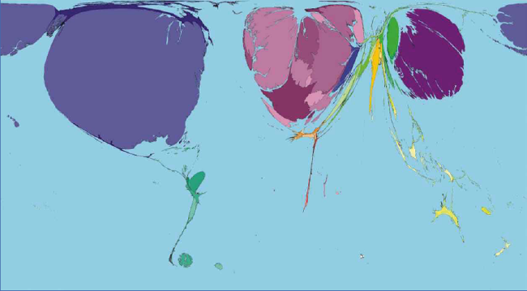
Notes:
The top image of the world at night. The world’s light emissions are a rough proxy for the location of energy use, industry and scientific capacity. In the bottom image the size of countries is weighted by the annual value of patents, licences and fees they receive. What these images represent is the global differences in science and technical knowledge which still exceeds that global differences in wealth or incomes.
IDRC cannot fill this gap, but it does make a difference. IDRC adopts a problem-oriented approach, linking people and ideas together. Many of the problems IDRC addresses cross borders – many people have a stake in resolving them. It is in the collective interest to work together to address the problems that threaten all people or that generate the innovations that hold the potential for mutual benefit. Societies advance when they expose all ideas to review and rigorous debate. IDRC help support collectively learning on what works, where and why.

Slide 11
IP as a cross-cutting theme
IP research capacity in developing country
Need for endogenous research capacity
Situating IP within innovation for Development
Development-----Economic growth + social equity
Sustainability
Security
Environment

Slide 12
ITS project
Accessing patented knowledge for innovation
OBJECTIVES:
Research Exemption in patent law – optimum formulation, its use and impact on key industrial sectors.
Compulsory Licences - The framing and implementation of the right to ensure the widest and least costly access to patented technologies to address pressing social and economic challenges.
Patent Pools and Patent Clearing Houses - appropriate and effective use .

Slide 13
ITS project
Accessing patented knowledge for innovation
Our intentions
Field building in IP research
Understand the IP research domain in developing countries - Opportunities in TRIPs
Who is doing what ? Outcomes?
What are the aspirations and constraints ?
What role can IDRC play ?

Slide 14
Methodology
Open competitive call
Thematic areas
  – research exemptions
  Compulsory licensing
  Patent pooling
No comparative framework to begin with
Current status and opportunities
Focus on research for innovation
Networking and sharing of experiences
Notes:
Global call - 31 proposals received qualifying call criteria
8 selected

Slide 15
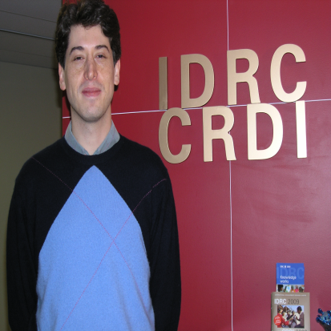
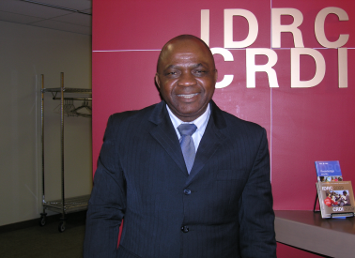

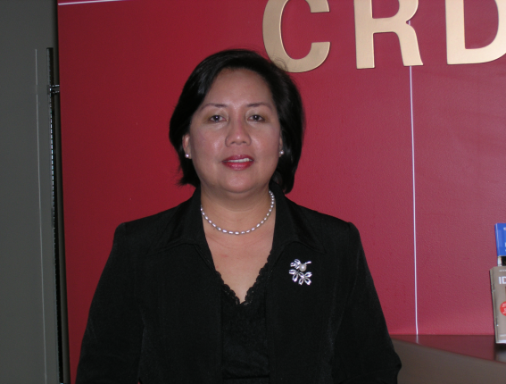

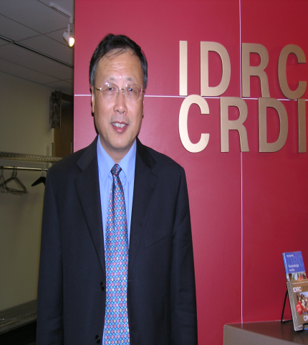


Slide 16
What have we learnt
Demand for IP research capacity building is very high – balancing economic and social goals
IP policy making at various levels – institutional, organisational, national and regional levels
Exemptions are necessary but not sufficient conditions for innovation
Room for framing national IP legislation around social policy imperatives

Slide 17
What have we learnt
Patent pooling is an emerging trend in a few countries (China, india and Philippines) but too early to find patterns.
Drivers of PP could be voluntary private sector, state or third party push for public goods / services
Need for tangible incentives for research leading to innovation – the role of the state
Notes:
And I am happy to say that I don’t think it is just Canada that is taking this approach … (a) the G8 Summit in Okinawa side meeting; (b) in Italy; (c) countries like Japan/Germany Science diplomacy – OECD, CST, GSF …
Attaining Excellence through research sometimes requires building research capacity; (IDRC-DFID program)
Finally, because sometimes partnering is about capacity building….both because it is the right thing to do…and because it is an investment in our own future prosperity to have partners of high capacity with whom we can learn together, and innovate to create wealth;
All countries must develop, attract and retain highly skilled people. They must generate new ideas and innovations. And the must translate knowledge into practical applications to improve wealth, wellness and well-being.
Canada understands that these advantages are vital to our prosperity and security. It is only natural that these advantageous guide our cooperation with developing countries.
There is a demand…We know that Canadian Researchers are already collaborating with those in developing countries…mostly with those in the BRICS…and our colleagues at the tricouncils are telling us that demand outstrips supply;

Slide 18
The Functionality of the “three-step test” in Widening the Scope of Research Exemptions: Transposing the Copyright Experience into the Patent Field
Instituto de Direito do Comércio Internacional e Desenvolvimento
Edson Beas Rodriguez Junior
BRAZIL

Slide 19
Research findings - Brazil
Terms of article 30 (3 step test of patent law) – limited in interpretation.
A reinterpretation of the terms is possible AND mandatory that reconciles commercial and social interests
Makes a case for research AND development exemption in TRIPS
Notes:
The only panel report handed down by the World Trade Organization´s dispute settlement body, which construed the terms of the article 30 of TRIPS (the “3-step-test of patent law”) was misguided and even breached the WTO rules of interpretation. Accordingly, the interpretation adopted excessively restricts the policy space left to WTO Member States to adopt exceptions to patent law which genuinely foster non-commercial interests.
A re-interpretation of the terms of the 3-step test in the light of the objectives of the TRIPS Agreement is not only possible but mandatory. Bearing in mind the imperative of reconciling commercial with social interests, and mandated by article 7 of TRIPS, we found WTO Member States are allowed to adopt wide patent exceptions, as long as they purport to foster socially relevant interests, e.g. right to life, right to health, right to food security.
Considering the emerging “commercial science reality” we found that the sectors devoted to R&D demand patent exceptions which offer a wider leeway for carrying out basic, humanitarian and commercial-oriented research. In other words, the industry , universities and governmental research institutions demand not simply a “research exception”, but a “research and development exception”.
Fortunately, the re-interpretation of the terms of article 30 of TRIPS in the light of its purposes and objectives allows WTO Member States to adopt a “R&D exception” which: (a) frees the use of patented technologies for non-commercial and for humanitarian uses (e.g. the development of new products and processes designed for meeting the neglected needs of developing and least developed countries); (b) authorizes the use of patented technologies for R&D purposes, as long as a pre-set fee is paid by potential users.

Slide 20
Assessing the Challenges of Patent and Research Exemption on Research Capacity and Utilization in Universities, Research Institutions and Industry in Botswana
University of Botswana, Gaborone
Dr. Njoku Ola Ama
BOTSWANA

Slide 21
Key findings - Botswana
Very low level of awareness
  IP legislation 1966 but very low awareness
  Awareness of researchers on IP is superficial
  Existing legal framework is ineffective
IP law exists but
  scope of exemptions and options not understood
  need for endogenous research
Notes:
The level of patent awareness and possibly intellectual property awareness in the country generally is low. The study showed that only about 67 percent of the studied sample was aware of the use of patent rights to protect their invention.
Most researchers, whether in the academia or in industry, claim some awareness about the existence of patents but on closer questioning, it becomes clear that such knowledge is usually very superficial.
Hence, the existence of a legal framework dealing with patents and its attempts to provide incentives and promote research and innovations, especially through research exemptions is bound to be ineffective in the absence of patent awareness.
Second, whilst it is clear that the existing legal framework recognises and protects patents, the nature and scope for encouraging research use of patented inventions through research exemption is less clear. A wide variety of options are available for addressing the problems associated with experimenting with patented products. It is necessary that for patent legislation to be balanced, it must also contain an experimental use exemption to enhance the prospects of encouraging research and innovation with respect to patented products.
As indicated by participants during the Focus Group Discussion (FGD), many of the applications submitted by locals (residents of Botswana) were rejected because of lack of clarity in presenting their applications and not necessarily because they lacked content. The need for assistance of a patent attorney or agent who will represent their interests during the application process was therefore recommended so as to improve acceptability of local patent applications.
Finally, it is also necessary that incentives to innovate, such as royalty sharing agreements and special achievement awards are provided to encourage inventors. At the end of the day, the critical issue seems to be the need to create an awareness of the potential benefits of patents and research exemptions in underdeveloped countries if the legal protection provided is going to have any practical effects on researchers

Slide 22
Key findings - Botswana
Real need –capacity building for domestic patent filing process
  Content exists but lacks clarity and articulation
  Insignificant numbers of domestic patentees
Research exemptions are not enough
  Incentives for researchers to innovate

Slide 23
Accessing Technologies and Information Contained in Patent Documents to Enhance Innovative Research in Tanzania: The TRIPS Agreement Research Exemption
Tanzania Commission for Science and Technology (COSTECH)
Georges Silas Shemdoe
TANZANIA

Slide 24
Key findings - Tanzania
Tanzanian researchers have a low level of intellectual property awareness
IP information should be integrated in capacity building strategies.
Researchers are not aware of IP issues because IP is not taught at all level of education.
Notes:
Low awareness of Intellectual Property Rights system among Tanzanian researchers has caused national R&D institutions in Tanzania to “re-invent the wheel”, making inefficient use of scarce research resources. This study revealed that a lack of IP awareness, wrong perception of the patent system and lack of institutional policies are the major factors hindering the use of the patent system in Tanzania.
Mainstreaming of intellectual property (IP) issues in the curricula at all levels of education are among the logical and sustainable ways to improve its use in Tanzania. Although several initiatives have been created to raise awareness of IP among Tanzanian researchers – including the creation of the Tanzania Intellectual Property Advisory Services and Information Centre (TIPASIC) – further actions are needed to ensure that knowledge on IP is understood and used.

Slide 25
Key findings - Tanzania
Low motivation for innovation and technology transfer in R& D institutions due to lack of Institutional IP Policies.
The use the patent system will contribute to the socio-economic development of Tanzania.

Slide 26
Main Findings
Use of the patent system among researchers is low.
Awareness of researchers on industrial property is low.

Slide 27
Dans quelle mesure l’exemption de la recherche peut-elle promouvoir l’innovation à travers une formulation la plus à même de favoriser l’accès aux connaissances brevetées?
Association pour la Promotion de la Propriété Intellectuelle en Afrique, Yaoundé-Messa, Cameroun
Loumou Bikoun Alain Désiré
CAMEROUN

Slide 28
Key Issues - Cameroun
Low level of knowledge and awareness
Difficulty in accessing patented information
Absence of IP policy in research institute
Weak/absence technical infrastructure funding and research resources ( data bases)
Senior authorities and policy makers- awareness and capacity building
Lack of incentives for researches to innovate

Slide 29
Key findings - Cameroun
Research towards reliable statistics on impact of IP restriction on R& D innovation
Broaden scope of research- research exemption
Strengthen R&D for innovation
Better access condition for research resources

Slide 30
Patent Pools in China – Patenting Behaviour of Foreign I Firms and Implication on Local Innovation Capabilities and IP Policy Challenges
Bei Hang University (Beijing University of Aeronautics & Astronautics), China
Xiangdong Chen
CHINA

Slide 31
Main Findings- China
Increasingly competitive patterns of patenting behaviour between groups of foreign and domestic firms. Foreign firms dominated in patenting volume throughout 1990’s and early 2000’s, however, domestic firms are increasingly catching up in patenting volume during mid and late 2000’s
Overseas invention patenting and granted patents are highly concentrated by sources of owners from limited countries, and closely correlated to quality of overseas capital inflows (in terms of Foreign Direct Investment), measured by size of the average investment.

Slide 32
Main Findings - China
China based patent records are increasingly comparable with international patent database such as USTPO, JPO, EPO, and overall PCT, not only in terms of patenting movement but also in terms of Index of Patent Right (IPR), however, there are still some discontinuity in patenting movement and granted patents, which indicates typical feature and uniqueness of China based patent studies

Slide 33
Main Findings-China
Based on special measurement techniques on patent breadth and patent life cycle, there is a quality difference between Chinese domestic patents and overseas owned patents in China. There are also differences among industrial sectors in general, which indicates that the measurement technique can be applied to both quality issues and technical competition issues in different sectors, and moreover, the Patent Pool issues. The impact effect from In-Pool Patents / Firms upon local Off-Pool Patents / non-Pool Firms is also examined through similar studies.

Slide 34
Main Findings - China
Based on some overseas Patent Pool cases (such as DVD, MPEG-2, WCDMA) in China, Patent Pooling indeed provides member companies larger competitive power over those Off-Pool patents and especially non-Pool firms. However, such kind of extra power is not evenly distributed among different pools in a same product or industry sector, some pools have higher impact over others, especially higher impact upon Chinese local companies in the fields.

Slide 35
Main findings - China
Interesting technical findings are revealed between In-Pool and Off-Pool Patents owned by In-Pool Firms, when Patent Breadth and Patent Life Cycle measurement are used, e.g., while In-Pool Patents revealed longer life cycle, they are narrower in Patent Breadth compared with Off-Pool Patents. These findings indicates reasonable arrangement for patent owners in the pool to support longer life for In-Pool patents, and to apply just-in-use field to those patents in the pool.

Slide 36
Main Findings - China
Impact issues can be important for policy makers and companies in developing countries in general, if further findings can be revealed through wider scope of Patent Pool case study on motives and results of In-Pool firms in managing their patents In-Pools and Off-Pools, and dynamic changes on strength of local Chinese patenting capability in particular technical areas, in and around pooled technologies. These are planned for the research project to be completed in the near future.

Slide 37
Patent pooling and Access to Knowledge: A case study of biotechnology with reference to India
The Energy and Resources Institute, New Delhi, INDIA
Nitya Nanda
INDIA

Slide 38
Main Findings - India
Even up to 2006, there were a few biotech patents that were granted in India but most of them were owned by Indian entities. But from 2007 there has been substantial increase and a large majority of them are owned by foreign companies
Patent pool as a concept is little known in India and there is no specific legal framework to govern the issue. There are very few examples of operational patent pools in biotechnology and the experience is not well documented

Slide 39
Main Findings - India
There are very few examples of operational patent pools in biotechnology and the experience is not well documented

Slide 40
Patent pools are likely to work if / when
When there are incentives for firms contributing their high-valued patents to a patent pool
There is a viable governance mechanism for the pool
When there is no clear incentive, compulsory licensing may be an additional requirement for patent pooling particularly in non-voluntary types
If a patent pool can provide an alternative to existing inaccessible patents, then it can provide value or enhance access to knowledge
May work in case of patents that may not have good potentials in lucrative markets (e.g., tropical neglected diseases)

Slide 41
Exploring Patent Pooling As a Tool for National Development
Arellano Law Foundation, Inc., Manila, Philippines
    Josephine Santiago
THE PHILIPPINES

Slide 42
Key issues - Philippines
Limited private sector R&D participation -
Lack of IP awareness and understanding among IP stakeholders resulting in indifference or distrust of the IP system –
low levels of R&D investment in view of limited government resources
Weak linkages among higher educational institutions (HEI), RDIs and industry
Notes:
Limited private sector R&D participation -
Laws must be strengthened to encourage innovation and support the taking of risks of the industry
Bill on technology commercialization must be approved by Congress
Lack of IP awareness and understanding among IP stakeholders resulting in indifference or distrust of the IP system –
Massive information campaign on the benefits of securing protection of rights
Strengthen implementation and enforcement of IP rights
3. Conduct further study on the cost-benefit of the various alternative directions the country should have in terms of available knowledge for clear state policy direction
Should the country increase its budget on R&D?
Should it buy technology instead rather than engage in risky R&Ds?
Should it encourage licensing of technology for manufacture or commercialization?
4. Weak linkages among higher educational institutions (HEI), RDIs and industry
Strengthen networking between and among the sectors by creating academic clusters in certain geographical area to address industry needs. Do demand or market-driven technologies. Specific industry may adopt a university or university cluster to develop technology through sponsored research.
Allow location of industry R&D in university campuses for close coordination and sharing of facilities

Slide 43
Research Findings - Philippines
Patent pooling per se cannot as yet be a tool for national development in the country.
  Technology pooling must be encouraged where potentially new products and services may be available
  Support initiatives for providing management of technology portfolio for better bargaining and negotiating power
  Simplify approach for assistance to technology generators and researchers

Slide 44
Utilizing Compulsory License as a Means to Access Platform Technologies in the Healthcare Sector
Centre for Trade and Development, New Delhi
Yogesh Pai, Associate Fellow
INDIA
( Research work is in progress)

Slide 45
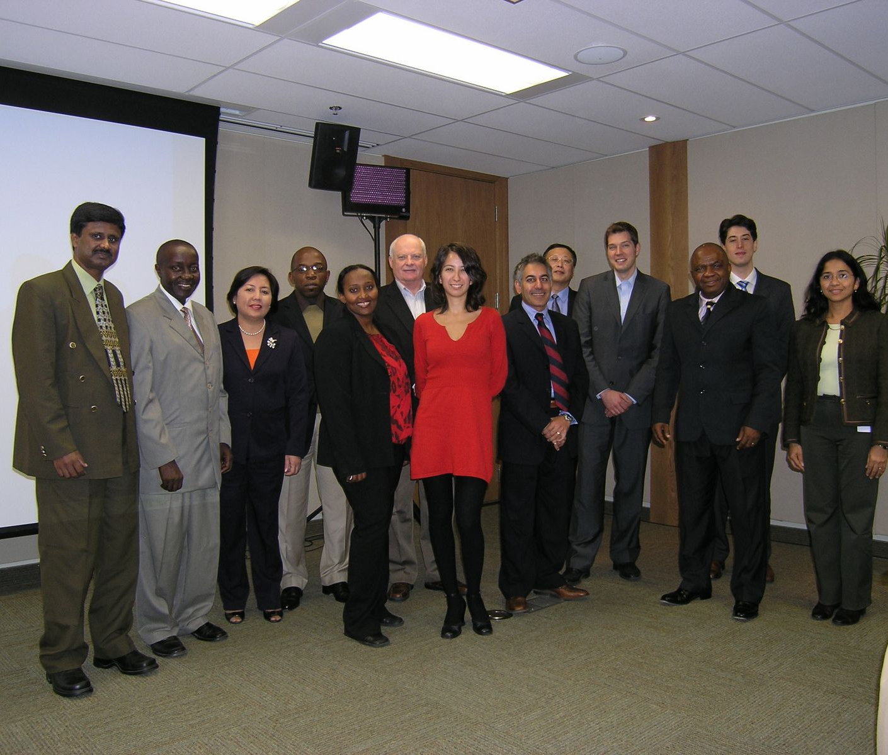
Workshop
Knowledge sharing and Networking
Accessing Patented Knowledge for Innovation
20-21 October 2009
Ottawa

Slide 46
Next Steps
Consolidation of findings
  Book , research network - 2010
Building core research capacity building on IP
  A few selected countries?
  Training of trainers?
  Accessing WIPO and WTO training resources
  Building on this work and sustainability
IDRC seeks partnerships

Slide 47
Veena Ravichandran
Senior Program Officer
Innovation, Technology and Society
IDRC vravichandran@idrc.ca
THANK YOU

