Slide 2
LICENSING
Licensing Definitions
Licensing means any transaction where the owner or party that controls IP grants another party the right to use that IP typically for a limited time
Licensor is the party granting the rights
Licensee is the party acquiring the rights

Slide 3
LICENSING INTRODUCTION
Licensing Possibilities for Developers:
Developer may license IP to:
Help in game development (software)
Use IP as the basis for a game
In a game to create realism
improve the gaming Experience (music)
Developer that has original IP may license the IP to third parties:
Consumer products
Film
eSports merchandise
Software for games

Slide 4
EXAMPLES-POSSIBLE LICENSED IP INCLUDED IN GAMES-SOURCES OF IP
Creating a game based on a licensed property
Using IP (trademarks) as part of the game (words, names, titles, symbols, brands, logos)
Streaming music that might appear on a juke box in a game or in the background
Placing buildings, artwork, posters, or photos in a game
Using a person’s likeness in a game such as actors, musicians, or athletes
Using 3rd party software in helping develop a game (Unreal Engine (Epic))

Slide 5
WAYS LICENSED IP USED IN GAMES
1. Games specifically based on 3rd party content (Primary License)
sources
Book (Harry Potter)
Film (Batman)
Comic book (Spiderman)
Television show (Walking Dead)
Sports PROPERTIES (FIFA)
Toys (Legos)
Games will incorporate:
story lines
characters
logos, names
and other elements from the licensed property
SOME LICENSORS ALLOWING DEVELOPERS TO CREATE NEW IP BASED (E.G., CHARACTERS, STORYLINES) (OWNED BY LICENSOR)

Slide 6
USES OF IP
2. Games that include IP licenses such as TM’s but mostly adding realism to games (secondary license)
3. Games that include important 3rd party IP but does not serve as the basis for a game
Cars that are part of a racing game
Microsoft’s Forza racing game
4. CHARACTER CROSS-OVER INTEGRATION
DOWNLOADABLE CONTENT
REQUIRES AN ADDITIONAL PAYMENT
MOSTLY ACCESSIBLE FOR A LIMITED TIME-MIGHT BE TIED TO A SPECIAL EVENT (E.G., MUSIC CONCERT)

Slide 7
POSSIBLE BENEFITS OF LICENSING
Benefits for the Developer
Consumer recognition of a brand
PROVIDES REALISM TO A GAME
Potentially huge spend on marketing of the brand (i.e., film release)
AVOIDING SOME OF THE HIGH COSTS AND RISKS ASSOCIATED WITH DEVELOPING A NEW FRANCHISE
Benefits for the Licensor
Money
Publicity and retail promotion targeting video game consumers
EXPANDS THEIR TRADEMARK PORTFOLIO

Slide 8
ORIGINAL IP
Original IP created by the developer
Advantages:
Ownership of IP and controls rights for distribution, reproducing, public performance, and derivatives
No approvals from 3rd parties
Total creative control
Potentially more lucrative since don’t have to share revenues
AS LIFE CYCLES EXTEND, GREATER IP VALUE
Risks:
Could involve large investment with little return

Slide 9
LICENSING
Risks if fail to obtain rights unless it falls into an exception:
1. Prevent a game’s distribution
2. Be forced to pay damages (including profits from actual use of the unlicensed IP)
3. Redesign the game to avoid IP infringement issues
This could delay the release of a game
Could cause increase in expenses
4. Enter into a license agreement if available on unfavorable terms
5. Cause additional problems with 1st party distributors such as Sony, Microsoft, Apple
6. High costs (monetary, lost time) even if you win
7. Damage future relationships with a licensor

Slide 10
EXCEPTIONS (U.S. EXAMPLE)
Exceptions vary depending on a particular legal system
1. Fair use-law permits certain “fair” uses of copyright
Criticism
Commentary
News
Reporting
Teaching and research
Be cautious-It’s a defense against a claim; can be expensive to defend especially when results can be unpredictable
Be aware of fair use myths:
Its use is under 10 seconds
Given away for free
For personal use
It promotes the original

Slide 11
EXCEPTIONS
2. Public-Domain-free to use*
Copyright term has expired
Failed to obtain proper copyright notice at the time
Be Aware: Materials in the Public Domain may be treated differently by county
What is may be considered Public Domain in one country may be different in another country
For example, the original Robin Hood story is in the public domain in the U.S. but not in England
Be Aware: Public domain material can contain new IP
Can own new and original contributions that developer adds to public domain materials

Slide 12
EXCEPTIONS
3. US specific-First Amendment protections
In the US, courts have balanced issues dealing with First Amendment rights of developers with owners of IP
First Amendment provides protections for various forms of speech including written and oral
U.S. COURTS HAVE PROVIDED MORE FREEDOM DEALING WITH TMS BUT CAN BE UNPREDICTABLE

Slide 13
ISSUES IN OBTAINING A LICENSE
Which party owns or controls the rights?
DOES THE LICENSOR HAVE A LICENSING PROGRAM OR DO THEY USE AN AGENT?
HOW DIFFICULT IS IT TO WORK WITH THE LICENSOR?
Will THE INCLUSION OF THE LICENSES INCREASE SALES (PRIMARY AND SIGNIFICANT SECONDARY LICENSES) AND outweigh licensing costs and approvals?
What is the Developer’s budget and have they factored in licensing costs?
DOES THE LICENSED IP HAVE WORLD-WIDE RECOGNITION?
WILL THE DEVELOPER BE ALLOWED TO ALTER THE LICENSED PROPERTY?

Slide 14
ISSUES IN OBTAINING A LICENSE
What will market conditions look like?
HOW DOES THE LICENSOR PROTECT THEIR IP?
DO THEY PURSUE INFRINGERS?
WHAT WILL BUSINESS TERMS LOOK LIKE?
WHAT RIGHTS IS LICENSEE OBTAINING (PLATFORMS, GENRE, EXCLUSIVITY)?
TERM, TERRITORY
COSTS TO OBTAIN THE LICENSE (ADVANCES, GUARANTEES, ROYALTIES)?
WHAT DEDUCTIONS WILL BE PERMITTED IN DETERMINING ROYALTY PAYMENTS?
WHAT ARE LICENSOR’S COMMITMENTS (E.G. CONTINUING MARKETING THE IP)?

Slide 15
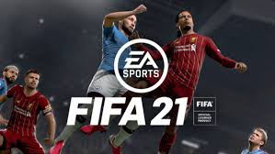
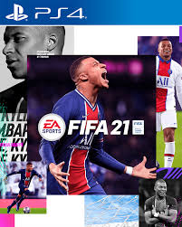
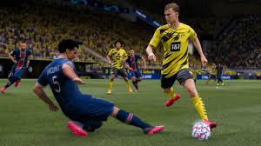
EA-FIFA FOOTBALL GAME
IP EXAMPLES

Slide 16
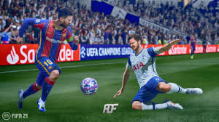
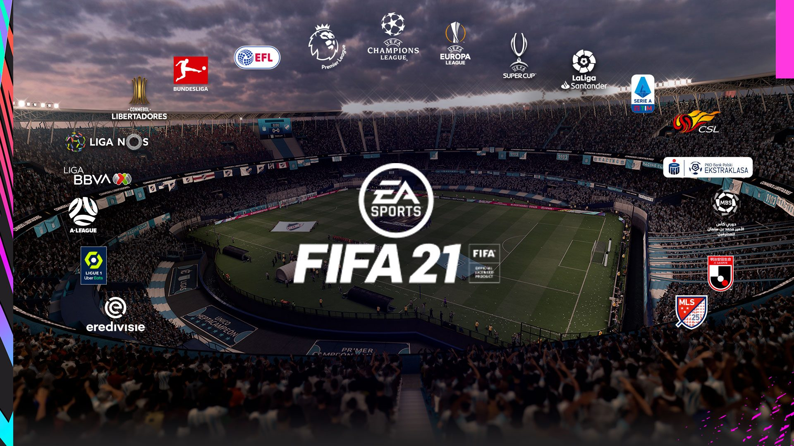
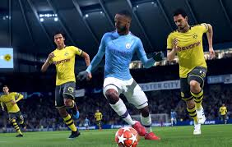
EA-FIFA 21
EA-FIFA 21 IMAGES

Slide 17
WHAT MIGHT REQUIRE PERMISSION? Some Examples of IP Uses in FIFA Games
Some examples of IP issues in FIFA ’21 game
Athletes in game
Teams, Football Associations (e.g., names, logos)
Announcers in the game
Logos on apparel or sports uniforms
Music in the game
Architecture (e.g., stadiums)
Advertising in the stadium
Tattoos

Slide 18
LICENSING MODEL (PRIMARY LIC)
Licensor ----------------------Licensee
(Owner of IP) (Game Developer)
Development of Game
Approvals _____________Development
Distribution
Introduce product into the market (retail; digital)
Approvals _______________ Marketing
Royalties _______________ Sales

Slide 19
LICENSING MODEL
Consideration
Advances REVENUE EARNED
Guarantees DEDUCTIONS
Royalties NET REVENUE earned from sales
Accounting and statements

Slide 20
EXAMPLES OF TM CASES LICENSING RELATED
In the United States, courts have balanced issues dealing with First Amendment rights (i.e., right of free speech) and the use of third-party trademarks
Many courts have adopted a test referred to as the Rogers test when balancing 1st Amendment interests with trademark protections

Slide 21
TM CASES
The Rogers’ test allows a party to use a trademark in an expressive work (e.g., a film, book, art, video game) without violating TM rights if it satisfies these 2 issues:
Whether the use of the third-party trademark has artistic relevance and
If it has some artistic relevance, is it deliberately misleading as to the source or content of the work (Does it cause consumer confusion?)
The defendant (i.e., game developer) has the burden of showing the use has some minimal relevance to the artistic goal of the work
The owner of the IP has the burden of showing the defendant’s use of the mark indicated the plaintiff’s approval or appeared as an endorsement
Cases are fact specific but some of the notable TM-Video Game cases include:

Slide 22
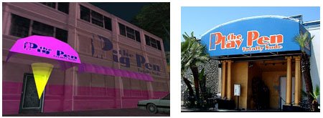
EXAMPLES OF THE ROGERS TEST- TEXTBOOK TM CASES
E.S.S Entertainment 2000 v. Rock Star Videos, Inc., 547 F.3d 1095 (9th Cir. 2008)
A real world strip club named Play Pen claimed infringement of their trademarks in Grand Theft Auto: San Andreas
The court found use of the mark “Pig Pen” which was a variation of the strip club trademark was protected speech under the First Amendment

Slide 23
TM CASES
Under the Rogers test: The club was only in the background and found that the threshold for artistic relevance only needs to be more than zero which the creation of the LA atmosphere met
The defendants artistic goal…to develop a cartoon styled parody of East LA surpassed this hurdle
There was nothing to indicate players thought the real strip club had anything to do with the game and the use was relevant to the story

Slide 24
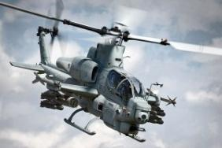
TM CASES
EA v. Textron, Inc., 103 U.S.P.Q.2d 1984 (N.D. Cal. 2012)
EA depicted Bell helicopters in a game (Battlefield 3) without a license
EA is sued for trademark infringement by Textron (holder of the Bell trademarks)

Slide 25
TM CASES
EA v. Textron, Inc.
EA argued they had the right to depict real life military helicopters in its game under the 1st Amendment
Would people think that Bell provided expertise to EA to create its realistic simulation of the workings of Bell Helicopters?
The court found consumers might think Textron/Bell had something to do with the game
Distinguished from the Pig Pen case
Pig Pen strip club was merely part of the background while helicopters were more prominent in the game and in ads
Case settled out of court

Slide 26
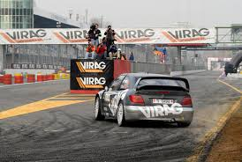
TM CASES
Virag, S.R.L. v. Sony Computer Entm’t AM., No. 16-15137 (9th Cir. 2017)
Virag’s logo appeared on a bridge in the game and sued for TM infringement
Court found that incorporating real world elements in Gran Turismo 5 & 6 was protected by the 1st Amendment and did not infringe on plaintiff’s trademark rights.
Logo was used for artistic and expressive purposes rather than for commercial gain. Furthered game’s realism
Did not make any explicit statement that would cause consumer confusion

Slide 27
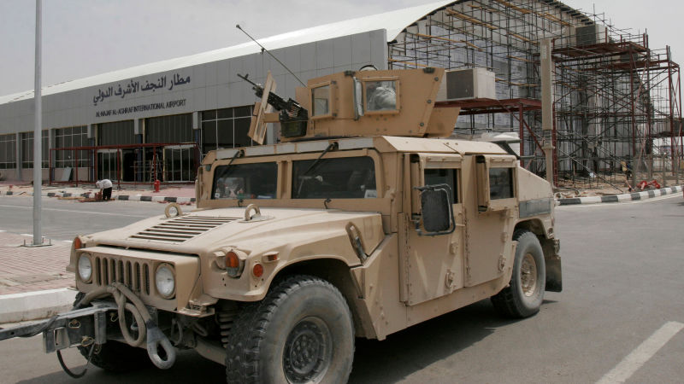
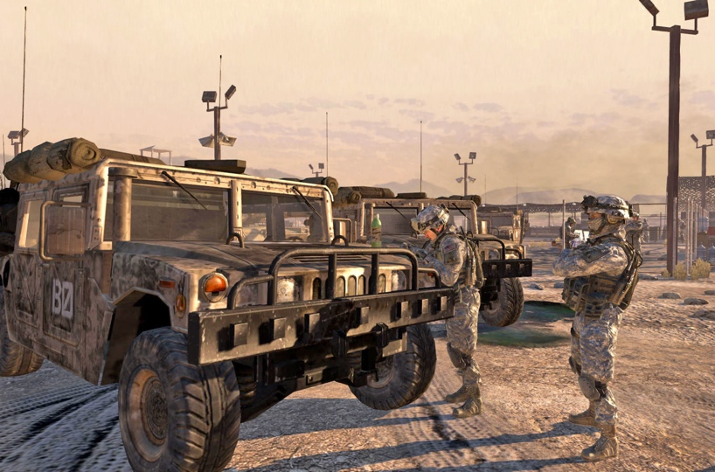
TM CASES
Am Gen. LLC v. Activision, Blizzard, Inc., 2019 U.S. Dist. LEXIS 57121 (S.D.N.Y., Mar. 31, 2020)
Am General in late 2017 sued Activision for trademark infringement involving the use of the Humvee vehicles in the Call of Duty video game series
The vehicles appeared in games varying in duration ranging from brief appearances in the background and being mentioned in dialogue to players riding in them for several minutes and even controlling them

Slide 28
TM CASES
Activision did not enter into any agreements to include the Humvee vehicle or HMMW’s trademarks in their games
Activision argued they did not need to since they were creating realistic historical events in their games which was protected by the First Amendment
Court used the Rogers test:
Relevance
The court noted the use of the vehicles had artistic relevance since the vehicles were used in military operations throughout the world and therefore provided realism to the game
Does it explicitly mislead as to the source of the content?
Court said no and mere existence of some confusion would not be enough and that it must be particularly compelling to outweigh the First Amendment interest recognized in Rogers

Slide 29
SEGA V. MANCHESTER UNITED
In 2020, the Manchester United football team (“MU”) sued Sega Publishing Europe Limited (publisher) and Sports Interactive Limited (developer) in England covering a series of games called Football Manager
MU claimed that the use of their name which appeared next to unofficial team crests was an infringement of their trademark
MU, argued that using unofficial crests deprived them of licensing opportunities.
In response, Sega claimed among other things, that the way in which the logo was used would not indicate the logo was licensed
The case was settled out of court in August 2021 and as part of the settlement Sega agreed to rename MU for games beginning with FM22

Slide 30
RISK ANALYSIS-TM
Is any TM used in the title of the game or within the game or in marketing/publicity materials not owned by Developer?
If yes, have rights been obtained?
If no, has the mark been changed or modified?
Would it cause consumer confusion?
What is the purpose it serves in the work?
Additional questions:
Who owns the mark?
Is the mark registered?
Where is the game going to be exploited? Different TM laws could apply in different territories
Is the mark used in the same class of goods
Time: Make sure the analysis occurs way before it becomes costly to make revisions if necessary

Slide 31
COPYRIGHT EXAMPLES-GAME DEVELOPMENT
Recent lawsuits involving copyright, in the U.S. in a time of advanced technology in game development
Tattoos
Game developers accused of infringing the copyrights involving tattoos appearing on athletes
Tattoos digitally recreated on player avatars
Recently, one court case ruled in favor of developers. Other cases pending
Prior to the case, disputes have been settled out of court and prior to any decision rendered about whether tattoos are copyrightable

Slide 32
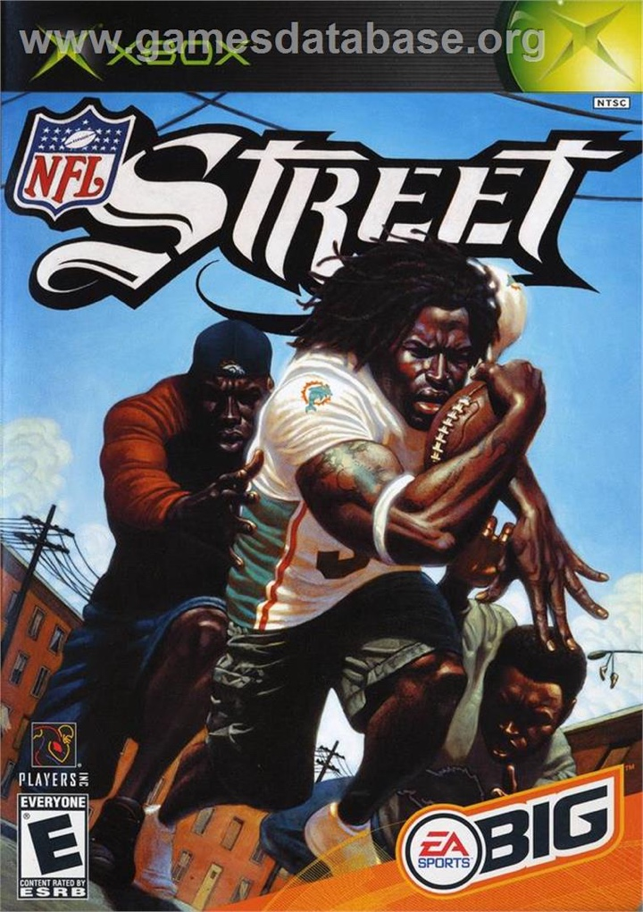
PREVIOUS CASES-PACKAGING
Tattoo artist sues EA for box cover using Ricky Williams displaying tattoo on various football games including NFL Street, Madden NFL 10, and Madden NFL 11
Settle out of court
Prior to Solid Oak case, all previous
cased involving tattoos in games and
films were settled out of court
Warner Bros. Hangover II (Tyson)
THQ & UFC (bankruptcy court)
Rasheed Wallace (Nike TV spot)

Slide 33
SOLID OAK-BASKETBALL GAMES
Solid Oak sues for copyright infringement involving 5 tattoos depicted in Take-Two’s NBA 2K. Solid Oak Sketches, LLC. v. 2k Games, Inc. and Take Two Interactive Software, Inc
Solid Oak is a company that acquired the rights from the tattoo artists
No agreement signed between artist and athletes
Easily could have been resolved with proper agreement
Licenses for an NBA game:
League and team names and logos (NBA league)
Player’s likeness (typically players association)
Arenas, ads and other IP obtained by separate licenses
What about tattoos on players?

Slide 34
SOLID OAK CASE
The court ruled:
1. The use was so unsubstantial it was considered de minimus and therefore not grounds for copyright infringement
Court ruled that the tattoos were so small and blurry during game play that they did not reach the level required for substantial similarity
Also, de minimus since played such a small part in the game and marketing materials. Hard to notice tattoos when playing game
2. The use of the tattoos constituted fair use
Lack of economic harm affecting the plaintiffs
Tattoos are merely incidental. Consumers are not buying games for the tattoos
Use was transformative in that one was creative expression versus the creation of a realistic game

Slide 35
SOLID OAK CASE
3. Plaintiffs granted an implied, sublicense to the players (which could subsequently be sublicensed) and they testified that knew that the tattoos would become part of the player’s image
The players were likely likely to appear in public, on television, and in other forms of media.

Slide 36
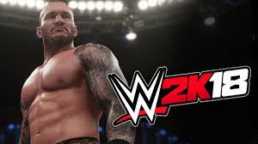
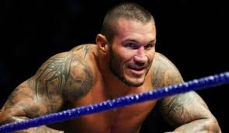
TATTOOS-RECENT CASES
But in another case, artist sues a number of companies for copyright infringement for including artist’s tattoo on the wrestler Randy Orton in a series of WWE-2k wrestling video games
Artists sues:
Game publisher (2K)
Developer (Yuke’s) (dismissed for lack of jurisdiction), and
Sports licensor (WWE)
Pending. Survived motion to dismiss despite similar arguments in the Solid Oaks case
See https://www.scribd.com/document/389959215/20181002-First-Amended-Complaint-Alexander-vs-Take-Two-2K-WWE-Visual-Concepts-Yukes

Slide 37
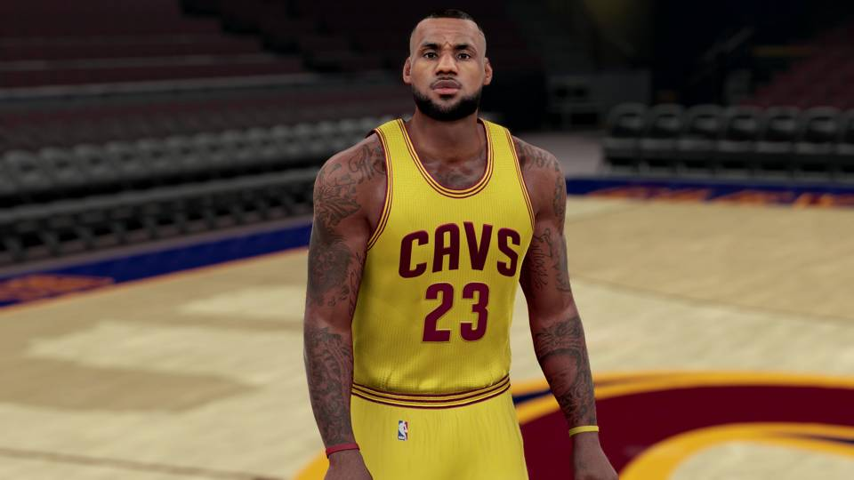
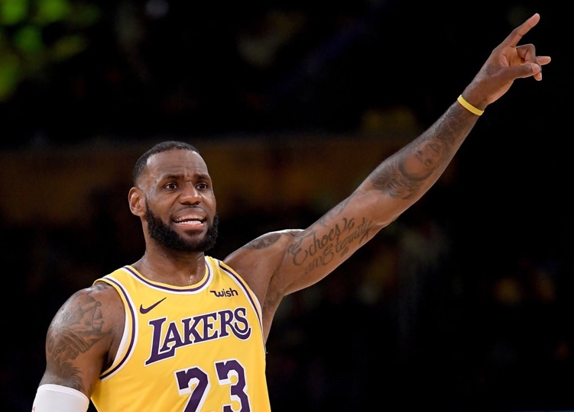
TATTOOS-BASKETBALL GAMES
Artist sues for copyright infringement when his tattoos appear in various 2K basketball games.
Artist inked a number of tattoos on NBA players including LeBron James and other former Cleveland Cavalier players.
James Hayden v. 2K Games, Inc., Take Two Interactive Software, Inc. https://www.courthousenews.com/wp-content/uploads/2017/12/James-Hayden.pdf
Pending

Slide 38
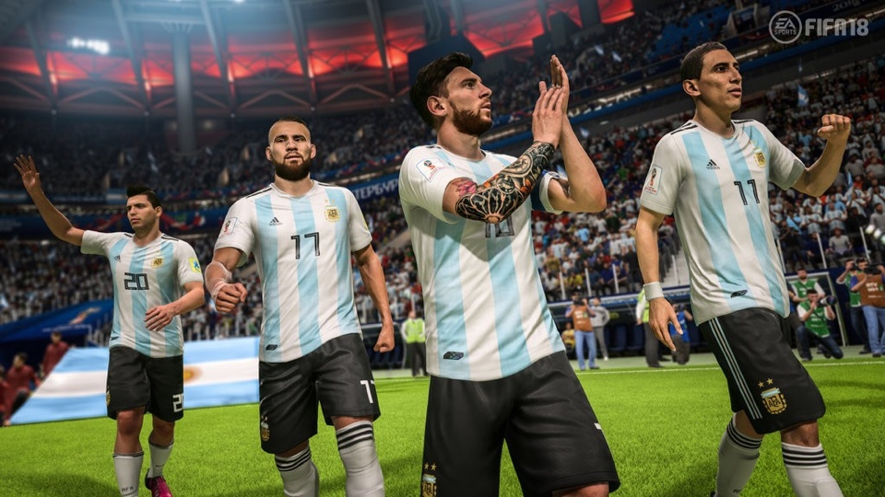
CHANGES IN DEVELOPMENT
EA appears to have limited recreating tattoos in their sports games
Only a handful of athletes have tattoos in EA’s Madden
NFLPA (Union for professional NFL players) since 2014 has informed players tattoos will not appear in games, merchandise or ads without a license from artist
Below, Lionel Messi in EA’s FIFA game

Slide 39
RISK ANALYSIS-COPYRIGHT
It’s an evolving field, games are becoming more realistic and the industry is projected to hit US$200 billion word-wide revenue in 2022. Expect more litigation
The law will continue to evolve and can be unpredictable
Laws vary among countries
Understand the risks
A license can still be cheaper than arguing various defenses

Slide 40
THANK YOU-MULTUMESC
SEE MASTERING THE GAME AT https://www.wipo.int/publications/en/details.jsp?id=3233
2ND EDITION COMING SOON!
If you have any questions or comments, please contact me at david.greenspan@yahoo.com
COPYRIGHT 2021GREENSPAN
Screenshots and photos are the copyrights of their respective owners

