Slide 1
Roundtable: Fight against Piracy and Counterfeiting in Developing Countries and LDCs: Progresses and Challenges – National Strategy: Cambodia’s activities
Second WIPO Inter-Regional Meeting on South-South Cooperation on Patents, Trademarks, GI, Industrial Designs and Enforcement
Cairo, May 08, 2013
Secretariat of National Committee for IPRs
Ministry of Commerce, Cambodia

Slide 2
IP Enforcement Agencies in Cambodia
D/IPR
D/IP
D/CR
Courts
Custom
Litigation
Bureau
Arbitration
Center
Inter-ministerial Committee for Copyright Piracy Suppression
Economic
Police
Camcontrol
Notes:
2

Slide 3
Most Common Methods employed by Cambodia for Coping with Infringement
Cease-and-Desist Letters: Administrative procedure
Public Notice or Warning: Administrative procedure
Solution by D/IPR Mediation: Administrative procedure
Border Measures: Customs/Camcontrol
Internal Markets: Action by Economic Police and/or Camcontrol
Injunction (Provisional Measure): Court
Civil and Criminal prosecution: Courts

Slide 4
Levels of Cambodia Courts
The
Supreme
Court
The Court of Appeal
Municipal Court and
The Courts of First Instance
* Cambodia is on the way to establish Commercial Court that will handle also the IP cases.
Notes:
4

Slide 5
Legal Prosecution against
IP Infringement
Administrative Procedure
Civil Procedure
Criminal Procedure

Slide 6
Relief in Civil Cases
Compensation of damages
Equitable relief

Slide 7
Equitable Relief
- Preliminary injunction (Provisional Measure)
- Final injunction (Provisional Measure confirmed)
- Civil Seizure and Destruction of Infringing Goods.

Slide 8
Preliminary Injunction Relief
- Likelihood of success on the merits
- Likelihood of irreparable harm if Preliminary injunction is not granted.
- Balance of hardship.
- Public interest.

Slide 9
Final Injunction
- Irreparable harm
- Likelihood of success on the merits
- Balancing of the equities/hardship
- Public interest

Slide 10
Border Measure
Ex Officio Action. Article 43
- Counterfeit goods
- Goods bearing confusing similar mark
- Pirated goods
Cease and Desist Order
Seizure and Forfeiture Order
Can be prosecuted based on complaints and Ex Officio Action (state prosecution)

Slide 11
Criminal Prosecution
Trafficking in counterfeit trademark, service mark (Art. 64 of TM law)
Trafficking in counterfeit labels, documentation and packaging (Art.65 of TM law)
Unauthorized production, reproduction, performance or communication to the public a copyrights works (art. 64 of CRL)

Slide 12
Civil Seizure and Destruction of Infringing Goods
- Prevent infringing articles from entering into the channel of commerce.
- Cambodian IP law contain authorization for civil seizures and destruction Art. 69 of TM, Art 57 of CRL.
- Seizures may be done pre-trial in copyrights or trademark counterfeiting cases.

Slide 13
Alternative Dispute Resolution at D/IPR
The D/IPR acts similarly as mediator:
- At the request of right holder to take action against the infringement
A non-binding procedure in which a neutral intermediary, assists the parties in reaching a settlement of the disputes
- The two parties will be invited to discuss and find out the common dispute resolution
- A commitment contract should be signed by the two parties
Restraining Order (effective than a warning letter of the right holder)
Revoke the validity of the registration
Compensation of damages can be made upon the agreement of both parties
Penalties and fine can not be made here
Seizure or destruction of counterfeit goods can not be made, unless otherwise agreed by the parties

Slide 14
Some figures on IP protection and enforcement
Mark Registration:
Note: Increase in application number, but decrease in registration number, because of lack of Examiners.
YEAR | APPLICATION |  |  | REGISTRATION
 | Total | Local | Foreign | Total | Local | Foreign
2011 | 4,144 | 721 | 3,423 | 3,600 | 657 | 2,943
2012 | 5,140 | 906 | 4,234 | 3,490 | 705 | 2,785

Slide 15
- Patents and Utility Models Registrations:
- Industrial Design Registration:
YEAR | APPLICATION | REGISTRATION
2011 | 42 | 0
2012 | 56 | 0
YEAR | APPLICATION | REGISTRATION
2011 | 43 | 35
2012 | 47 | 47

Slide 16
- Copyright Registration:
- Utilization of Copyright without heir:
YEAR | APPLICATION | REGISTRATION
2011 | 54 | 54
2012 | 21 | 21
YEAR | APPLICATION | PERMITED (SONG)
2011 | 181 songs | 181 songs
2012 | 158 songs | 158 songs

Slide 17
Enforcement:
  Cancellation of Marks:
  Litigation of Mark Infringement:
Year | App. | Result: 08 Applications |  |  |  | Carried Over
 |  | Cancelled | Amended | Self Cancelled | Refuse
2012 | 34 including 20 applications from 2011 | 2 | 2 | 1 | 03 | 26
Year | App. | Result: 24 Applications |  | Carried Over
 |  | Adm. Means | Rejected
2012 | 38 including 9 Apps. from 2011 | 20 | 4 | 14

Slide 18
Copyright piracy:
M. Interior (Police):
YEAR | Suppressing & Destroying , Equipment, Materials, and CD, VCD, and DVD
 | CD, VCD, DVD | Equipment, Materials
2011 | 347,842 | - Computer: 5 set
2012 | 268,233 | TV: 5 Pcs; VCR: 9 Pcs; photocopy machine: 8Pcs; Computer: 2Pcs; and other materials

Slide 19
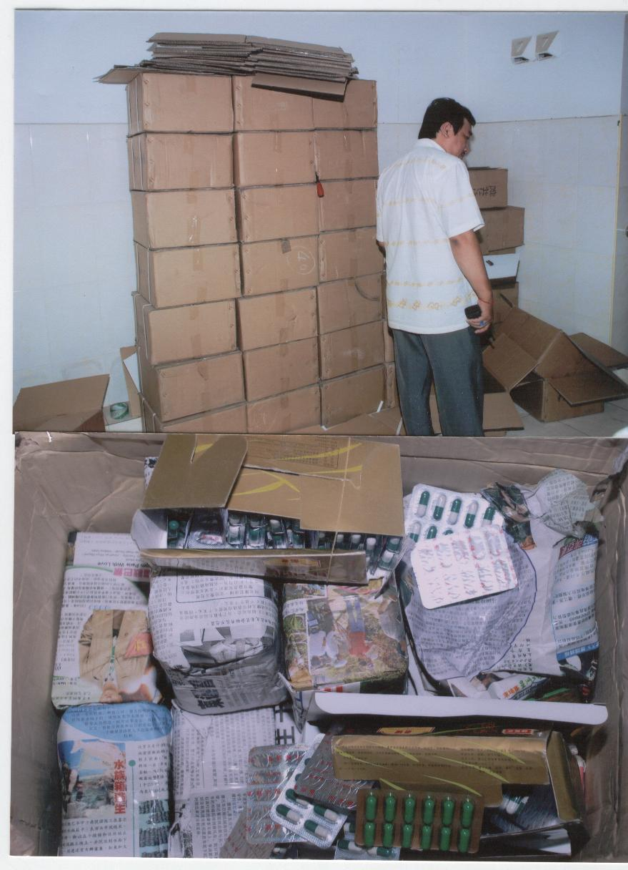
- Fake pharmaceutical: 19.280 Ton
- Importer arrested
- Detention Date: March 08, 2010
Merits of the case initiated by the Prosecutor + Police leading to prosecution.
- Counterfeiting goods have been destructed.

Slide 20
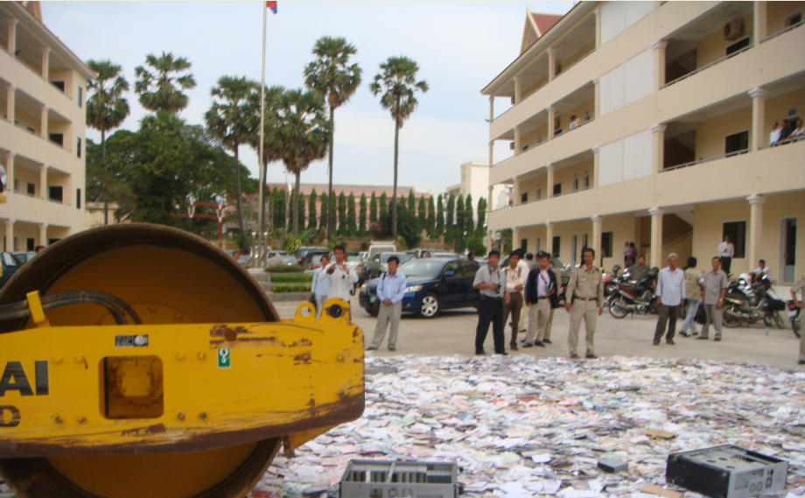
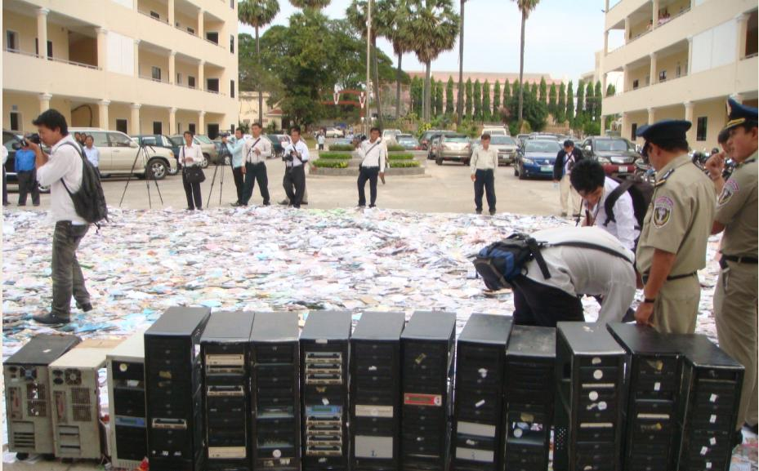
Pirated goods: 256,034 pieces
Relevant materials

Slide 21
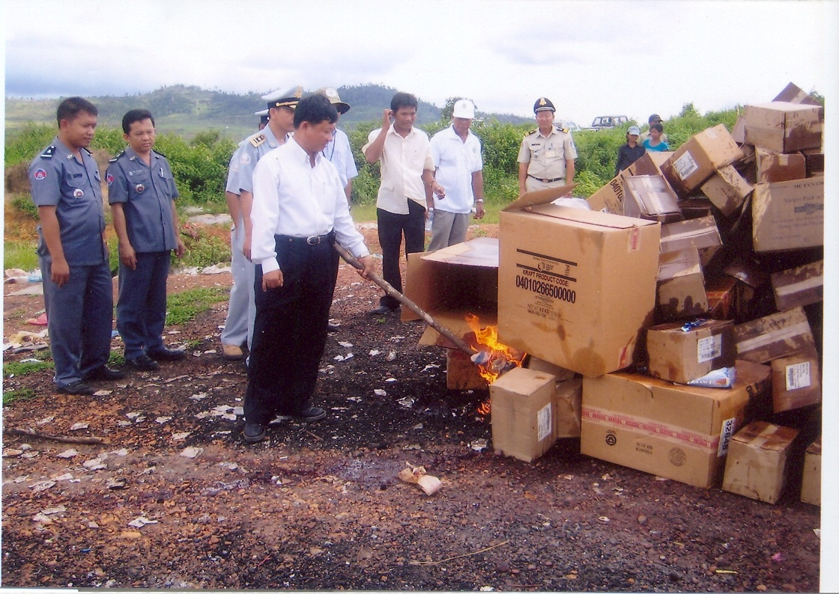

Slide 22
Challenges
Counterfeit and pirated goods can be found everywhere and in most cases have been popularly endorsed by consumers: consumer attitude and awareness.
Reluctance of Rights holders: Costs to rights holders and their contribution to IPRs enforcement: an important factor.
Counterfeit goods on the Internet present one of the biggest emerging challenges, and require further details about the Internet-related enforcement activities: which are not available in most LDCs.
Counterfeiting of medicine: high cost of medicinal products lead to the possibility of counterfeiting.

Slide 23
National Strategies
Improve the capability and capacity within the Cambodian Government to deliver intellectual property policy, services and enforcement: Increase resources and develop targeted training for intellectual property agencies to improve enforcement capacity.
Improve relationship between right holders, consumers, and enforcement agencies: encourage active participant.
Increase IP awareness and building IP Culture among consumer and general public.
(Implement National IP Strategy and ASEAN IP Work Plan).

